Slide 1


Class : 8 A
Mrs :

Slide 2


Slide 3
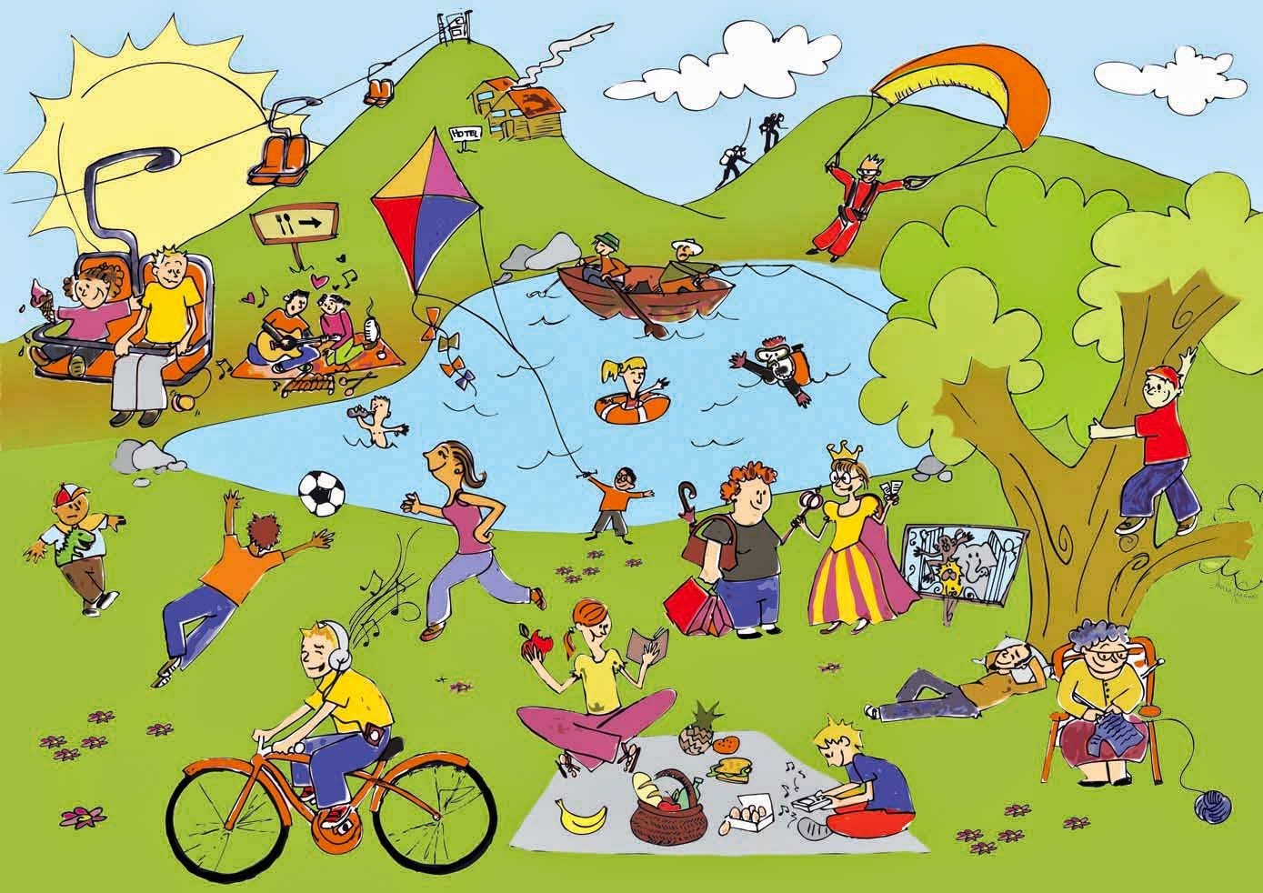
* WARM-UP
Who knows more?
Name the activities in the picture:
Go fishing
Play a sport
Go to the park
Fly the kites
Listen to music
Go out with friends
Sailing
Go swimming
go on a picnic
Jogging
climb tree
LEISURE ACTIVITIES

Slide 4


Unit
1
LEISURE TIME
LESSON 1: GETTING STARTED
I’m keen on DIY (do-it-yourself).

Slide 5


* Vocabulary
- DIY (n) = (do-it-yourself):
tự tay làm
/ˌdiːaɪˈwaɪ/

Slide 6
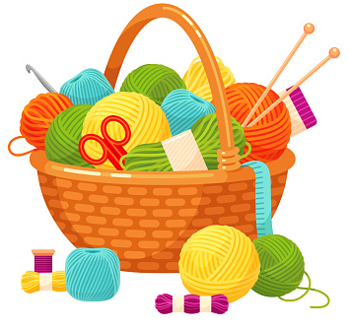
* Vocabulary
- knitting kit (n):
bộ dụng cụ đan len
/ˈnɪtɪŋ kɪt/

Slide 7
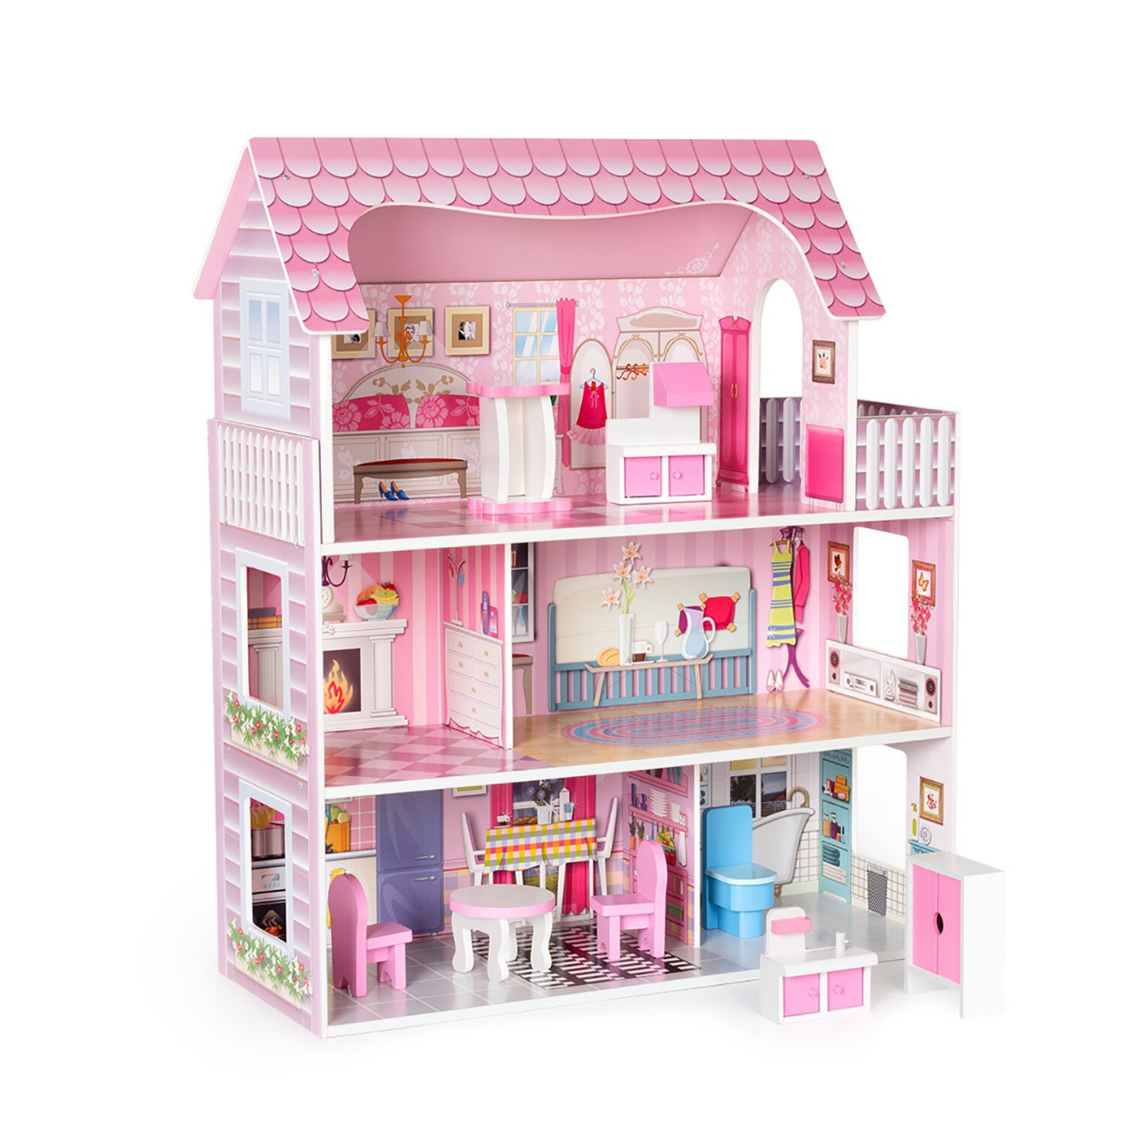
* Vocabulary
- dollhouse (n):
nhà búp bê
/ˈdɒlhaʊs/

Slide 8
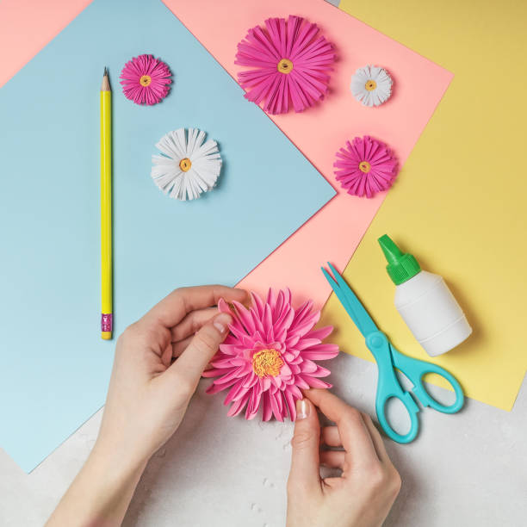
* Vocabulary
- make paper flowers (v.phr):
làm hoa giấy
/meɪk 'peɪpər 'flaʊərz/

Slide 9
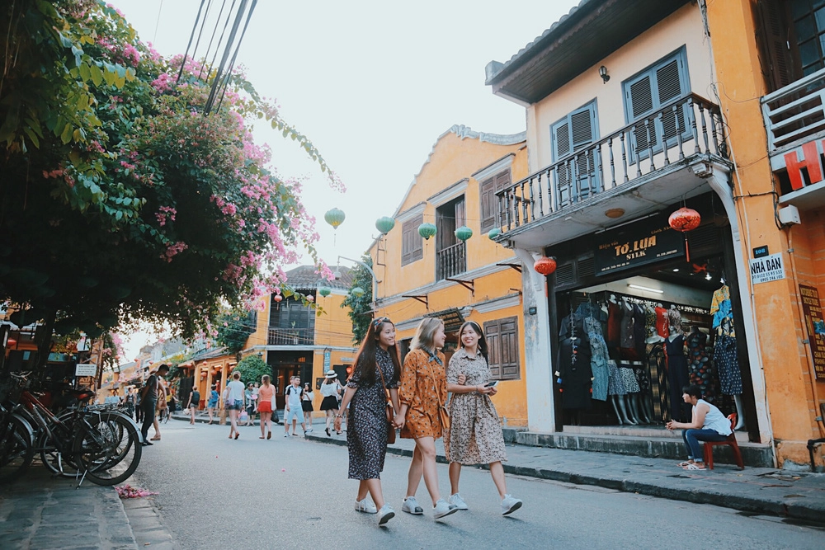
* Vocabulary
- hang out (v):
đi chơi
/hæŋ aʊt/

Slide 10
* Vocabulary
New words | Pronunciation | Meaning
1. DIY (n) | /ˌdiːaɪˈwaɪ/ | tự tay làm
2. knitting kit (n) | /ˈnɪtɪŋ kɪt/ | bộ dung cụ đan len
3. dollhouse (n) | /ˈdɒlˌhaʊs/ | nhà búp bê
4. make paper flowers (v.phr) | /meɪk 'peɪpər 'flaʊərz/ | làm hoa giấy
5. hang out (v) | /hæŋ aʊt/ | đi chơi

Slide 11

* PRACTICE
1
Listen and read.
Tom: Hi, Trang. Surprised to see you. What brings you here?
Trang: Oh, hello Tom. I’m looking for a knitting kit.
Tom: A knitting kit? I didn’t know you like knitting.
Trang: Actually, I’m keen on many DIY activities. In my leisure time, I love
knitting, building dollhouses, and making paper flowers.
Tom: I see. So, you like spending time on your own.
Trang: Yes. What do you do in your free time?
Tom: I’m a bit different. I usually hang out with my friends. We go to the
cinema, go cycling, or play sport in the park.
Trang: You love spending free time with other people, don’t you?
Tom: That’s right. By the way, would you like to go to the cinema with me and
Mark this Sunday? There’s a new comedy at New World Cinema.
Trang: Yes, I’d love to. Can I ask Mai to join us?
Tom: Sure. Let’s meet outside the cinema at 9 a.m.

Slide 12
2
Read the conversation again and complete the sentences.
Trang is looking for a ____________.
She likes doing DIY in her ____________.
Tom loves spending his free time with ____________.
Tom and his friends usually _________ together.
Tom, Mark, Trang, and Mai are going to see a comedy this _______.
Game

Slide 13


LUCKY NUMBERS
1
2
3
4
5
6
7
8
GA
2
4
6
8
10
12
14
GB
2
4
6
8
10
12
14

Slide 14
2
Read the conversation again and complete the sentences.
Trang is looking for a ____________.
knitting kit
Tom: Hi, Trang. Surprised to see you. What brings you here?
Trang: Oh, hello Tom. I’m looking for a knitting kit.

Slide 15
2
Read the conversation again and complete the sentences.
2. She likes doing DIY in her ____________.
leisure time
Trang: Actually, I’m keen on many DIY activities. In my leisure time, I love knitting, building dollhouses, and making paper flowers.

Slide 16
2
Read the conversation again and complete the sentences.
3. Tom loves spending his free time with ____________.
other people
Trang: You love spending free time with other people, don’t you?
Tom: That’s right. By the way, would you like to go to the cinema with me and Mark this Sunday? There’s a new comedy at New World Cinema.

Slide 17
2
Read the conversation again and complete the sentences.
4. Tom and his friends usually _________ together.
hang out
Tom: I’m a bit different. I usually hang out with my friends. We go to the cinema, go cycling, or play sport in the park.

Slide 18
2
Read the conversation again and complete the sentences.
5. Tom, Mark, Trang, and Mai are going to see a comedy this _______.
Sunday
Tom: That’s right. By the way, would you like to go to the cinema with me and Mark this Sunday? There’s a new comedy at New World Cinema.

Slide 19


UNLUCKY NUMBER

Slide 20



Slide 22
2
Read the conversation again and complete the sentences.
Trang is looking for a ____________.
She likes doing DIY in her ____________.
Tom loves spending his free time with ____________.
Tom and his friends usually _________ together.
Tom, Mark, Trang, and Mai are going to see a comedy this _______.
knitting kit
leisure time
other people
hang out
Sunday

Slide 23
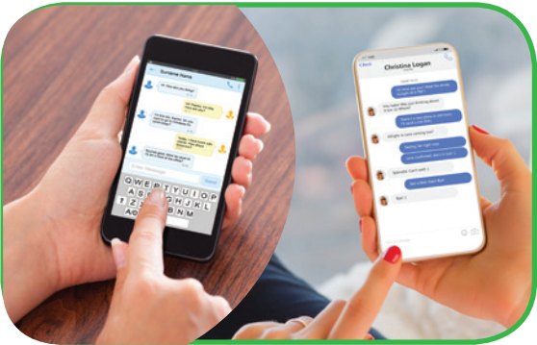
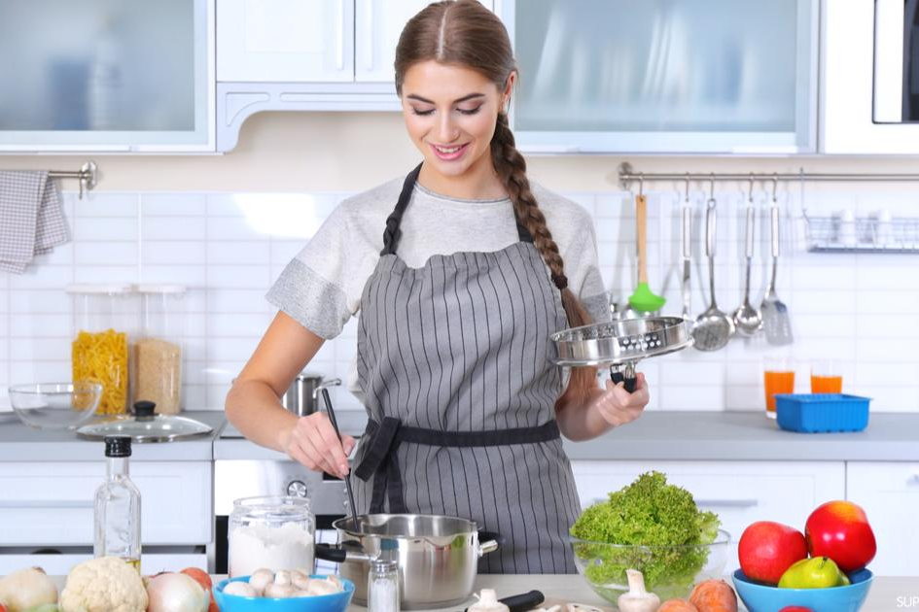
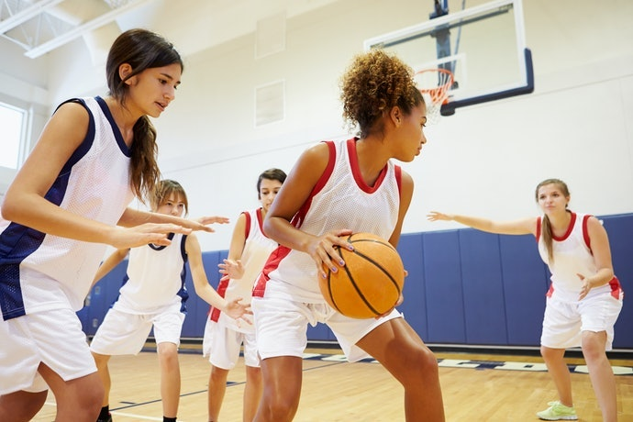
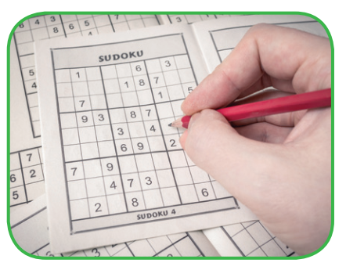
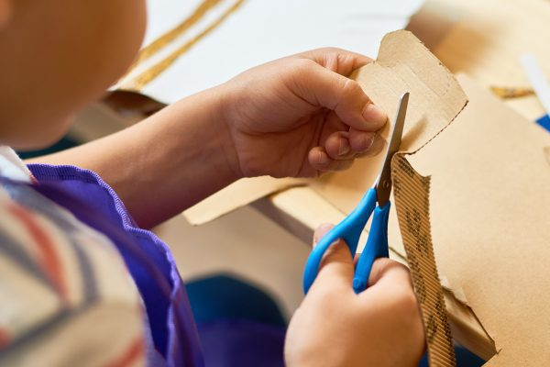
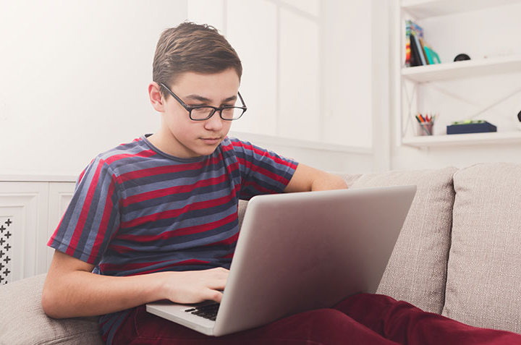
3
Work in pairs. Write the activities from the box under the correct pictures.
doing DIY
cooking
doing puzzles
playing sport
surfing the net
messaging friends

Slide 24
4
Work in pairs. Read the word and phrases, and guess which activities in 3 are described.
improve memory, a mental exercise
save money, increase creativity
improve physical health, make friends
keep in touch, be relaxed
learn something about IT, computer skills
doing puzzles
doing DIY
playing sport
messaging friends
surfing the net

Slide 25


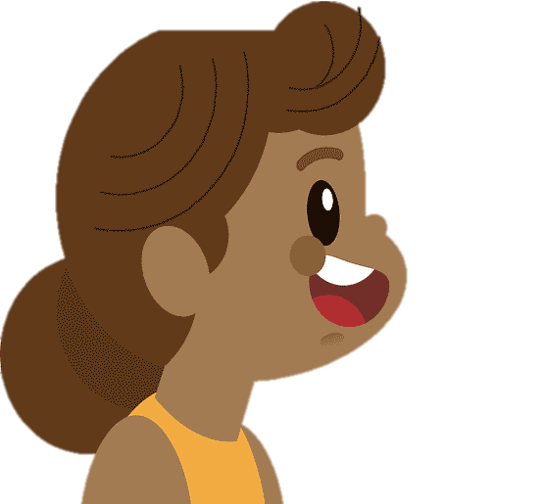
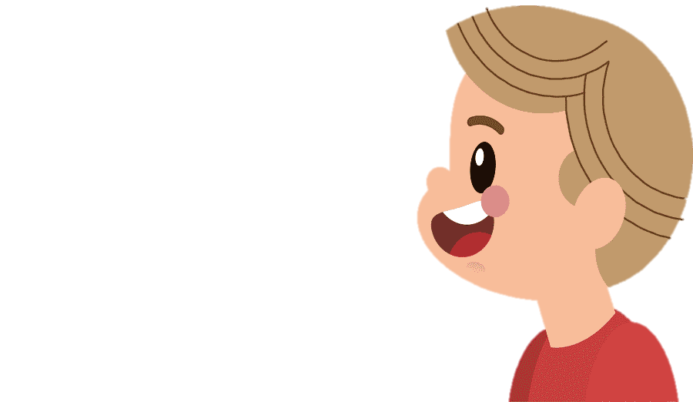
* PRODUCTION
5
Work in groups. Ask one another the question below. Then report your friends’ answers to the class.
Hai: If you have some free time this weekend, what will you do?
Huong: If you have some free time this weekend,
I will hang out with my friends. I love talking to them.
Huy: If I have free time this weekend, I will go to the cinema to see the latest film.

Slide 26


* PRODUCTION
5
Report your friends’ answers to the class.
This weekend, If Huong has some free time she’ll
hang out with her friends. She loves talking to her friends.
And Huy will go to the cinema to see the latest film.

Slide 27
* PRODUCTION
5
Report your friends’ answers to the class.
If I have some time this weekend, I’ll play badminton with my father in the morning. In the afternoon, I’ll hang out with my friends, and we’ll drink milk tea together. In the evening, I’ll message my friends and surf the net to watch some interesting programme.

Slide 28

* Homework
Name a list of cheap expensive, easy and difficult leisure activities.
Do exercises in the workbook.
Prepare for the Project of Unit 1.

Slide 29

Thanks for your atendance!
Goodbye. See you again
Notes:
29

Slide 30


