Slide 1


SONG VE SECONDARY SCHOOL
Hello everyone !!!
love

Slide 2
* Answer the following questions:
* WARM-UP
CHATTING
+ How do you say when you want sb to pass you a pen?
- Can/ Could you pass me the pen?
+ How do you say when you want sb to tell you more about the music club?
- Can/Could you tell me more about the English club?
+ What will we do if we want to ask politely somebody to do sth?
MAKING REQUESTS

Slide 3



Unit
3
TEENAGERS
LESSON 4: COMMUNICATION

Slide 4



* EVERYDAY ENGLISH
1
Listen and read the dialogues below. Pay attention to the highlighted sentences.
Student: Can you tell me more about the music club, please?
School club leader: Certainly. It meets on Mondays and Thursdays.
Student: Could you tell me the time it meets?
School club leader: Yes, it’s after school, from 5:00 p.m. to 6:30 p.m.

Slide 5
* EVERYDAY ENGLISH
Making requests | Examples
- Can you…, please? - Could you…(, please)? | - Can you tell me more about the music club, please? - Could you tell me the time it meets?

Slide 6
* EVERYDAY ENGLISH
2
Work in pairs. Make similar conversations, using the cues below.
Ask to borrow a book from your classmate.
Request some advice on how to do your science project.

Slide 7
* EVERYDAY ENGLISH
2
Work in pairs. Make similar conversations, using the cues below.
Ask to borrow a book from your classmat
* Example:
A: Can you lend me your book that you finished reading, please?
B: Sure. Here you are!

Slide 8
* EVERYDAY ENGLISH
2
Work in pairs. Make similar conversations, using the cues below.
Request some advice on how to do your science project.
Example:
A: Could you tell me how to start a science project?
B: Certainly. You may go to the library and borrow some book about your science project and read carefully. It has all the informations that you need.

Slide 9
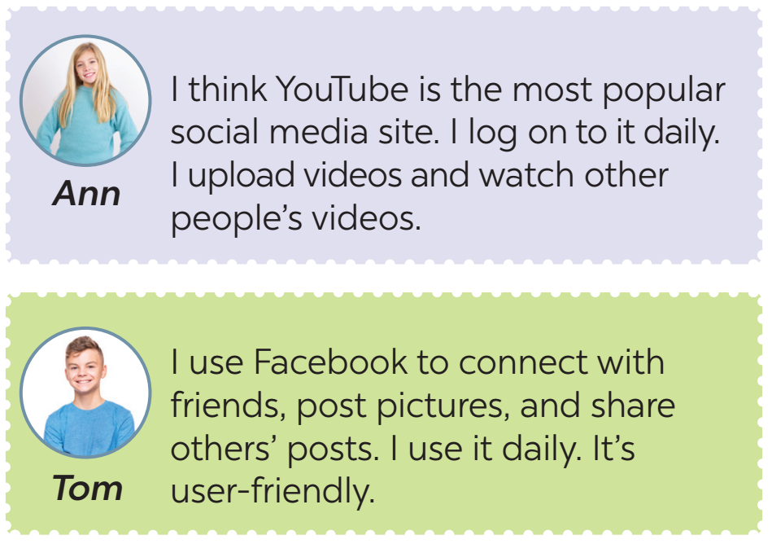
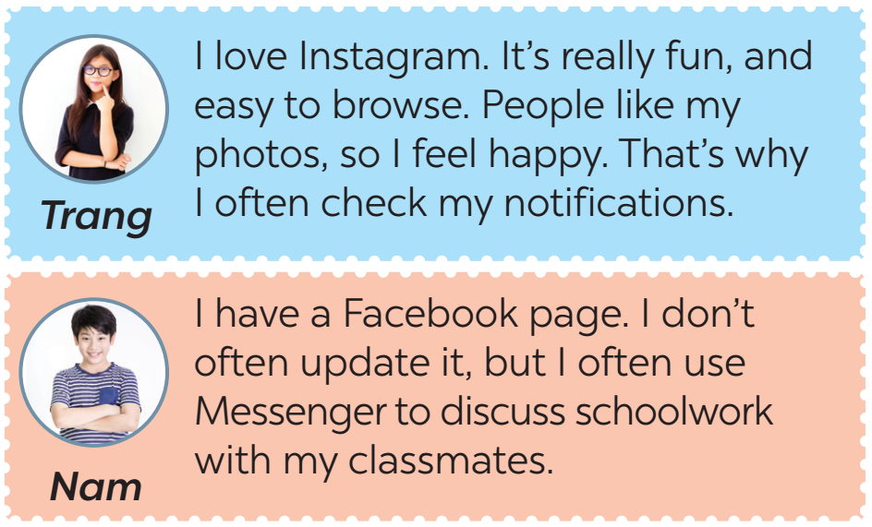
SOCIAL MEDIA POPULAR AMONG TEENS
3
Read some posts on a forum about different social media and match the names of the posters with their activities.

Slide 10
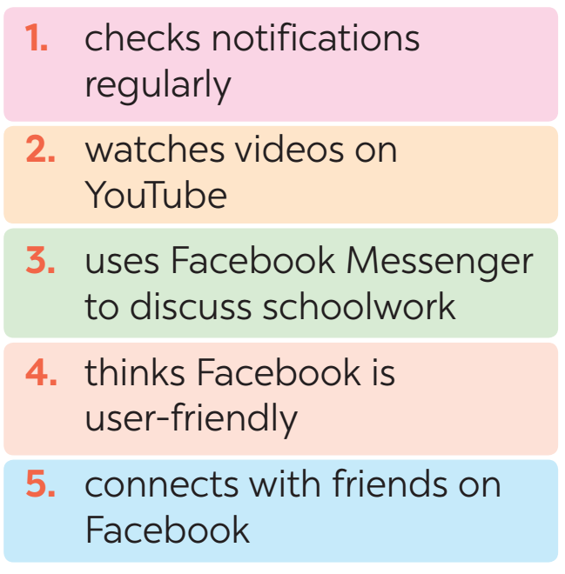

3
Read some posts on a forum about different social media and match the names of the posters with their activities.

Slide 11
4
Work in pairs. Ask and answer questions about what social media the teens in 3 use, why, and how often they use them.
Tom: What social media does Ann use?
Nam: She uses YouTube.
Tom: What does she use it for?
Nam: She uploads her videos and watch other people’s videos.
Tom: How often does she use it?
Nam: Every day.

Slide 12
4
Work in pairs. Ask and answer questions about what social media the teens in 3 use, why, and how often they use them.
Trang: What social media does Tom use?
Ann: He use Facebook.
Trang: What does he use it for?
Ann: He use it to connect with friends, post pictures, and share others’ posts.
Trang: How often does he use it?
Ann: Every day.
Tom: How does he feel about it?
Nam: User-friendly.

Slide 13
5
Work in groups. Discuss the following questions:
What social media do you use?
How often do you use it?
What do you use it for?
I'm using Facebook and Zalo
I use it every day, about 2 - 4 hours per day.
I use it to chat and message with my friends and
upload stories or photos.
Report your group’s results to the class.

Slide 14

Retell 2 ways of making requests
List some popular social media among teens.
* CONSOLIDATION

Slide 15

* Homework
Do exercises in the workbook.
Prepare lesson 5 ( skills 1)

Slide 16
Thank you!
Goodbye!

