Slide 1




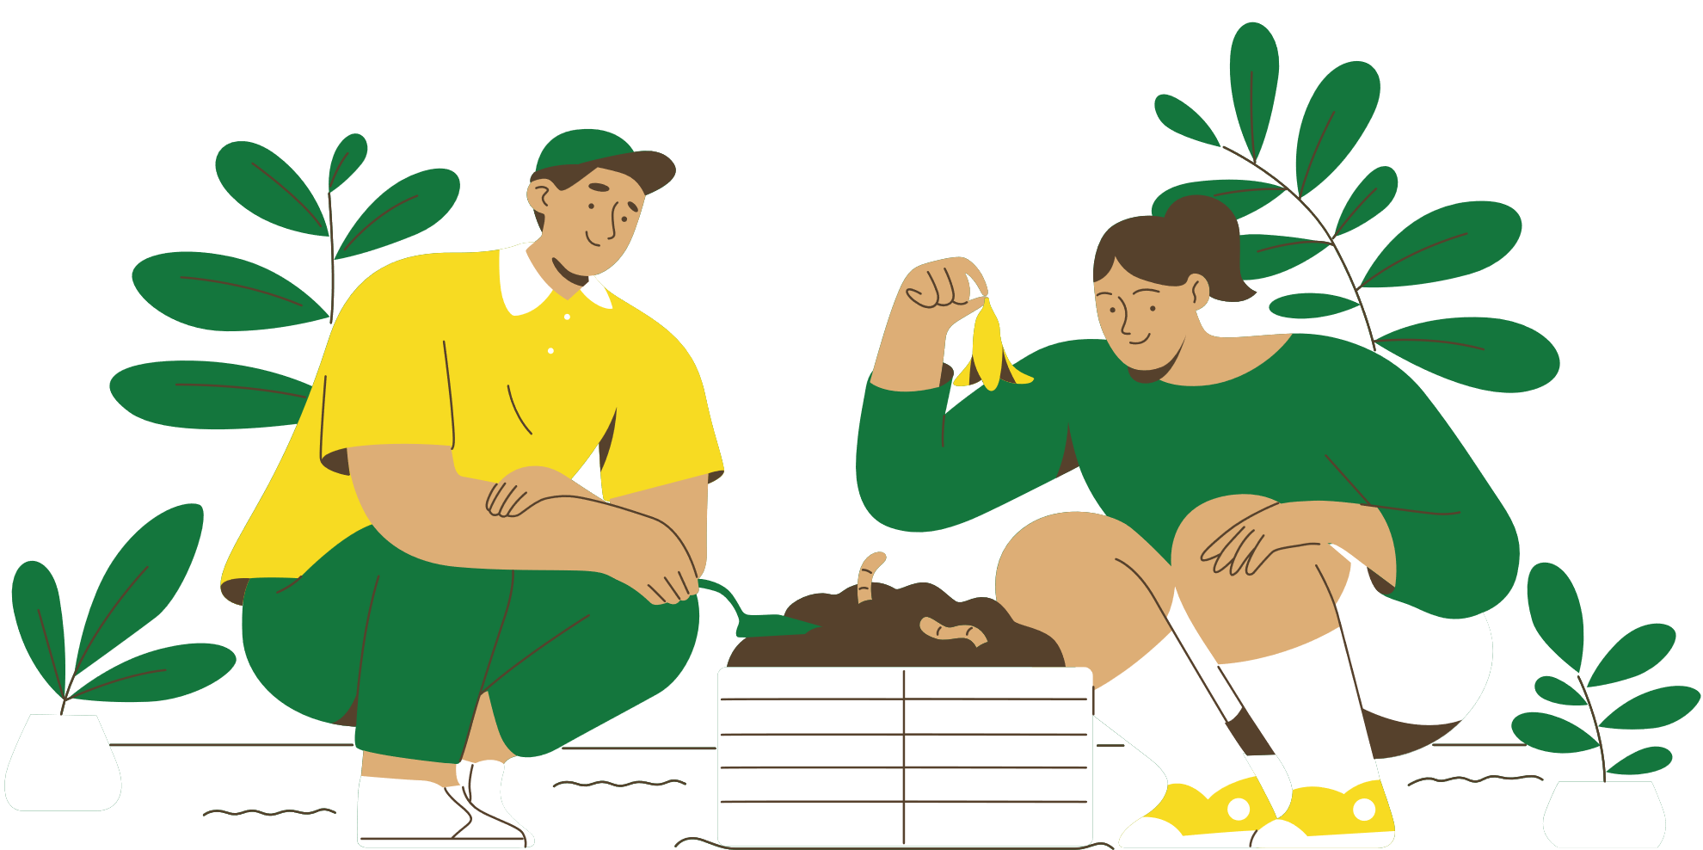


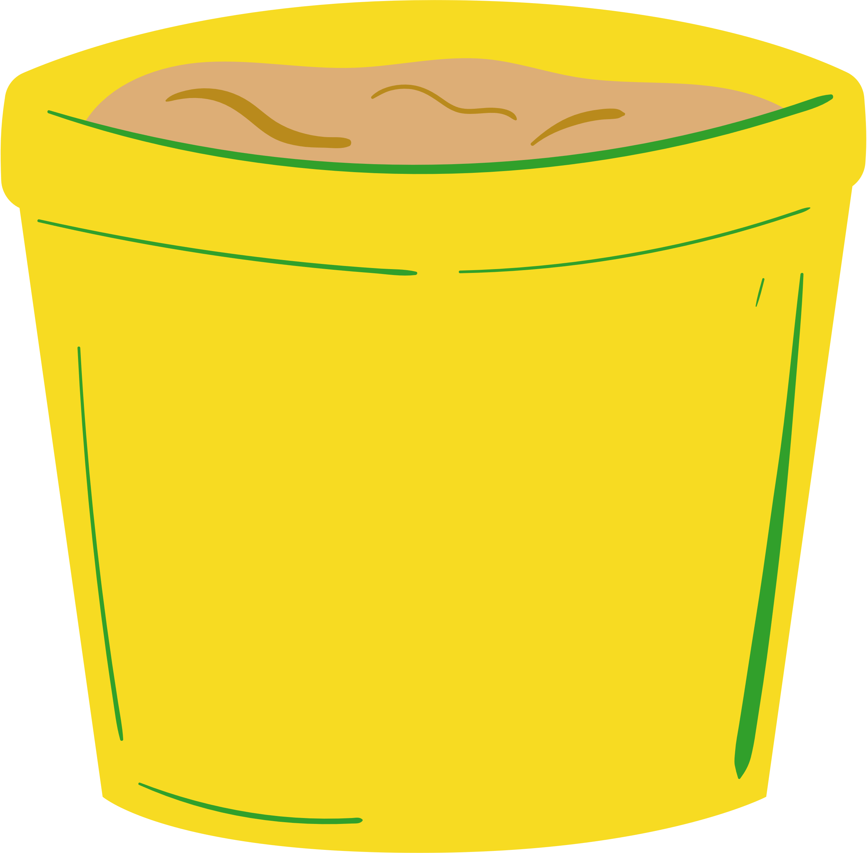
WELCOME TO OUR CLASS!
Teacher: …………………………………

Slide 2




REARRANGE THE CONVERSATION
03
Oh, thank you.
‘Single-use products’ are products made to be used once only.
04
It is the increase in the atmosphere’s temperatures caused by the rise of gases, especially carbon dioxide.
02
And what does it mean by ‘global warming’?
01
05
What do you mean by ‘single-use products’?

Slide 3


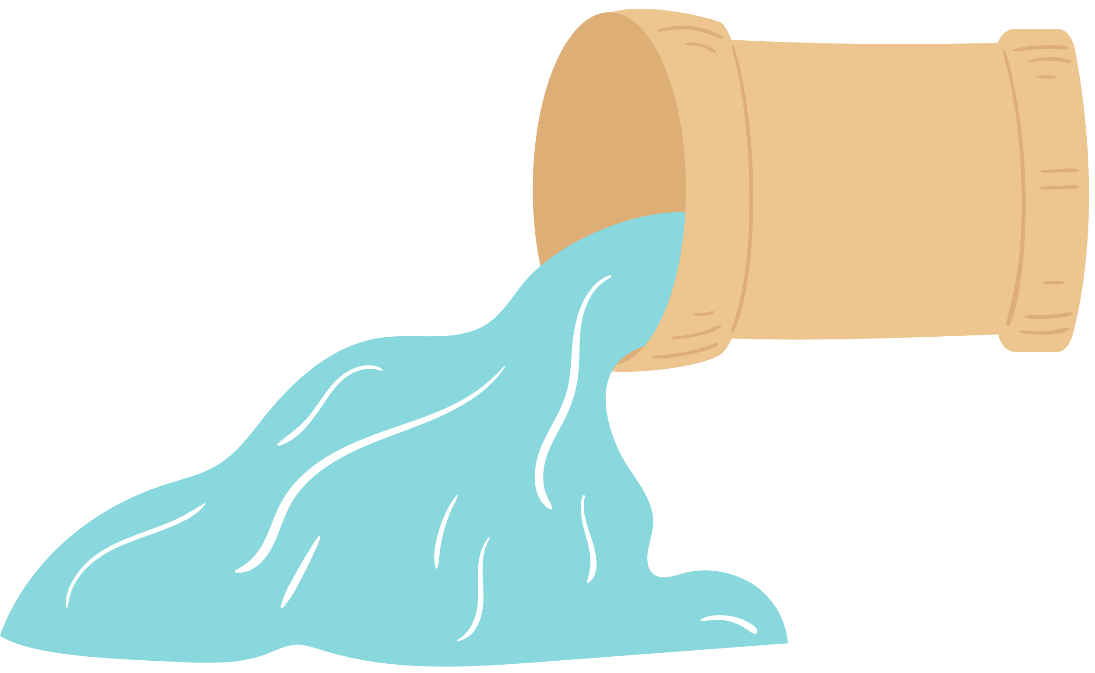
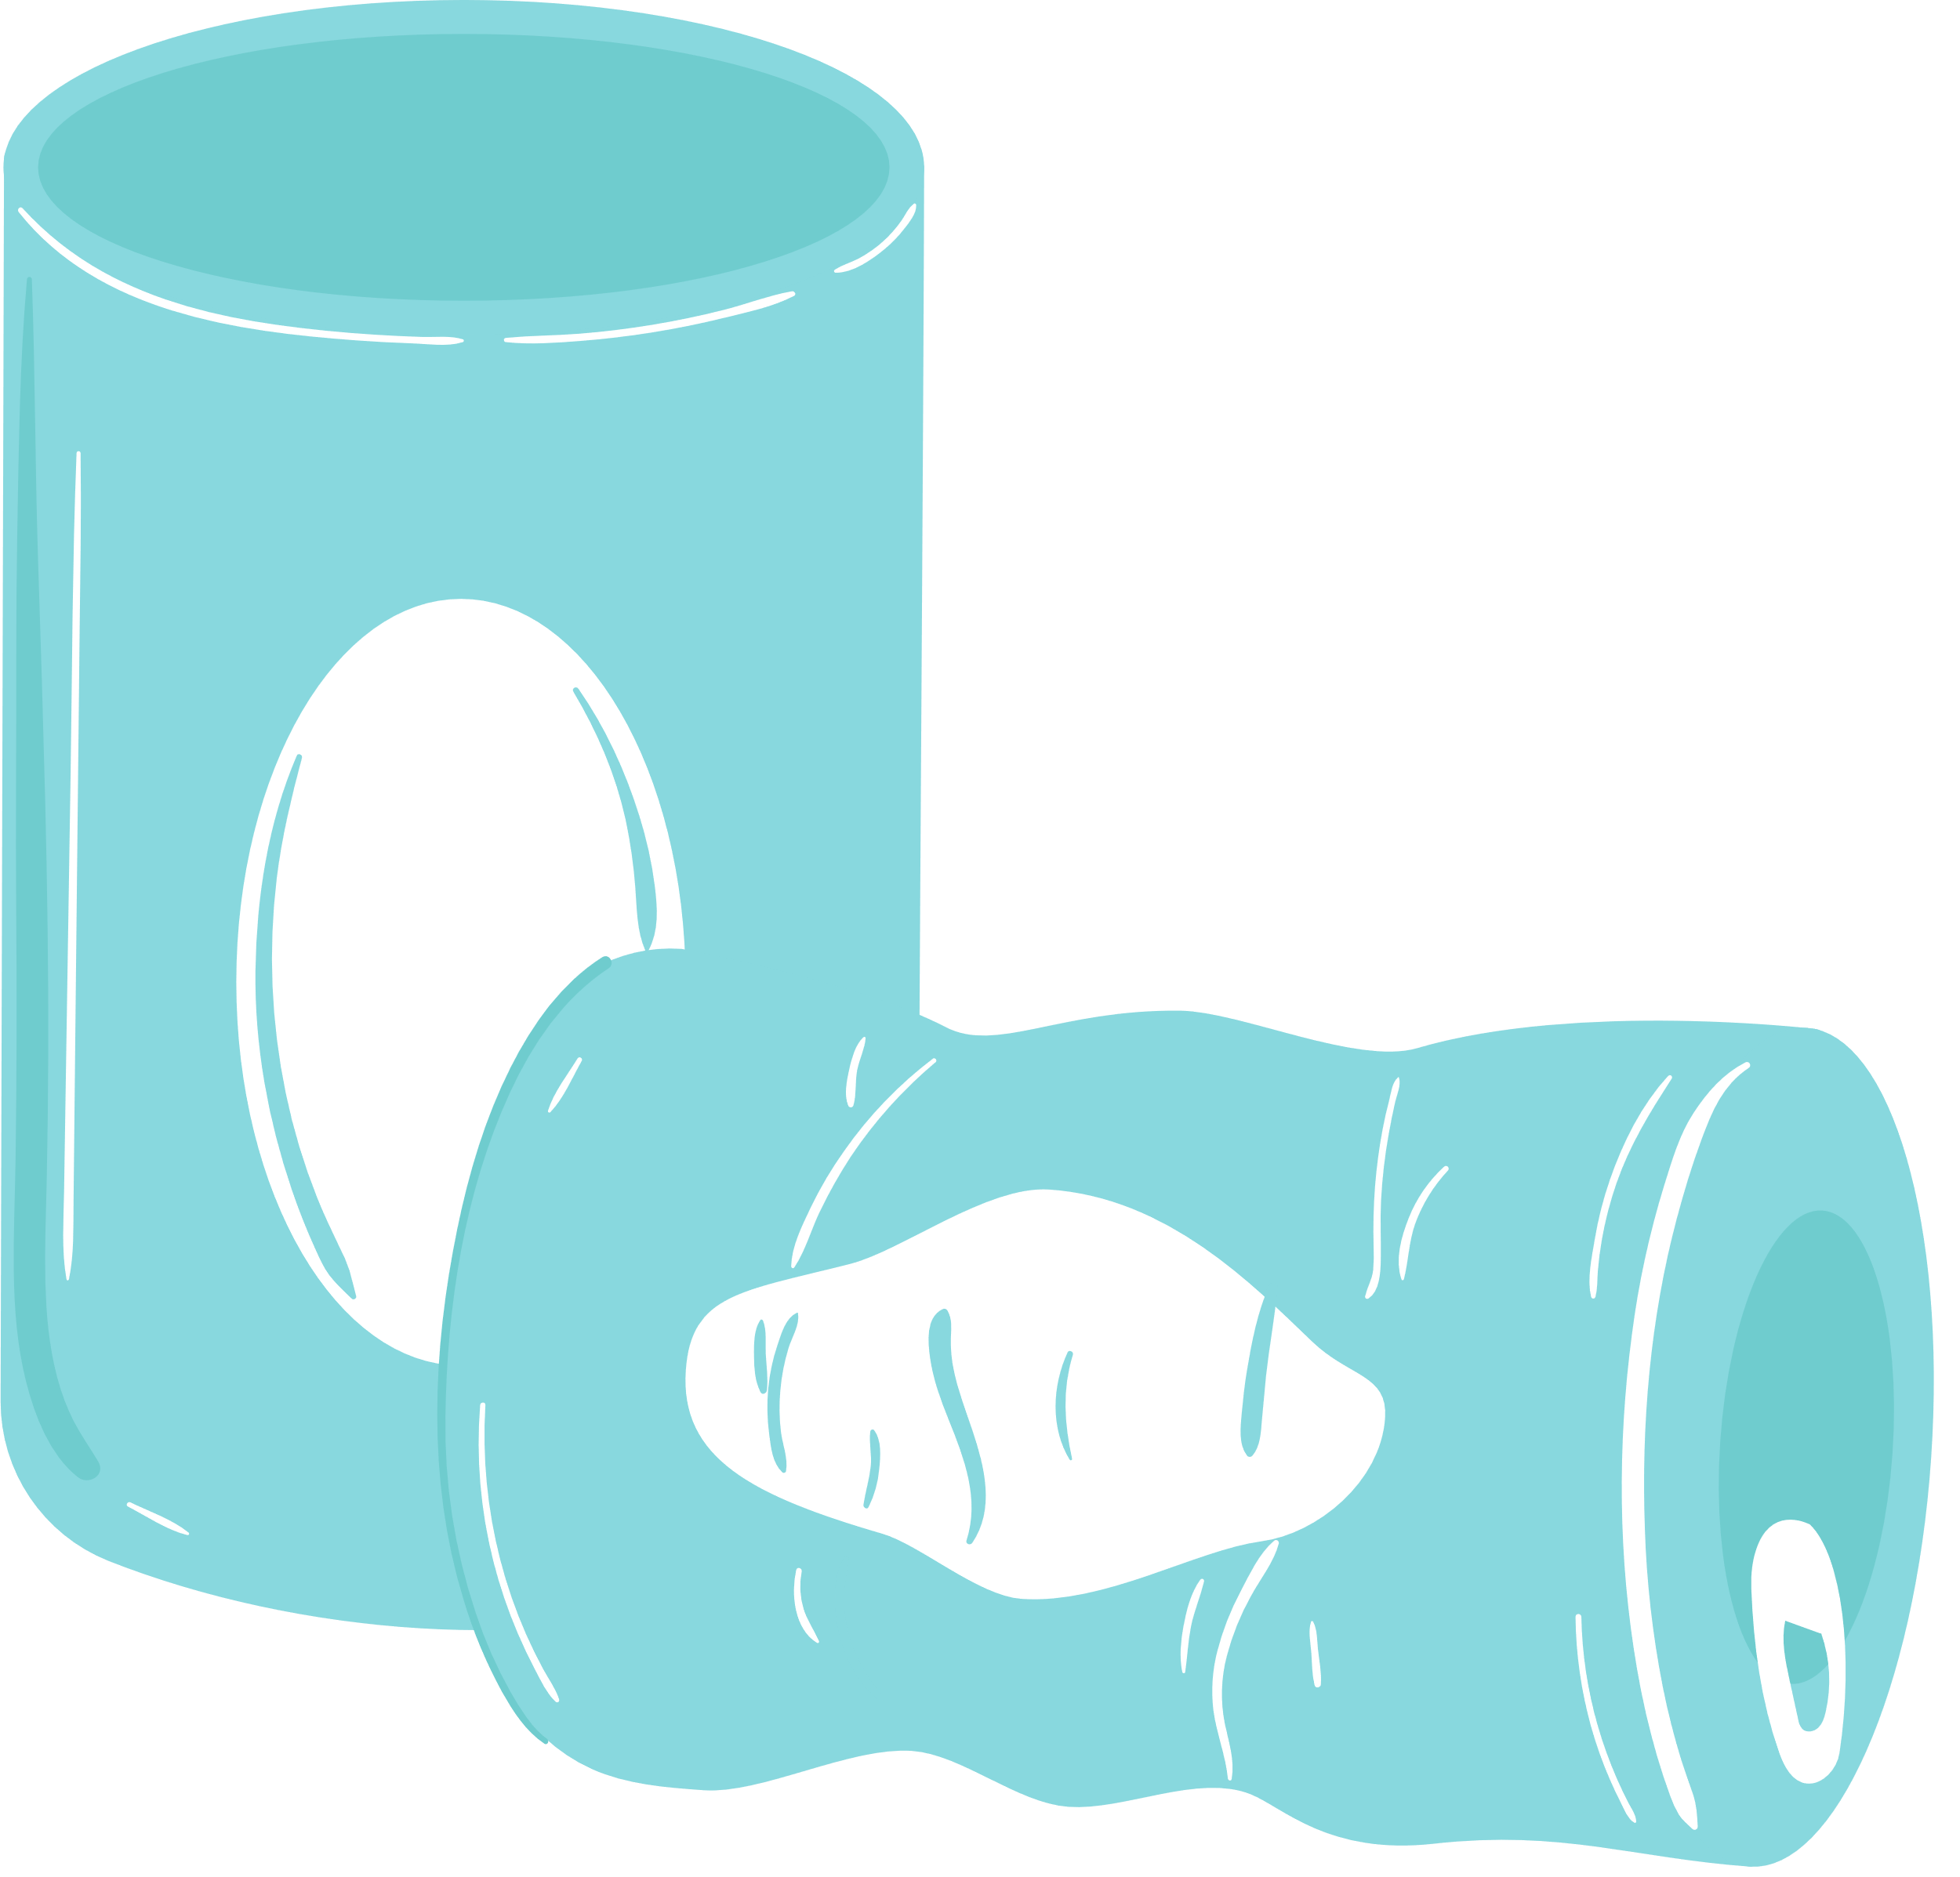

Check the answers
05
What do you mean by ‘single-use products’?
02
‘Single-use products’ are products made to be used once only.
01
And what does it mean by ‘global warming’?
04
It is the increase in the atmosphere’s temperatures caused by the rise of gases, especially carbon dioxide.
03
Oh, thank you.

Slide 4


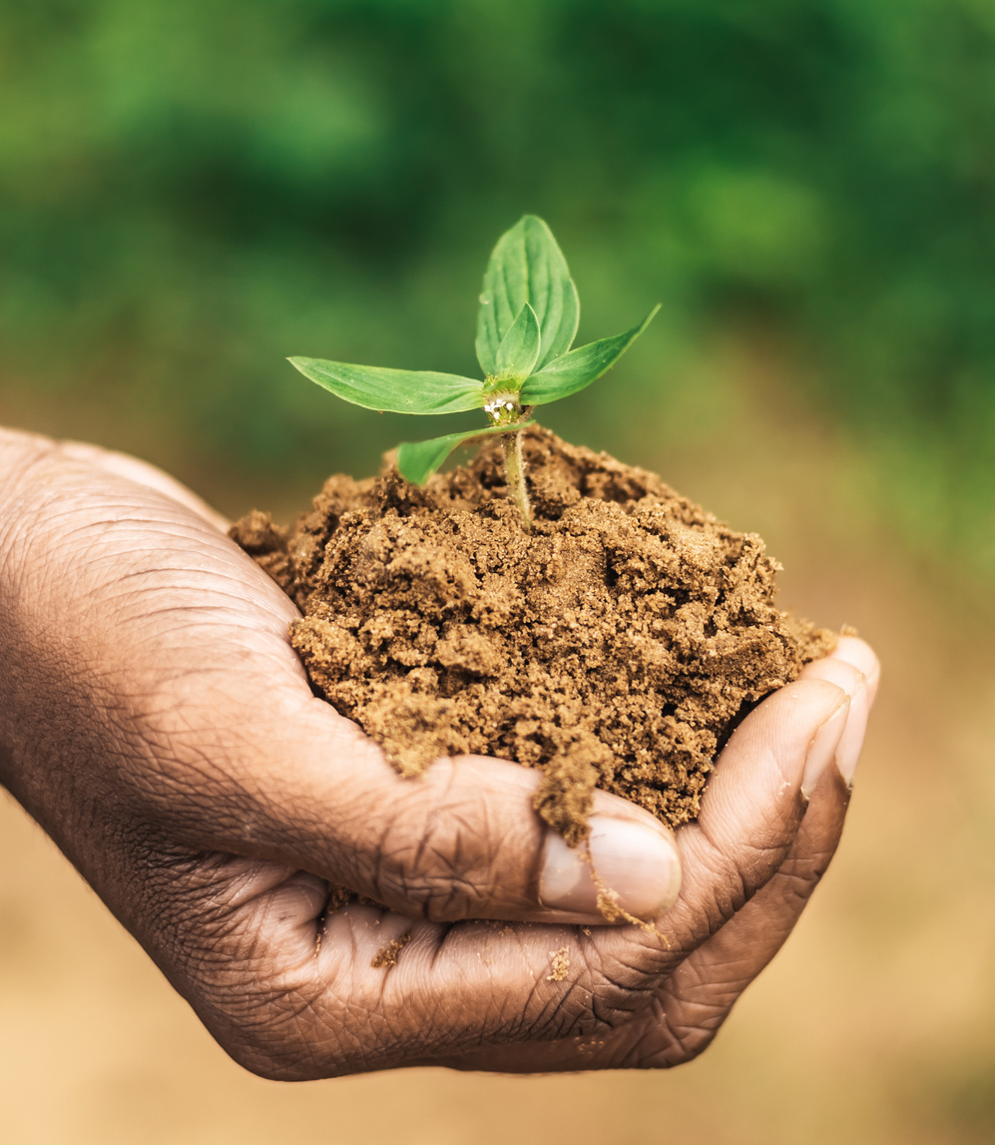
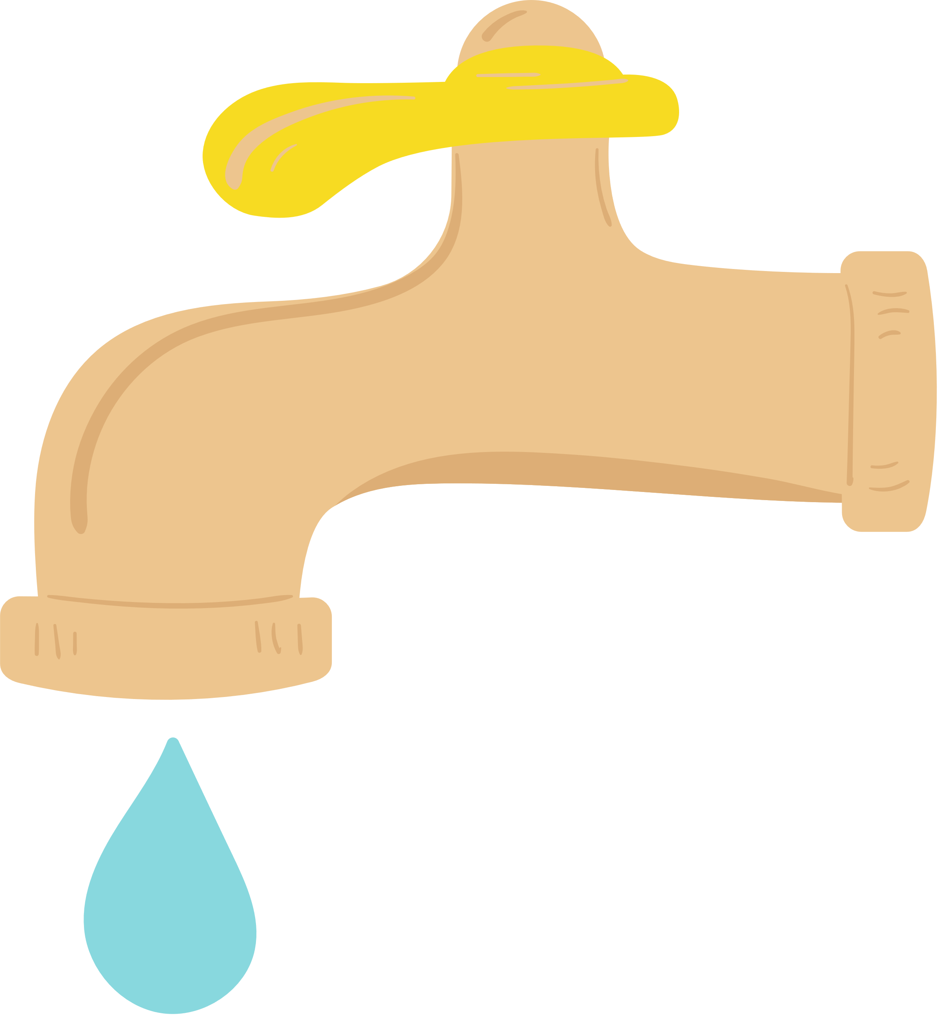


Unit 7:
ENVIRONMENTAL PROTECTION
Lesson 4: Communication

Slide 5


EVERYDAY ENGLISH
Asking and giving clarification

Slide 6

1. Listen and read the conversations. Pay attention to the highlighted sentences
Mi: Hey, Linda. What does ‘endangered species’ mean?
Linda: Endangered species are animals in the wild that face a high risk of extinction.
Mi: And what do you mean by ‘in the wild’?
Linda: That means animals that live in their natural habitats, not in zoos.
Mi: Oh, I get it now. Thanks, Linda.
Asking for clarifications:
Giving clarifications:
What does S mean?
What do you mean by …?
It means ….. / S is/are …
That means

Slide 7
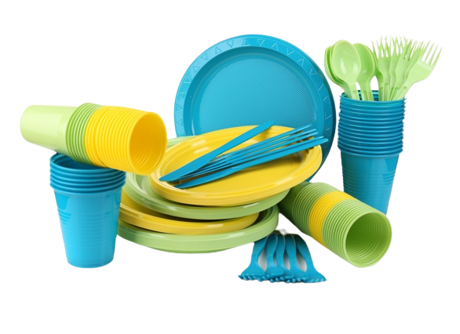
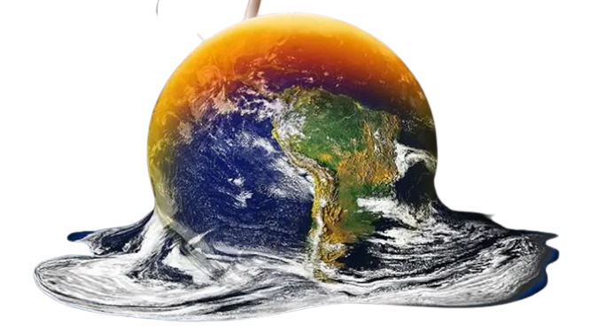
Single-use products
Global warming

Slide 8
2. Work in pairs. Make similar conversations to ask for and give clarification
SINGLE-USE PRODUCT:
A: What does it mean by ‘single-use products’?
B: ‘Single-use products’ are products made to be used once only.
A: Oh, thank you.
GLOBAL WARMING:
A: What do you mean by ‘global warming’?
B: It is the increase in the atmosphere’s temperatures caused by the rise of gases, especially carbon dioxide.
A: Oh, thank you.

Slide 9



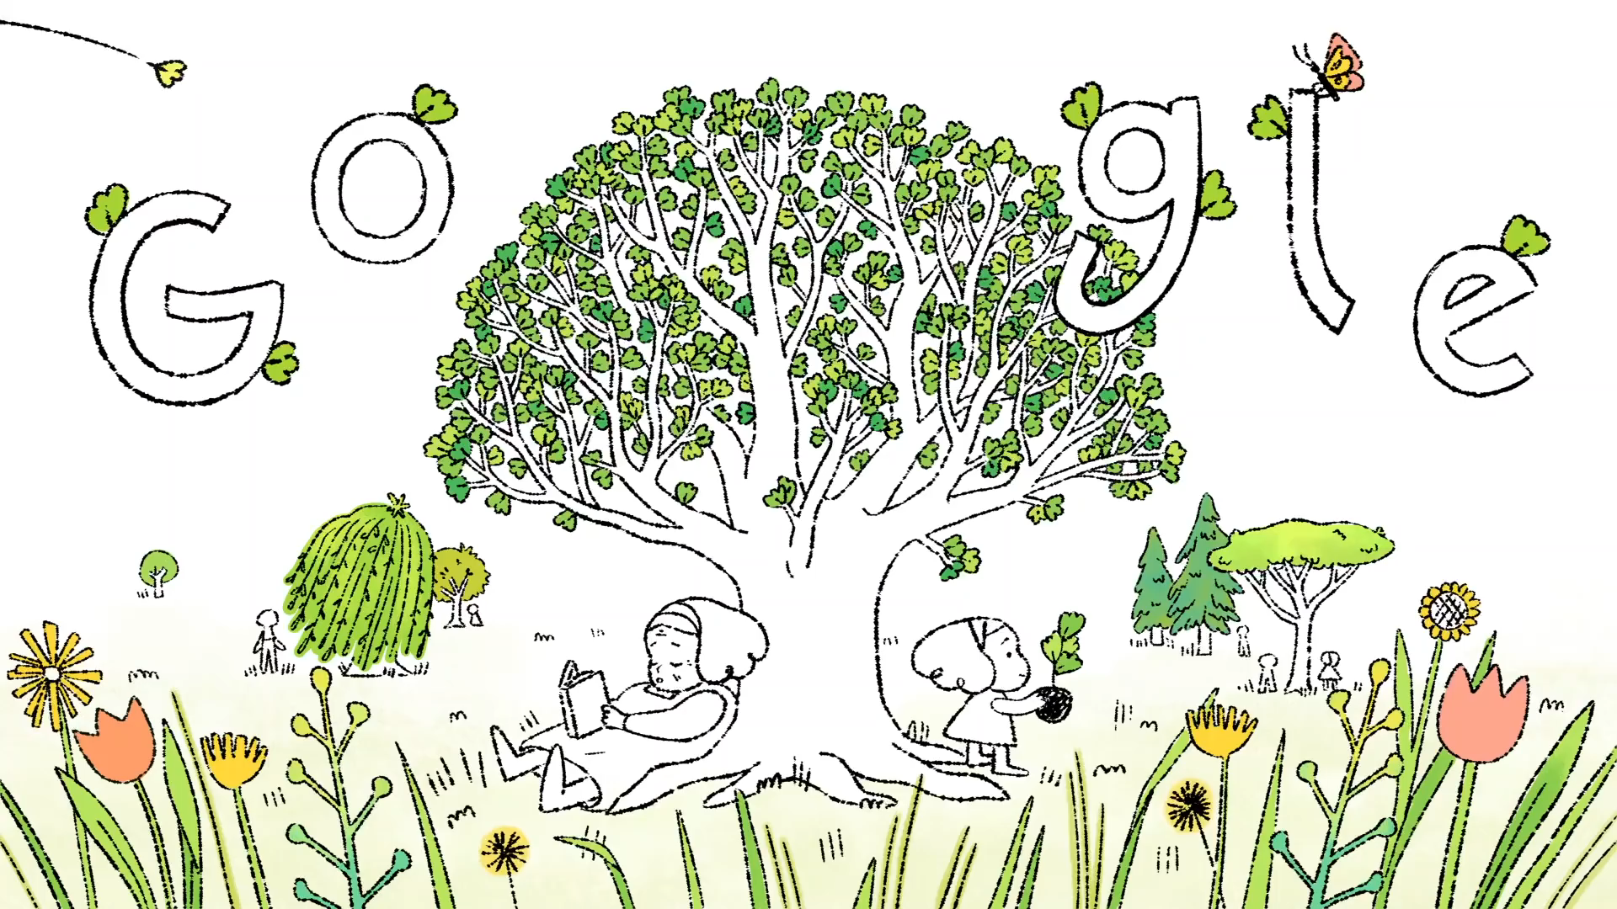


What’s the meaning of the video?

Slide 10
EARTH DAY

Slide 11
3. Read the passage and tick the correct answers.
WHAT ACTIVITIES DO PEOPLE DO ON EARTH DAY?
Every year on April 22nd, more than 190 countries celebrate Earth Day to protect the planet. The first Earth Day started in 1970 in America. Today more than 1 billion people participate in Earth Day activities each year, making it one of the largest movements. By taking part in activities like picking up litter and planting trees, you can help protect nature and the environment. You can also do things like buying green products and practicing reduce, reuse and recycle. We can celebrate Earth Day and protect the earth at the same time. Moreover, we should continue doing things to save the earth every day of the year.
1. picking up litter
2. protecting endangered species
3. planting trees
4. buying green products
5. helping neighbours

Slide 12



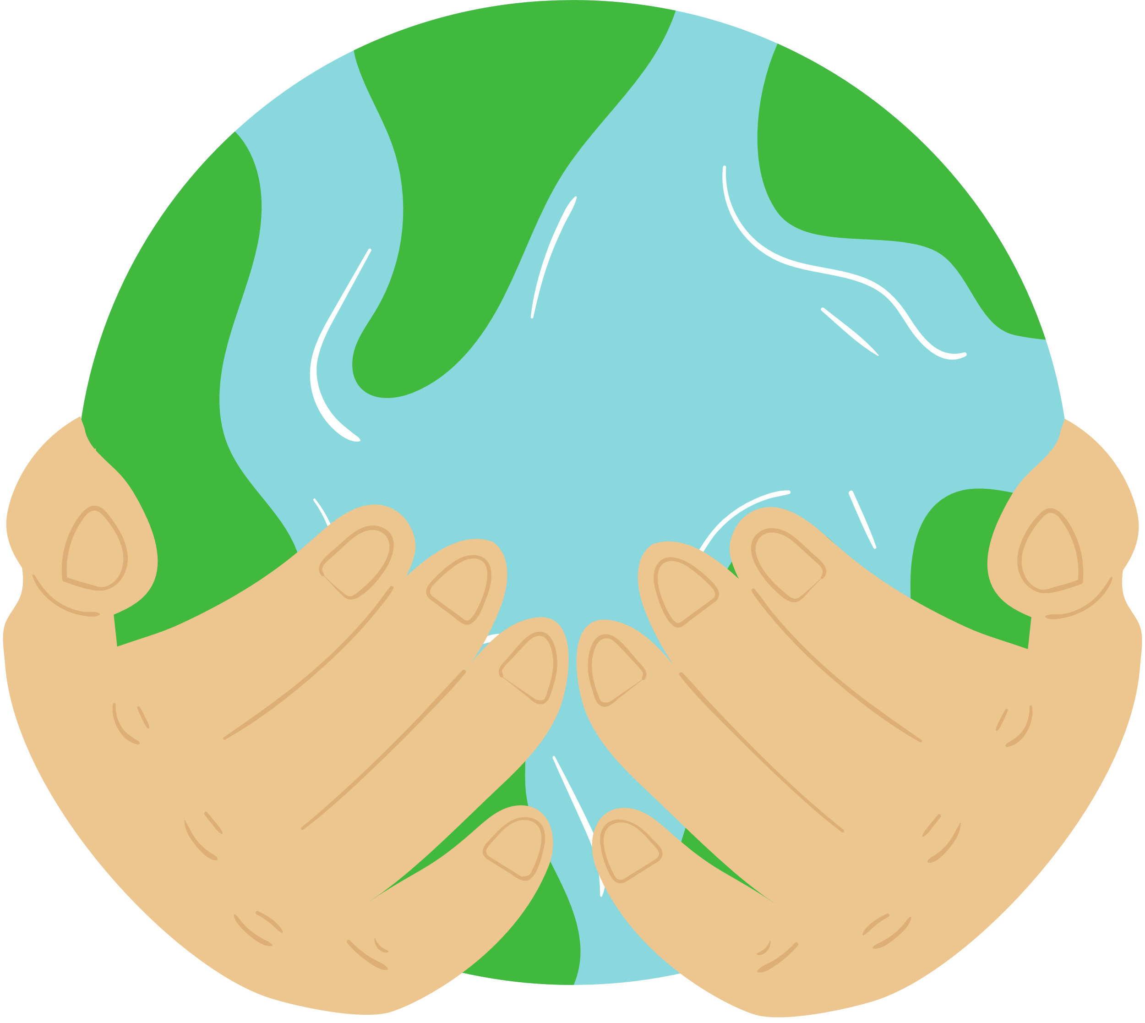

4. Work in groups. Match the activities people do on Earth Day with their results.
1. planting trees
2. buying green products
3. picking up litter
4. turning off the lights
a. making our environment clean, reducing pollution
b. reducing global warming, protecting animal habitats
c. saving electricity to save natural resources
d. improving our health, reducing pollution

Slide 13
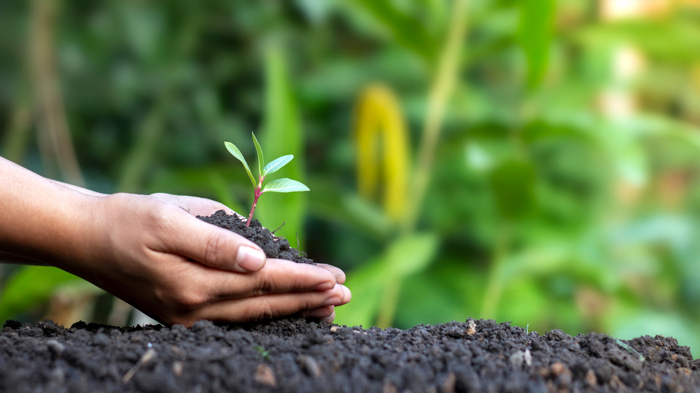
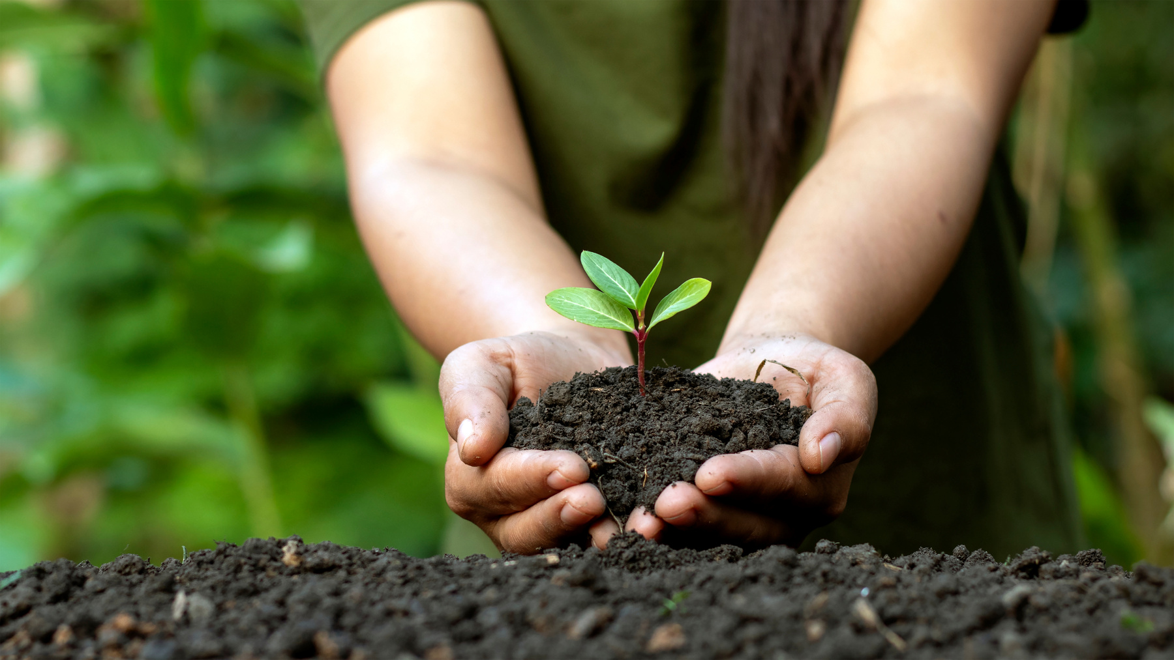
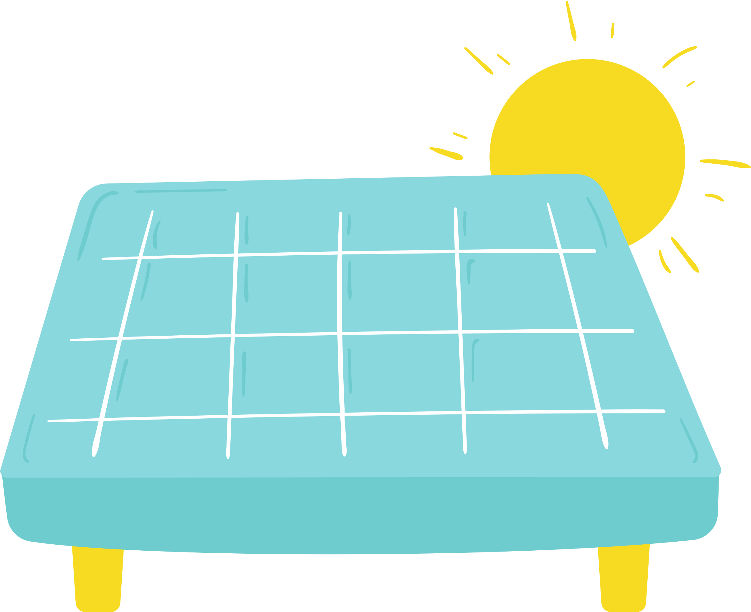
What we need to do to protect the environment:

Slide 14
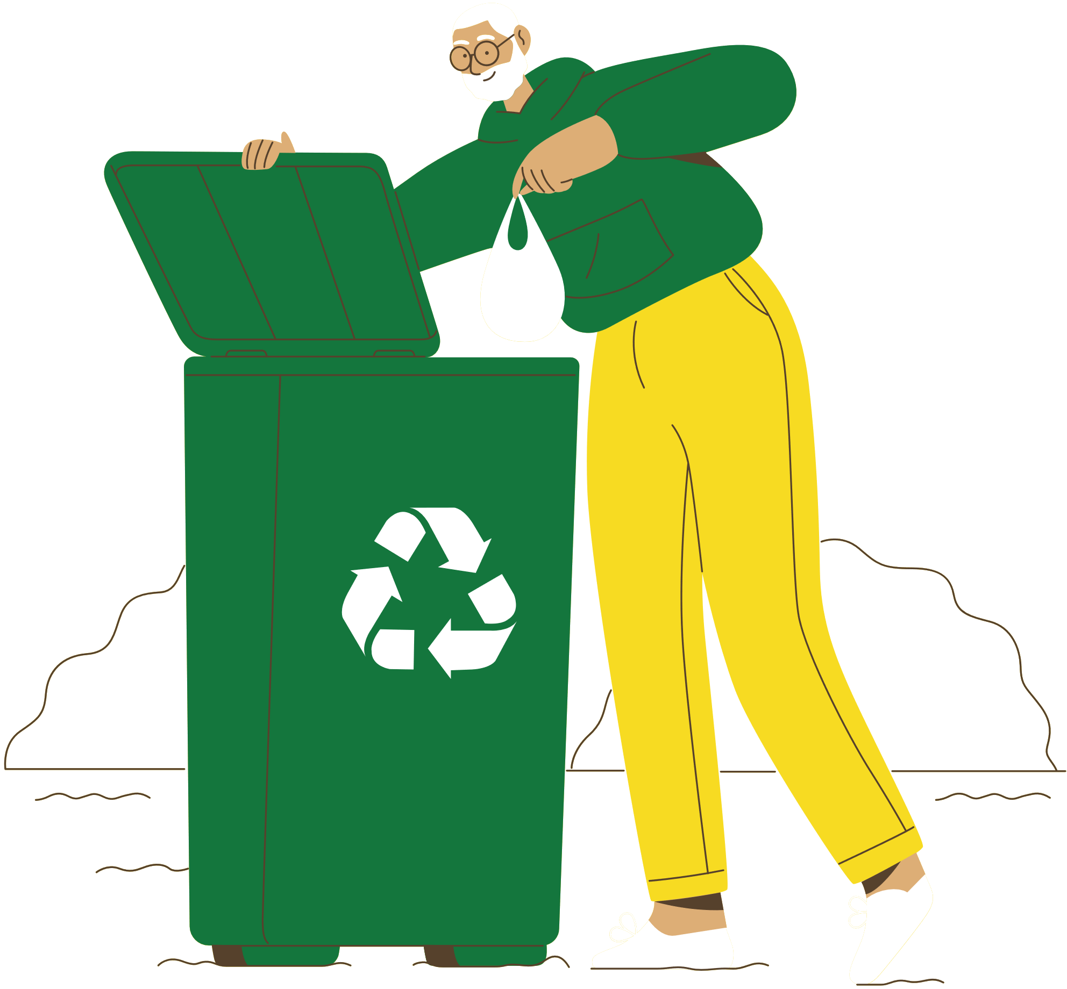
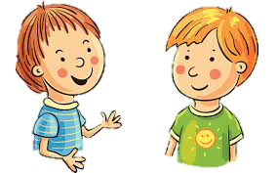
5. Work in pairs. Ask and answer about the things you and your friends do on Earth Day
We pick up litter and clean the
streets. And you?
What do you do on Earth day?
…

Slide 15
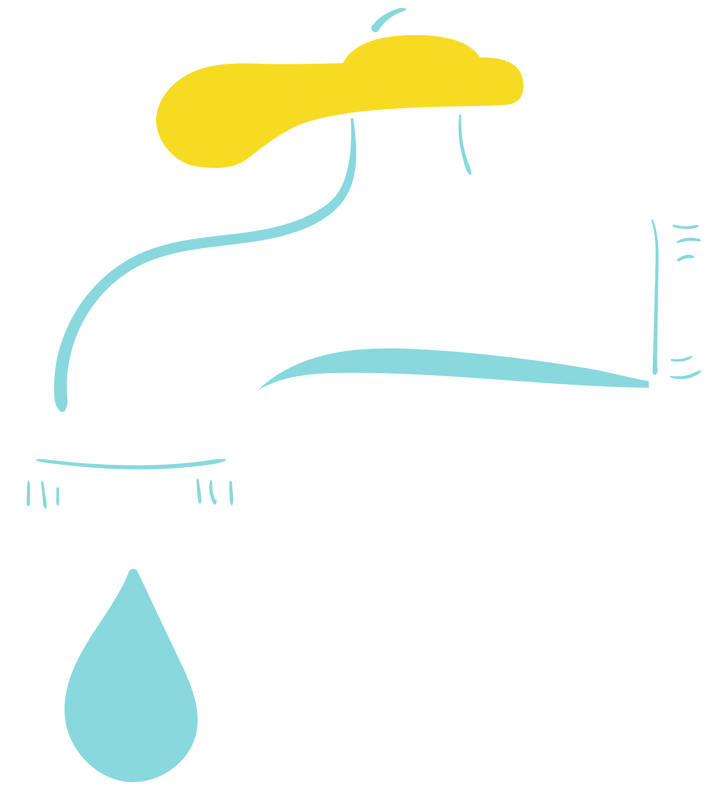
Wrap-up
What have we learned in this lesson?
Asking for clarification
Get information about Earth Day

Slide 16


THANK YOU

