Slide 1




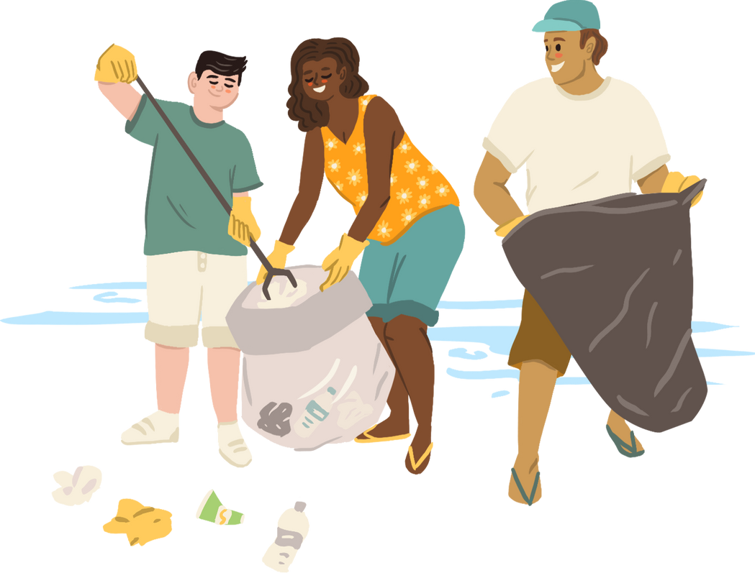


WELCOME TO OUR CLASS
Presented by Mr/Mrs:…………..

Slide 2



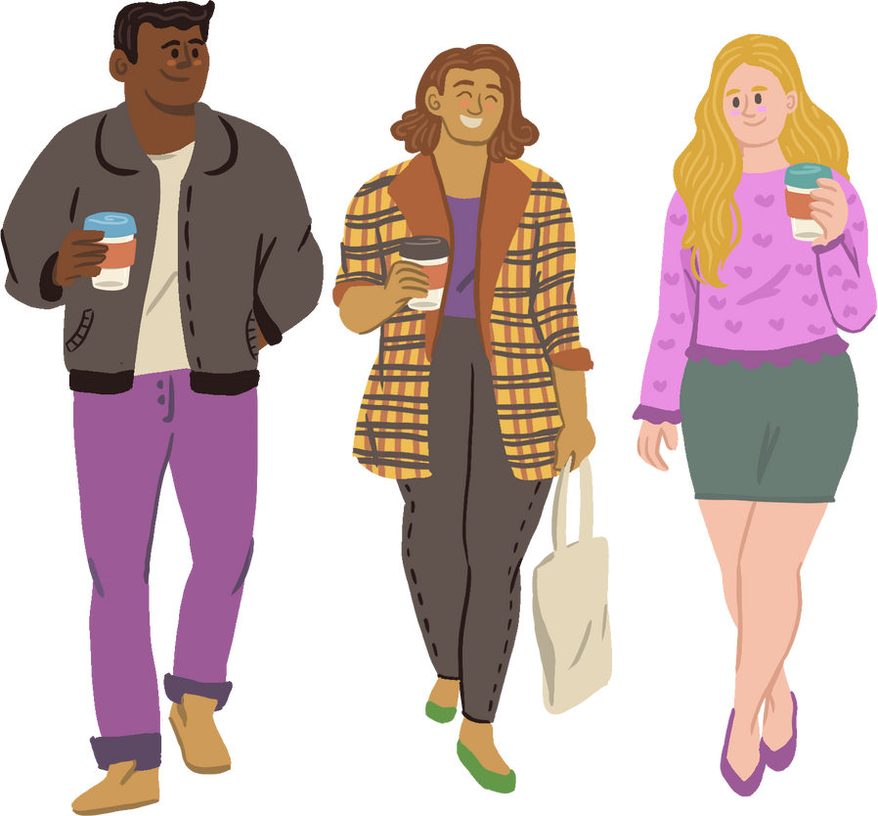





WARM UP
WORD SEARCH

Slide 3



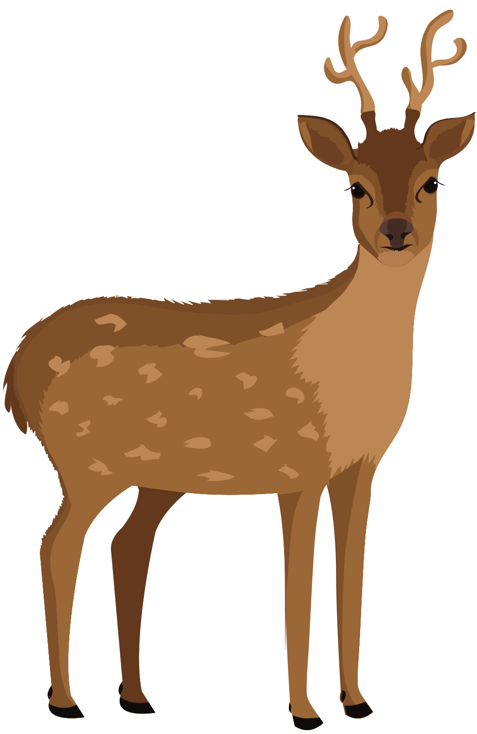

ENVIRONMENT
WORD SEARCH
Find the words listed below and mark them.
A | P | L | A | N | T | E | K | L | R | M | E
N | O | C | E | A | N | P | I | R | E | W | C
T | L | I | F | O | R | E | S | T | C | I | O
U | L | A | N | D | U | J | W | Q | Y | L | S
R | U | B | B | I | S | H | R | Z | C | D | Y
V | T | H | I | J | A | K | E | M | L | L | S
Y | I | H | A | B | I | T | A | T | E | I | T
P | O | P | U | L | A | T | I | O | N | F | E
Z | N | U | X | A | Q | E | R | F | G | E | M
  PLANT
  FOREST
  AIR
  POLLUTION
  HABITAT
  LAND
  OCEAN
  RECYCLE
  WILDLIFE
  ECOSYSTEM
  RUBBISH
  POPULATION
Notes:
Teacher can click here for Ss to play game.
https://www.liveworksheets.com/c?a=c&sr=n&im=n&l=go&i=sufnnns&r=6i&f=dzdtznzd&ms=uz&cd=kllbjpxelllp1ongnzglgnxg&mw=hs

Slide 4
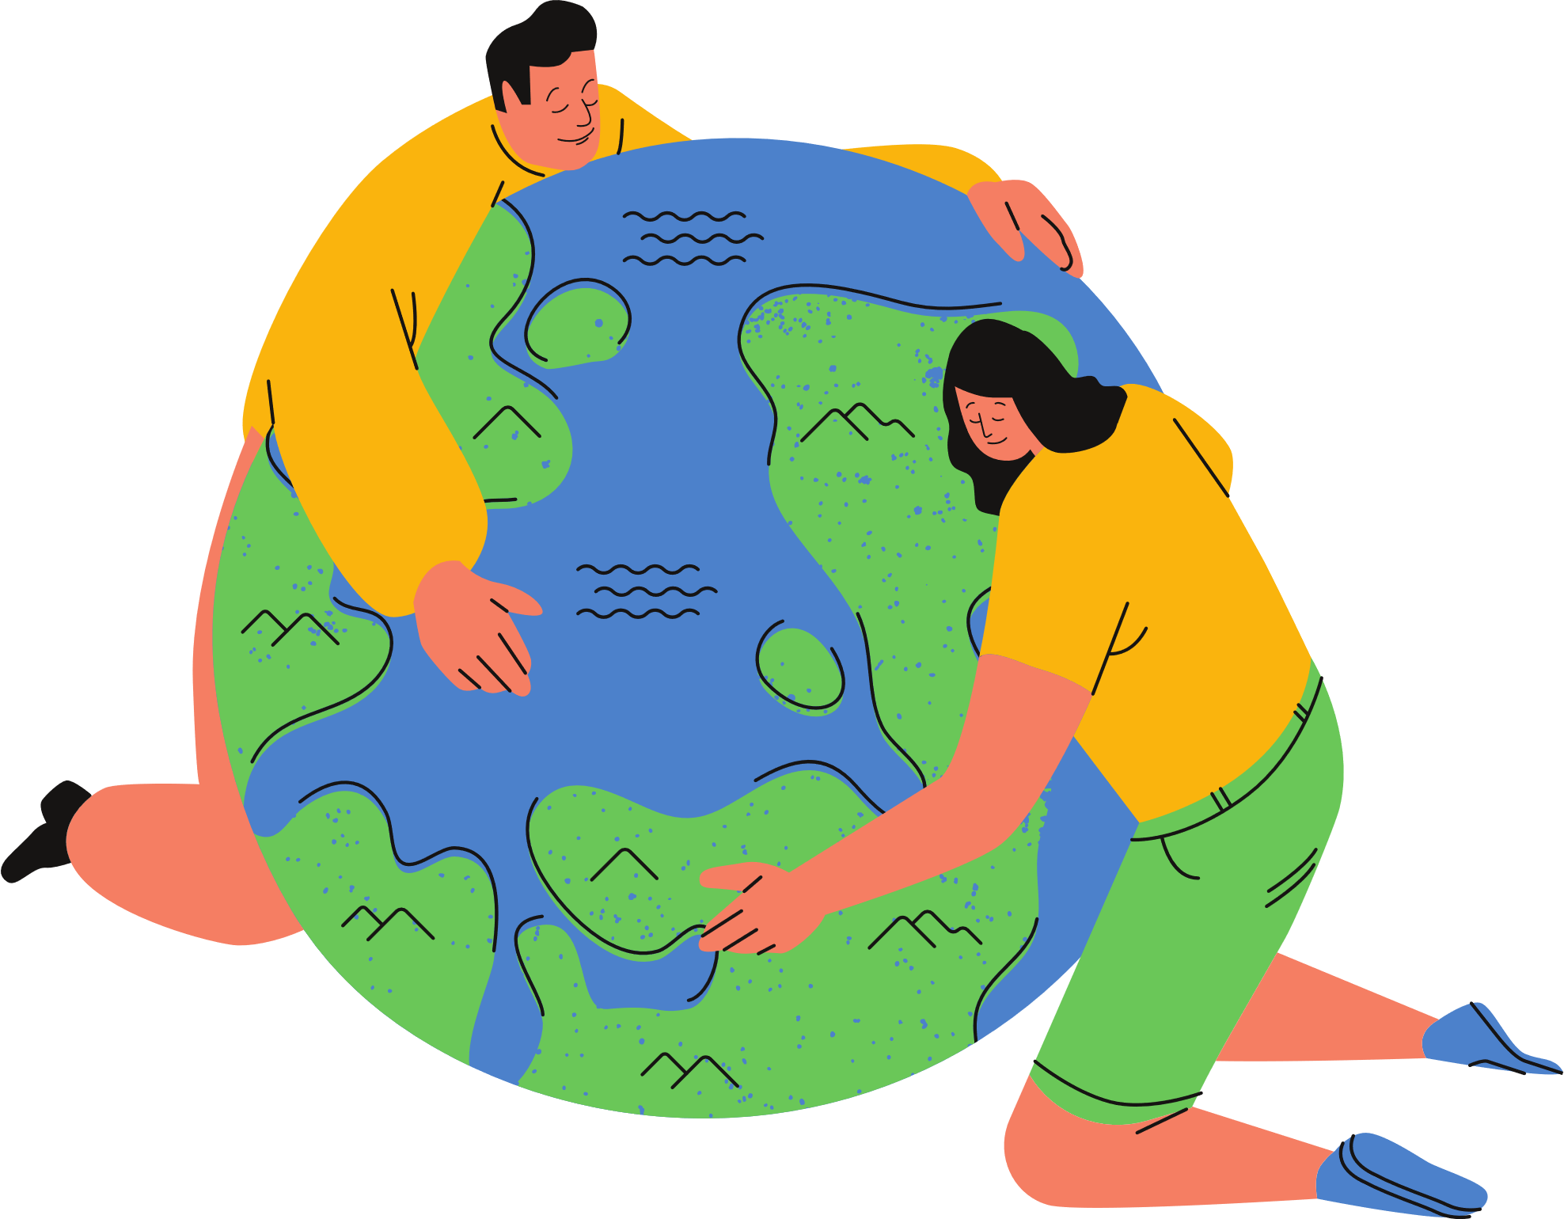
UNIT 7: ENVIRONMENTAL PROTECTION
Lesson 1: Getting Started
At the Go Green Club

Slide 5
VOCABULARY

Slide 6
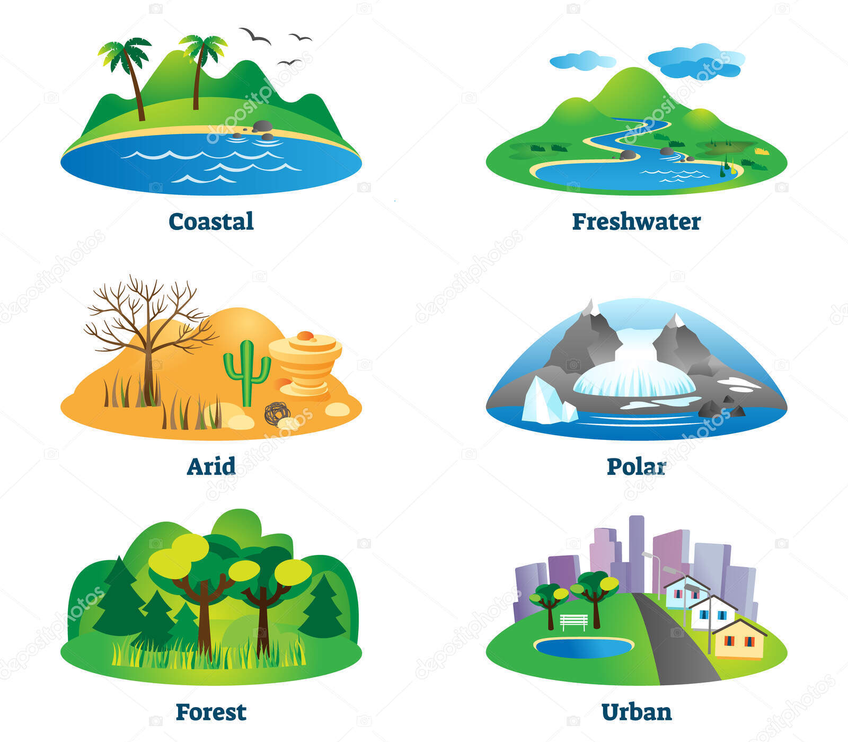

VOCABULARY
habitat (n)
/ˈhæbɪtæt/
môi trường sống

Slide 7

VOCABULARY
endangered species (n)
/ɪnˈdeɪndʒəd ˈspiːʃiːz/
động vật có nguy cơ bị tuyệt chủng

Slide 8
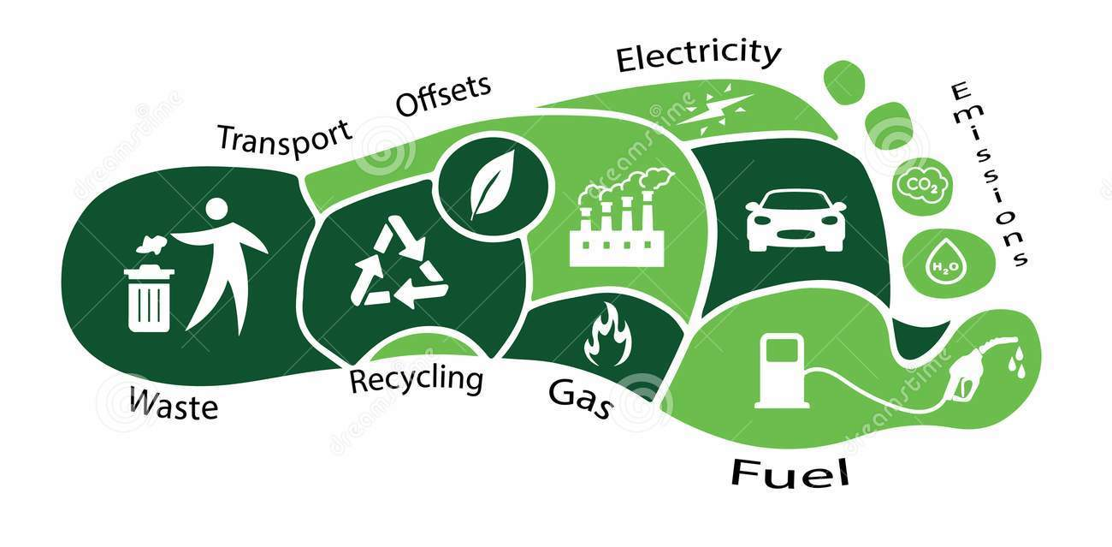
VOCABULARY
carbon footprint (n)
/ˌkɑːbən ˈfʊtprɪnt/
dấu chân cac-bon

Slide 9

VOCABULARY
release (v)
/rɪˈliːs/
thải ra

Slide 10

VOCABULARY
single-use (adj)
/ˌsɪŋɡl ˈjuːs/
dùng một lần

Slide 11
VOCABULARY
New words | Pronunciation | Meaning
- habitat (n) | /ˈhæbɪtæt/ | môi trường sống
- endangered species (n) | /ɪnˈdeɪndʒəd ˈspiːʃiːz/ | động vật có nguy cơ tuyệt chủng
- carbon footprint (n) | /ˌkɑːbən ˈfʊtprɪnt/ | dấu chân cacbon
- release (v) | /rɪˈliːs/ | thải ra
- single-use (adj) | /ˌsɪŋɡl ˈjuːs/ | dùng một lần

Slide 12
LISTENING & READING

Slide 13

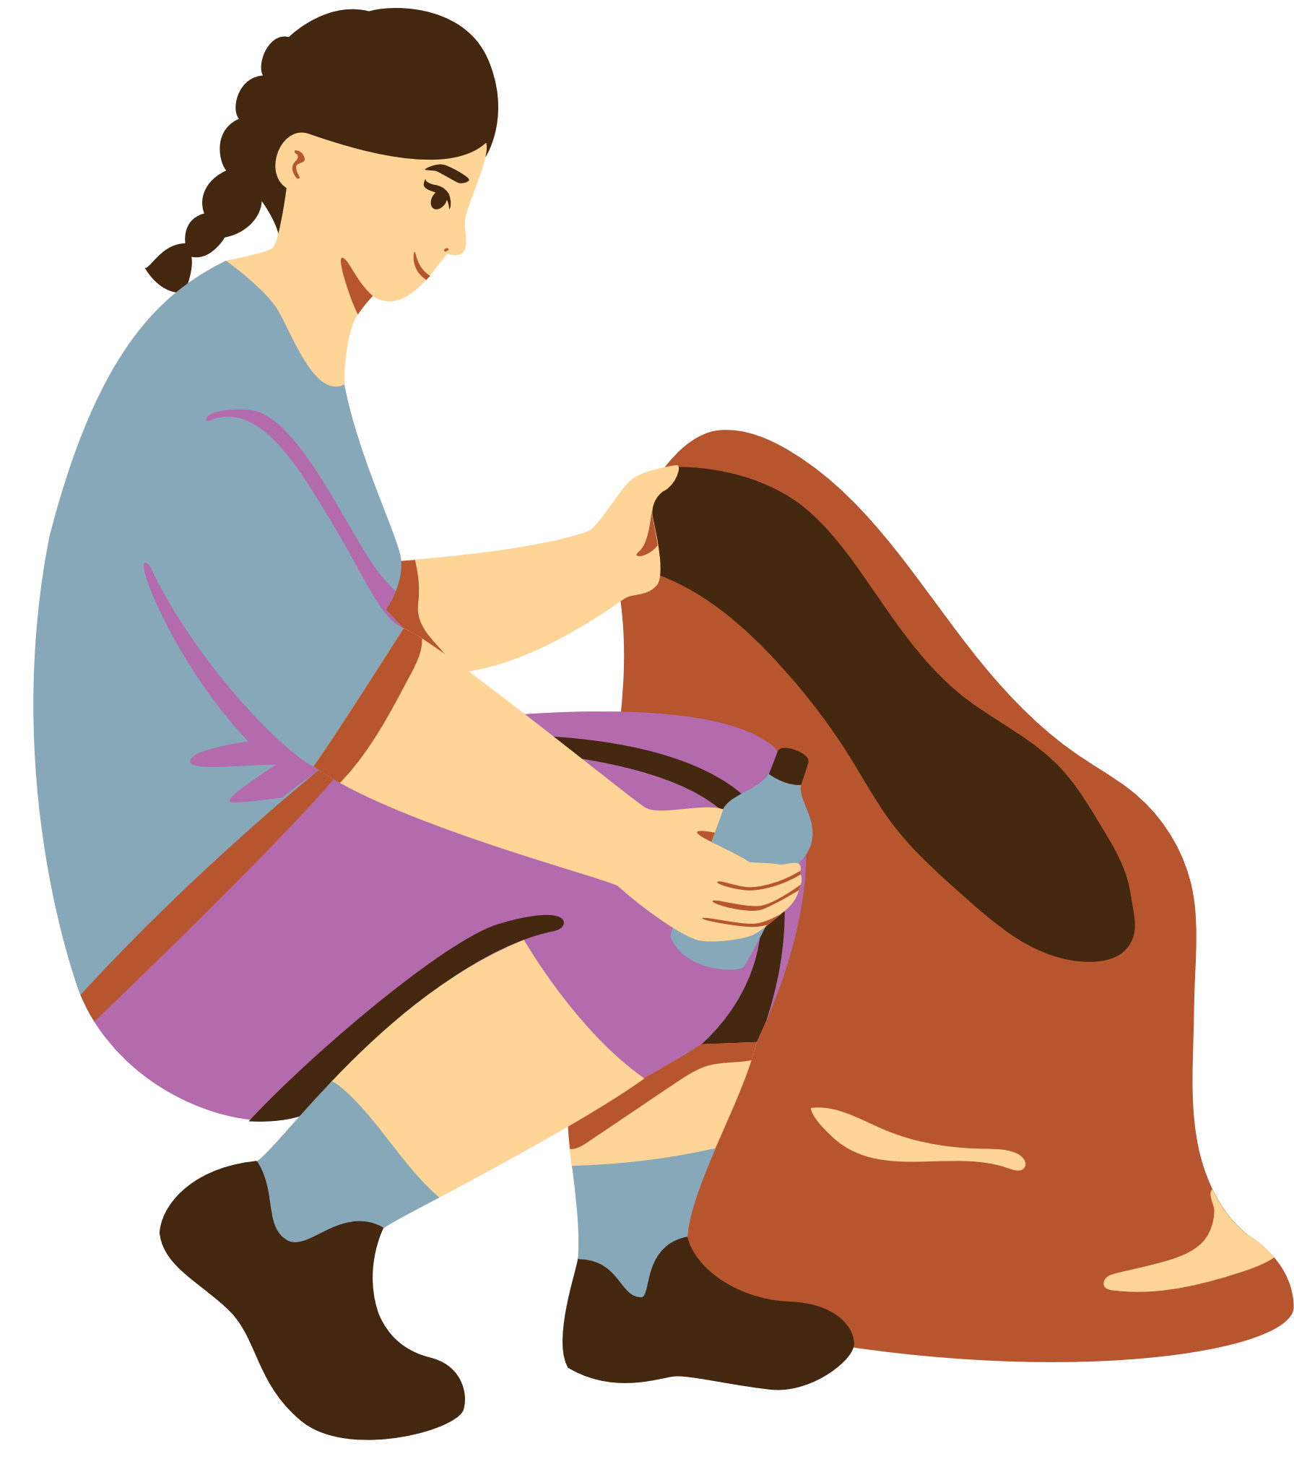


What are our serious environmental problems now?
pollution
global warming
poverty
habitat loss
population explosion
illiteracy
endangered species loss
Listen and tick

Slide 14


1. Listen and read
Club leader: Hello. Welcome back. Today we’re discussing environmental problems and environmental protection. What are our serious environmental problems now?
Nam: Pollution and habitat loss, I think.
Ann: I agree. The air and water quality are getting worse and worse.
Club leader: Any others?
Ann: Yes, I can think of some like global warming, endangered species loss, …
Nam: So what should we do to help protect our environment?
Club leader: We can reduce our carbon footprint even in our homes.
Ann: What do you mean by ‘carbon footprint’?
Club leader: It’s the amount of carbon dioxide we release into the environment.
Ann: I see. So we can do things like turning off devices when we’re not using them.
Club leader: Right … And there is much more we can do, like practising the 3Rs.
Nam: We can plant more trees in our neighbourhood too.
Ann: And try to avoid using single-use products, like plastic bags, and stop littering.
Club leader: Yeah. And we can volunteer at some local environment programmes to save endangered species.

Slide 15
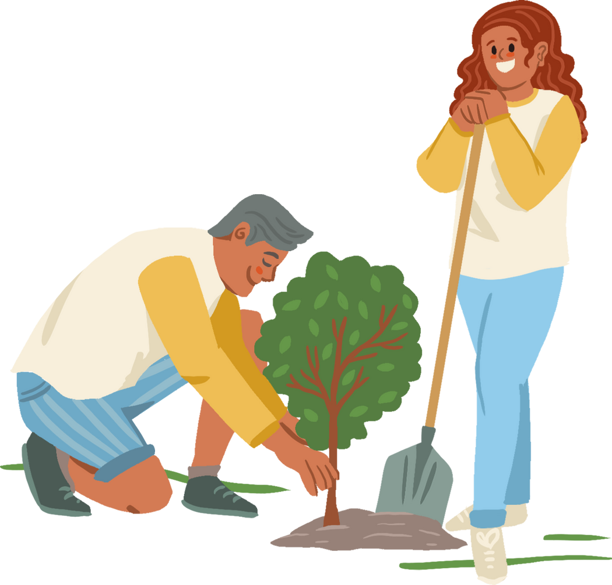
2. Read the conversation again and match the two halves in the two columns
1. C
2. D
3. E
4. A
5. B
To protect the environment, we should:
1. reduce 2. turn off 3. plant 4. avoid 5. stop | a. using single-use products b. littering c. our carbon footprint d. devices when we’re not using them e. more trees in our neighbourhood

Slide 16
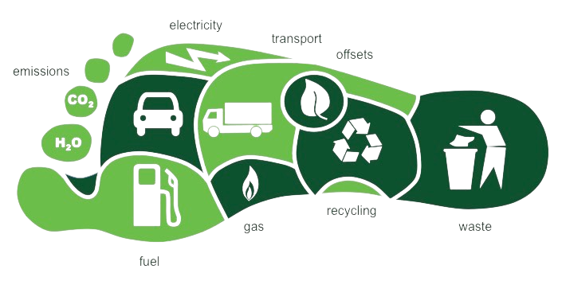
2. Read the conversation again and match the two halves in the two columns
To protect the environment, we should:
c. our carbon footprint
1. reduce

Slide 17

2. Read the conversation again and match the two halves in the two columns
To protect the environment, we should:
2. turn off
d. devices when we’re not using them

Slide 18
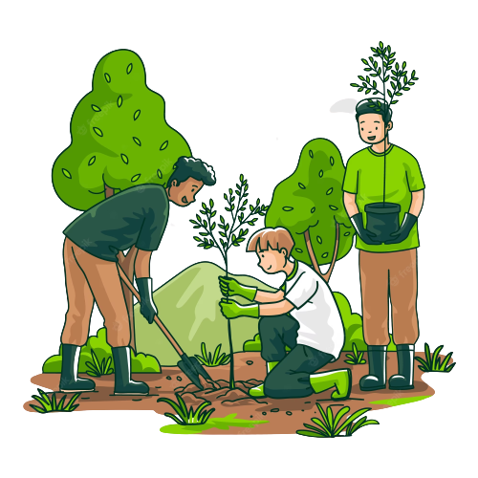
2. Read the conversation again and match the two halves in the two columns
To protect the environment, we should:
e. more trees in our neighbourhood
3. plant

Slide 19
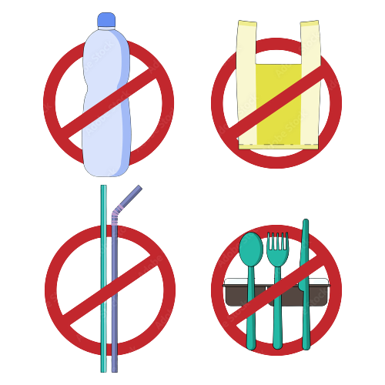
2. Read the conversation again and match the two halves in the two columns
To protect the environment, we should:
4. avoid
a. using single-use products

Slide 20

2. Read the conversation again and match the two halves in the two columns
To protect the environment, we should:
5. stop
b. littering

Slide 21
Look at the answers again
To protect the environment, we should:
1. reduce our carbon footprint 2. turn off devices when we’re not using them 3. plant more trees in our neighbourhood 4. avoid using single-use products 5. stop littering

Slide 22
3. Complete each sentence with one word or phrase from the box.
reduce | single-use | pollution | carbon footprint | environment programme
Pollution
1. _______________ is a serious problem everywhere.
2. We should avoid dumping waste into lakes and rivers to _________________ water pollution.
3. We shouldn’t throw away ________________ products but recycle them.
4. _____________________ is the amount of carbon dioxide
we release into the environment.
5. We hope a lot more people join our ______________________.
reduce
single-use
Carbon footprint
environment programme

Slide 23

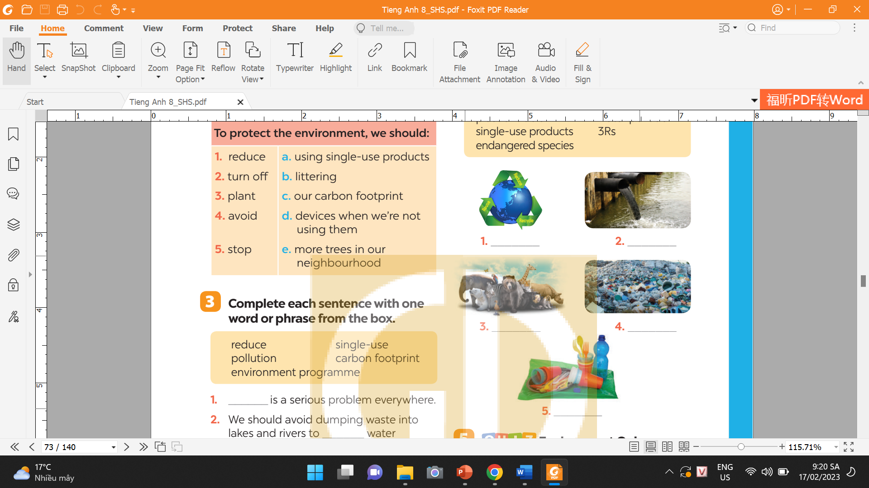
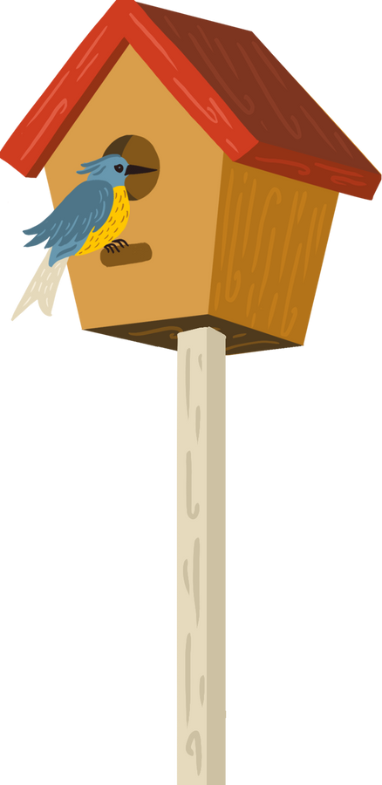
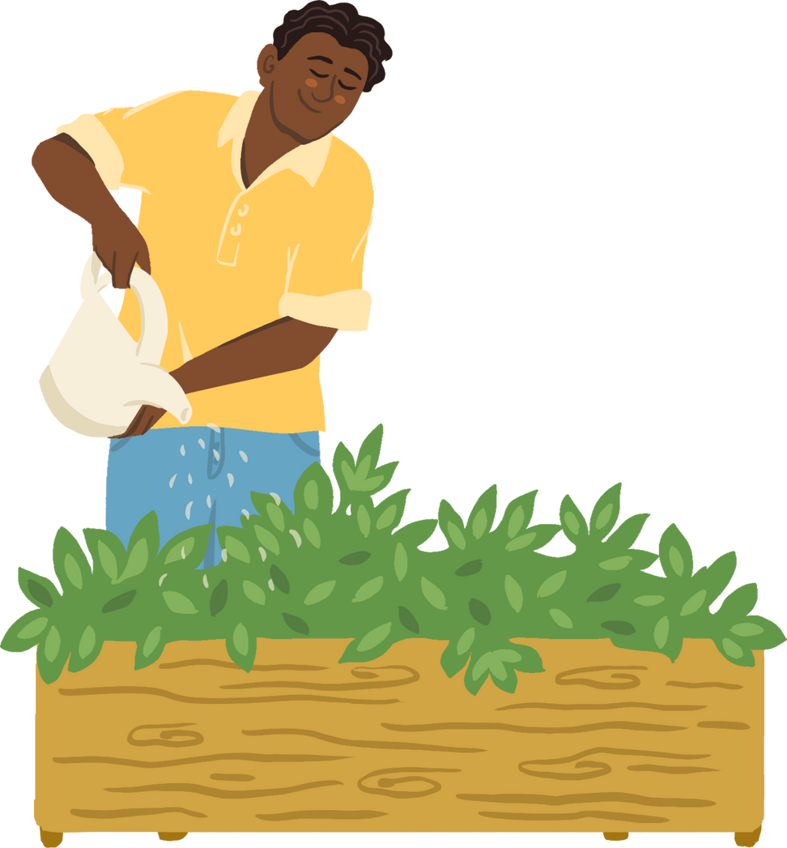

4. Write a phrase from the box under each picture.
plastic rubbish | single-use products | endangered species | water pollution | 3Rs
1. ___________
2. ___________
3. ___________
4. ___________
5. ___________

Slide 24

Game: SHUFFLE THE CARDS
3Rs

Slide 25
Game: SHUFFLE THE CARDS
water pollution

Slide 26
Game: SHUFFLE THE CARDS
endangered species

Slide 27
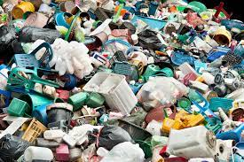
Game: SHUFFLE THE CARDS
plastic rubbish

Slide 28
Game: SHUFFLE THE CARDS
single-use products

Slide 29
Look at the answers again.
1. 3Rs
2. water pollution
3. endangered species
4. plastic rubbish
5. single-use products

Slide 30
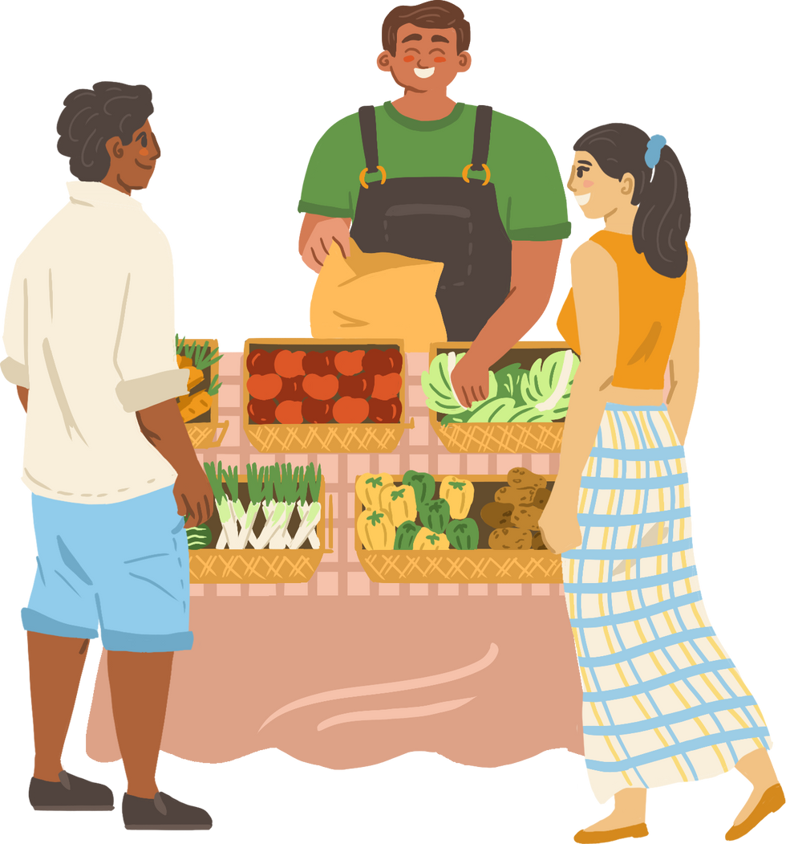


Environment Quiz
1. Which of the following is the greenest form of transport?
A. Motorbike. B. Bus. C. Bicycle.
2. Which of the following is a renewable source?
A. Coal. B. Oil. C. Wind.
3. What causes the most pollution?
A. Factories. B. Animals. C. Hospitals.
4. The surroundings in which we live are our ______.
A. habitat B. place C. environment
5. Which of these will reduce your carbon footprint?
    Cutting down a lot of trees.
    Recycling paper products.
C. Leaving the TV on all night.

Slide 31
WRAP - UP
What have we learnt in this lesson?
identify the topic of the unit
use lexical items related to environment protections
identify the language features that are covered in the unit

Slide 32
HOMEWORK
Learn by heart vocabulary
Doing exercises in the workbook
Prepare for the next lesson

Slide 33

THANK YOU

