Slide 1








WEDNESDAY, NOVEMBER 13TH , 2024
WELCOME ALL THE TEACHERS TO
VISIT OUR CLASS
School year: 2024 -2025
Teacher : Ho Thi Tư

Slide 2



Slide 3
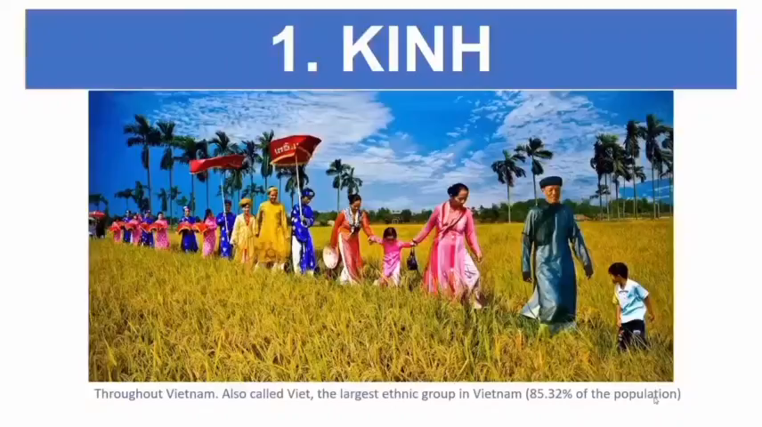
54 DÂN TỘC VIỆT NAM( ETHNIC GROUPS OF VIET NAM

Slide 4

WARM-UP: NETWORK
The Koho
The Giay
The Muong
The Tay
The Bru-Van Kieu
Ethnic groups of Viet Nam
The Nung
The Bahnar
The Yao
The Kinh
The Hmong
……
The Brau
START TIMER
1 : 00
0 : 59
0 : 58
0 : 57
0 : 56
0 : 55
0 : 54
0 : 53
0 : 52
0 : 51
0 : 50
0 : 49
0 : 48
0 : 47
0 : 46
0 : 45
0 : 44
0 : 43
0 : 42
0 : 41
0 : 40
0 : 39
0 : 38
0 : 37
0 : 36
0 : 35
0 : 34
0 : 43
0 : 32
0 : 31
0 : 30
0 : 29
0 : 28
0 : 27
0 : 26
0 : 25
0 : 24
0 : 23
0 : 22
0 : 21
0 : 20
0 : 19
0 : 18
0 : 17
0 : 16
0 : 15
0 : 14
0 : 13
0 : 12
0 : 11
0 : 10
0 : 09
0 : 08
0 : 07
0 : 06
0 : 05
0 : 04
0 : 03
0 : 02
0 : 01
0 : 00
TIME’S UP!

Slide 5

Unit
4
ETHNIC GROUPS OF VIET NAM
Unit
ETHNIC GROUPS OF VIET NAM
LESSON 1: GETTING STARTED
I’m from the Tay ethnic group

Slide 6


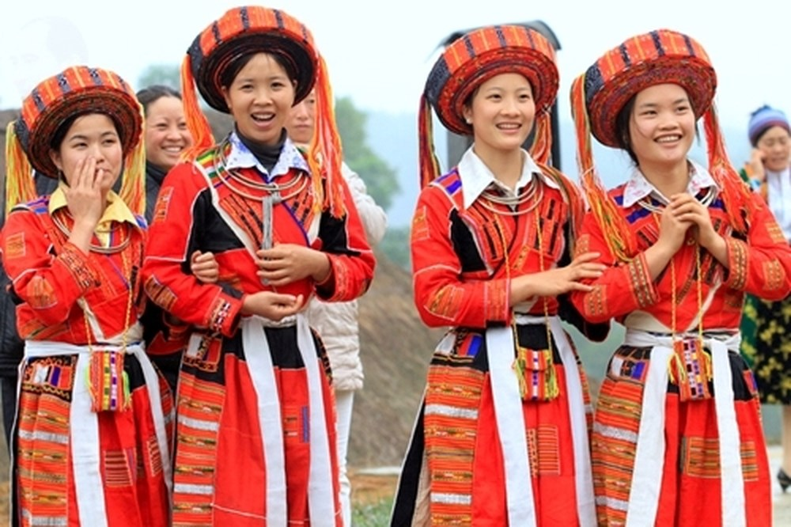
Unit
4
ETHNIC GROUPS OF VIET NAM
Unit
ETHNIC GROUPS OF VIET NAM
LESSON 1: GETTING STARTED
I. Vocabulary
1. ethnic (group) (adj)
/ˈeθnɪk / (/gru:p/)
(nhóm) dân tộc

Slide 7
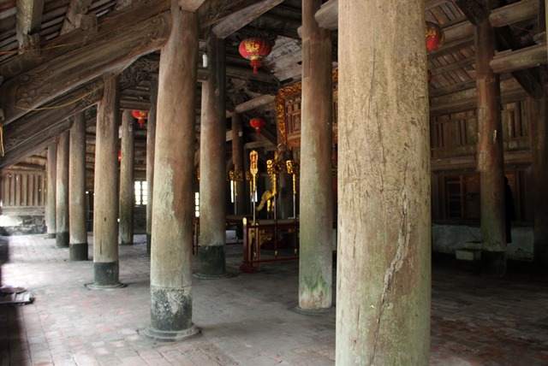
Unit
4
ETHNIC GROUPS OF VIET NAM
ETHNIC GROUPS OF VIET NAM
Unit
ETHNIC GROUPS OF VIET NAM
Unit
LESSON 1: GETTING STARTED
I. Vocabulary
2. post (n)
/pəʊst/
cột

Slide 8
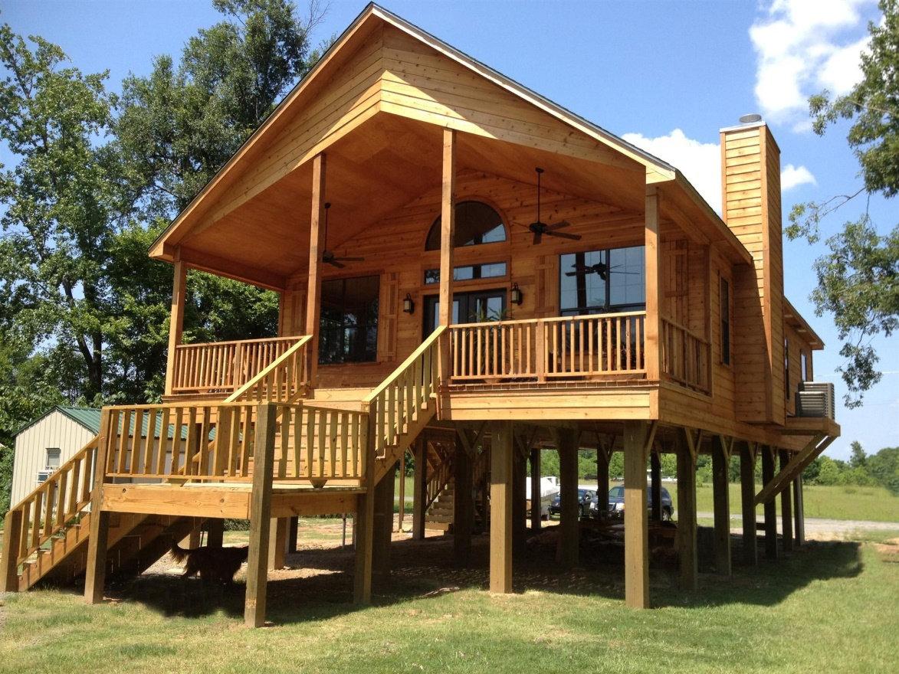
Unit
4
ETHNIC GROUPS OF VIET NAM
ETHNIC GROUPS OF VIET NAM
Unit
ETHNIC GROUPS OF VIET NAM
Unit
LESSON 1: GETTING STARTED
I. Vocabulary
3. stilt house (n)
/stilt haus/
nhà sàn

Slide 9
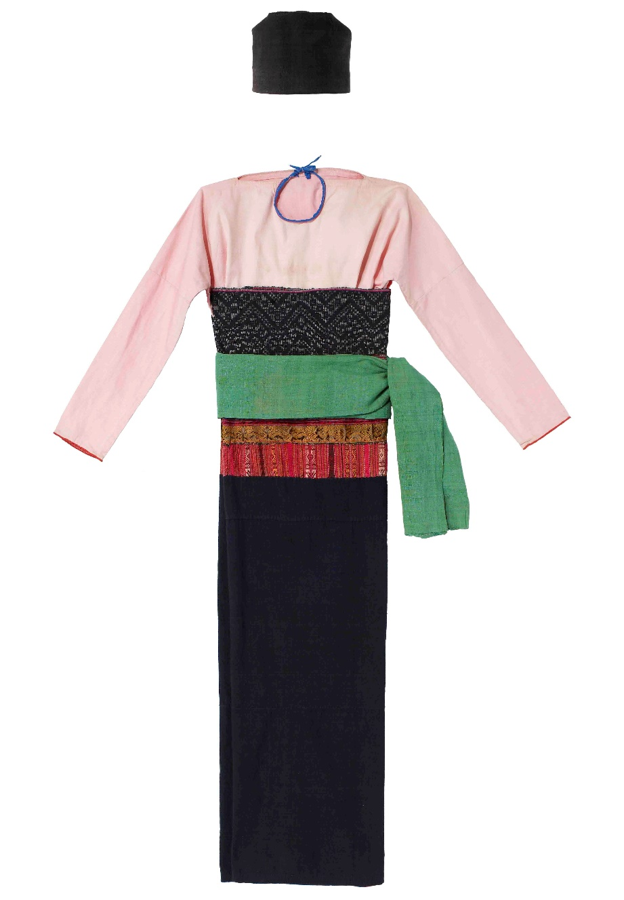
Unit
4
ETHNIC GROUPS OF VIET NAM
ETHNIC GROUPS OF VIET NAM
Unit
ETHNIC GROUPS OF VIET NAM
Unit
LESSON 1: GETTING STARTED
I. Vocabulary
4.costume (n)
/'kɔstju:m/
trang phục

Slide 10
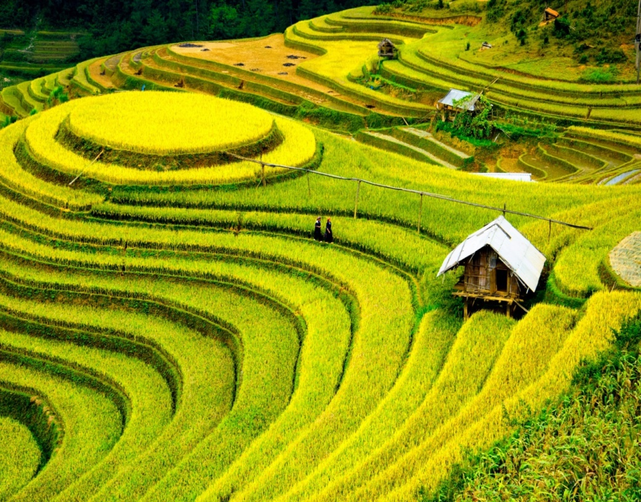
Unit
4
ETHNIC GROUPS OF VIET NAM
ETHNIC GROUPS OF VIET NAM
Unit
ETHNIC GROUPS OF VIET NAM
Unit
LESSON 1: GETTING STARTED
I. Vocabulary
5. terraced field (n)
/ˈterəst fiːld /
ruộng bậc thang

Slide 11
Unit
4
ETHNIC GROUPS OF VIET NAM
ETHNIC GROUPS OF VIET NAM
Unit
ETHNIC GROUPS OF VIET NAM
Unit
LESSON 1: GETTING STARTED
I. Vocabulary
Ex:Our house overlooks terraced field.
6. overlook (v)
/ˌəʊvəˈlʊk/
nhìn ra
Unit

Slide 12
Unit
4
ETHNIC GROUPS OF VIET NAM
Unit
ETHNIC GROUPS OF VIET NAM
LESSON 1: GETTING STARTED
I. VOCABULARY
1. ethnic (group) (adj) | (nhóm) dân tộc
2. post (n) | cột
3. overlook (v) | nhìn ra
4. stilt house (n) | nhà sàn
5. costume (n) | trang phục
6. terraced field (n) | ruộng bậc thang

Slide 13
Unit
4
ETHNIC GROUPS OF VIET NAM
Unit
ETHNIC GROUPS OF VIET NAM
LESSON 1: GETTING STARTED
CHECKING
1. ethnic (group) (adj) |  | nhìn ra
2. post (n) |  | nhà sàn
3. overlook (v) |  | (nhóm) dân tộc
4. stilt house (n) |  | cột
5. costume (n) |  | ruộng bậc thang
6. terraced field (n) |  | trang phục

Slide 14
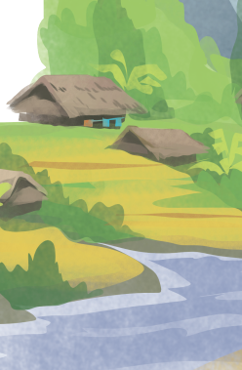
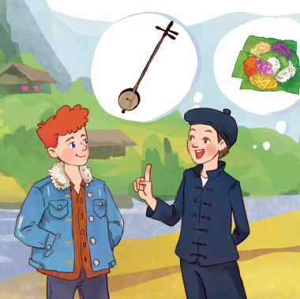
Unit
4
ETHNIC GROUPS OF VIET NAM
Unit
ETHNIC GROUPS OF VIET NAM
LESSON 1: GETTING STARTED
1
Listen and read.
- What do you think Lai and Tom talking about?
- Do you know anything about the Tay ethnic group?

Slide 15
Unit
4
ETHNIC GROUPS OF VIET NAM
Unit
ETHNIC GROUPS OF VIET NAM
LESSON 1: GETTING STARTED
1
Listen and read.
Tom: Hi, I’m Tom. You look new here.
Lai: I am. I’m Lai from Ha Giang.
Tom: Oh, I’ve heard about beautiful Ha Giang. Do you live in the mountains?
Lai: Yes, I do. I’m from the Tay ethnic group. We are the second largest ethnic group in Viet Nam, only after the Kinh.
Tom: Oh … I once saw a bamboo house on high posts in a travel brochure. Do you live in a home like that?
Lai: Yes, we call it a “stilt house”. Our house overlooks terraced fields.
Tom: Awesome. What is life in your village like?
Lai: It’s peaceful. There are 16 houses in my village. We live very close to nature.
Tom: I love it. Can you tell me something about your culture?
Lai: Certainly. We have our own culture. You can see it in our folk dances, musical instruments like the dan tinh, and our special five-colour sticky rice.
Tom: It sounds interesting. I hope to visit Ha Giang one day.

Slide 16


Travelling to Ha Giang with Doraemon

Slide 17

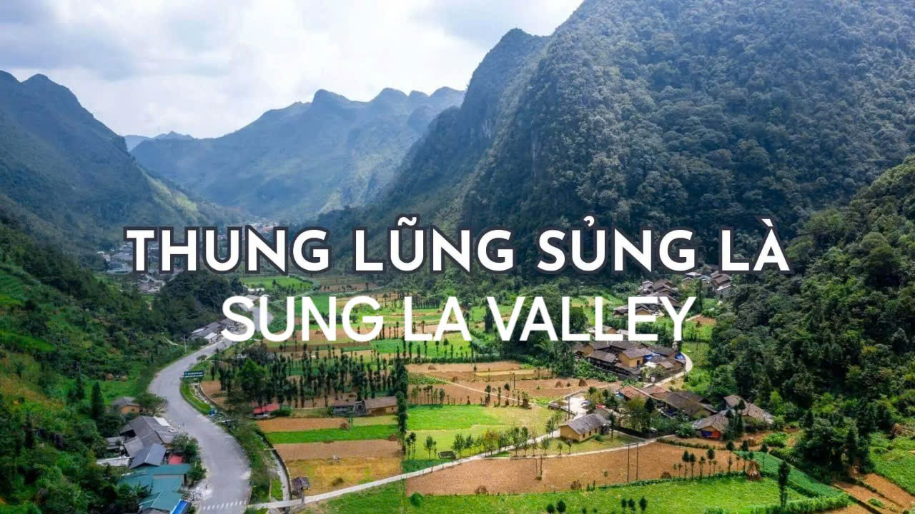



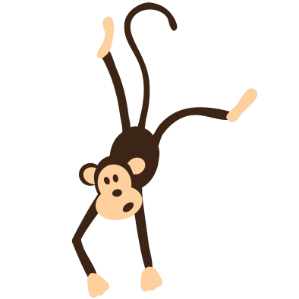

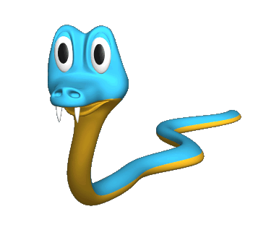

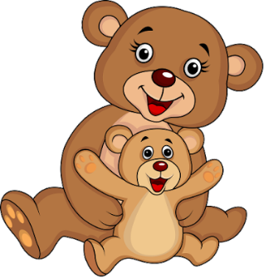
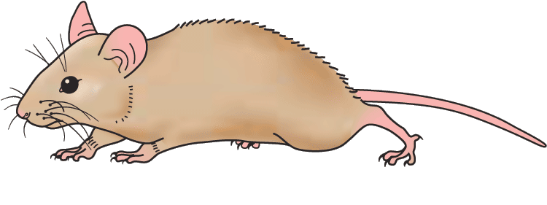
Q1. Lai mentions …. of the Tay people.
A.costumes
B.folk dances
A.
B.

Slide 18

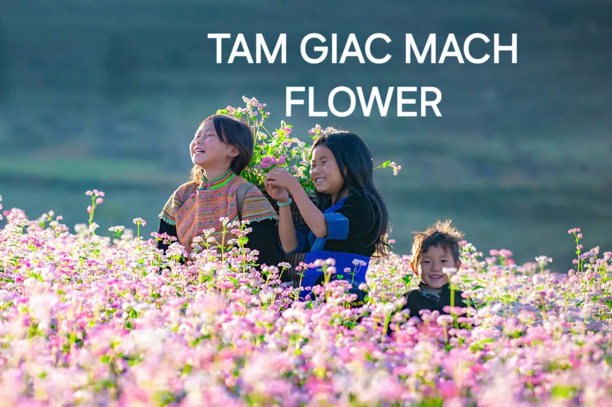

Q2: A “stilt house”……
A. is on high posts
B. always faces a field
A.
B.

Slide 19


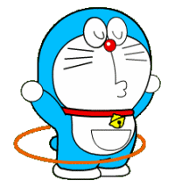
Q3: What’re Tom and Lai talking about?
A. Life of the Tay people
B. Minority groups of Viet Nam
A.
B.

Slide 20

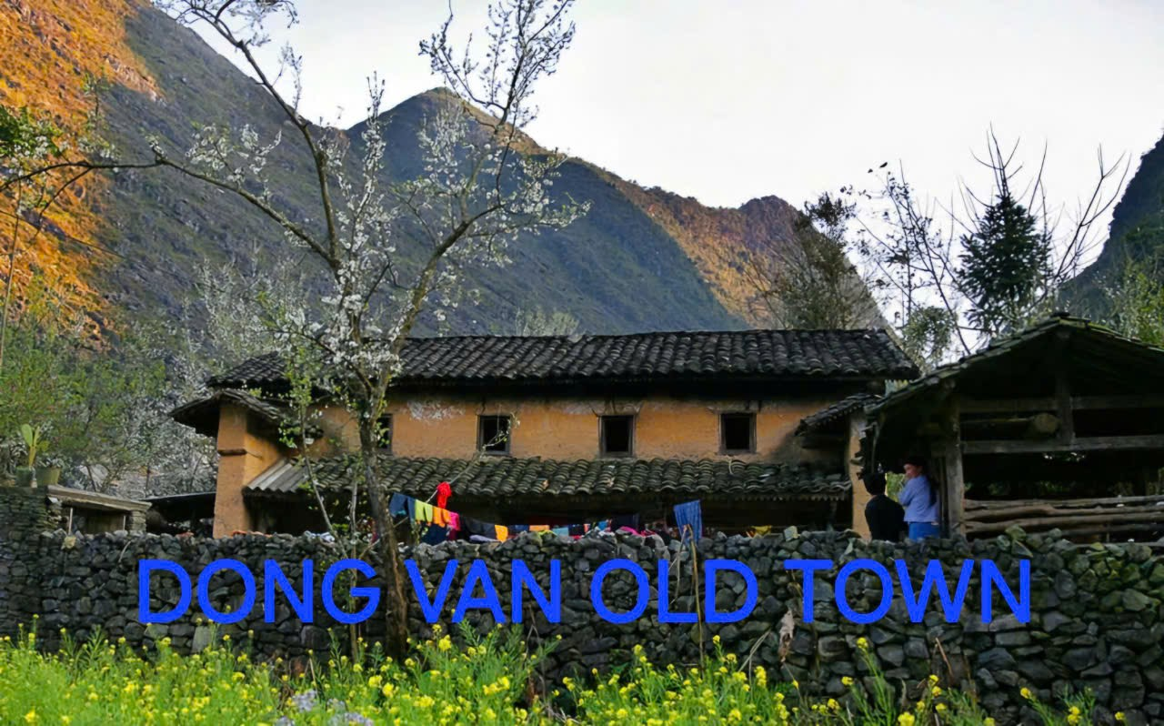

Q4: Where is Lai from?
A. Thai Binh
B. Ha Giang
A.
B.

Slide 21
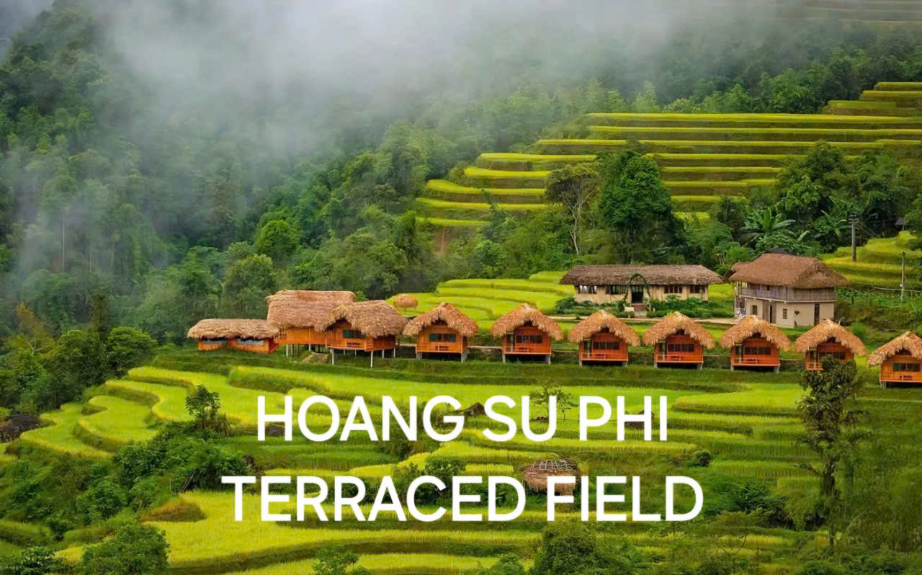

Q5: How many houses are there in Lai’s village?
A. 26
B. 16
Love bridge
Danang Vietnam
A.
B.

Slide 22

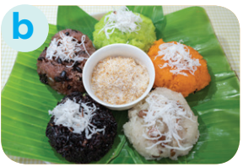

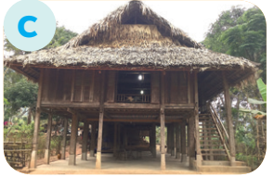
Unit
4
ETHNIC GROUPS OF VIET NAM
Unit
ETHNIC GROUPS OF VIET NAM
LESSON 1: GETTING STARTED
3
Match the pictures with the word and phrases from the conversation.
1. stilt house
2. terraced fields
3. bamboo
4. five-colour sticky rice

Slide 23
4
Complete the sentences with the words and phrases from the box.
overlooks musical instrument ethnic groups
folk dance traditional
1. I love mua sap, a popular _________ of the Thai people.
2. Their beautiful stilt house _________ a large rice field.
3. A: What is the name of a popular Tay’s __________________?
B: It’s dan tinh.
4. Every ethnic group has their own __________ culture.
5. Of the 54 ______________ in Viet Nam, the Kinh is the largest
folk dance
overlooks
musical instrument
traditional
ethnic groups

Slide 24
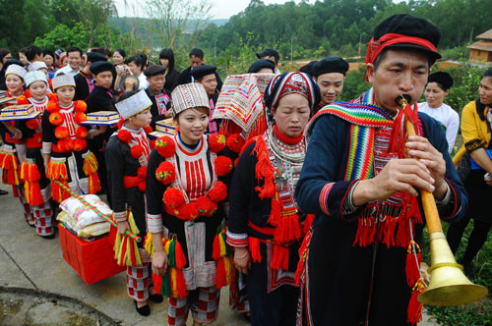
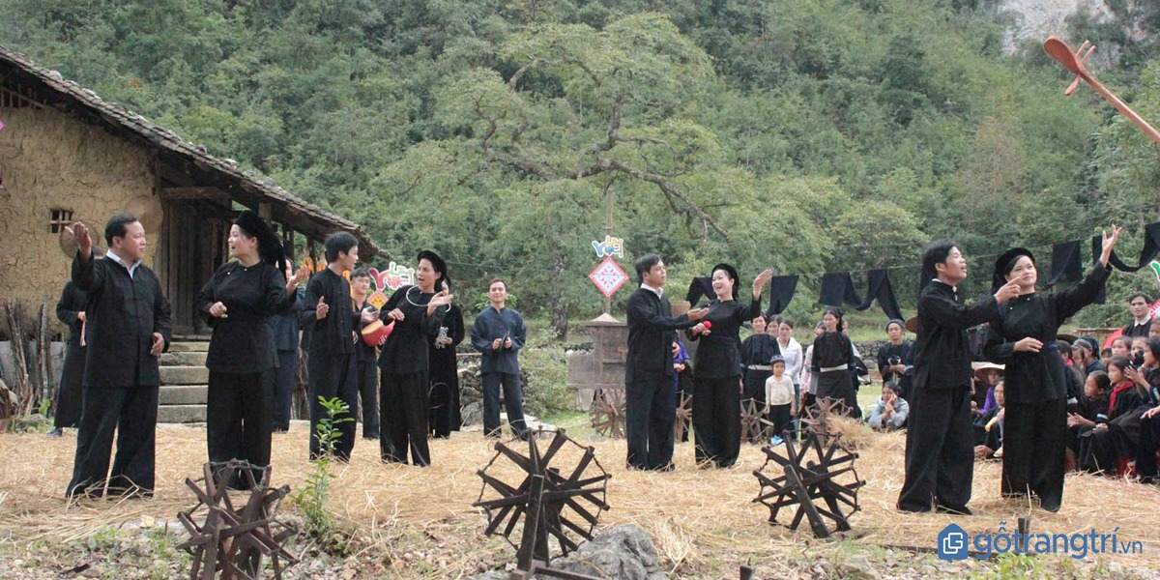
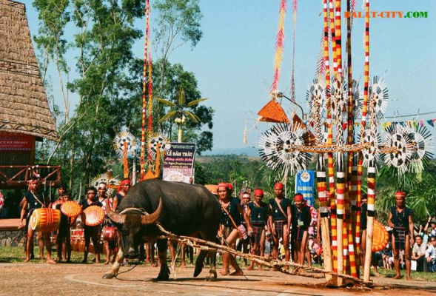
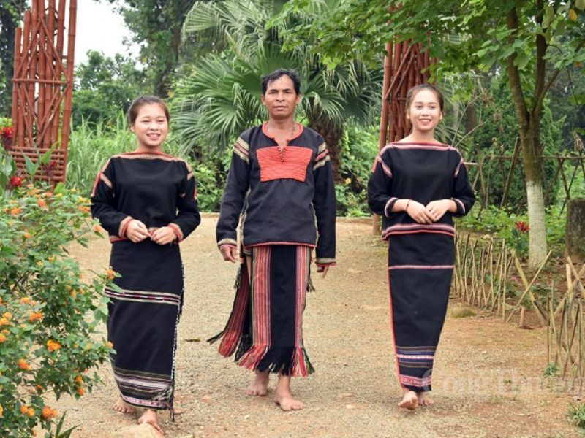
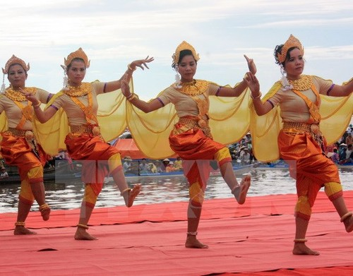
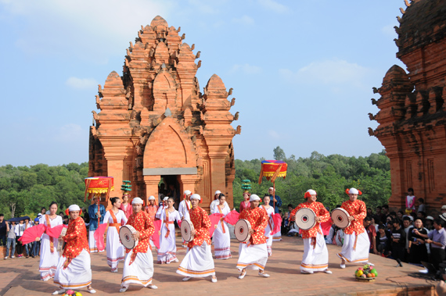
The HMong live mostly in the mountains, 1,000 meters above sea level, in the northern region, in Thanh Hoa and Nghe An province, and in the central highlands.
The Nung live in all 63 provinces of Vietnam, but mainly in northern provinces of Lang Son, Cao Bang, Bac Can, Thai Nguyen, Bac Giang, and Tuyen Quang.
As the ethnic group Bahnar with the largest population. They southern Central Vietnam and Cochinchina
Travel around VN
The Ede live in the south-eastern provinces of Dak Lak, Gai Lai, Khanh Hoa and Phu Yen. The Êde live in small villages, usually gathering twenty to fifty houses.
Vietnam has 1.3 million Khmer people living in the southern provinces of Tra Vinh, Soc Trang, Kien Giang... The Khmer do farm work, fish, and produce handicraft products.
The Cham ethnic minority group have lived on the central coast of Vietnam for a long time

Slide 25
5.Vietnam has 1.3 million Khmer people living in the southern provinces of Tra Vinh, Soc Trang, Kien Giang... The Khmer do farm work, fish, and produce handicraft products.
2. The Nung live in all 63 provinces of Vietnam, but mainly in northern provinces of Lang Son, Cao Bang, Bac Can, Thai Nguyen, Bac Giang, and Tuyen Quang.
1.The HMong live mostly in the mountains, 1,000 meters above sea level, in the northern region, in Thanh Hoa and Nghe An province, and in the central highlands.
4.The Ede live in the south-eastern provinces of Dak Lak, Gai Lai, Khanh Hoa and Phu Yen. The Êde live in small villages, usually gathering twenty to fifty houses.
3.As the ethnic group Bahnar with the largest population. They live mainly in the southern Central Vietnam and Cochinchina
6. The Cham ethnic minority group have lived on the central coast of Vietnam for a long time

Slide 26
The HMong live mostly in the mountains, 1,000 meters above sea level, in the northern region, in Thanh Hoa and Nghe An province, and in the central highlands.
The Nung live in all 63 provinces of Vietnam, but mainly in northern provinces of Lang Son, Cao Bang, Bac Can, Thai Nguyen, Bac Giang, and Tuyen Quang.
As the ethnic group Bahnar with the largest population. They southern Central Vietnam and Cochinchina
Travel around VN
The Ede live in the south-eastern provinces of Dak Lak, Gai Lai, Khanh Hoa and Phu Yen. The Êde live in small villages, usually gathering twenty to fifty houses.
Vietnam has 1.3 million Khmer people living in the southern provinces of Tra Vinh, Soc Trang, Kien Giang... The Khmer do farm work, fish, and produce handicraft products.
The Cham ethnic minority group have lived on the central coast of Vietnam for a long time

Slide 27
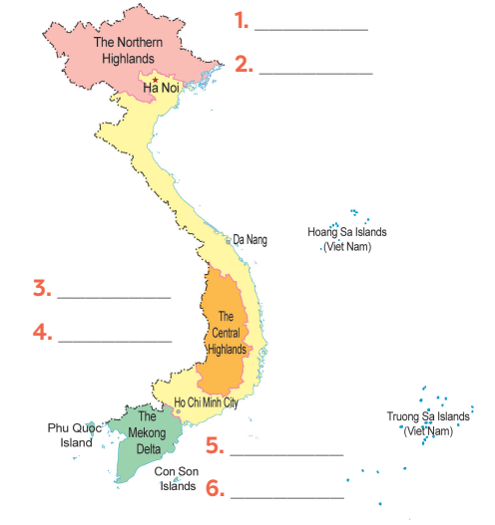
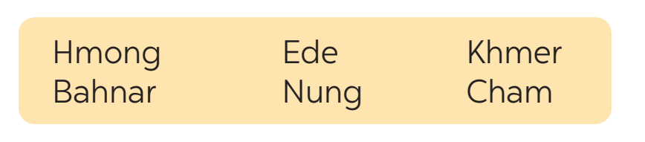
5
Game: Where are they?
Hmong
Label the Map with the names of the ethnic groups.
Nung
Ede
Who wants to be a tourist guide?
Bahnar
Khmer
Cham

Slide 28
Unit
4
ETHNIC GROUPS OF VIET NAM
Unit
ETHNIC GROUPS OF VIET NAM
LESSON 1: GETTING STARTED
Mainly in the Northeast …(3).. :
Ha Giang, Tuyen Quang, Lao Cai…
LOCATION
…(1)… ETHNIC GROUPS OF VIET NAM
THE…(2)... ETHNIC GROUP
- Tradition musical instrument: …..(4)…
- Stilt House
Terraced fields
Bamboo
Special food: ..(5)..
FEATURES

Slide 29
Unit
4
ETHNIC GROUPS OF VIET NAM
Unit
ETHNIC GROUPS OF VIET NAM
LESSON 1: GETTING STARTED
Mainly in the Northeast provinces:
Ha Giang, Tuyen Quang, Lao Cai…
LOCATION
54 ETHNIC GROUPS OF VIET NAM
THE TAY ETHNIC GROUP
- Tradition musical instrument: Dan Tinh
- Stilt House
Terraced fields
Bamboo
Special food: Five-colour sticky rice
FEATURES

Slide 30


Unit
4
ETHNIC GROUPS OF VIET NAM
Unit
ETHNIC GROUPS OF VIET NAM
LESSON 1: GETTING STARTED
Homework
- Start preparing for the Project of the unit: choose an ethnic group in Viet Nam that you are most interested in and make a poster/ a video about it .You will show and present their posters in Lesson 7 – Looking back and Project..)

Slide 31

THANKS FOR YOUR ATTENTION

