Slide 1


Slide 2
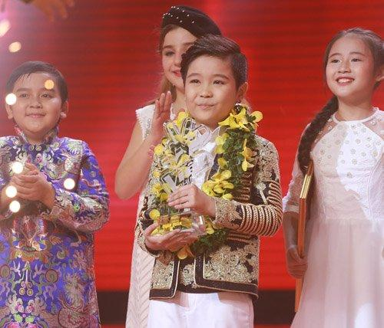
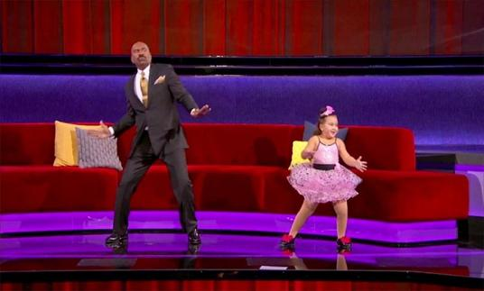
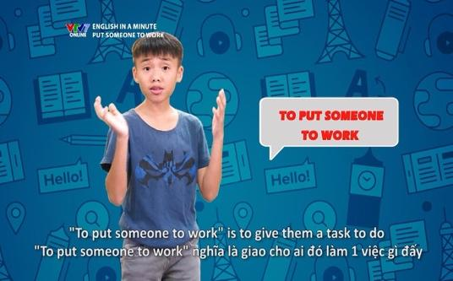
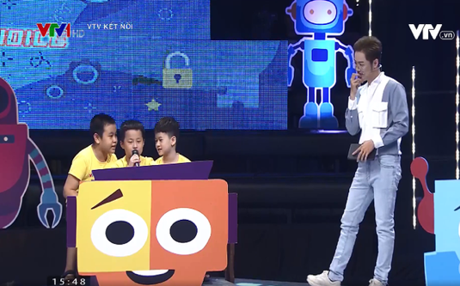
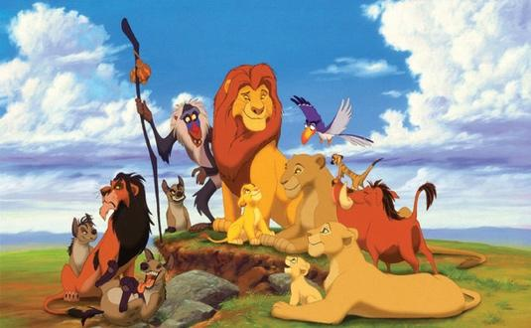

The Voice Kids
Little Big Shots
English in a Minute
Alo English
The Lion King
Moana
Little Big Shots | Alo English | The Lion King
English in a Minute | The Voice Kids | Moana

Slide 3

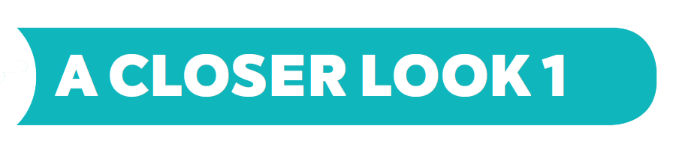
Vocabulary

Slide 4
Vocabulary:
- comedy (n): phim hài
- viewer (n): người xem
- performer (n): người biểu diễn
- popular (adj) : phổ biến
- live (adj): sống
- boring (adj) : nhàm chán\

Slide 5


Write the words / phrases in the box next to the definition.
talent show
comedy
educational programme
viewer
character
1.
an animal or person in a film
character
2.
a programme which teaches maths, English, etc.
educational programme
3.
a film / show which makes people laugh
comedy
4.
a competition to choose the best performer
talent show
5.
a person who watches TV
viewer

Slide 6

Complete the sentences with the words / phrases in the box.
character
viewers
game show
animated films
comedies
channel
Do you watch Bibi, the popular for children?
1.
channel
2.
Which do you prefer: Jerry the mouse or Tom the cat?
character
I love
animated films like Happy Feet and Coco.
3.
like Happy Feet and Coco.
I love Children are Always Right, a
game show for kids.
4.
for kids.
5.
My father often watches
comedies. They’re so funny.
. They’re so funny.
6.
A popular programme has a lot of .
viewers

Slide 7

Complete the sentences with the adjectives in the box.
popular
educational
cute
boring
live
funny
popular
1.
The most channel for children is the Cartoon Network.
2.
. I don’t want to watch it.
This film is very
boring. I don’t want to watch it.
Cat Kitty is a very
cute character. Children love her.
3.
character. Children love her.
4.
You can watch this programme at the same time it happens. It’s
live.
.
5.
Comedies are
funny. People laugh a lot when they watch them.
. People laugh a lot when they watch them.
6.
We learn a lot from Discovery Channel. This channel is
educational.
.

Slide 8
Pronunciation
/θ/and /ð/

Slide 9


Listen and repeat the words.
/θ/ | /ð/
theatre earth anything both through | there them neither weather than

Slide 10


Tongue Twister. Take turns to read the sentences quickly and correctly.
1.
They are thinking about the weather there.
2.
The new theatre opens on Thursday the third.

Slide 11
* Home assigment:
- Do more exercises in workbook.
- Revise the words in Vocabulary and find 5 more words with /θ/ and 5 more words with /ð/.

Slide 12


