Slide 1

Do you have a lot of friends?

Slide 2

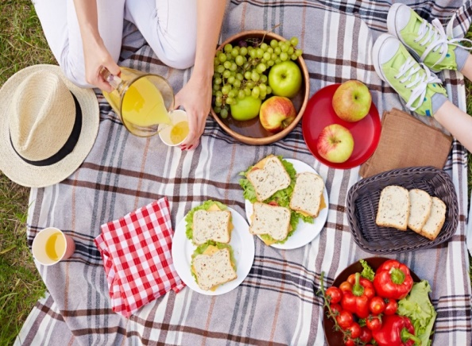
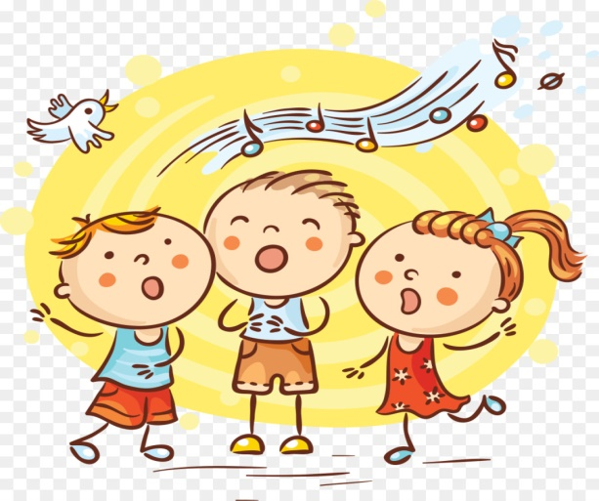
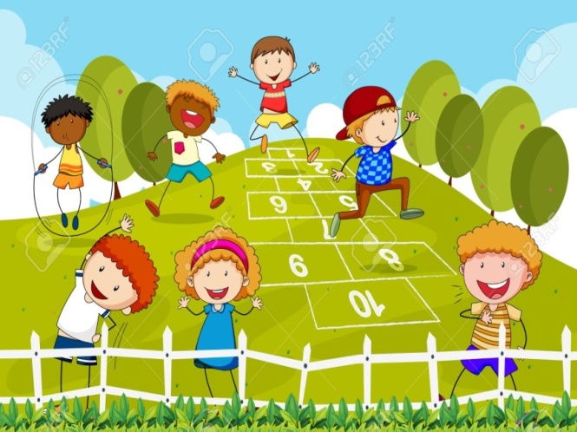
What can you do with your friends?
…………….
We can eat and drink together
We can play some games
we sing some songs

Slide 3

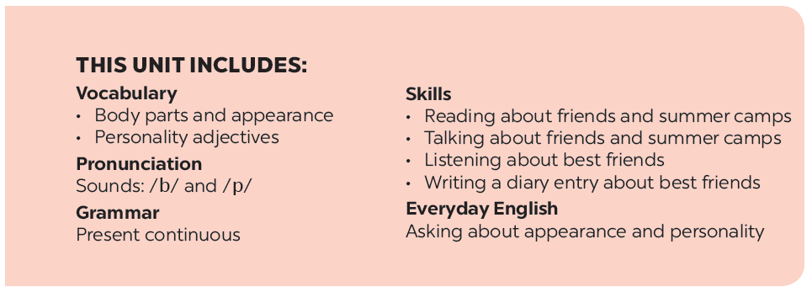

Slide 4








A surprise guest
Listen and read.
Work in groups. Complete the word webs.
Fill the blanks with the words from the conversation.
Guessing
Label the body parts with the words in the box.
Work in groups. Take turns to describe a classmate. Other group members guess who he / she is.

Slide 5
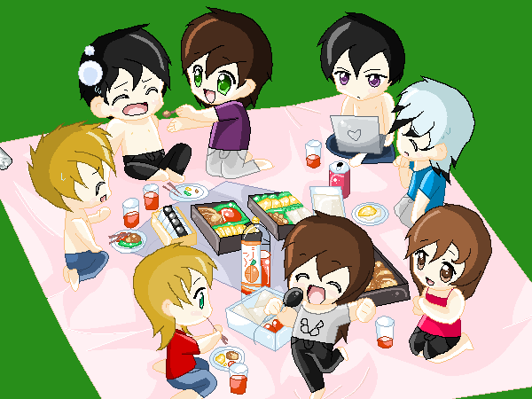
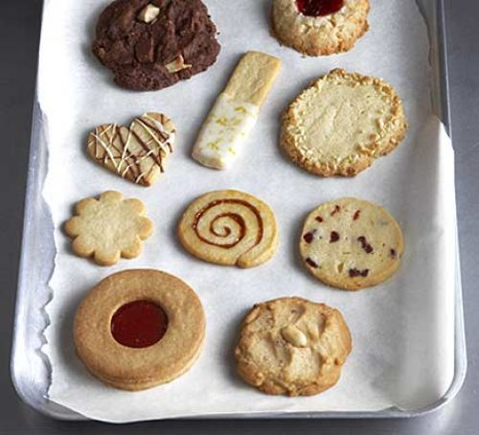


Tuesday, October 12th 2021
Period 16. UNIT 3: MY FRIENDS
LESSON 1: Gettingstarted
* Vocabulary:
- Picnic (n):
dã ngoại
- Biscuit (n):
bánh quy
pass (v) :
chuyển qua, đưa qua
Glasses (n ) :
mắt kính
Magazine (n):
tạp chí
- surprise (adj):
bất ngờ, ngạc nhiên

Slide 6
* Checking words:
What and Where
picnic
pass
glasses
biscuit
Magazine
surprise

Slide 7


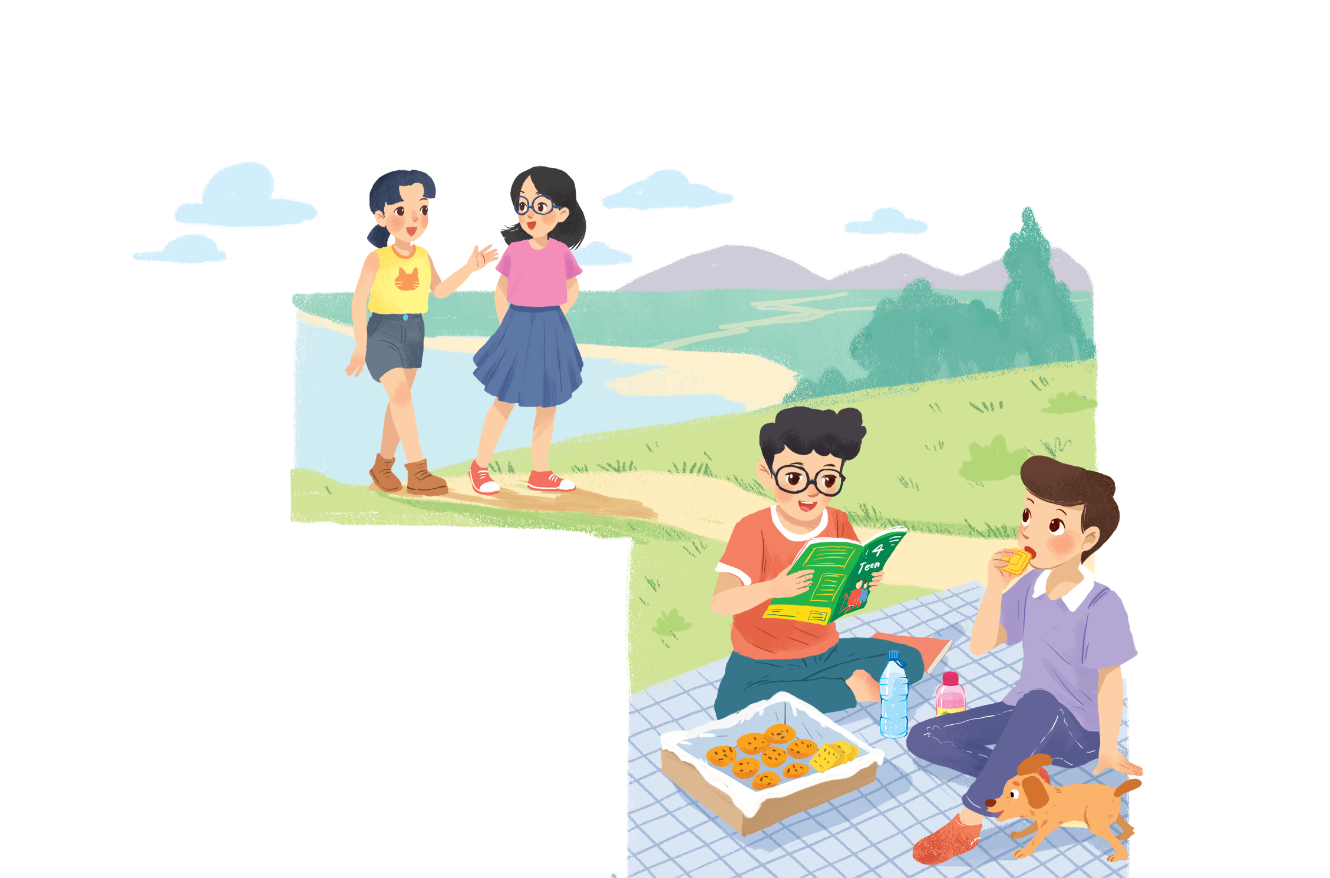

Listen and read.
A surprise guest
Notes:
Thiếu tên bài đọc.

Slide 8

Fill the blanks with the words from the conversation.
Phong and Nam are having a .
1.
picnic
4Teen is Phong’s
favourite magazin
2.
.
3.
Mai
Châu
Phong and Nam see and
.
4.
glasses
long black hair
Chau has and
.
5.
Mai and Chau
are going to
the bookshop.

Slide 9

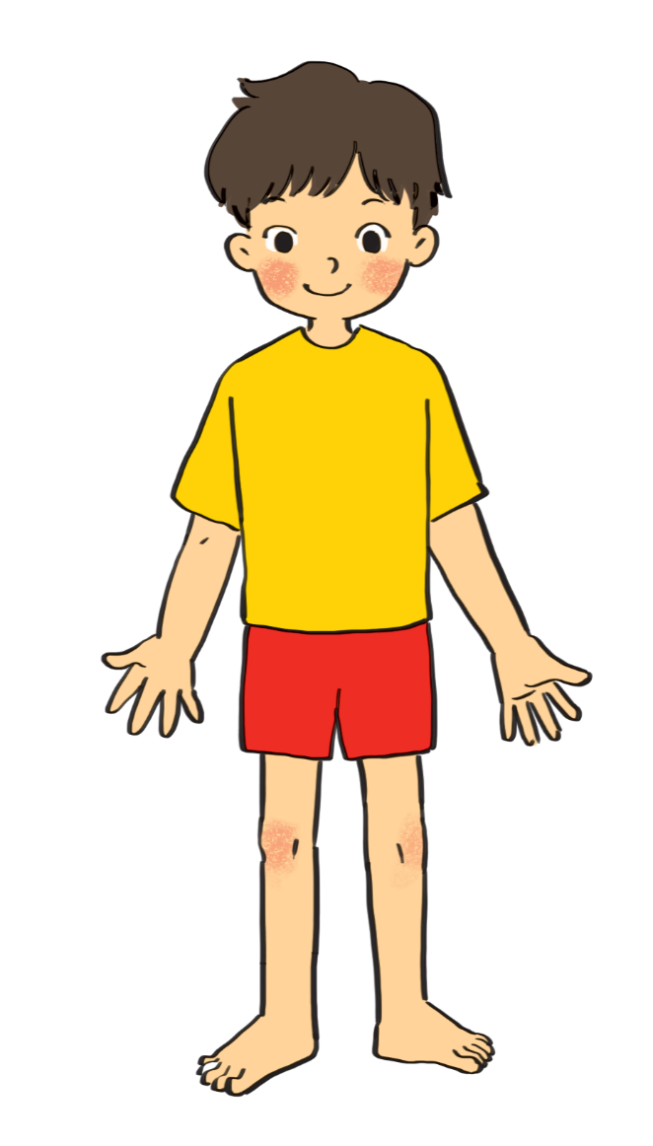
Label the body parts with the words in the box.
1.
10.
9.
2.
8.
3.
7.
4.
5.
6.
Do you know any other words for body parts?

Slide 10
Match the word with it’s meaning
cheek
Mắt
eye
Cánh tay
hand
Gò má
arm
Bàn tay
mouth
chân
leg
mũi
nose
Miệng
hair
tóc
shoulder
Bàn chân
foot
vai

Slide 11
Do you know any other words for body parts?
finger
ears
elbow
knee
head
face
finger
toes
tooth
lips

Slide 12
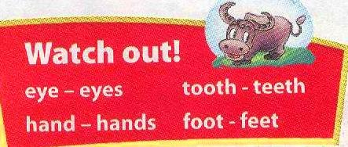
cheek
eye
hand
arm
mouth
cheek
eye
hand
arm
mouth
leg
shoulder
leg
nose
hair
shoulder
foot
nose
hair
foot
eye
hair
1.
10.
cheek
nose
9.
2.
mouth
8.
shoulder
3.
arm
7.
hand
4.
leg
5.
foot
6.
Do you know any other words for body parts?

Slide 13

Work in groups. Complete the word webs.
Example:
arms
hair
nose
eyes
long / short
big / small
blonde
curly
hair

Slide 14
Work in groups. Complete the word webs.
Example:
arms
hair
long / short
Finger/toe
leg
tail

Slide 15
Work in groups. Complete the word webs.
Example:
nose
eyes
big / small
head
feet
hand
ears

Slide 16
Work in groups. Complete the word webs.
Example:
blonde
curly
long/short
black
hair
wavy
straight
fair
dyed

Slide 17

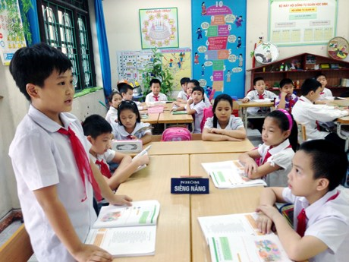
Guessing
Work in groups. Take turns to describe a classmate. Other group members guess who he / she is.
Example:
A: She has _________ and __________.
B: Is that _____?
A: That’s right.
long hair
big eyes
Lan

Slide 18







