Slide 1


Tien Thanh Secondary School
Welcome Teachers to Our Class
Shool year: 2024 - 2025
Team: Social Science
Teacher: Pham Hong Thu

Slide 2
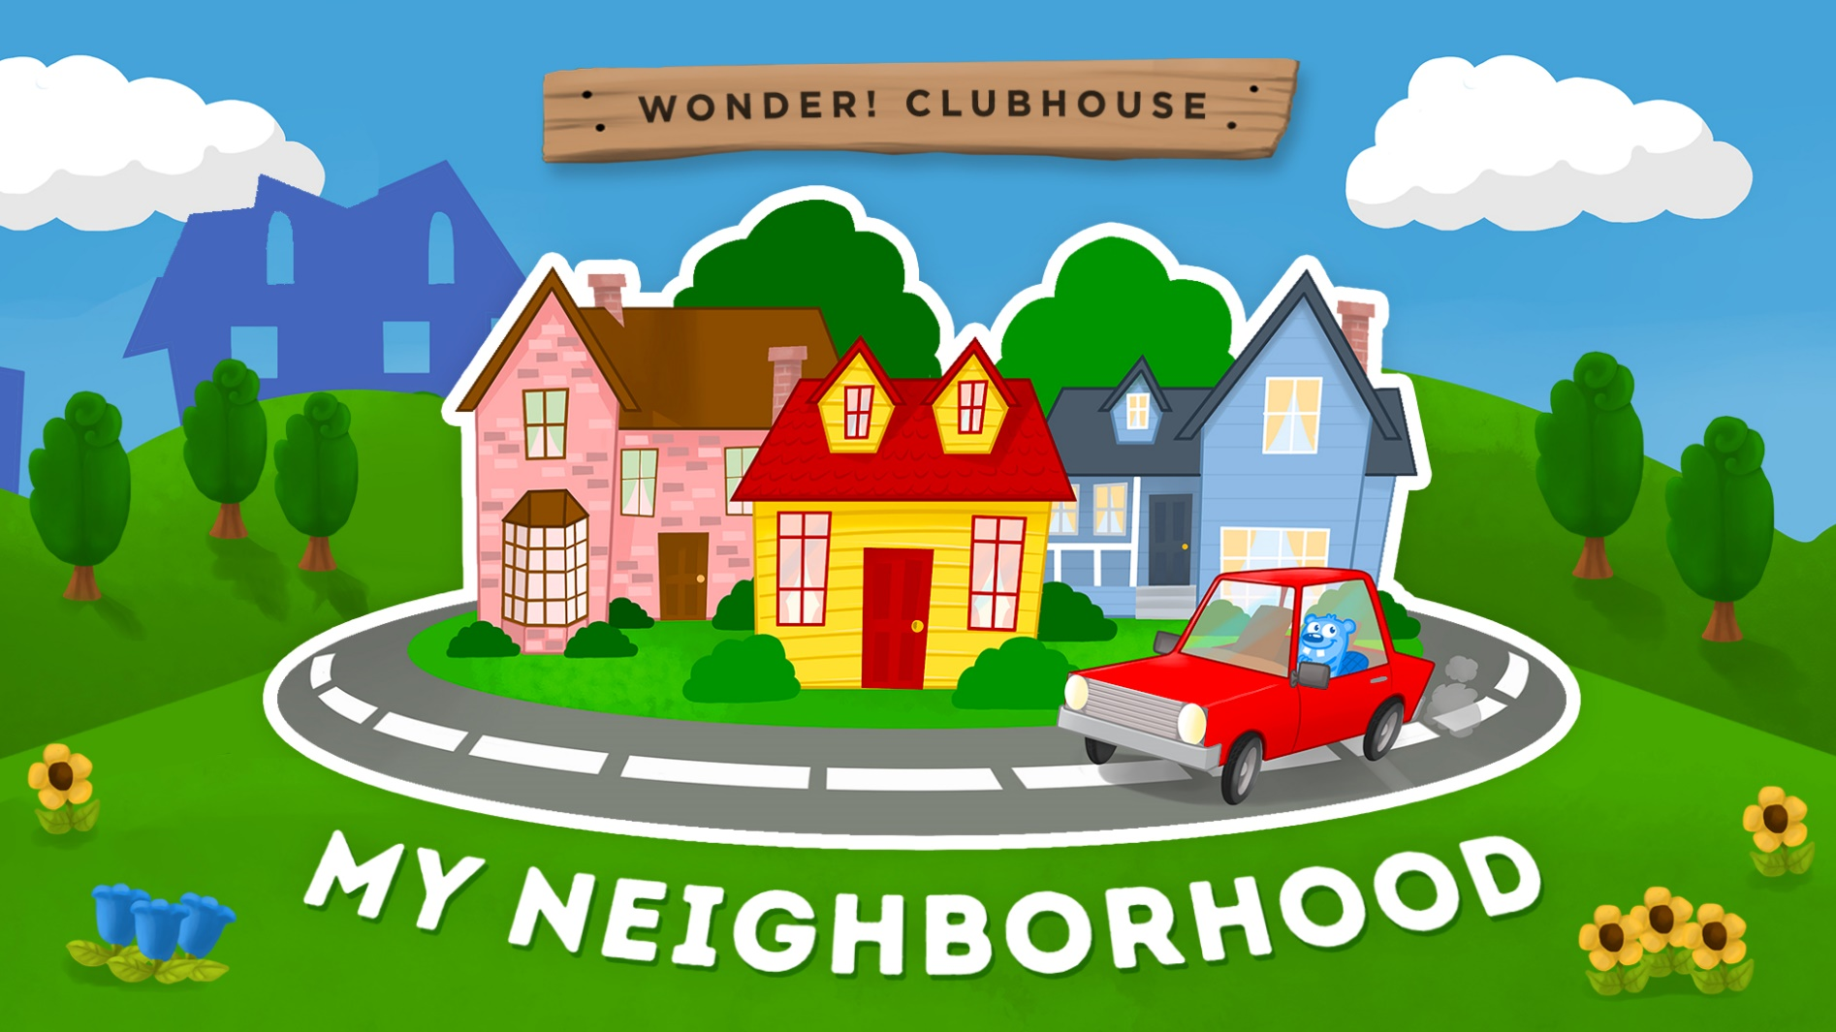
Warm up:
Jumbled Words
Name some places
IN

Slide 3
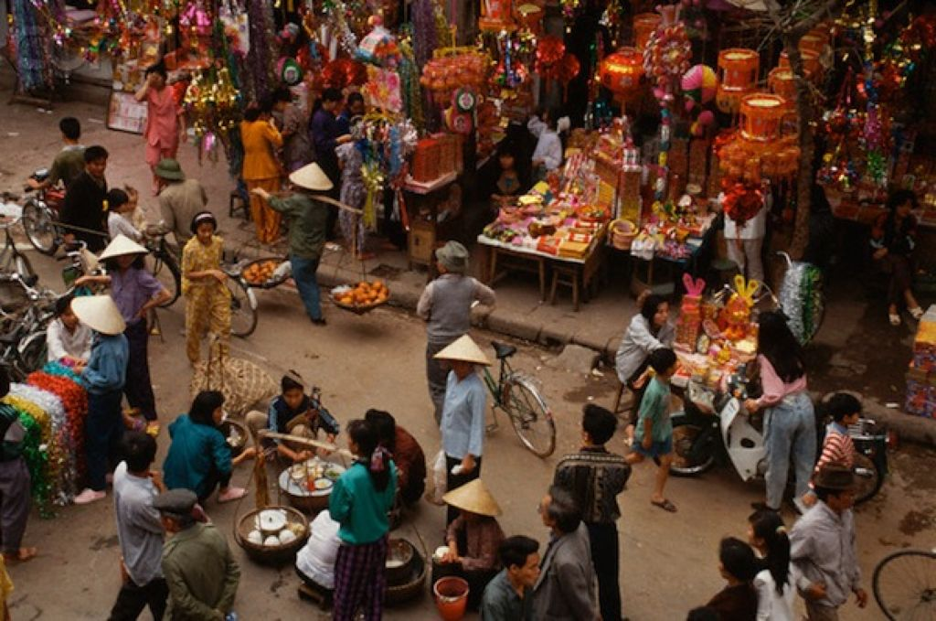
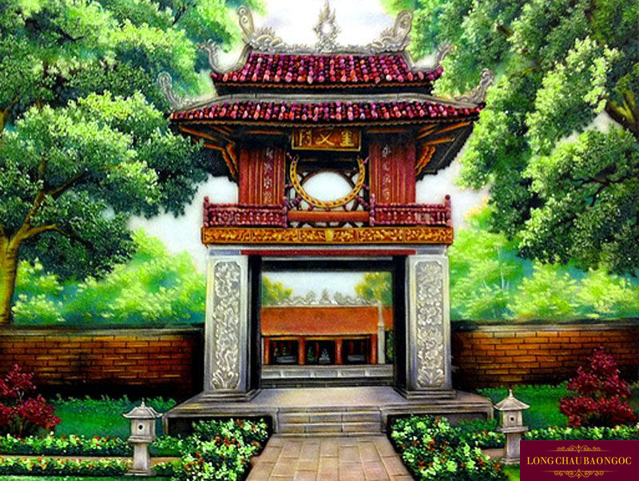

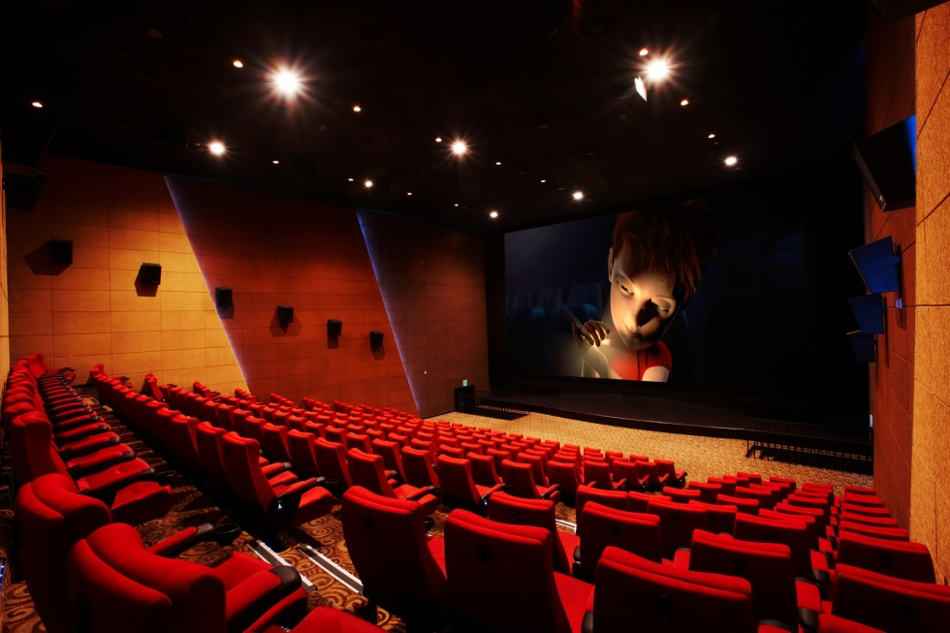
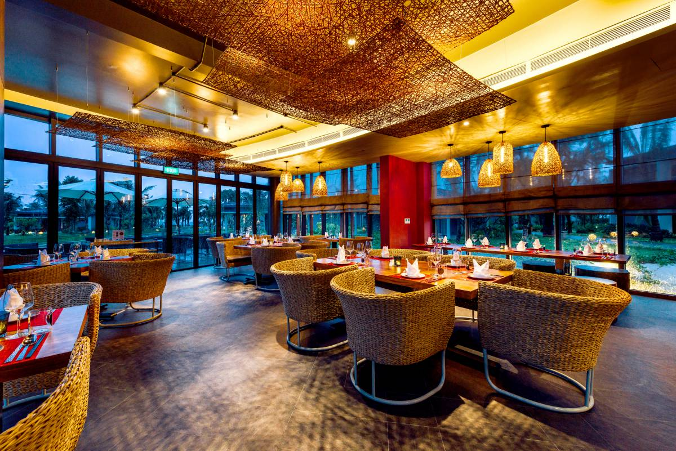
2. temple
3. apoilths
1. takmre
4. aiencm
5. arnuastetr

Slide 4
2. temple
3. hospital
1. market
4. cinema
5. restaurant

Slide 5



UNIT 4: MY NEIGHBOURHOOD
Lesson 2: A Closer look 1

Slide 6
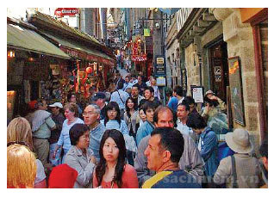
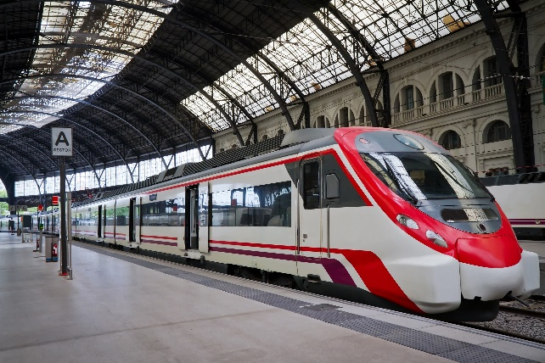
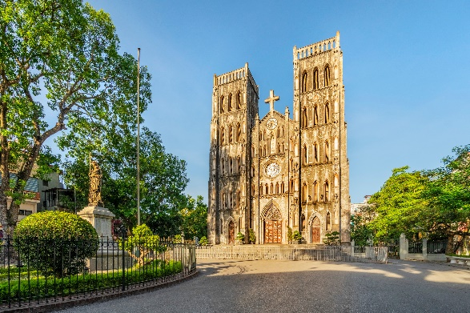
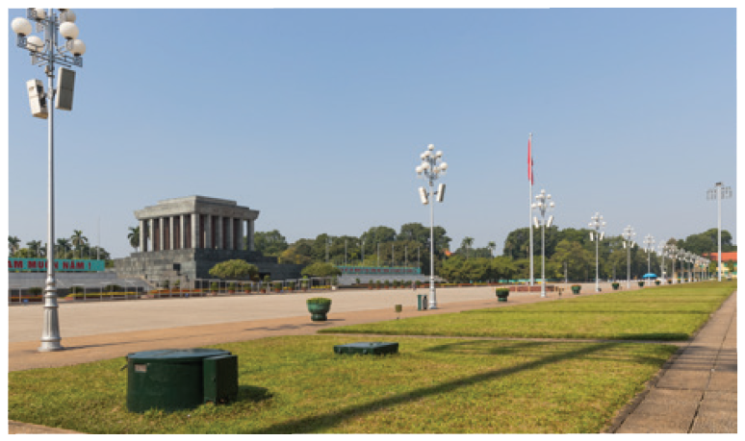
UNIT 4: MY NEIGHBOURHOOD
Lesson 2: A Closer look 1
VOCABULARY

Slide 7
UNIT 4: MY NEIGHBOURHOOD
Lesson 2: A Closer look 1
UNIT 4: MY NEIGHBOURHOOD
Lesson 2: A Closer look 1
VOCABULARY
square (n) /skweə/
quảng trường
cathedral (n) /kəˈθiːdrəl/
thánh đường
railway station (n) /ˈreɪlweɪ ˈsteɪʃən/
nhà ga xe lửa
crowded (adj) /ˈkraʊdɪd/
đông đúc
peaceful (adj) /ˈpiːsfl/
thanh bình
= quiet (adj)
modern (adj) /ˈmɑːdərn/
hiện đại
≠ historic (adj)
boring (adj) /ˈbɔːrɪŋ/
buồn chán
≠ interesting(adj)

Slide 8
UNIT 4: MY NEIGHBOURHOOD
Lesson 2: A Closer look 1
CHECK VOCABULARY
cathedral (n) /kəˈθiːdrəl/
thánh đường
square (n) /skweə/
quảng trường
modern (adj) /ˈmɑːdərn/
hiện đại
peaceful (adj) /ˈpiːsfl/
thanh bình
crowded (adj) /ˈkraʊdɪd/
đông đúc
boring (adj) /ˈbɔːrɪŋ/
buồn chán
railway station (n) /ˈreɪlweɪ ˈsteɪʃən/
nhà ga xe lửa

Slide 9


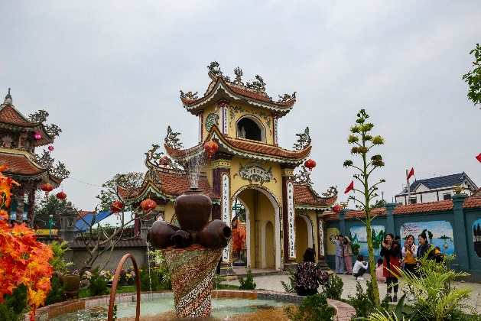
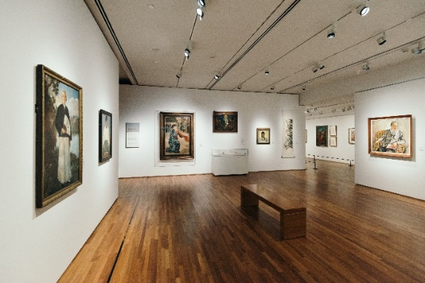
Match the places below with the pictures. Then listen, check and repeat the words.
a
1. square
b
b
2. art gallery
a
3. catherdral
4. temple
4. temple
5. railway station
5. railway station
4. temple
5. railway station
c
e
d
1. square
3. cathedral
2. art gallery

Slide 10

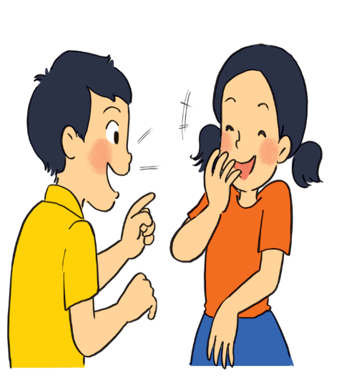
school
market
hotel
hospital
park
Name some other places in your neighbourhood
bookstore
cinema
bank
temple
restaurant
supermarket
Post office
Work in pairs. Ask and answer questions about where you live.
Example:
A: Is there a square in your neighbourhood?
B: Yes, there is. / No, these isn’t.

Slide 11


Work in groups. Ask and answer about your neighbourhood. You can use the adjectives below.
noisy
busy
modern
peaceful
quiet
crowded
boring
beautiful
Example:
A: Is your neighbourhood quiet?
B: Yes, it is. / No, it’s noisy.

Slide 12


* Pronunciation:
/ɪ/ and /i:/
Listen and repeat the words. Pay attention to the sounds /ɪ/ and /i:/.
noisy
cheap
peaceful
expensive
noisy
cheap
peaceful
expensive
clean
exciting
friendly
convenient
clean
exciting
friendly
convenient
Now, in pairs put the words in the correct column.
/ɪ/ | /i:/
noisy
convenient
expensive
cheap
exciting
peaceful
friendly
clean

Slide 13
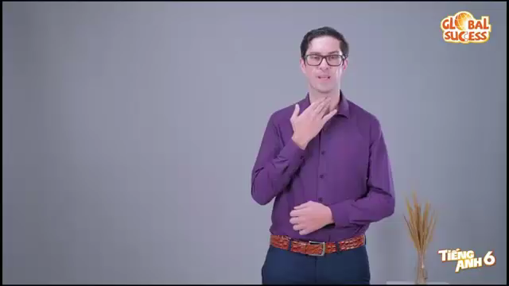
Watch the video. Pay attention to the sounds /ɪ/

Slide 14

Watch the video. Pay attention to the sounds /i:/.

Slide 15


Listen and practise the chant. Notice the sounds /ɪ/ and /i:/.
MY NEIGHBOURHOOD
My city is very noisy.
There are lots of trees growing. The people here are busy.
It’s a lively place to live in.
My village is very pretty.
There are lots of places to see.
The people here are friendly.
It’s a fantastic place to be.

Slide 16

Listen and practise the chant. Notice the sounds /ɪ/ and /i:/.

Slide 17
6
Work in groups. Practise reading the following sentences.
1. Pick a seat and sit.
2. The sheep on the ship were sick.
3. He took a chilly dip six feet deep in the sea. He says it keeps him fit.

Slide 18

WRAP UP AND HOMEWORK
Wrap up
What are the main points we have just learnt?
Vocabulary
Pronunciation
Places in a neighbourhood
sounds /i/ and /i:/
HOMEWORK
- Learn by heart Vocab.
Find 5 more words with the sound /i/
and 5 more words with the sound /i:/.
Prepare lesson 3 .

Slide 19

Thank you very much.

