Slide 1


Slide 2




Welcome to our class today!
Class: 6B1

Slide 3
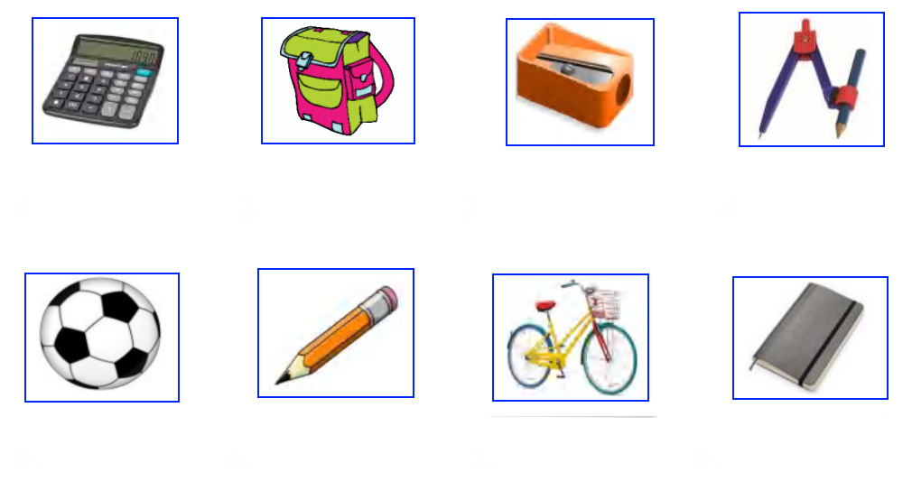
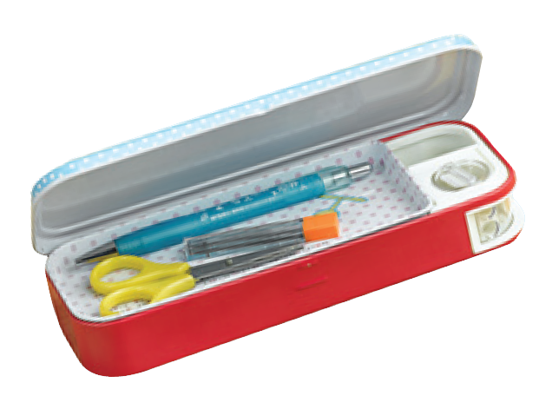
WARM-UP:
Give the names of school things in the pictures.
calculator
schoolbag
pencil-sharpener
compass
pencil case
pencil
bicycle
notebook

Slide 4

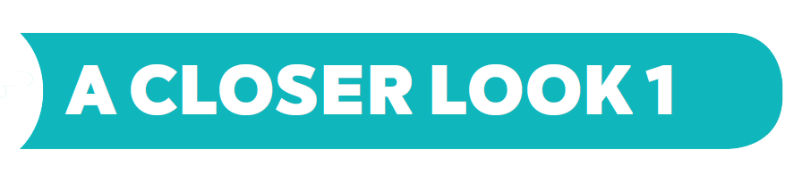
UNIT 1: MY NEW SCHOOL
LESSON 2:

Slide 5
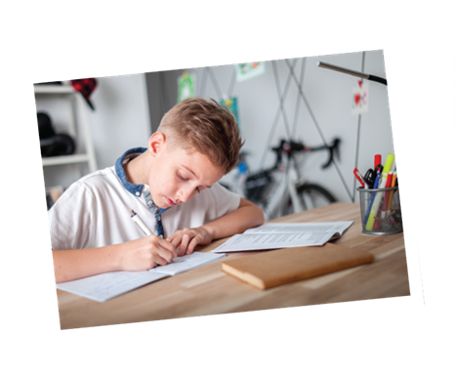


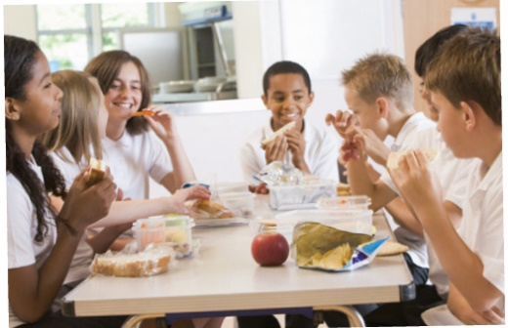
* Vocabulary
- exercise (n):
bài tập
- history (n):
lịch sử
- lesson (n):
bài học
- science (n):
môn khoa học
- school lunch: :
bữa trưa ở trường

Slide 6
Checking Vocabulary:
Rub out and remember
(n): bài tập, tập thể dục
(n) : lịch sử
(n) : bài hoc
(n): bữa trưa ở trường
(n) : môn khoa học
exercise
history
lesson
school lunch
science

Slide 7


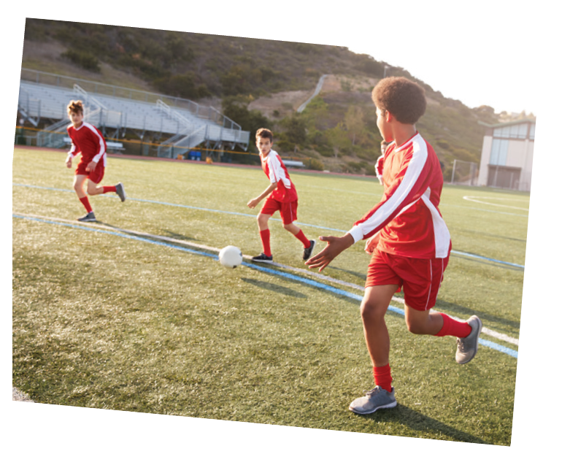

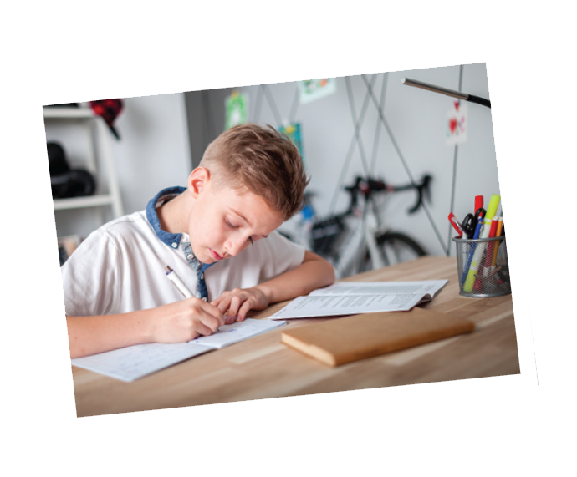
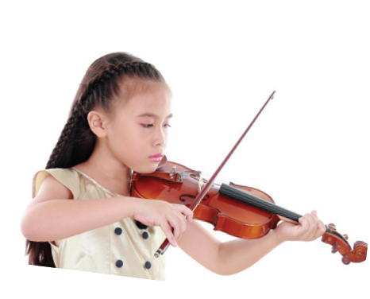
Listen and repeat the words.
* Vocabulary
shool lunch
excercise
English
science
history
football
homework
lessons
music

Slide 8


Work in pairs. Put the words in 1 in the correct columns.
football
school lunch
history
football
school lunch
history
science
homework
science
English
homework
English
music
lessons
music
exercise
lessons
exercise
play | do | have | study
football
homework
school lunch
English
music
exercise
lessons
history
volleyball
The housework
A new uniform
science
IT
Can you add more
words to each column?

Slide 9
NOTES:
1 – DO: Kết hợp với các danh từ chỉ các hoạt động giải trí hoặc các môn thể thao trong nhà, không liên quan tới trái bóng, thường mang tính cá nhân và không mang tính chiến đấu, ganh đua.
Ví dụ: do yoga, karate, judo, exercise…
2 – PLAY: Kết hợp với các danh từ chỉ môn thể thao liên quan đến trái bóng hoặc một vật tương tự trái bóng như trái cầu/ quả cầu; nhạc cụ (musical instument).
Ví dụ: play football, volleyball, tennis, guitar, piano…
3 – STUDY: Đứng trước các danh từ chỉ một môn học, một lĩnh vực, một đề tài nghiên cứu.
Ví dụ: study Math, English, literature, chemistry…
4 – HAVE: Trước các danh từ để diễn đạt sự sở hữu.
Ví dụ: have a car, a book, a shirt, a house…

Slide 10

Put one of these words in each blank.
* GAME:
WHO’S FASTER
lessons
science
homework
football
exercise
1.
Vy and I often do our after school.
2.
Nick plays for the school team.
3.
Mrs Nguyen teaches all my history .
4.
They are healthy. They do every day.
5.
I study maths, English and on Mondays.

Slide 11


3
4
5
6
2
1
7
WHO’S FASTER ?

Slide 12
homework
1. Vy and I often do our ………………. after school.

Slide 13
football
2. Nick plays ……………….for the school team.

Slide 14
lessons
3. Mrs Nguyen teaches all my history…………….

Slide 15
exercise
4. They are healthy. They do …………. every day.

Slide 16
science
5. I study maths, English and…………. on Mondays.

Slide 17
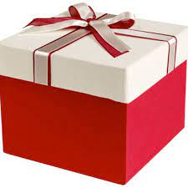
LUCKY apple
YOU GET A GIFT

Slide 18
LUCKY apple
YOU GET A GIFT

Slide 19
Put one of these words in each blank.
lessons
science
homework
football
exercise
homework
1.
Vy and I often do our after school.
Nick plays for the school team.
2.
football
lessons
3.
Mrs Nguyen teaches all my history .
They are healthy. They do every day.
4.
exercise
5.
I study maths, English and on Mondays.
science

Slide 20

* Pronunciation
/ɑ:/ and /ʌ/
Listen and repeat. Pay attention to the sounds /ɑ:/ and /ʌ/.
1
/ɑ:/
2
/ʌ/
smart
subject
art
study
carton
Monday
class
compass

Slide 21

Listen and repeat. Then listen again and underline the words with the sounds /ɑ:/ and /ʌ/.
1.
My brother has a new compass.
/ʌ/
/ʌ/
2.
Our classroom is large.
/a:/
/a:/
3.
They look smart on their first day at school.
/a:/
4.
The art lesson starts at nine o’clock.
/a:/
/a:/
5.
He goes out to have lunch every Sunday.
/ʌ/
/ʌ/

Slide 22
* Production: Write sentences about yourself using some verbs above.
Suggestion:
Hi, everybody! I am Huy. I study at Tran Hung Dao Secondary School. At school I have many subjects: English, Maths, Physics, History, Science and Music. I love English and I study English well. I have English on Monday, Wednesday and Friday. When I have free time, I usually play football with my friends.

Slide 23


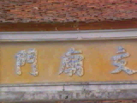
HOMEWORK
Learn the new words by heart.
Practice pronunciation “ɑ:” ,
“ʌ” again.
- Do exercises in workbook.
+

Slide 24
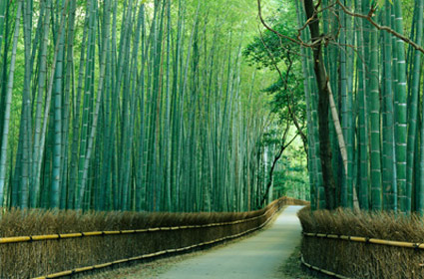
THANKS FOR YOUR ATTENTION!
Goodbye!
See you again!

Slide 25
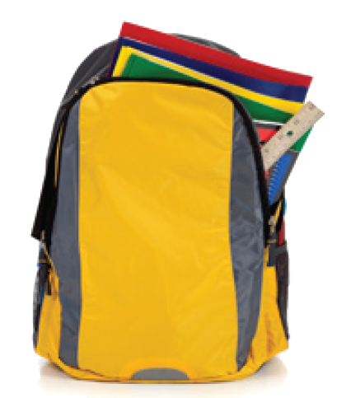
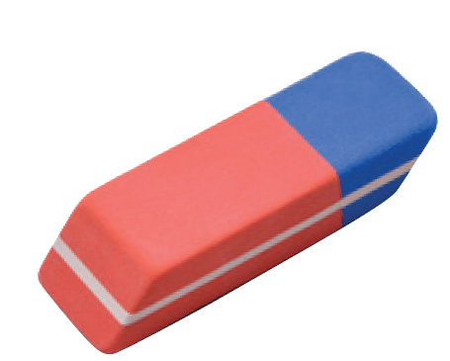
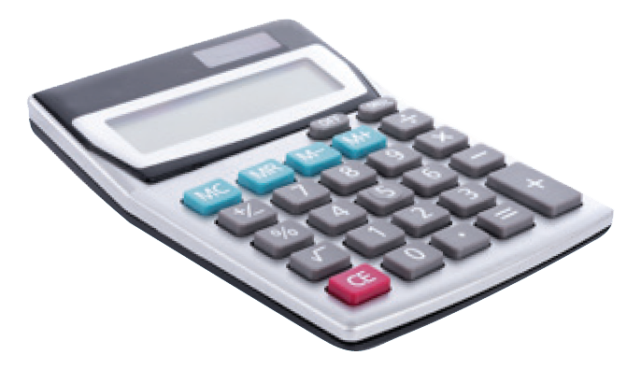

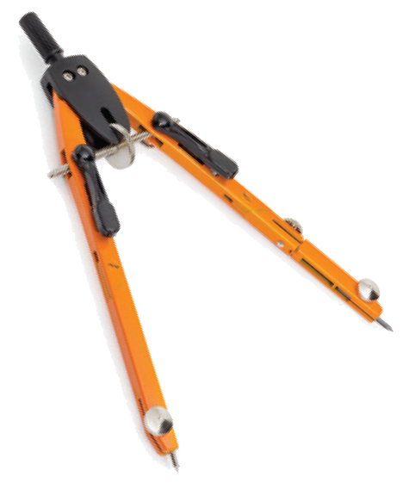

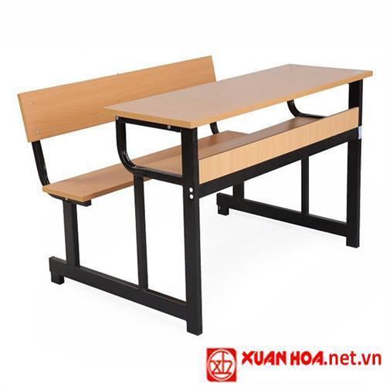
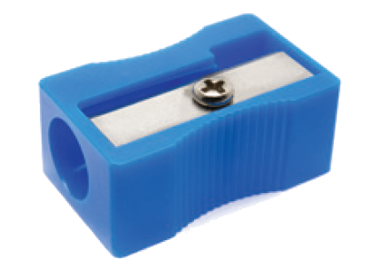
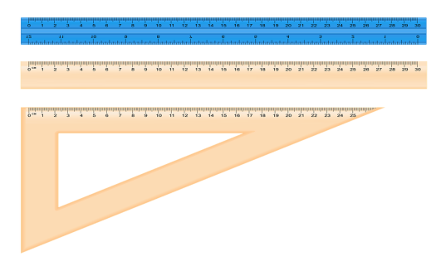
Warm up:
Kim’s game
School things

Slide 26
School-bag
rubber
Pencil case
pencil
School things
School things
caculator
book
compass
ruler
Pencil sharpener
desk

