Slide 1

Listen to the song and guess the topic.
Topic?
My friends
You’ve got a friend in me – Toy Story

Slide 2
UNIT 3:
My friends
Lesson 1: Getting started

Slide 3
OBJECTIVES
01
Have an overview about the topic “My friends”.
Use the lexical items to talk about body parts and appearance to describe people’s appearance.
02

Slide 4
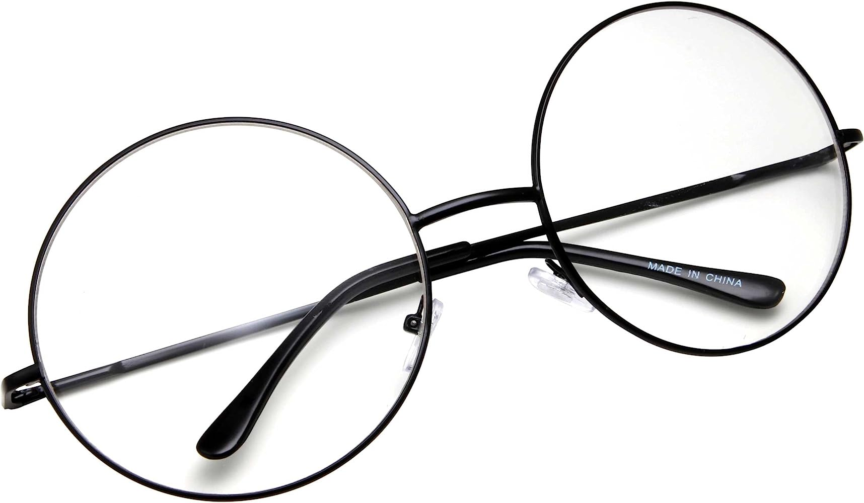

PRESENTATION
glasses (n)
/ˈɡlɑːsɪz/
mắt kính

Slide 5
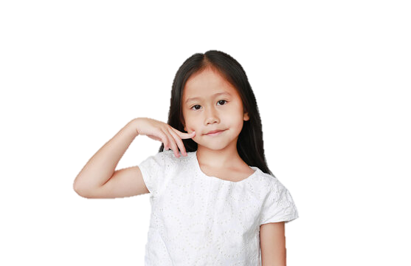
PRESENTATION
cheek (n)
/tʃiːk/
má

Slide 6
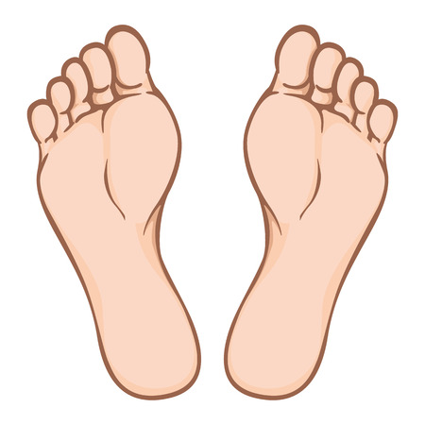
PRESENTATION
foot (n-s)
feet (n-p)
/fʊt/
/fiːt/
bàn chân

Slide 7
PRESENTATION
New words | Pronunciation | Meaning
1. glasses (n) | /ʌnˈjuːʒuəl/ | kính
2. cheek (n) | /tʃiːk/ | má
3. foot (n-s) / feet (n-p) | /fʊt/ /fiːt/ | bàn chân

Slide 8
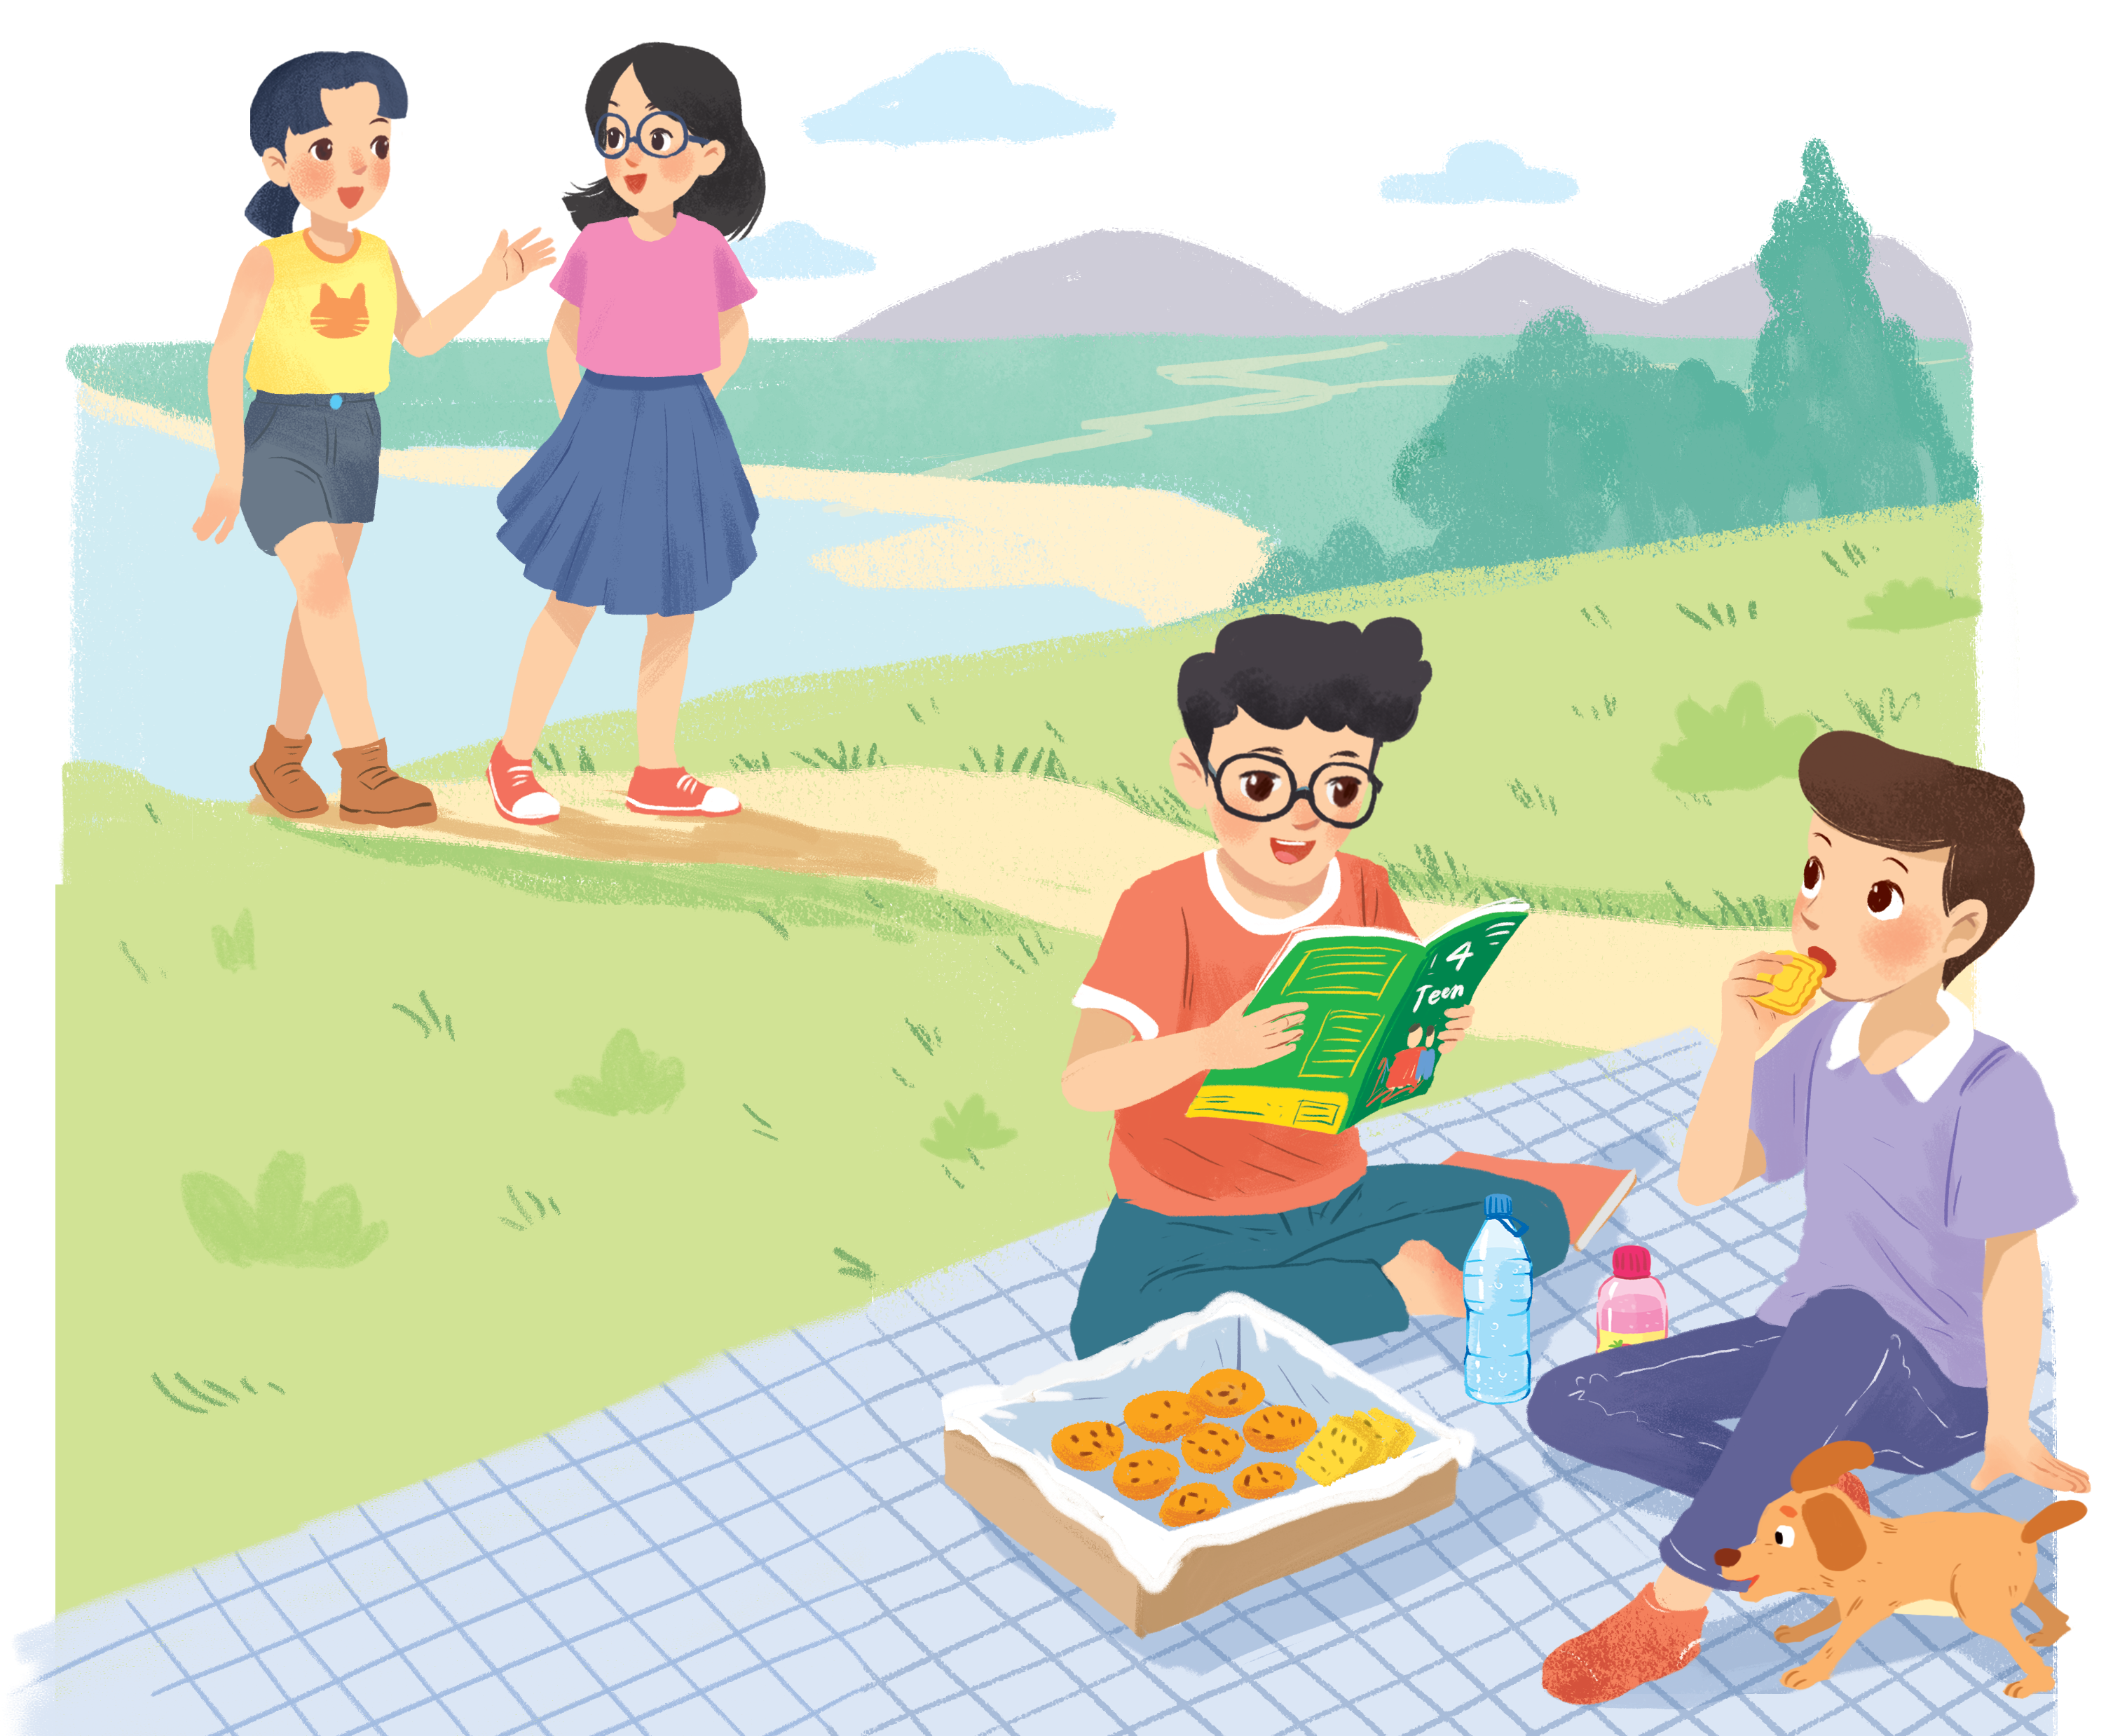
Look and answer.
1. Who are they?
They are Chau, Mai, Phong and Nam.
2. What is Phong doing?
He is reading a magazine.
Nam
3. What are Phong and Nam eating and drinking?
Chau
Mai
Biscuits and water.
4. What are they talking about?
Phong
Listen and check

Slide 9
Listen and read. (P.26)
Phong: That was a great idea, Nam. I love picnics!
Nam: Please pass me the biscuits.
Phong: Sure. Here you are.
Nam: Thanks. What are you reading, Phong?
Phong: 4Teen. It's my favourite magazine!
Nam: Look! It's Mai. And she is with someone.
Phong: Oh, who's that? She has glasses and long black hair.
Nam: I don't know. They're coming over.
Mai: Hi there. This is my friend Chau.
Phong & Nam: Hi, Chau. Nice to meet you.
Chau: Nice to meet you, too.
Nam: Would you like to sit down? We have lots of food.
Mai: Oh, sorry, we can't. We're going to the bookshop.
Chau: Bye for now.
Phong & Nam: Bye bye.

Slide 10
Let’s check!
4. What are they talking about?
A special guess.
Nam: Look! It's Mai. And she is with someone.
Phong: Oh, who's that? She has glasses and long black hair.
Nam: I don't know. They're coming over.
Mai: Hi there. This is my friend Chau.
Phong & Nam: Hi, Chau. Nice to meet you.
Chau: Nice to meet you, too.
Nam
Chau
Mai
Phong

Slide 11
2. Read again and fill in the blanks!
1. Phuc and Nam are having a ____________.
2. Teen is Phong's ____________________ .
3. Phong and Nam see _______ and ___________.
4. Chau has________, and _________________.
5. Mai and Chau _____________ the bookshop.

Slide 12
Let’s check!
1. Phuc and Nam are having a ____________.
picnic
Phong: That was a great idea, Nam. I love picnics!
Nam: Please pass me the biscuits.
2. 4Teen is Phong's __________________.
favourite magazine
Nam: Thanks. What are you reading, Phong?
Phong: 4Teen. It's my favourite magazine!

Slide 13
Let’s check!
3. Phong and Nam see ___________ and ___________.
Mai
Chau
Nam: Look! It's Mai. And she is with someone.
Phong: Oh, who's that? She has glasses and long black hair.
Nam: I don't know. They're coming over.
Mai: Hi there. This is my friend Chau.
Phong & Nam: Hi, Chau. Nice to meet you.

Slide 14
Let’s check!
4. Chau has _____________, and _________________.
glasses
long black hair
Nam: Look! It's Mai. And she is with someone.
Phong: Oh, who's that? She has glasses and long black hair.
Nam: I don't know. They're coming over.
Mai: Hi there. This is my friend Chau.
Phong & Nam: Hi, Chau. Nice to meet you.

Slide 15
Let’s check!
5. Mai and Chau _____________ the bookshop.
are going to
Phong & Nam: Hi, Chau. Nice to meet you.
Chau: Nice to meet you, too.
Nam: Would you like to sit down? We have lots of food.
Mai: Oh, sorry, we can't. We're going to the bookshop.

Slide 16

Watch and write as many body parts as you can

Slide 17
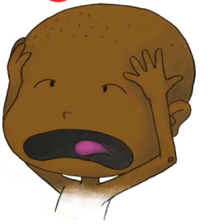
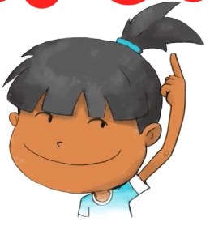
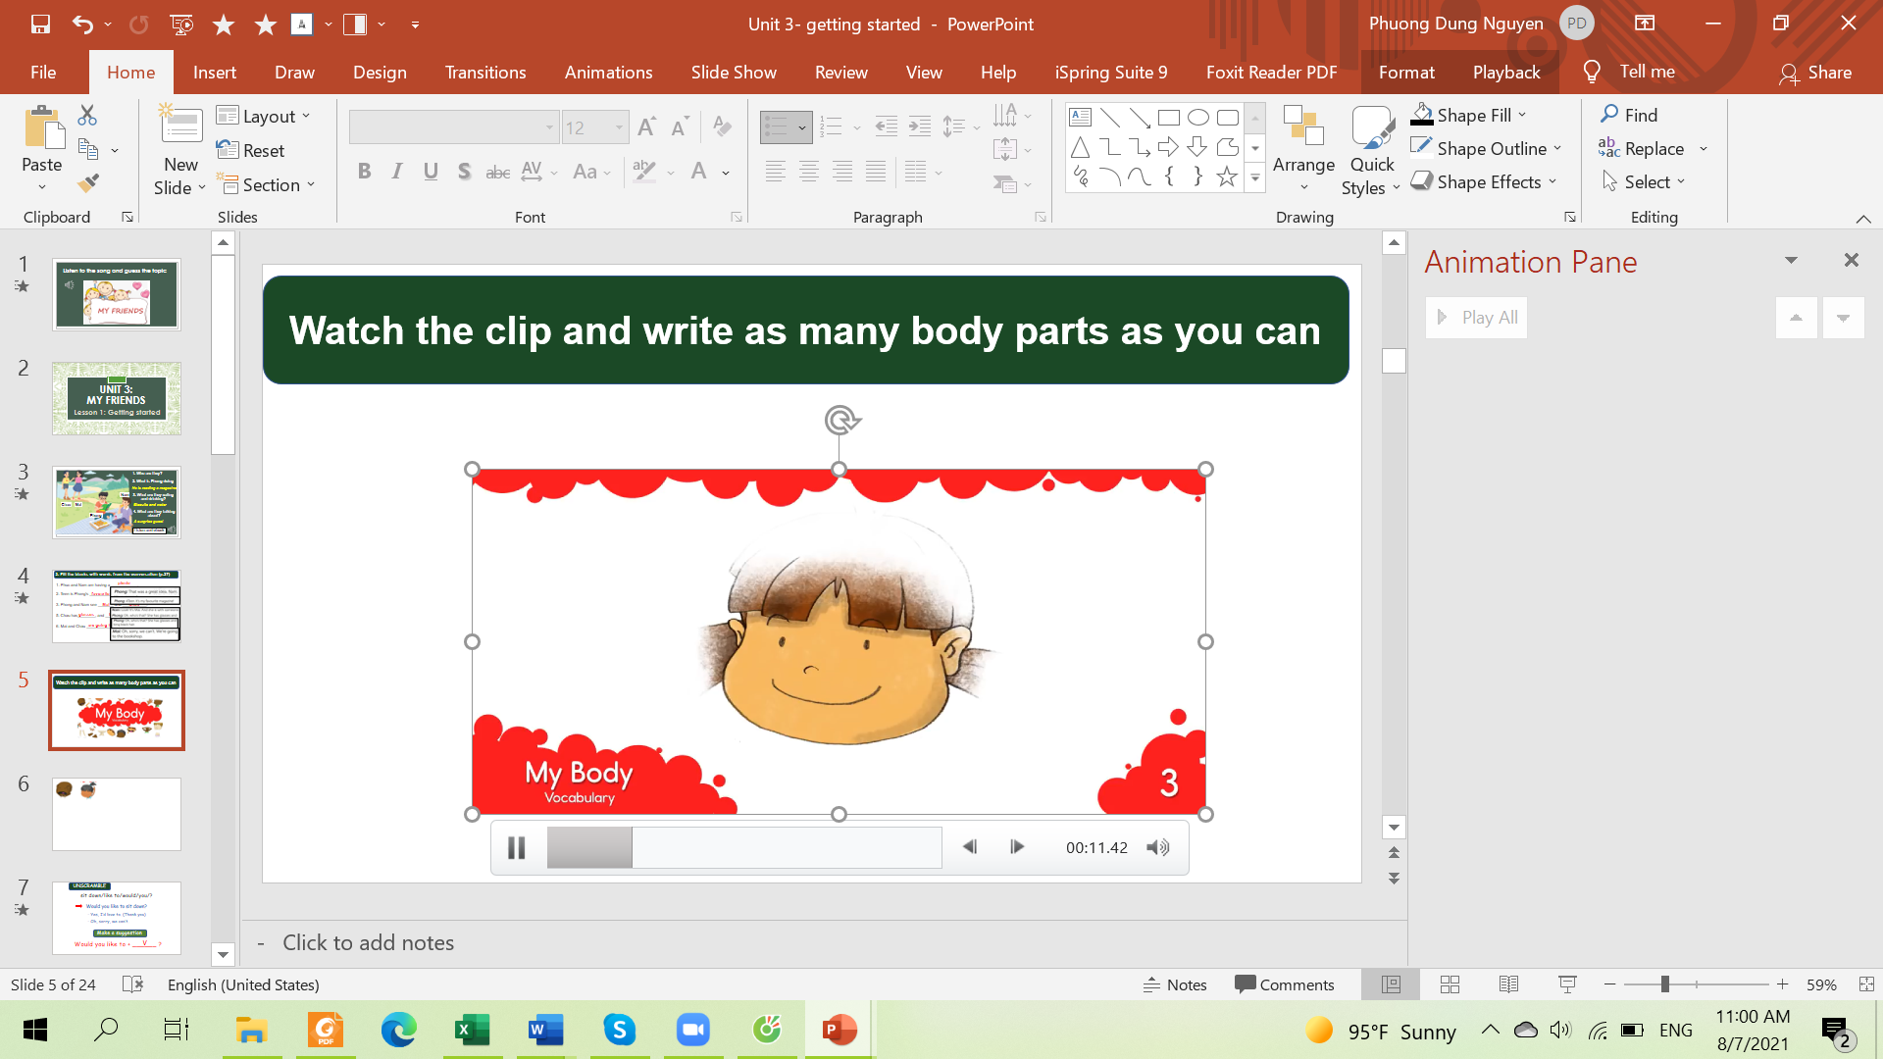
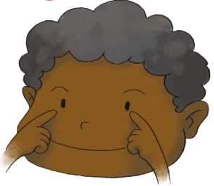
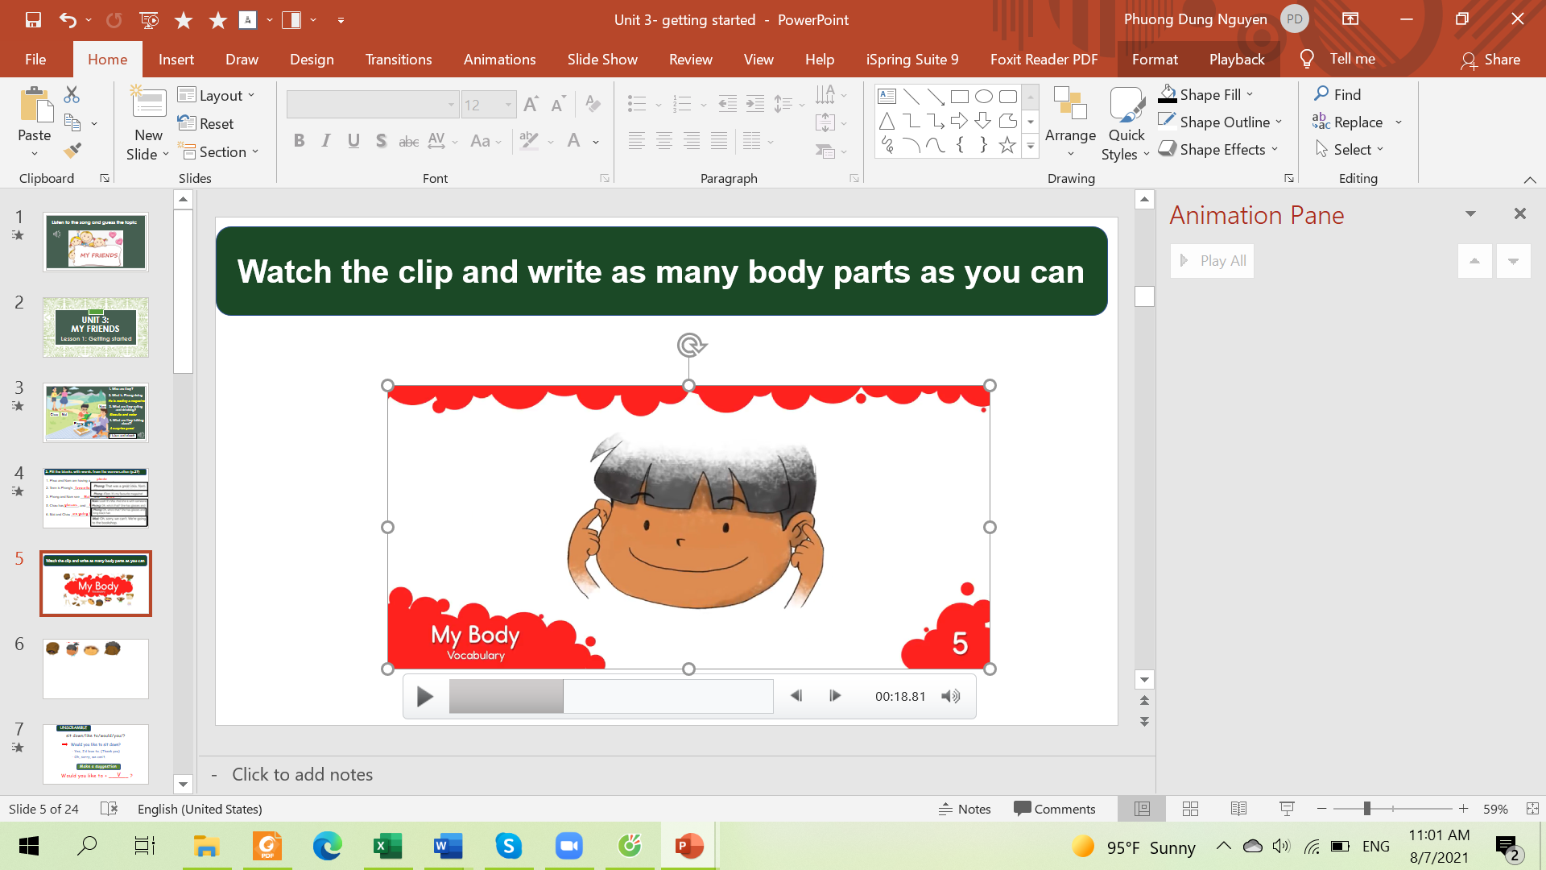
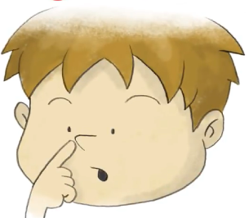
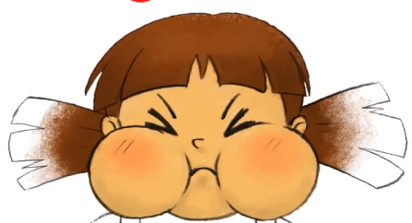
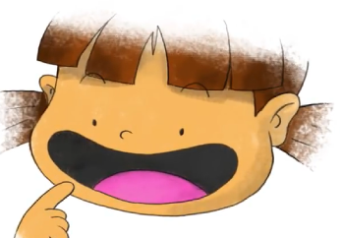


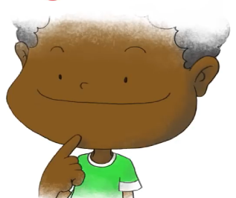
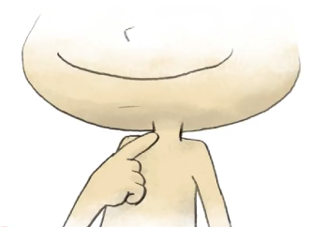
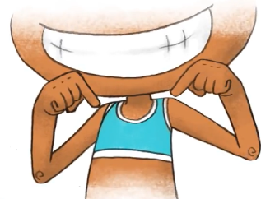
head
hair
face
eyes
ears
nose
cheeks
mouth
teeth
tongue
Listen and repeat
chin
neck
shoulders

Slide 18
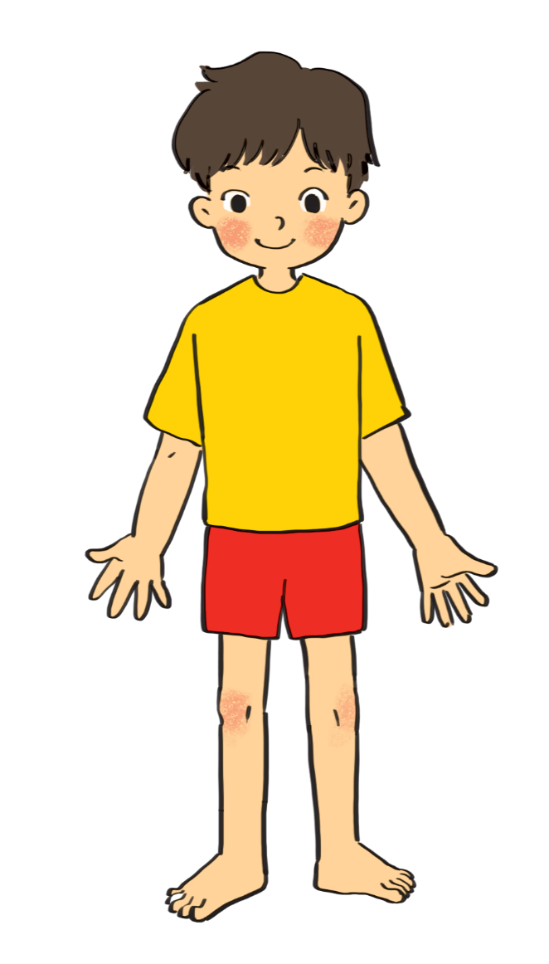

3. Label the body parts (p.27)
1.
eye
10.
hair
9.
cheek
Swap the answer with your partner
nose
2.
8.
mouth
3.
shoulder
7.
arm
4.
hand
5.
leg
6.
foot

Slide 19
How can you describe your friends?

She has long hair.
BFF
✗
She has long eyes.
Which one is correct?
Notes:
Some words go together but some don’t

Slide 20
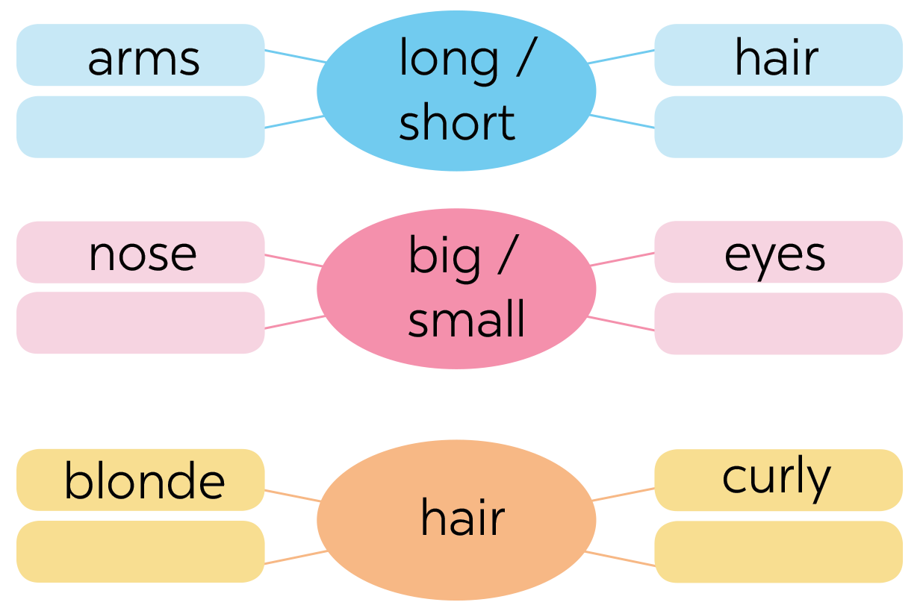

4. Work in group of 4. Complete the word webs.
legs
feet
hands
ears
black
straight

Slide 21
5. Mini game
Secret man

Slide 22
5. Game: Secret man.
Choose a friend in your class
Don’t tell his/her name to others
Write two sentences to describe that friend (2 mins)
Come to the board & ask others to guess your friend

Slide 23
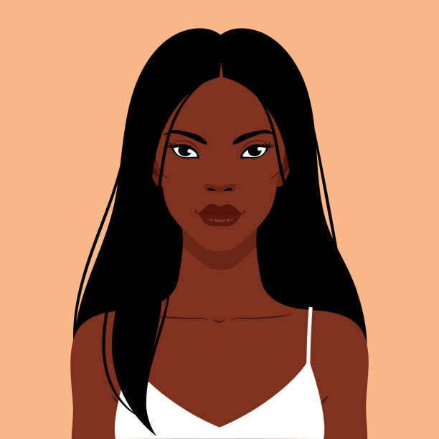
RECAP
What adjectives do we use to describe hair?
01


long
curly
small

blonde
big

straight
Which are correct?
02
She is black long hair.

She has long black hair.
She has straight long hair.

Slide 24
Thanks!
Do you have any questions?

