Slide 1



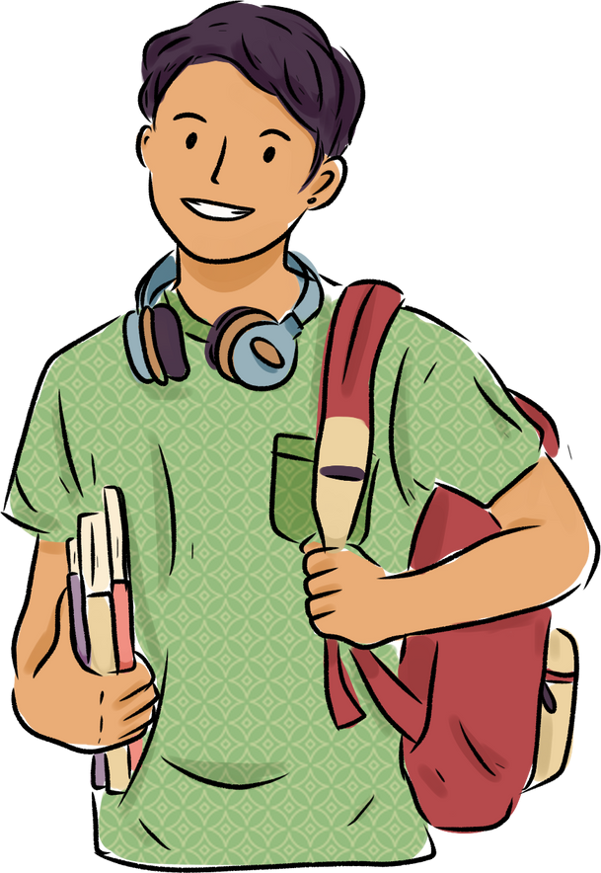

Welcome to our class!
Presented by: ……..

Slide 2


I.N.I.T.I.A.L GAME
Work in 2 teams.
Look at 10 pictures.
Find the word for each picture, then take the first letter from each picture to form the mystery word.
Which team finds the mystery word first will become the winner.
RULES

Slide 3

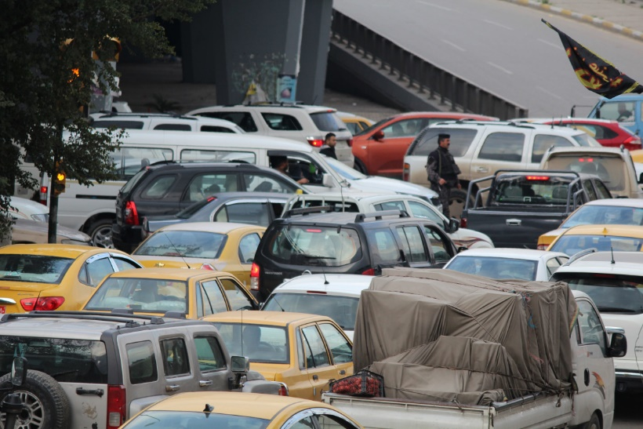
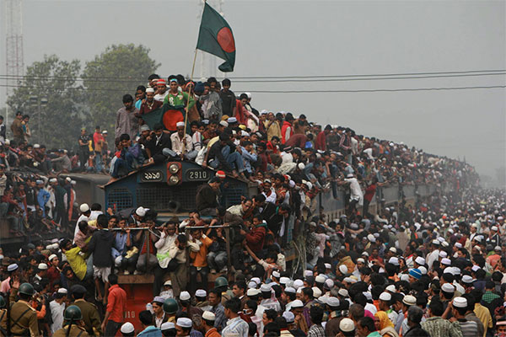
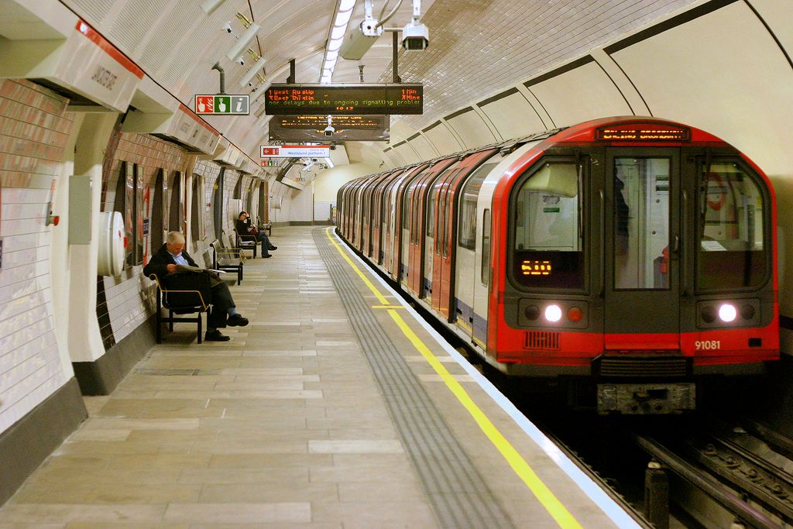



I.N.I.T.I.A.L GAME
Congestion
Overcrowded
Underground
Noise
Sky train
Electrician

Slide 4
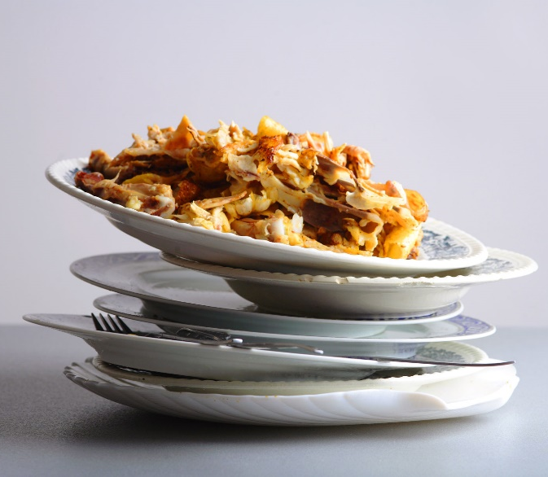
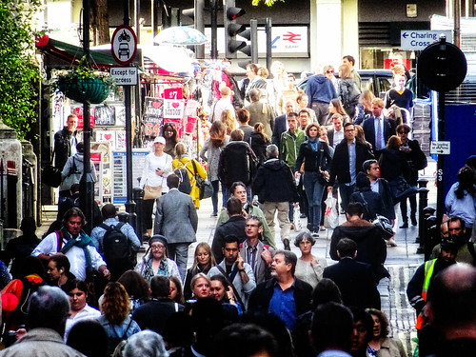
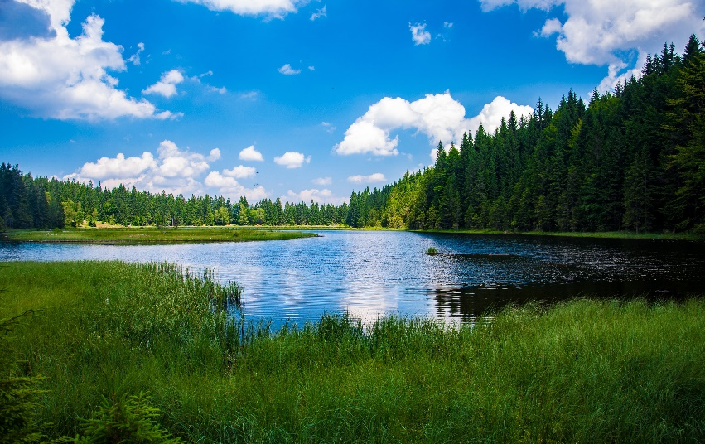
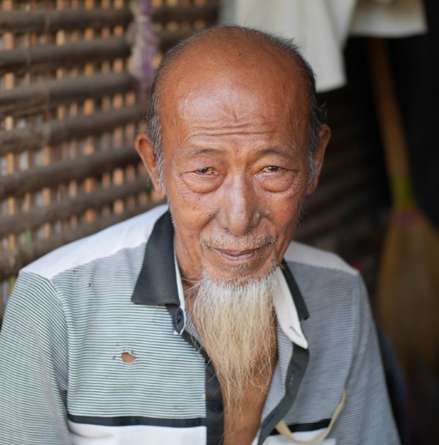
I.N.I.T.I.A.L GAME
Leftovers
Lake
Old
Rush hour
COUNSELLOR

Slide 5
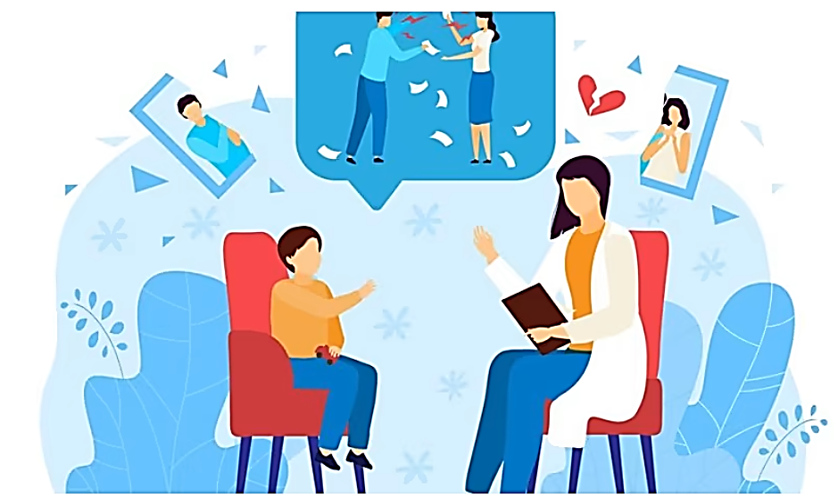
ANSWER
Does your secondary school have a school counsellor?
What does a school counsellor do in a secondary school?

Slide 6
Unit 3:
HEALTHY LIVING FOR TEENS
Lesson 1: getting started

Slide 7


VOCABULARY
maintain (v)
.
/meɪnˈteɪn/
duy trì
Notes:
Maintain (v): make something continue at the same level, standard, etc

Slide 8

VOCABULARY
advice (n)
/ədˈvaɪs/
lời khuyên
Notes:
Advice (n): an opinion or a suggestion about what somebody should do in a particular situation

Slide 9

VOCABULARY
bring about (ph. v)
/brɪŋ əˈbaʊt/
đem lại, gây ra
Notes:
Bring about (ph.v): make something happen

Slide 10

VOCABULARY
balance (v)
/ˈbæləns/
cân bằng
Notes:
Balance (v): to give equal importance to two things or parts of something which are very different

Slide 11

VOCABULARY
manage (v)
.
/ˈmænɪdʒ/
quản lý
Notes:
Manage (v): control or be in charge of a business, a team, an organization, land, etc.

Slide 12

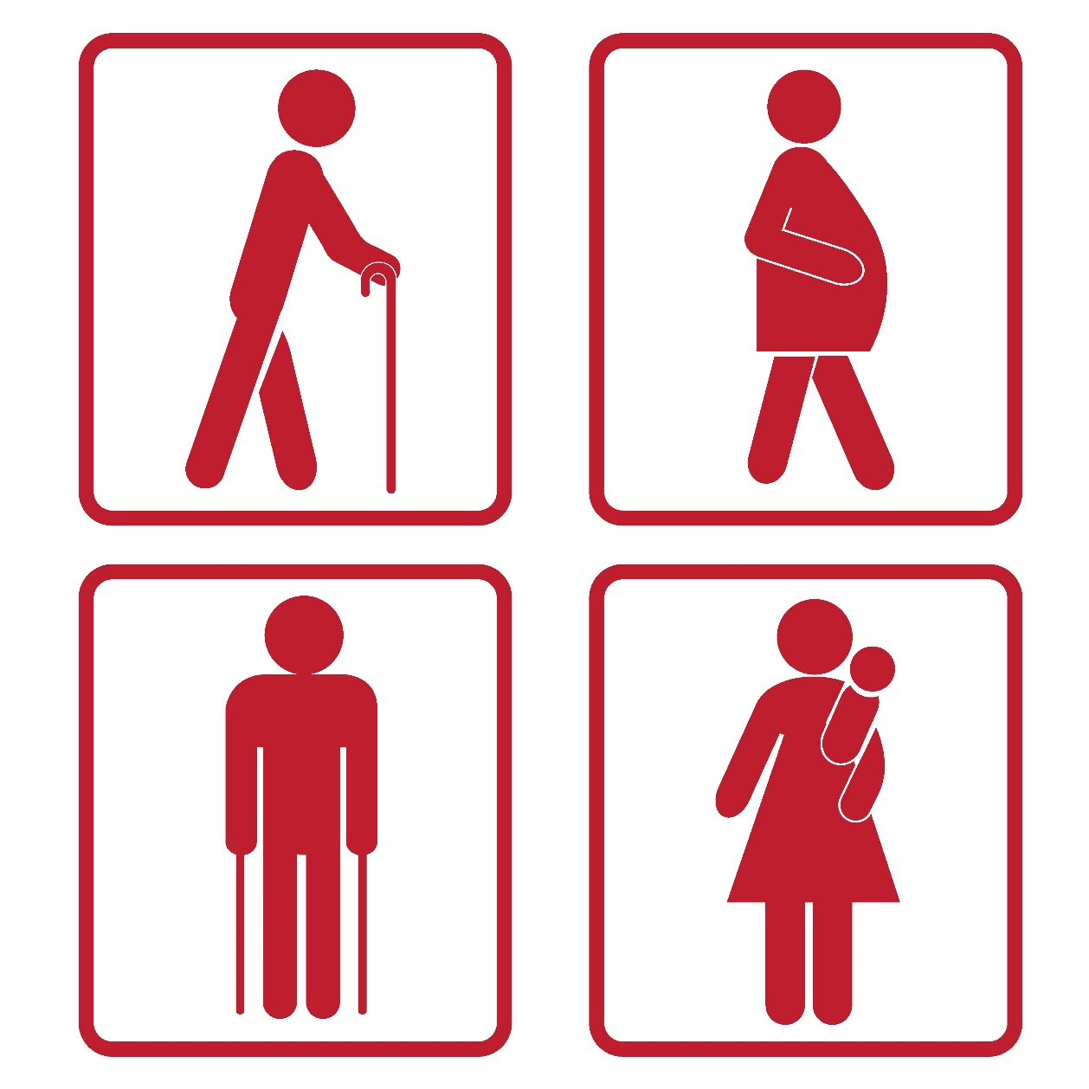
VOCABULARY
priority (n)
/praɪˈɔːr.ə.t̬i/
sự ưu tiên
Notes:
Balance (v): to give equal importance to two things or parts of something which are very different

Slide 13
VOCABULARY
1. maintain (v) | /meɪnˈteɪn/ | duy trì
2. advice (n) | /ədˈvaɪs/ | lời khuyên
3. bring about (ph.v) | /brɪŋ əˈbaʊt/ | đem lại, gây ra
4. balance (n) | /ˈbæləns/ | cân bằng
5. manage (v) | /ˈmænɪdʒ/ | quản lý
6. priority (n) | /praɪˈɔːrət/ | sự ưu tiên

Slide 14

Advice from a school counsellor
School Counsellor: Good morning, class. Welcome to our “Tips for Good Physical and Mental Health”. In this session, feel free to ask any questions.
Nick: How can we maintain good physical health?
School Counsellor: You should get enough sleep, eat a healthy diet, and do physical exercise regularly.
Mai: My parents say students of our age need to sleep at least eight hours a day. Is that right?
School Counsellor: Yes, it is.
Phong: But we often find it difficult to get a good night’s sleep, especially before exams. Could you offer us any advice?
School Counsellor: I understand that exams bring about lots of stress. You can reduce this stress by studying long before the exam, not waiting until the night before it.
Phong: Thank you. Do you have any tips about looking after our mental health?
School Counsellor: If you want to have good mental health, you should have a well-balanced life. I mean you should balance your study and life.
Nick: But how can we balance them? School Counsellor: Well, you have to manage your time by planning your schedule and giving priority to your work. And you should keep a balance between study and play.
Notes:
Look at the conversation and answer: - Who are in the conversation? – What are they talking about? => They are a school counsellor, Nick, Mai and Phong. They are talking about how to maintain good physical and mental health.

Slide 15

2. Read the conversation again and write T (true) or F (False).
 | TRUE (T) | FALSE (F)
1. The counsellor is giving advice on how to maintain good physical and mental health.
2. According to Mai’s parents, students shouldn’t sleep more than eight hours a day.
3. Many students find it easy to get a good night’s sleep before exams.
4. Nick doesn’t know how to have a well-balanced life.
5. The school counsellor advises the students to balance their study and play time.

Slide 16
3. Match the words with their definitions.
1. physical
a. a person whose job is to help and support people with problems
b. connected with a person’s body rather than their mind
c. something that you think is more important than other things and should be dealt with first
d. connected with the state of health of the mind
e. having the right amounts of all the different parts that make up something
2. mental
3. well-balanced
4. priority
5. counsellor

Slide 17
4. Complete the sentences with the words in the box.
physical counsellor well-balanced priority mental
1. You should make a list of all the jobs you have to do and give _________ to them.
2. Maintaining a ______________ life often means making time for the things you have to do, as well as the things you want to do in a suitable way.
3. The police asked them to describe his ___________ appearance.
4. You need to maintain your physical and ___________ health.
5. The ______________ is willing to listen to the students to help them solve their problems.
priority
well-balanced
physical
mental
counsellor

Slide 18
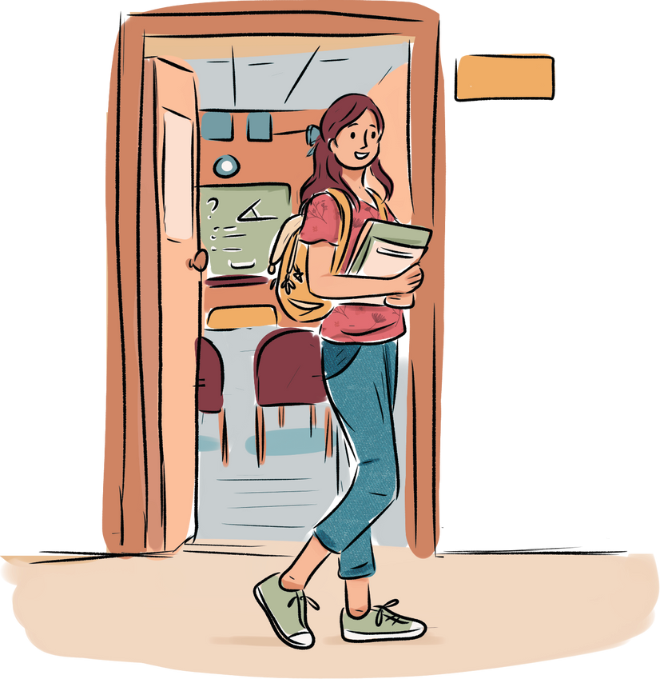
5. Work in pairs. Interview each other about how healthy you are. Give each other advice.
Example:
A: How healthy are you? B: I’m tired.
A: You should take a break and do some physical exercise

Slide 19

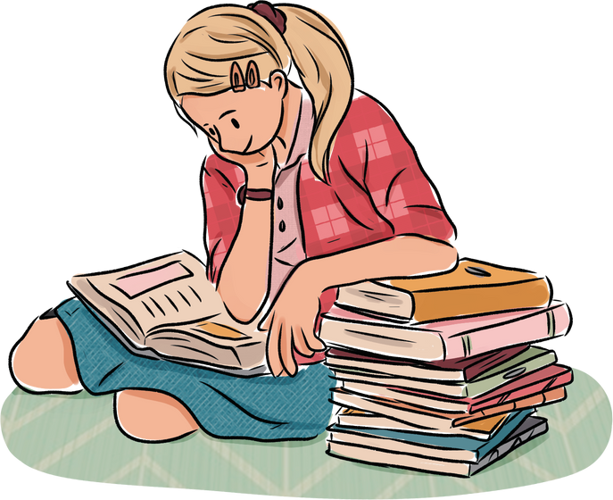
WRAP - UP
What have we learnt in this lesson?
Identify the topic of the unit;
Use lexical items related to Healthy living for teens;
Identify the language features that are covered in the unit.

Slide 20
HOMEWORK
Do exercises in the workbook.
Start preparing for the Project of the unit.
Prepare: A Closer Look 1

