Slide 1
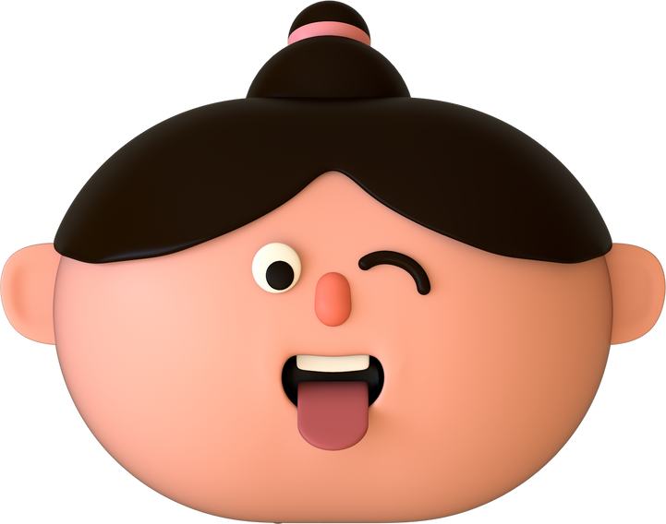


WELCOME TO OUR CLASS!
PRESENTED BY: ………………………..

Slide 2
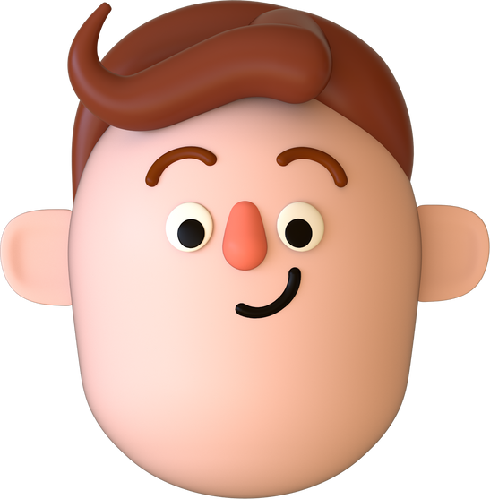
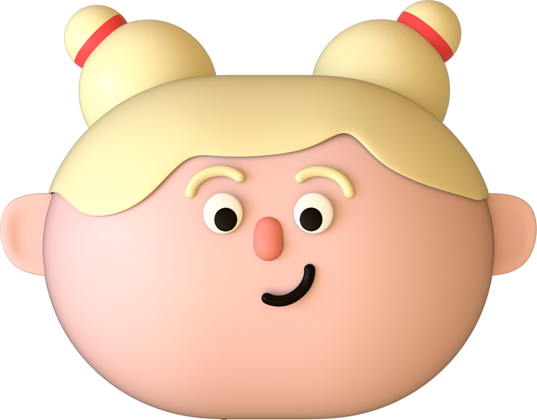
MEMORIZING GAME

Slide 3
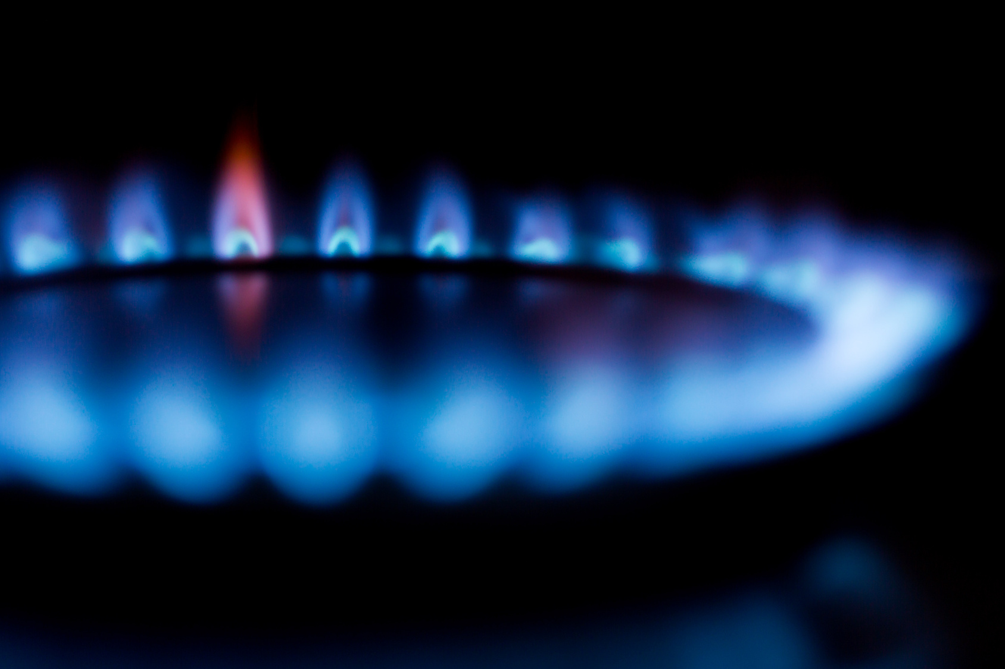
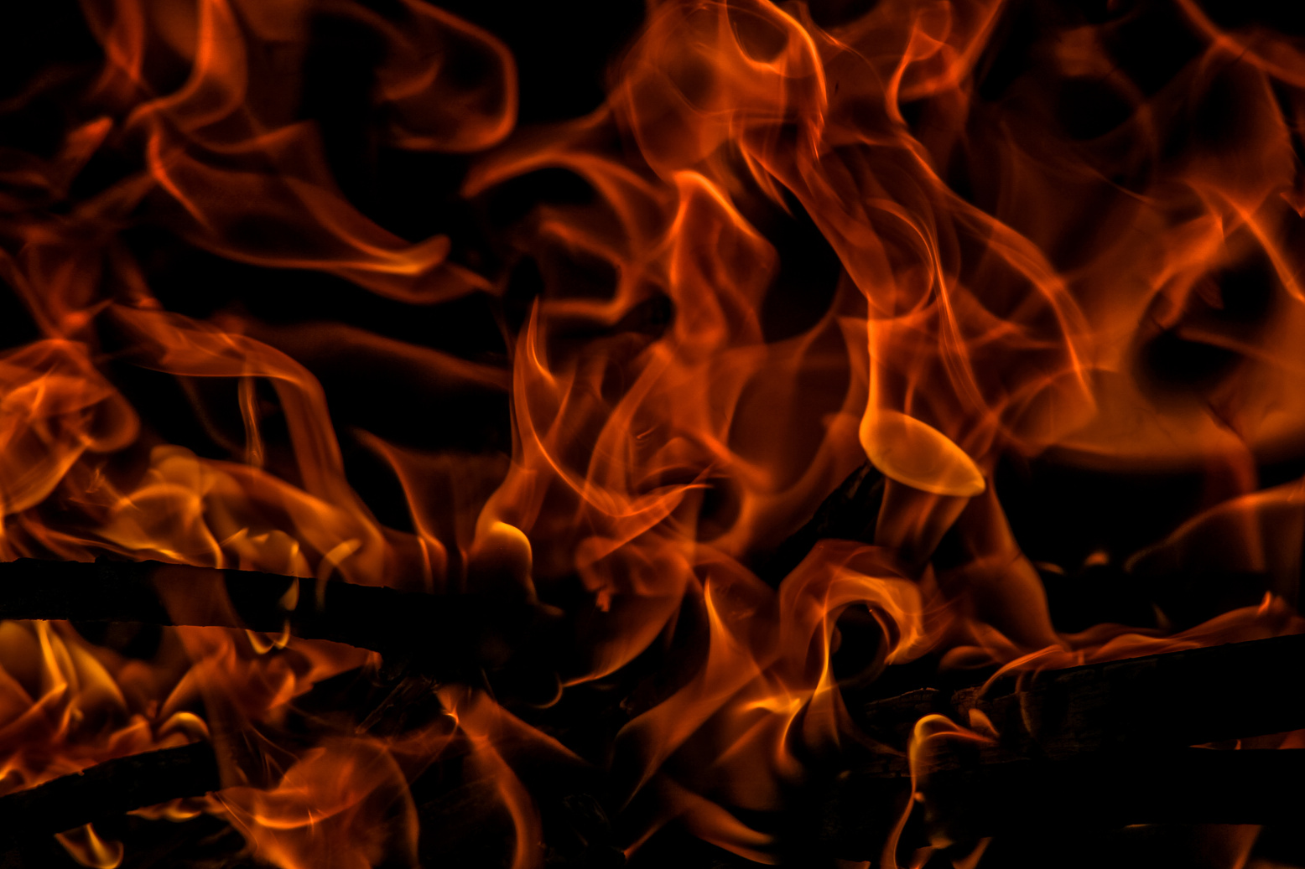
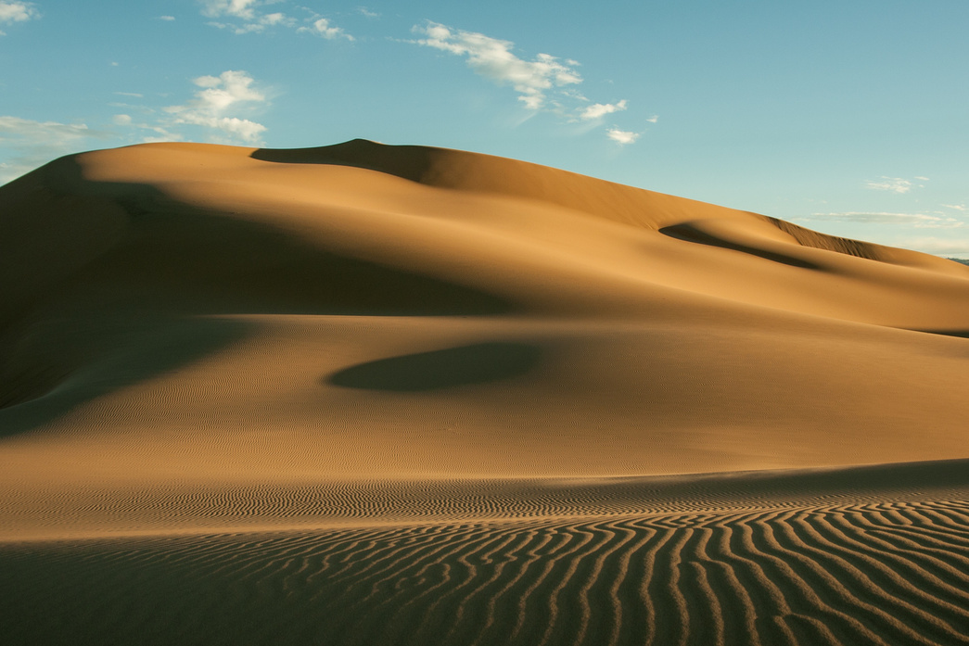
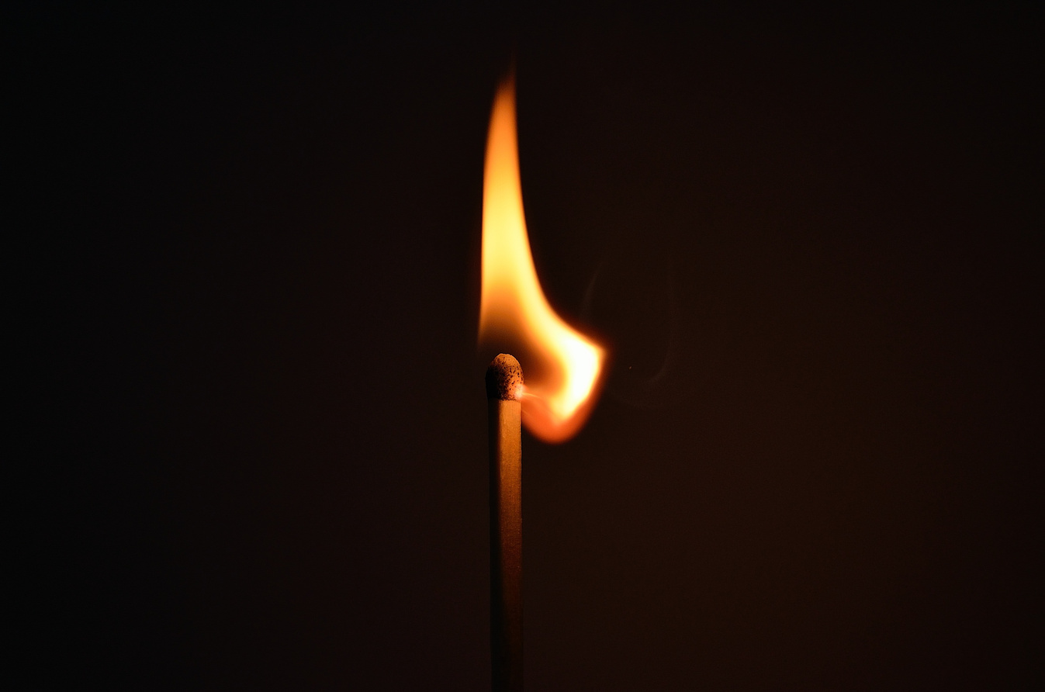
MEMORIZING GAME
- Work in 2 teams.
- Look at the pictures in 30 seconds and try to remember as many details as possible.
- Answer the questions.
- 10 points/correct answer

Slide 4
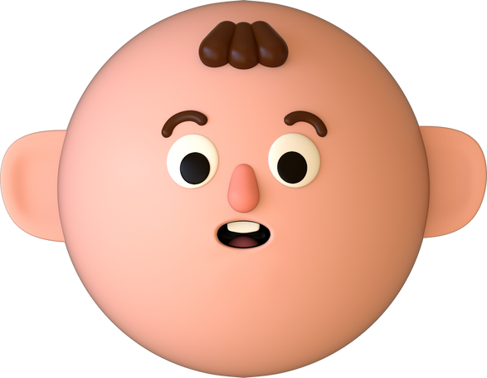
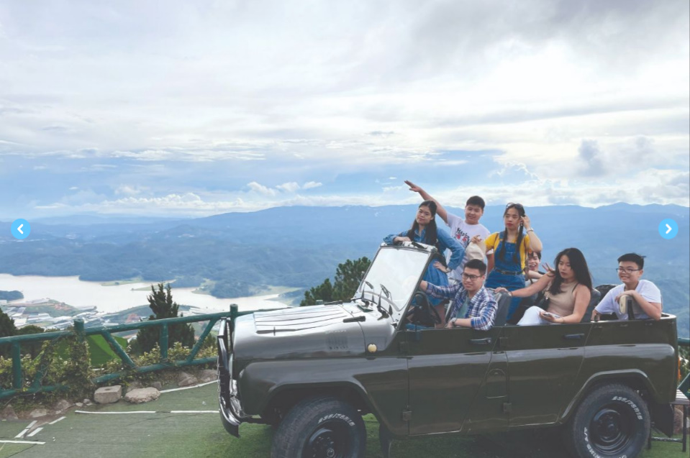


Slide 5
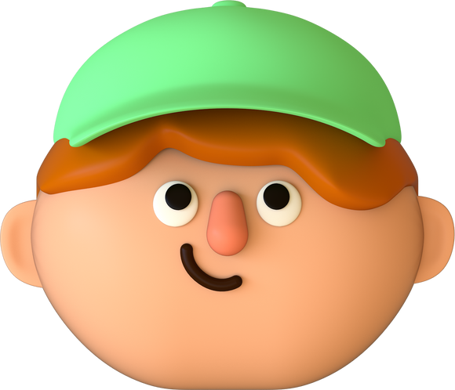
Questions:
1. How many people can you see in the picture?
2. What type of vehicle are they are riding?
3. Where are they?

Slide 6


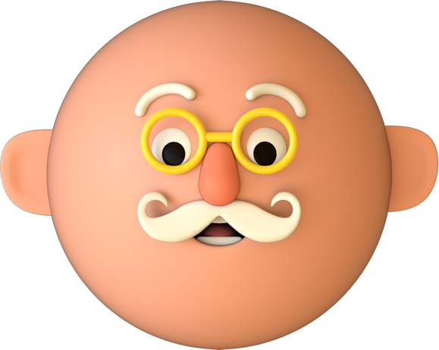
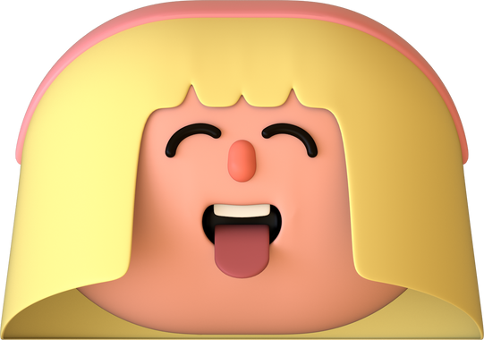
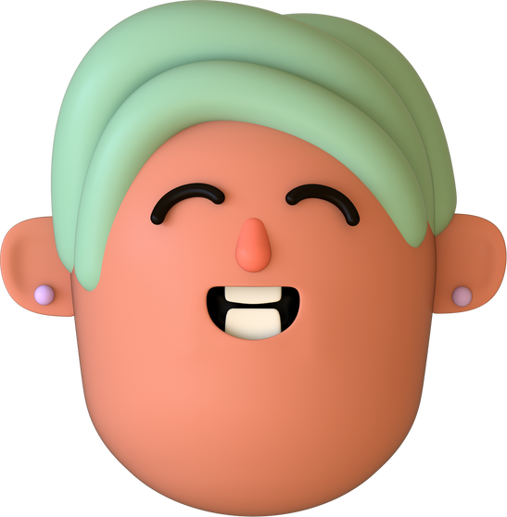
UNIT 5:
OUR EXPERIENCES
LESSON 1: GETTING STARTED

Slide 7
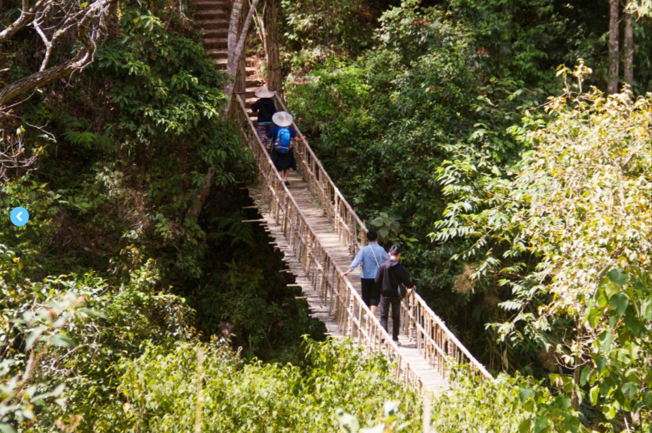
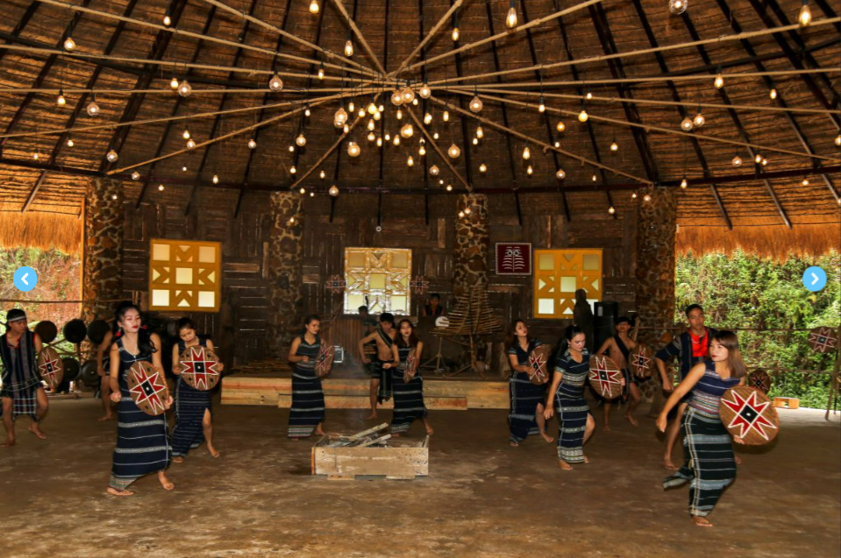
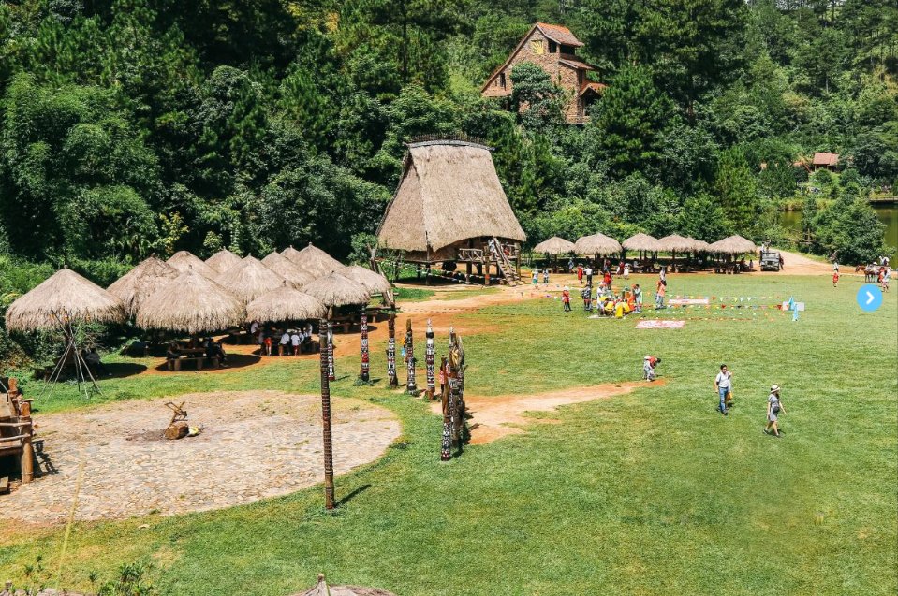
Look and answer
- What can you see in the four pictures?
- What do you think Mi and Tom are talking about?

Slide 8
The teenagers are riding a jeep.

Slide 9
Cu Lan village. There are stilt houses, and someone is riding a horse.

Slide 10
People are performing gong dance.

Slide 11
People are exploring an area.

Slide 12
VOCABULARY

Slide 13


VOCABULARY
experience (n)
/ɪkˈspɪəriəns/
sự trải nghiệm

Slide 14
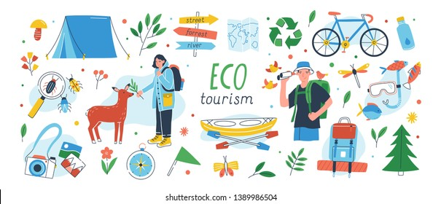
VOCABULARY
eco-tour (n)
/ˈiːkə-tʊə(r)/
du lịch sinh thái

Slide 15
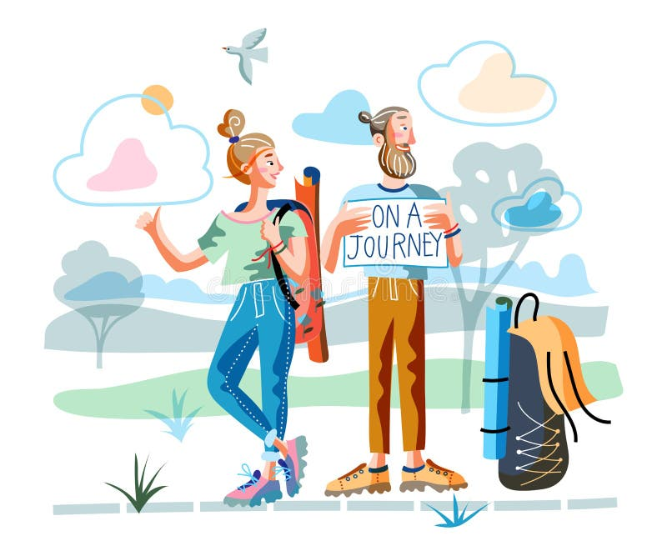
VOCABULARY
memorable (n)
/ˈmemərəbl/
đáng nhớ

Slide 16

VOCABULARY
brilliant (adj)
/ˈbrɪliənt/
rất ấn tượng

Slide 17

VOCABULARY
flora (n)
/ˈflɔːrə/
tất cả thực vật của một khu vực

Slide 18
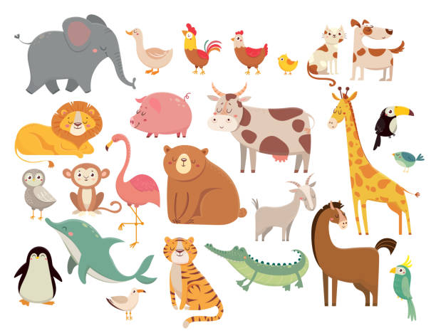
VOCABULARY
fauna (n)
/ˈfɔːnə/
tất cả động vật của một khu vực

Slide 19
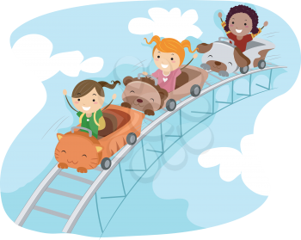
VOCABULARY
thrilling (adj)
/ˈθrɪlɪŋ/
phấn khích

Slide 20
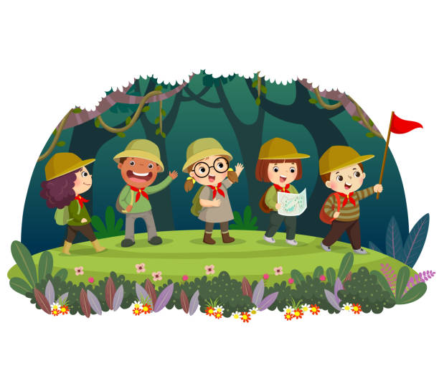
VOCABULARY
explore (V)
/ɪkˈsplɔː(r)/
khám phá

Slide 21

VOCABULARY
seabed (n)
/ˈsi:bed/
đáy biển

Slide 22
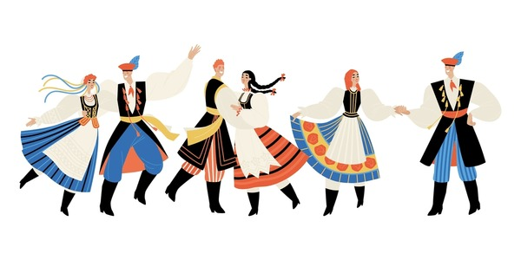
VOCABULARY
tribal dance (n)
/ˈtraɪbl dɑːns/
điệu múa của bộ tộc

Slide 23
VOCABULARY
New words | Pronunciation | Meaning
1. experience (n) | /ɪkˈspɪəriəns/ | sự trải nghiệm
2. eco-tour (n) | /ˈiːkə-tʊə(r)/ | du lịch sinh thái
3. memorable (adj) | / ˈmemərəbl/ | đáng nhớ
4. brilliant (adj) | /ˈbrɪliənt/ | rất ấn tượng
5. flora (n) | /ˈflɔːrə/ | tất cả thực vật của một khu vực

Slide 24
VOCABULARY
New words | Pronunciation | Meaning
6. fauna (n) | /ˈfɔːnə/ | tất cả động vật của một khu vực
7. thrilling (adj) | /ˈθrɪlɪŋ/ | phấn khích
8. explore (v) | /ɪkˈsplɔː(r)/ | khám phá
9. seabed (n) | /ˈsi:bed/ | đáy biển
10. tribal dance (n) | /ˈtraɪbl dɑːns/ | điệu múa của bộ tộc

Slide 25
LISTEN AND READ
Tom: Hi Mi, I’m back from Da Lat now. I have some local specialities for you.
Mi: Thanks Tom. I guess you and your family had a great time there.
Tom: Yeah. We visited LangBiang Mountain, and Cu Lan Village. We saw a gong show in the evening.
Mi: What did you do on LangBiang Mountain?
Tom: We rode a jeep to the top. It was a thrilling ride up there. Then we took an eco-tour of LangBiang Mountain. They said that the area is rich in flora and fauna with more than 150 plant and animal species.
Mi: Sounds amazing! What did you do then?
Tom: We took pictures of the magnificent scenery. It was really enjoyable!
Mi: Then did you explore Cu Lan Village?
Tom: Yes. We had a brilliant tour around the village. We also rode horses and a jeep along a stream.
Mi: That must have been exciting, Tom.
Tom: It definitely was. In the evening we saw an interesting gong show. We danced and sang with the locals. And we tried grilled pork. It was a really memorable evening. I’ll show you some pictures I took there.

Slide 26
2. Read the conversation again and write T (true) or F (False).
F
1. Mi and Tom had a great time in Da Lat. ______
2. Tom had an eco-tour of Langbiang Mountain. ______
3. There are more than 150 plant and animal species ______
on Langbiang Mountain.
4. Tom didn’t like his experiences in Cu Lan Village. ______
5. Tom danced and sang with the local people ______
at a gong show.
T
T
F
T

Slide 27
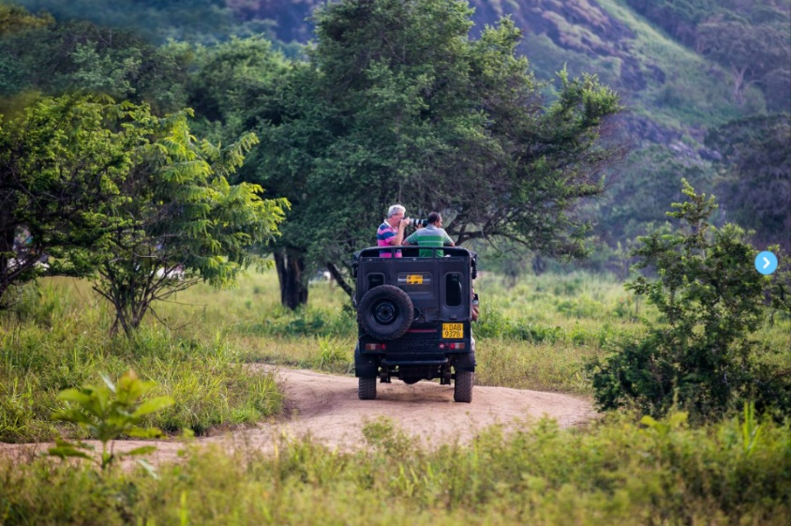
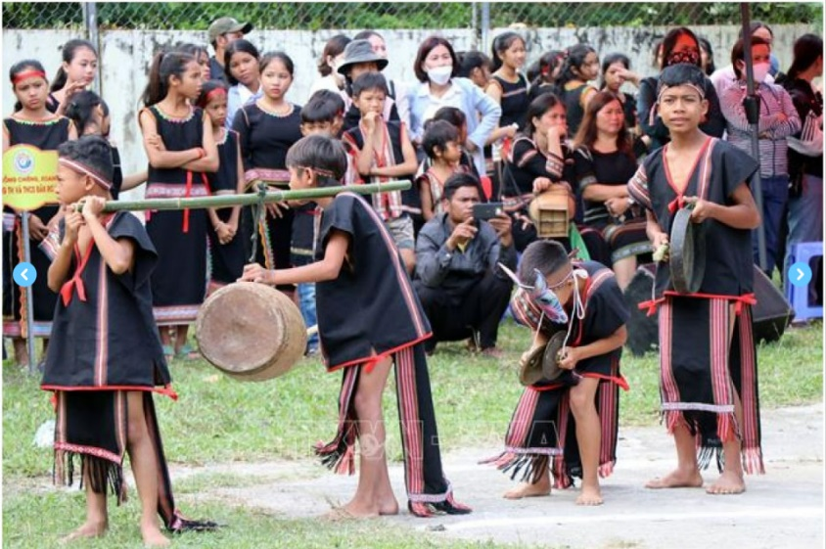
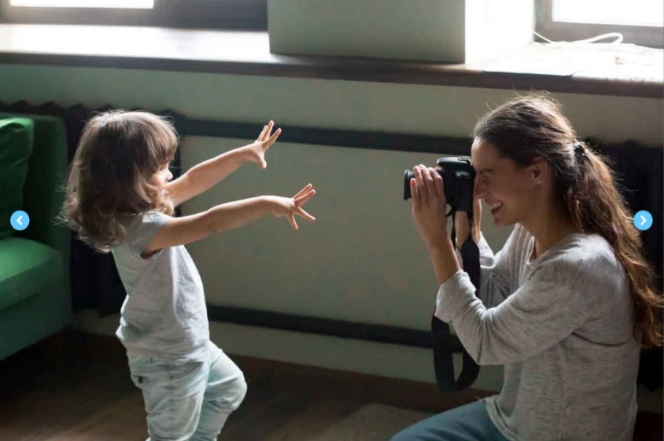
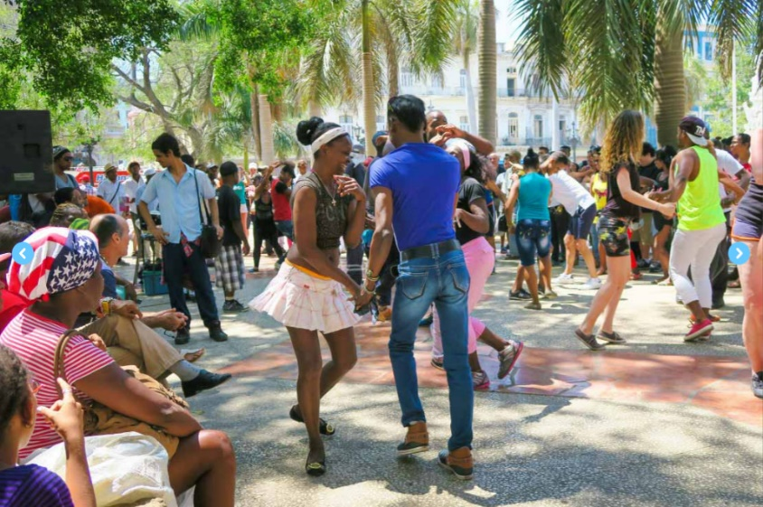
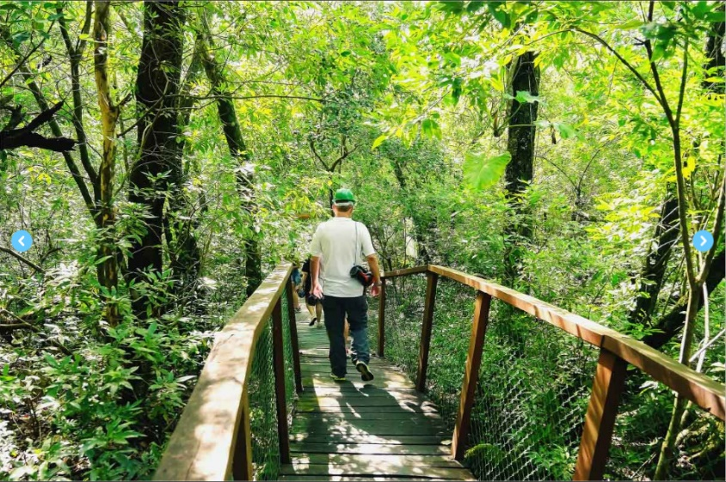
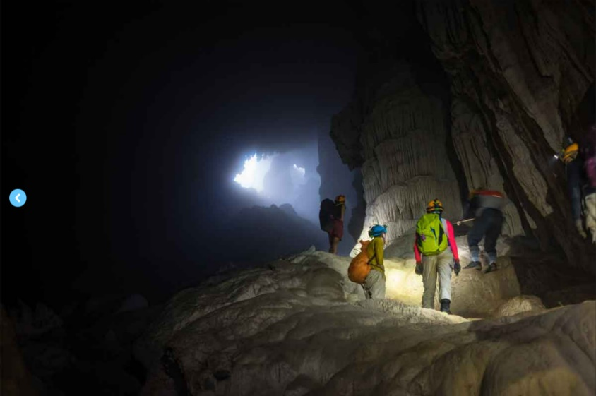
3. Write activities under the pictures.
taking photos | riding a jeep | taking an eco-tour
exploring a site | dancing with local people | seeing a gong show
1. ____________
2. ____________
3. ____________
4. ____________
5. ____________
6. ____________

Slide 28
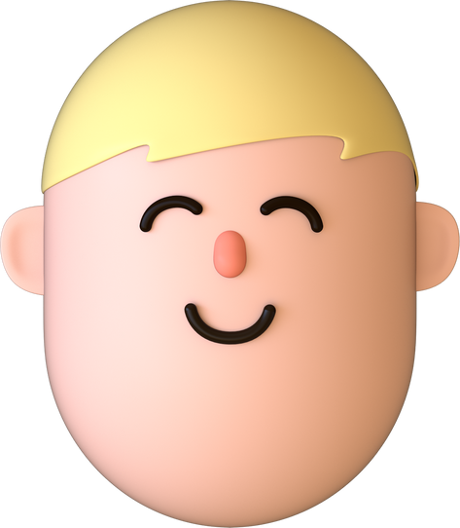
3. Write activities under the pictures.
taking photos | riding a jeep | taking an eco-tour
exploring a site | dancing with local people | seeing a gong show
riding a jeep

Slide 29

3. Write activities under the pictures.
taking photos | riding a jeep | taking an eco-tour
exploring a site | dancing with local people | seeing a gong show
exploring a site

Slide 30

3. Write activities under the pictures.
taking photos | riding a jeep | taking an eco-tour
exploring a site | dancing with local people | seeing a gong show
taking an eco-tour

Slide 31
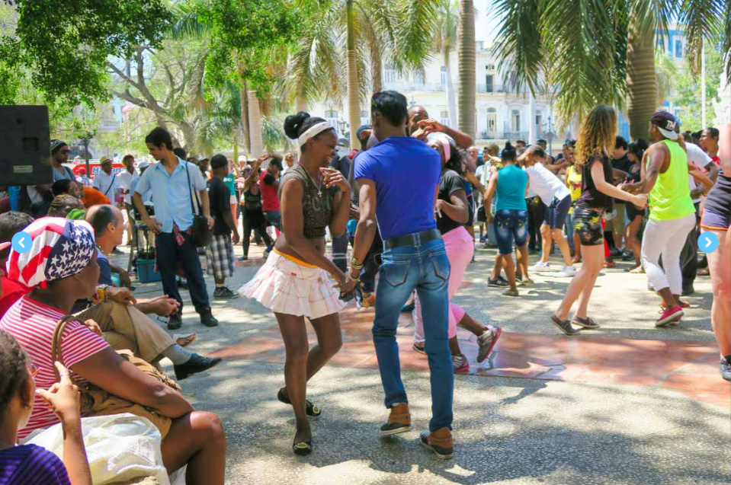
3. Write activities under the pictures.
taking photos | riding a jeep | taking an eco-tour
exploring a site | dancing with local people | seeing a gong show
dancing with local people

Slide 32
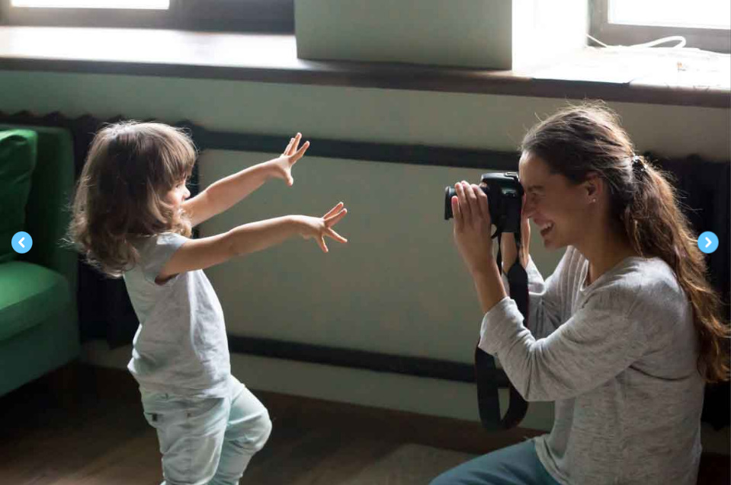
3. Write activities under the pictures.
taking photos | riding a jeep | taking an eco-tour
exploring a site | dancing with local people | seeing a gong show
taking photos

Slide 33

3. Write activities under the pictures.
taking photos | riding a jeep | taking an eco-tour
exploring a site | dancing with local people | seeing a gong show
seeing a gong show

Slide 34
Look at the answers again
1. riding a jeep
2. seeing a gong show
3. taking photos
4. dancing with local people
5. taking an eco-tour
6. exploring a site

Slide 35
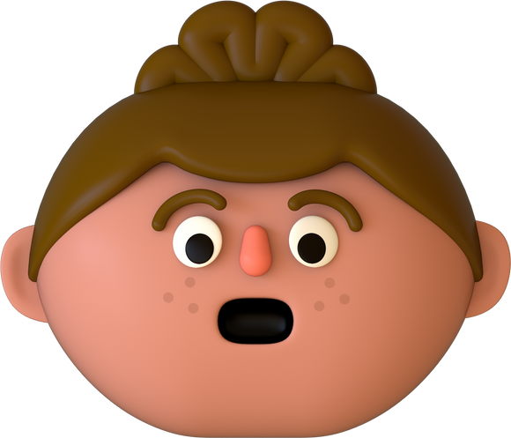
4. Read the conversation again and match the activities with the adjectives.
1. riding a jeep | a. enjoyable
2. seeing a gong show | b. thrilling
3. taking an eco-tour | c. amazing
4. exploring a site | d. interesting
5. taking pictures | e. brilliant
Riding a jeep is thrilling.

Slide 36
5. Work in groups. Carry out a survey.
 | Yes | No
1. climbing a mountain
2. taking an eco-tour
3. exploring the seabed
4. taking photos from a mountain top
5. seeing a tribal dance show
Do you like climbing a mountain?
Yes, I do. / No, I don’t.

Slide 37
5. report your group’s findings to the class.
Example:
I did a survey with 3 peers. Two like climbing a mountain, 3 like taking eco-tours, nobody likes exploring the seabed….

Slide 38
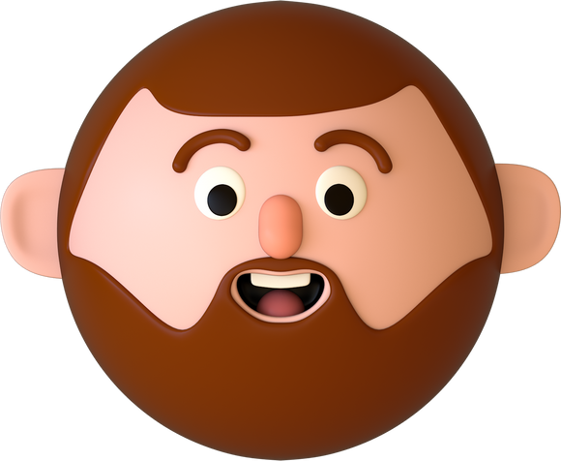
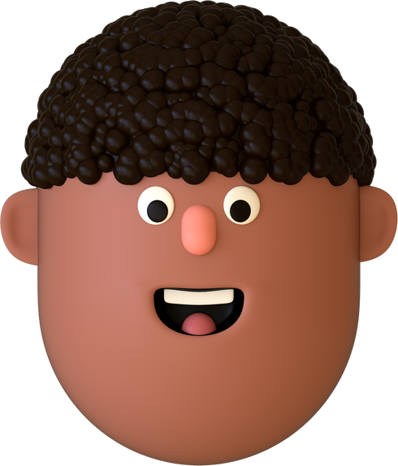
WRAP-UP
What have we learnt in this lesson?
identify the topic of the unit
use lexical items related to experiences
identify the language features that are covered in the unit

Slide 39
HOMEWORK
Do exercises in the workbook.
Make a list of adjectives to describe experiences.
Start preparing for the Project of the unit 5.

