Slide 1



WELCOME TO OUR CLASS!
Presented by: ………………………….

Slide 2



Unit 5:
OUR EXPERIENCES
Lesson 5: Skills 1

Slide 3



1. Tick (√) the experiences you have had.
1. Joining a performance
2. Attending an army course
3. Travelling to a new place without parents

Slide 4
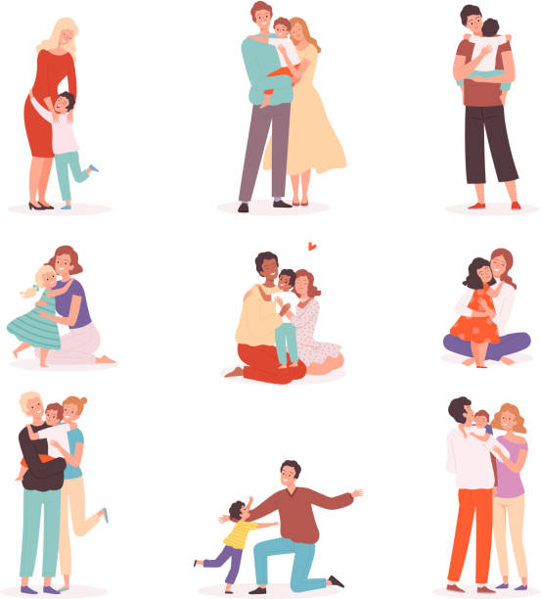


VOCABULARY
touching (adj)
/ˈtʌtʃɪŋ/
gây xúc động

Slide 5
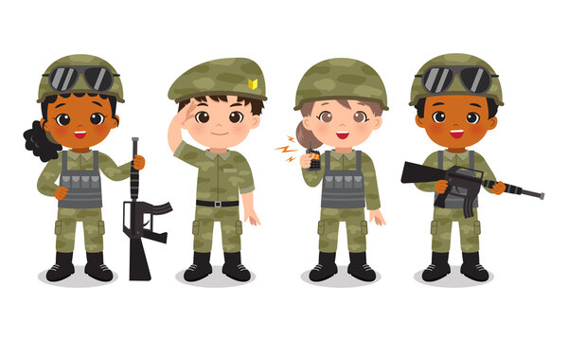
VOCABULARY
soldier (n)
/ˈsəʊldʒə(r)/
người lính

Slide 6
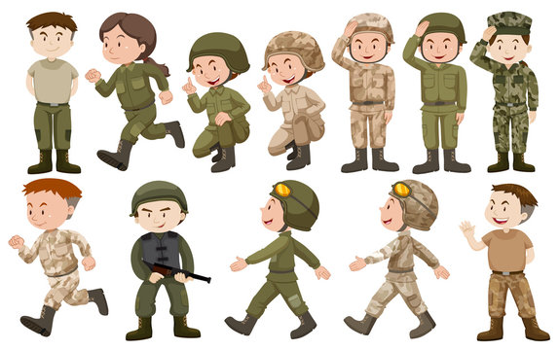
VOCABULARY
army-like (adj)
/ɑːmi- ‘laɪk/
như trong quân đội

Slide 7
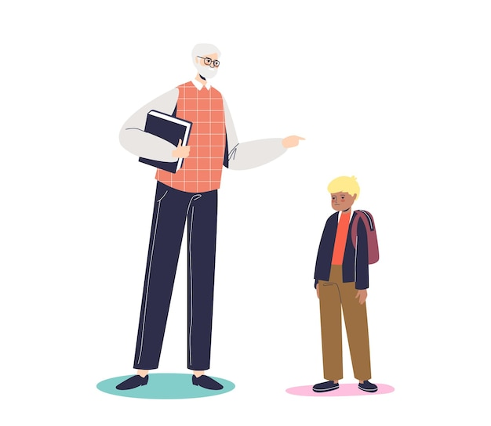
VOCABULARY
strict (adj)
/strɪkt/
nghiêm khắc

Slide 8

VOCABULARY
theme (n)
/θiːm/
chủ đề

Slide 9
VOCABULARY
New words | Pronunciation | Meaning
1. touching (adj) | /ˈtʌtʃɪŋ/ | gây xúc động
2. soldier (n) | /ˈsəʊldʒə(r)/ | người lính
3. army-like (adj) | /ɑːmi- ‘laɪk/ | như trong quân đội
4. strict (adj) | /strɪkt/ | nghiêm khắc
5. theme (n) | /θiːm/ | chủ đề

Slide 10
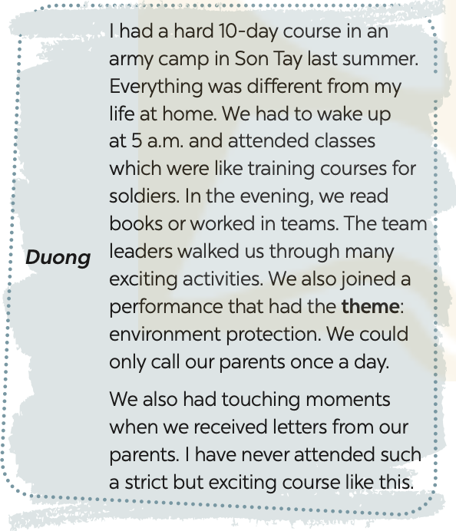
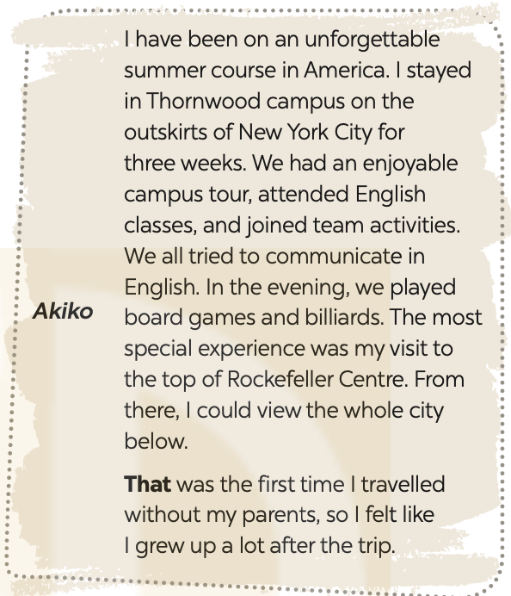
2. Read the texts and choose the correct answer A, B, C or D

Slide 11

2. Read the texts and choose the correct answer A, B, C or D
1. Duong and Akiko talked about ______.
A. their English summer courses B. experiences at summer courses C. activities in summer D. their army training
2. What didn’t Duong do during his course?
A. Get up early. B. Work as a leader.
C. Receive letters from home. D. Work in teams.
3. The word “theme” means ______.
A. performance B. environment C. activity D. topic
4. The experience at Rockefeller Centre was ______ for Akiko.
A. unforgettable B. enjoyable C. special D. touching
5. The word “that” refers to ______.
A. travelling to America B. touring the Thornwood campus
C. visiting Rockefeller Centre D. viewing the city below

Slide 12

3. Read the texts again and tick Duong or Akiko
Experiences | Duong | Akiko
1. attending an English course
2. attending an army-like course
3. joining a performance
4. touring a campus
5. receiving letters from home

Slide 13
4. Match the questions in A with the answers in B. Share your answers with a classmate.
A | B
1. What course did you attend? | a. It was in June.
2. When was that? | b. I felt that I grew up a lot after that course.
3. What did you do? | c. I attended a course on soft skills with a group of young trainers.
4. What do you remember most about it? | d. We worked in groups on different projects. We also learned to solve problems. We has various experiences.
5. How did you feel? | e. I remember being so embarrassed at first. But the trainers and my peers were great and they helped me a lot.

Slide 14
5. Work in pairs. Ask and answer about a course you have experienced. Use the questions in 4 as cues. Then report your partner’s answers to the class.
Minh attended a memorable summer course last year. It was a presentation skill course. He learnt how to organise the talk, and how to use visual aids. He also practised using gestures, and having eye contacts with the audience. He felt that the course was so impressive and memorable.
Example:

Slide 15
Wrap-up
What have we learnt in this lesson?
Read about Duong and Akiko’s experiences in their last summer.
Talk about a course you have experienced.

Slide 16
Homework
Do exercises in the workbook
Write down your friend’s experiences in your notebooks.

