Slide 1


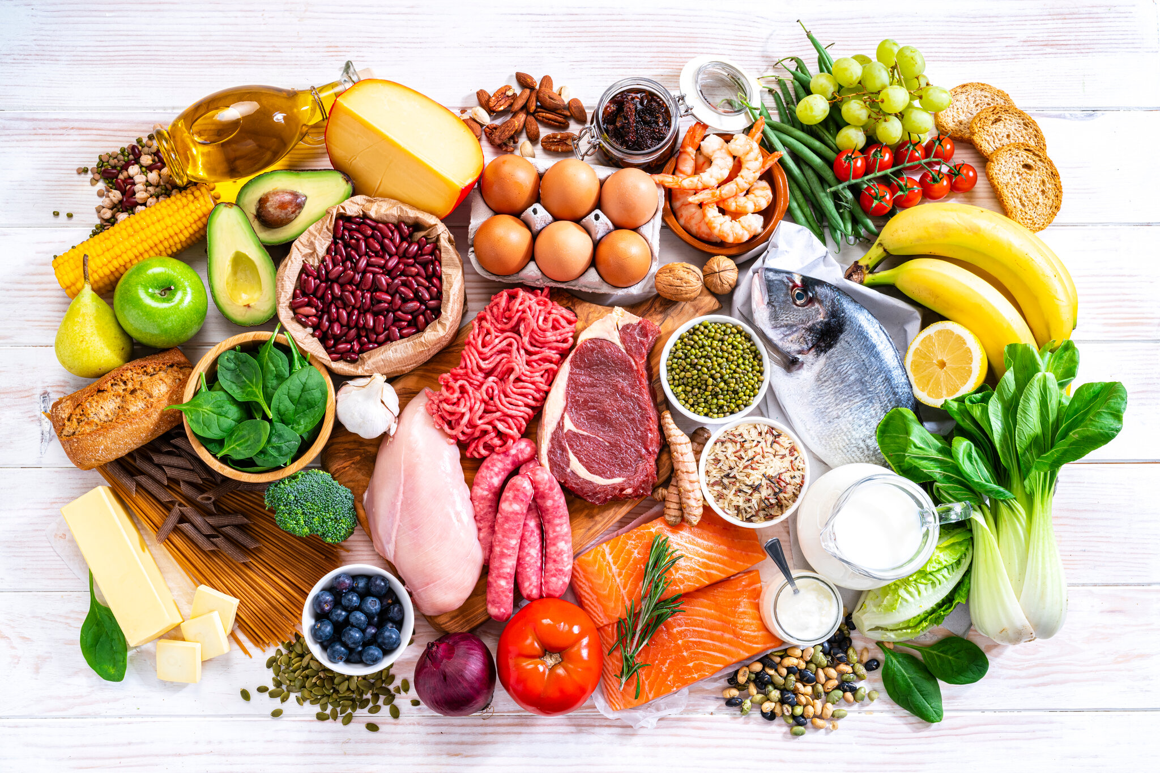
Unit
5
FOOD AND DRINK
HOBBIES

Slide 2

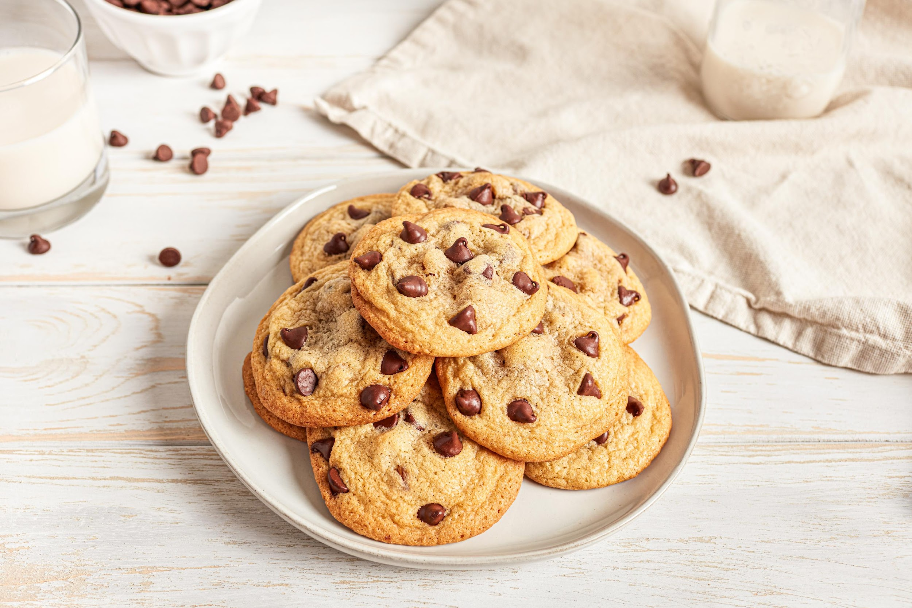
LESSON 1: GETTING STARTED
WARM-UP
Mini game

Slide 3
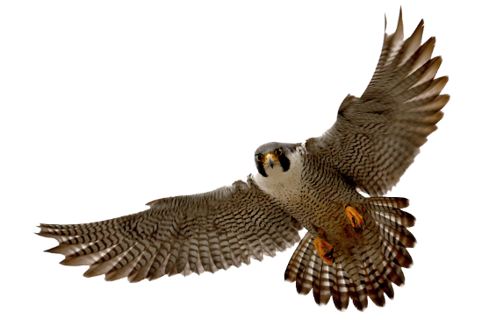
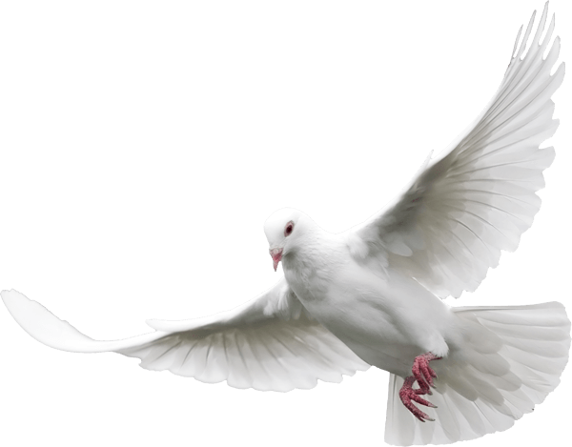


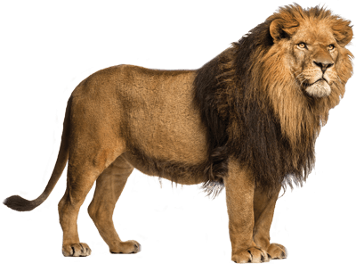
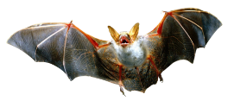
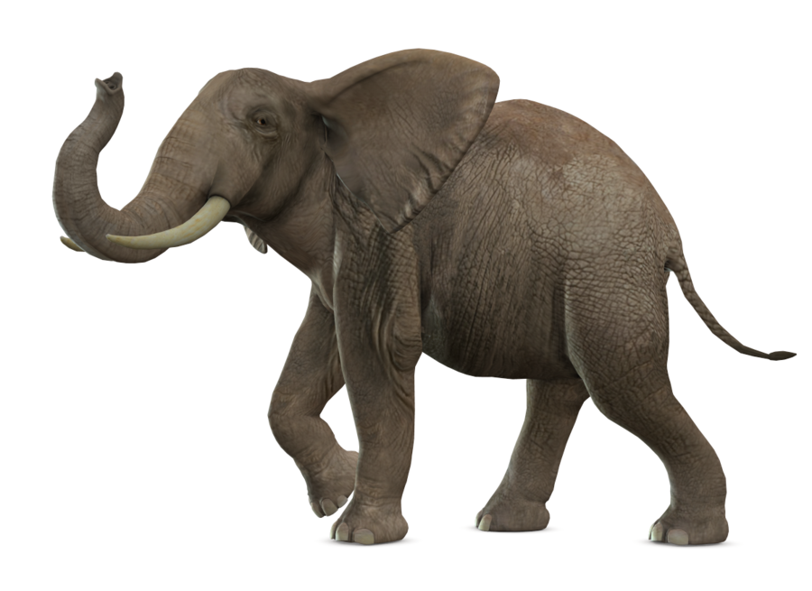
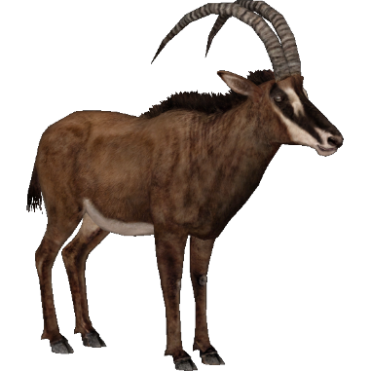
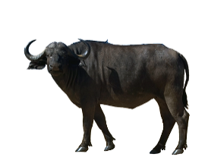
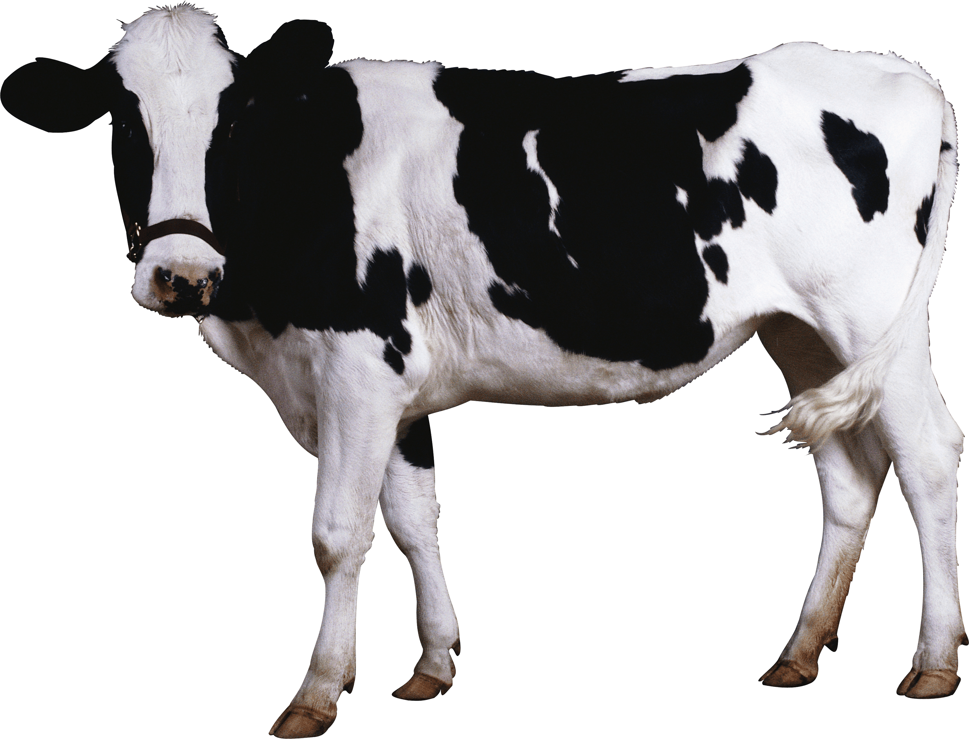
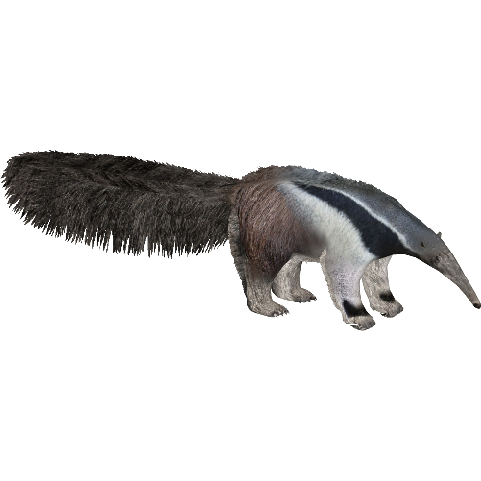
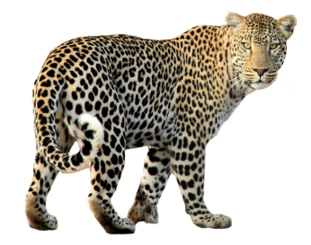

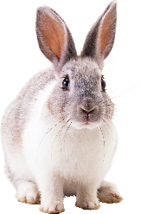
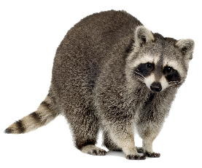

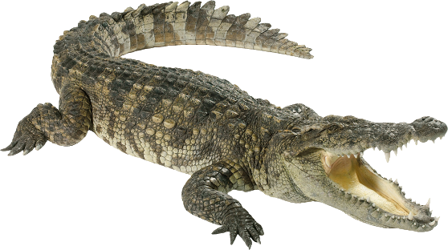
WHAT IS IT ?

Slide 4

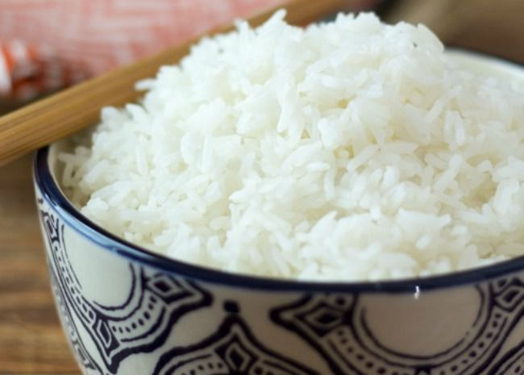
PRE
NEXT
A. RICE
B. NOODLES
C. PHO
D. FISH

Slide 5
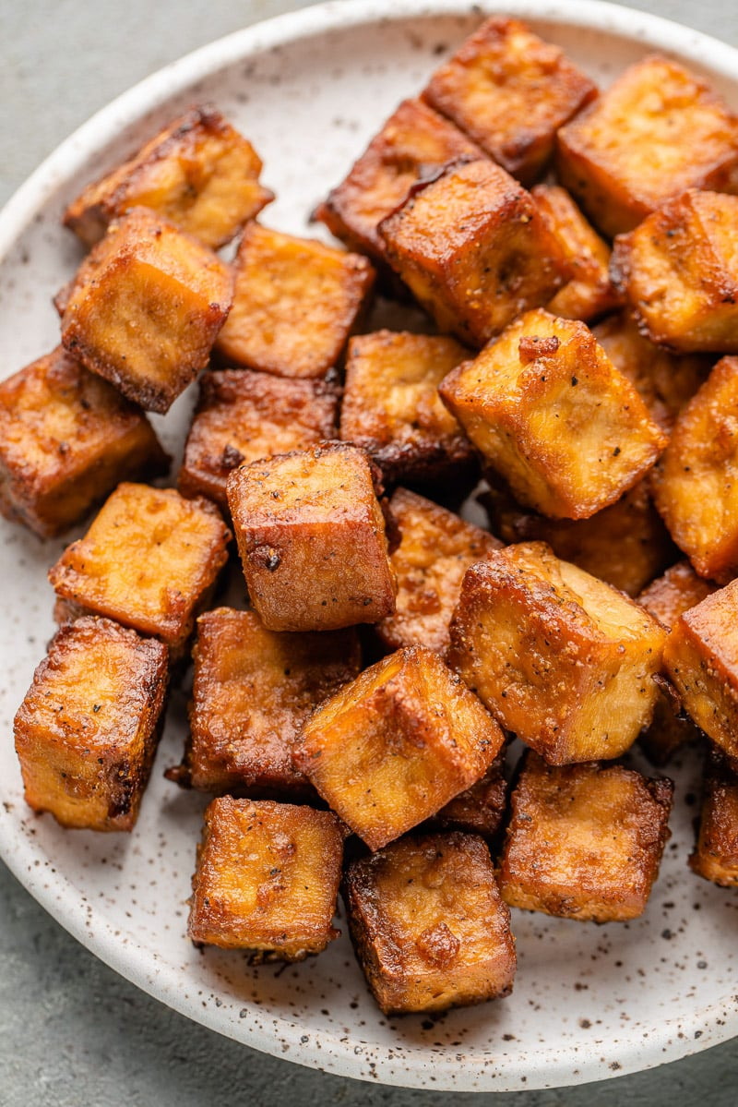
PRE
NEXT
A. RICE
B. TOFU
C. MEAT
D. PORK

Slide 6
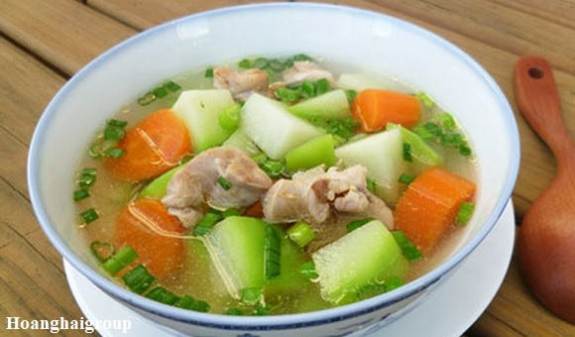
PRE
NEXT
A. SAUCE
B. JUICE
C. CANH
D. TEA

Slide 7
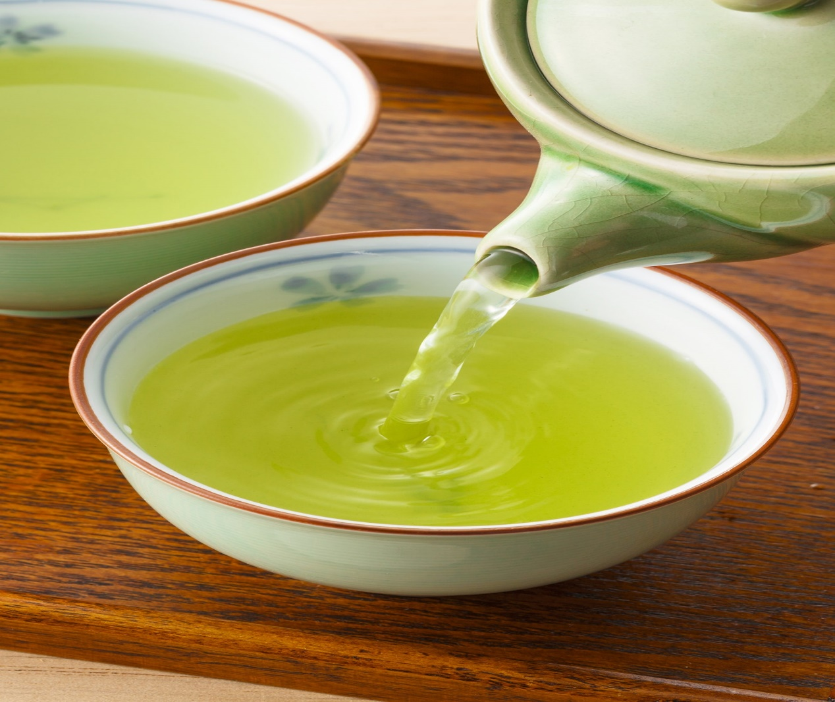
PRE
NEXT
A. MILK
B. WATER
C. SOUP
D. GREEN TEA

Slide 8
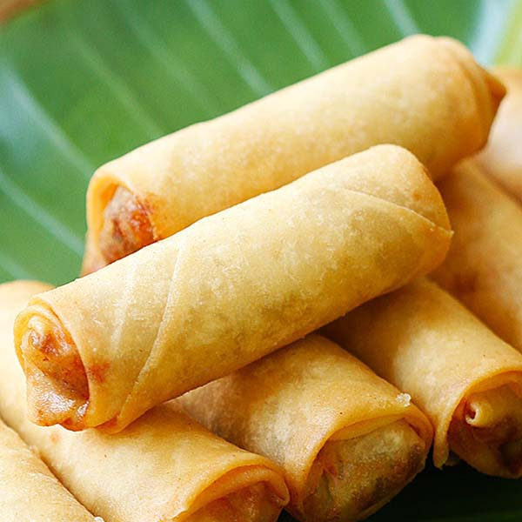
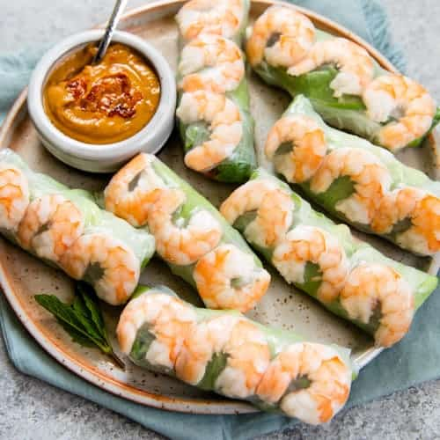
PRE
NEXT
A. STICKY RICE
B. SPRING ROLLS
C. BEEF STEAK
D. CAKE

Slide 9
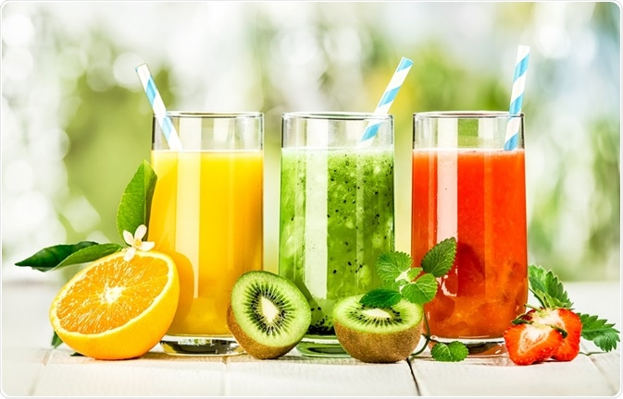
PRE
NEXT
A. JUICE
B. FRUIT
C. SODA
D. WATER

Slide 10
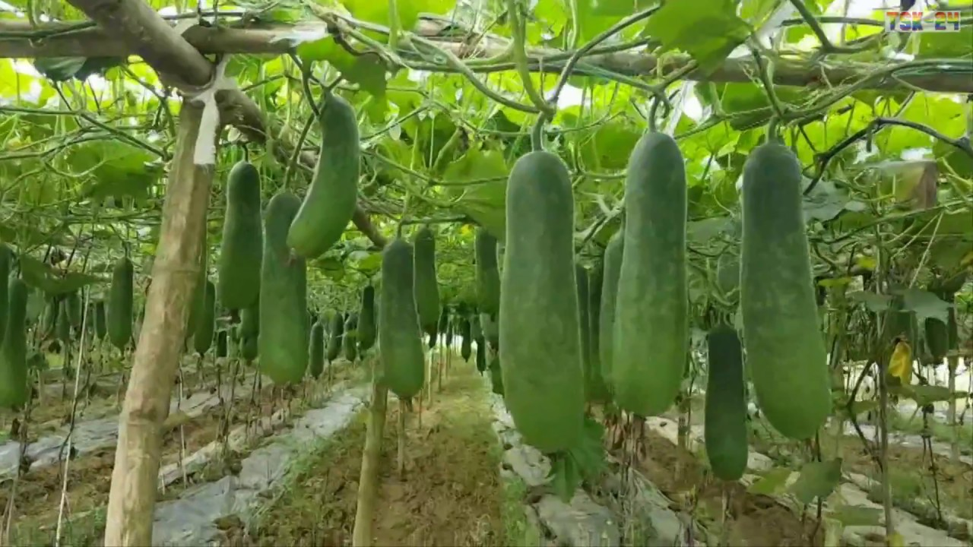
PRE
NEXT
A. FRUIT
B. WATER MELON
C. BANANA
D. WINTER MELON

Slide 11
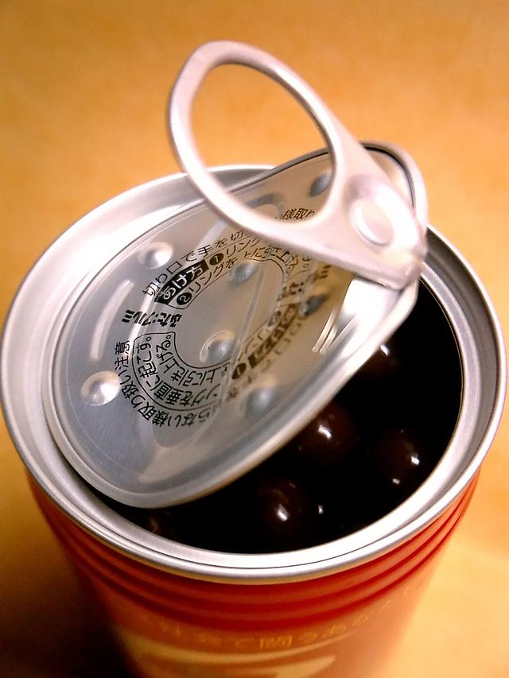
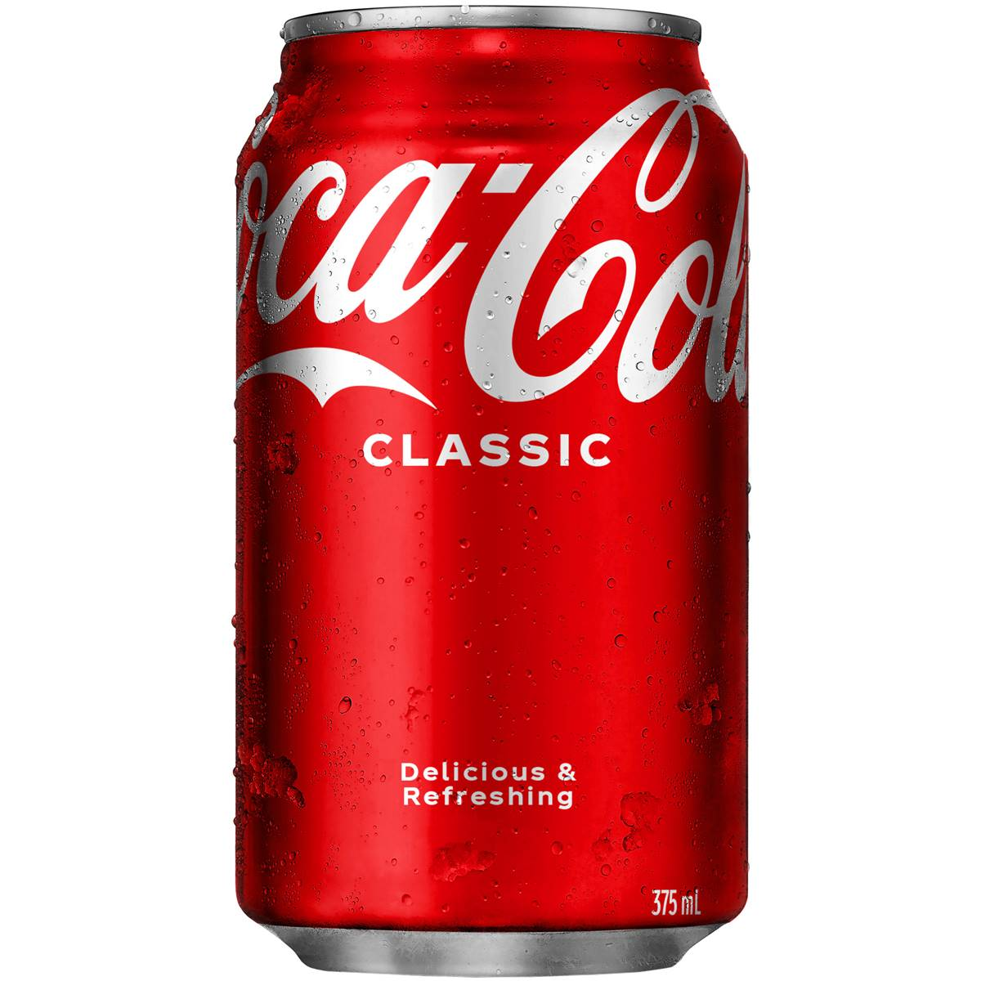
PRE
NEXT
A. BOTTLE
B. GLASS
C. CAN
D. CUP

Slide 12
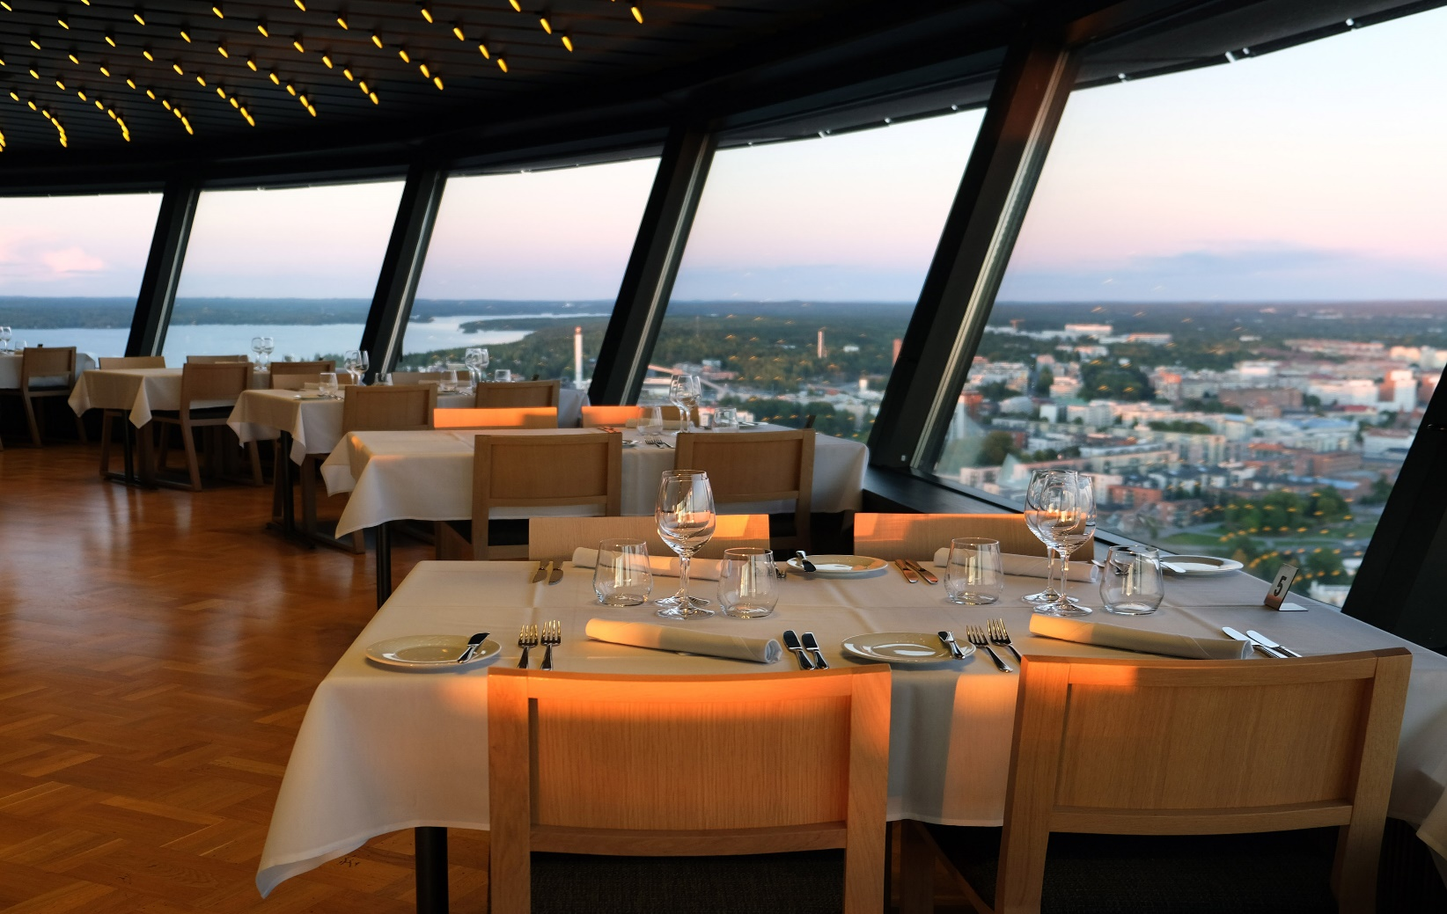
PRE
NEXT
A. RESTAURANT
B. HOUSE
C. VILLAGE
D. TABLE

Slide 13
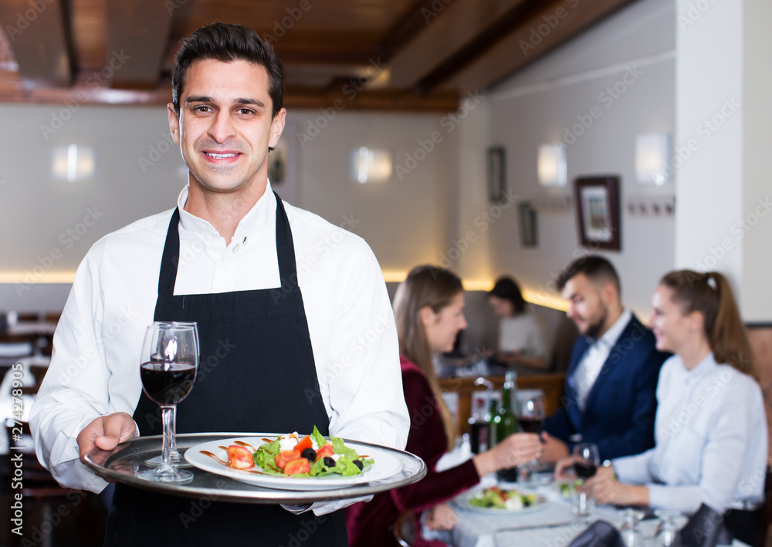
PRE
NEXT
A. TEACHER
B. WORKER
B. WAITER
D. FARMER

Slide 14
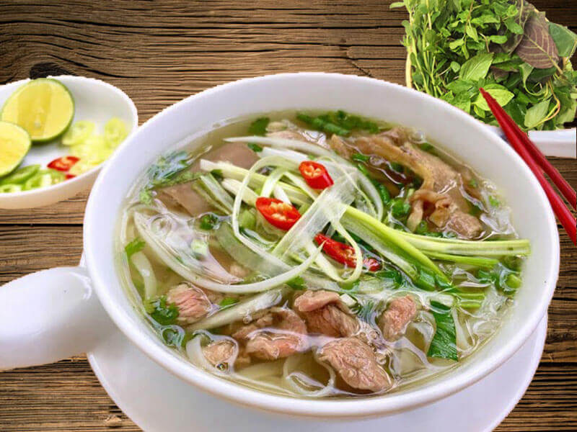
PRE
NEXT
A. CANH
B. Falcon
C. CHICKEN
D. PHO BO – BEEF NOODLE SOUP

Slide 15
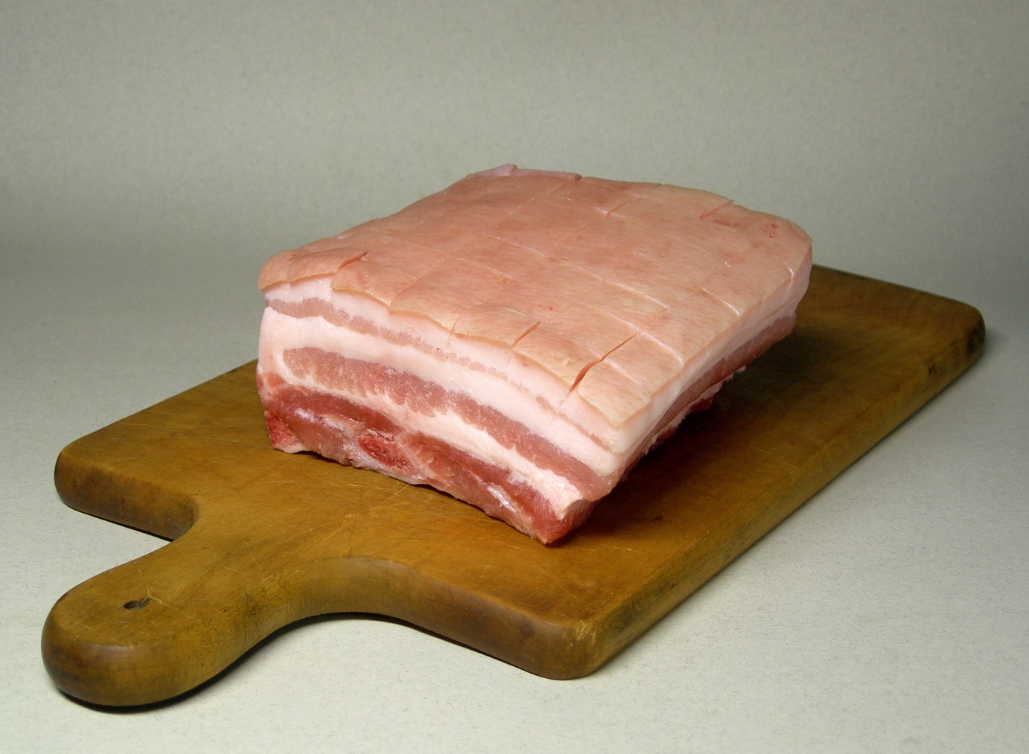
PRE
NEXT
A. PORK
B. BEEF
C. CHICKEN
C. FISH

Slide 16
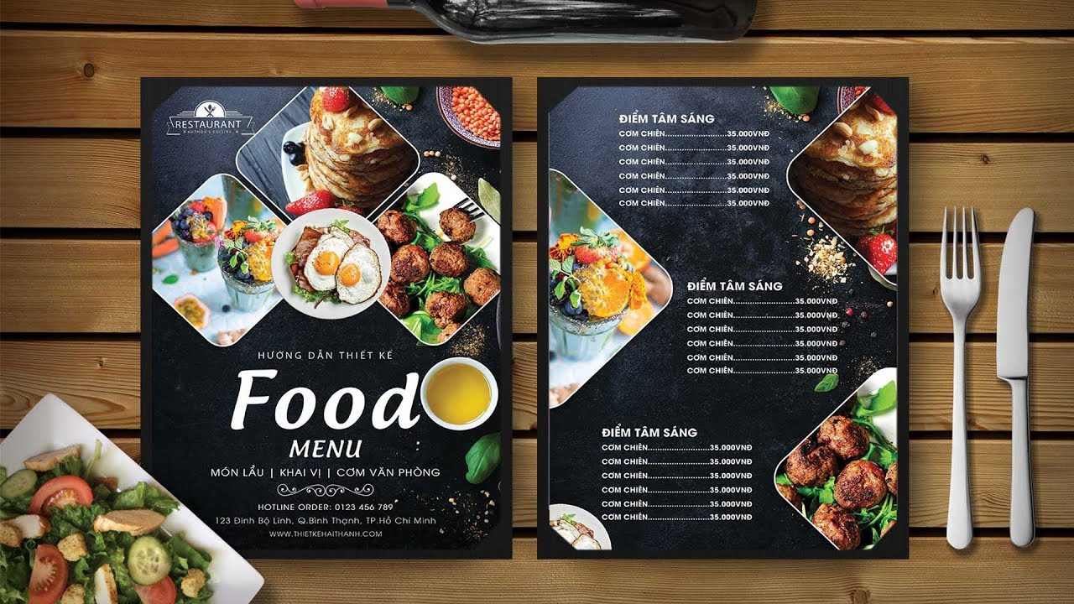
PRE
NEXT
A. BOOK
B. FOOD
C. MENU
D. RESRAURANT

Slide 17

The end

Slide 18
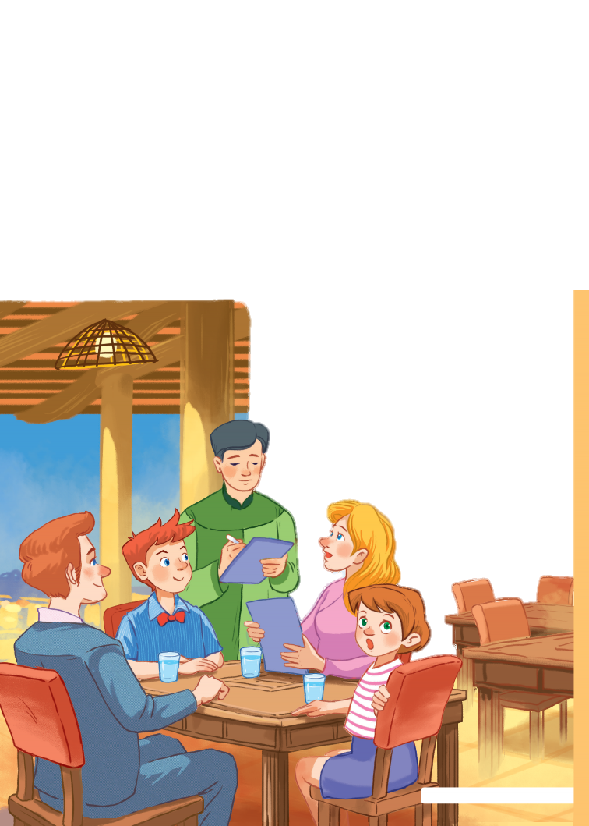
Unit
5
FOOD AND DRINK
LESSON 1: GETTING STARTED
At a Vietnamese restaurant
HOBBIES

Slide 19
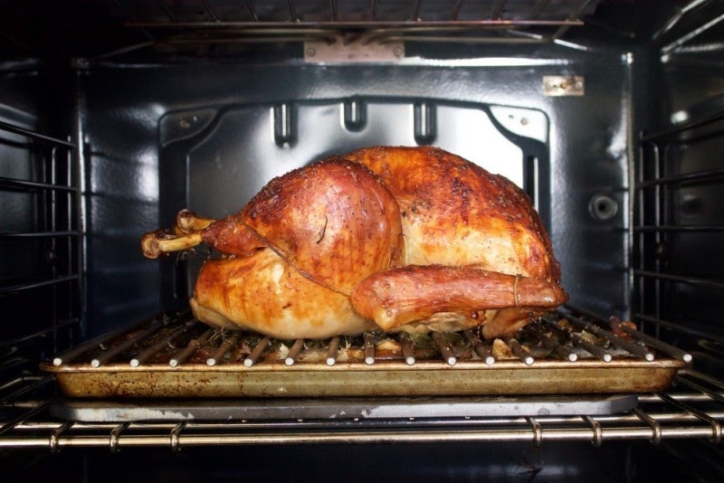
VOCABULARY
roast (v)
/rəʊst/
quay, nướng (thịt..)

Slide 20
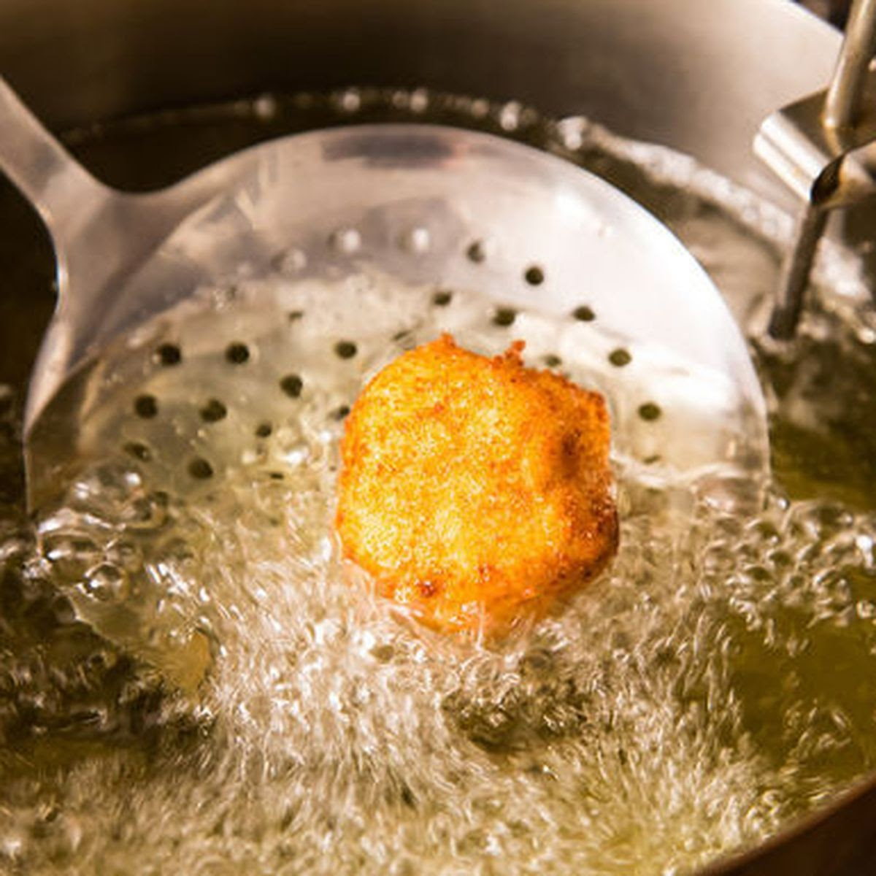
VOCABULARY
fry (v)
/fraɪ/
rán

Slide 21
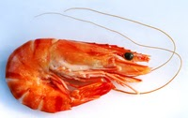
VOCABULARY
shrimp (n)
/ʃrɪmp/
con tôm

Slide 22
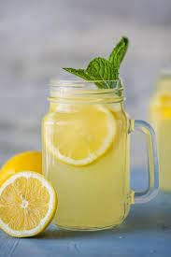
VOCABULARY
lemonade (n)
/leməˈneɪd/
nước chanh

Slide 23
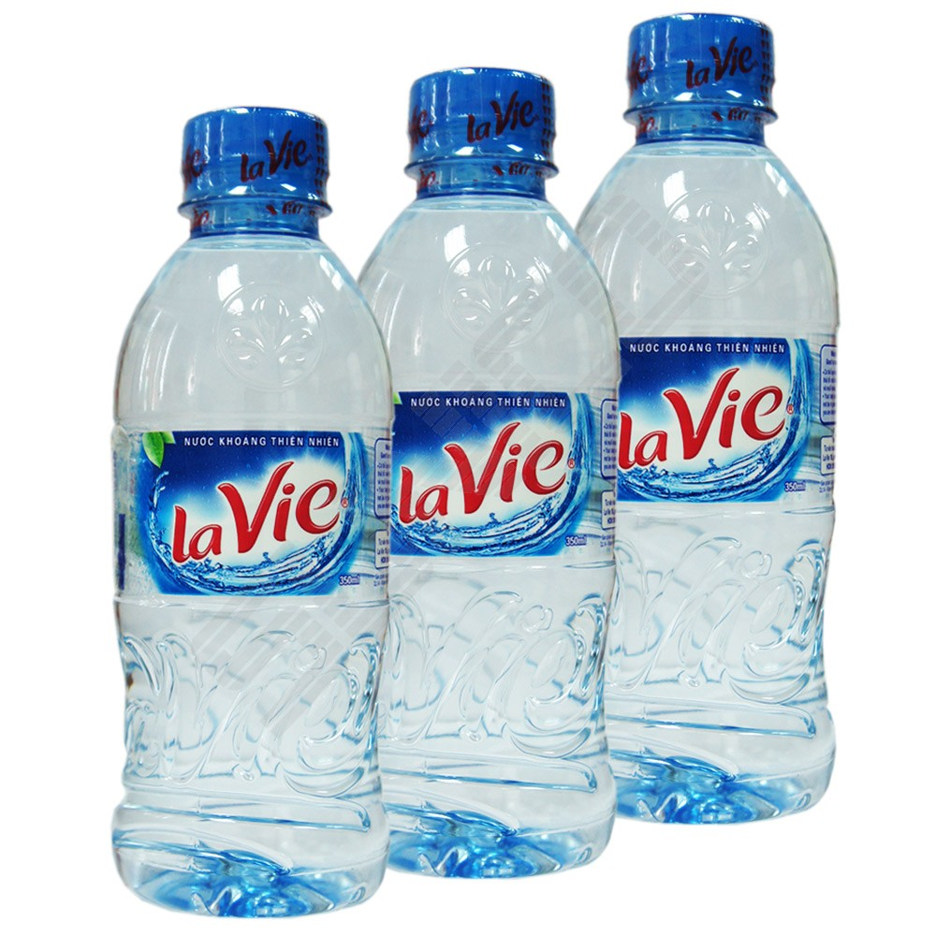
VOCABULARY
Mineral water (n)
/ˈmɪnərəl ˈwɔːtə/
nước khoáng

Slide 24
VOCABULARY
New words | Pronunciation | Meaning
roast | /rəʊst/ | quay, nướng (thịt..)
fry | /fraɪ/ | rán
shrimp | /ʃrɪmp/ | con tôm
lemonade | /leməˈneɪd/ | nước chanh
mineral water | /ˈmɪnərəl ˈwɔːtə/ | nước khoáng

Slide 25
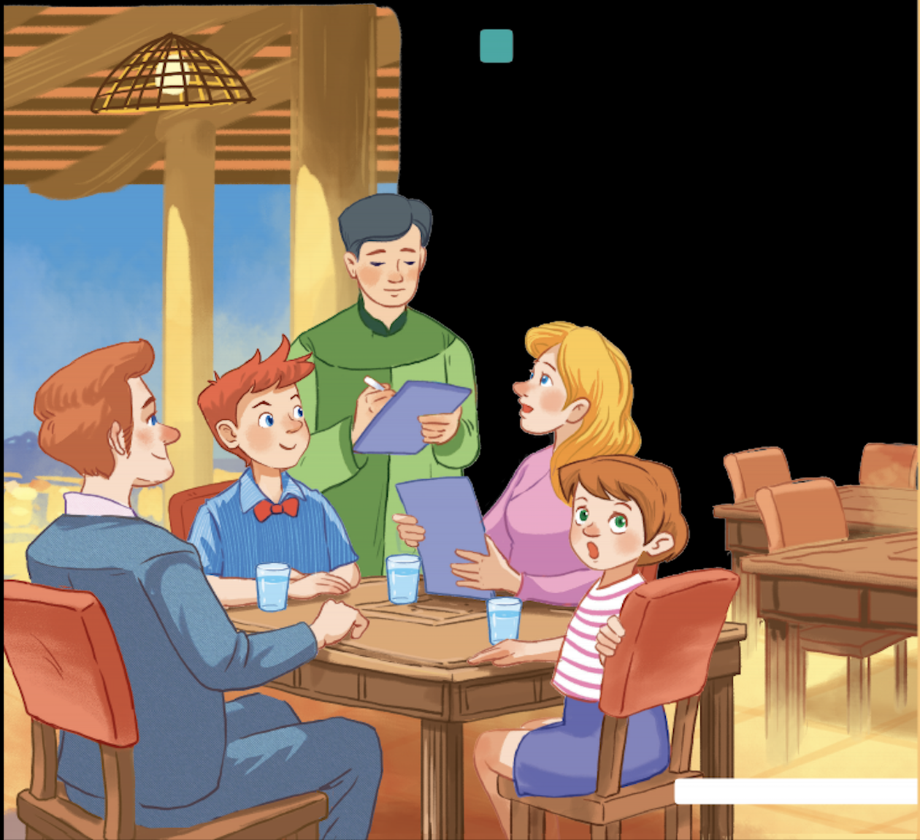
LEAD-IN
1
Look at the pictures and answer the questions.

Slide 26
LEAD-IN
1
Look at the pictures and answer the questions
What is Mark's family doing?
A. Ordering food for dinner.
B. Preparing for their dinner.
C. Talking about their favourite food.

Slide 27
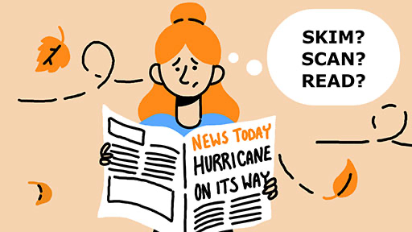
PRACTICE
2
Find the words and phrases about food and drink in the conversation and write them in the correct columns.

Slide 28
PRACTICE
2
Find the words and phrases about food and drink in the conversation and write them in the correct columns.
rice
Waiter: Good evening. What can I get you today? Mark's mum: We'd like rice with some pork cooked in fish sauce. Oh, could we also have an order of roast chicken and fried vegetables?
Mark: And I'd like some fried tofu and spring rolls too.
Waiter: OK. Would you like any canh? It's a kind of Vietnamese soup. We often have it with rice.
Mark's dad: Let me see ... I think we'll try some canh.
Waiter. With shrimp or fish?
Mark's dad: With shrimp, please.
Waiter: Would you like anything to drink? We have a lot of drinks: juice, lemonade, green tea, mineral water, ...
Mark's mum: Mineral water for me, green tea for my husband, and juice for my children.
Waiter: What kind of juice would you like?
Mark's sister: Do you have winter melon juice?
Waiter: Let me see. Er, yes. How many cans would you like?
Mark's sister: One ... No, wait, two please. By the way, how much is a can of winter melon juice?
Mark: The menu says it's 10,000 dong.
Waiter: That's right. I'll be right back with your order.
Food | Drink
pork
fish sauce
roast chicken
fried vegetables
rice
pork
fish sauce
juice
lemonade
fried tofu
spring rolls
roast chicken
canh
green tea
fried vegetables
mineral water
fried tofu
spring rolls
winter melon juice
fish
canh (soup)
shrimp
shrimp
fish
lemonade
mineral water
green tea
juice
winter melon juice

Slide 29
PRACTICE
3
Read the conversation again and tick (✓) T (True) or F (False).

Slide 30
PRACTICE
3
Read the conversation again and tick (✓) T (True) or F (False).
Waiter: Good evening. What can I get you today? Mark's mum: We'd like rice with some pork cooked in fish sauce. Oh, could we also have an order of roast chicken and fried vegetables?
Mark: And I'd like some fried tofu and spring rolls too.
Waiter: OK. Would you like any canh? It's a kind of Vietnamese soup. We often have it with rice.
Mark's dad: Let me see ... I think we'll try some canh.
Waiter: With shrimp or fish?
Mark's dad: With shrimp, please.
Waiter: Would you like anything to drink? We have a lot of drinks: juice, lemonade, green tea, mineral water, ...
Mark's mum: Mineral water for me, green tea for my husband, and juice for my children.
Waiter: What kind of juice would you like?
Mark's sister: Do you have winter melon juice?
Waiter: Let me see. Er, yes. How many cans would you like?
Mark's sister: One ... No, wait, two please. By the way, how much is a can of winter melon juice?
Mark: The menu says it's 10,000 dong.
Waiter: That's right. I'll be right back with your order.
a Vietnamese
restaurant
1. Mark's family is at a Vietnamese restaurant.
2. Mark wants fried tofu and beef for dinner.
3. They don't order canh.
4. Mark's mum wants mineral water.
5. His mum doesn't allow her children to drink juice during dinner.
TRUE
Mark
fried tofu
spring rolls
Vietnamese
Mark
fried tofu
beef
FALSE
we'll try some canh
don't order canh
FALSE
mum
mineral water
mum
Mineral water
juice for my
TRUE
children
mum
doesn't allow
drink
juice
FALSE

Slide 31
PRACTICE
4
Work in pairs. Think about your favorite food and drink. Then ask your partner about his or her favorite food and drink.

Slide 32
PRACTICE
4
Work in pairs. Think about your favorite food and drink. Then ask your partner about his or her favorite food and drink.
Divide the class into 2 main groups:
Group 1: Vietnamese tour guide
Discuss and list all of the favourite food in Ha Noi/ Viet Nam, using some suggested questions (What kinds of food are most popular? What ingredients are there? What is the food like? …)
Group 2: French visitors (who visit Vietnam for the 1st time)
Think of, discuss and list as many questions to ask about the most favourite Vietnamese food as possible.
Each tour guide pairs with a French visitor. Role play talking about the most favourite food in Viet Nam.

Slide 33
CONSOLIDATION
1
WRAP-UP
Food and Drink
Favourite food and drink
Topic of the unit
Vocabulary

Slide 34
CONSOLIDATION
2
HOMEWORK
Talk about your favourite food (for a minute)
Do the exercises in the workbook

