Slide 1




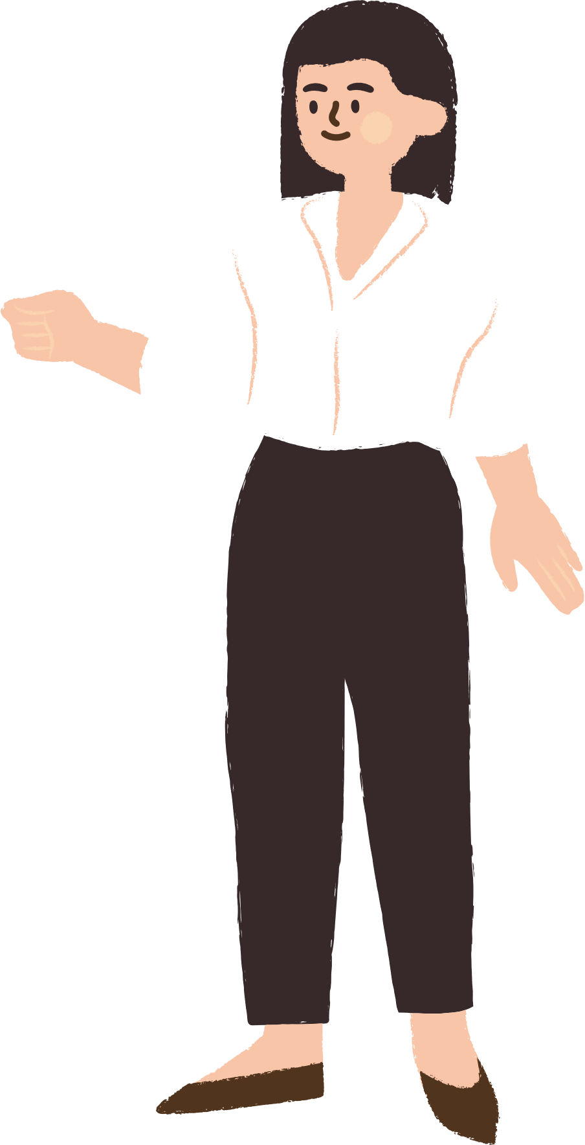





Warmly welcome to our class

Slide 2


Slide 3
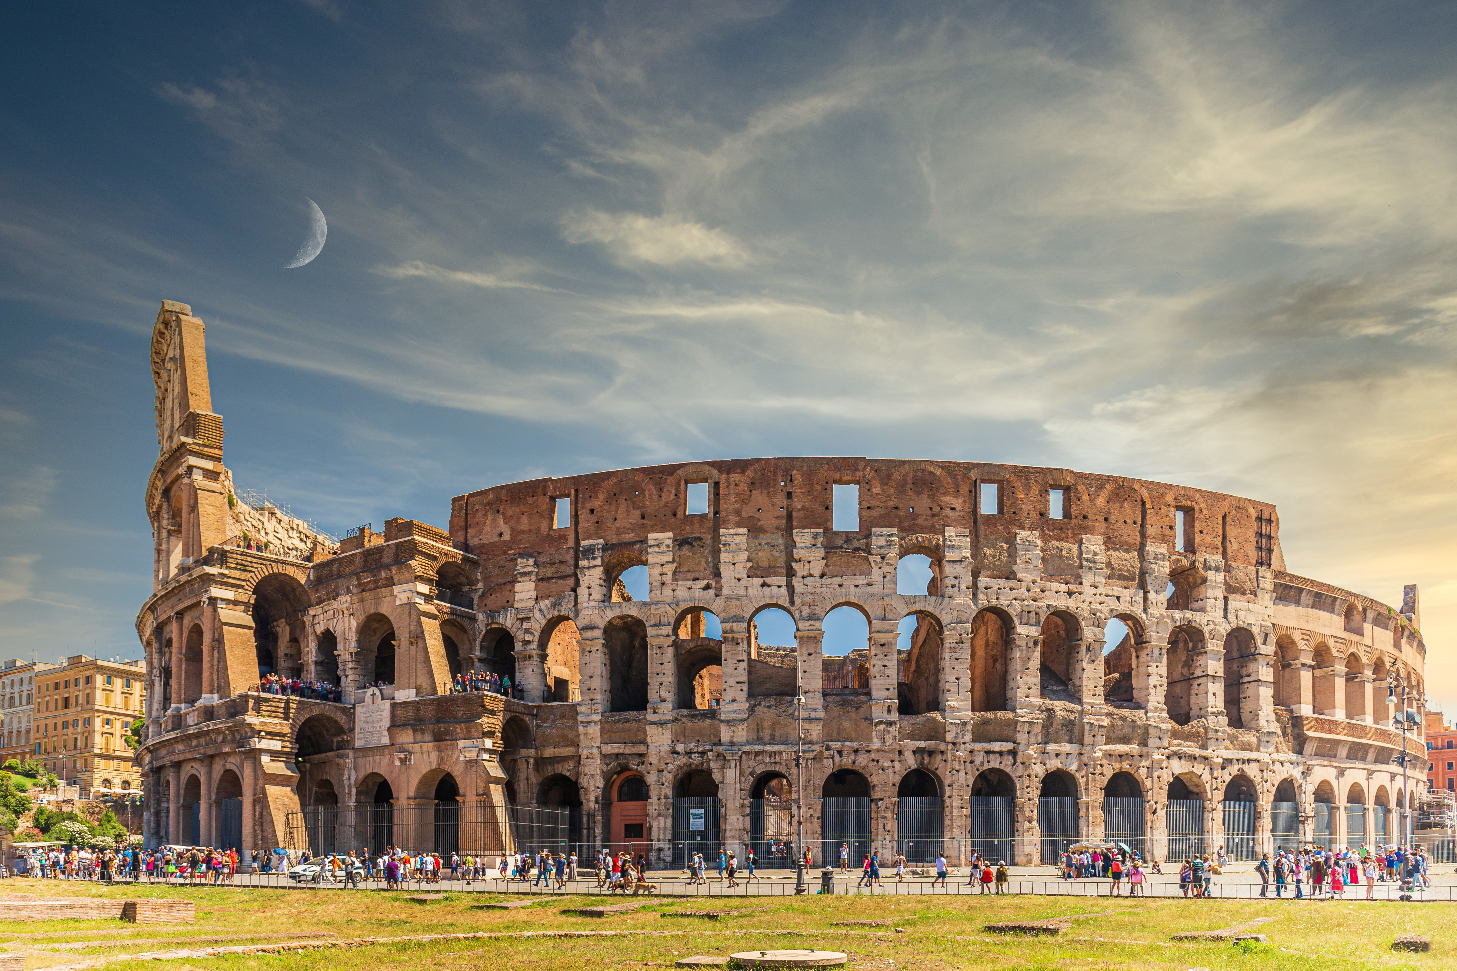


Unit
4
REMEMBERING
THE PAST
LESSON 3: A CLOSER LOOK 2

Slide 4

live make preserve
work build
THE PAST CONTINUOUS
E.g: We were cooking at 6 p.m yesterday.
FORM:

Slide 5
live make preserve
work build
THE PAST CONTINUOUS
We also use the past continuous to emphasise how long an action took and how much time somebody spent doing it. We usually use adverb phrases that explain the length of time such as:
all morning / week / year/ for hours / days / weeks / months / years
* Example:
We were cooking all morning because we had our friends coming for lunch.
We use the past continuous to describe an action that was happening at a particular time in the past, or a past action that was happening when another action interrupted it.

Slide 6
live make preserve
work build
THE PAST CONTINUOUS
Chúng ta dùng thì quá khứ tiếp diễn để diễn tả một hành động đang xảy ra tại một thời điểm cụ thể trong quá khứ hoặc một hành động quá khứ đang xảy ra thì có một hành động khác xen vào.
Chúng ta cũng dùng thì quá khứ tiếp diễn để nhấn mạnh một hành động diễn ra trong bao lâu và ai đó đã dành bao nhiêu thời gian để thực hiện nó. Chúng ta thường sử dụng các cụm trạng từ để giải thích độ dài thời gian như: all morning / week / year; for hours / days / weeks / months years

Slide 7

THE PAST CONTINUOUS
1
Put the verbs in brackets in the past continuous
was visiting
1. My dad first met my mum when he (visit) _____________ Hoi An Ancient Town.
2. Tom had a nightmare while he (sleep) ____________ in the camp by the old castle.
was sleeping
was going
3. David hurt his foot while he (go) ___________down the steps of the pagoda.

Slide 8
1
Put the verbs in brackets in the past continuous
was looking
4. My brother was just sitting while I (look) ______________ around the weaving workshop.
Were
watching
5. ______ you (watch) __________ TV at 9 p.m. last night? There was a very good programme on Duong Lam Ancient Village preservation.

Slide 9
2
Complete the sentences, using the past continuous forms of the given verbs.
live make preserve work build
were preserving
1. People ________________ the monument for years because it had great value.
2. When I finished school, my family ___________in the countryside.
was living
were building
3. People ________________the Taj Mahal – a World Heritage Site while Shah Jahan was emperor.
Were
working
4. “______ you still __________ on the coffee farm when the war broke out, Grandpa?”
was making
5. I ______________ a presentation when the microphone stopped working.

Slide 10
WISH + PAST SIMPLE
Look at the Grammar Box p.43
We use wish + past form verb when we want something now or in the future to be different.
Subject + wish + subject + past simple
Example:
I wish I had enough money to travel around the world.
I wish (that) my mother didn’t have to work so hard.

Slide 11
WISH + PAST SIMPLE
Chúng ta sử dụng wish + động từ dạng quá khứ khi chúng ta muốn một điều gì đó ở hiện tại hoặc tương lai trở nên khác đi.
S + wish + S + past simple
Lưu ý:
1. Trong các trường hợp trang trọng, ta dùng were thay cho was trong câu ước. Tuy nhiên cách dùng was cũng được chấp nhận.
2. Chúng ta có thề sử dụng could trong câu wish để thể hiện khả năng làm một việc gì đó hoặc khả năng xảy ra điều gì đó.

Slide 12
WISH + PAST SIMPLE
3
Put the verbs in brackets in the correct forms.
1. The children wish they (get) ______more presents every Christmas
2. I wish I (have) ___________ enough money to visit London and Windsor Castle.
3. Do you wish we (have) ________a swimming pool in our school?
4. We wish we (can spend) ______________our summer holiday on the seaside.
5. I wish I (can go) ___________ back to my grandparents’ time.
Game

Slide 13



1
2
3
4
5
6
7
8
Lucky Star Game

Slide 14
WISH + PAST SIMPLE
3
Put the verbs in brackets in the correct forms.
1. The children wish they (get) ______more presents every Christmas
got

Slide 15
WISH + PAST SIMPLE
3
Put the verbs in brackets in the correct forms.
2. I wish I (have) ___________ enough money to visit London and Windsor Castle.
had

Slide 16
WISH + PAST SIMPLE
3
Put the verbs in brackets in the correct forms.
3. Do you wish we (have) ________a swimming pool in
our school?
had

Slide 17
WISH + PAST SIMPLE
3
Put the verbs in brackets in the correct forms.
4. We wish we (can spend) ______________our summer holiday on the seaside.
could spend

Slide 18
WISH + PAST SIMPLE
3
Put the verbs in brackets in the correct forms.
5. I wish I (can go) ___________ back to my grandparents’ time.
could go

Slide 19


UNLUCKY NUMBER

Slide 20


Lucky number
Congratulation !

Slide 21
Lucky number
Congratulation !

Slide 22
WISH + PAST SIMPLE
3
Put the verbs in brackets in the correct forms.
got
1. The children wish they (get) ______more presents every Christmas
2. I wish I (have) ___________ enough money to visit London and Windsor Castle.
had
3. Do you wish we (have) ________a swimming pool in our school?
had
could spend
4. We wish we (can spend) ______________our summer holiday on the seaside.
5. I wish I (can go) ___________ back to my grandparents’ time.
could go

Slide 23
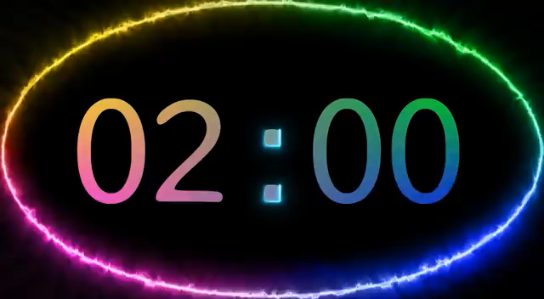
WISH + PAST SIMPLE
4
Read the passage and write down five things that Jenny might wish for.
Example:
Jenny wishes (that) her sister Jane was tidier.
My sister Jane is very untidy. She and I share the same room, but I have to clean it every day. Whenever she’s at home, she lies in bed reading or playing computer games. She often puts her dirty clothes on my bed. I’d like to have my own room, but it’s impossible now.
I hope she can change her way one day.
Jenny, 14

Slide 24
WISH + PAST SIMPLE
My sister Jane is very untidy. She and I sharethe same room, but I have to clean it every day. Whenever she’s at home, she lies in bed reading or playing computer games. She often puts her dirty clothes on my bed. I’d like to have my own room, but it’s impossible now.
I hope she can change her way one day.
Jenny, 14
Example:
Jenny wishes (that) her sister Jane was tidier.
1. Jenny wishes (that) she didn’t have to share the room with her sister.
2. Jenny wishes (that) she didn’t have to clean the room every day.
3. She wishes (that) her sister Jane didn’t lie in bed reading or playing computer games.
4. She wishes (that) her sister Jane didn’t put dirty clothes on her bed.
5. She wishes (that) she had her own room.

Slide 25
1. Jenny wishes (that) she didn’t have to share the room with her sister.
2. Jenny wishes (that) she didn’t have to clean the room every day.
3. She wishes (that) her sister Jane didn’t lie in bed reading or playing computer games.
4. She wishes (that) her sister Jane didn’t put dirty clothes on her bed.
5. She wishes (that) she had her own room.

Slide 26
5
Work in pairs. Tell your partner three wishes.
- Work in pairs and exchange your wishes
Example:
I wish I had a dishwasher to do the washing-up for me every day.
I wish I could travel to Korea.
I wish I got a high score in the final exam.
I wish I could speak English fluently.
I wish I had more money to spend on my hobbies.

Slide 27

Home assignments
Do exercises in the workbook.
Make 5 sentences using wish sentences
Learn by heart the structure of the past continuous
.

Slide 28

Thank you!
Goodbye!

