Slide 1






……. Secondary School
WELCOME TO OUR CLASS!
Presented by: ………………………

Slide 2




Answer some questions:
1. Where do you live?
2. What and where is famous in your hometown?
3 Do you love to live in your hometown?

Slide 3
Unit 1:
LOCAL COMMUNITY
Lesson 1: Getting Started

Slide 4




?
VOCABULARY
?
?

Slide 5
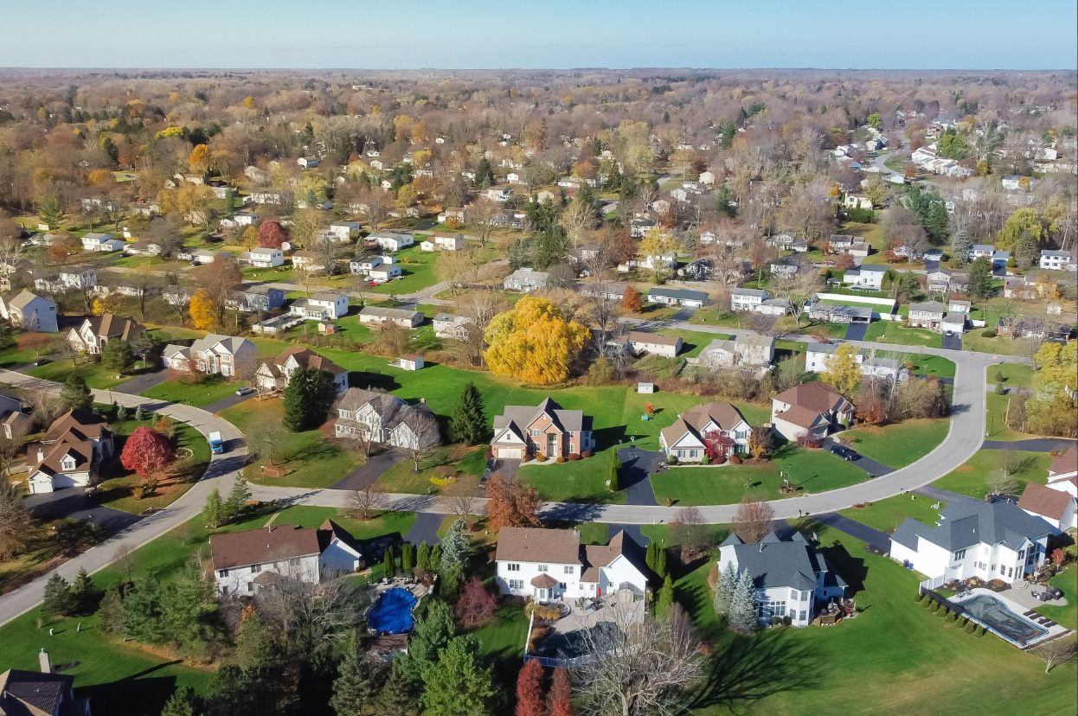

VOCABULARY
suburb (n)
/ˈsʌbɜːb/
vùng ngoại ô

Slide 6
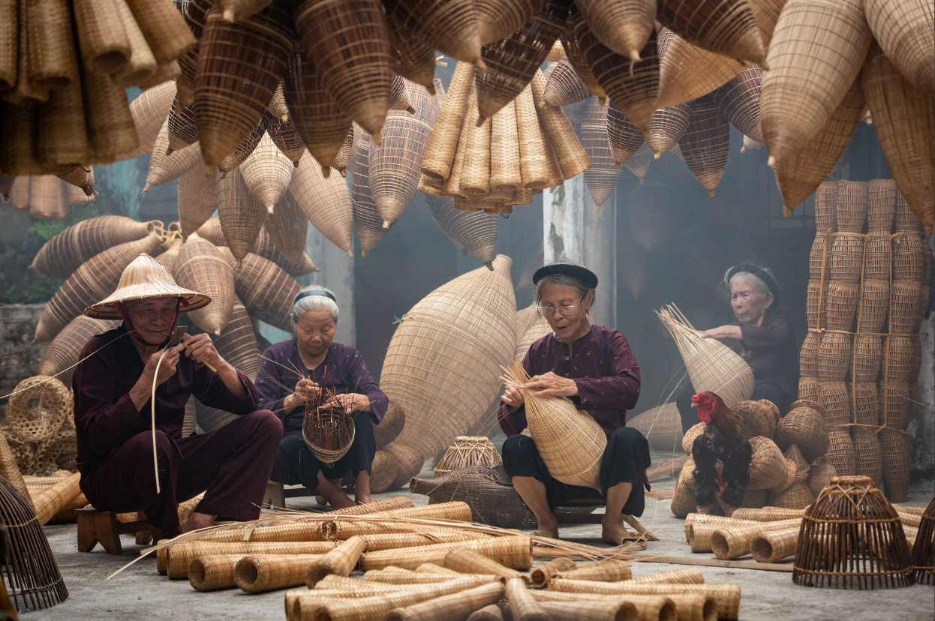
VOCABULARY
craft village (n)
/krɑːft ˈvɪlɪdʒ/
làng nghề thủ công

Slide 7
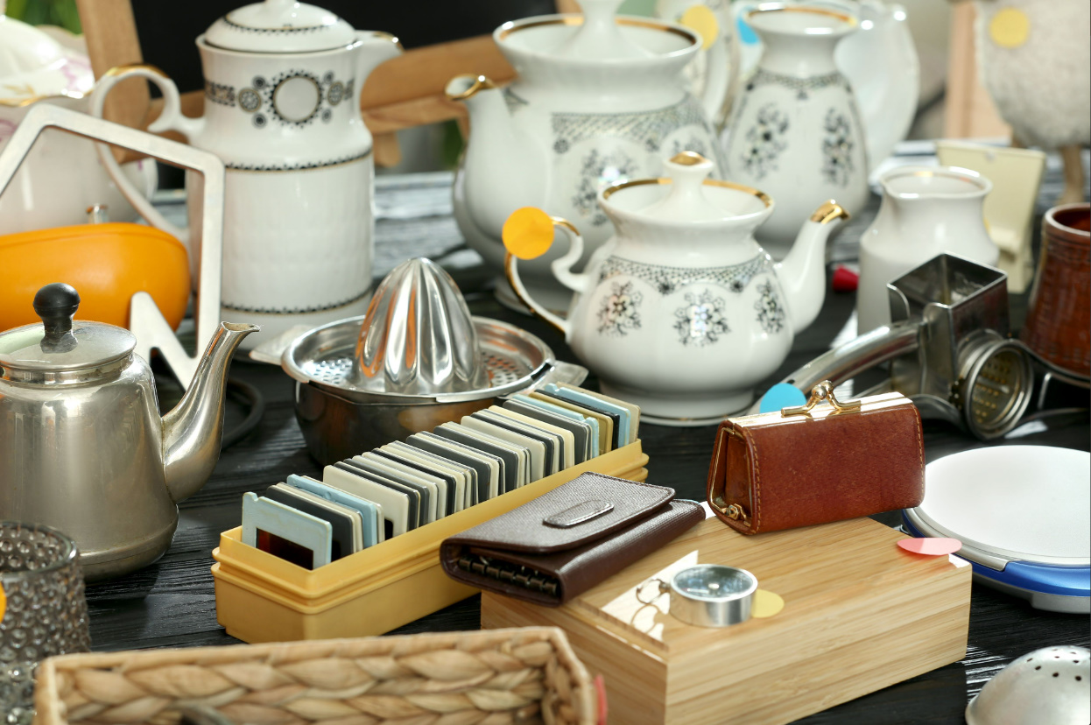
VOCABULARY
stuff (n)
/stʌf/
thứ, đồ đạc, món

Slide 8
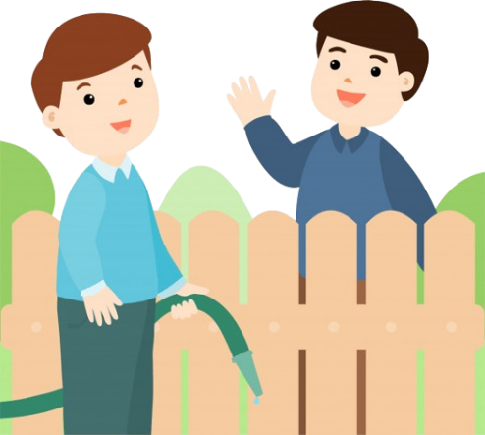
VOCABULARY
get on with (phr v)
/ɡet ɒn wɪð/
có quan hệ tốt với ai..

Slide 9
VOCABULARY
suburb (n)
/ˈsʌbɜːb/
vùng ngoại ô
craft village (n)
/krɑːft ˈvɪlɪdʒ/
làng nghề thủ công
/stʌf/
stuff (n)
thứ, đồ đạc, món
/ɡet ɒn wɪð/
get on with (phr v)
có quan hệ tốt với ai..

Slide 10
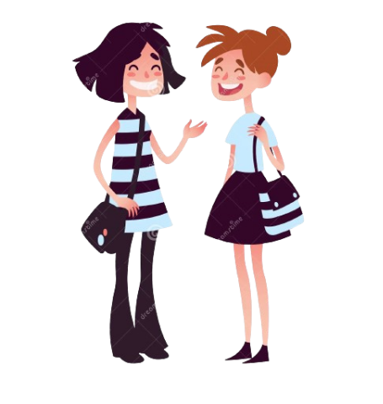

I really love where I live now
Ann: Hi, Mi. Long time no see. How’re you doing?
Mi: I’m fine, thanks. By the way, we moved to a new house in a suburb last month.
Ann: Oh, that’s why I haven’t seen you in the Reading Club very often.
Mi: Yes. We’re still busy moving in, you know.
Ann: How’s your new neighbourhood?
Mi: It’s much bigger than our old one. The streets are wider, and there are fewer people.
Ann: What about the facilities?
Mi: It has all the things we need: shopping malls, parks, and hospitals. And there’s a craft village near our house.
Ann: Great! How’re your new neighbours?
Mi: They’re nice. Last Sunday when I was looking for the way to the bus station, a lady came and showed me the way. I think we will get on with them.
Ann: That reminds me of the time our family moved to Viet Nam. We didn’t know where to buy stuff for our house, and the new neighbours in the community gave us useful advice. I guess you like your new place.
Mi: Sure. I really love where I live now.
Ann
Mi

Slide 11

2. Read the conversation again. Fill in each blank with no more than TWO words from the conversation.
1. Mi’s family moved to a new house in a suburb ______.
2. Her new neighbourhood is bigger with wider streets and ______.
3. There is a ____________ near Mi’s house.
4. Mi thinks she will get on with her new ______.
5. People in Ann’s community gave her family ______ on where to buy stuff.

Slide 12


Check your answer
1. Mi’s family moved to a new house in a suburb ___________.
last month
Mi: I’m fine, thanks. By the way, we moved to a new house in a suburb last month.

Slide 13
Check your answer
2. Her new neighbourhood is bigger with wider streets and ___________.
Mi: It’s much bigger than our old one. The streets are wider, and there are fewer people.
fewer people

Slide 14
Mi: It has all the things we need: shopping malls, parks, and hospitals. And there’s a craft village near our house.
Check your answer
3. There is a ____________ near Mi’s house.
craft village

Slide 15
Check your answer
Ann: Great! How’re your new neighbours?
Mi: They’re nice. Last Sunday when I was looking for the way to the bus station, a lady came and showed me the way. I think we will get on with them.
4. Mi thinks she will get on with her new ___________.
neighbours

Slide 16
Ann: That reminds me of the time our family moved to Viet Nam. We didn’t know where to buy stuff for our house, and the new neighbours in the community gave us useful advice.
Check your answer
5. People in Ann’s community gave her family ____________ on where to buy stuff.
useful advice

Slide 17
Look at the answers again.
1. Mi’s family moved to a new house in a suburb last month.
2. Her new neighbourhood is bigger with wider streets and fewer people.
3. There is a craft village near Mi’s house.
4. Mi thinks she will get on with her new neighbours.
5. People in Ann’s community gave her family useful advice on where to buy stuff.

Slide 18


3. Match each word or phrase with its definition
1.
suburb
a. the people living in a particular area
2.
facilities
b. to make somebody remember or think about somebody or something
community
c. to have a good relationship with somebody
3.
get on with
d. an area outside the centre of a city
4.
remind somebody of
5.
e. the buildings, equipment, and services provided for a particular purpose

Slide 19

4. Complete each sentence with a word or phrase from 3.
1. They don’t live in the city centre but in a ________ of Ha Noi.
2. I love our new neighbourhood because we _____________ the people here.
3. There are enough sports ____________ for people of all ages in our local park.
4. Souvenirs _________ people ______ a place, an occasion, or a holiday.
5. The local ____________ encourages us to protect the environment and keep our neighbourhood clean.

Slide 20







MONKEY AND BANANA

Slide 21
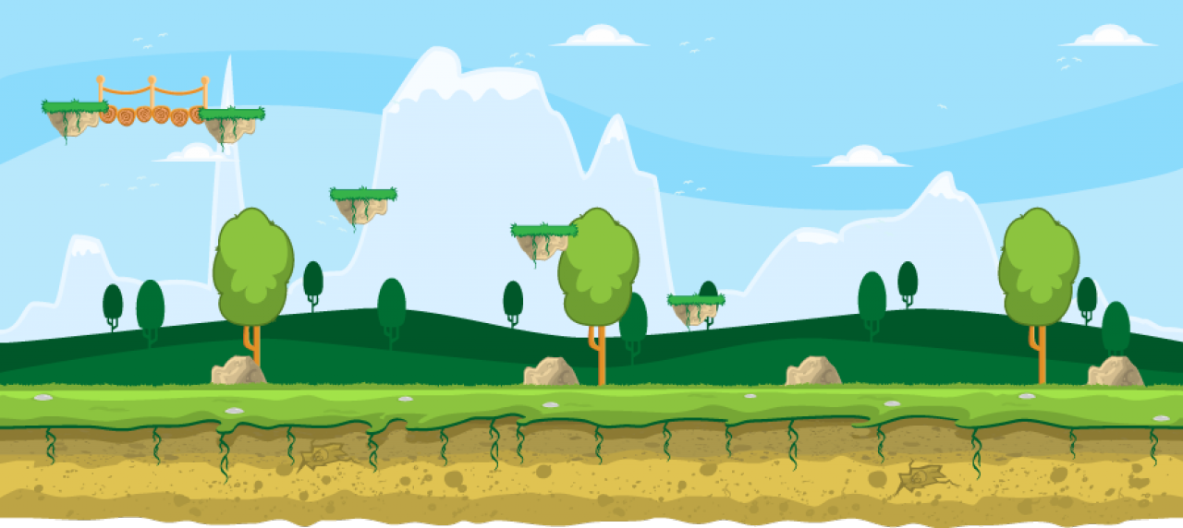
1. They don’t live in the city centre but in a ________ of Ha Noi.
suburb

Slide 22

2. I love our new neighbourhood because we ___________ the people here.
get on with

Slide 23

3. There are enough sports _________ for people of all ages in our local park.
facilities

Slide 24
4. Souvenirs _________ people ______ a place, an occasion, or a holiday.
remind
of

Slide 25
community
5. The local _______ encourages us to protect the environment and keep our neighbourhood clean.

Slide 26
Look at the answers again
1. They don’t live in the city centre but in a suburb of Ha Noi.
2. I love our new neighbourhood because we get on with the people here.
3. There are enough sports facilities for people of all ages in our local park.
4. Souvenirs remind people of a place, an occasion, or a holiday.
5. The local community encourages us to protect the environment and keep our neighbourhood clean.

Slide 27
MEMORY GAME

Slide 28
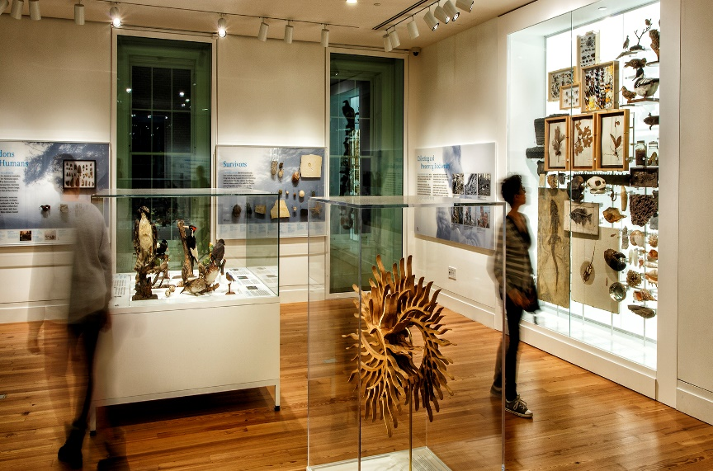
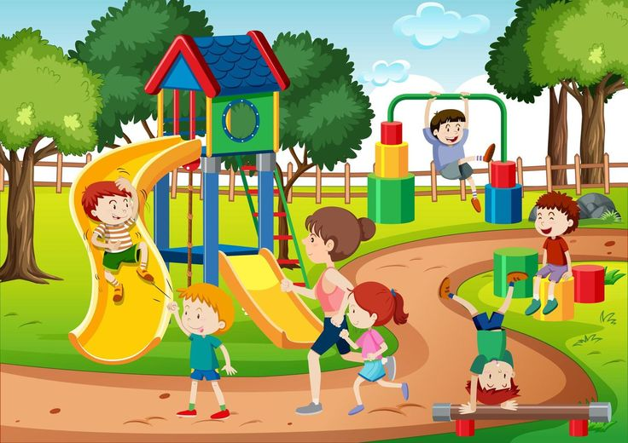


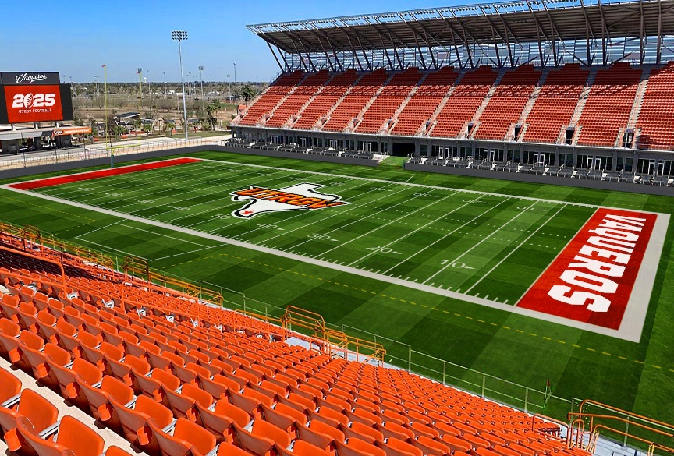
MATCH THE PICTURES WITH THE DESCRIPTIONS
Parents take their children there so that they can have fun.
1
2
People go there for health check-ups.
Visitors see objects from the past there.
3
4
5
6
People watch sports such as football there.
Children learn to read and write there.
7
8
9
10
Notes:
T allows Ss to say the number to review the pic/phrases
Key: 1-5; 2-4; 3-6; 7-10; 8-9
These’re the way to help the env, so let’s find out your friends’ ways of saving the env.

Slide 29
WRAP UP
What have we learnt in this lesson?
identify the topic of the unit
use lexical items related to local community
identify the language features that are covered in the unit

Slide 30


Homework
- Learn by heart vocabulary
- Do exercises in the Workbook.
- Start preparing for the Project of the unit by working in groups of 5 to brainstorm about your community.

Slide 31
Thank you!

Slide 32
?
Question
Time
?
?

