Slide 1
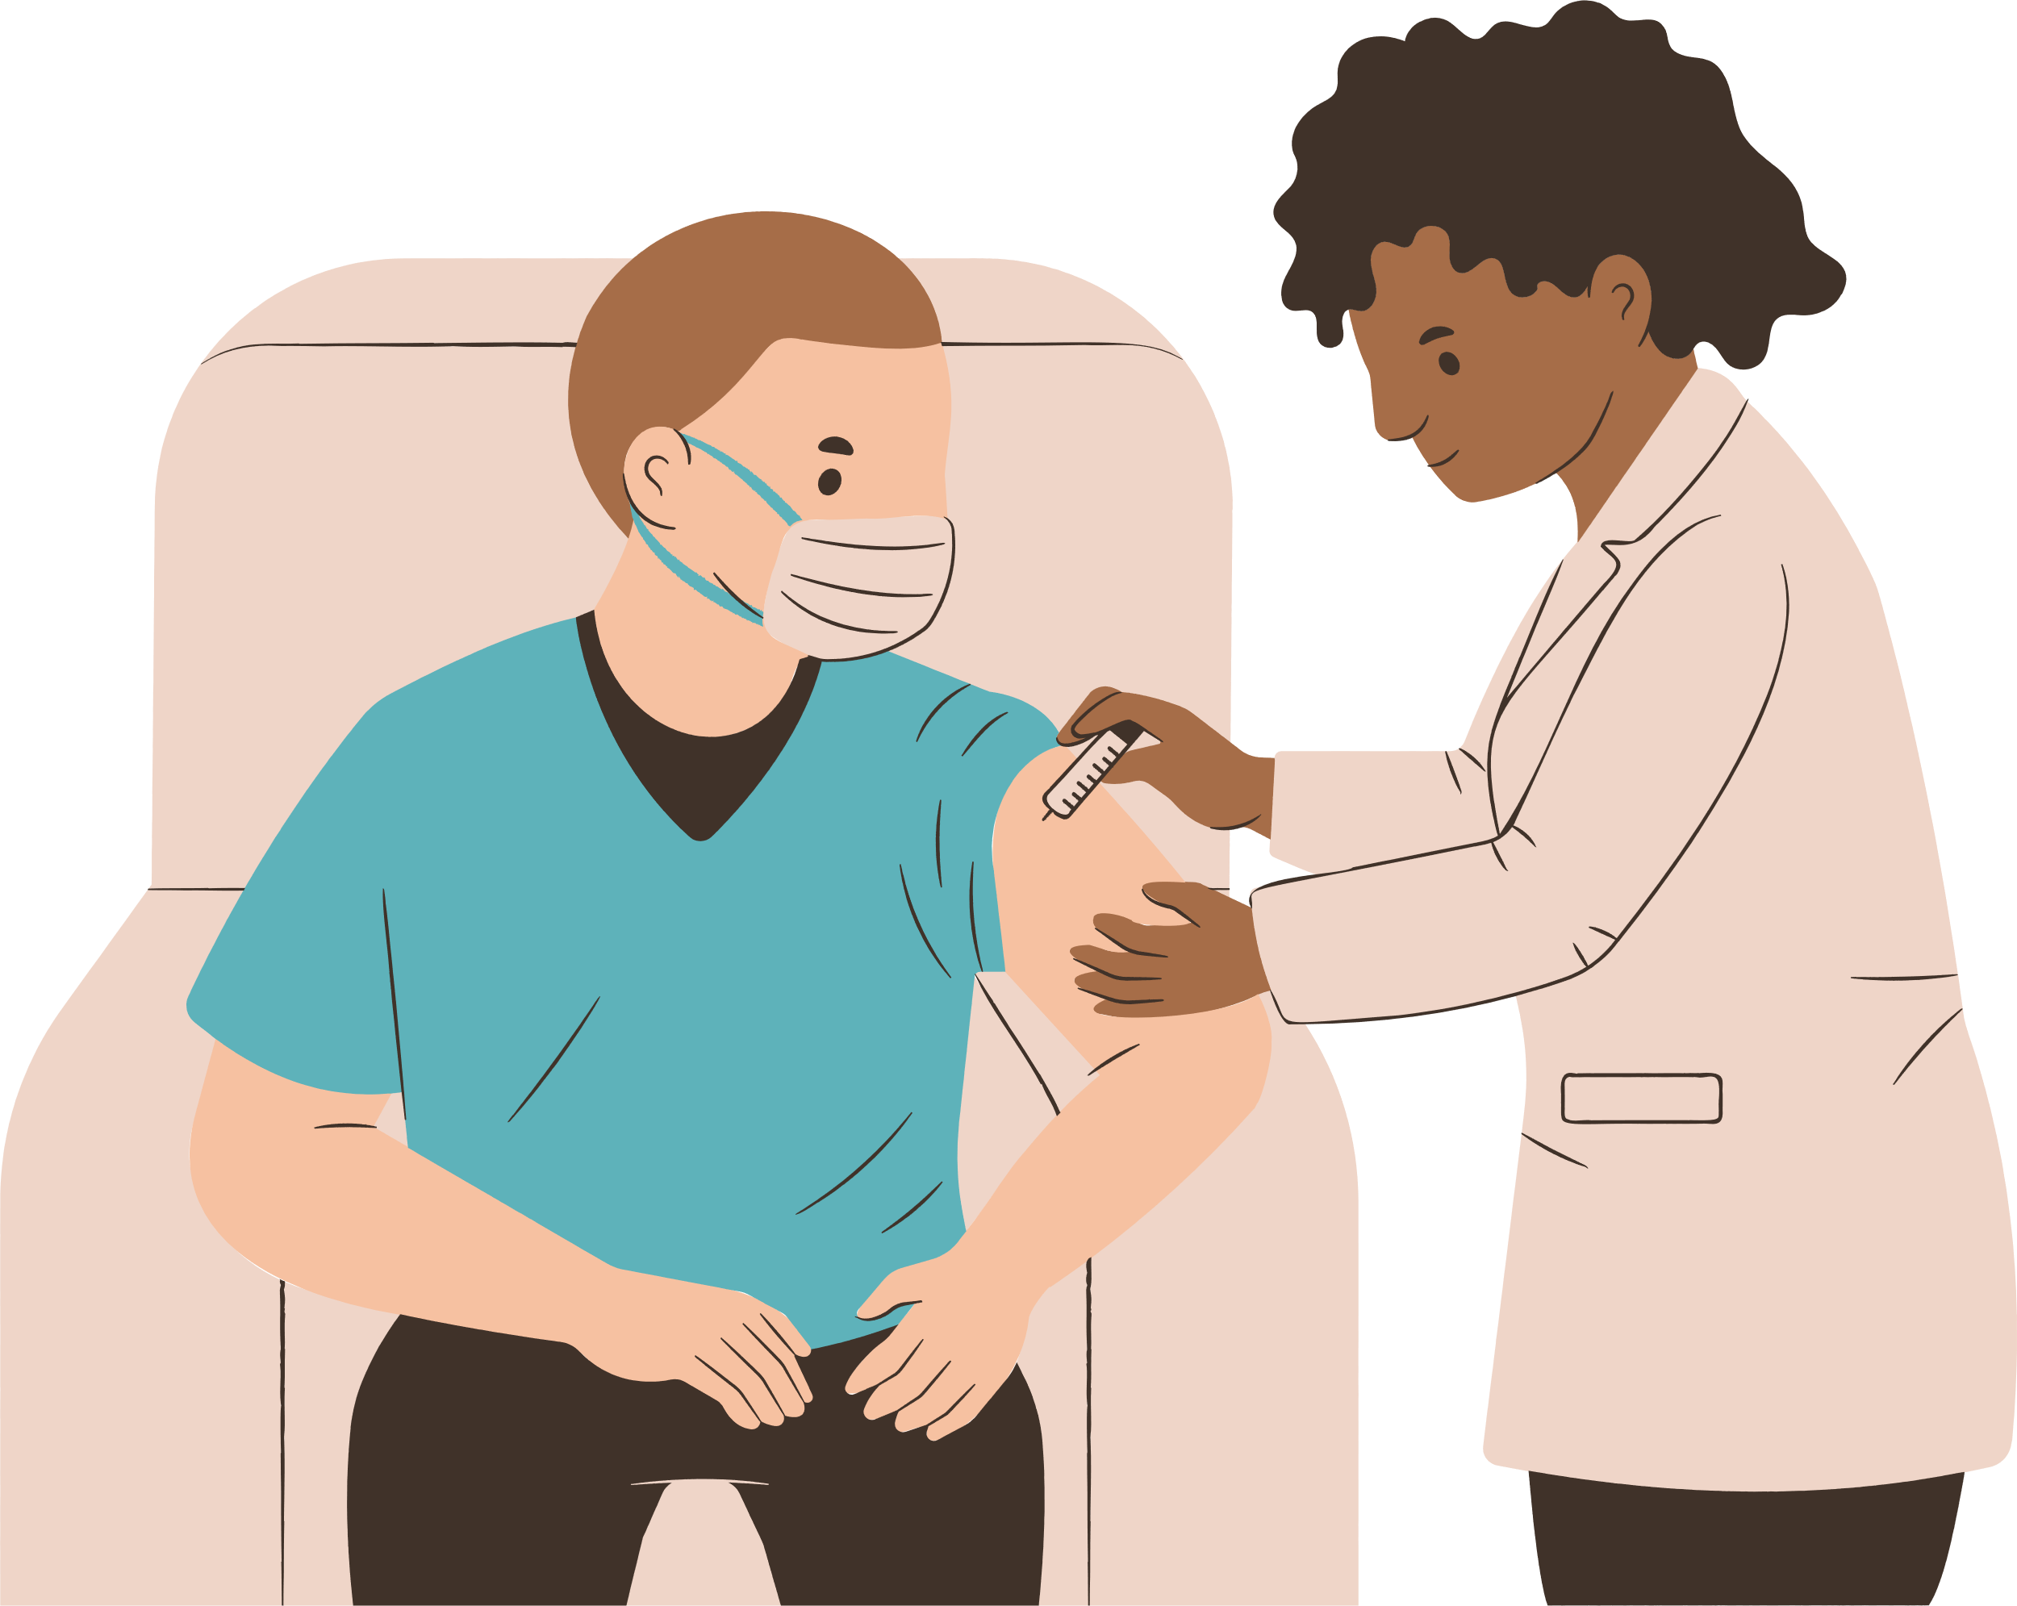
……………….. SECONDARY SCHOOL
WELCOME TO OUR CLASS!
Presented by:……………………………..

Slide 2
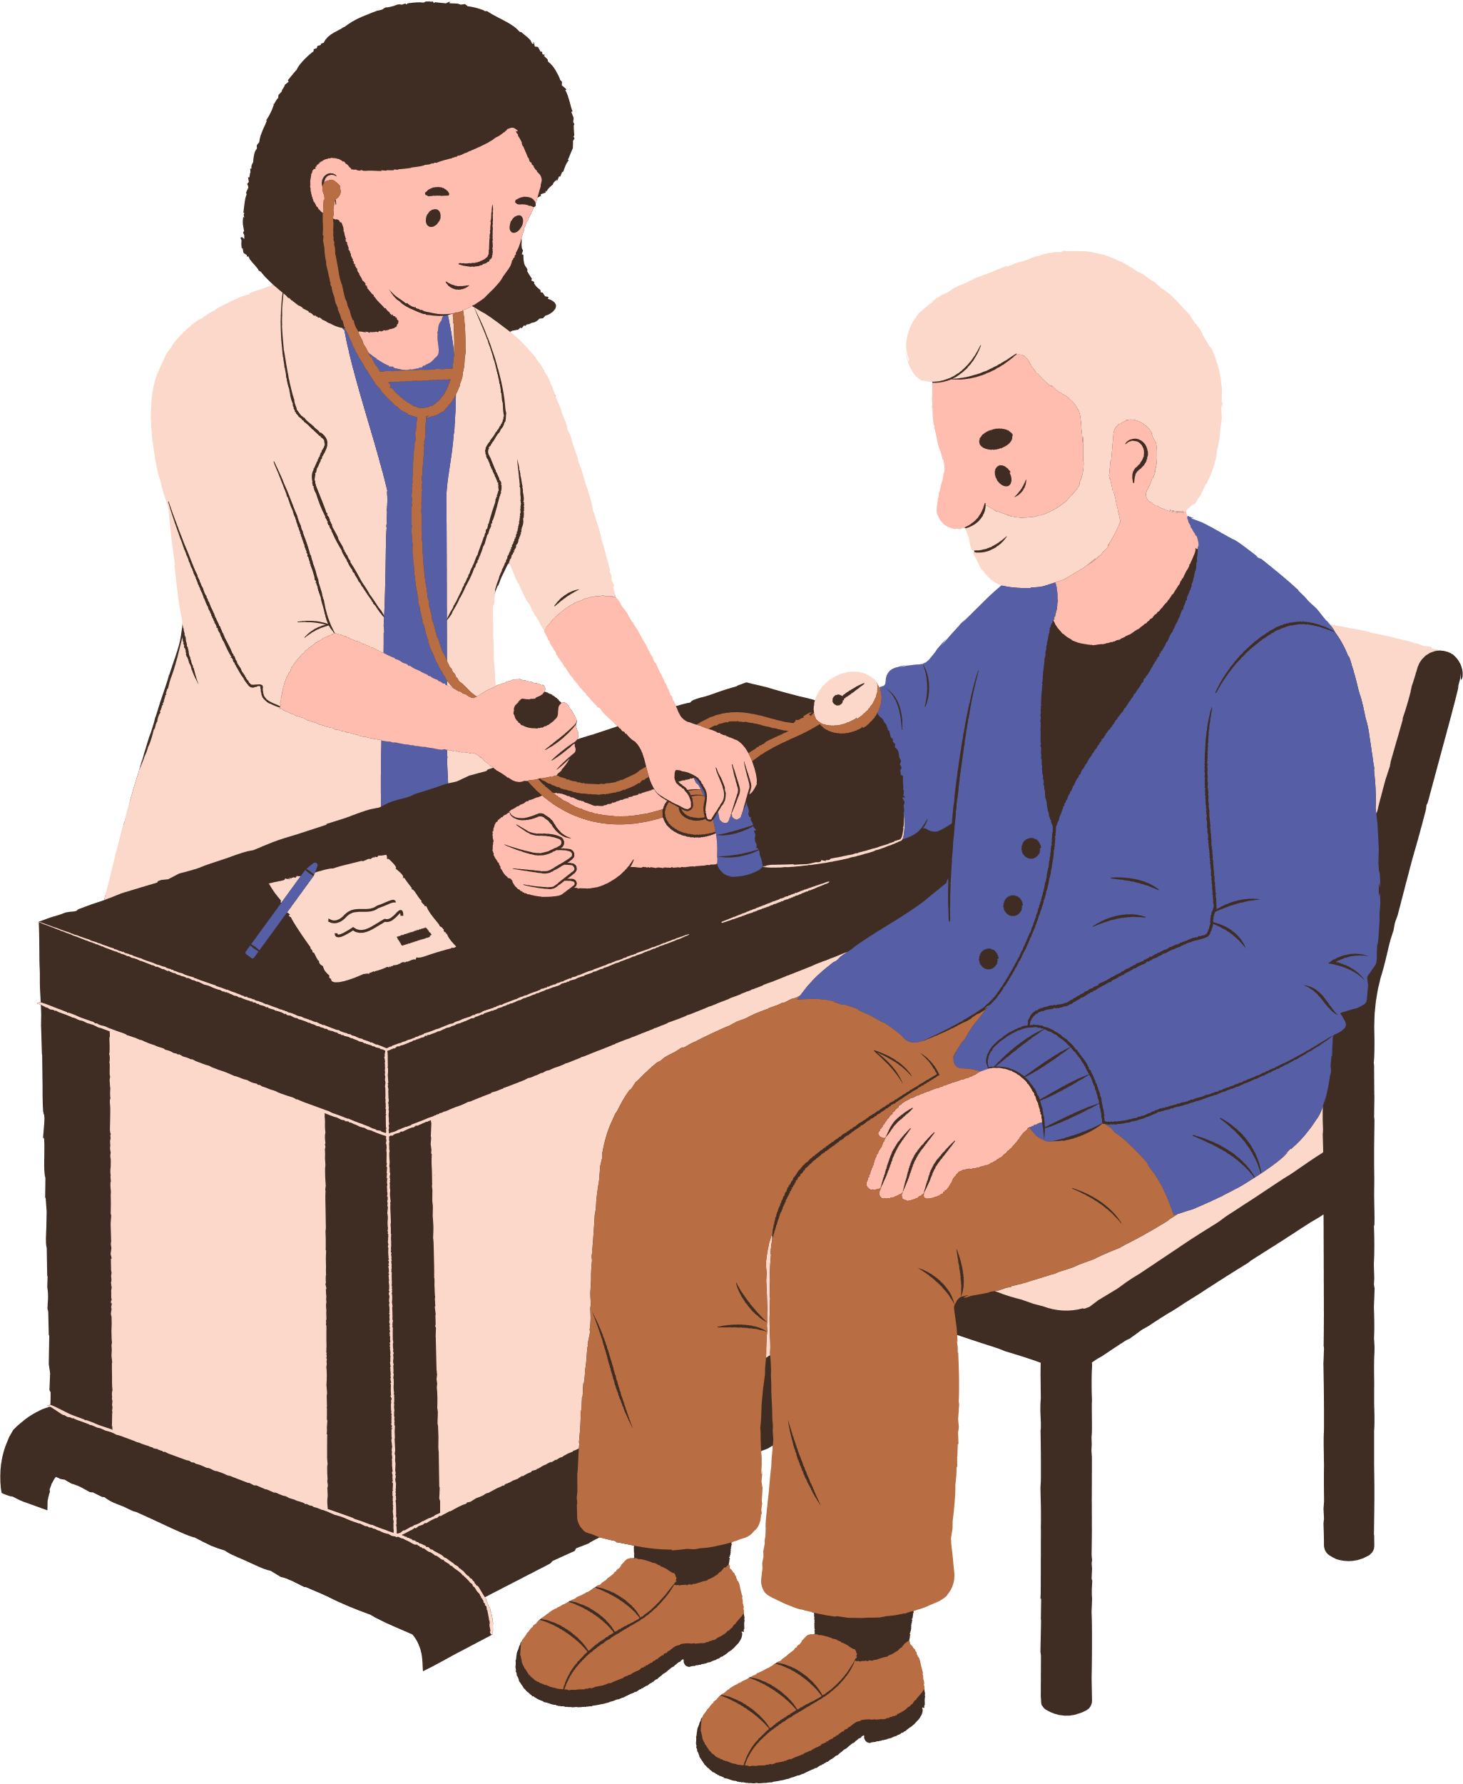
PHOTO FLASH!
Watch and remember the jobs

Slide 3
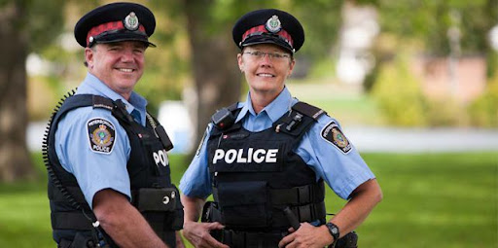
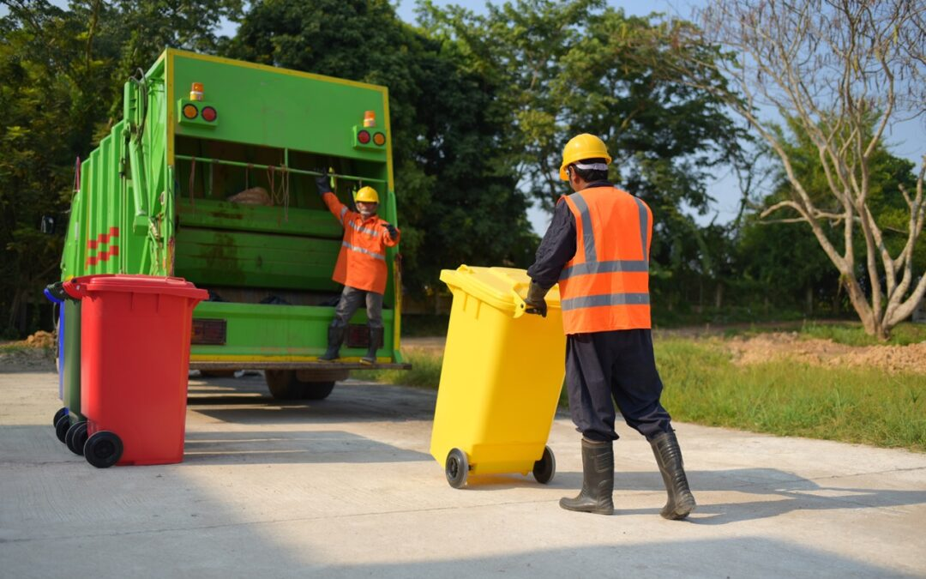
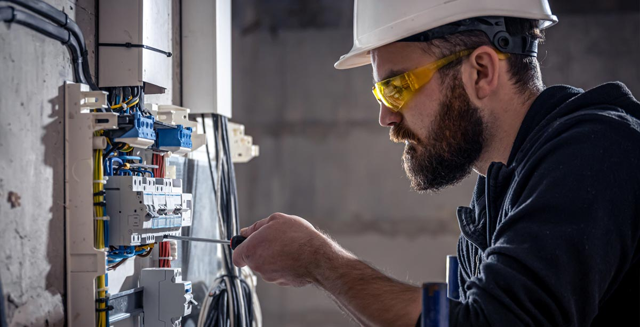
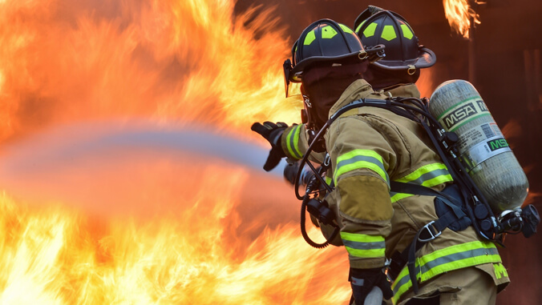
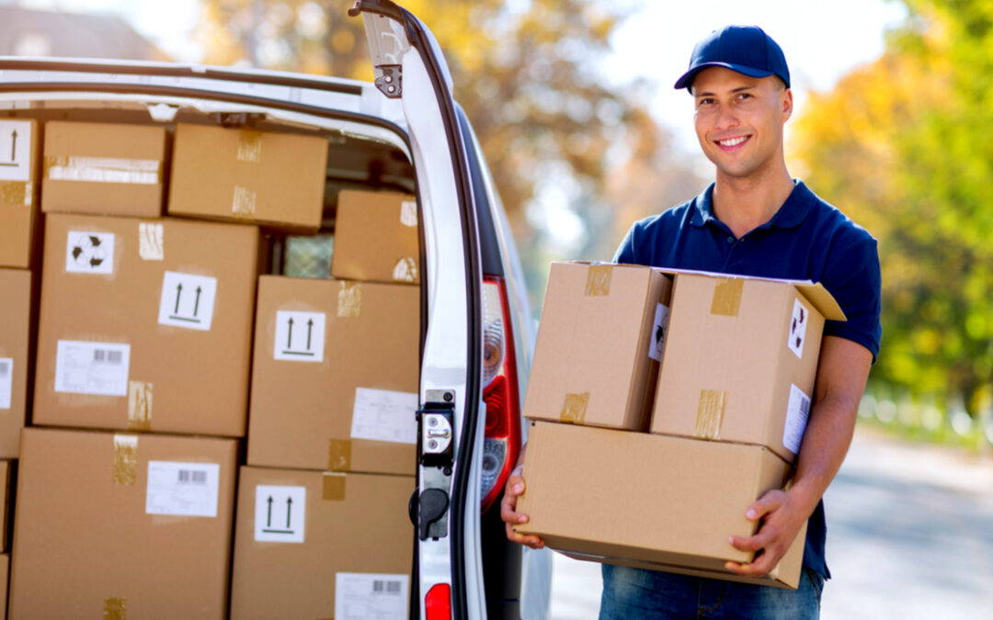


Show all
Fast
Medium
Slow
Hide all
Notes:
Right-click on an image and select change picture.
Select your picture. Click on insert.
Start your presentation.
Click on Fast, Medium or Slow to show the series of images.
Click Show All to see all the images.
Click Hide All to hide all the images.

Slide 4
Look and check
What are their responsibilities?
police officer
garbage collector
electrician
firefighter
delivery person
teacher

Slide 5
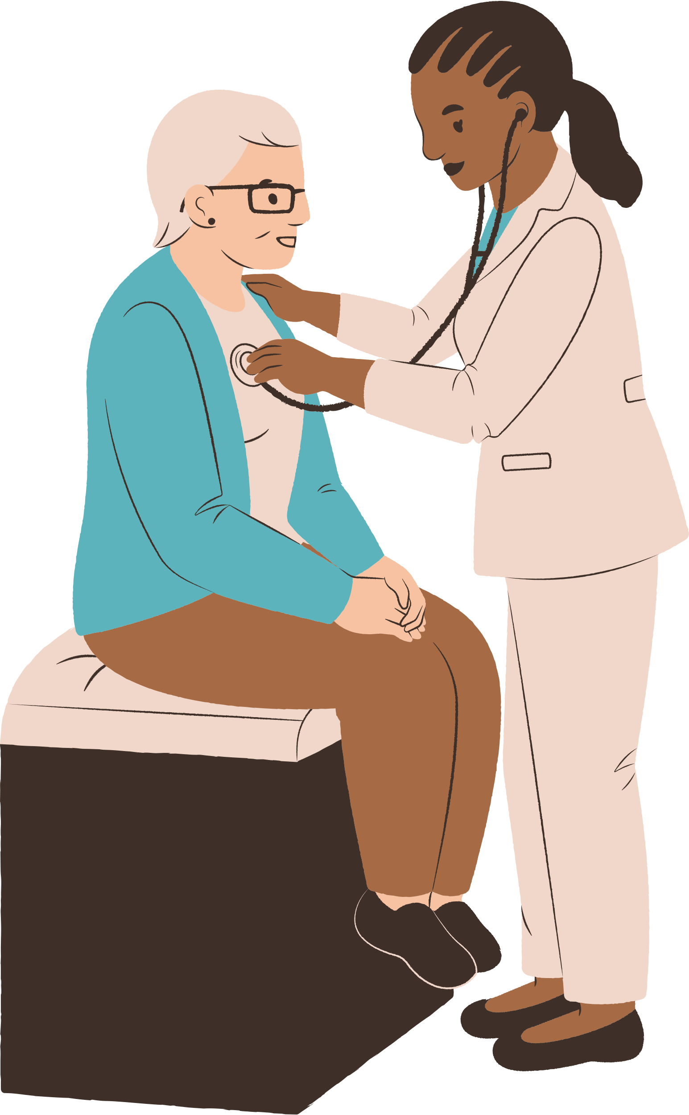
Unit 1:
LOCAL COMMUNITY
Lesson 2: A Closer Look 1

Slide 6
VOCABULARY

Slide 7
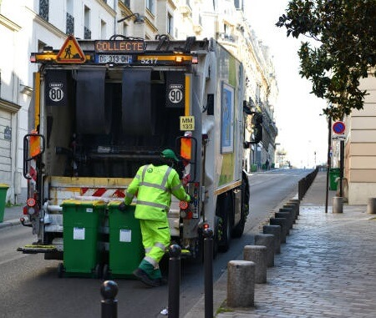

Vocabulary
garbage collector (n)
/ˈɡɑːbɪdʒ kəlektə/
nhân viên dọn
vệ sinh

Slide 8
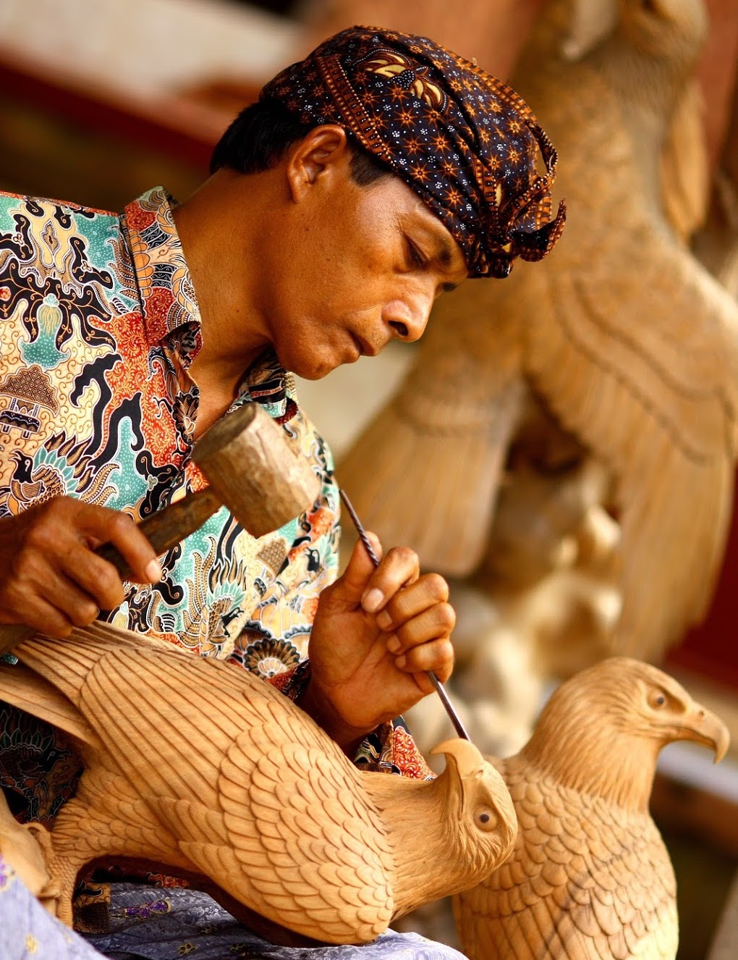
Vocabulary
artisan (n)
/ˌɑːtɪˈzæn/
thợ làm nghề thủ công

Slide 9

Vocabulary
pottery (n)
/ˈpɒtəri/
đồ gốm

Slide 10
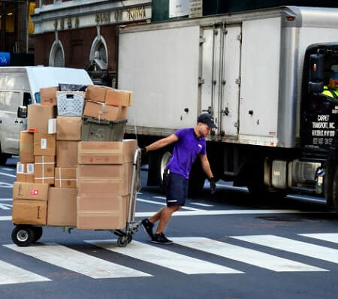
Vocabulary
delivery person
/dɪˈlɪvəri ˈpɜːrsn/
nhân viên
giao hàng

Slide 11
Vocabulary
New words | Pronunciation | Meaning
1. garbage collector (n) | /ˈɡɑːbɪdʒ kəlektə/ | nhân viên dọn vệ sinh
2. artisan (n) | /ˌɑːtɪˈzæn/ | thợ làm nghề thủ công
3. pottery (n) | /ˈpɒtəri/ | đồ gốm
2. delivery person (n) | /dɪˈlɪvəri ˈpɜːrsn/ | nhân viên giao hàng

Slide 12

1. Match the community helpers with their responsibilities
police officer
a. puts in, checks, and repairs electrical wires and equipment
1.
garbage collector
b. puts out fires and saves people from dangerous fires
2.
c. protects people and property, makes people obey the law, prevents and solves crimes
3.
electrician
firefighter
4.
d. delivers goods to people’s houses or workplaces
delivery person
5.
e. takes people’s rubbish away

Slide 13
What other community helpers can you add?
Look at the answers again
c. protects people and property, makes people obey the law, prevents and solves crimes
police officer
1.
garbage collector
2.
e. takes people’s rubbish away
3.
electrician
a. puts in, checks, and repairs electrical wires and equipment
firefighter
b. puts out fires and saves people from dangerous fires
4.
delivery person
d. delivers goods to people’s houses or workplaces
5.

Slide 14

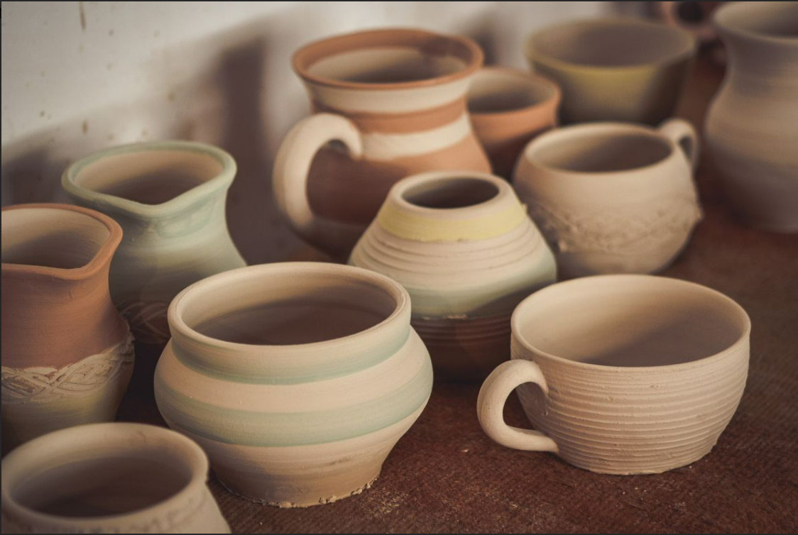
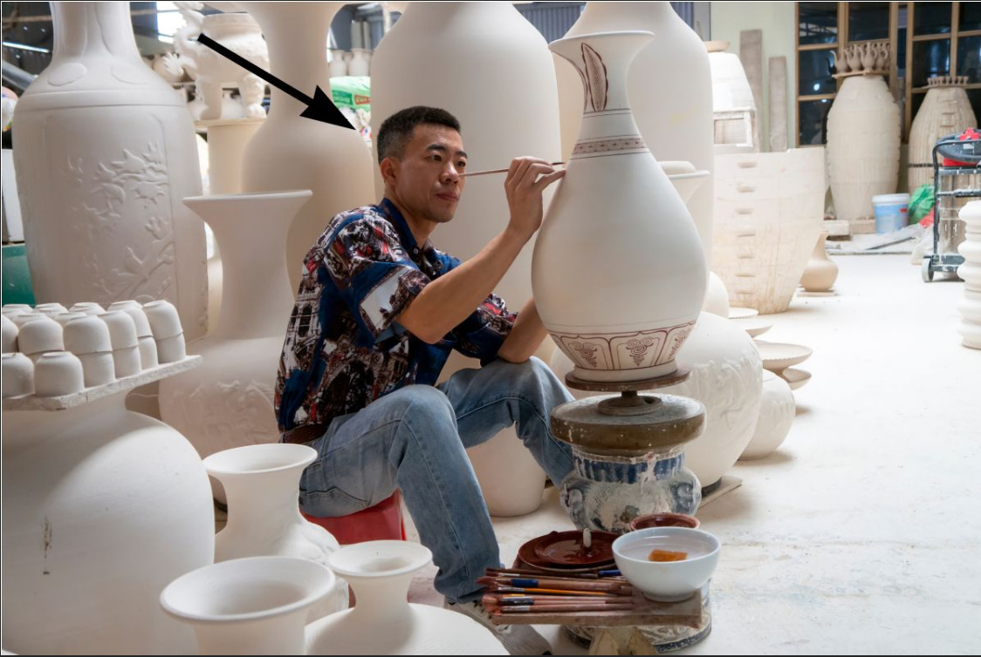
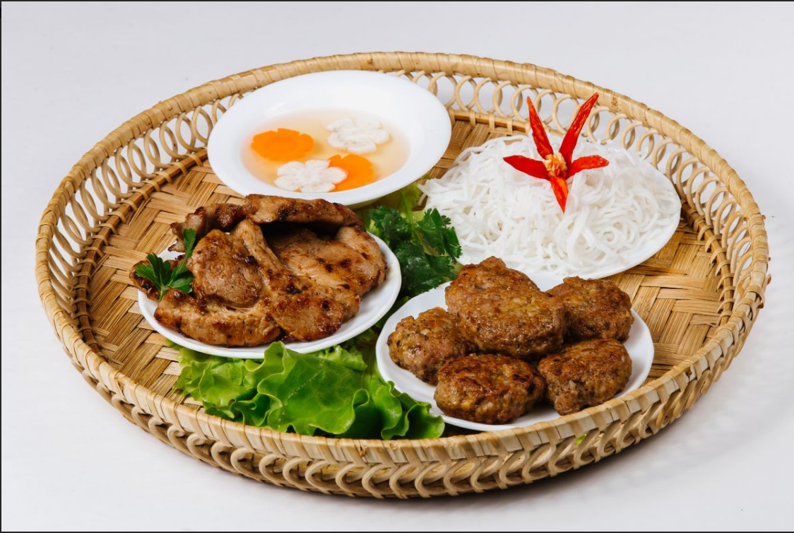

2. Write a word or phrase in the box under the correct picture
artisan
handicraft
pottery
speciality food
tourist attraction

Slide 15
artisan
handicraft
pottery
speciality food
tourist attraction
artisan

Slide 16
artisan
handicraft
pottery
speciality food
tourist attraction
tourist attraction

Slide 17
artisan
handicraft
pottery
speciality food
pottery
tourist attraction

Slide 18
artisan
handicraft
pottery
speciality food
tourist attraction
speciality food

Slide 19
artisan
handicraft
pottery
speciality food
tourist attraction
handicraft
Notes:
Write down the phrases of daily activities.

Slide 20
Look at the answer again
tourist attraction
pottery
artisan
speciality food
handicraft

Slide 21
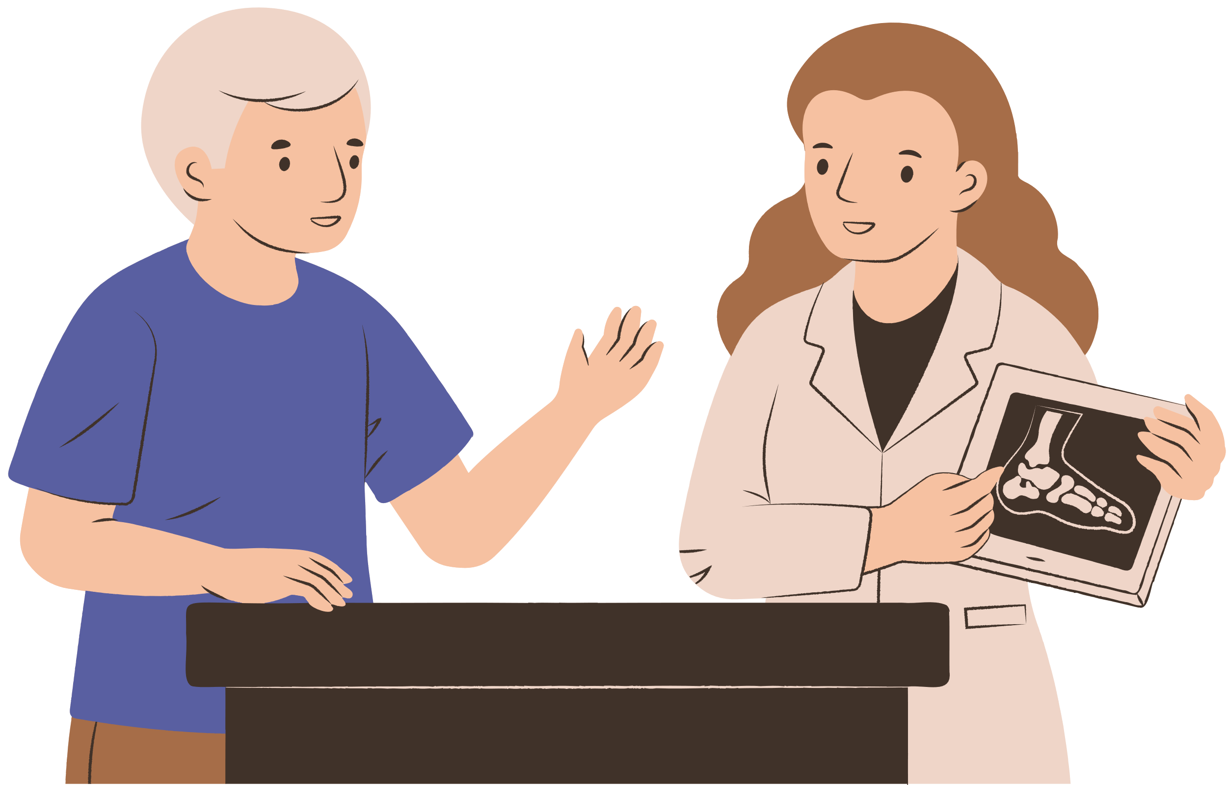
3. Fill in each blank with a word or phrase from the box
artisans | electrician | handicrafts | speciality food | garbage collector
artisans
1. Skilled local ____________ made these beautiful flower vases.
2. The electrical wires in our neighbourhood broke down yesterday, so we had to call a(n) ______________.
3. Bun cha, pho, and hu tieu are examples of famous Vietnamese ________________.
4. The ___________________ in our street usually comes at 6 p.m. to take the rubbish away.
5. Tourists to Hoi An usually buy traditional ______________ such as lanterns as souvenirs.
electrician
speciality food
garbage collector
handicrafts

Slide 22
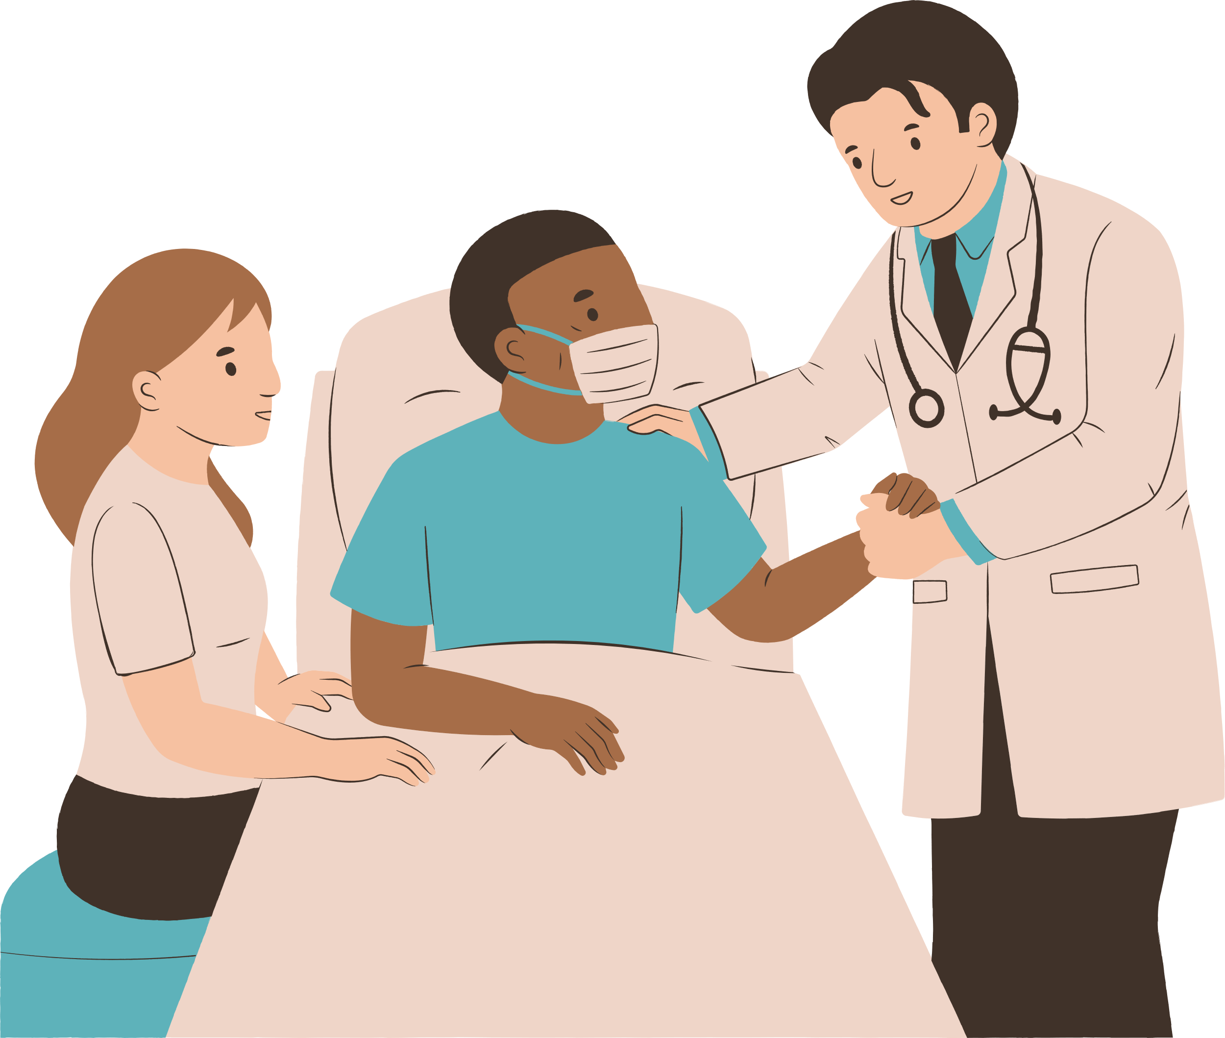
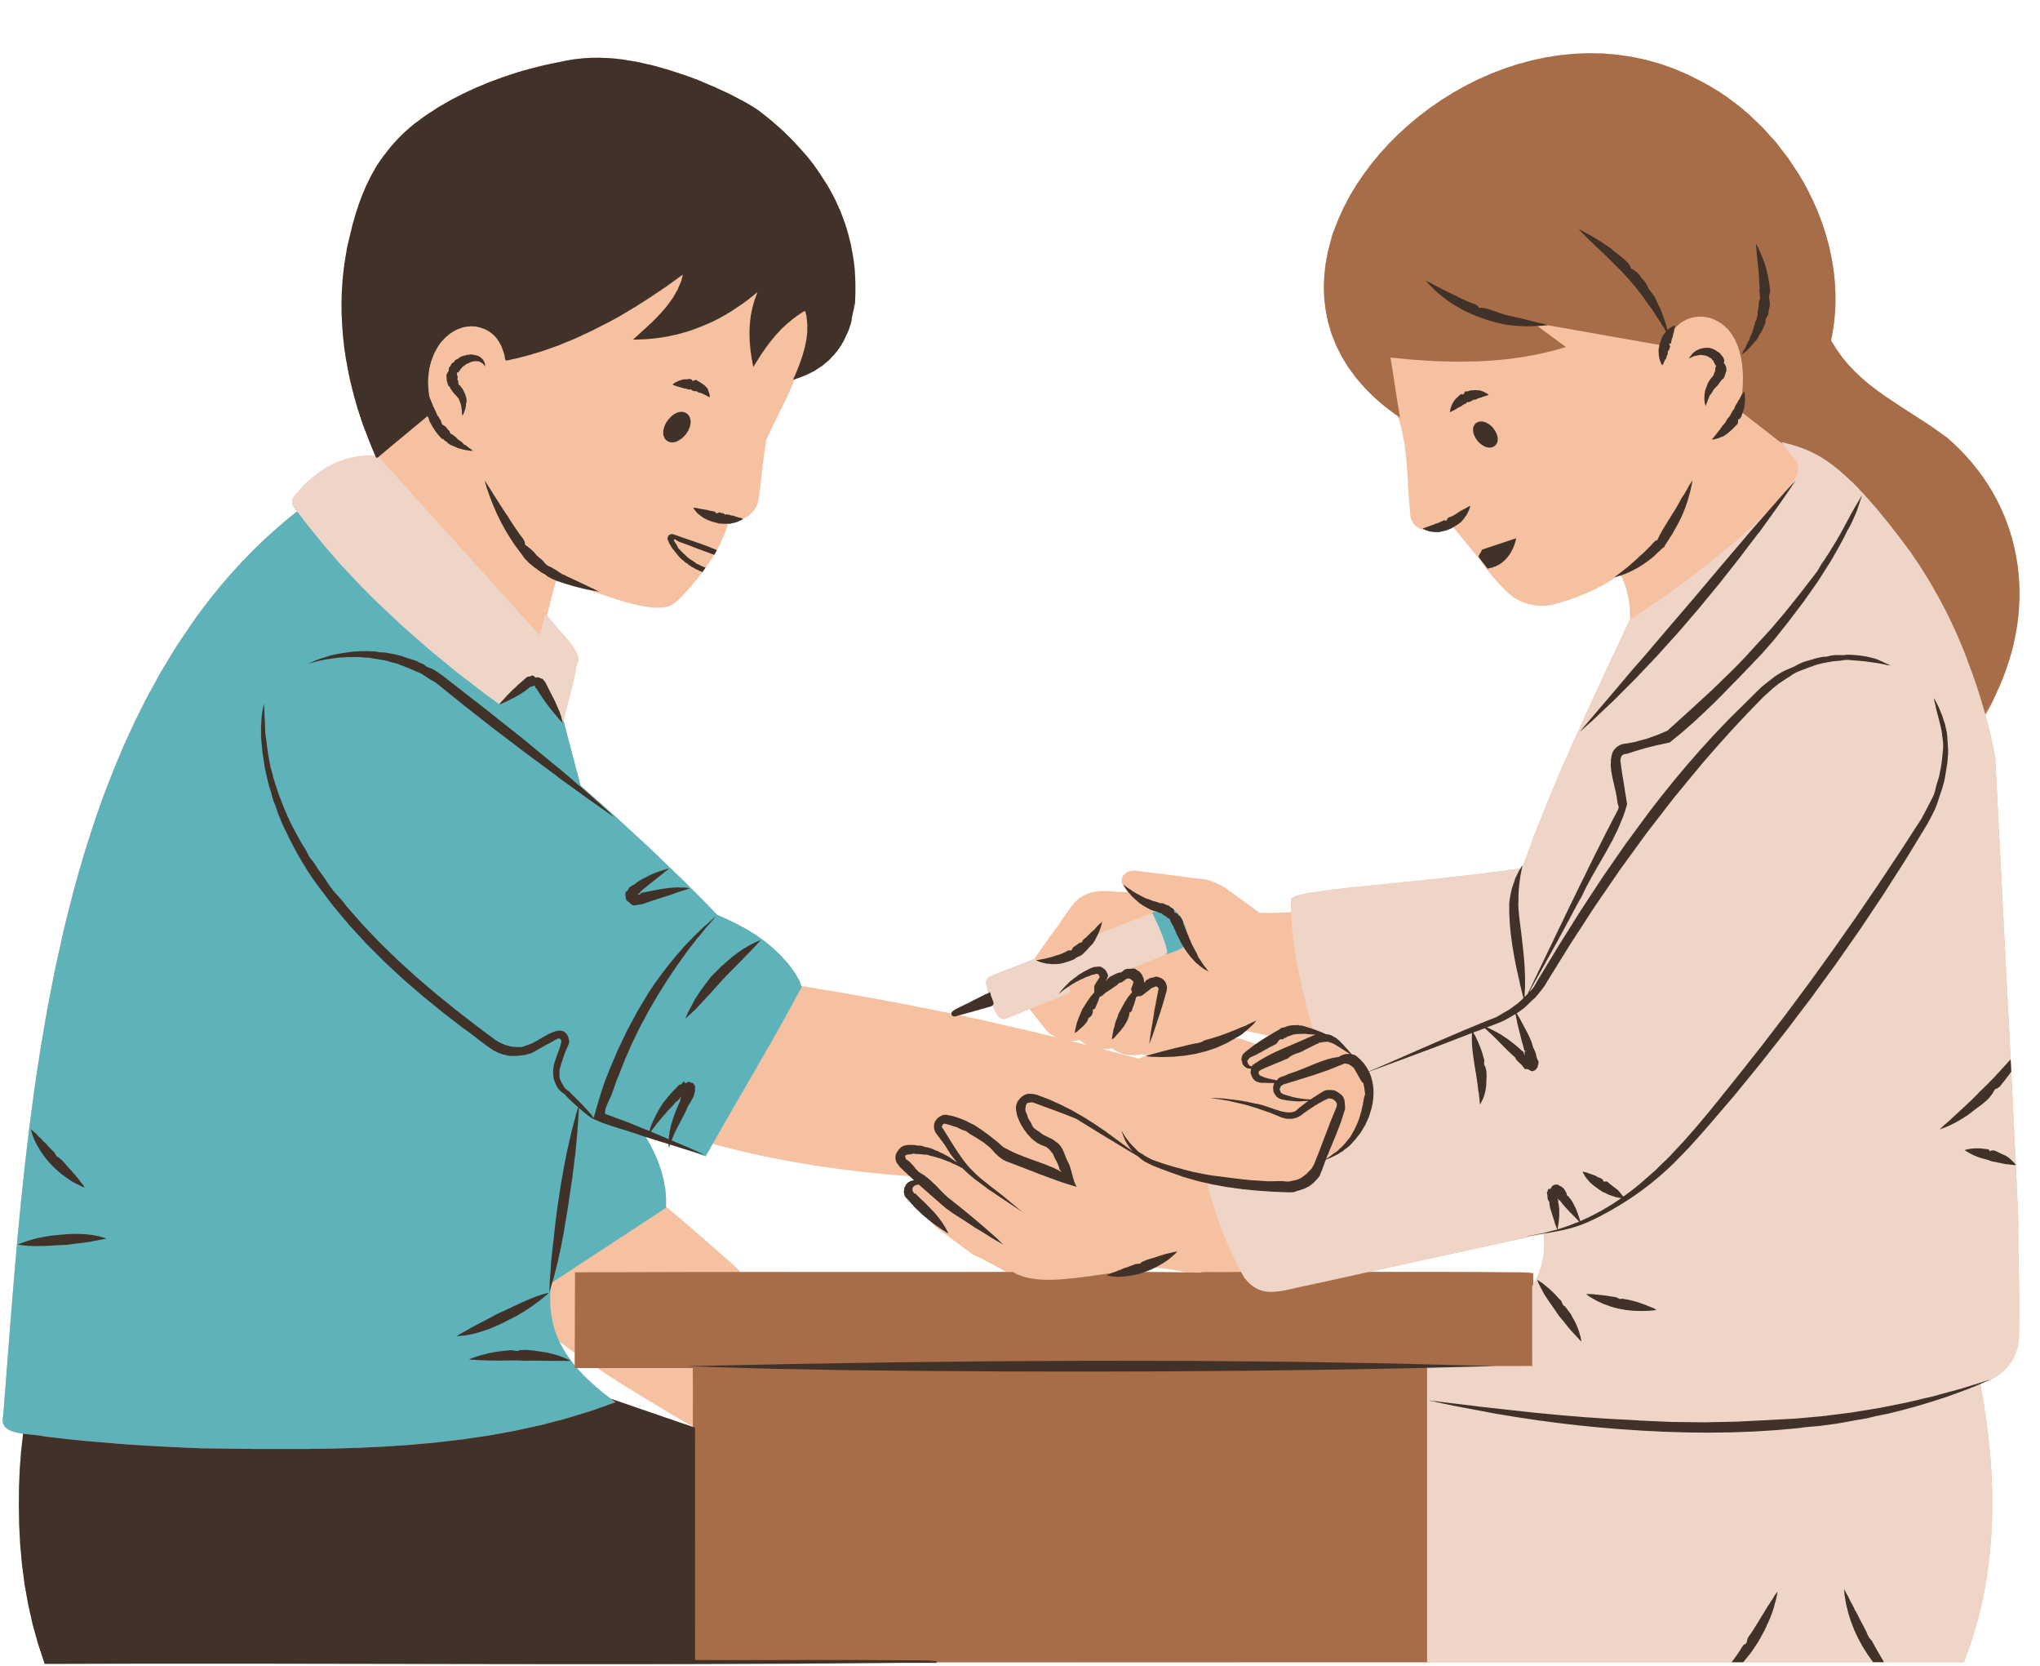
PRONUNCIATION
kettle
park
/e/
chat
/ɑː/
/æ/

Slide 23


* PRONUNCIATION
*
Vowel revision: /æ/, /ɑ:/, and /e/

Slide 24
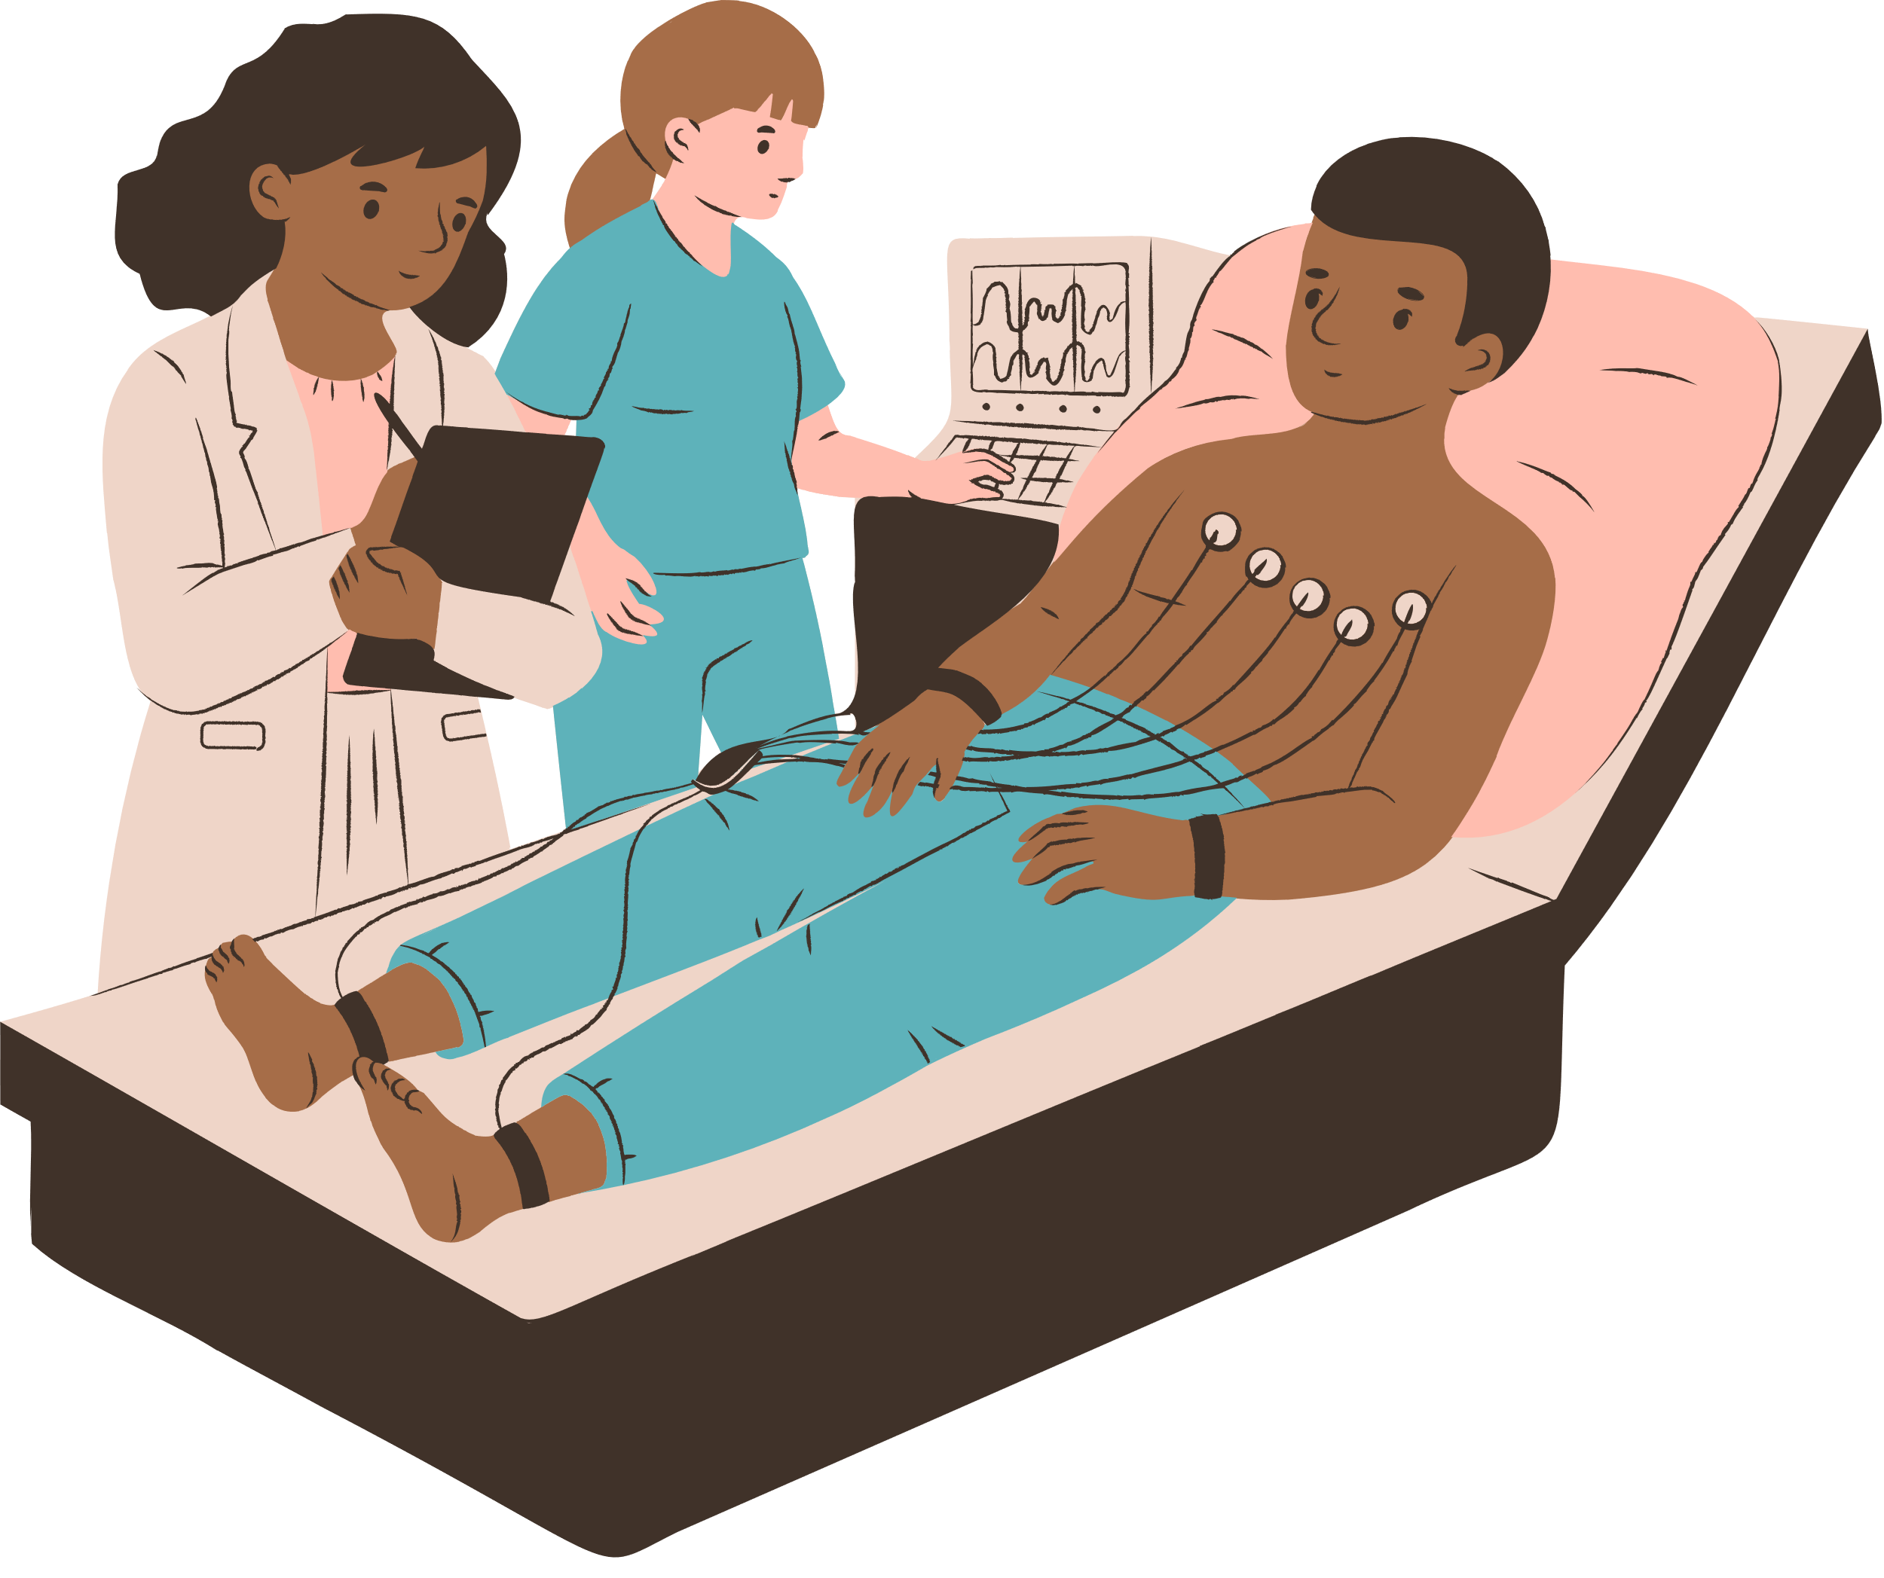
4. Listen and number the words you hear. Then listen again and repeat.
______ pack ______ park
______ kettle ______ cattle
______ marry ______ merry
______ chart ______ chat
3
5
7
4
8
2
1
6

Slide 25
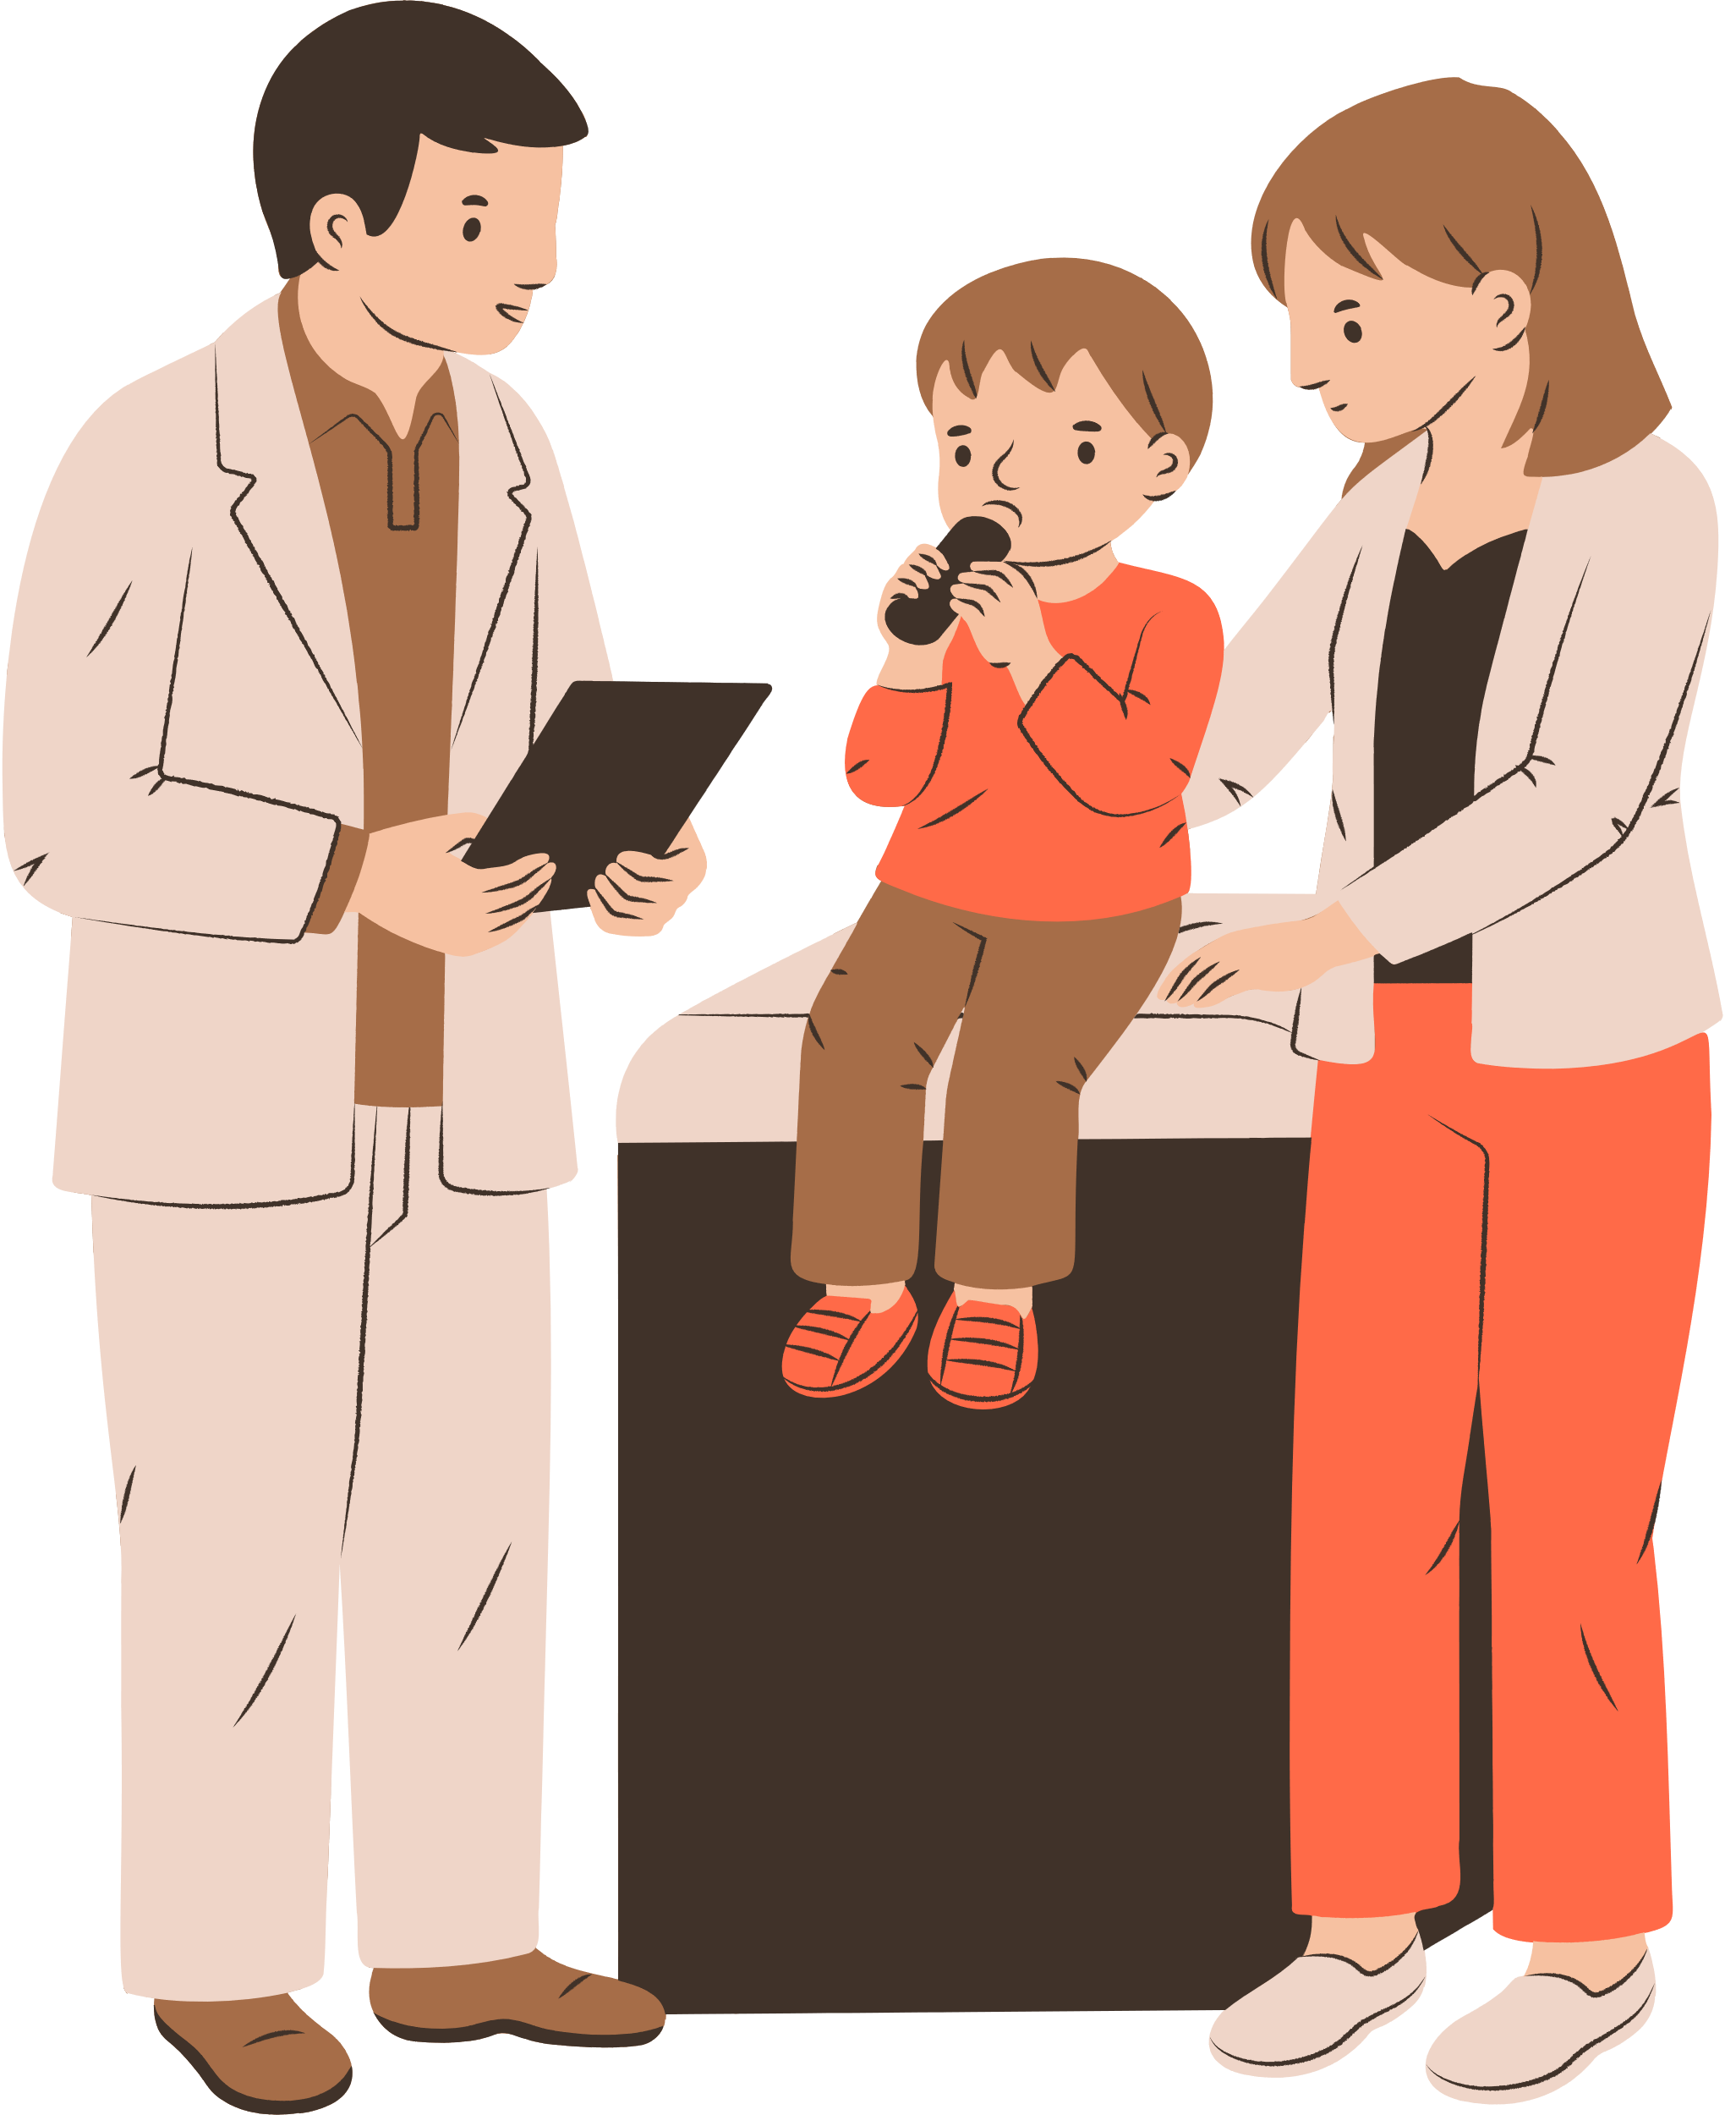
5. Listen and practise the sentences. Underline the bold words with /æ/, circle ○ the bold words with /ɑː/, and tick  the bold words with /e/.
1. Thanks to garbage collectors, our streets are clean.
2. My grandmother is a well-known artist.
3. That bakery makes the best bread in our neighbourhood.
4. Do you know where to buy bamboo beds?
5. We sometimes go to the park to relax.
/æ/
/ɑː/
/æ/
/æ/
/e/
/æ/
/e/
/ɑː/
/æ/

Slide 26

WRAP UP
What have we learnt in this lesson?
Use the lexical items related to the topic Local community;
Pronounce the vowel sounds /æ/, /ɑ:/, and /e/ in words and sentences correctly;

Slide 27
Thank you!

