Slide 1










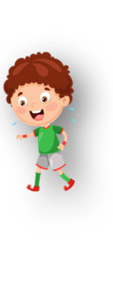











Unit 1 My family Lesson 1 – Task 1,2,3
Notes:
Để nguyên trang bìa như này, chỉ thay đổi tên bài trong quá trình làm. Logo của sách Wonderful World

Slide 2






Warm up
Finger family song.

Slide 3

Finger family song

Slide 4

Unit Opener
1. Is it a Chinese or Vietnamese family?
2. How many people are there in this photo?
3. What are they doing?
Notes:
Teacher introduce new lesson by asking 1,2,3 questions for students brainstorm:
Is it a Chinese family? Or Vietnamese family?
How many people are there in this photo?
What are they doing?

Slide 5



Notes:
Lead in: Teacher introduces her family.

Slide 6

Presentation
Task 1: Listen and point. Repeat.

Slide 7
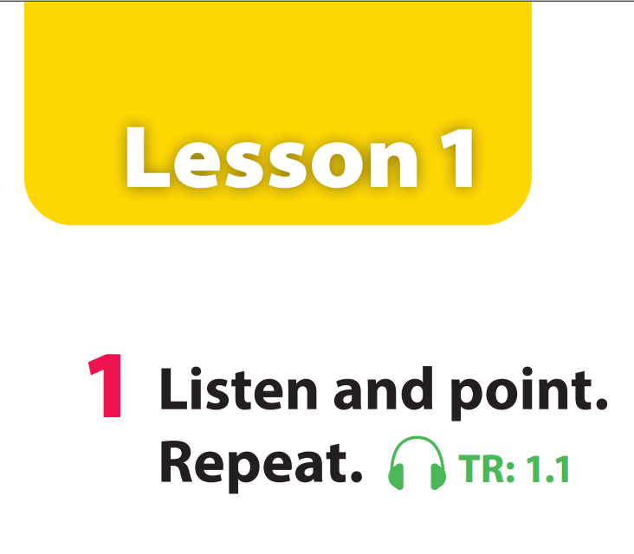

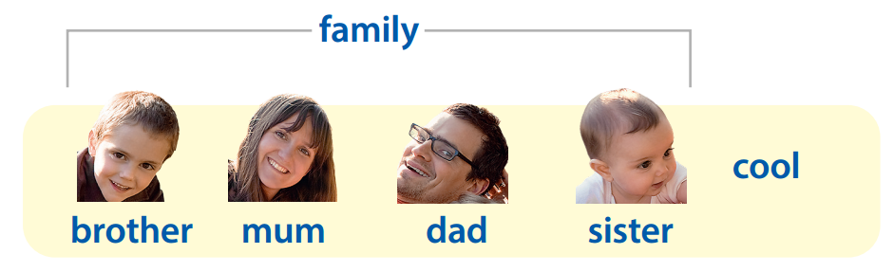

Notes:
GV click audio trước nghe tới đâu thì click point vào
Task 1: Listen and repeat. (Track 1.1)
- Use flashcards to introduce the vocabulary and structure of lesson.
- Say the words/sentences for students to repeat in chorus.
- Say a word/sentence for students to repeat then point.
- Play the track 1.1 for the students to listen to, point to, and repeat the words in chorus, group.
- Show pictures in random order and ask students to read out the correct words.
Task 1: Listen and repeat. (Track 1.1)
- Use flashcards to introduce the vocabulary and structure of lesson.
- Say the words/sentences for students to repeat in chorus.
- Say a word/sentence for students to repeat then point.
- Play the track 1.1 for the students to listen to, point to, and repeat the words in chorus, group.
- Show pictures in random order and ask students to read out the correct words.

Slide 8


Who’s missing?
Notes:
Mini game: Who’s missing?
Ask students to close their eyes.
Then teacher takes away one of the flashcards.
- The first student spot and say the missing one wins.
Hướng dẫn: Mini game: Who’s missing?
Yêu cầu học sinh nhắm mắt lại.
Sau đó, giáo viên lấy đi một trong những thẻ ghi nhớ.
Học sinh đầu tiên tìm thấy và nói rằng người mất tích sẽ thắng.

Slide 9

Notes:
Mum

Slide 10
Notes:
Brother

Slide 11
Notes:
Family

Slide 12
Notes:
Dad

Slide 13
Notes:
Sister

Slide 14
Notes:
Cool

Slide 15

Practice
Task 2: Listen and write

Slide 16

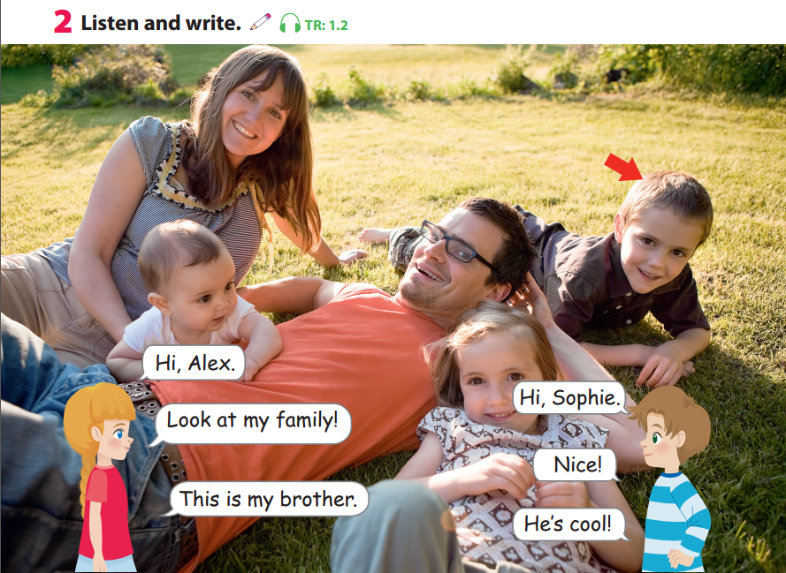

Notes:
Task 2: Listen and write. (Track 1.2)
- Point and read the new words in the dialogue. Ask students to repeat.
- Play the Track 1.2. Tell students to look at the picture, listen and follow the text with their fingers.

Slide 17
%
%
%
%
%
Notes:
Task 2: Listen and write. (Track 1.2)
- Point and read the new words in the dialogue. Ask students to repeat.
- Play the Track 1.2. Tell students to look at the picture, listen and follow the text with their fingers.

Slide 18

family
Let’s write!

Slide 19
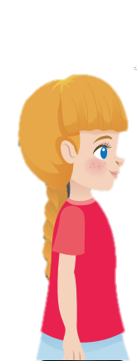
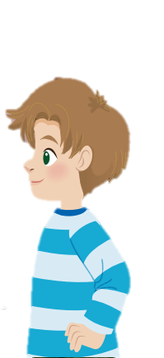
Role play!
Hi, Alex.
Hi, Sophie.
Look at my family!
Nice!
Notes:
Role play
- Model a conversation to introduce family by having two students come up to the front of the classroom. - Each student takes turn to ask and asnwer. - Ask students to act out the dialogue in pairs. Ask some volunteers to act it out in front of the whole class.
- Tell students to listen again and fill in the gap.
- Elicit the correct answer.
- Ask students to read a sentence again.

Slide 20
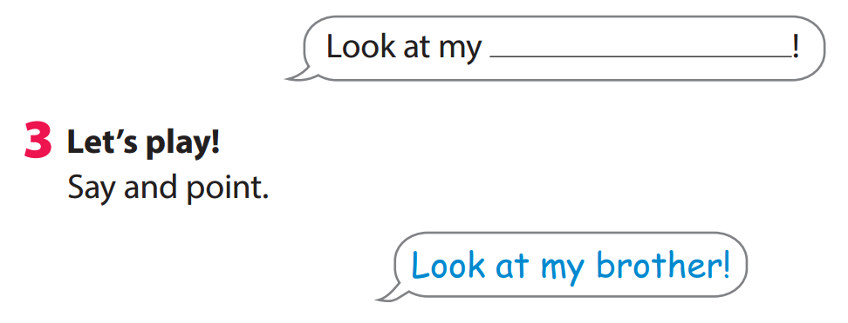


START
Notes:
Game: Point and say
- Ask students to work groups of four.
- One student looks at the photo in activity 2 and say Look at my ...! (e.g. Look at my mum!), and the other students have to quickly point at the person (e.g. mum) in the photo.
- The fastest student who points at the right person gets a point.
- Ask students to play in groups. Walk around and give help if necessary.
- Ask some volunteers to play in front of the whole class.
Hướng dẫn:
Game: Point and say
- Yêu cầu học sinh làm việc theo nhóm bốn người.
- Một học sinh nhìn vào bức ảnh trong hoạt động 2 và nói Nhìn vào tôi ...! (ví dụ: Nhìn vào mẹ tôi!), và những học sinh khác phải nhanh chóng chỉ vào người (ví dụ: mẹ) trong ảnh.
- Học sinh nào chỉ vào đúng người nhanh nhất sẽ được một điểm.
- Yêu cầu học sinh chơi theo nhóm. Đi xung quanh và giúp đỡ nếu cần thiết.
- Yêu cầu một số tình nguyện viên chơi trước cả lớp.

Slide 21

Production
Let’s make and play
with finger puppet

Slide 22

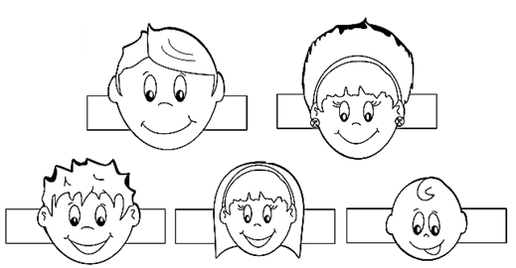


1
2
color
Make family
puppet
Notes:
Play a quick game: Teacher says "Wiggle the sister" and students have to quickly wiggle the right one.
Sing the song “Finger family”, wiggle the character who is mentioned
Hướng dẫn: Play a quick game: Giáo viên nói "Wiggle the sister"
Hát bài hát "Finger family", lắc lư nhân vật được nhắc đến

Slide 23



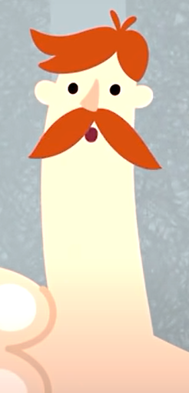

Let’s sing and play

Slide 24

Assessment
Write and match!

Slide 25




A. mum
B. dad
C. cool
D. sister
Notes:
Key: A

Slide 26

A. sister
B. brother
C. dad
D. family
Notes:
Key: C

Slide 27

A. sister
B. brother
C. dad
D. family
Notes:
Key: A

Slide 28
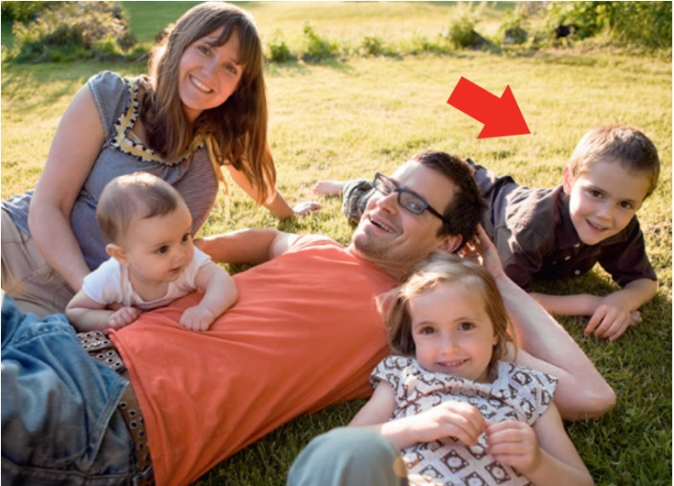
A. cool
B. family
C. mum
D. brother
Notes:
Key: B

Slide 29
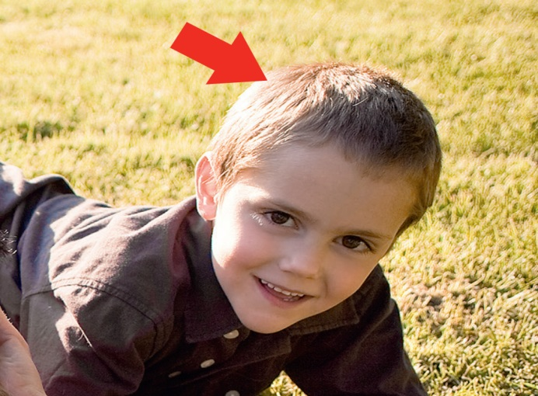
A. mum
B. sister
C. dad
D. brother
Notes:
Key: D

Slide 30



Good bye.
See you again!

