Slide 1

Unit 4: My body
Lesson 1.1: Vocabulary & Sentence Patterns
Page: 26

Slide 2
Lesson Outline
Warm-up
Vocabulary
Structure
Practice
Consolidation
Wrap-up

Slide 3
Objectives
By the end of this lesson, students will be able to identify and talk about parts of the body, using the target language.
Vocabulary:
head, leg, arm
Sentence pattern:
Touch your (head).

Slide 4

WARM UP

Slide 5



Let's have a look

Slide 6
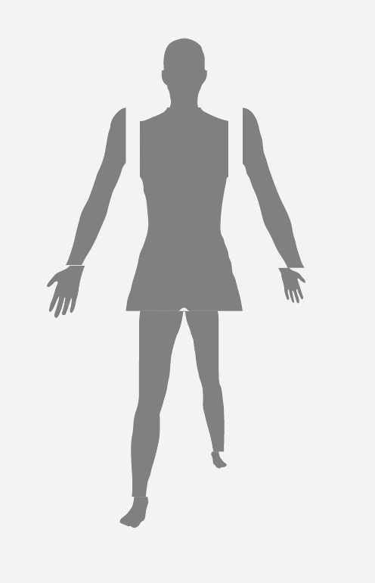

Slide 7

It’s time to learn …

Slide 8

New words
head, leg, arm

Slide 9

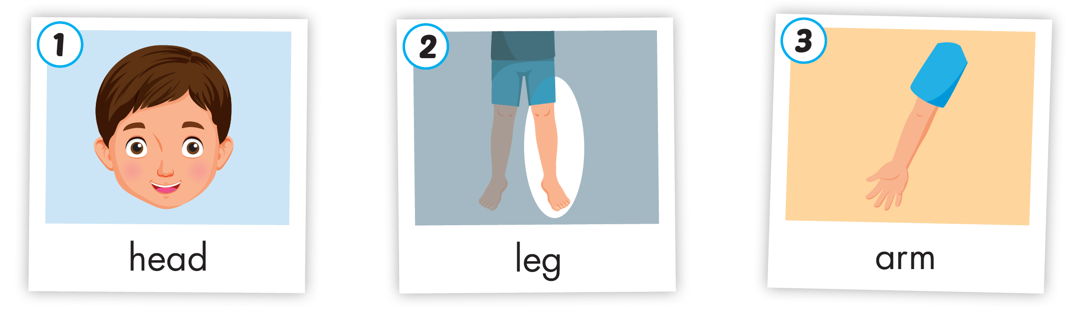
Click A to hear the sound

Slide 10
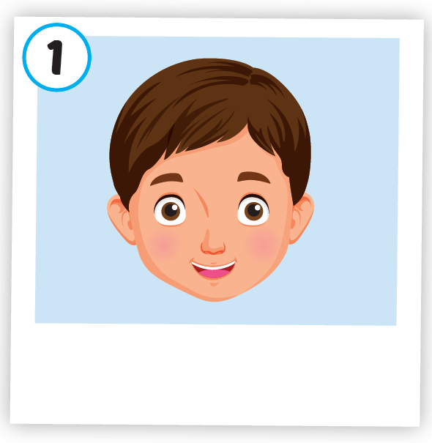
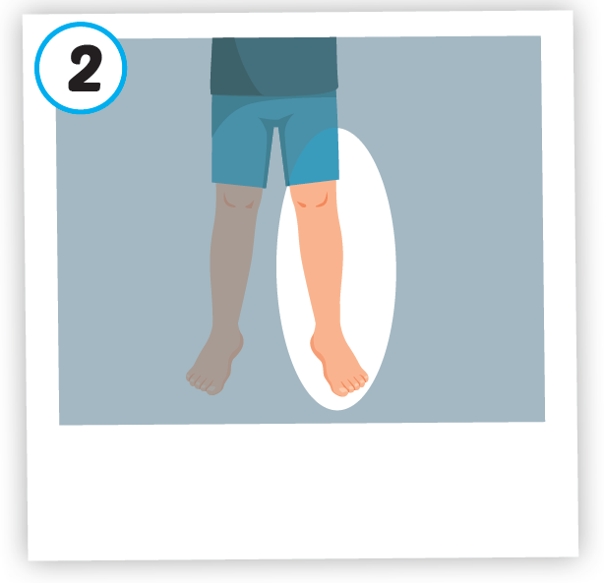
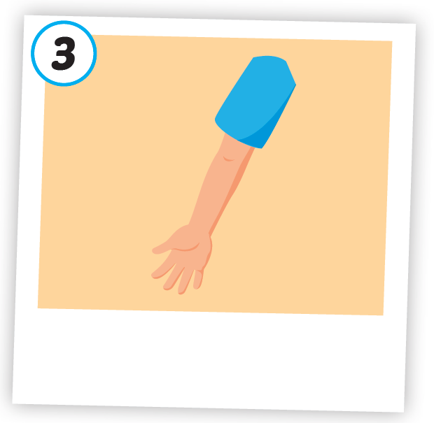



Click A to hear the sound
/hed/
đầu
/leɡ/
chân
/ɑːrm/
cánh tay

Slide 11

Click on the picture to hear the sound
/hed/
đầu

Slide 12
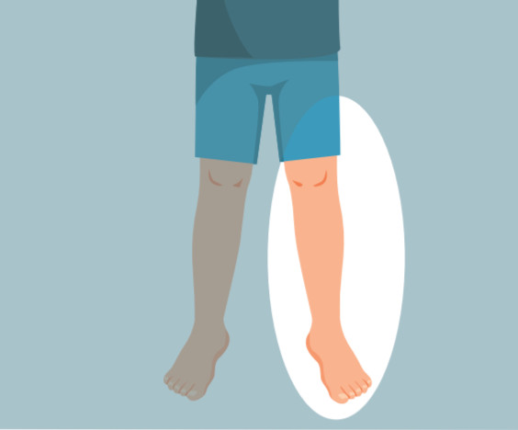
Click on the picture to hear the sound
/leɡ/
chân

Slide 13

Click on the picture to hear the sound
/ɑːrm/
cánh tay

Slide 14

Structures
Touch your (head).

Slide 15

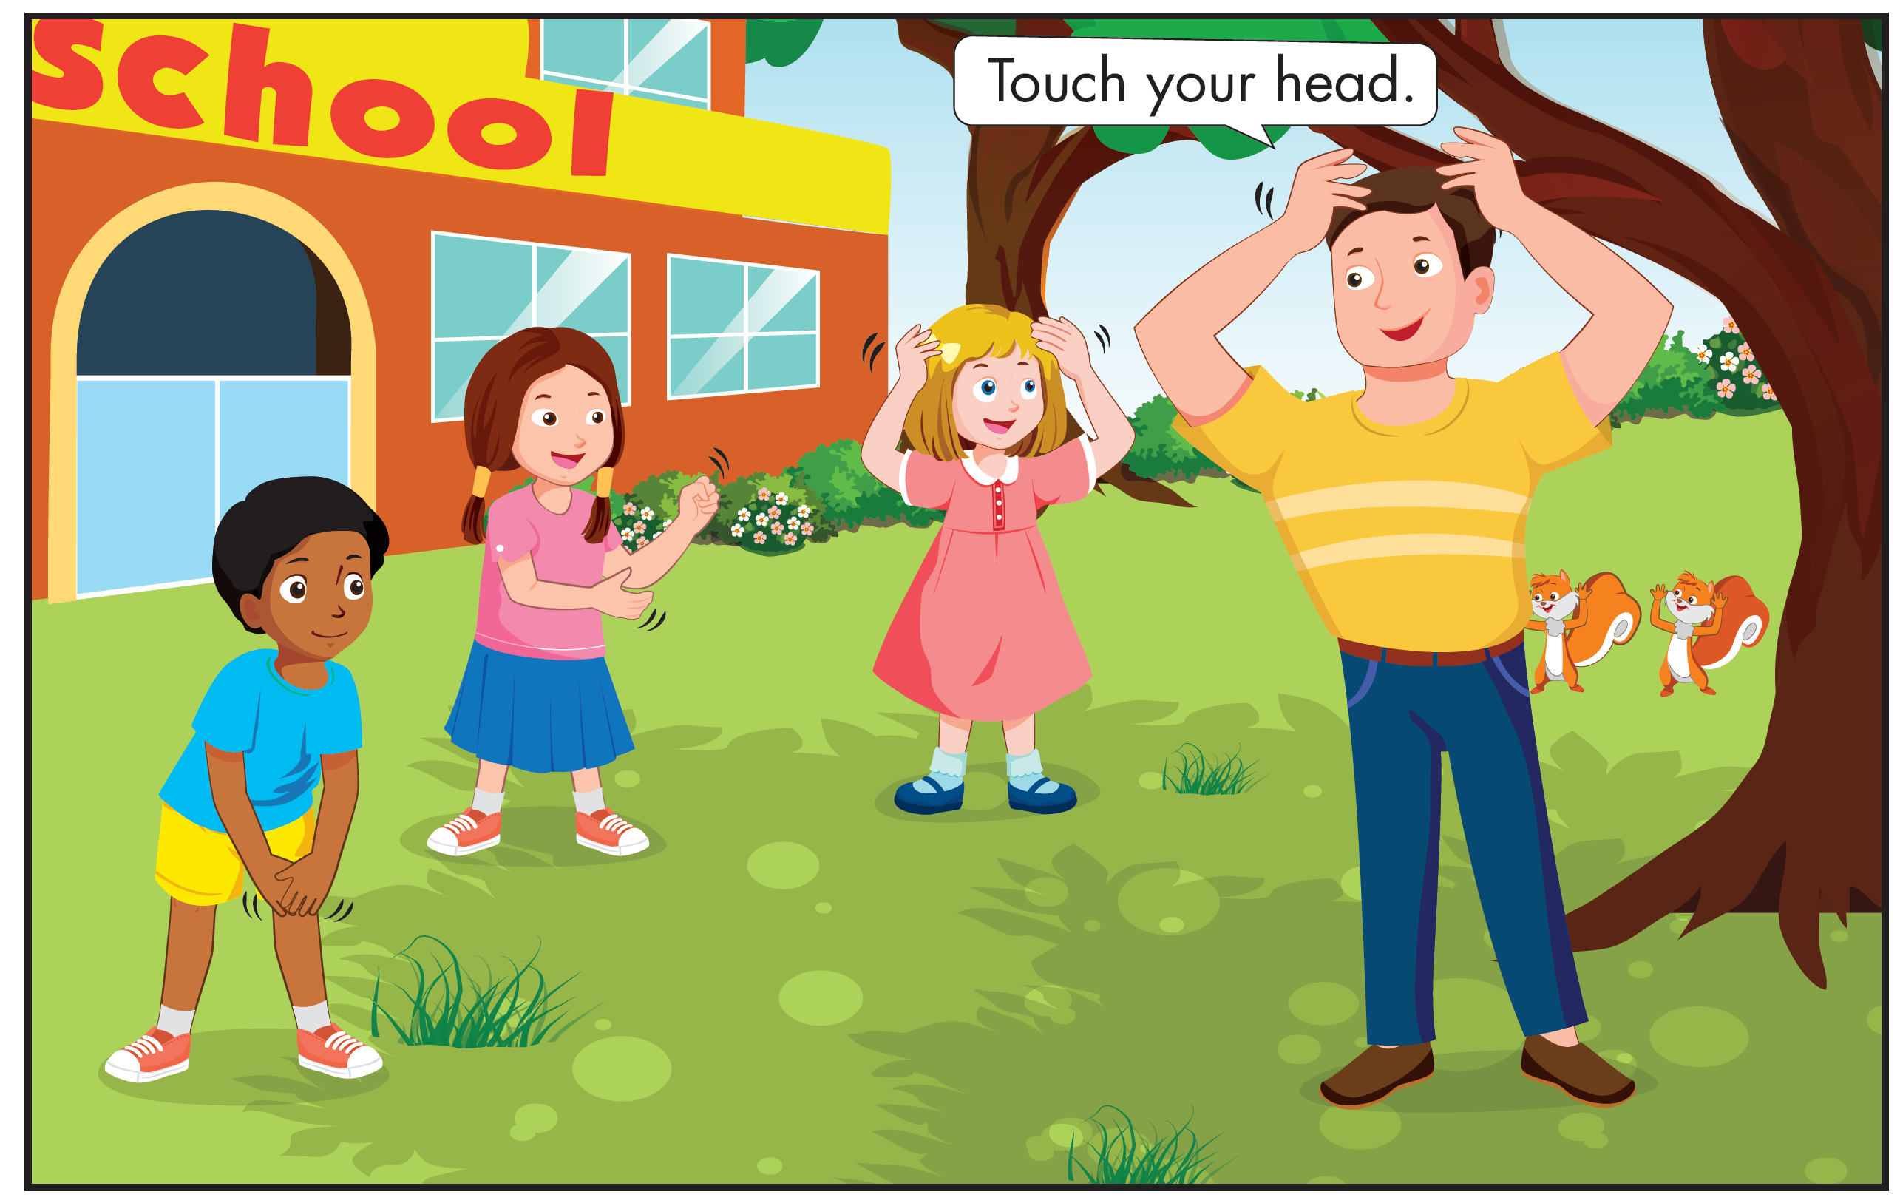
Click B to hear the sound
Who are they?

Slide 16
Click B to hear the sound
What are they talking about?

Slide 17
Click B to hear the sound

Slide 18

Practice

Slide 19







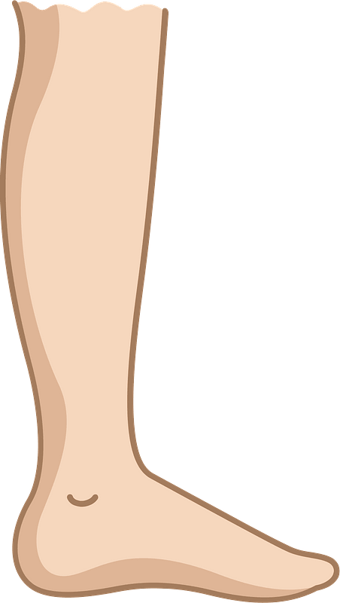
Listen and choose
A
C
B

Slide 20
Listen and choose
A
B
C

Slide 21
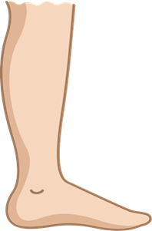
Listen and choose
A
B
B

Slide 22


Touch your head.
Touch your head.
Touch your leg.
Touch your arm.
Touch your leg.
Touch your arm.

Slide 23

Further Practice

Slide 24

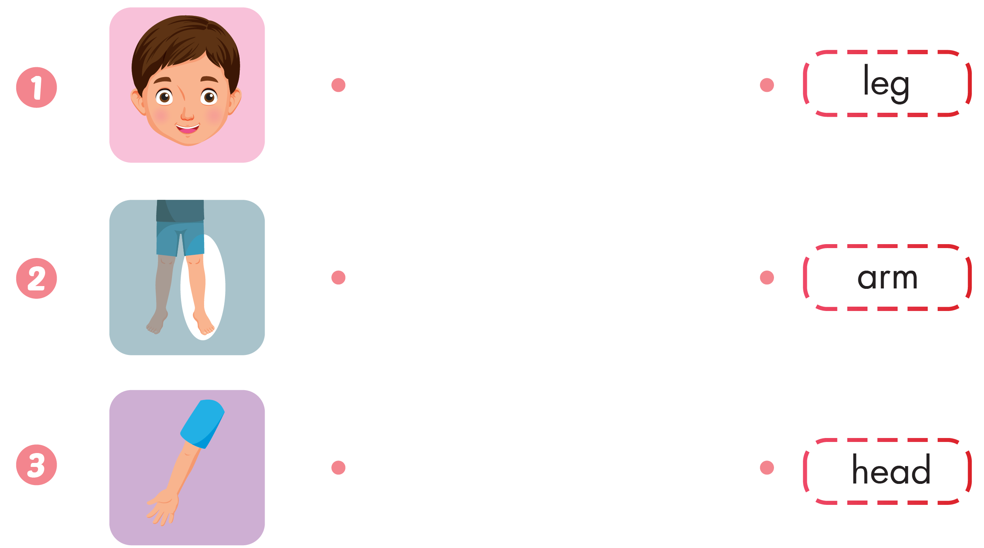

Slide 25
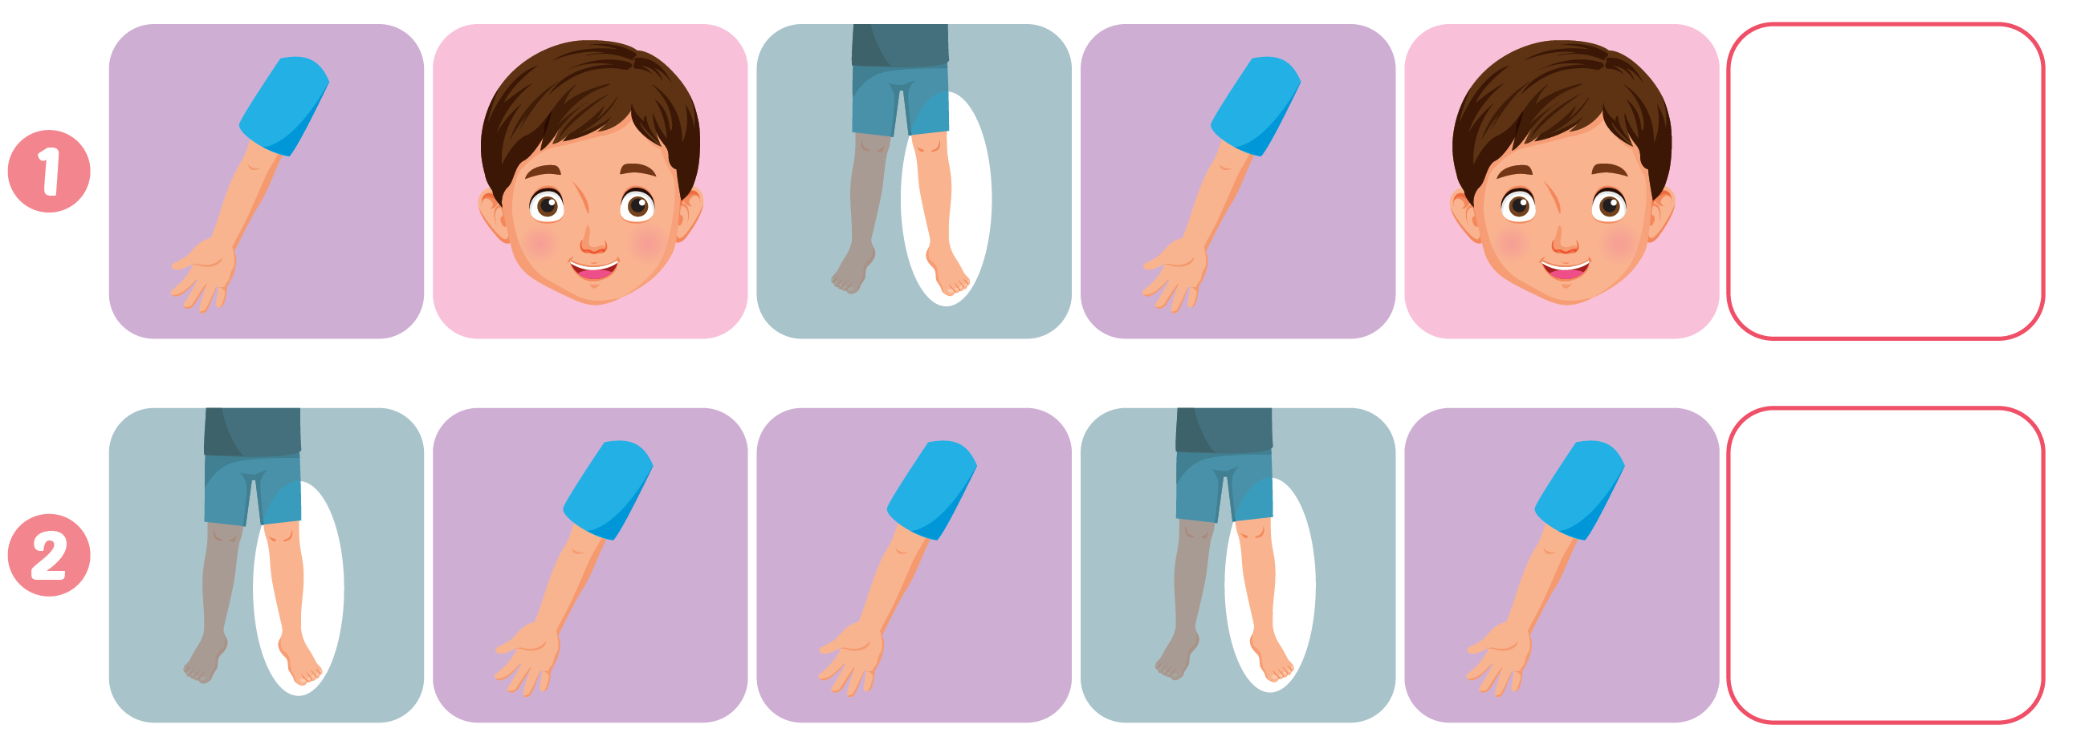



Slide 26

CONSOLIDATION

Slide 27
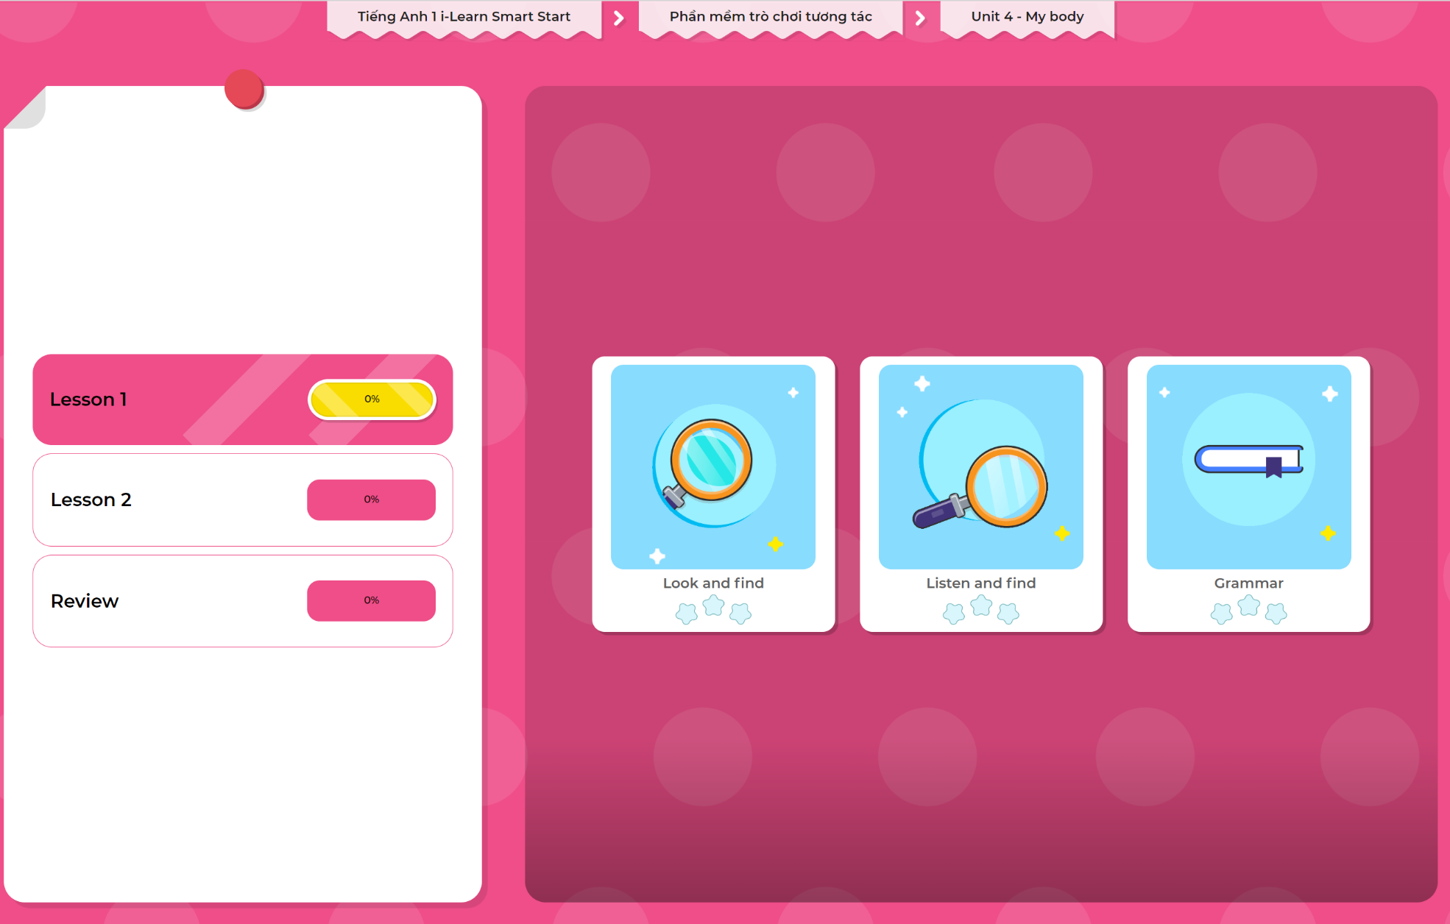
Extra Practice
DHA App
LET’S PLAY!
Click here to play the games

Slide 28

WRAP-UP

Slide 29
Today’s lesson
Structures/ Sentence patterns
Touch your (head).
Vocabulary
head, leg, arm

Slide 30
Homework
Practice vocabularies and structure. Make sentences using them.
Practice the vocabulary and structure in Tiếng Anh 1 i-Learn Smart Start Notebook (page 20)
Do the exercises in Tiếng Anh 1 i-Learn Smart Start Workbook (page 24)
Play the consolidation games in Tiếng Anh 1 i-Learn Smart Start DHA App on www.eduhome.com.vn
Prepare the next lesson (page 27 SB)

Slide 31

Enjoy your day!

