Slide 1

Unit 4: My body
Lesson 1.2: Speaking
Page: 27

Slide 2
Lesson Outline
Warm-up
Speaking
Practice
Consolidation
Wrap-up

Slide 3
Objectives
By the end of this lesson, students will be able to talk about parts of the body, using the target language.
Vocabulary:
Revise head, leg, arm
Sentence pattern:
Revise Touch your (head).

Slide 4

WARM UP

Slide 5




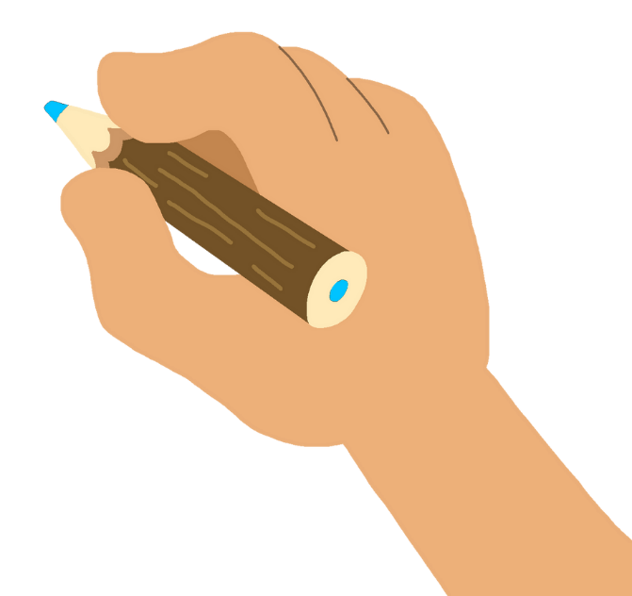
head
arm

Slide 6
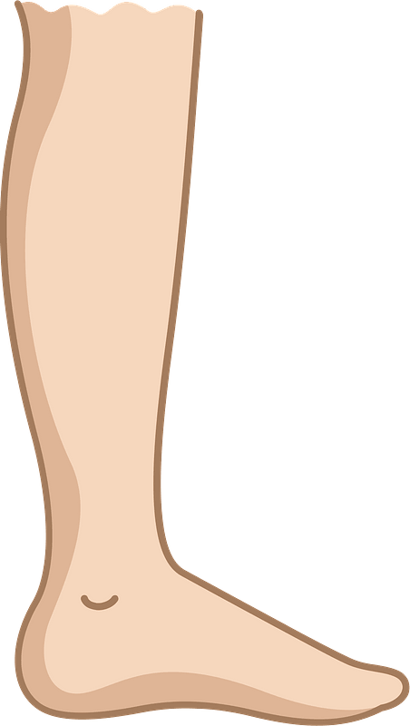
leg
arm

Slide 7

head
arm

Slide 8

It’s time to learn …

Slide 9

Speaking

Slide 10

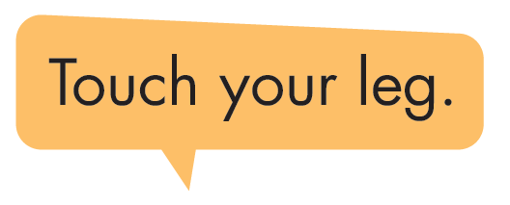


Slide 11
Touch your __________

Slide 12

Practice

Slide 13

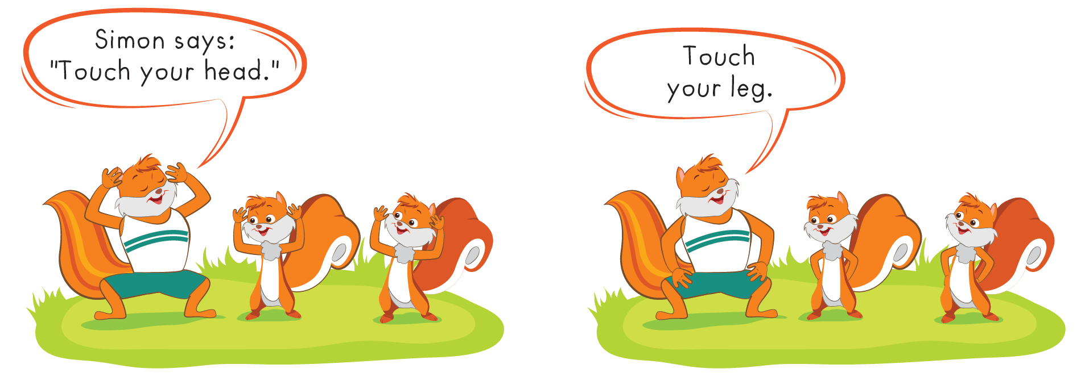

Slide 14
It’s time to play …

Slide 15



Save Peter Game
???

Slide 16

head
leg
arm

Slide 17
head
arm
leg

Slide 18

leg
arm
head

Slide 19

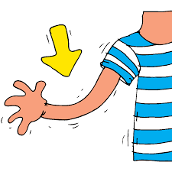

Touch your leg.

Slide 20
Touch your arm.

Slide 21
Touch your leg.

Slide 22
Touch your head.

Slide 23
Further Practice

Slide 24


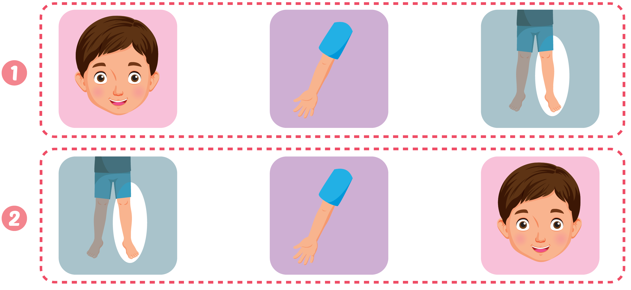


Click C to hear the sound

Slide 25

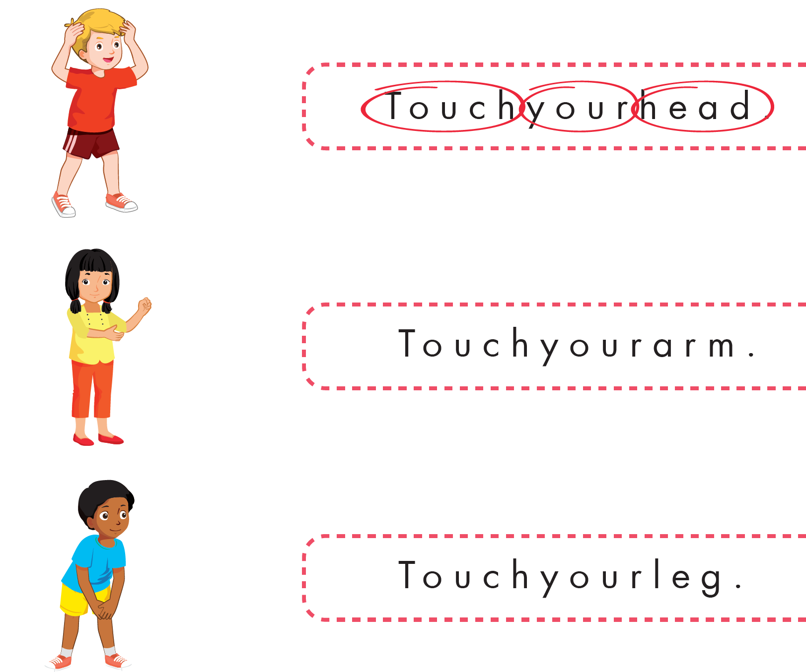

Slide 26

CONSOLIDATION

Slide 27
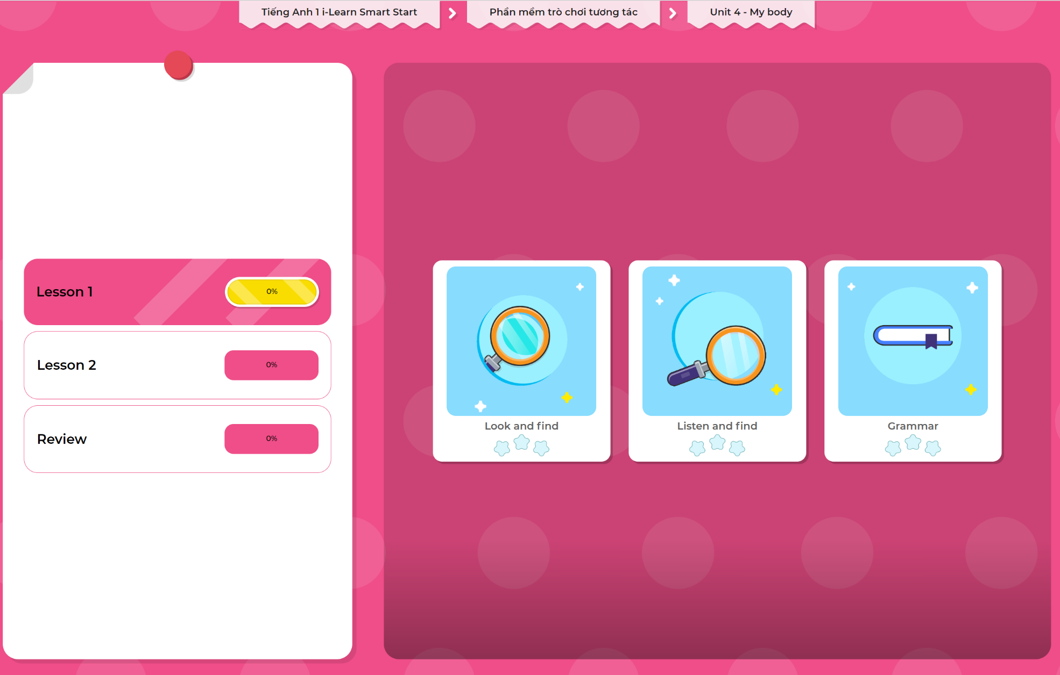
Extra Practice
DHA App
LET’S PLAY!
Click here to play the games

Slide 28

WRAP-UP

Slide 29
Today’s lesson
Structures/ Sentence patterns
Revise Touch your (head).
Vocabulary
Revise head, leg, arm

Slide 30
Homework
Review the vocabularies & structures and make sentences using them.
Practice the vocabulary and structure in Tiếng Anh 1 i-Learn Smart Start Notebook (page 21)
Do the exercises in Tiếng Anh 1 i-Learn Smart Start Workbook (page 25)
Play the consolidation games in Tiếng Anh 1 i-Learn Smart Start DHA App on www.eduhome.com.vn
Prepare the next lesson (page 28 SB)

Slide 31

Enjoy your day!

