Slide 1

Unit 4: My body
Lesson 2.1: Vocabulary & Phonics
Page: 28

Slide 2
Lesson Outline
Warm-up
Vocabulary
Structure
Practice
Consolidation
Wrap-up

Slide 3
Objectives
By the end of this lesson, students will be able to gain the following:
Phonics: /e/
Vocabulary:
elephant
Sentence pattern:
I have an elephant.
Skills:
Recognize the sound of the letter E/e, the sound /e/ and produce them individually.

Slide 4

WARM UP

Slide 5


SHOOTING
BALLOONS
START

Slide 6




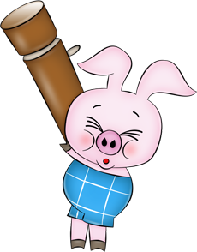


arm
head
leg

Slide 7

head
arm
leg

Slide 8

arm
leg
head

Slide 9

Touch your head
Touch your leg
Touch your arm

Slide 10
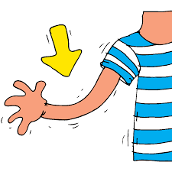
Touch your head
Touch your leg
Touch your arm

Slide 11

Touch your leg
Touch your arm
Touch your head

Slide 12
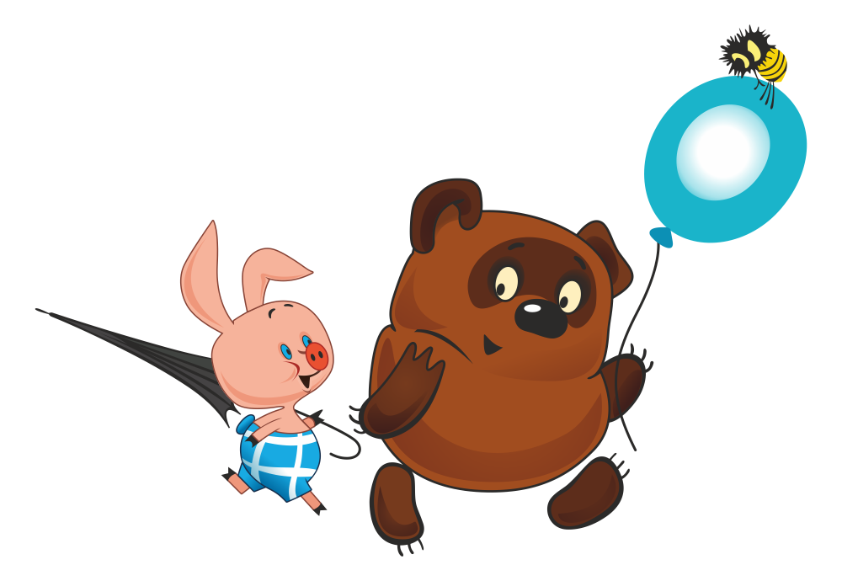
Well done!

Slide 13

It’s time to learn …

Slide 14

Phonics
/e/

Slide 15


Click Alphabet to hear the sound

Slide 16

New words
elephant

Slide 17
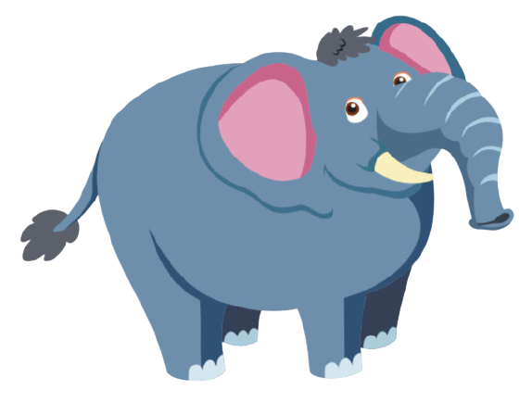

Click on the picture to hear the sound
/ˈelɪfənt/
con voi

Slide 18


Click 2/each part of the word to hear the sound
e
e
elephant

Slide 19
Funtime
Let's draw an elephant

Slide 20
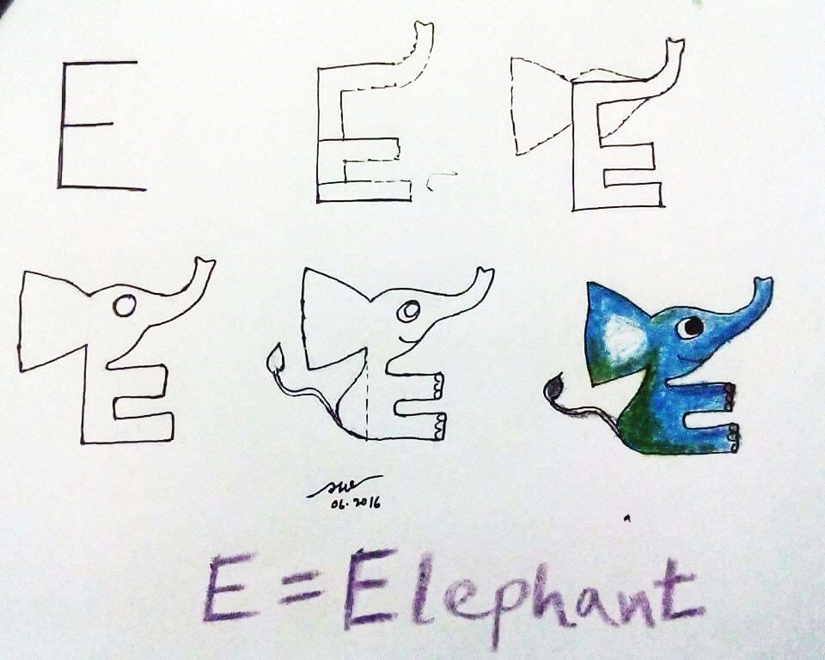

Slide 21

Practice

Slide 22



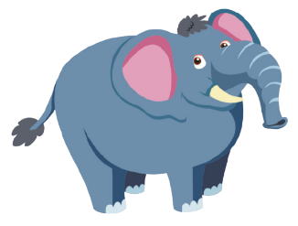

Click 3 to hear the sound
I have an ,
e, e, .
I have an ,
e, e, e.

Slide 23


Click 4/the picture to hear the sound

Slide 24
It’s time to play …

Slide 25
What’s next?
Look and choose the picture that fits the rule.

Slide 26
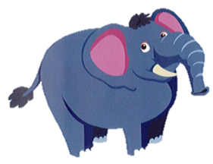
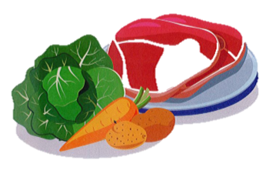

?

Slide 27
?

Slide 28
?

Slide 29
?

Slide 30
?

Slide 31
?

Slide 32

CONSOLIDATION

Slide 33
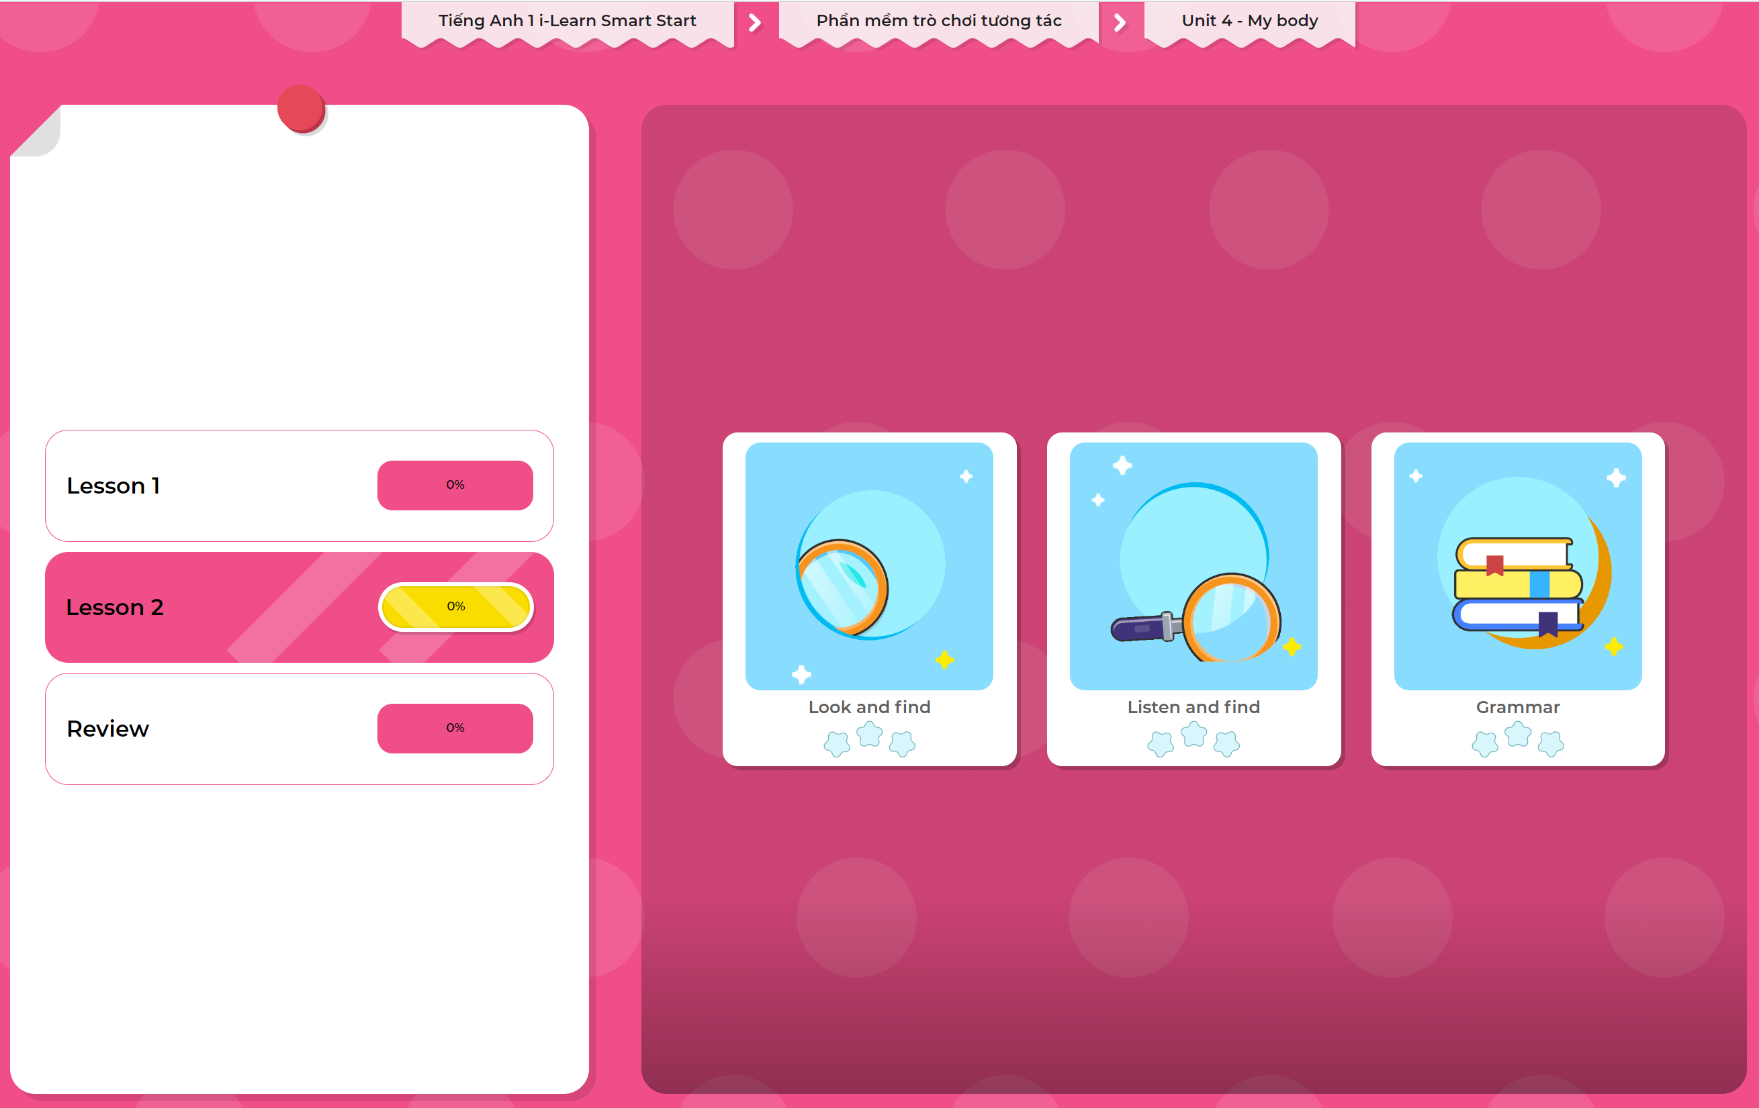
Extra Practice
DHA App
LET’S PLAY!
Click here to play the games

Slide 34

WRAP-UP

Slide 35
Today’s lesson
Structures/ Sentence patterns
I have an elephant.
Vocabulary
elephant

Slide 36
Homework
Practice vocabulary and phonics. Make sentences using them and practice saying them.
Practice the vocabulary and phonics in Tiếng Anh 1 i-Learn Smart Start Notebook (page 22)
Do the exercises in Tiếng Anh 1 i-Learn Smart Start Workbook (page 26)
Play the consolidation games in Tiếng Anh 1 i-Learn Smart Start DHA App on www.eduhome.com.vn
Prepare the next lesson (page 29 SB)

Slide 37

Enjoy your day!

