Slide 1

Unit 4: My body
Lesson 2.2: Vocabulary & Phonics
Page: 29

Slide 2
Lesson Outline
Warm-up
Vocabulary
Structure
Practice
Consolidation
Wrap-up

Slide 3
Objectives
By the end of this lesson, students will be able to gain the following:
Phonics: /f/
Vocabulary:
food
Sentence pattern:
This is my food.
Skills:
Recognize the sound of letter F/f, the sound /f/ and produce them individually.

Slide 4

WARM UP

Slide 5

It’s time to learn …

Slide 6

Phonics
/f/

Slide 7
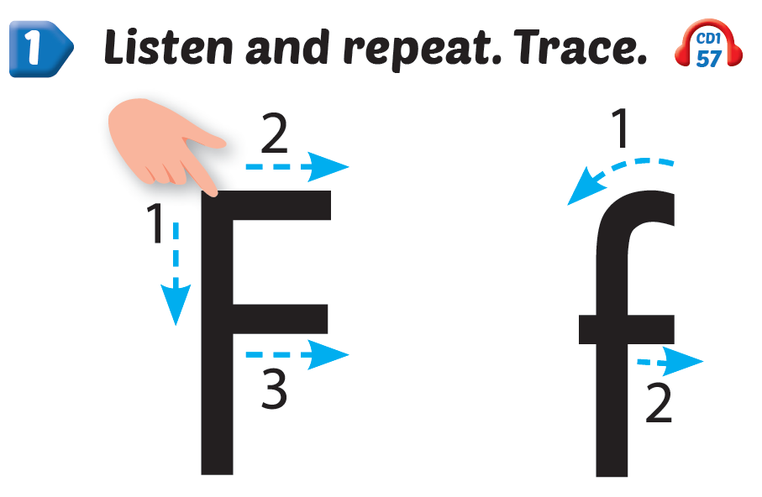
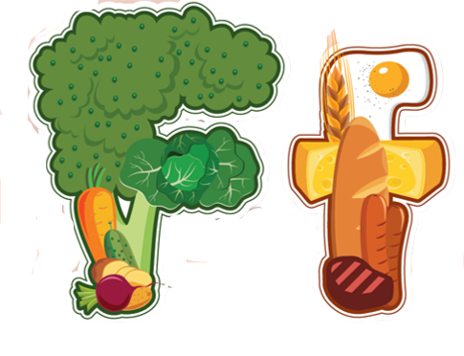
Click Alphabet to hear the sound

Slide 8

New words
food

Slide 9
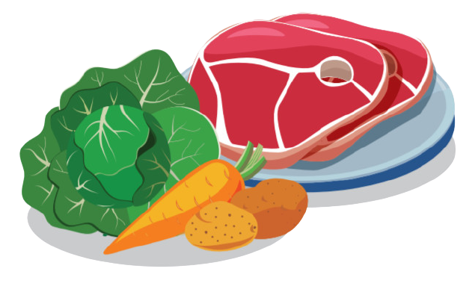

Click on the picture to hear the sound
/fuːd/
thức ăn

Slide 10


Click 2/each part of the word to hear the sound
f
f
food

Slide 11
Funtime
Let's draw a fish

Slide 12
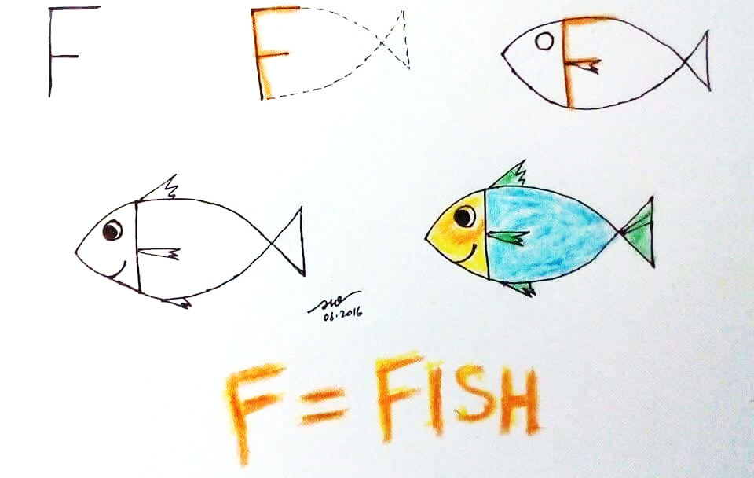

Slide 13

Practice

Slide 14





Click 3 to hear the sound
This is my ,
f, f, .
This is my ,
f, f, f.

Slide 15


Click 4/ the picture to hear the sound

Slide 16
It’s time to play …

Slide 17


D
F
C
C
C
B
E
A
Aa
F
Ff
Bb
A
E
B
D
B
F
Ee
Cc
C
D
A
F
E
Dd
A
E
D
B

Slide 18

Further Practice

Slide 19


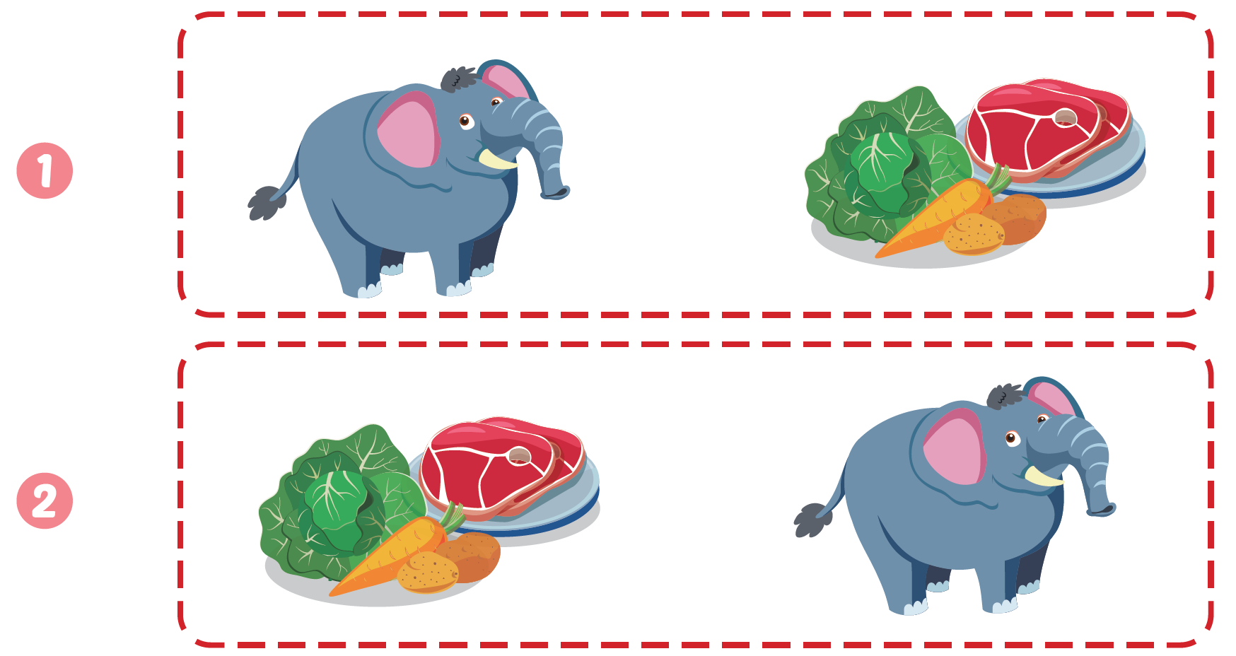
Click C to hear the sound

Slide 20

CONSOLIDATION

Slide 21
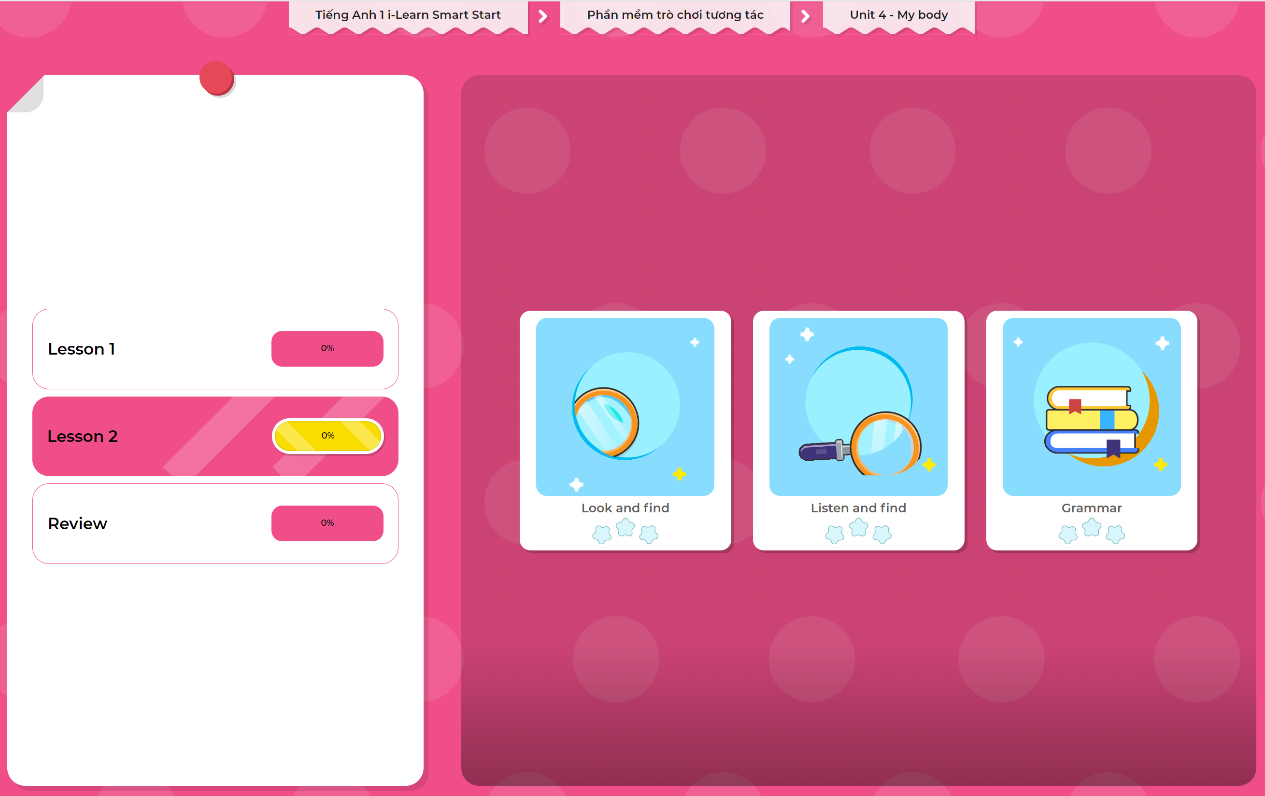
Extra Practice
DHA App
LET’S PLAY!
Click here to play the games

Slide 22

WRAP-UP

Slide 23
Today’s lesson
Structures/ Sentence patterns
This is my food.
Vocabulary
food

Slide 24
Homework
Practice vocabulary and phonics. Make sentences using them.
Practice the vocabulary and phonics in Tiếng Anh 1 i-Learn Smart Start Notebook (page 23)
Do the exercises in Tiếng Anh 1 i-Learn Smart Start Workbook (pages 26-27)
Play the consolidation games in Tiếng Anh 1 i-Learn Smart Start DHA App on www.eduhome.com.vn
Prepare the next lesson (page 30 SB)

Slide 25

Enjoy your day!

