Slide 1

Review 3
Revise
Page: 30

Slide 2
Lesson Outline
Warm-up
Practice
Consolidation
Wrap-up

Slide 3
Objectives
By the end of this lesson, students will be able to gain the following:
Vocabulary:
Revise pink, red, yellow, blue, white
Sentence pattern:
Revise “It’s ...”
Skills:
Revise identifying colors.

Slide 4

WARM UP

Slide 5

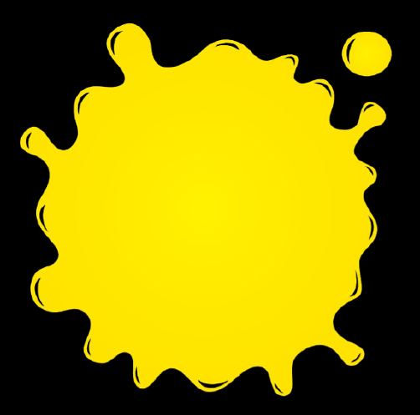



Review 3: Colors
Click on each color to hear the sound.
red
yellow
blue
pink
white

Slide 6

It’s time to learn …

Slide 7

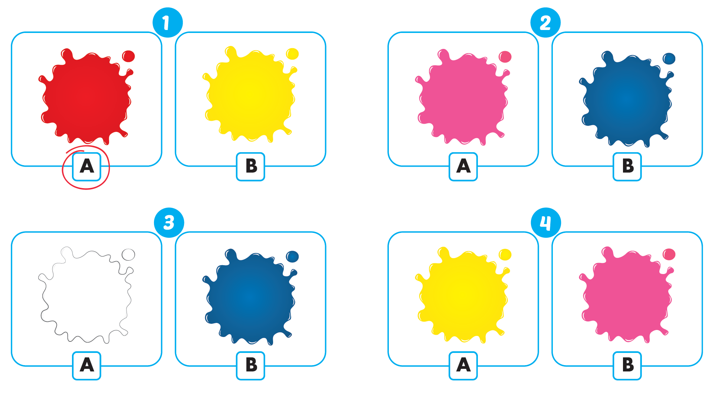

Click A to hear the sound
1
2
3
4

Slide 8

Practice

Slide 9

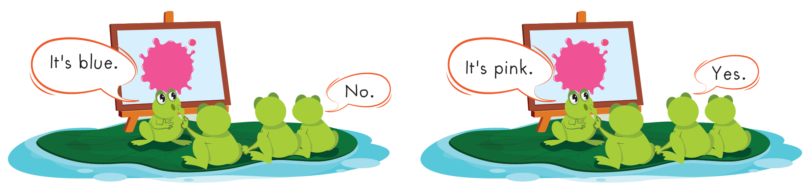

Slide 10
It’s time to speak …

Slide 11
Click on each color to hear the sound.
1
2
3
yellow
blue
red

Slide 12

Structure
It’s red.
Dùng để nói về màu sắc “Nó màu đỏ”

Slide 13




Speaking
It’s ...
Click on each color to hear the sound.

Slide 14
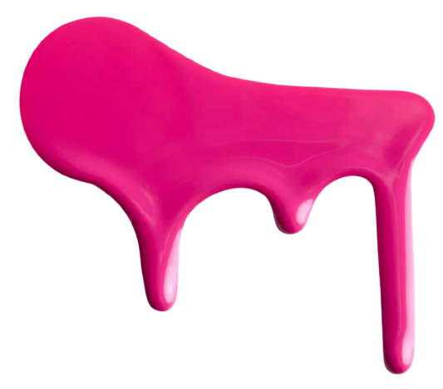
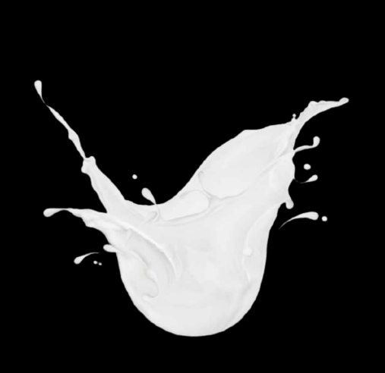

4
5
6
pink
white
flower

Slide 15

Structure
It’s a pink flower.
Dùng để diễn tả “Đó là một bông hoa màu hồng”

Slide 16



Speaking
It’s a ... flower.

Slide 17

Further Practice

Slide 18

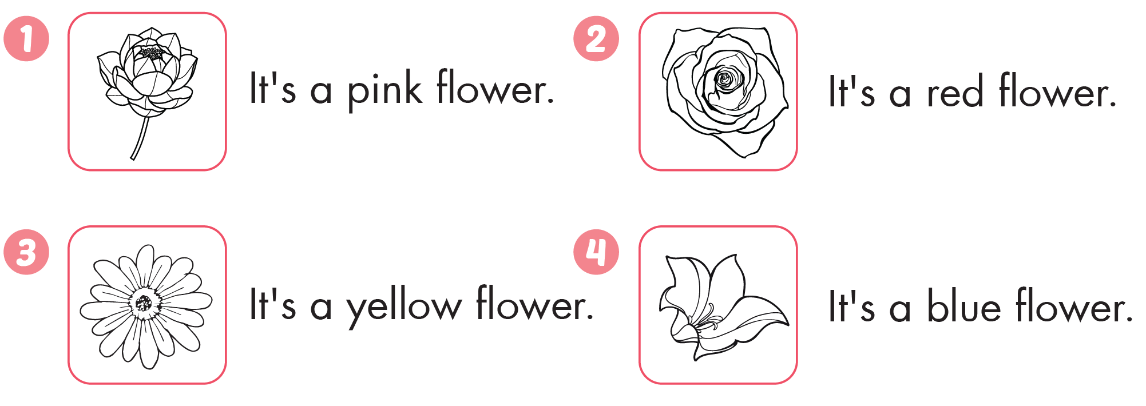





Slide 19

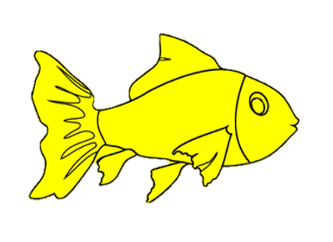
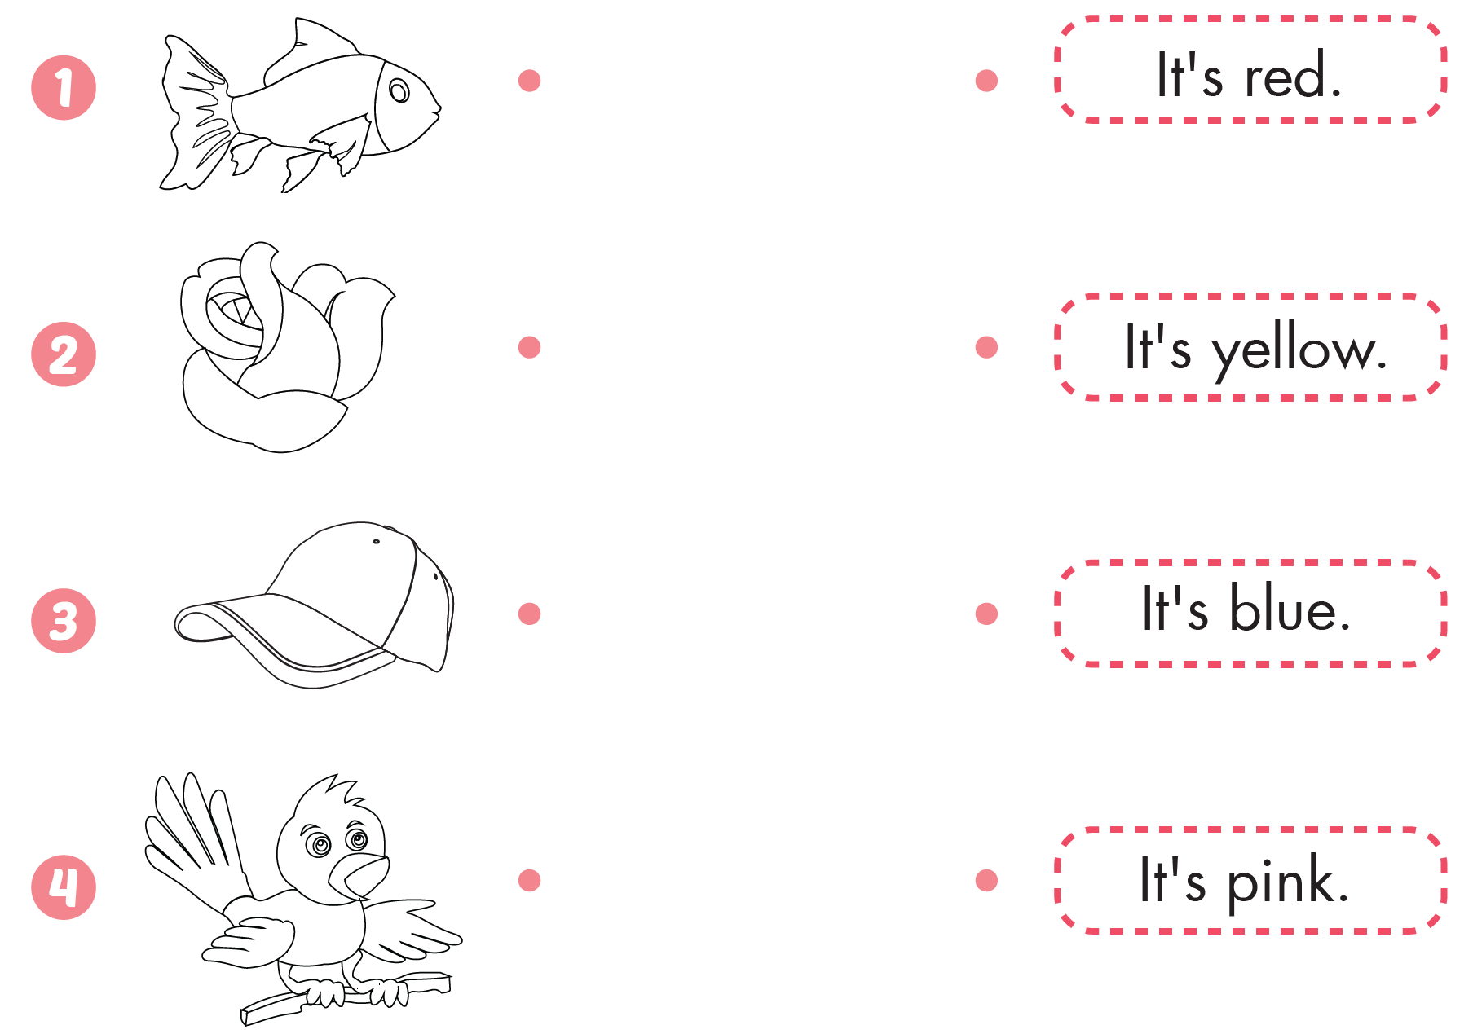

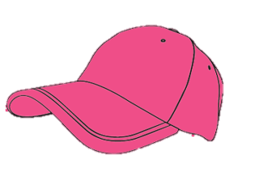

Click B to hear the sound.

Slide 20

CONSOLIDATION

Slide 21
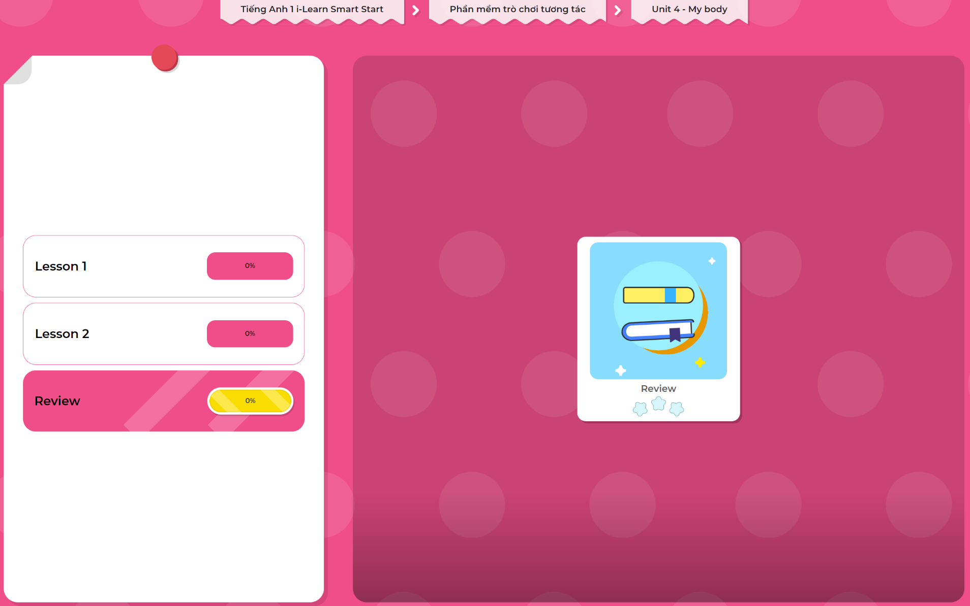
Extra Practice
DHA App
LET’S PLAY!
Click here to play the games

Slide 22

WRAP-UP

Slide 23
Today’s lesson
Structures/ Sentence patterns
Revise “It’s ...”
Vocabulary
Revise pink, red, yellow, blue, white

Slide 24
Homework
Practice vocabularies and structure. Make sentences using them.
Do the exercises in Tiếng Anh 1 i-Learn Smart Start Workbook (page 28)
Play the consolidation games in Tiếng Anh 1 i-Learn Smart Start DHA App on www.eduhome.com.vn
Prepare the next lesson (page 31 SB)

Slide 25

Enjoy your day!

