Slide 1

Review 4
Revise
Page: 31

Slide 2
Lesson Outline
Warm-up
Practice
Consolidation
Wrap-up

Slide 3
Objectives
By the end of this lesson, students will be able to gain the following:
Vocabulary:
Revise head, leg, arm
Sentence pattern:
Revise “Touch your head”
Skills:
Revise body parts.

Slide 4

WARM UP

Slide 5


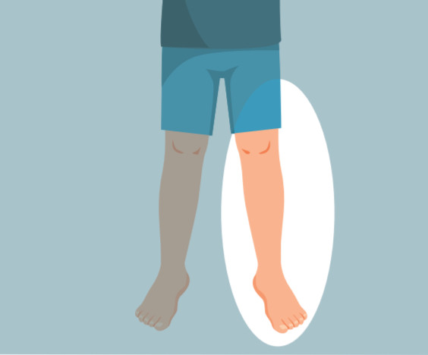
Review 4: My body
Click on each body part to hear the sound.
1
2
3
head
leg
arm

Slide 6

It’s time to learn …

Slide 7

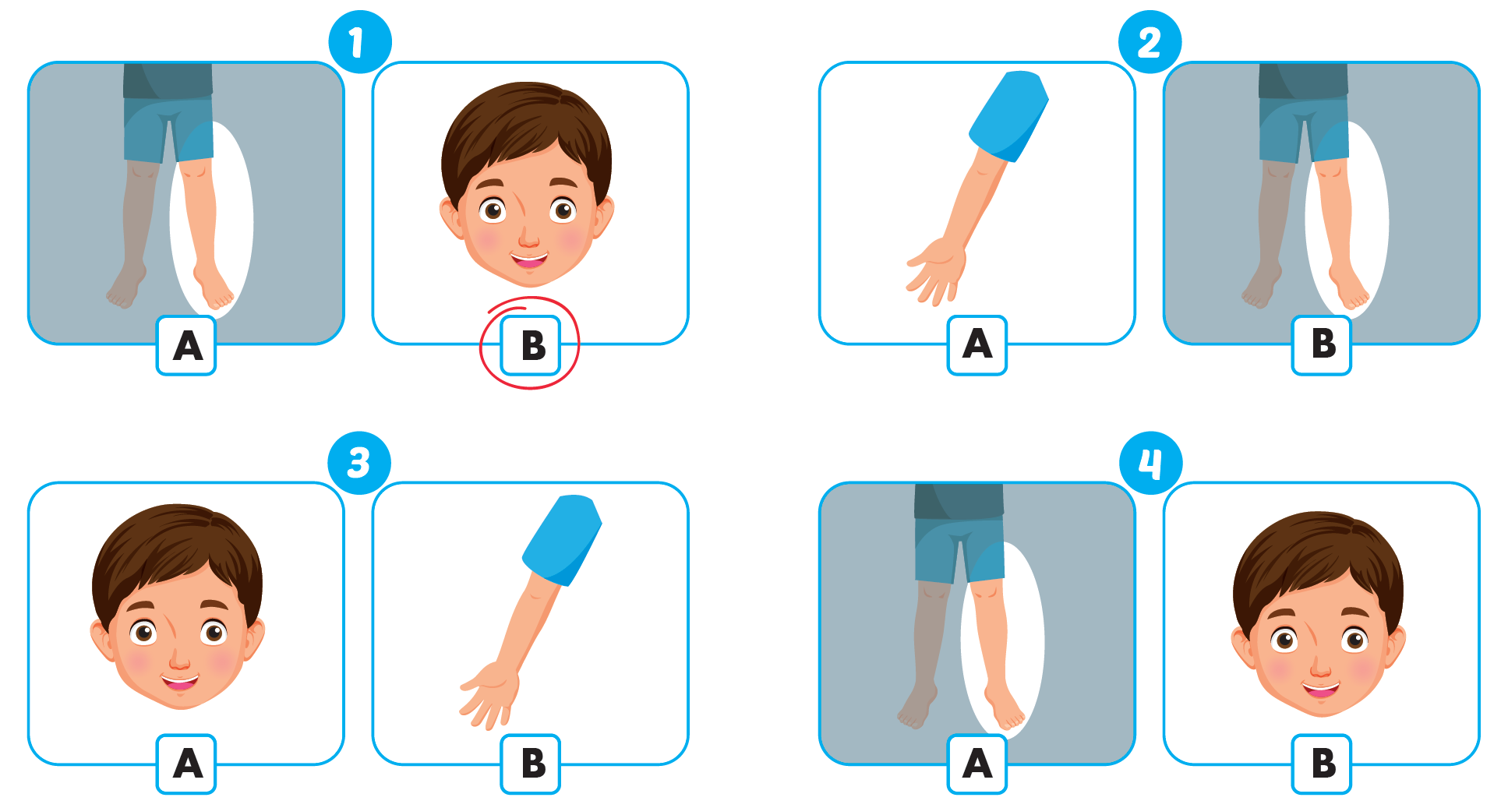

Click A to hear the sound
1
2
3
4

Slide 8

Practice

Slide 9

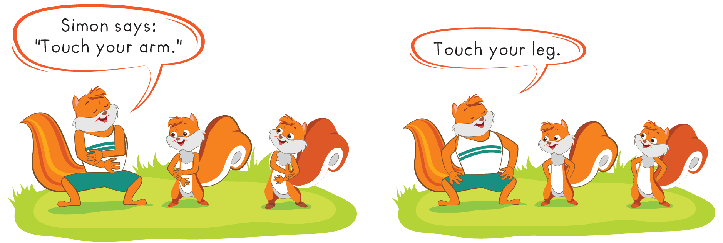

Slide 10
It’s time to speak …

Slide 11
Click on each body part to hear the sound.
1
2
3
head
leg
arm

Slide 12

Structure
Touch your head.
Dùng để đưa ra câu lệnh:
“Hãy chạm tay vào đầu của bạn”

Slide 13



Speaking
Touch your ...

Slide 14

Further Practice

Slide 15
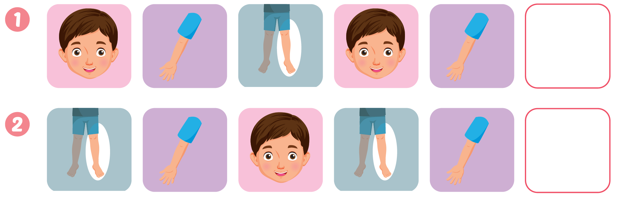



Slide 16

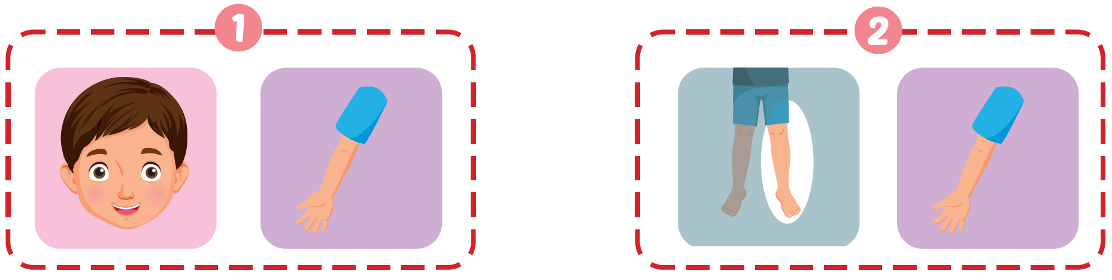

Click D to hear the sound.

Slide 17

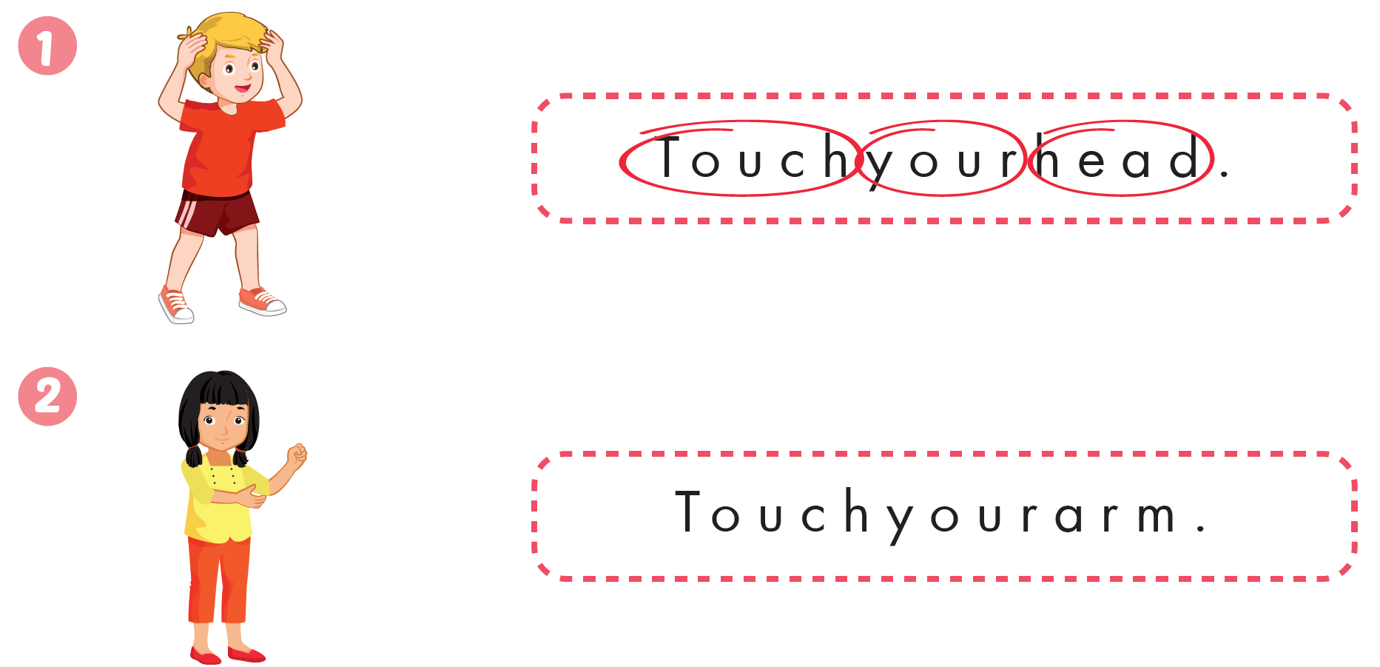


Slide 18

CONSOLIDATION

Slide 19
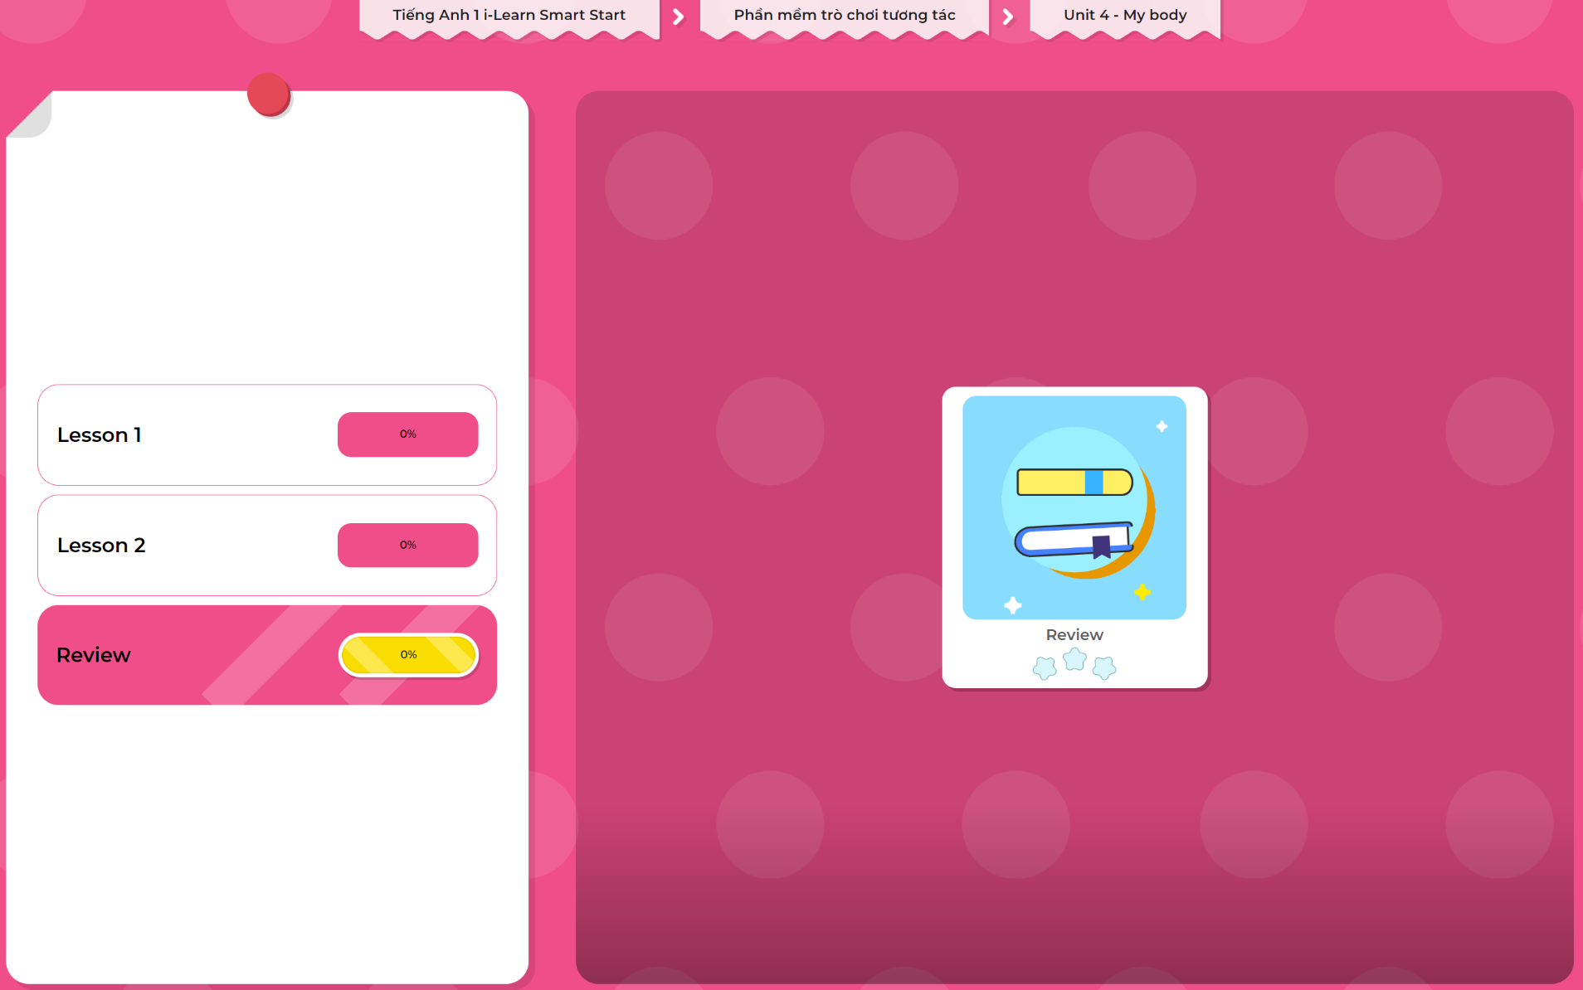
Extra Practice
DHA App
LET’S PLAY!
Click here to play the games

Slide 20

WRAP-UP

Slide 21
Today’s lesson
Structures/ Sentence patterns
Touch your head.
Vocabulary
Revise head, leg, arm

Slide 22
Homework
Review vocabularies and structure. Make sentences using them.
Do the exercises in Tiếng Anh 1 i-Learn Smart Start Workbook (page 29)
Play the consolidation games in Tiếng Anh 1 i-Learn Smart Start DHA App on www.eduhome.com.vn
Prepare the next lesson (page 32 SB)

Slide 23

Enjoy your day!

