Slide 1


Unit 5: Animals
Lesson 1.1
Page 32

Slide 2
Lesson Outline
Warm-up
Vocabulary
Structure
Consolidation
Wrap-up

Slide 3
Objectives
By the end of this lesson, students will be able to identify animals and say what animals they like.
Vocabulary: cat, dog, bird
Structure: I like (cats).

Slide 4

WARM-UP

Slide 5
Let’s play!
Simon says Game

Slide 6

It’s time to learn …

Slide 7

New words
Dog,
Cat,
Bird.

Slide 8

Presentation

Slide 9

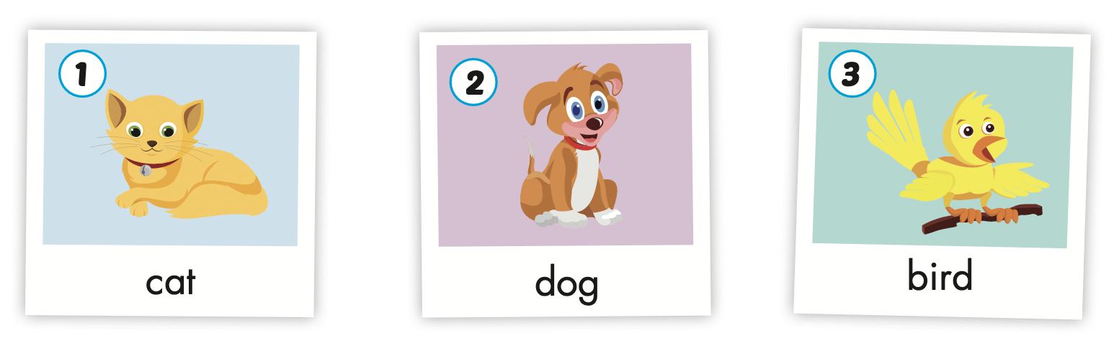

Slide 10
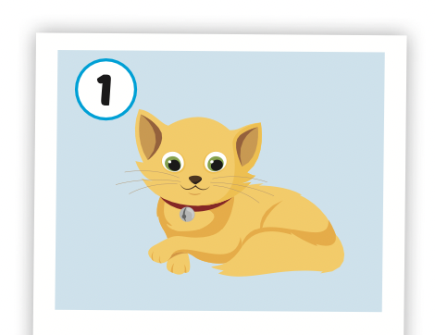
Click on the picture to hear the sound
cat
/kæt/
con mèo

Slide 11
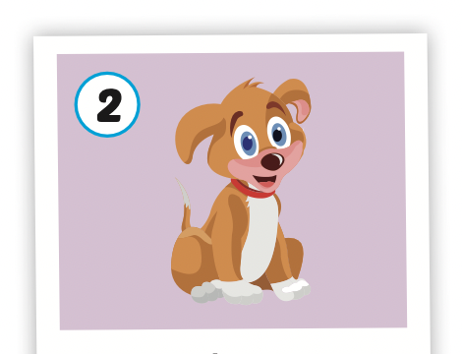
Click on the picture to hear the sound
dog
/dɔːɡ/
con chó

Slide 12
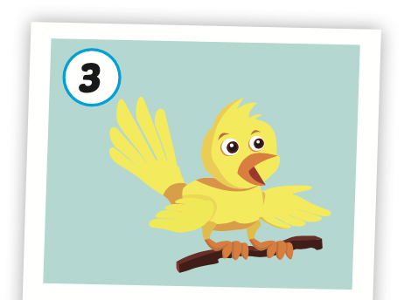
Click on the picture to hear the sound
bird
/bɝːrd/
con chim

Slide 13
Structures
I like (cats).

Slide 14

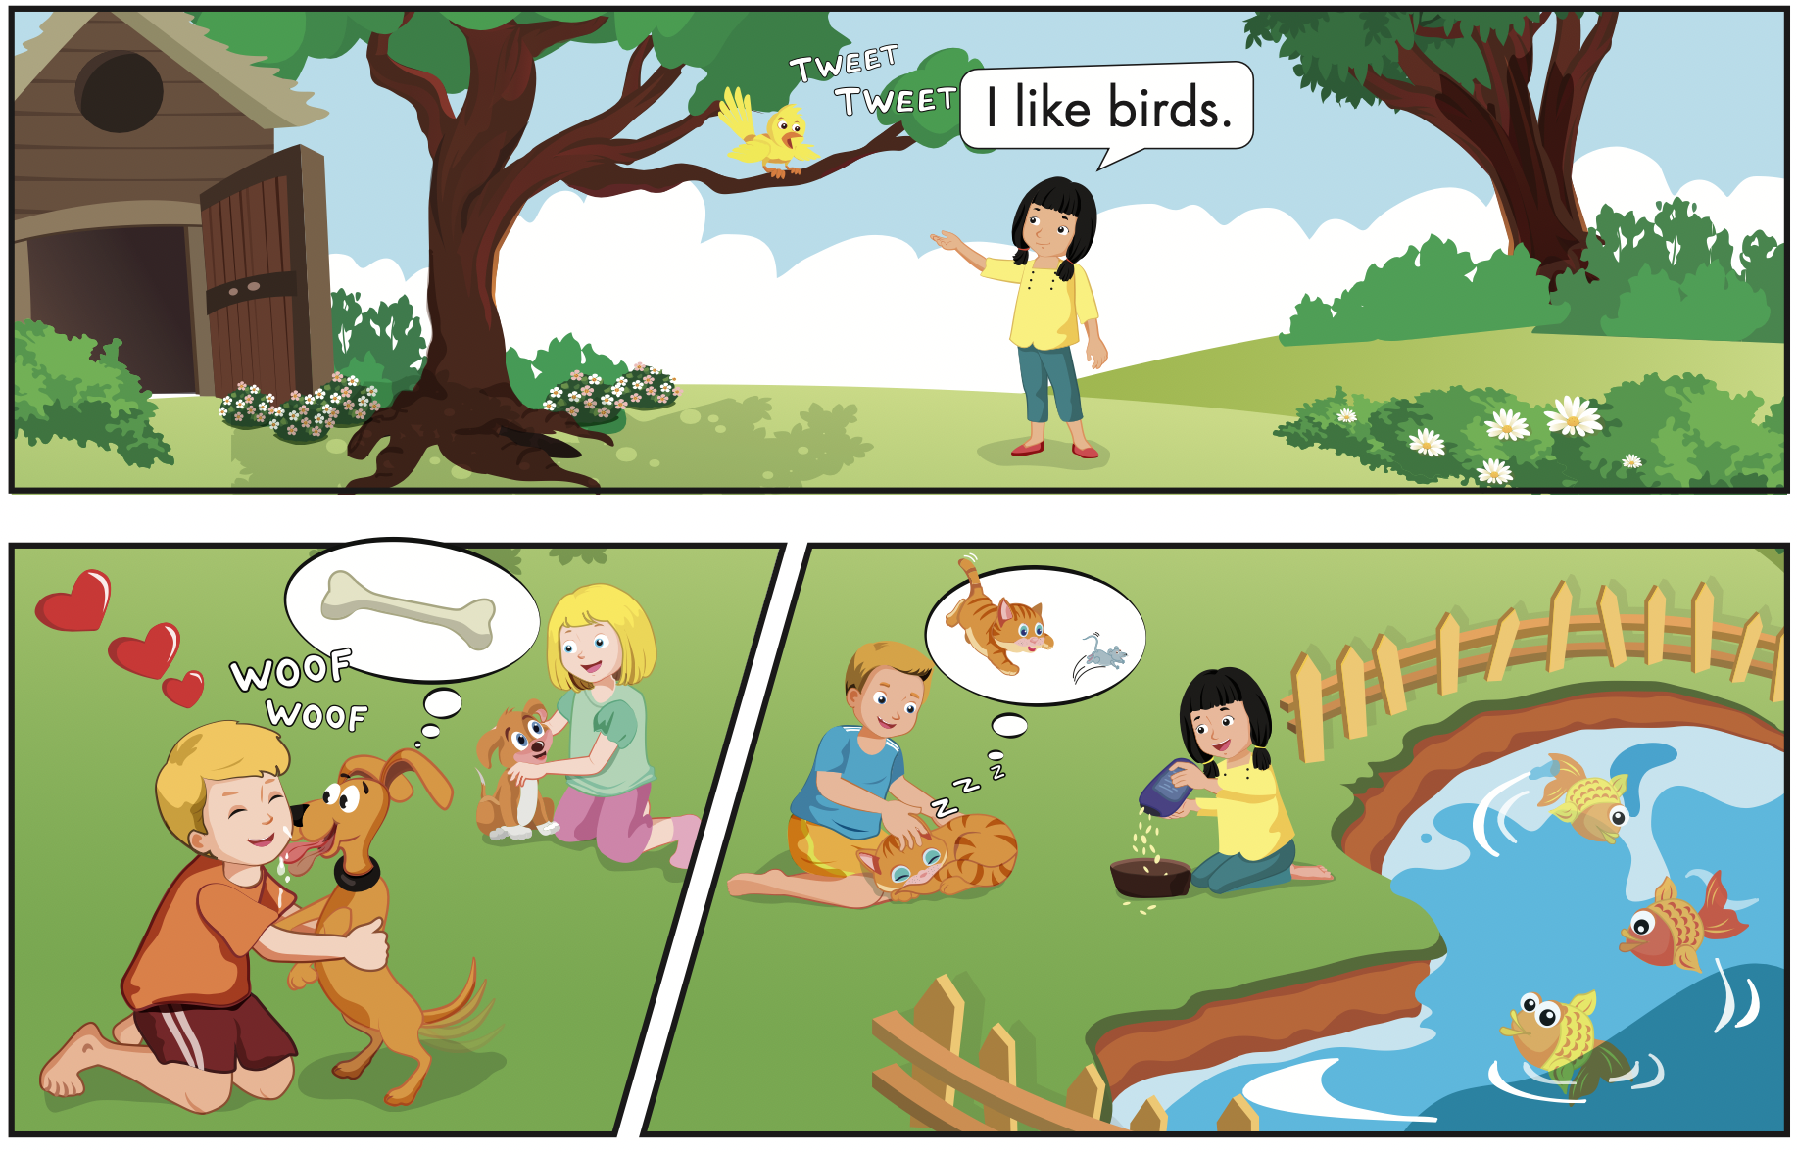
Click B to hear the sound

Slide 15

Speaking

Slide 16
Let’s say!
It’s a cat.
I like cats.

Slide 17
Let’s say!
It’s a dog.
I like dogs.

Slide 18
Let’s say!
It’s a bird.
I like birds.

Slide 19



Slide 21

Production

Slide 22
Let’s play!
Listen, look and say
I like……..

Slide 23




I like dogs.

Slide 24


I like birds.

Slide 25

I like cats.

Slide 26


Slide 27

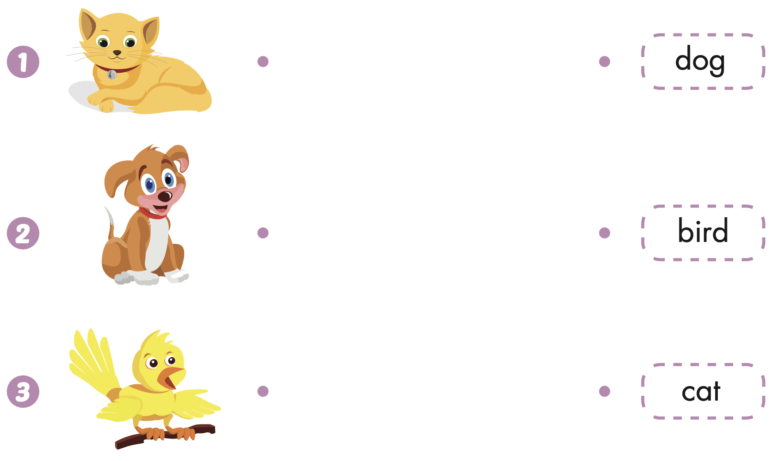
Extra Practice
WB, page 30

Slide 28
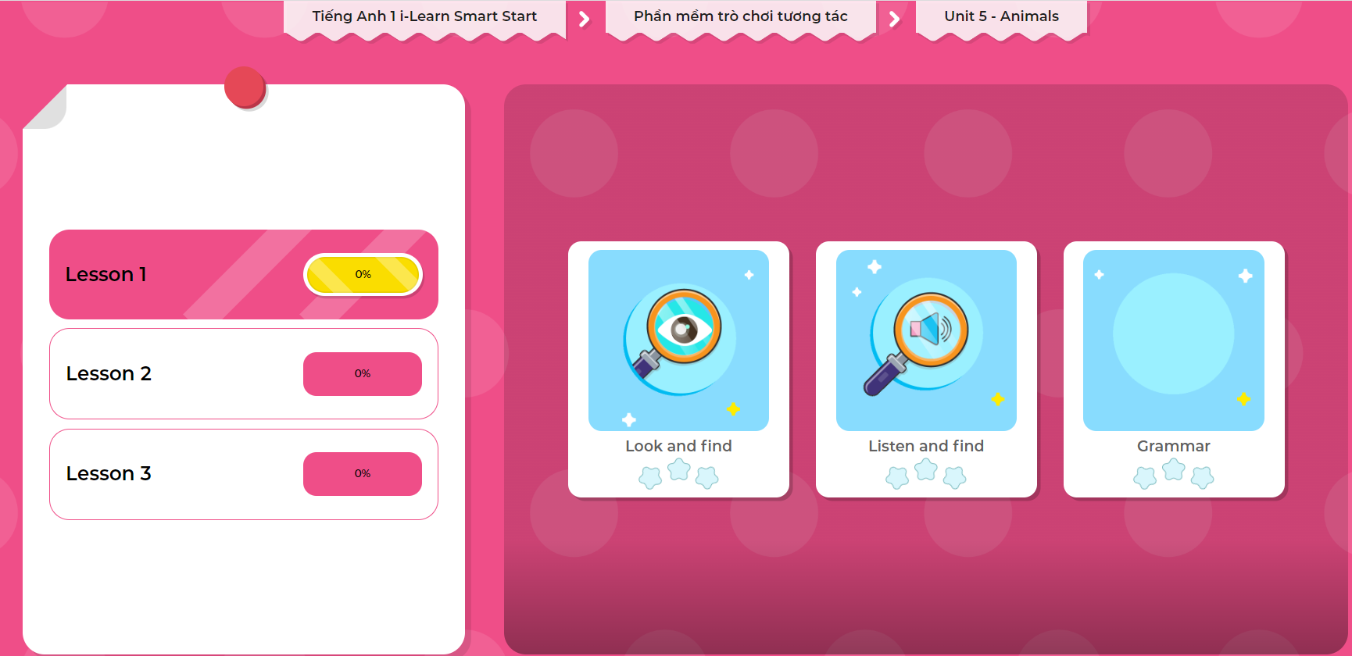
Extra Practice
DHA on Eduhome
LET’S PLAY!
Click on the picture below to play the games.

Slide 29

CONSOLIDATION

Slide 30

Let’s play!
Telephone Game

Slide 31

WRAP-UP

Slide 32
Today’s lesson
Vocabularies
Dog,
Cat,
Bird.
Structures/ Sentence patterns
I like(cats).

Slide 33
Homework
Practice the vocabularies and structure; and make sentences using them.
Do the exercises in Tiếng Anh 1 i-Learn Smart Start WB (page 30).
Do the exercises in Tiếng Anh 1 i-Learn Smart Start Notebook (page 24).
Prepare the next lesson (page 33 SB).
Play the consolidation games in Tiếng Anh 1 i-Learn Smart Start DHA App on www.eduhome.com.vn

Slide 34
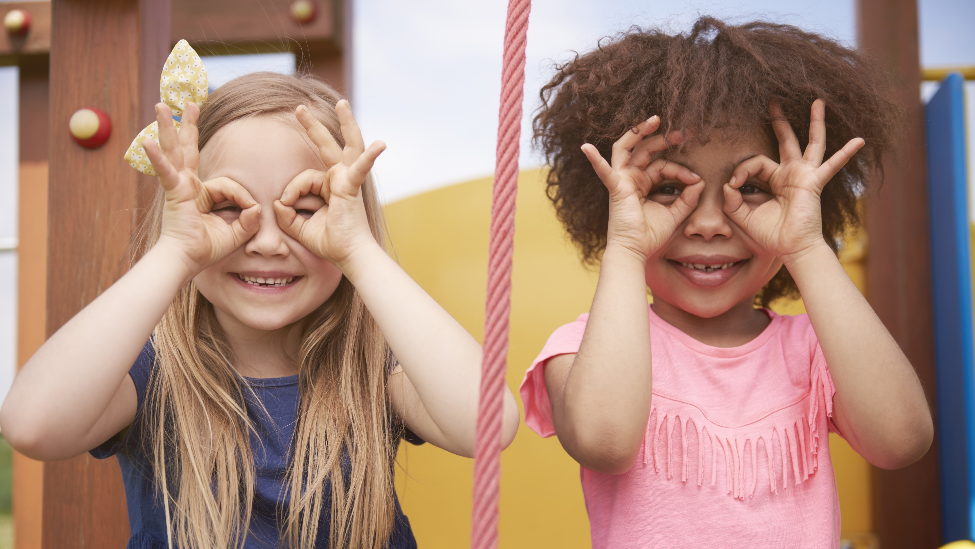
Enjoy your day!

