Slide 1


Unit 5: Animals
Lesson 1.2
Page 33

Slide 2
Objectives
By the end of this lesson, students will be able to identify animals and say what animals they like.
Vocabulary: cat, dog, bird
Structure: I like (cats).

Slide 3
Lesson Outline
Warm-up
Practice
Production
Consolidation
Wrap-up

Slide 4

WARM-UP

Slide 5
Let’s sing!

Slide 6


Slide 7

It’s time to learn …

Slide 8

Review

Slide 9

New words
Dog,
Cat,
Bird.

Slide 10

Let’s play!
Read my lips

Slide 11
Structures
I like (cats).

Slide 12

Speaking

Slide 13
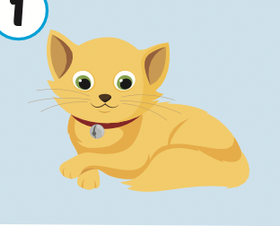
Let’s say!
I like cats.

Slide 14
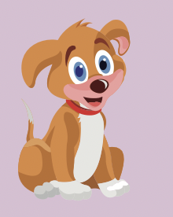
Let’s say!
I like dogs.

Slide 15
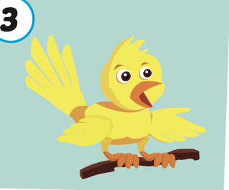
Let’s say!
I like birds.

Slide 16

Practice

Slide 17

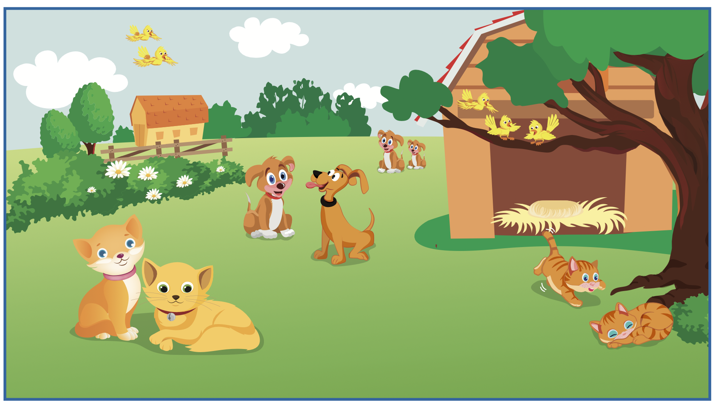


Slide 18
I like dogs.

Slide 19
I like birds.

Slide 20

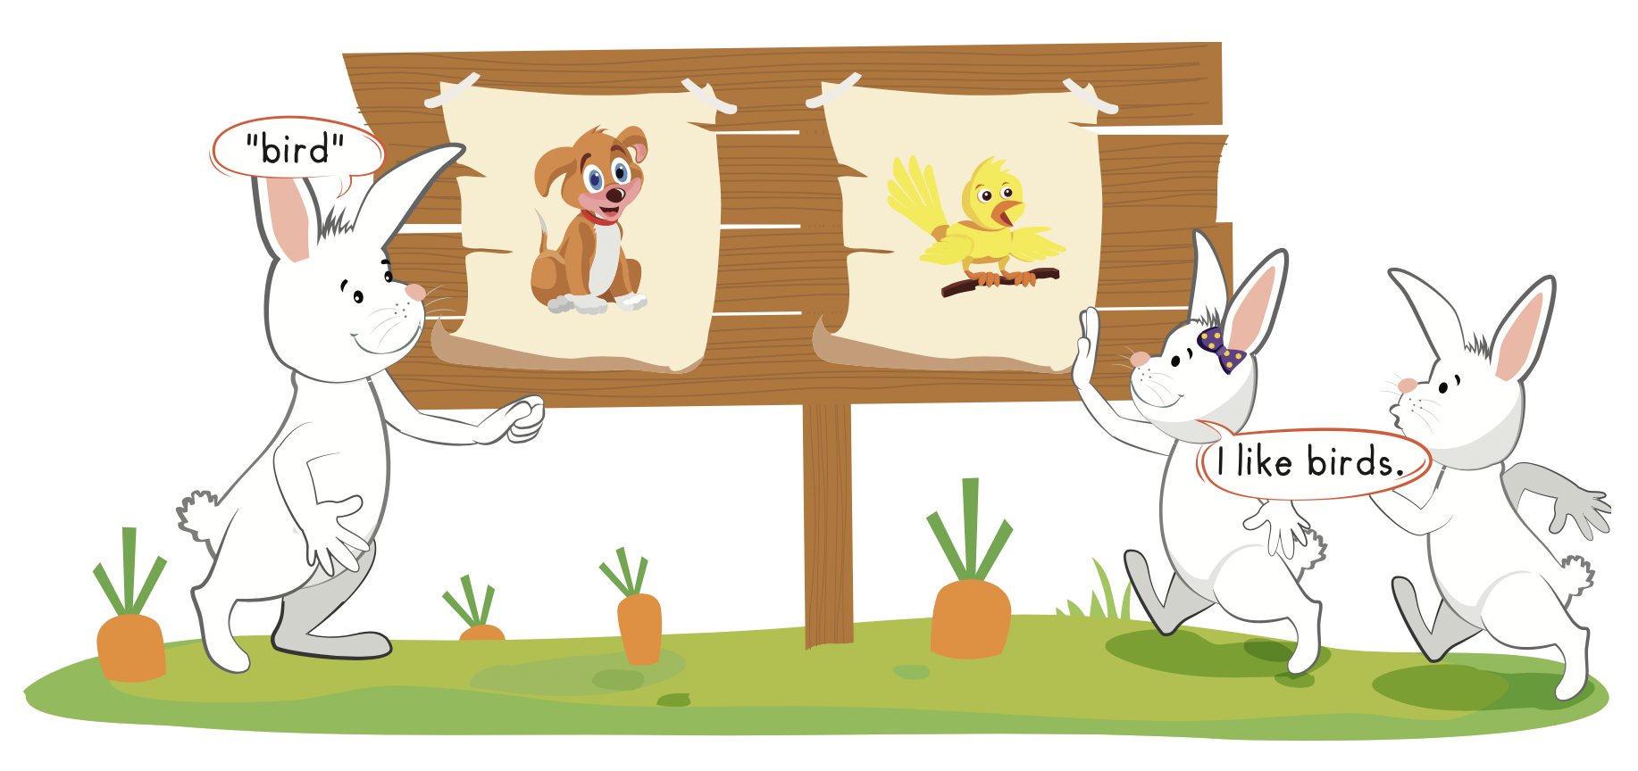

Slide 21

Production

Slide 22
Let’s play!
Look and guess

Slide 23
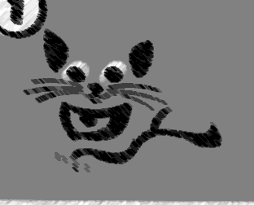

I like cats.

Slide 24
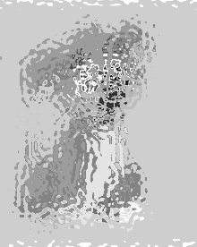
I like dogs.

Slide 25
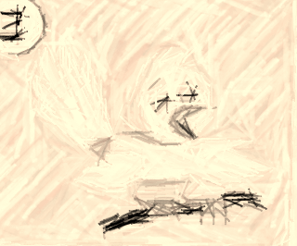
I like birds.

Slide 26
Good job!

Slide 27

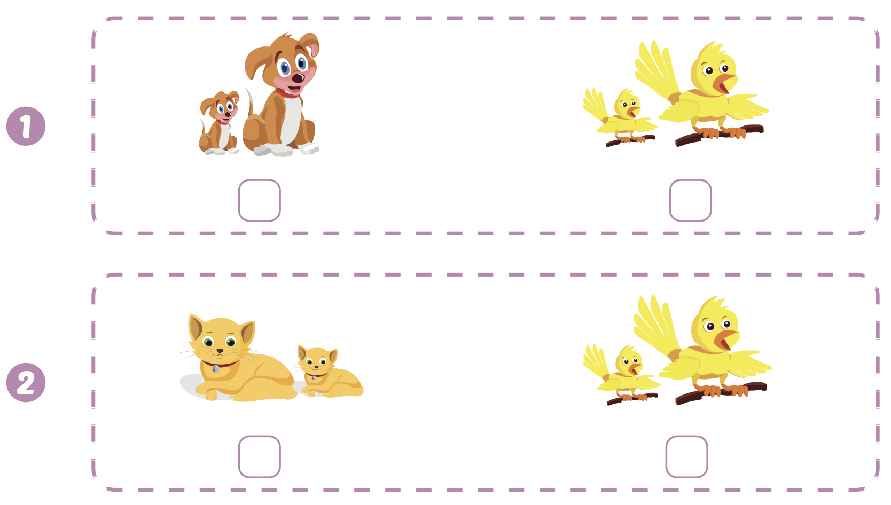

Extra Practice
WB, page 31

Slide 28
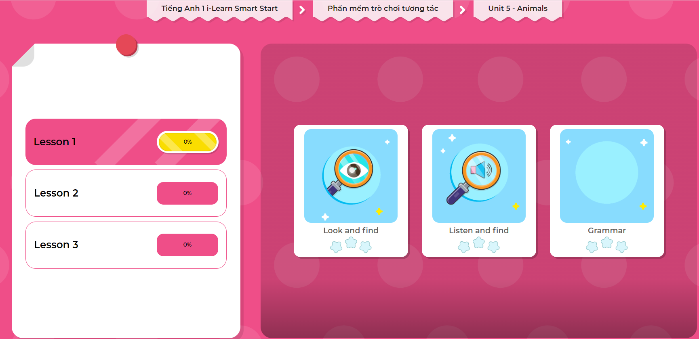
Extra Practice
DHA on Eduhome
LET’S PLAY!
Click on the picture below to play the games.

Slide 29

CONSOLIDATION

Slide 30
Let’s draw!
……………………………..

Slide 31

WRAP-UP

Slide 32
Today’s lesson
Vocabularies
Dog,
Cat,
Bird.
Structures/ Sentence patterns
I like(cats).

Slide 33
Homework
Practice the vocabularies and structure; and make sentences using them.
Do the exercises in Tiếng Anh 1 i-Learn Smart Start WB (page 31).
Do the exercises in Tiếng Anh 1 i-Learn Smart Start Notebook (page 25).
Prepare the next lesson (page 34 SB).
Play the consolidation games in Tiếng Anh 1 i-Learn Smart Start DHA App on www.eduhome.com.vn

Slide 34
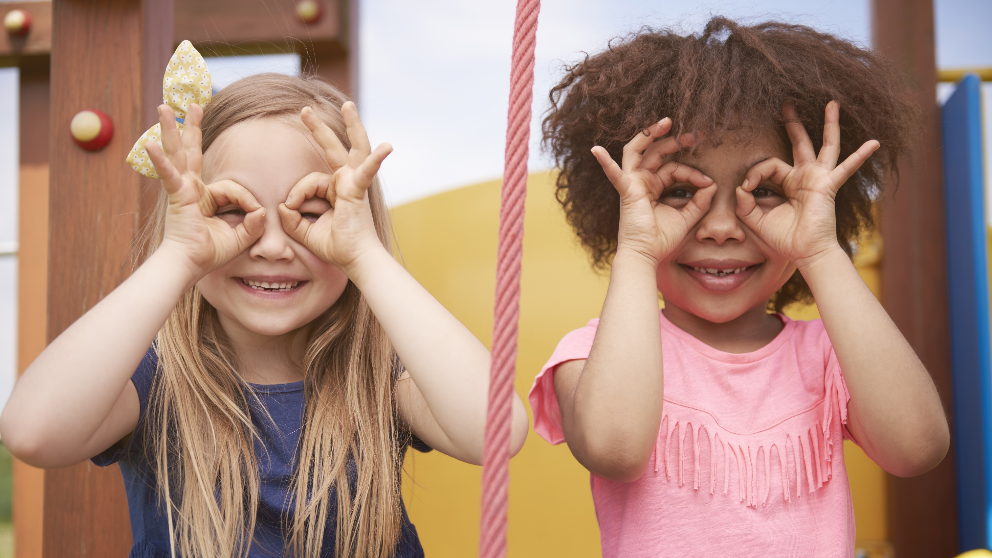
Enjoy your day!

