Slide 1


Unit 5: Animals
Lesson 2.2
Page 35

Slide 2
Objectives
By the end of this lesson, students will be able to recognize the / h / sound and pronounce it correctly.
Vocabulary: hop
Phonic: / h /

Slide 3
Lesson Outline
Warm-up
Listening
Consolidation
Wrap-up

Slide 4

WARM-UP

Slide 5
Let’s sing!

Slide 6


Slide 7

It’s time to learn …

Slide 8

Phonics
/h/

Slide 9

Presentation

Slide 10


H, h
/ h /

Slide 11
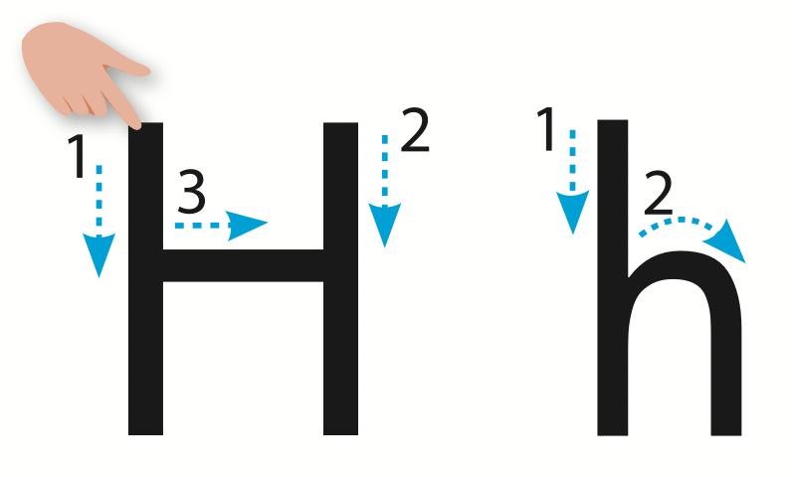
Let’s trace!

Slide 12

Practice

Slide 13

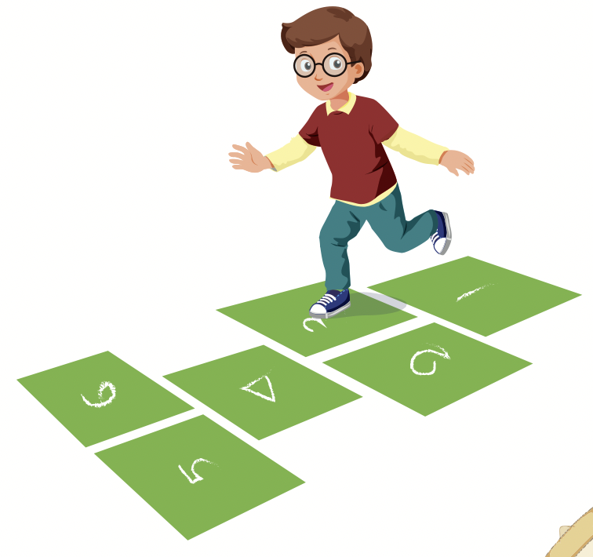


Slide 14
hop
/hɒp/
Nhảy lò cò

Slide 15

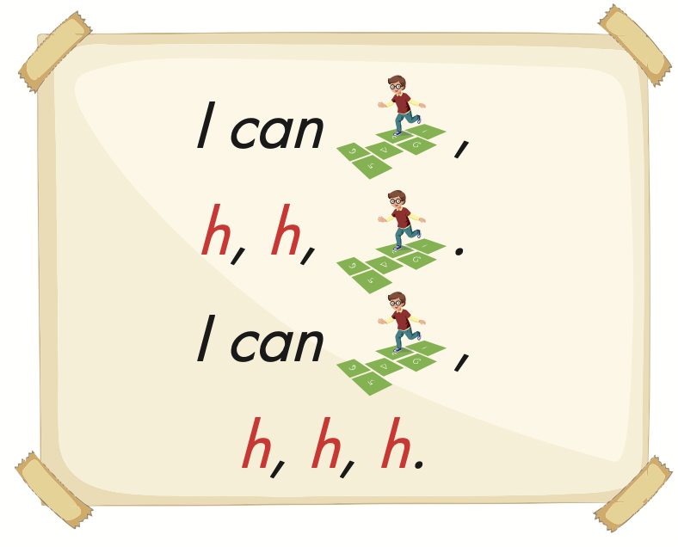

Slide 16



Slide 17

Production

Slide 18
Let’s play!
Match the letters correctly

Slide 19

h
ɡ
f

Slide 20
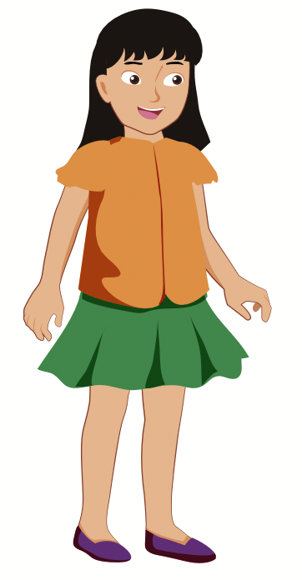
h
f
ɡ

Slide 21

a
b
d

Slide 22

a
c
d

Slide 23

b
f
h

Slide 24


Slide 25

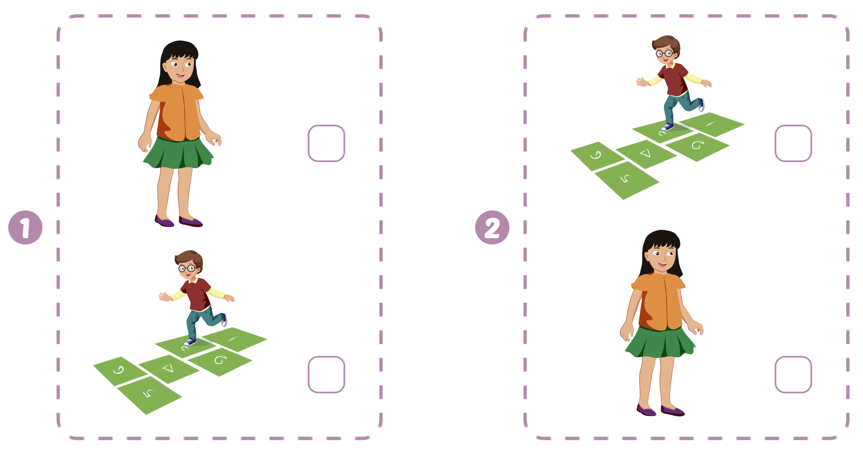

Extra Practice
WB, page 33

Slide 26

CONSOLIDATION

Slide 27

Let’s play!
Magic finger

Slide 28
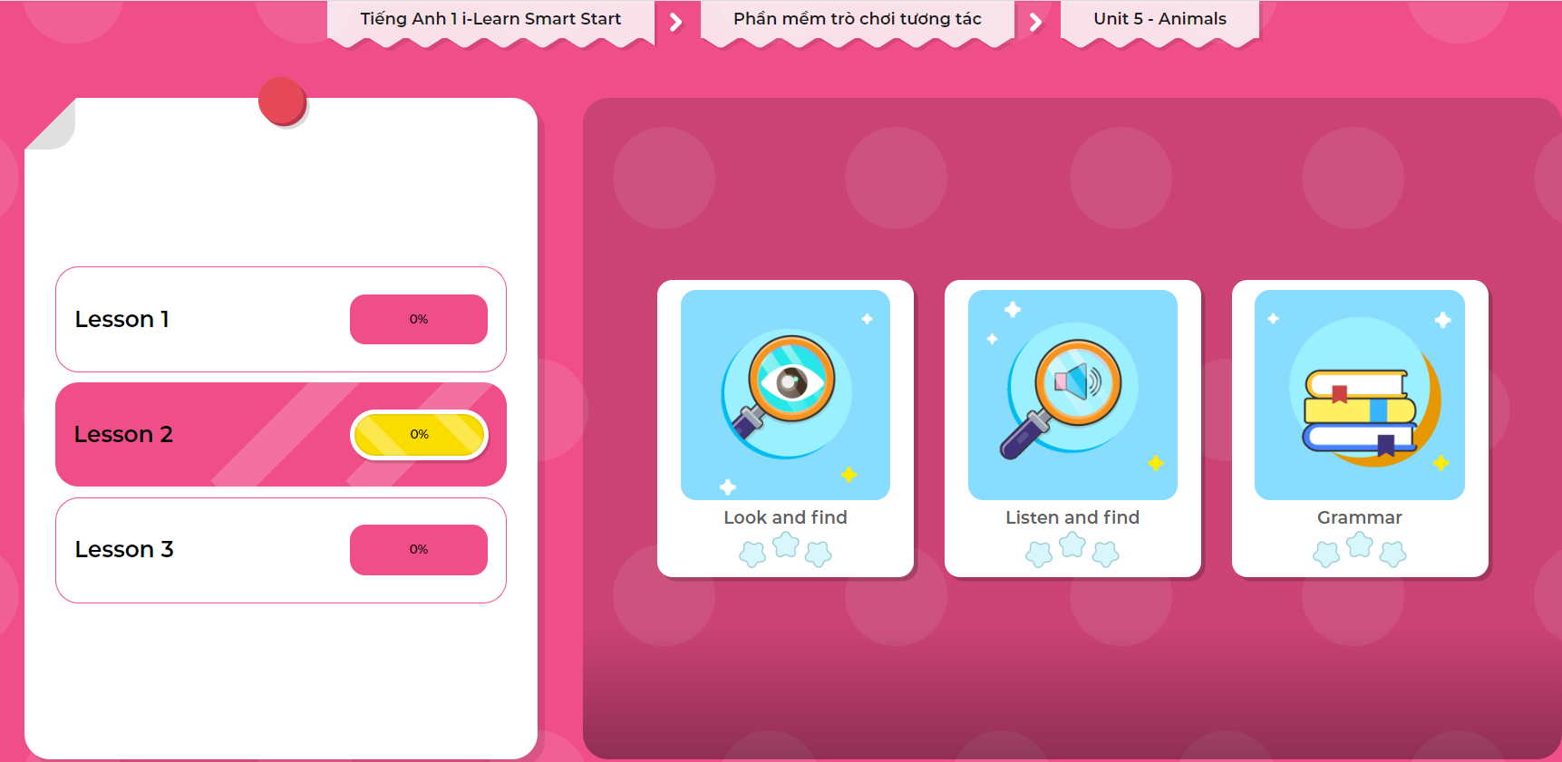
Extra Practice
DHA on Eduhome
LET’S PLAY!
Click on the picture below to play the games.

Slide 29

WRAP-UP

Slide 30
Today’s lesson
Vocabularies
hop
Phonics
/ h /

Slide 31
Homework
Practice saying the phonics.
Do the exercises in Tiếng Anh 1 i-Learn Smart Start WB (page 33).
Do the exercises in Tiếng Anh 1 i-Learn Smart Start Notebook (page 27).
Prepare the next lesson (page 36 SB).
Play the consolidation games in Tiếng Anh 1 i-Learn Smart Start DHA App on www.eduhome.com.vn

Slide 32

Enjoy your day!

