Slide 1


Unit 5: Animals
Lesson 3.1
Page 36

Slide 2
Objectives
By the end of this lesson, students will be able to identify animals.
Vocabulary: monkey, snake, bear
Structure: This is a (monkey).

Slide 3
Lesson Outline
Warm-up
Vocabulary
Structure
Consolidation
Wrap-up

Slide 4

WARM-UP

Slide 5

It’s time to learn …

Slide 6
Let’s sing!

Slide 7


Slide 8

New words
Monkey,
Snake,
Bear.

Slide 9

Presentation

Slide 10

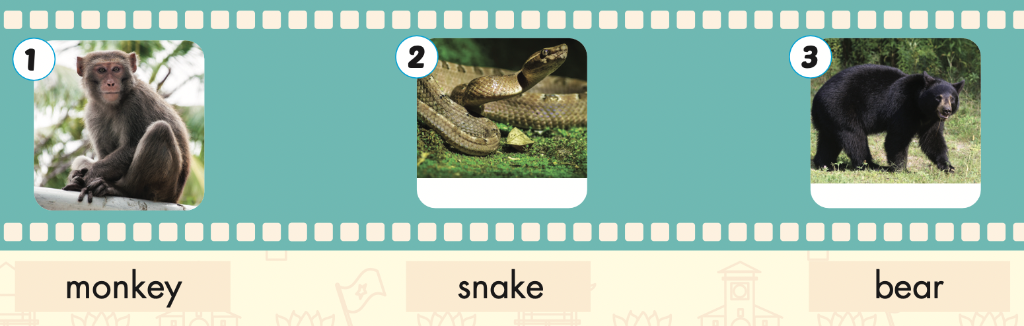

Slide 11

Practice

Slide 12

Listening

Slide 13
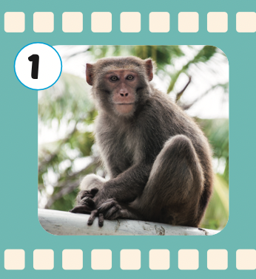
monkey
/ˈmʌŋki/
con khỉ

Slide 14
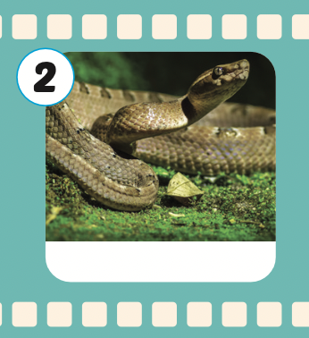
snake
/sneɪk/
con rắn

Slide 15
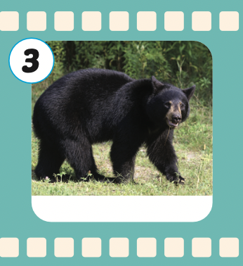
bear
/beə(r)/
con gấu

Slide 16
Structures
This is a (monkey).

Slide 17

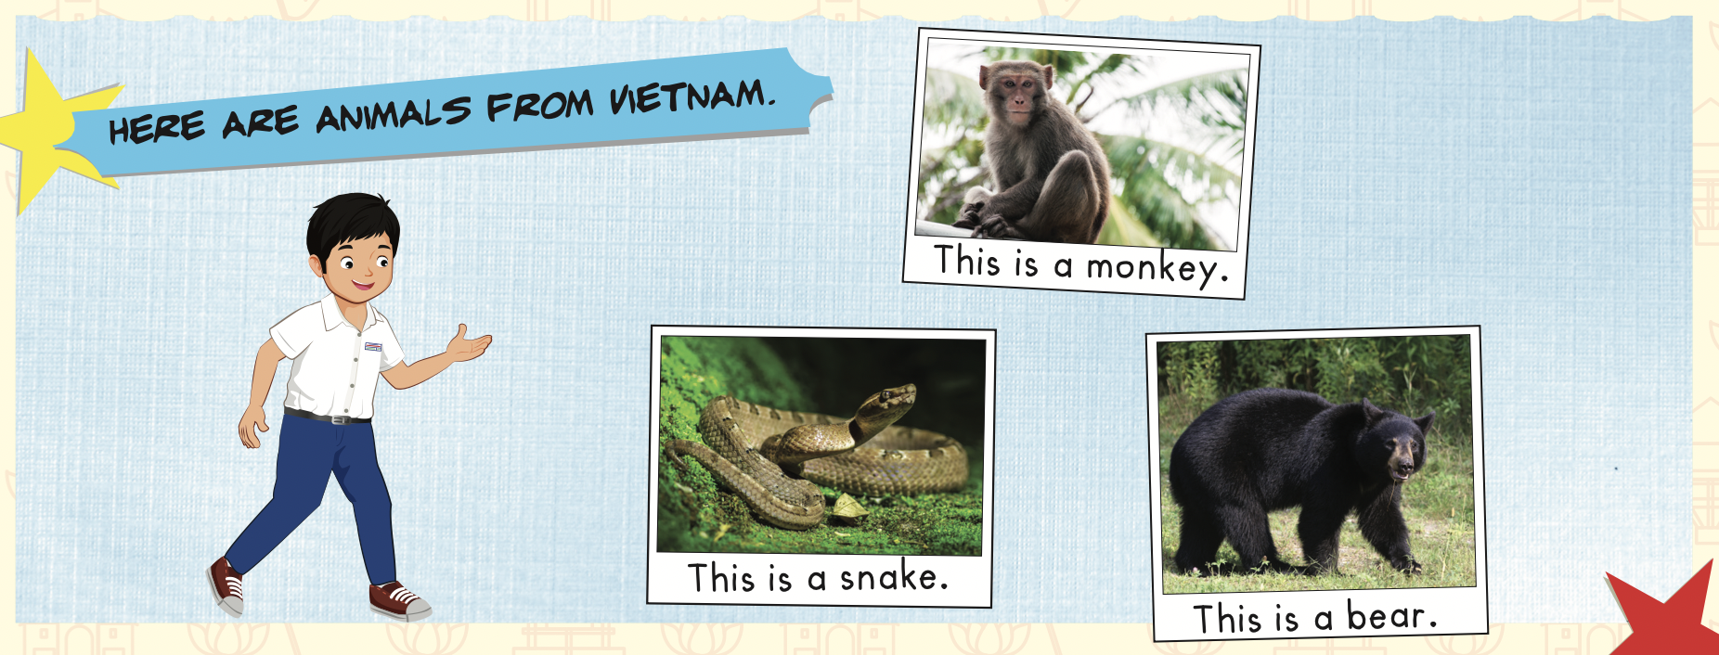

Slide 18

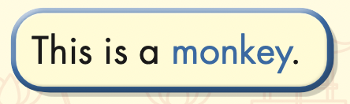

Slide 19

Speaking

Slide 20
Let’s say!
This is a monkey.

Slide 21
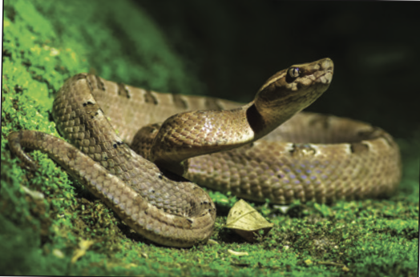
Let’s say!
This is a snake.

Slide 22
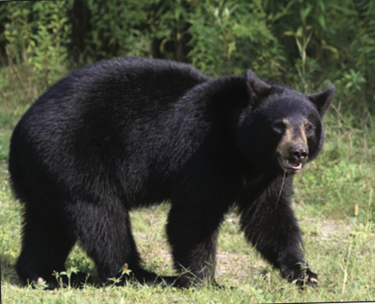
Let’s say!
This is a bear.

Slide 23

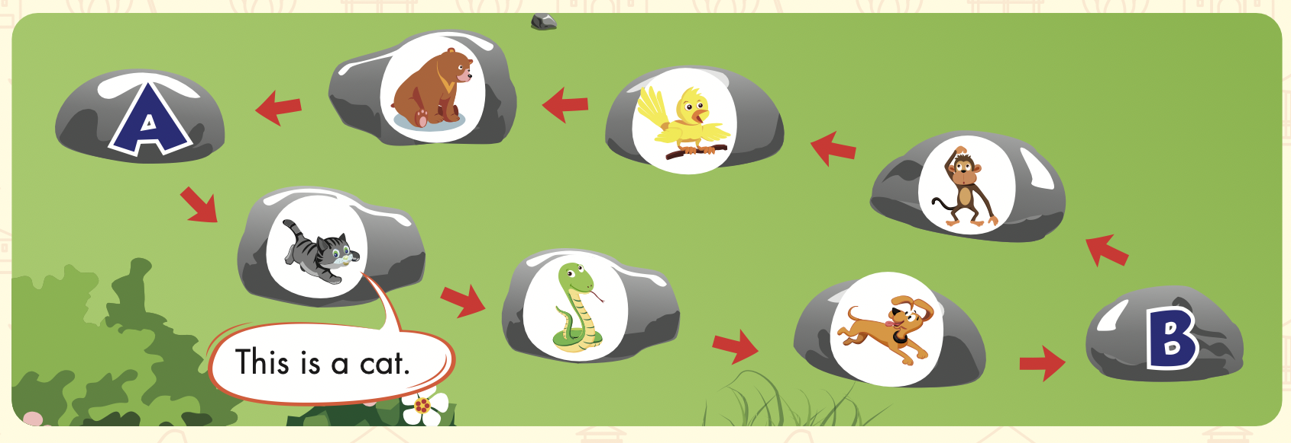

Slide 24

Production

Slide 25
Let’s play!
Listen, look and say

Slide 26


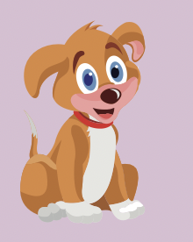

What’s this?
This is a dog.

Slide 27
What’s this?
This is a snake.

Slide 28
What’s this?
This is a bear.

Slide 29
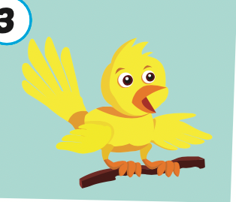
What’s this?
This is a bird.

Slide 30
What’s this?
This is a monkey.

Slide 31
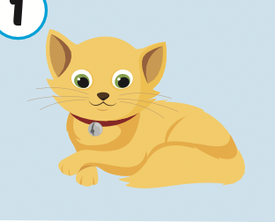
What’s this?
This is a cat.

Slide 32


Slide 33

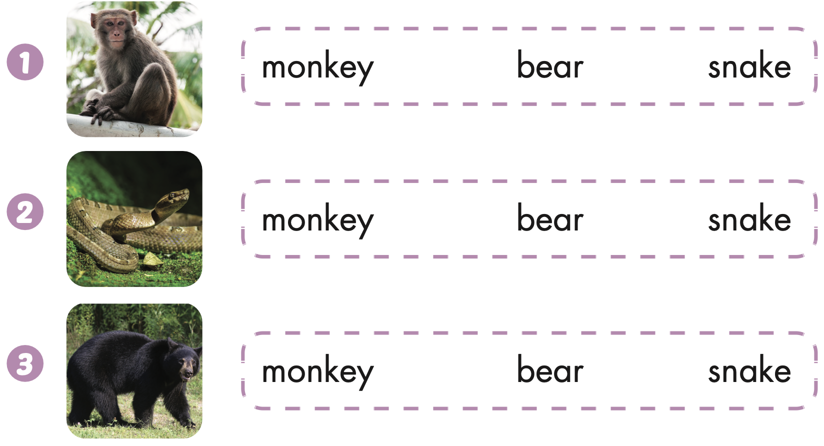
Extra Practice
WB, page 34

Slide 34
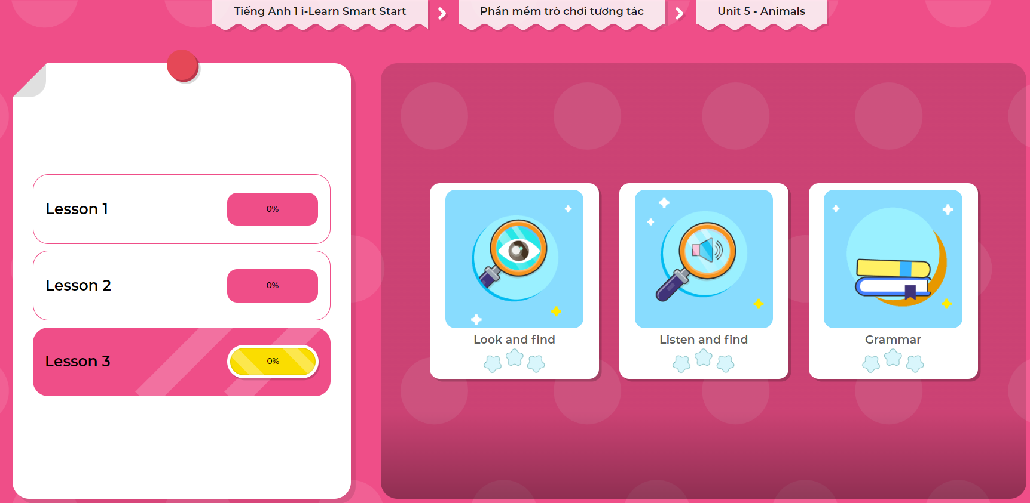
Extra Practice
DHA on Eduhome
LET’S PLAY!
Click on the picture below to play the games.

Slide 35

CONSOLIDATION

Slide 36

Let’s play!
What’s missing?

Slide 37

WRAP-UP

Slide 38
Today’s lesson
Vocabularies
Monkey,
Snake,
Bear.
Structures/ Sentence patterns
This is a (monkey).

Slide 39
Homework
Practice the vocabularies and structure; and make sentences using them.
Do the exercises in Tiếng Anh 1 i-Learn Smart Start WB (page 34).
Do the exercises in Tiếng Anh 1 i-Learn Smart Start Notebook (page 28).
Prepare the next lesson (page 37 SB) Play the consolidation games in Tiếng Anh 1 i-Learn Smart Start DHA App on www.eduhome.com.vn

Slide 40
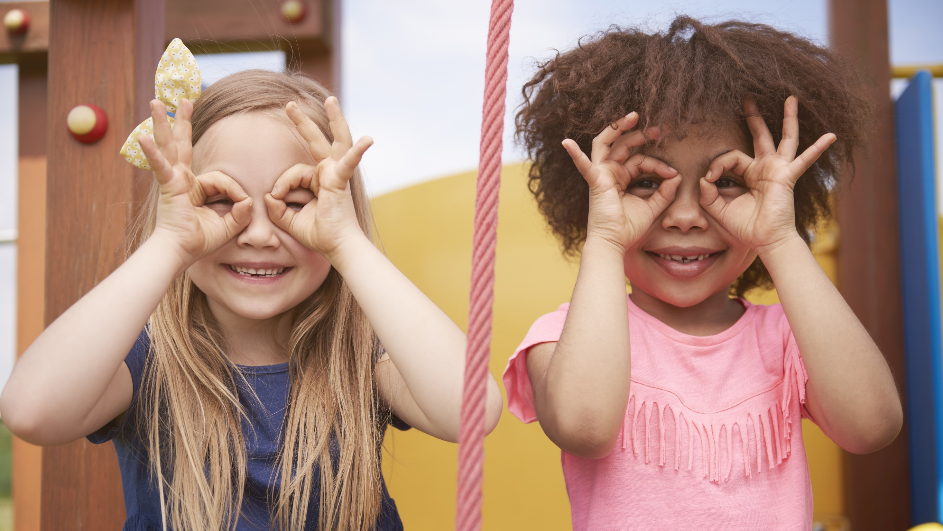
Enjoy your day!

