Slide 1






















Slide 2






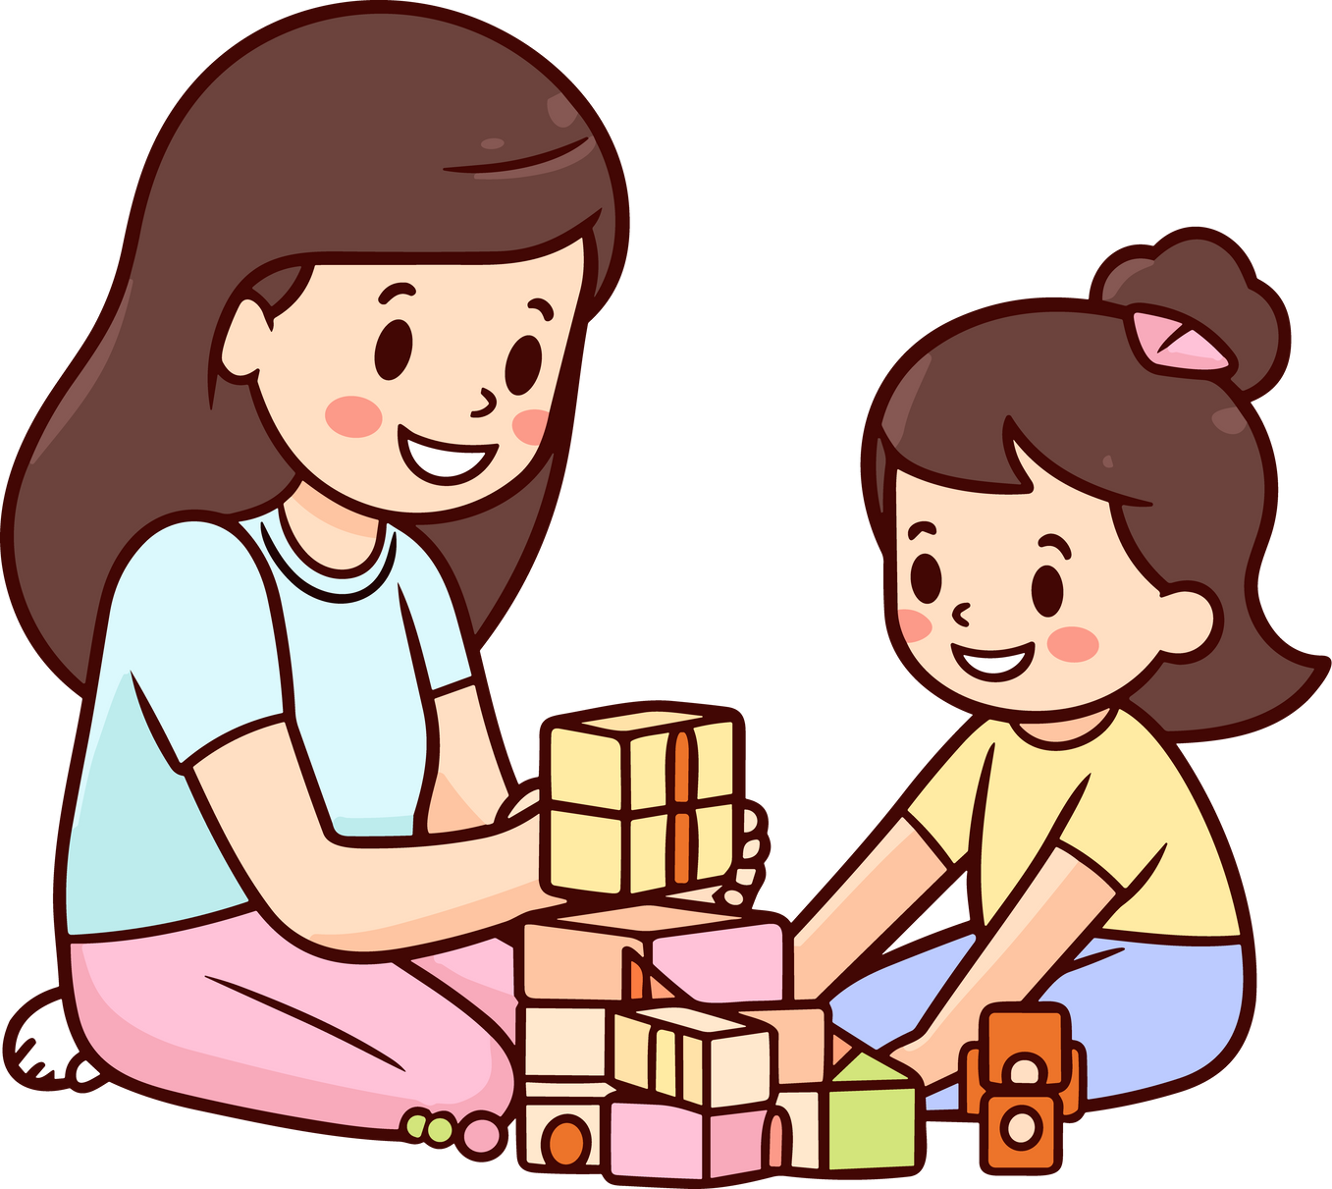

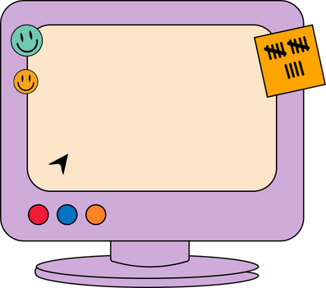


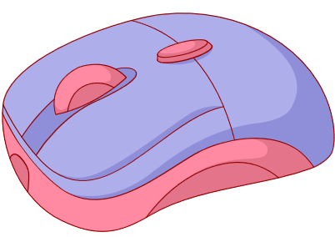




Unit 2
My Favourite Things
Lesson 2 Part 4-5-6

Slide 3













1
Warm Up
2
Presentation
3
Practice
Tables
of content
4
Production
5
Wrap-up &
Assessment

Slide 4

Warm Up
1
Pass the bomb!

Slide 5



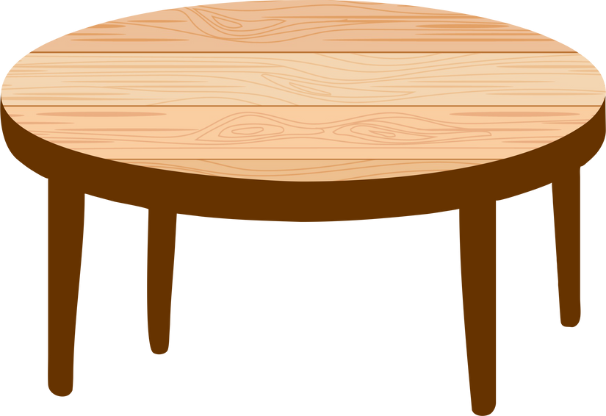

2
Presentation

Slide 6
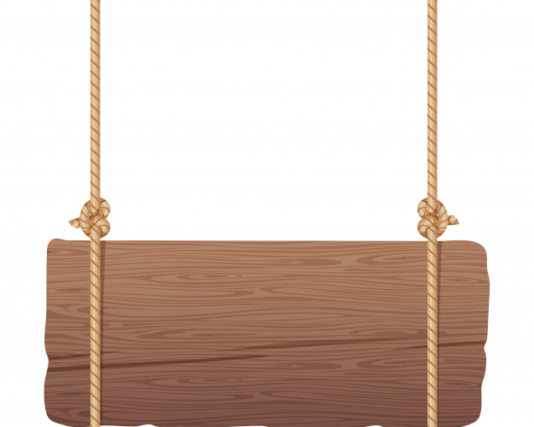
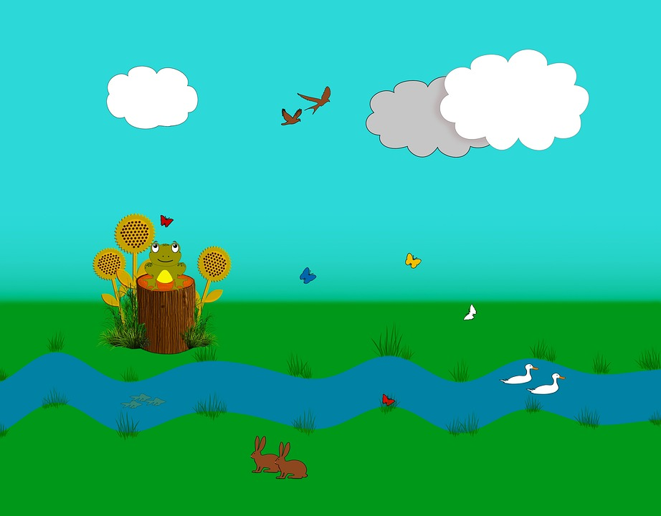
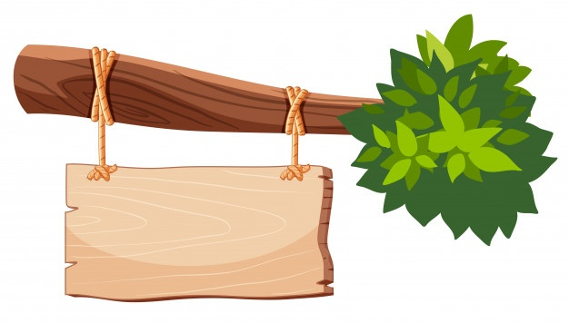
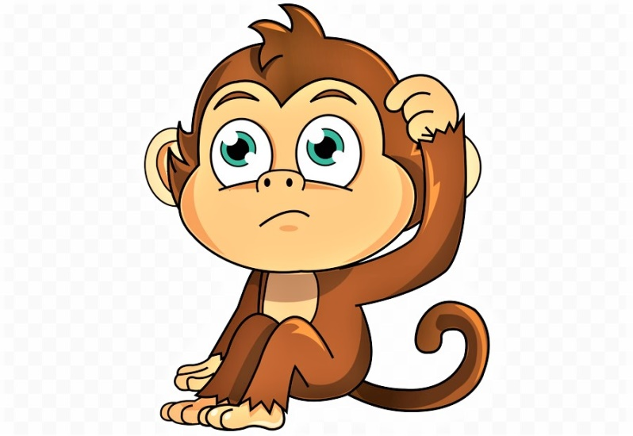
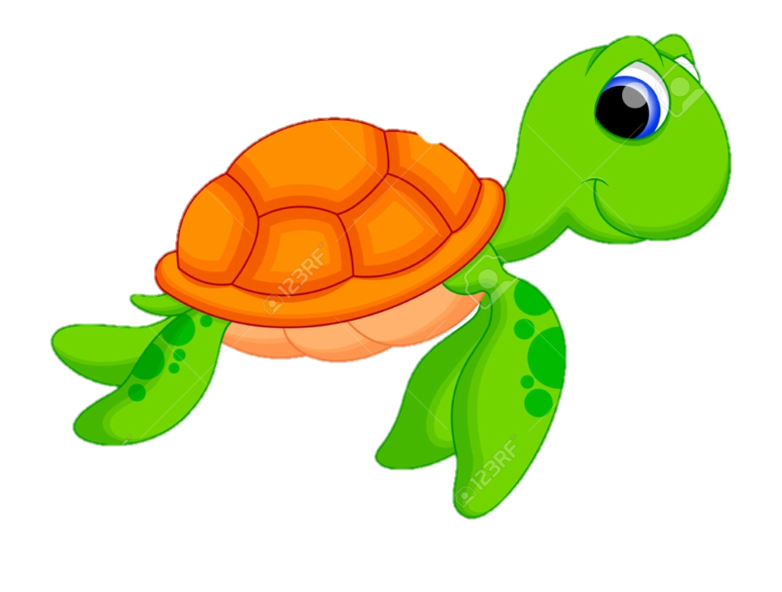
help the monkey

Slide 7

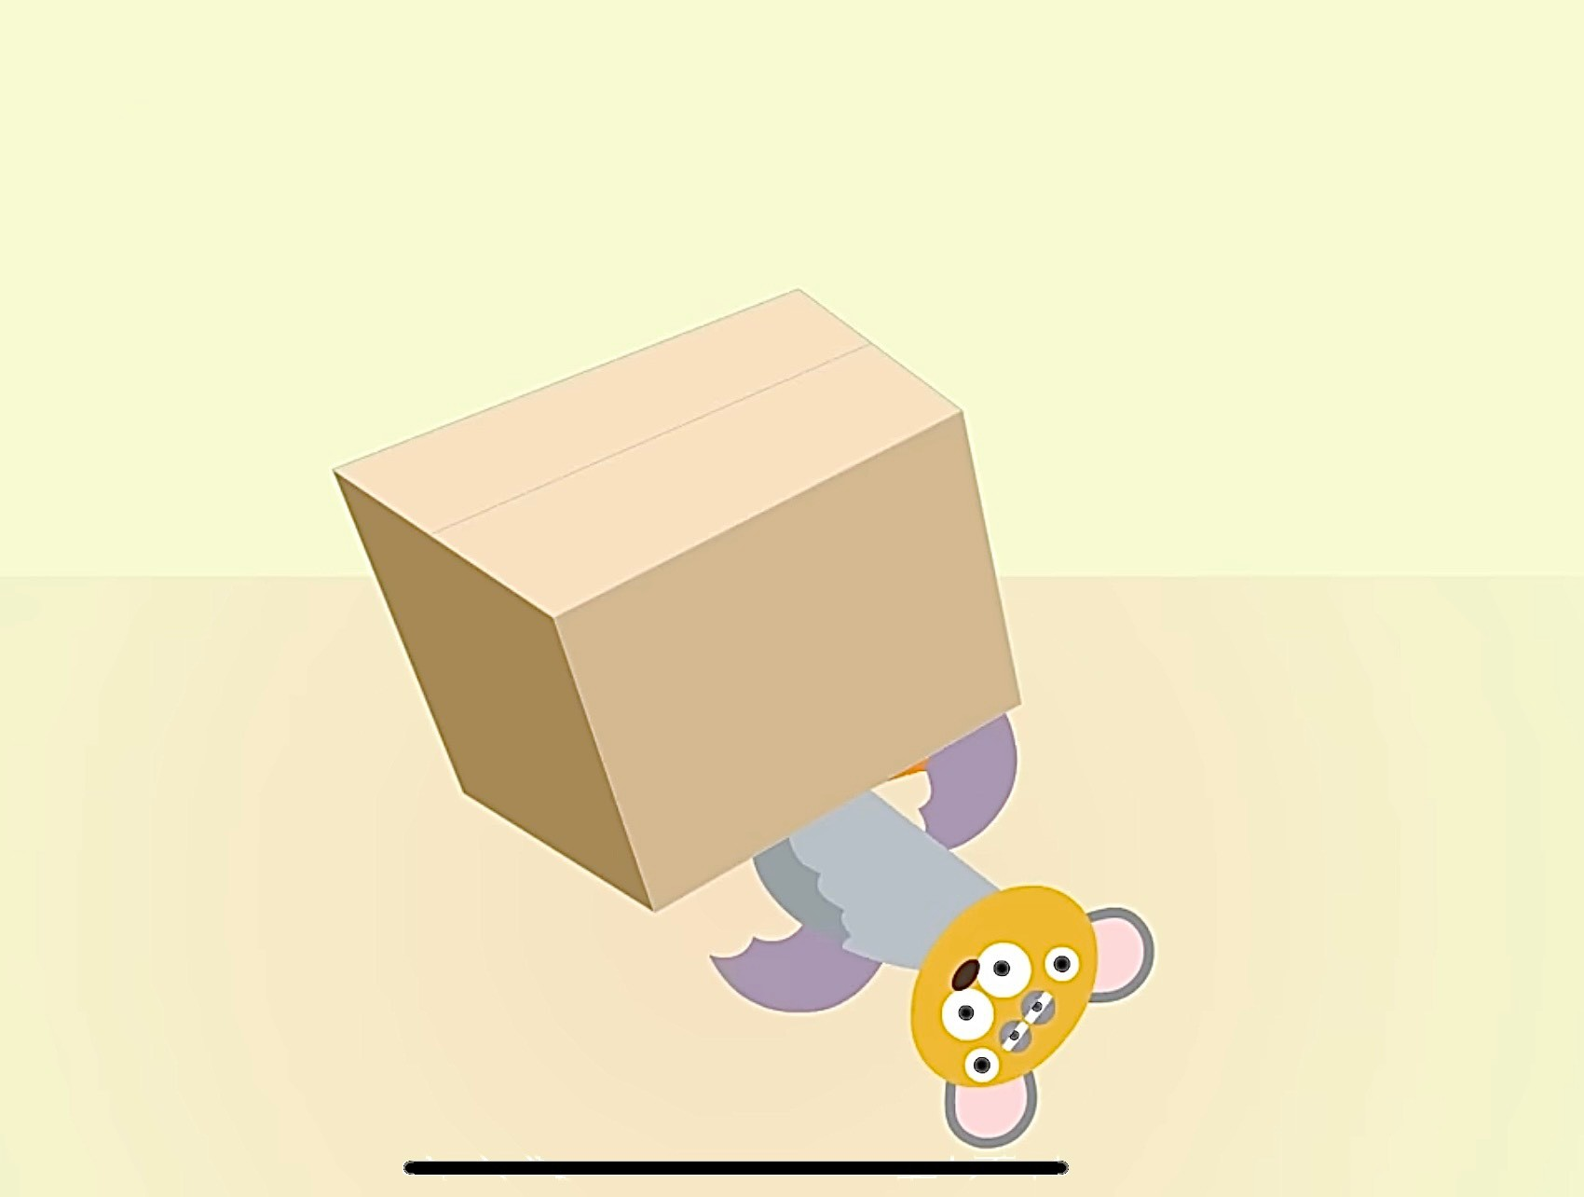
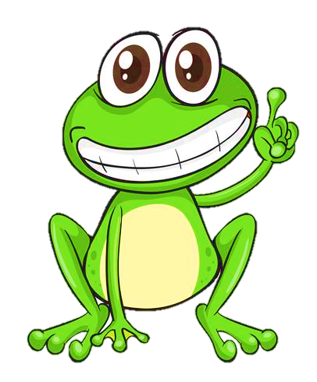

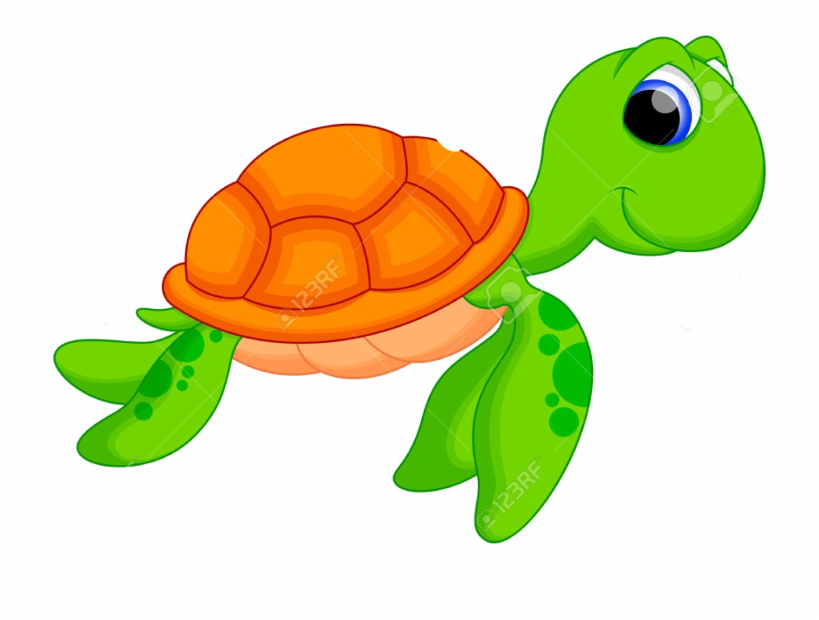
Question 1
The bat is ____ the box.
4 stars
Next to
above
below
Notes:
Ấn vào con ếch/ chim cánh cụt có đáp án đúng để xem điểm

Slide 8
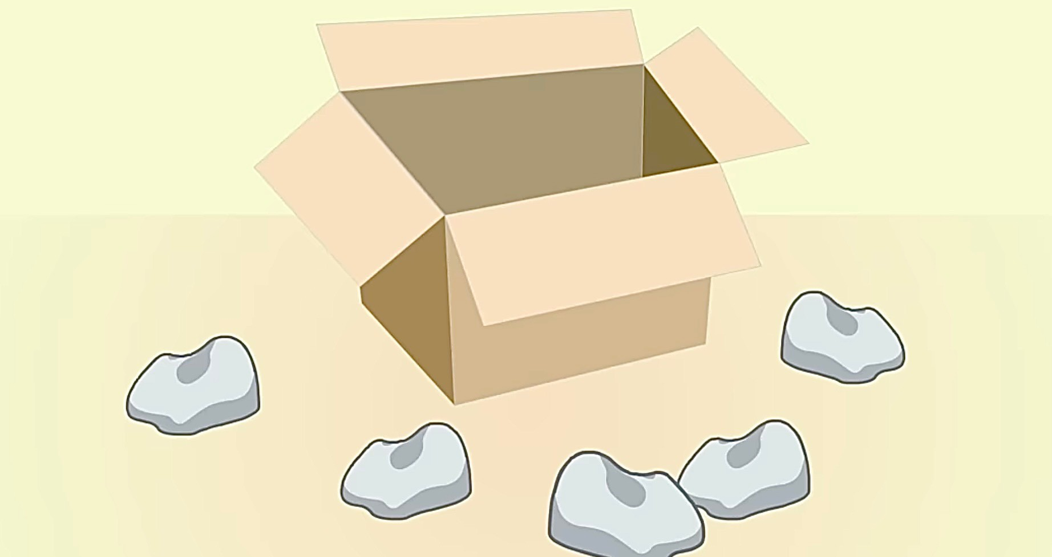


Question 2
The rocks are ____
the boxes.
outside
inside
7 stars

Slide 9
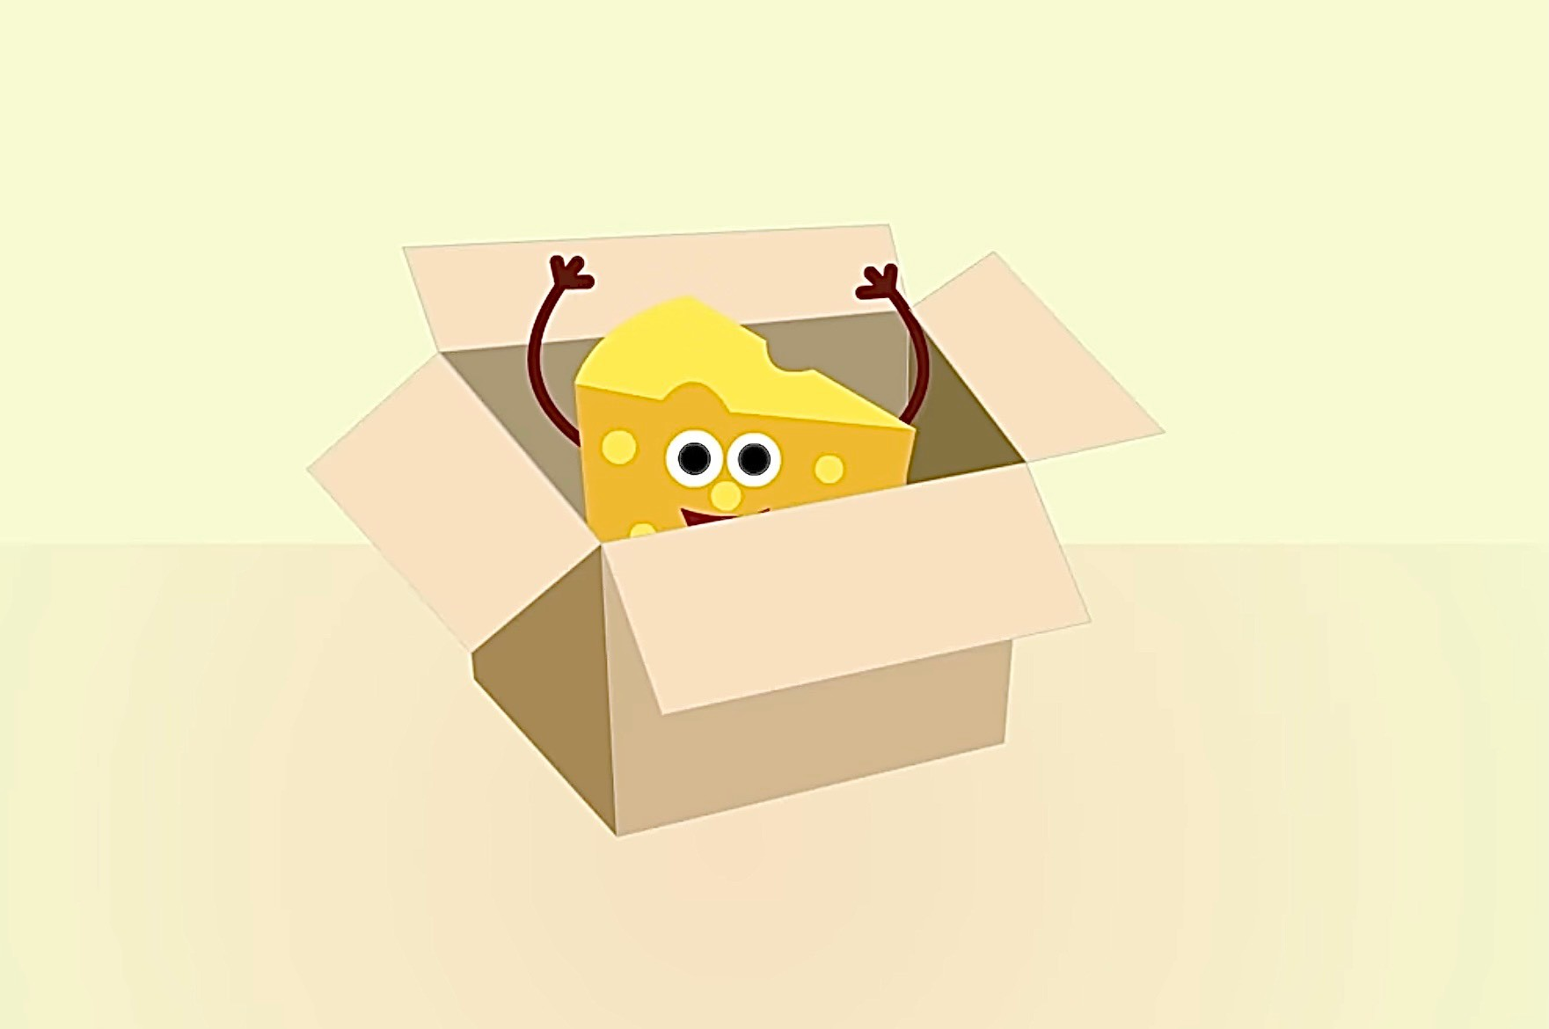
Question 3
The cheese is _____ the box.
6 stars
Next to
outside
inside

Slide 10
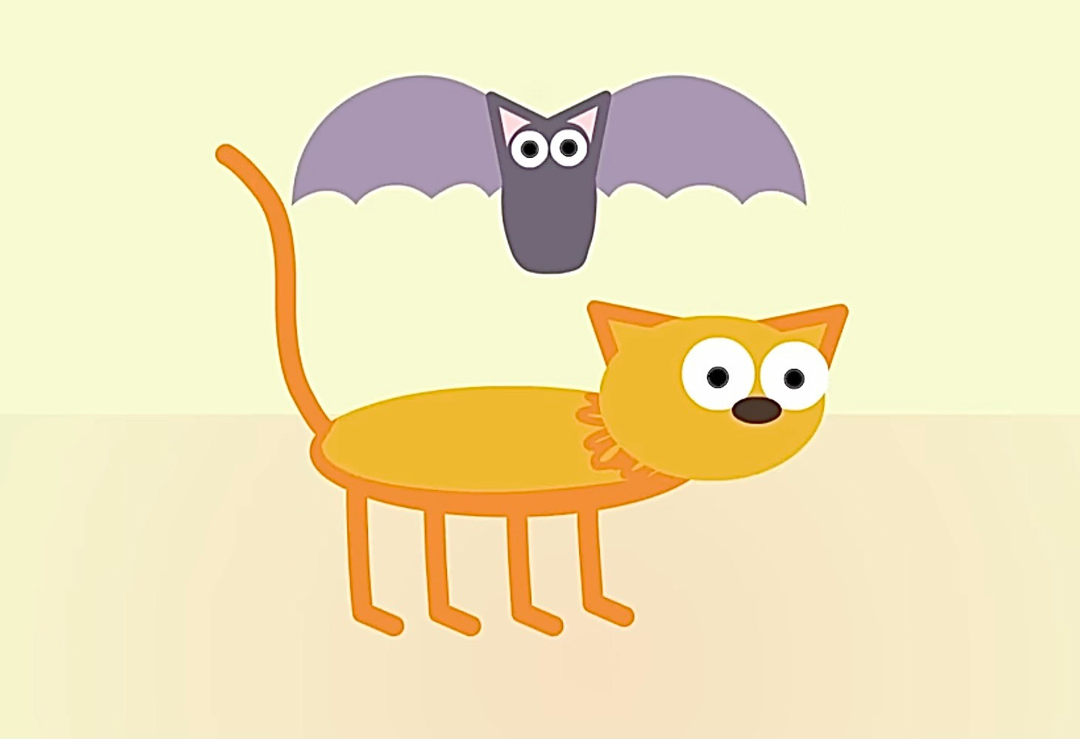
Question 4
The bat is ____ the cat.
under
above
5 stars

Slide 11



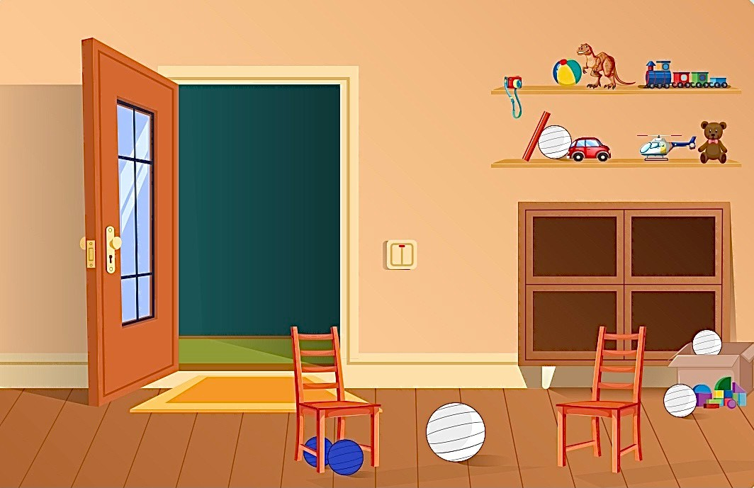
4
Listen and read.
1 Two blue balls are below the chair.
2 A green ball is above the cupboard.
3 A yellow ball is inside the box.
4 There is a pink ball outside the box.
5 There is a big red ball
in the middle of the room.

Slide 12
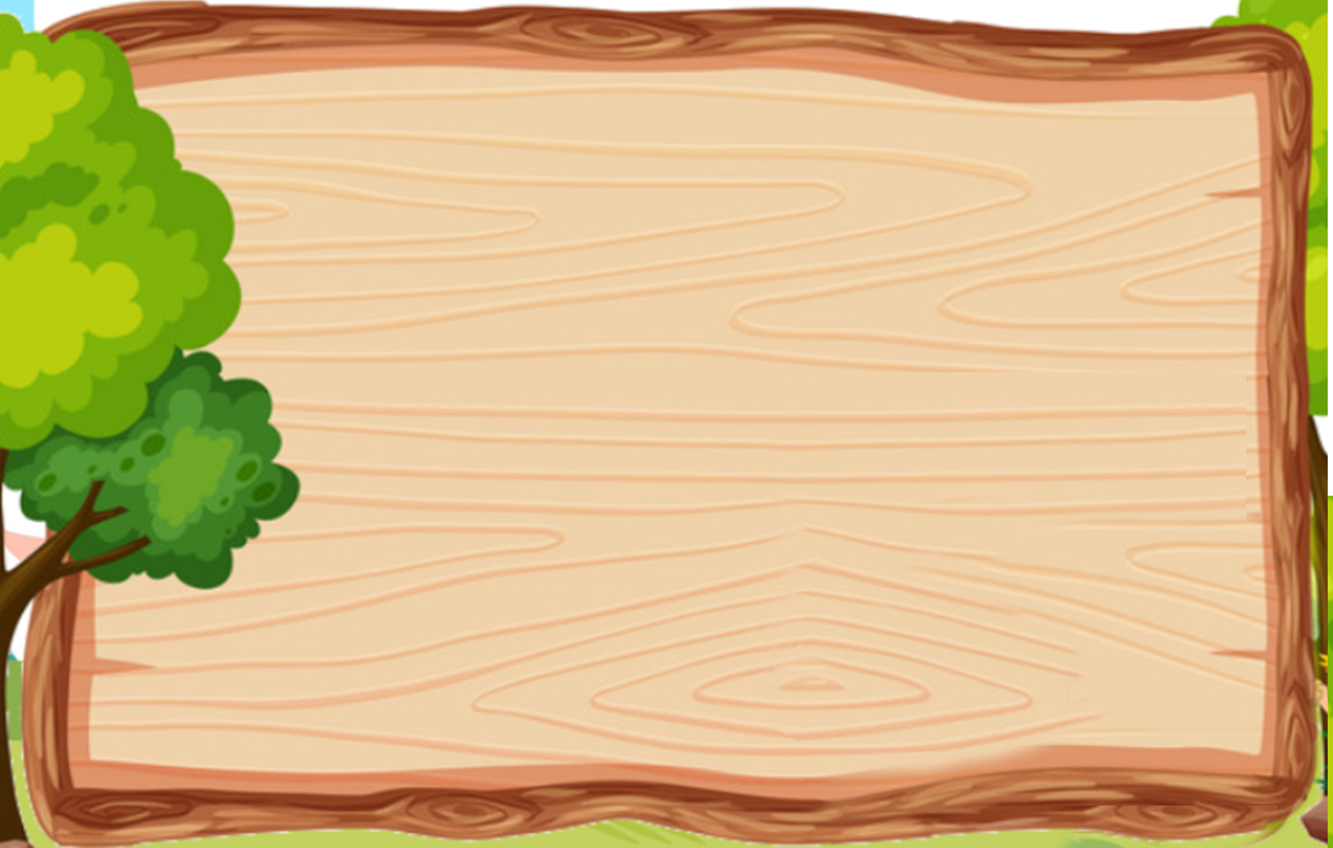


4 Listen and read. Then find and colour the ball.
1 Two blue balls are below the chair.
2 A green ball is above the cupboard.
3 A yellow ball is inside the box.
4 There is a pink ball outside the box.
5 There is a big red ball in the middle of the room.

Slide 13
Practice
3

Slide 14

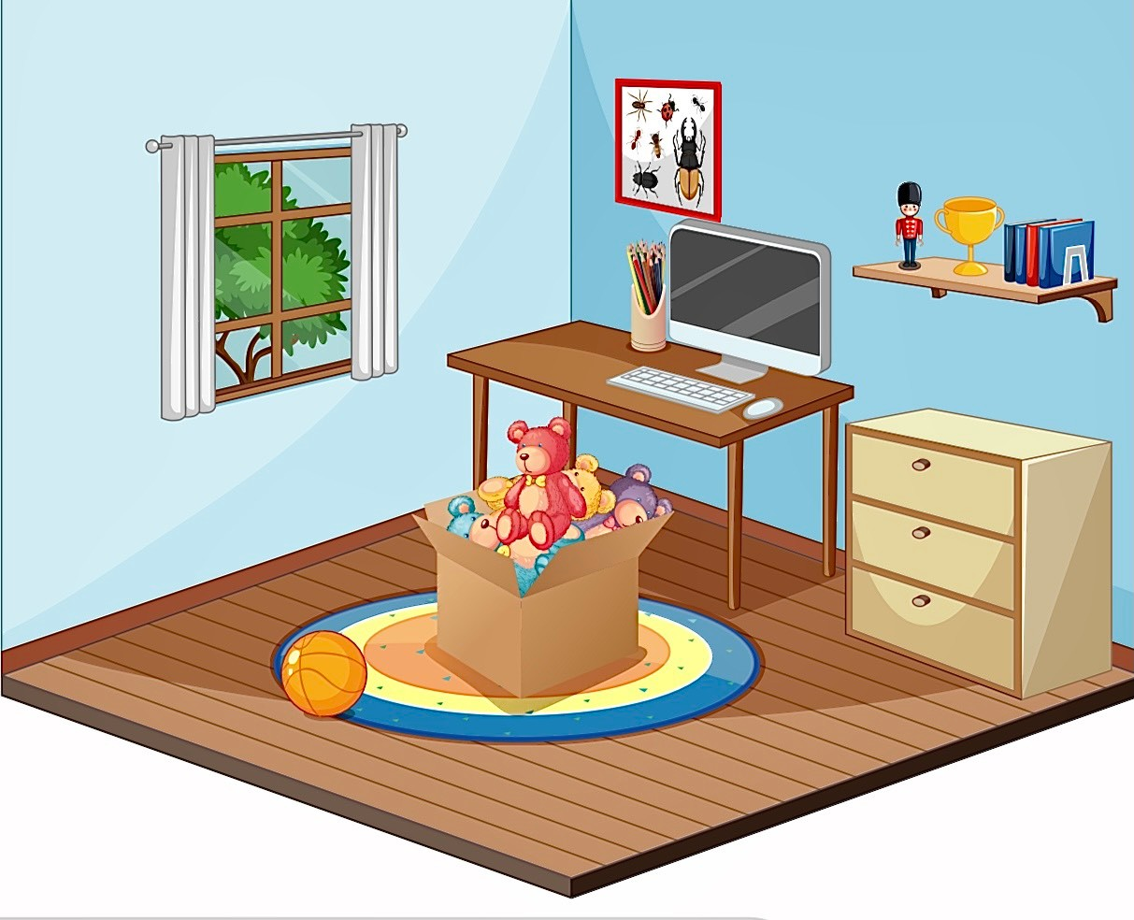
5 Look and write.
What can you see in the picture?

Slide 15
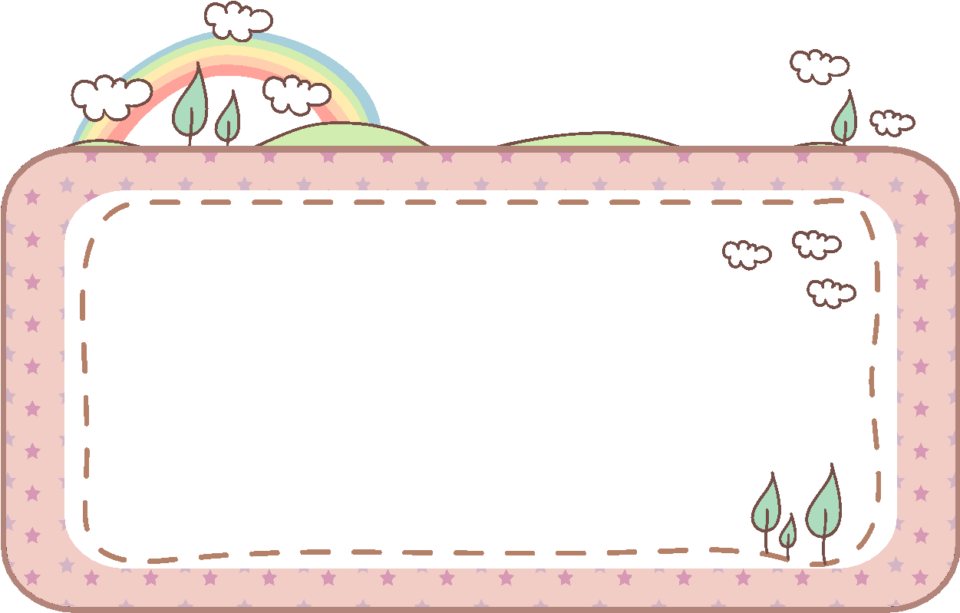
5 Look and write.
inside outside in the middle of above below
below
a. The pencils are _____ the picture.
outside
b. The ball is _____ the toy box.
above
c. The picture is _____ the table.
in the middle of
d. The toy box is _______________ the room.
inside
e. The teddy bears are ______ the toy box.

Slide 16
4
Production

Slide 17
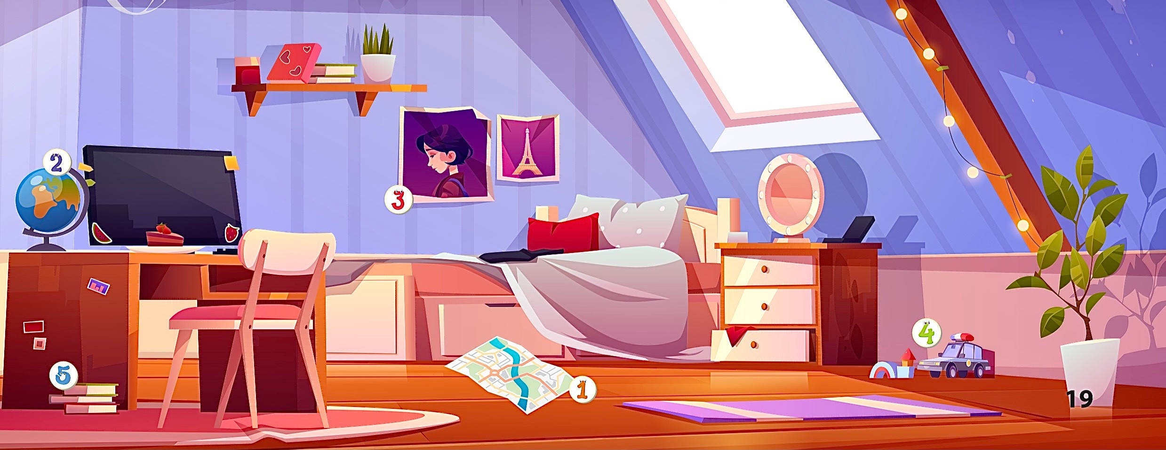

6 Let’s talk.
Where is
the map?

Slide 18

Thank you
for your attention

