Slide 1









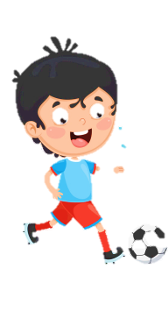

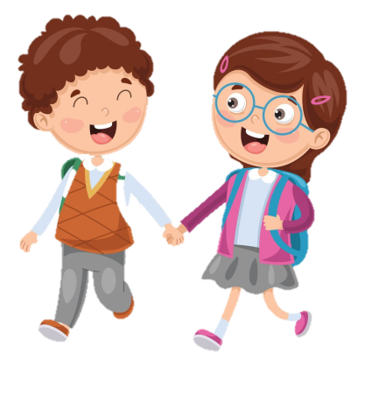



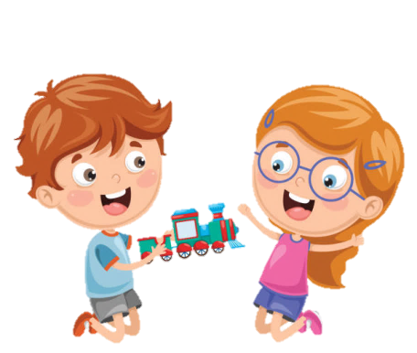






Slide 2
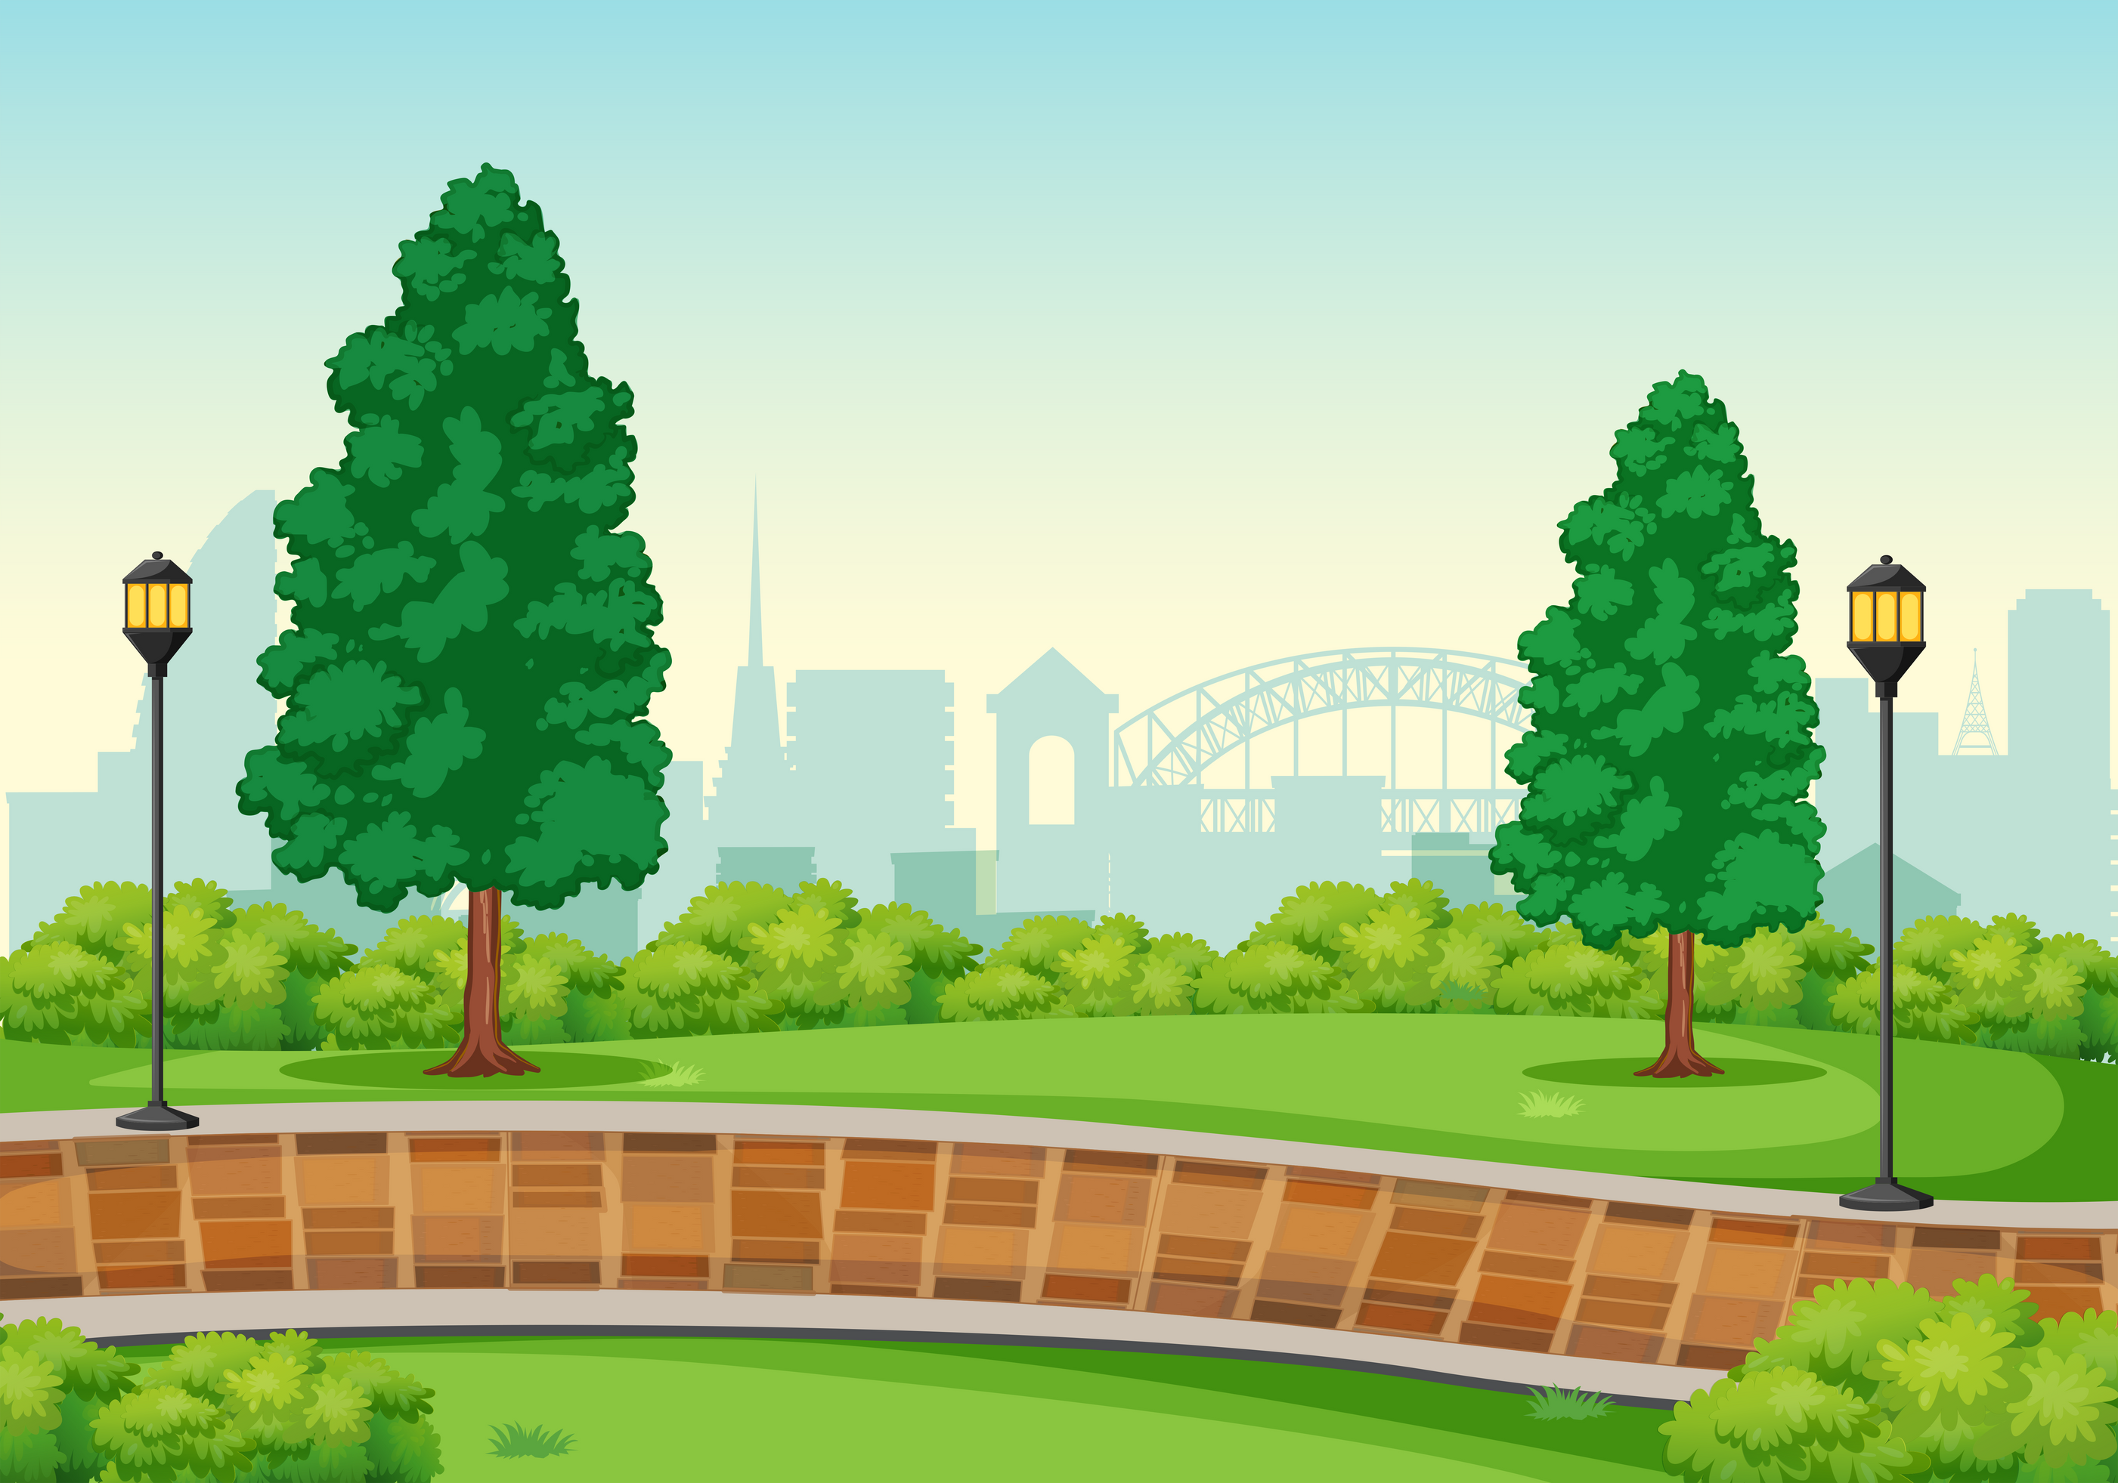


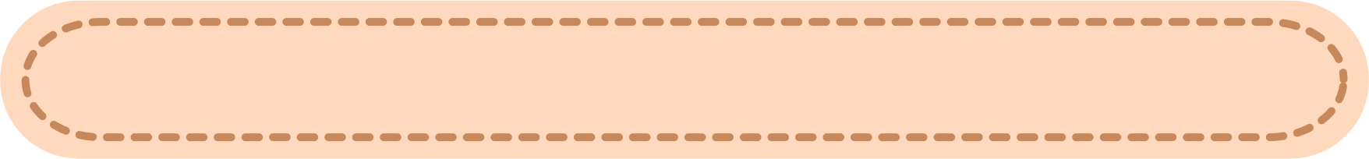
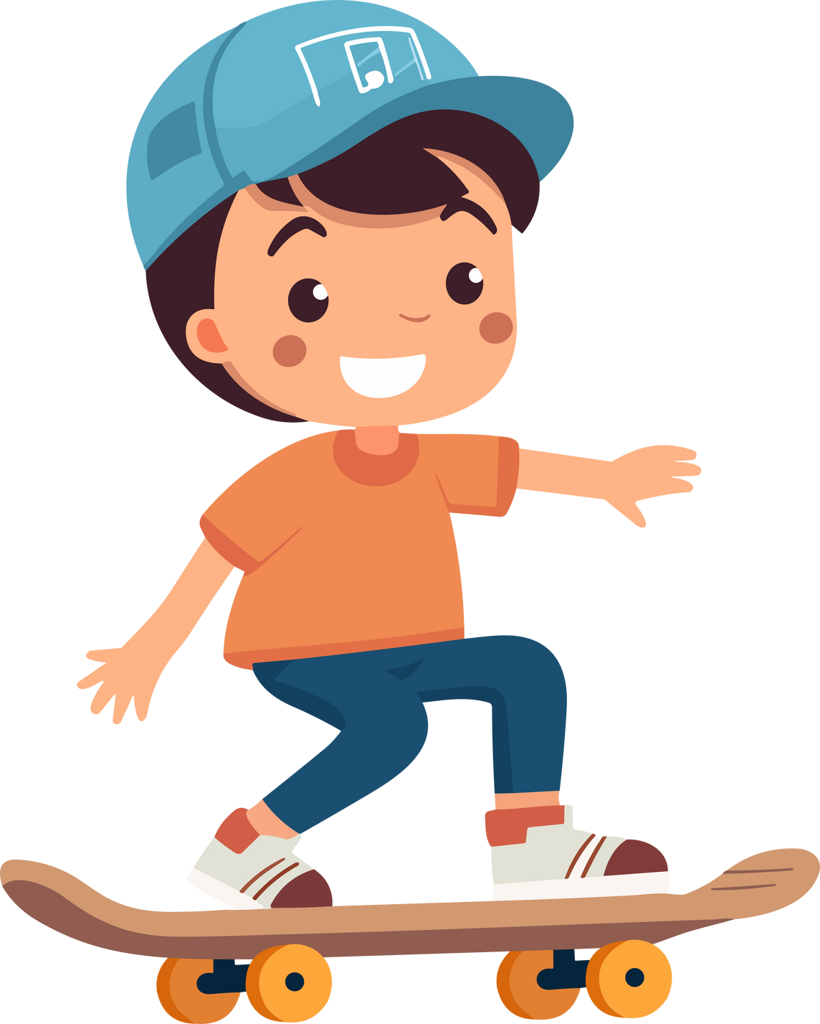
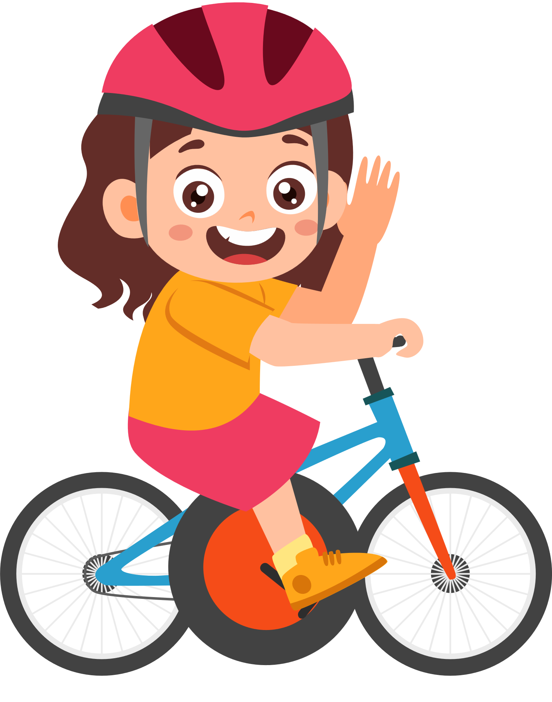




Unit 2
My favourite things
FUN TIME & PROJECT – Part 1

Slide 3




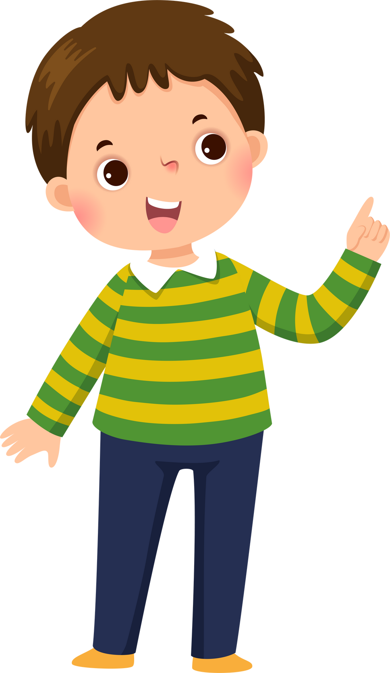
Table of contents
01
Warm-up
02
Review & Practice
03
Production
04
Wrap-up & Assessment

Slide 4
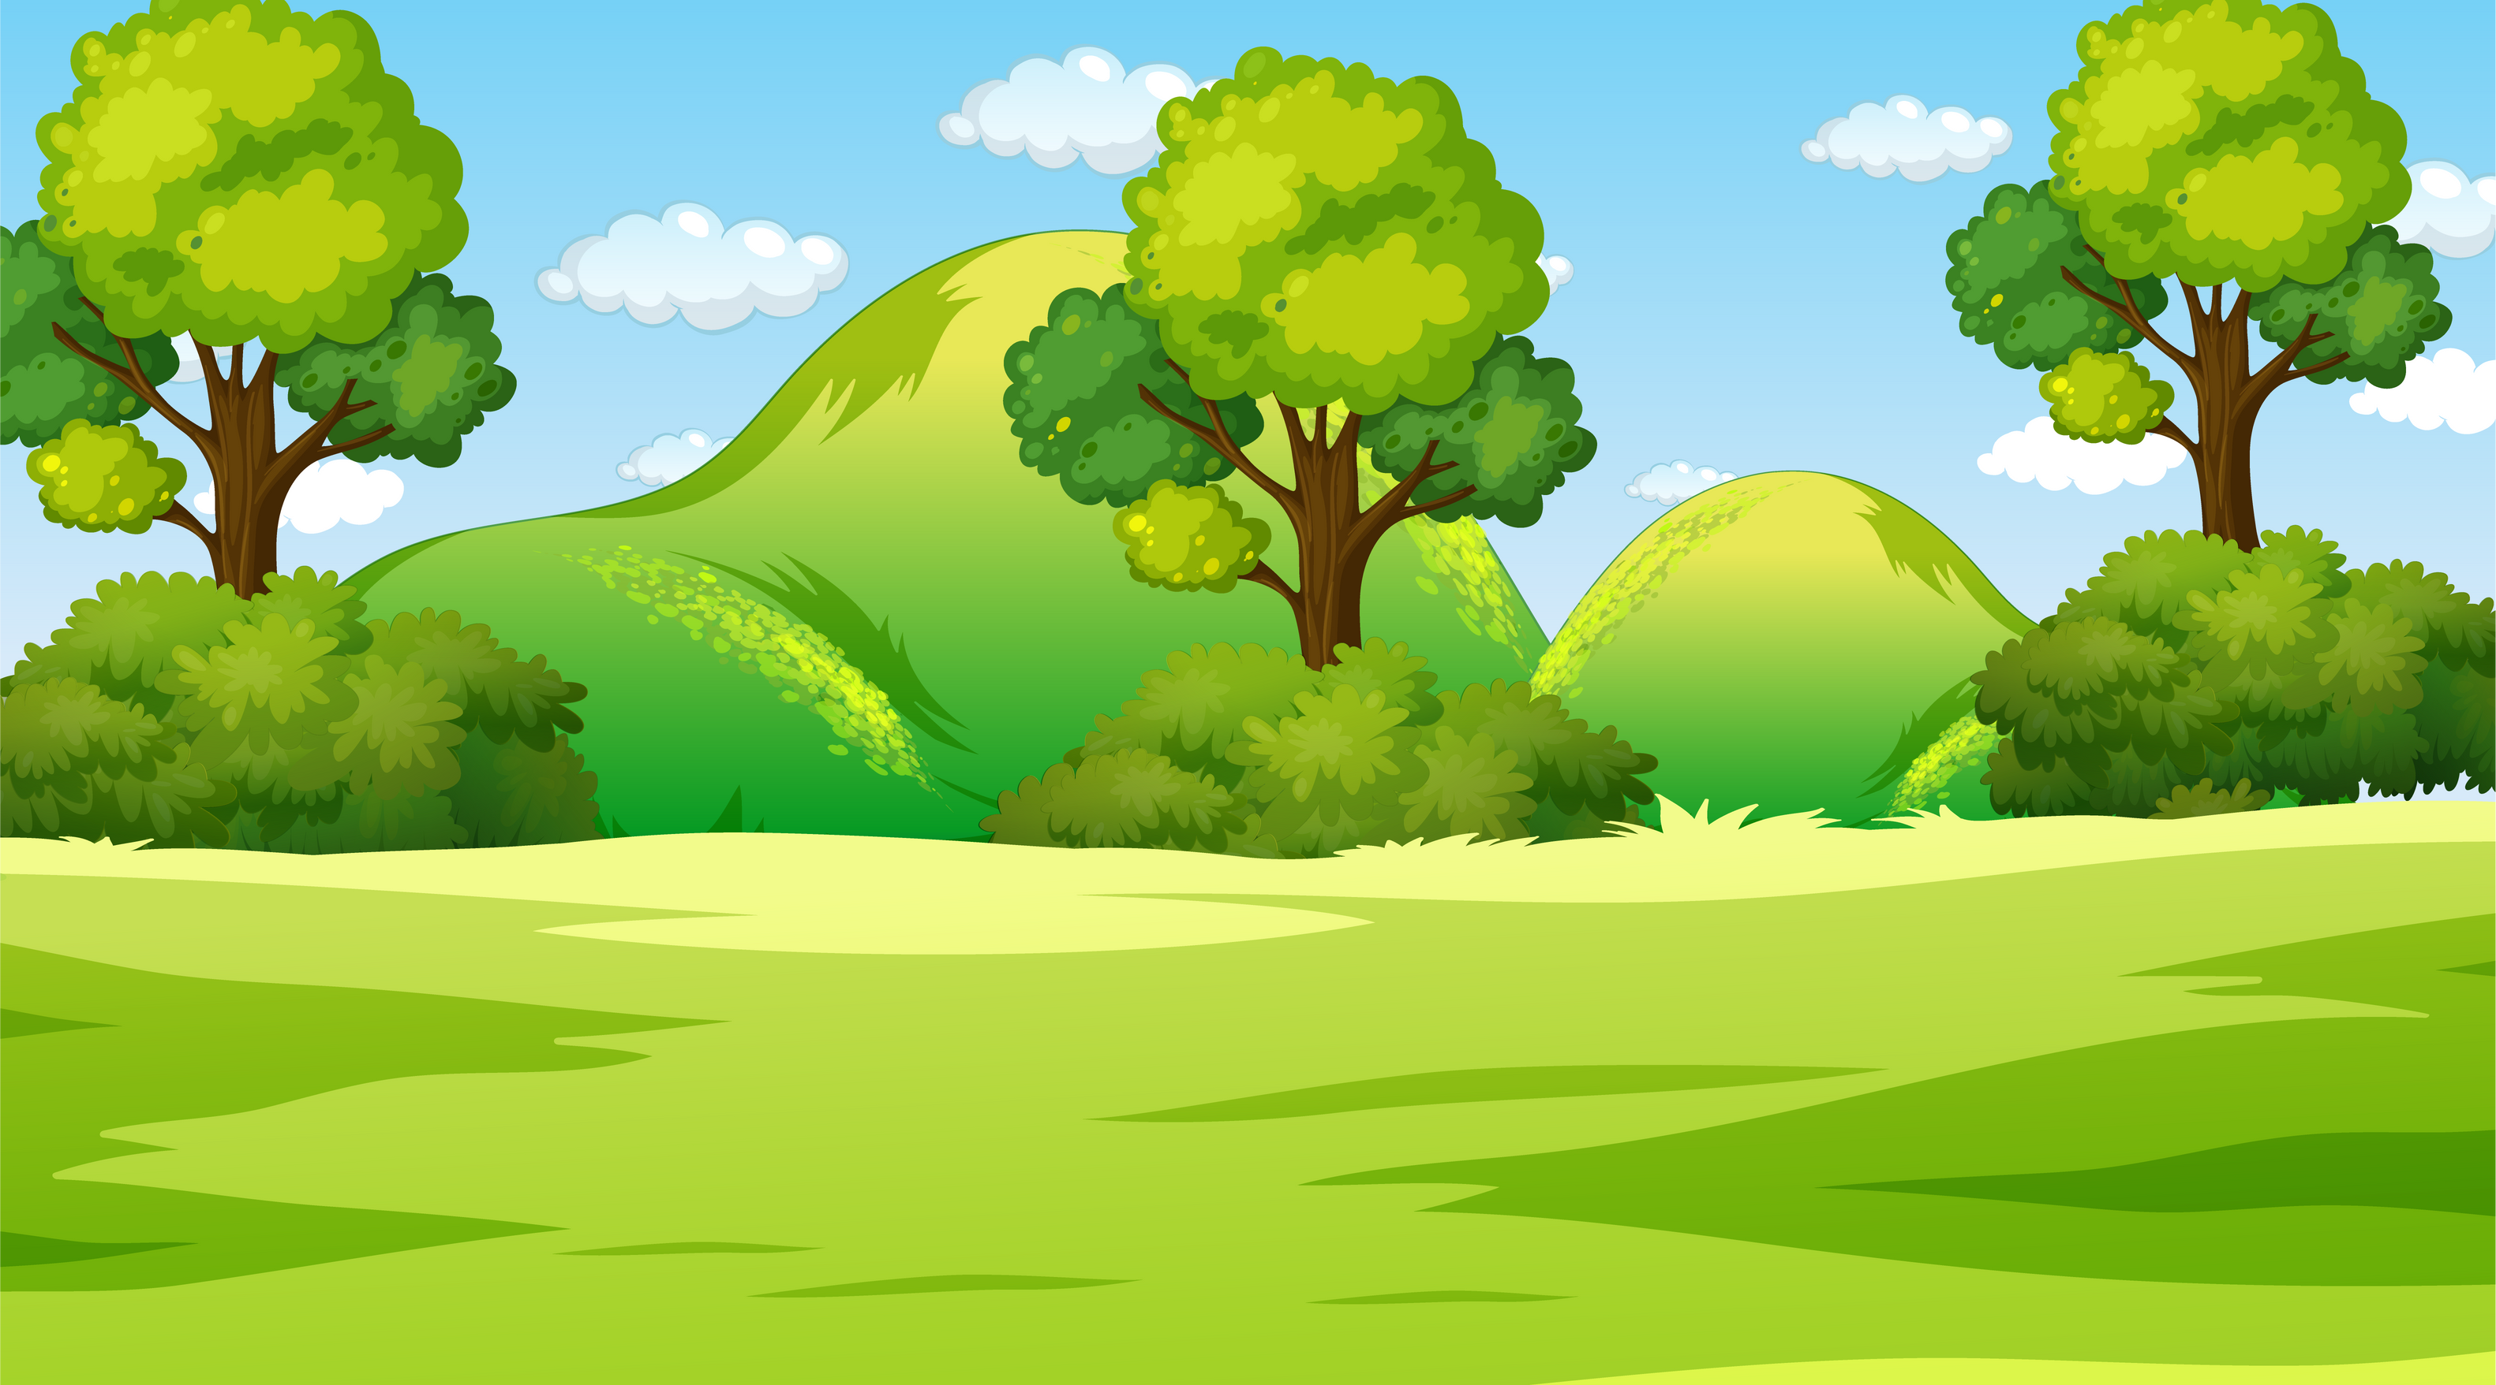

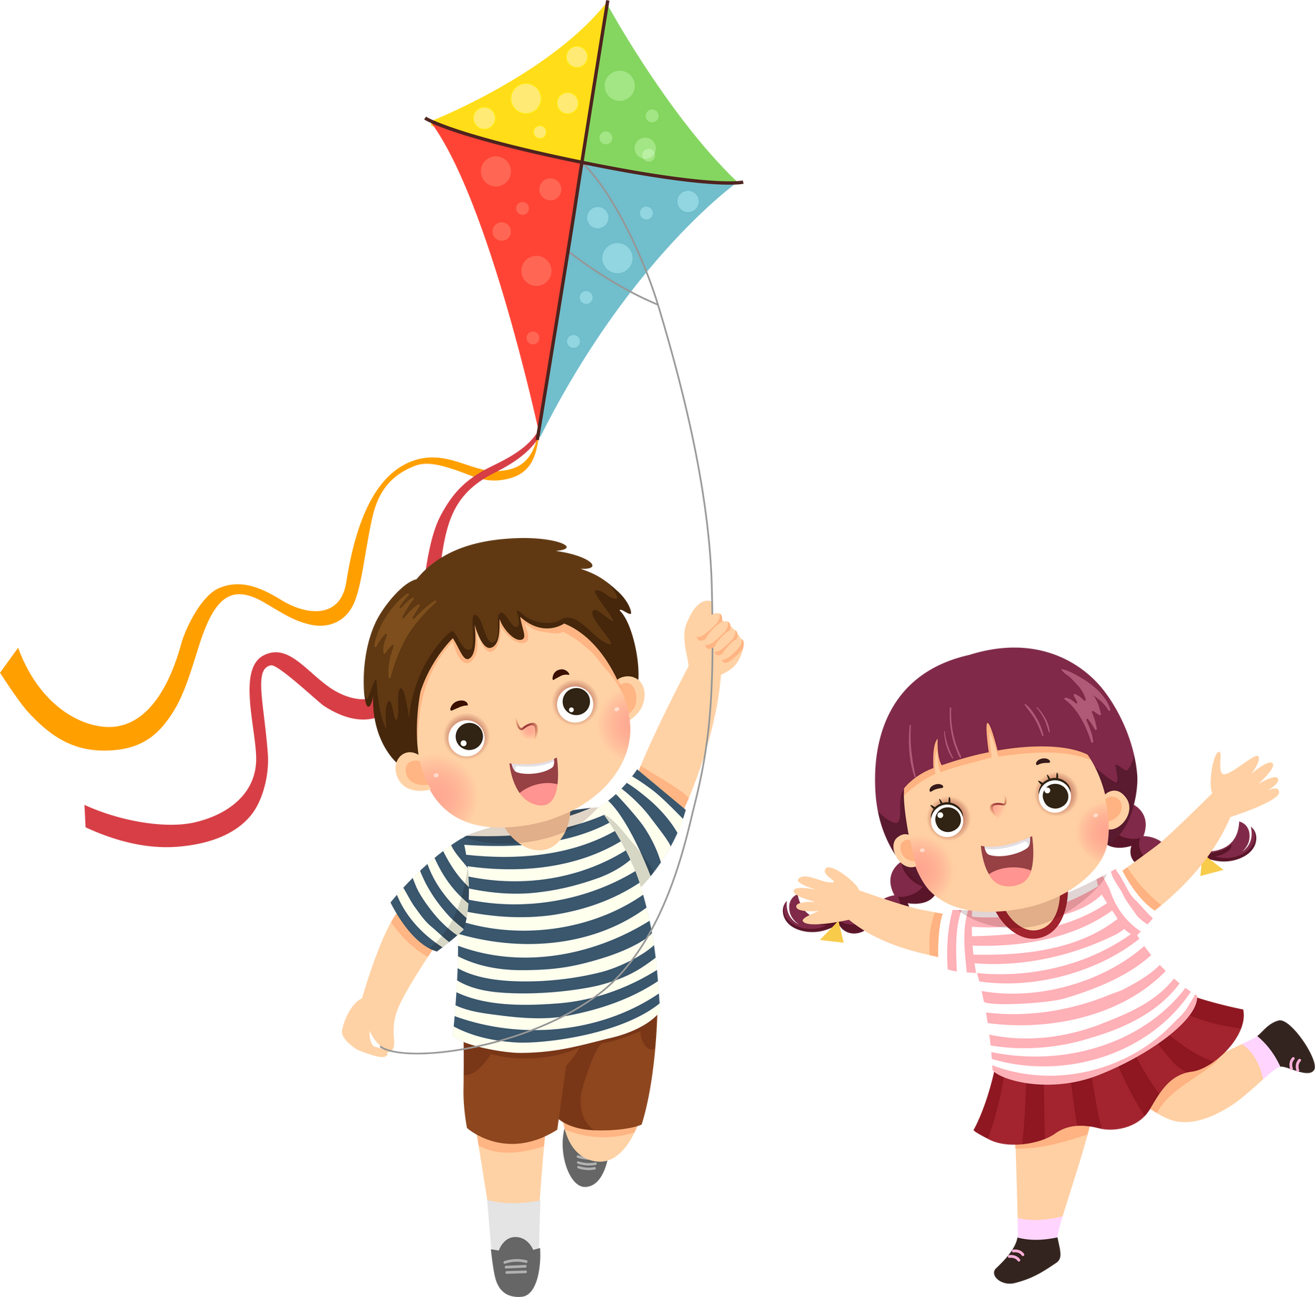
1
Warm-up

Slide 5



TOP 5 QUIZ
How to play:
  Write down ONE answer for each question.
  If your answer is in the “TOP 5” answers, you get the points.

Slide 6

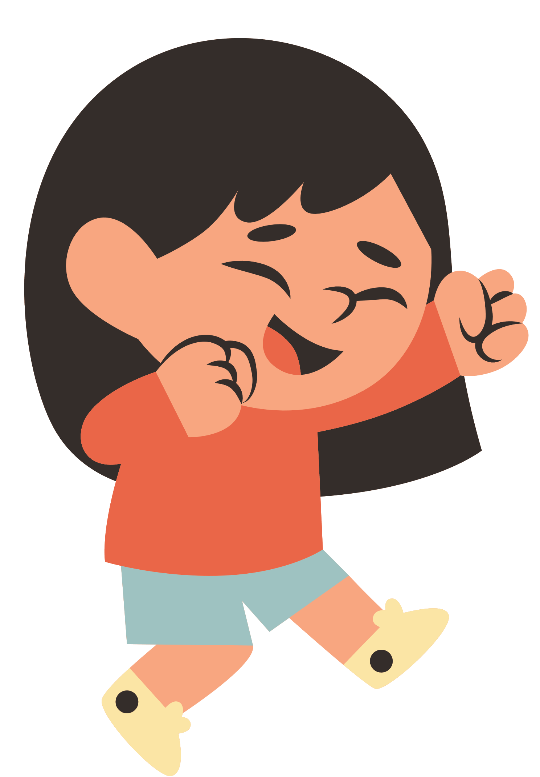

TOP 5 QUIZ
1 = 10 points
2 = 7 points
3 = 5 points
4 = 3 points
5 = 2 points

Slide 7






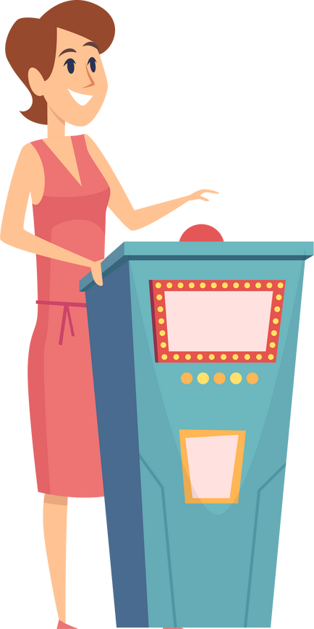
1
Name a colour.

Slide 8

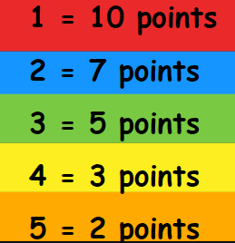
1 : red
2 : blue
3 : green
4: yellow
5 : orange

Slide 9
2
Name a day of the week.

Slide 10
1 : Sunday
2 : Monday
3 : Tuesday
4: Wednesday
5 : Thursday

Slide 11
3
Name a fruit.

Slide 12
1 : banana
2 : apple
3 : mango
4: strawberry
5 : cherry

Slide 13
4
Name a toy.

Slide 14
1 : car
2 : robot
3 : teddy bear
4: doll
5 : puzzle

Slide 15
5
Name an animal.

Slide 16
1 : dog
2 : cat
3 : elephant
4: lion
5 : tiger

Slide 17
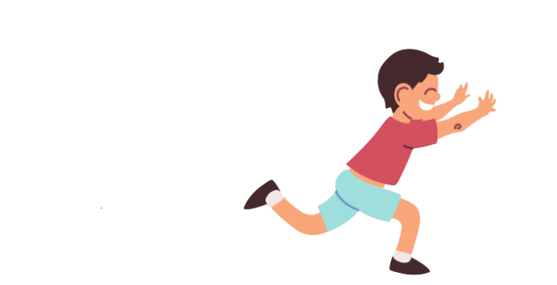
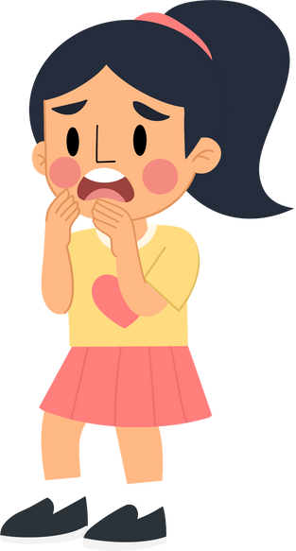
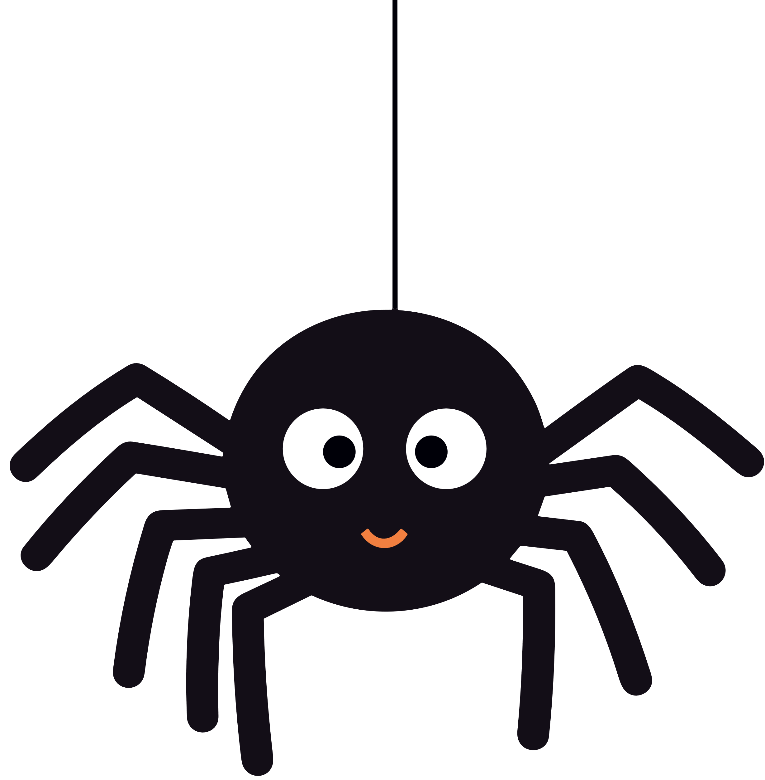
2
Review & Practice

Slide 18


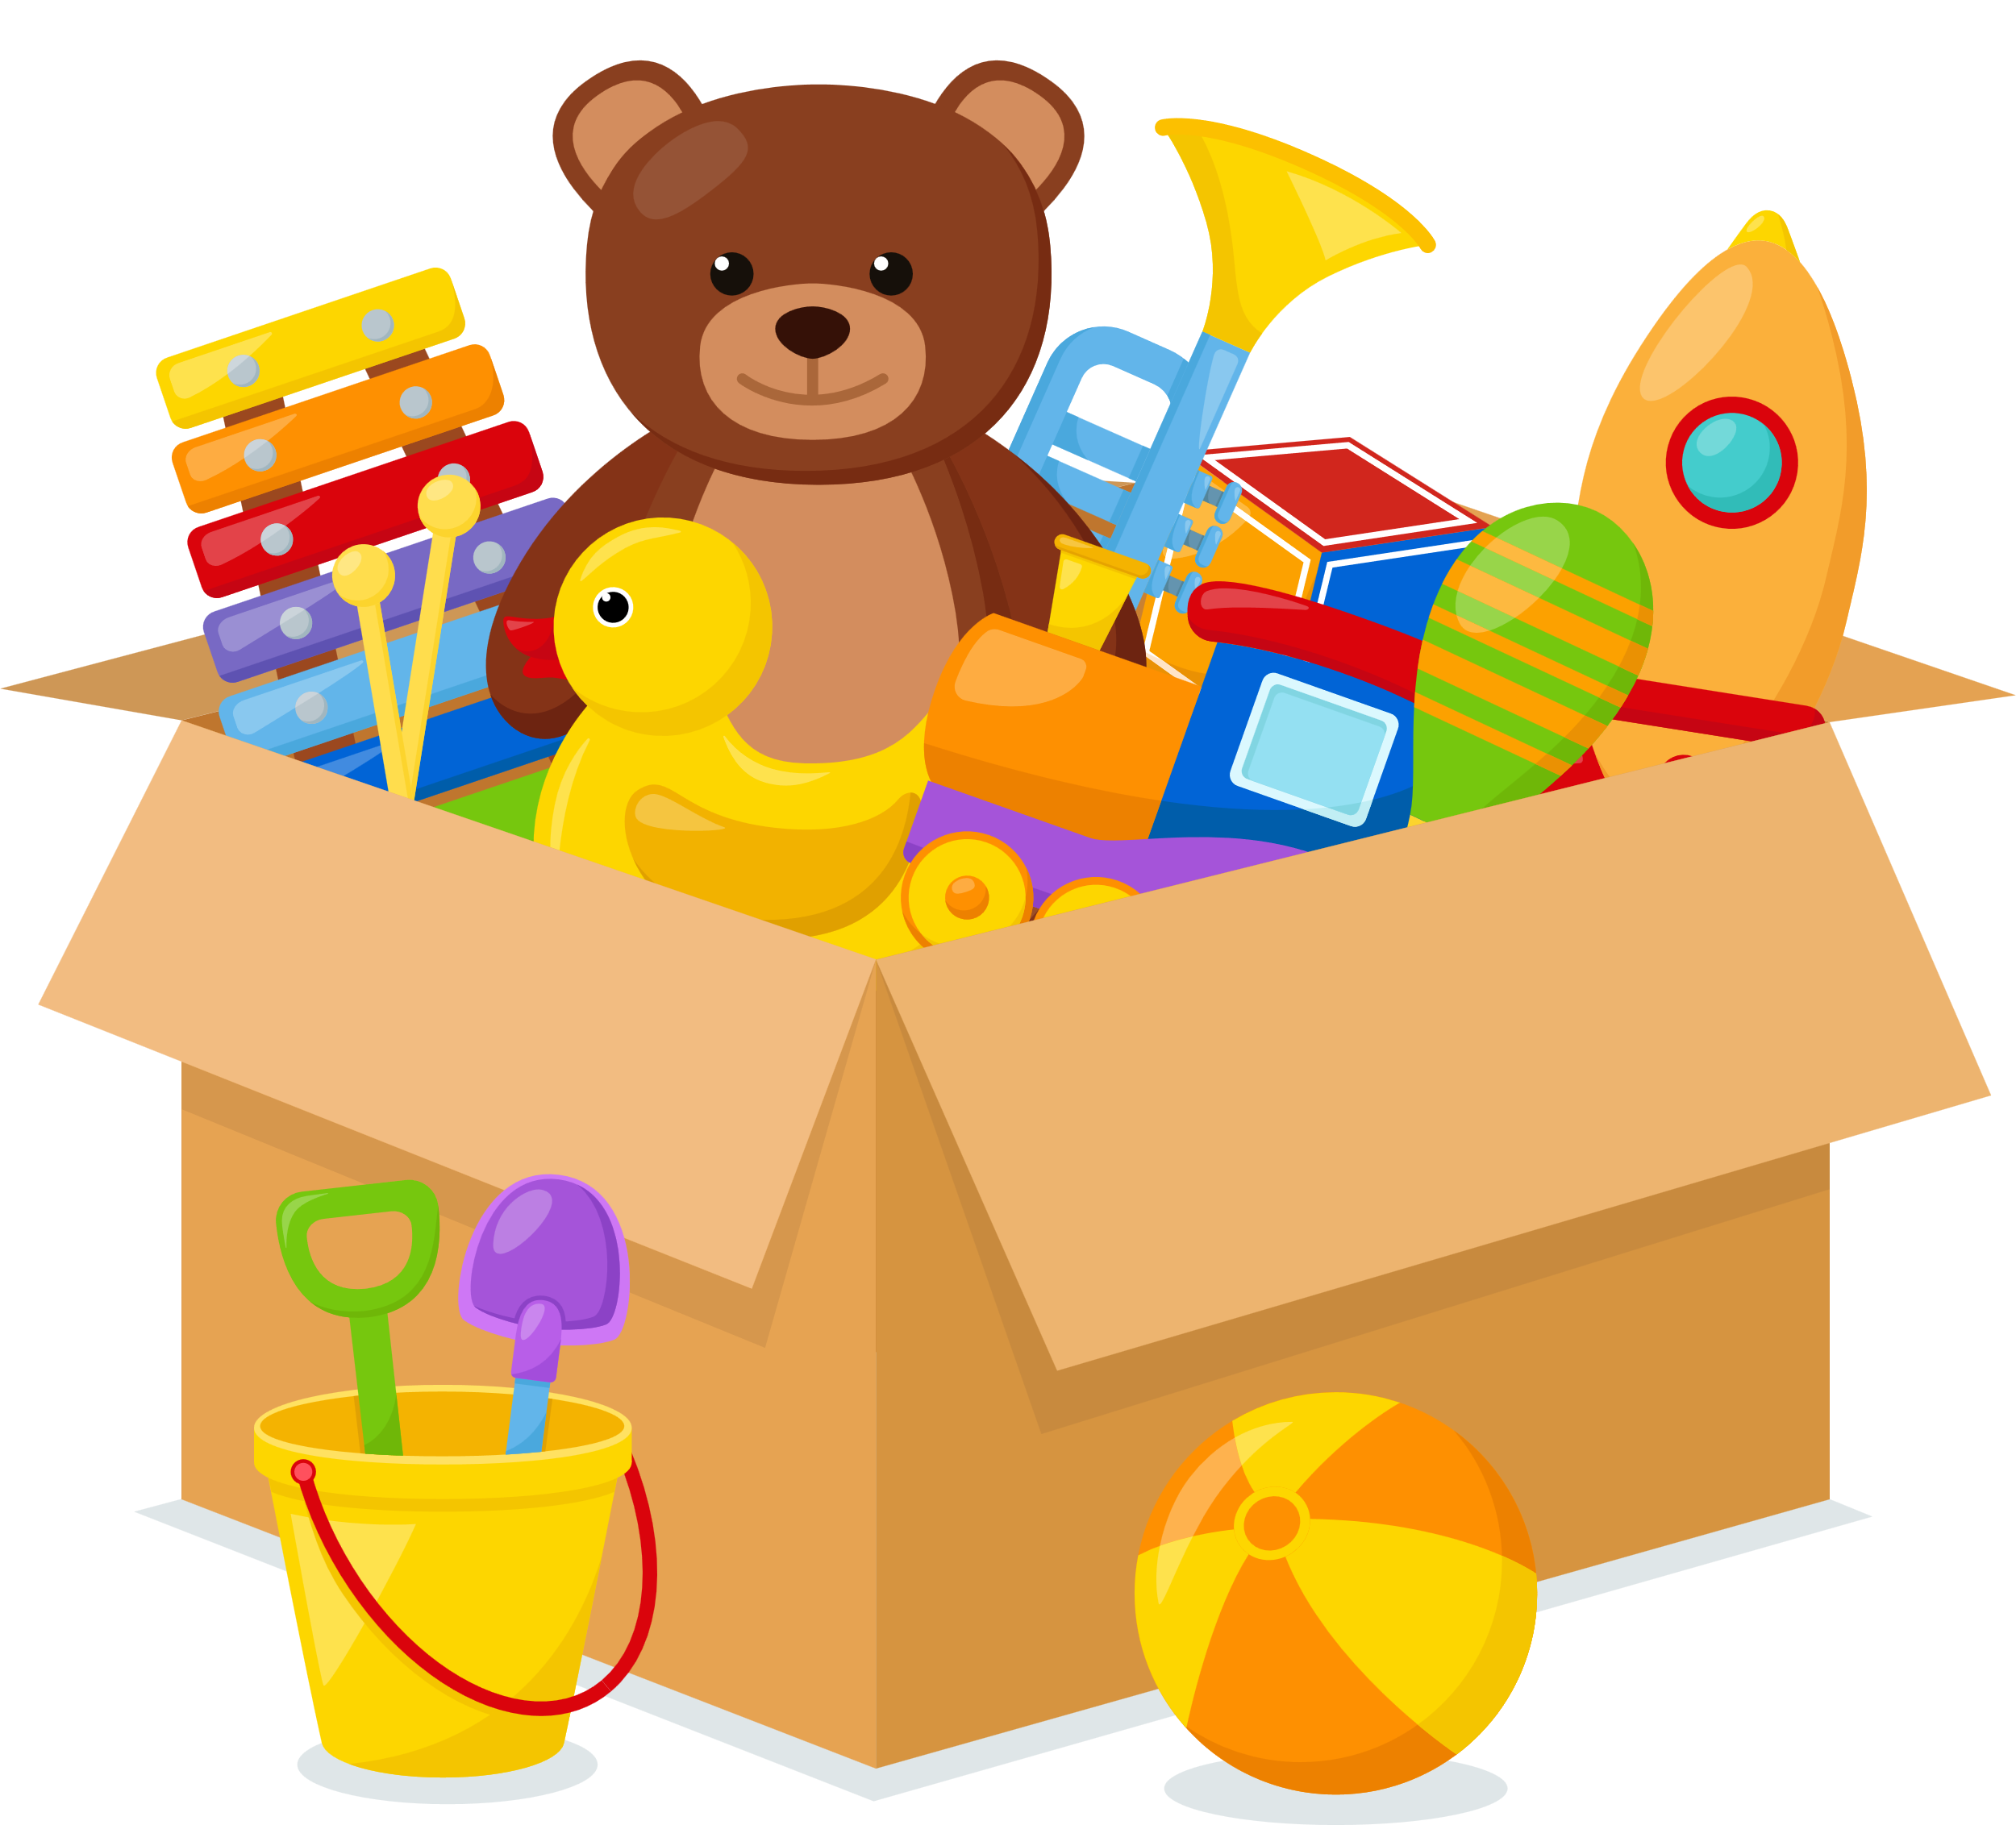

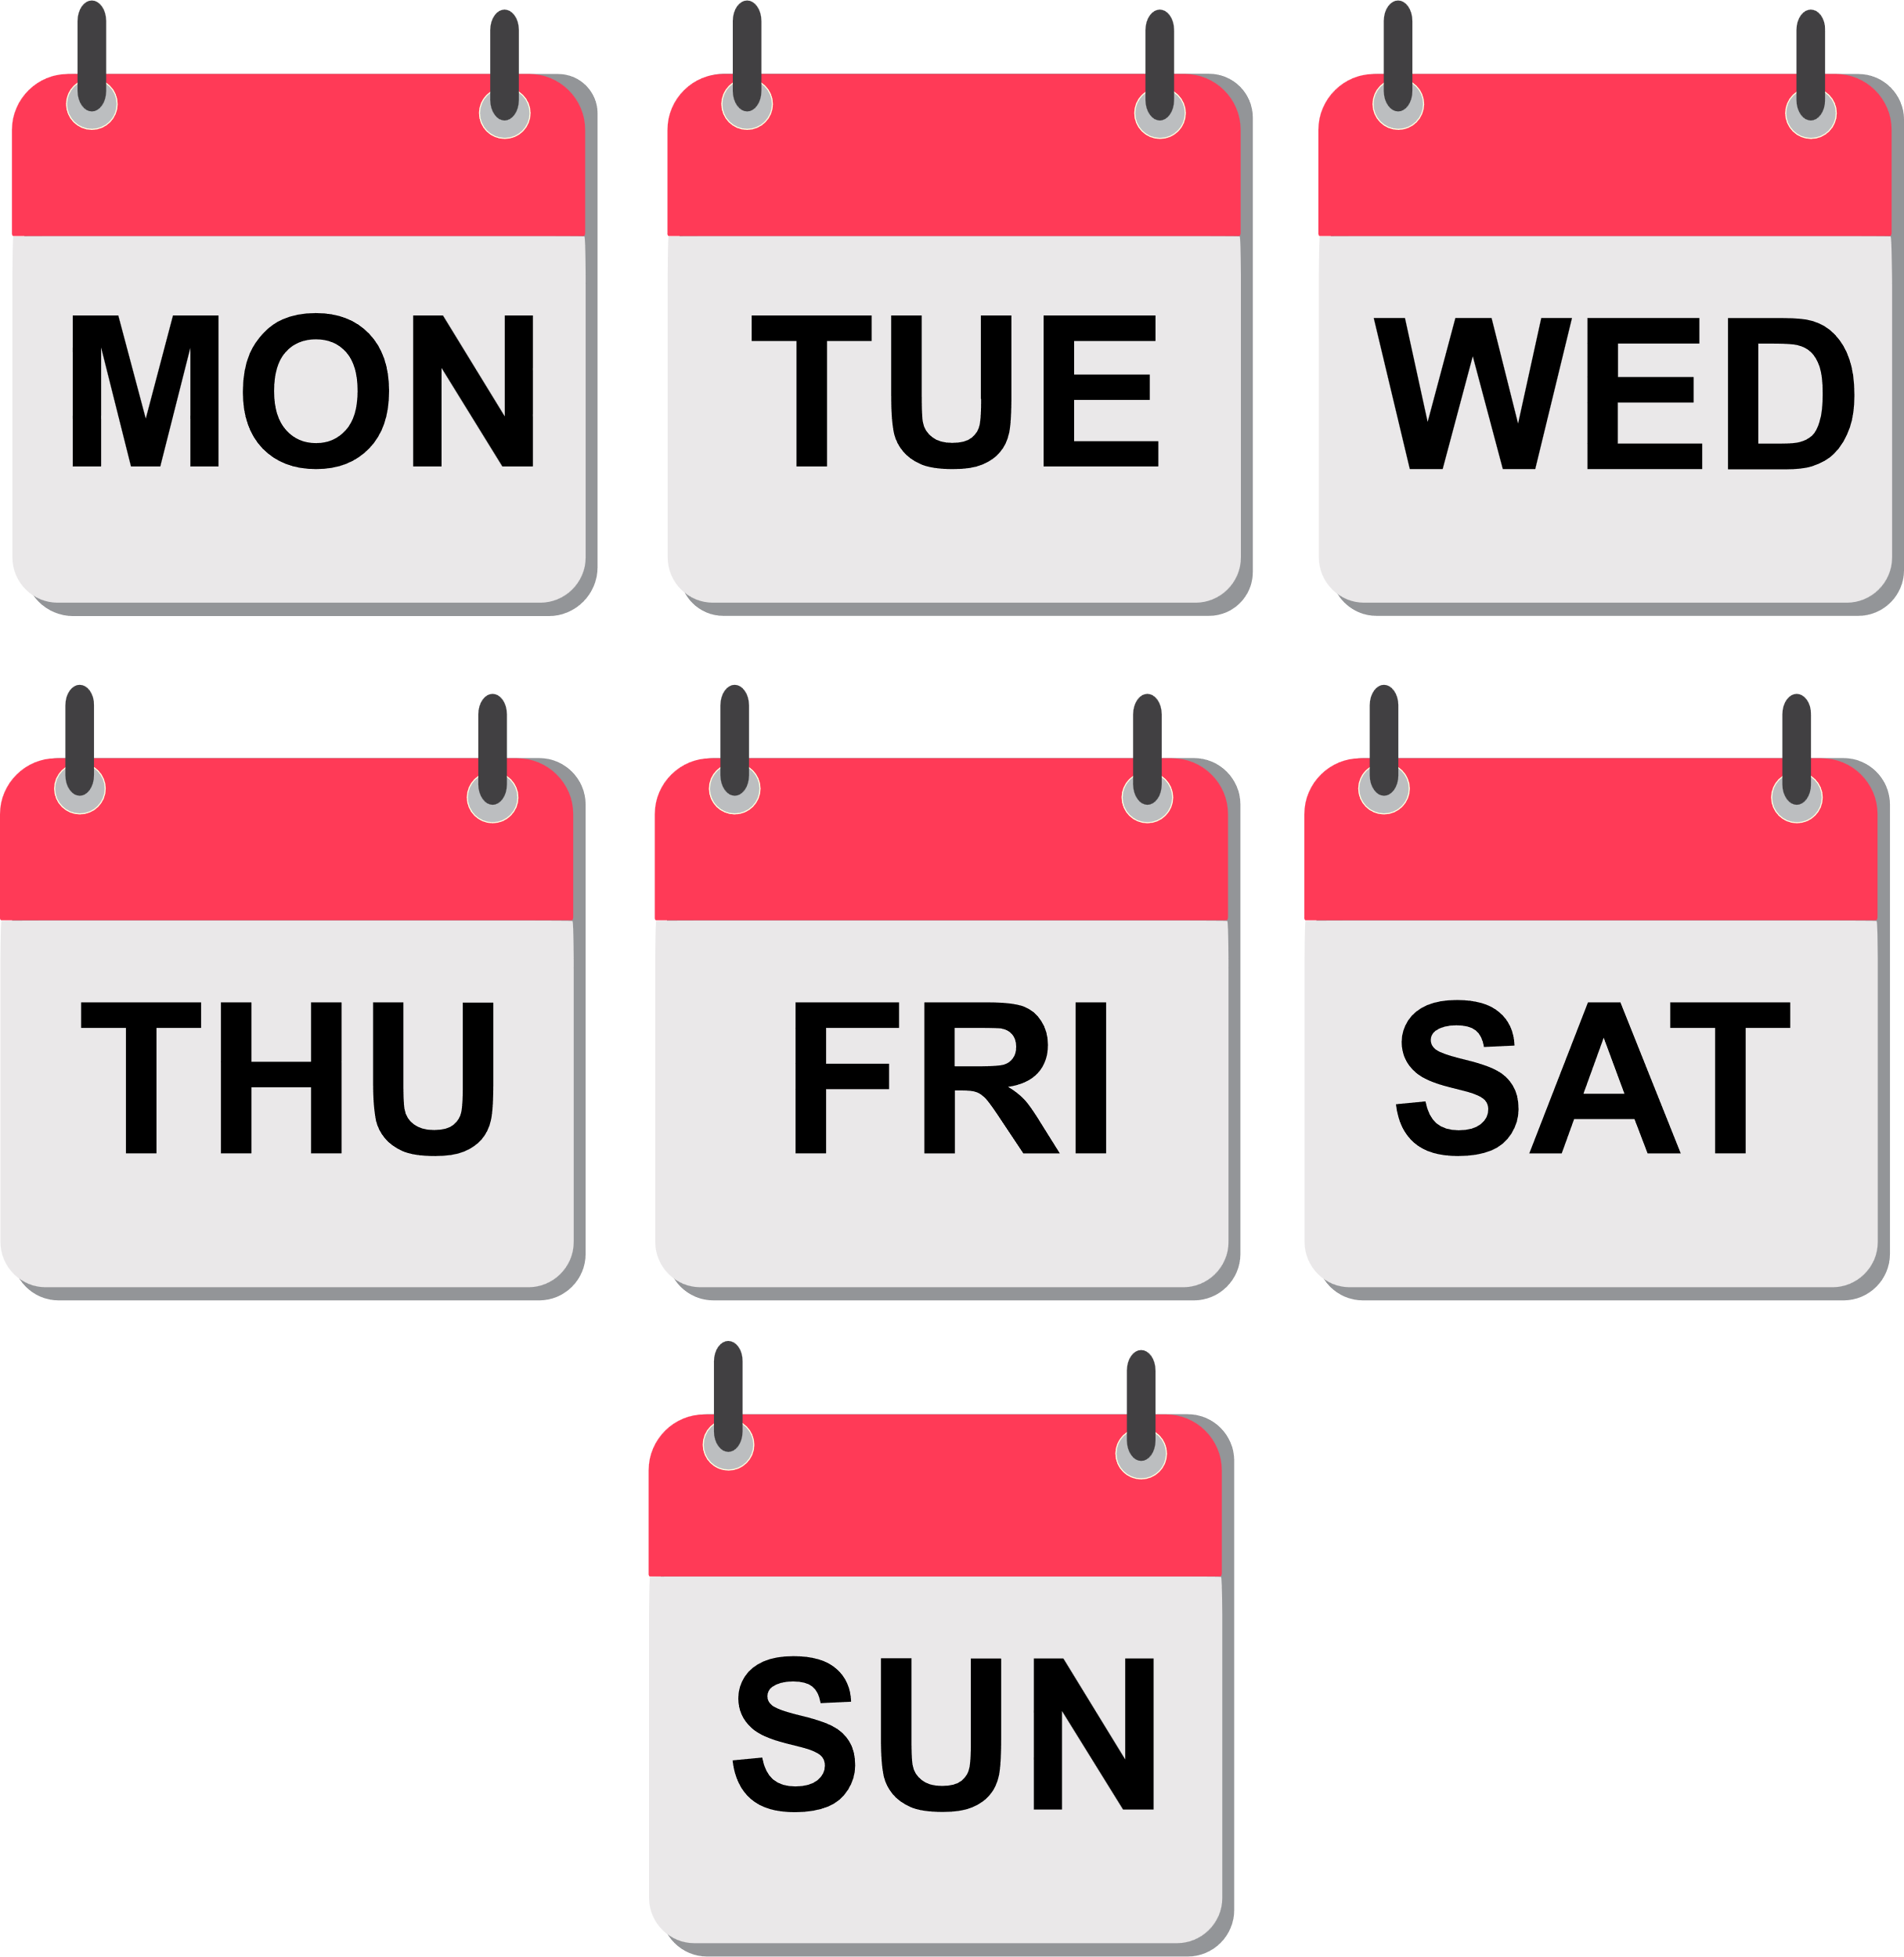

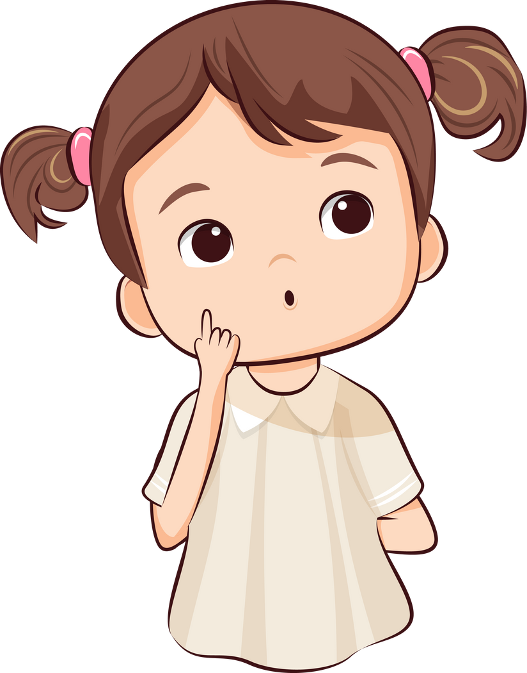
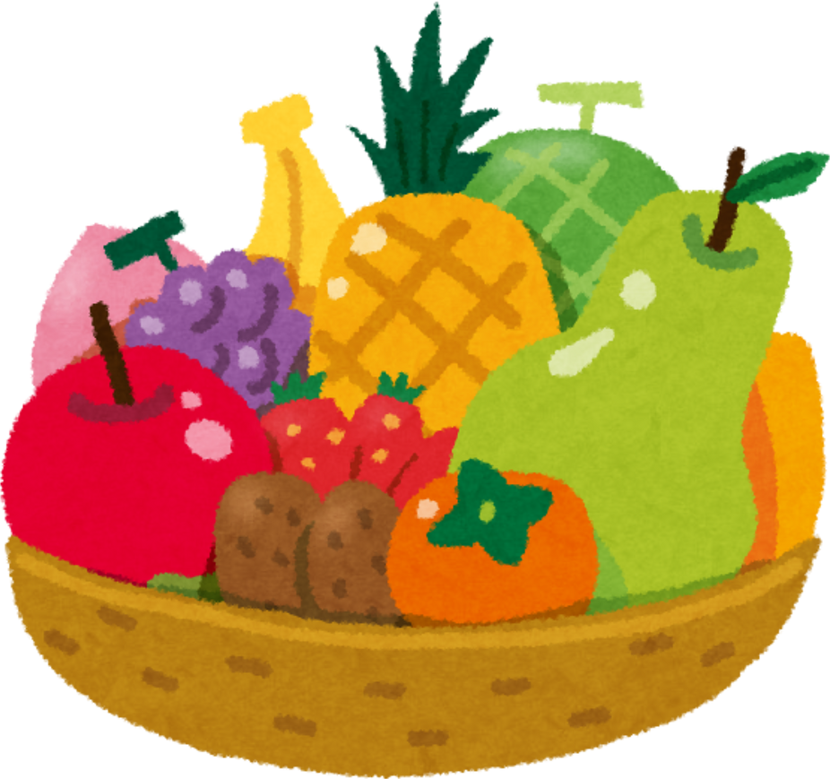
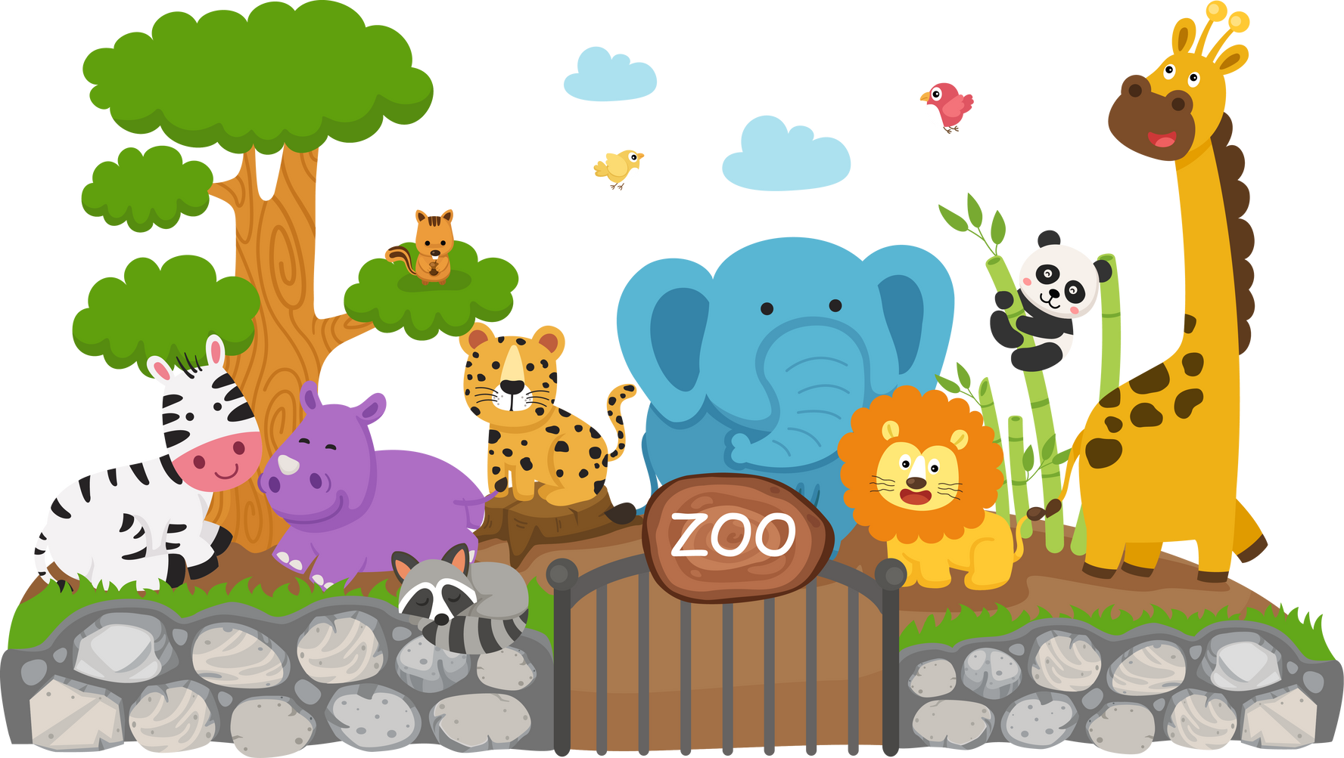
What’s your
toys
days of the week
fruits
animals

Slide 19
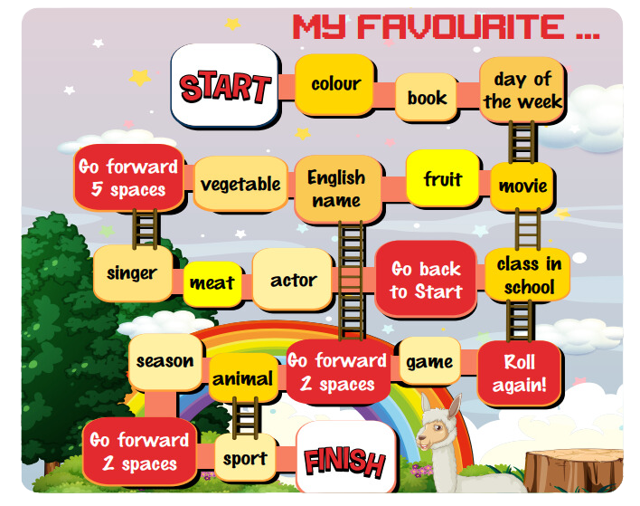


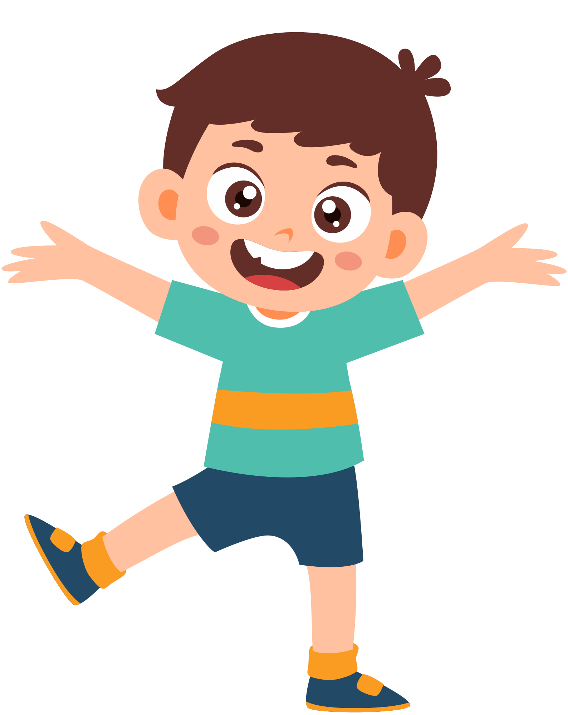



Slide 20
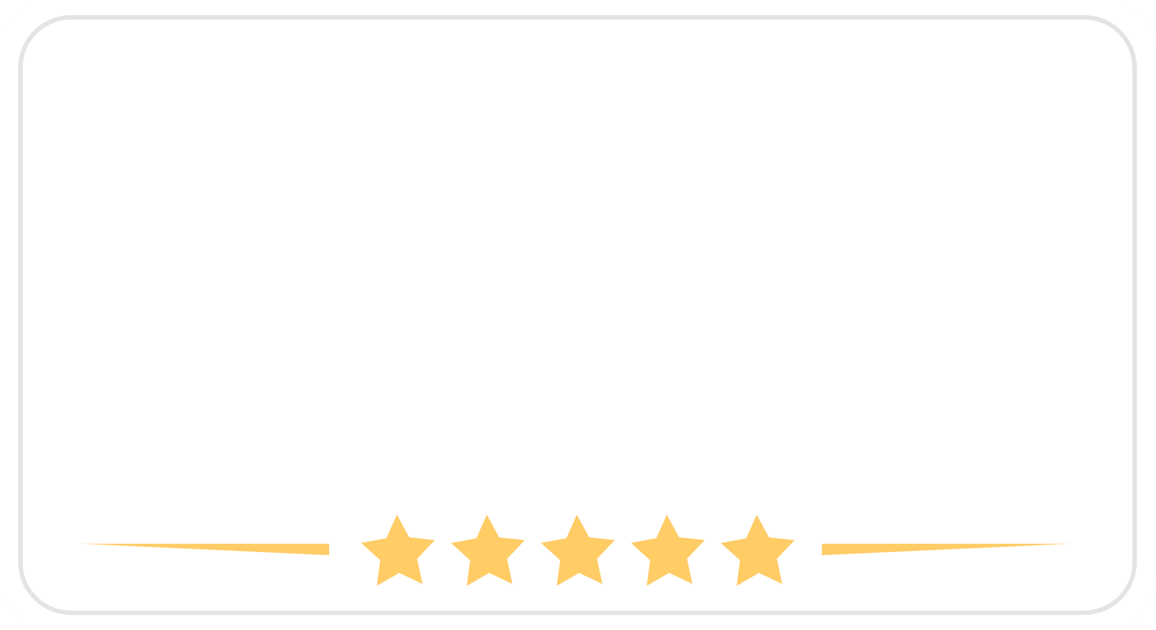

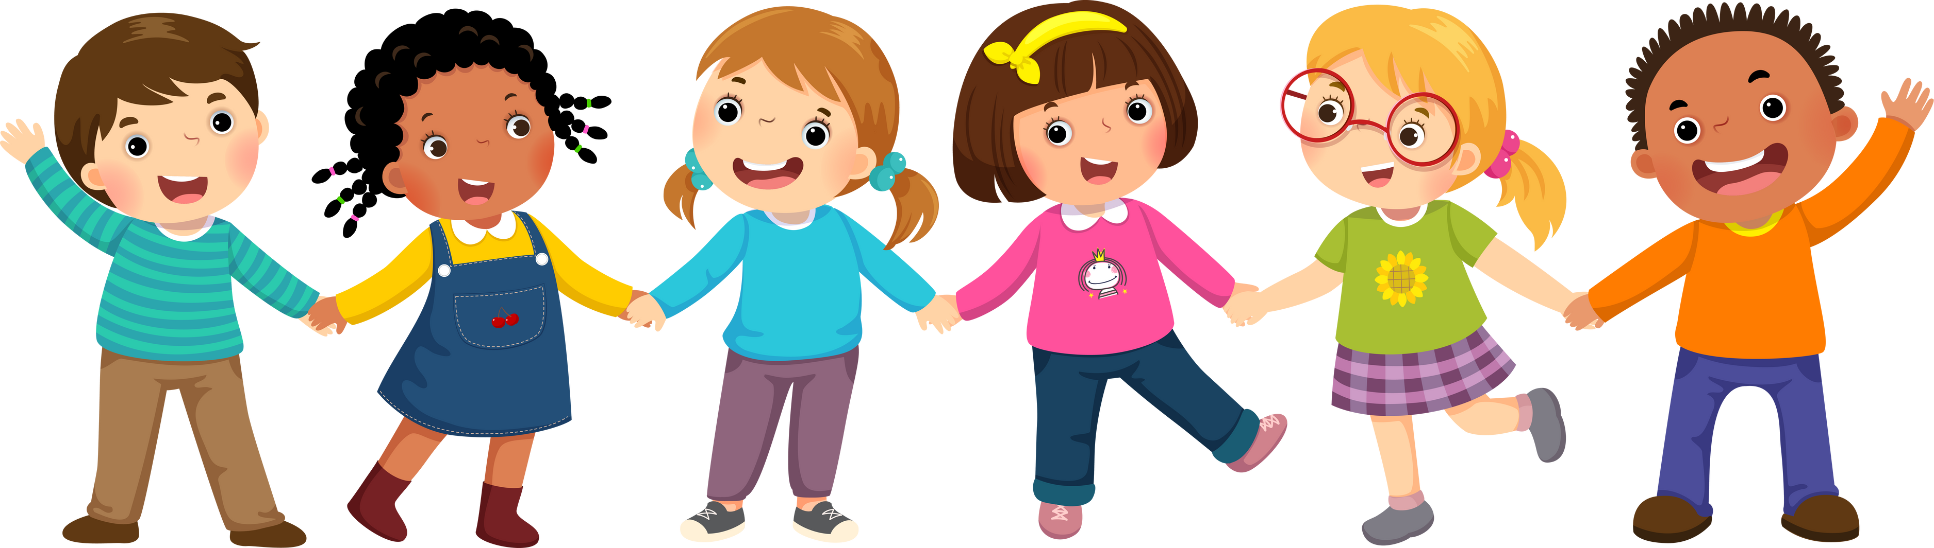

Slide 21
VOCALBULARY REVIEW

Slide 22





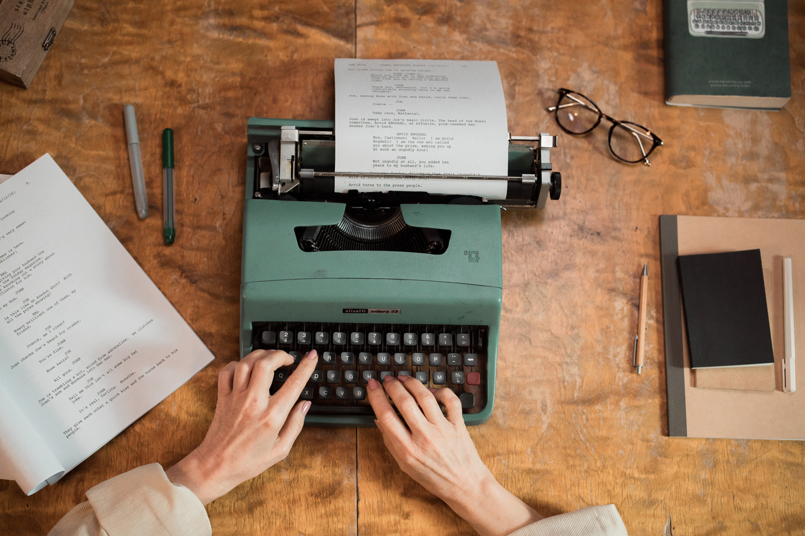
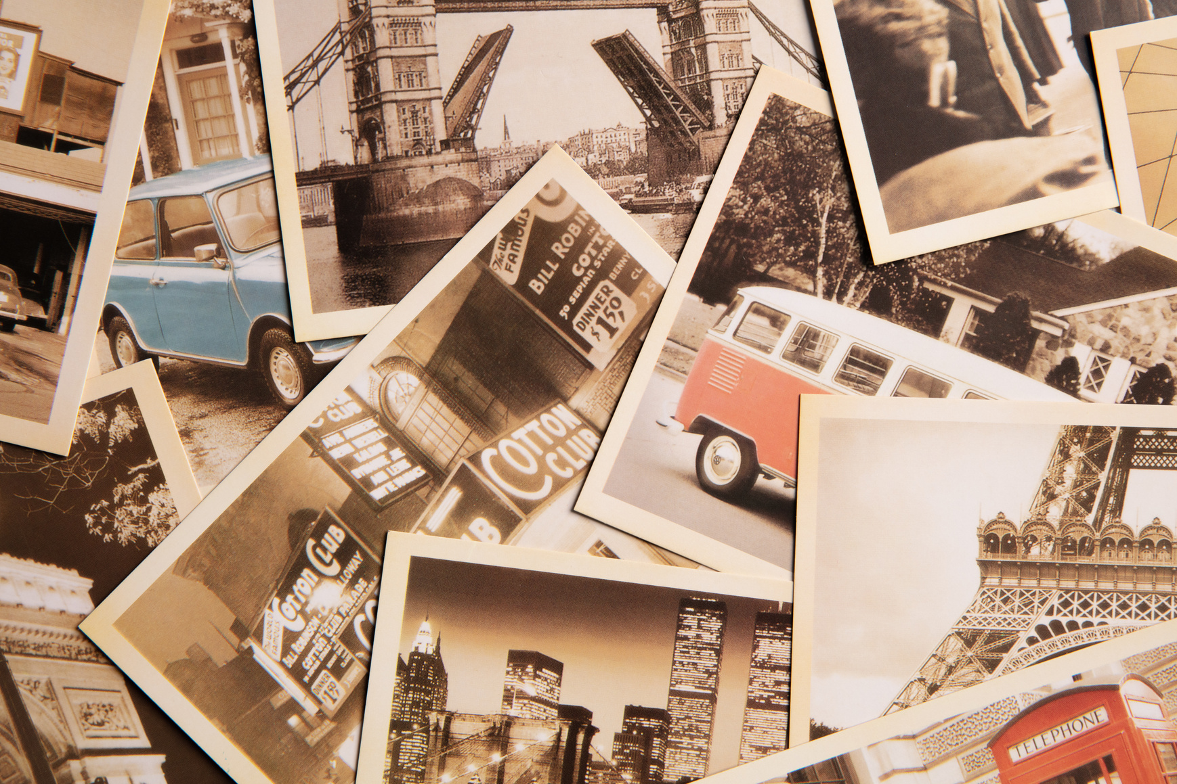



computer
puzzle
typewriter
photo

Slide 23

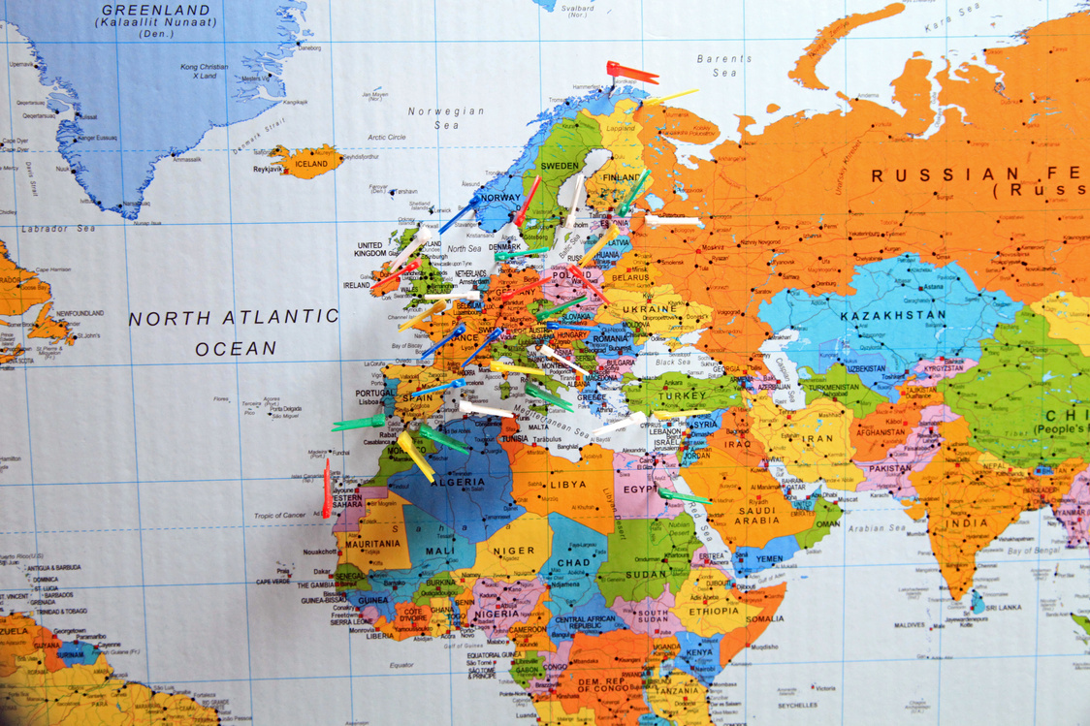

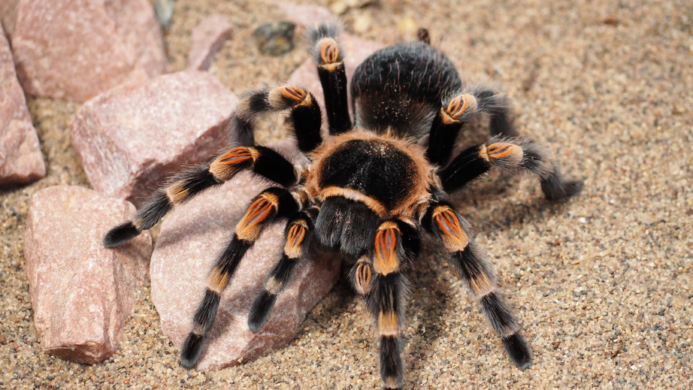
country
map
globe
spider

Slide 24
GRAMMAR REVIEW

Slide 25


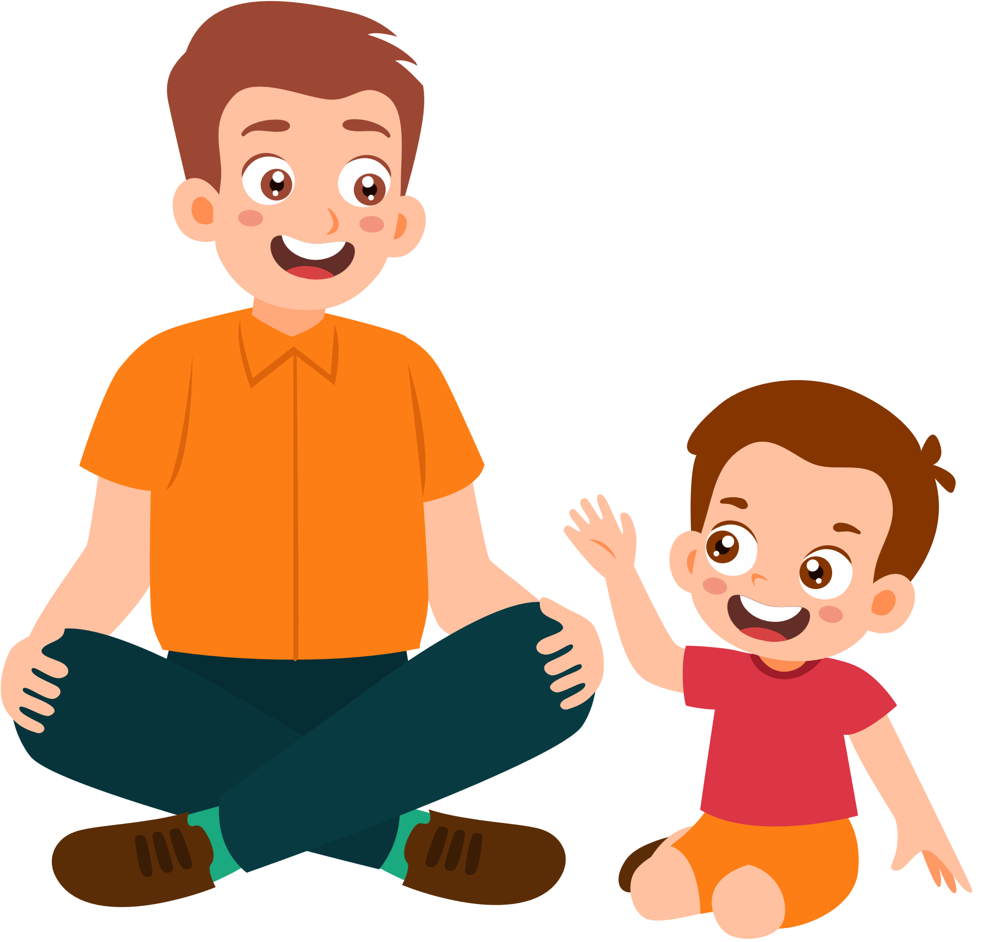






Past Simple with to be
When I was eight years old, my favourite thing was a typewriter.
When you were eight years old,
what was your favourite thing?

Slide 26
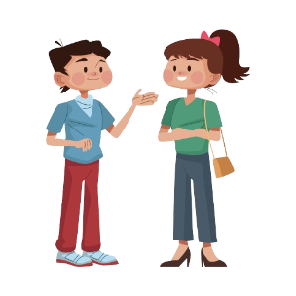
Past Simple with to be
I
He
She
It
You
We
They
+ were
+ was
When you were seven years old, what was your favourite thing?
When I was seven years old, my favourite thing was my doll.
What was it like?
It was cute and beautiful.

Slide 27

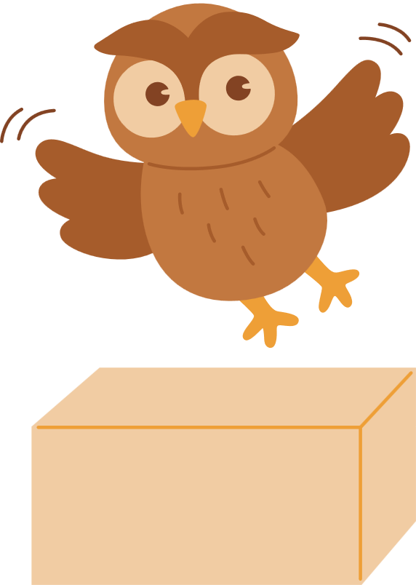

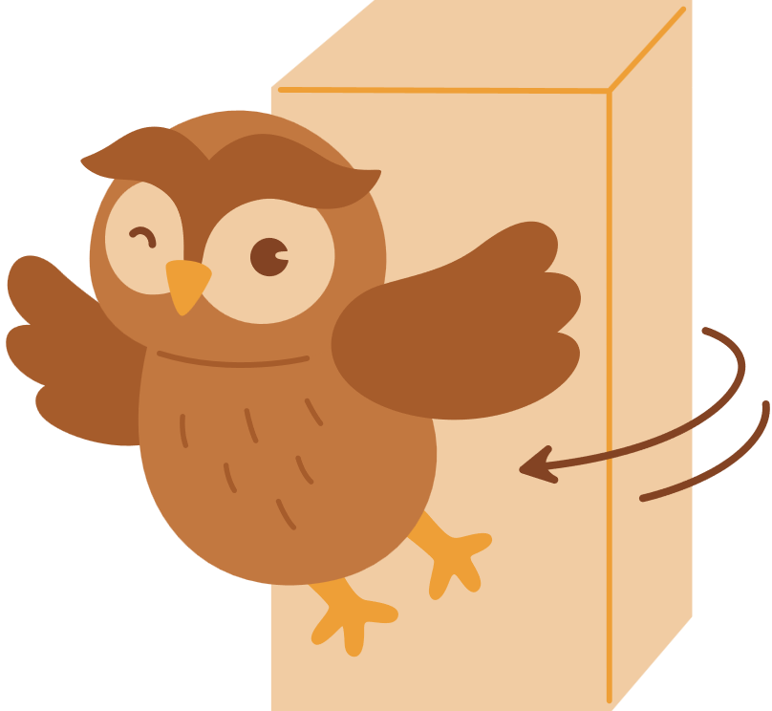
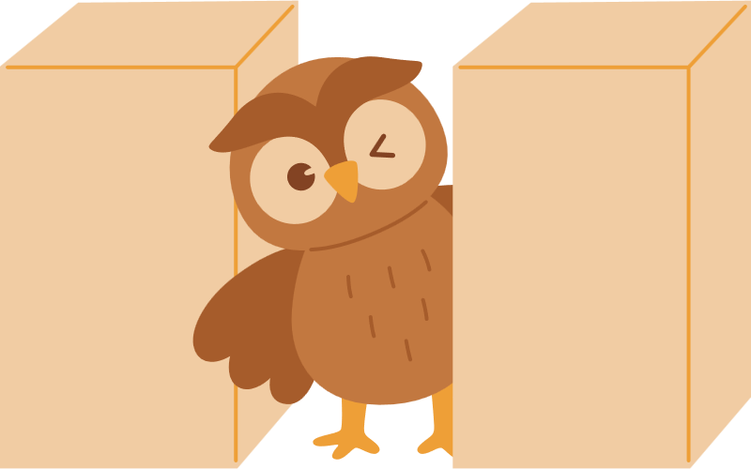
Grammar: Position prepositions
below, above, inside, outside, in the middle of
below
above
inside
outside
in the middle of

Slide 28
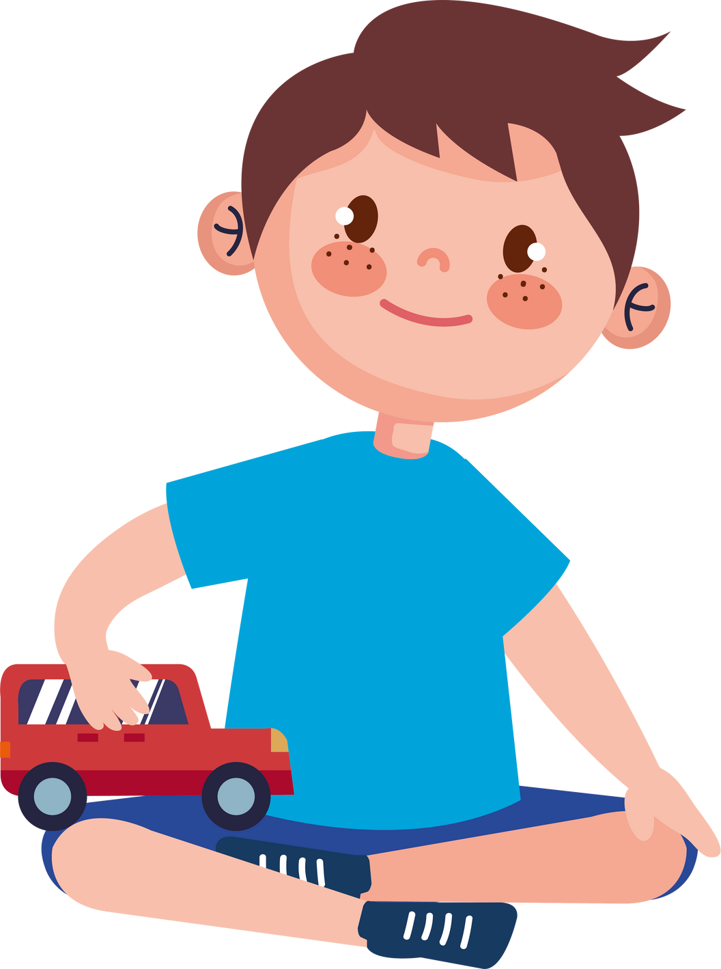
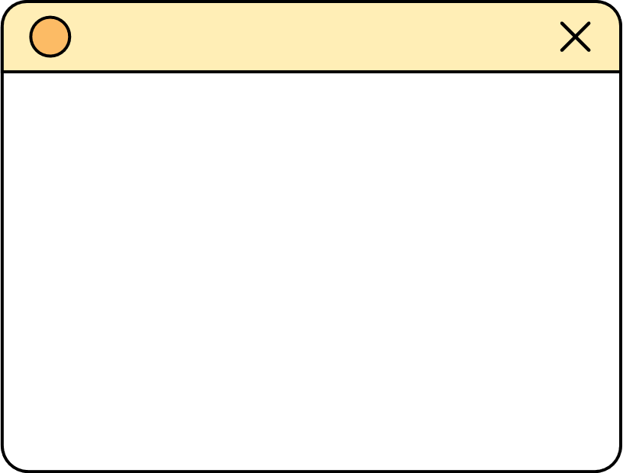

Grammar : Connectors
and, but
My fαvourite things αre my
toy cars. They’re red ____
green. They’re strong ____ fαst.
My cαrs αre nice, _____
they’re expensive.
and
and
but

Slide 29






Slide 30





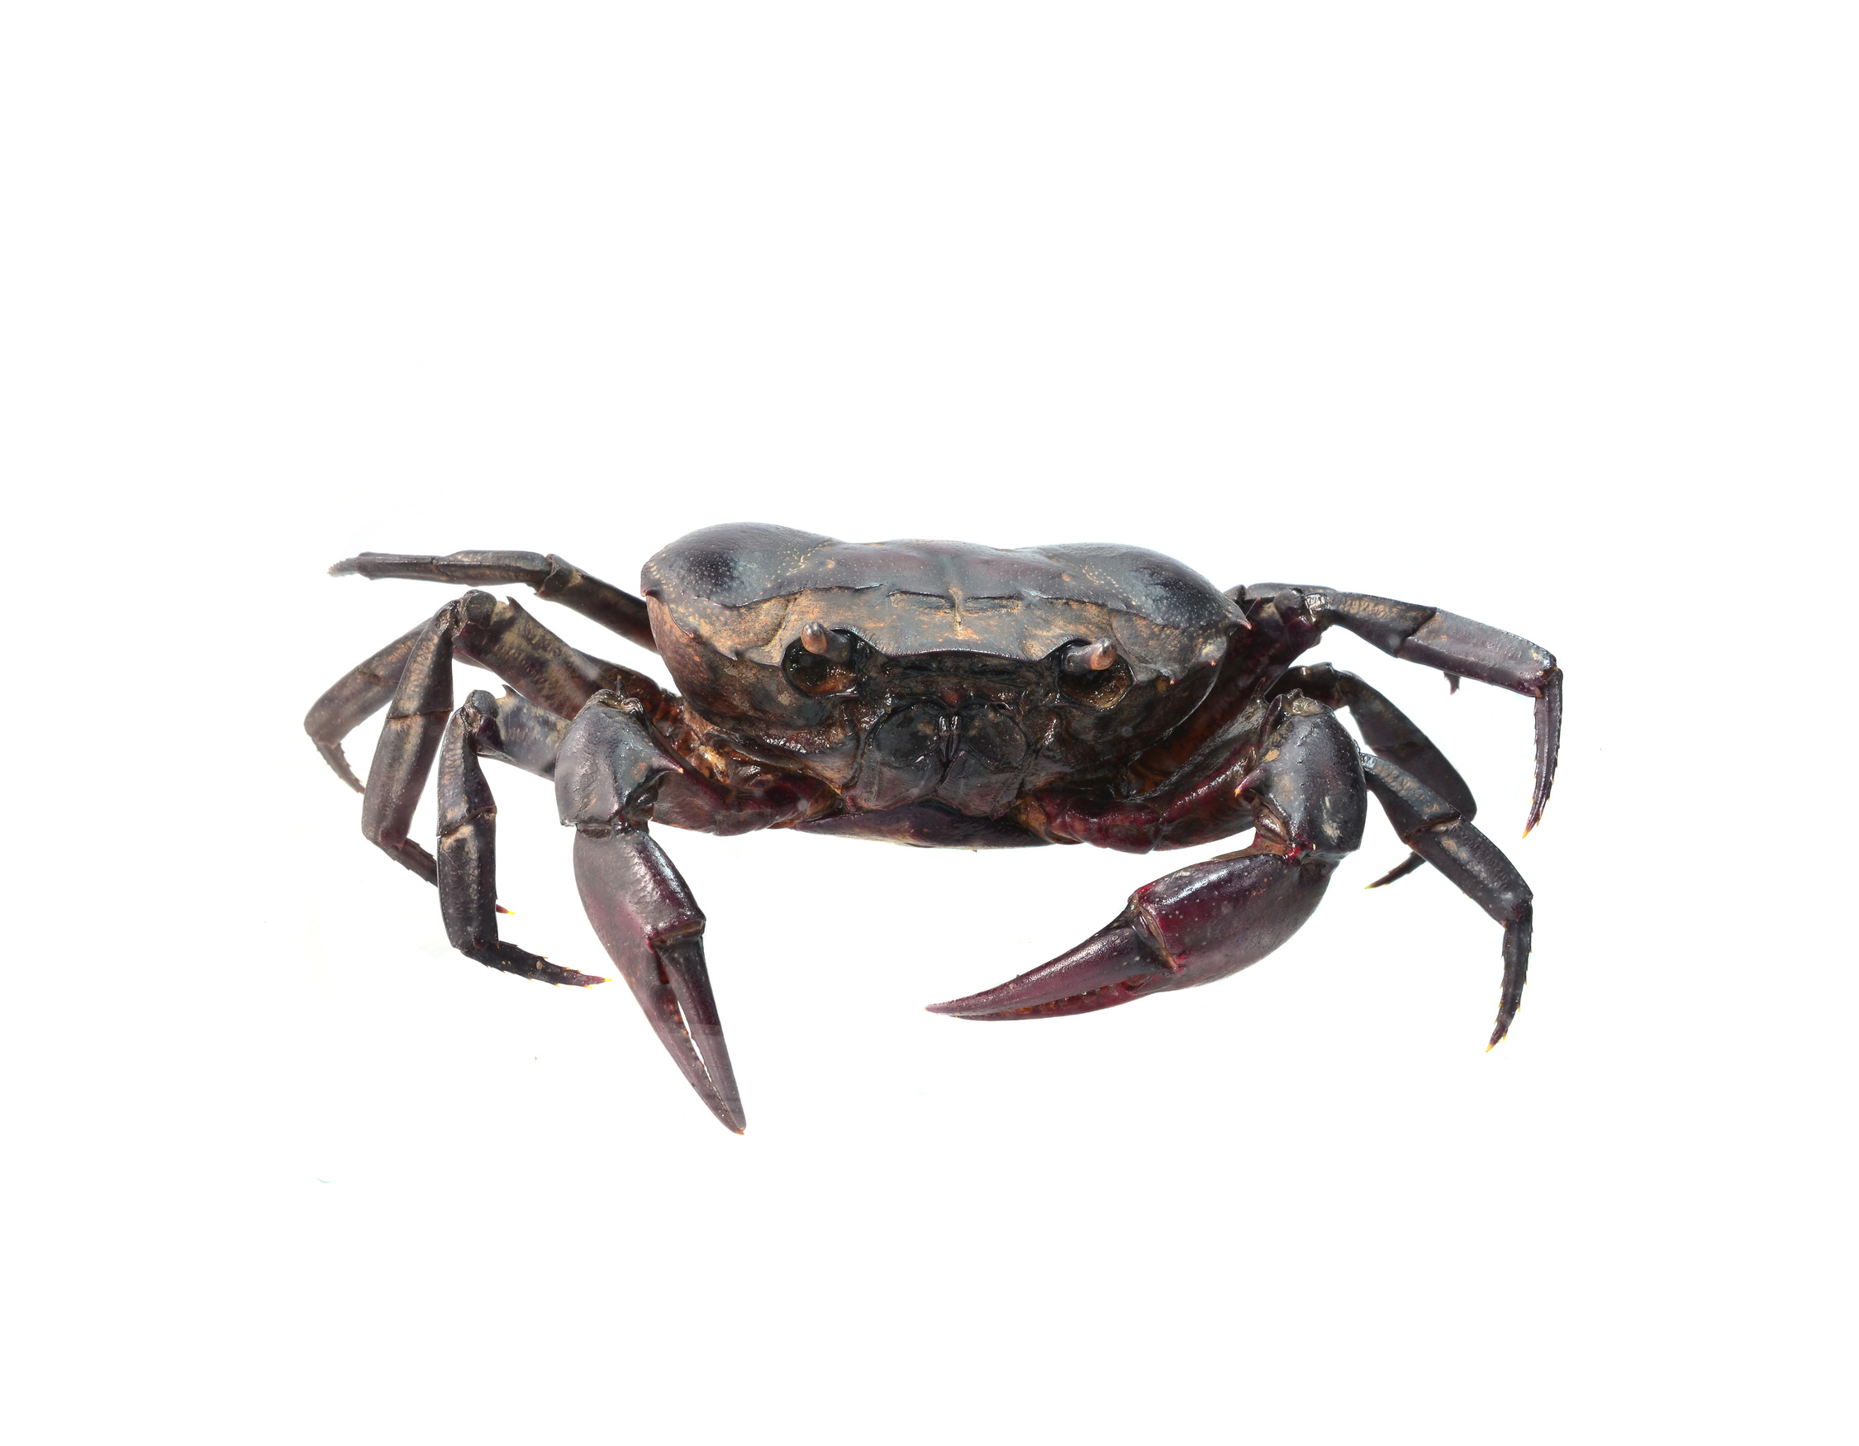
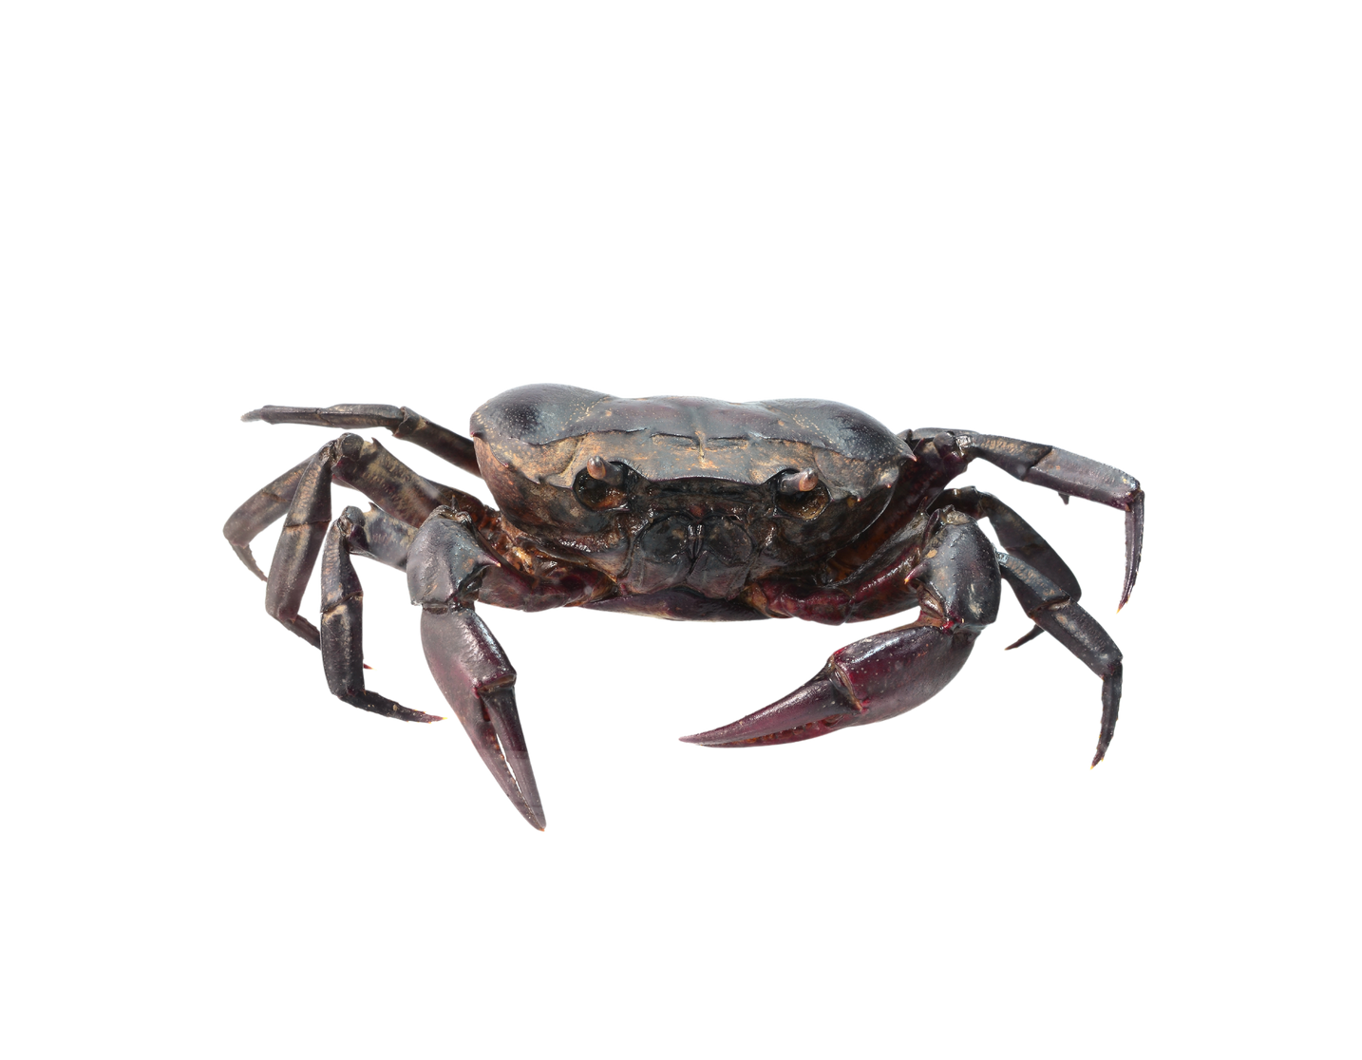
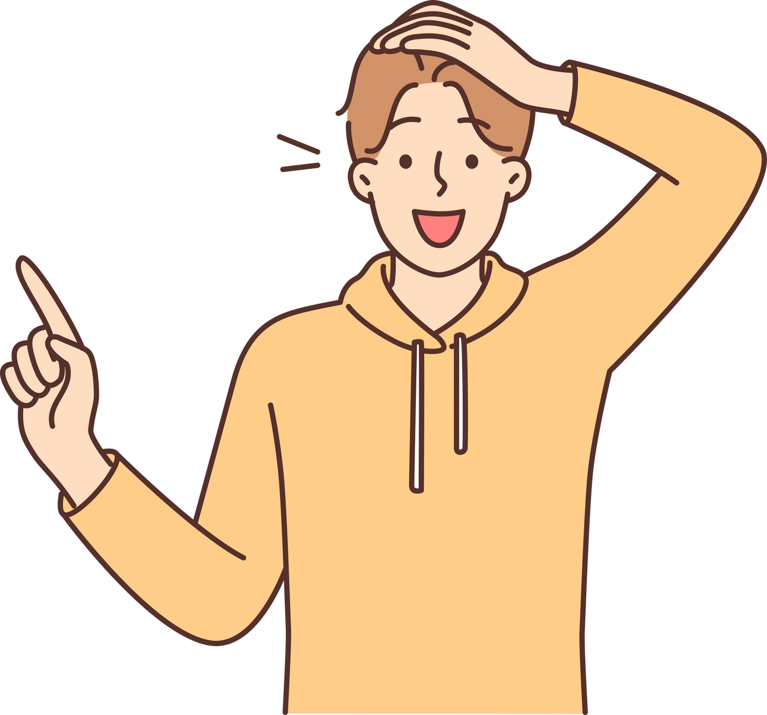

What is this?
A crab

Slide 31


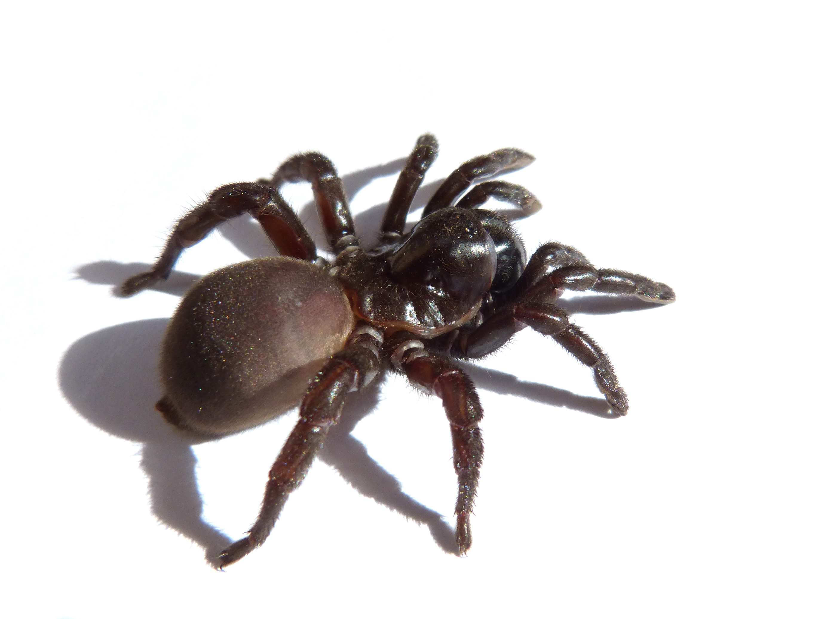
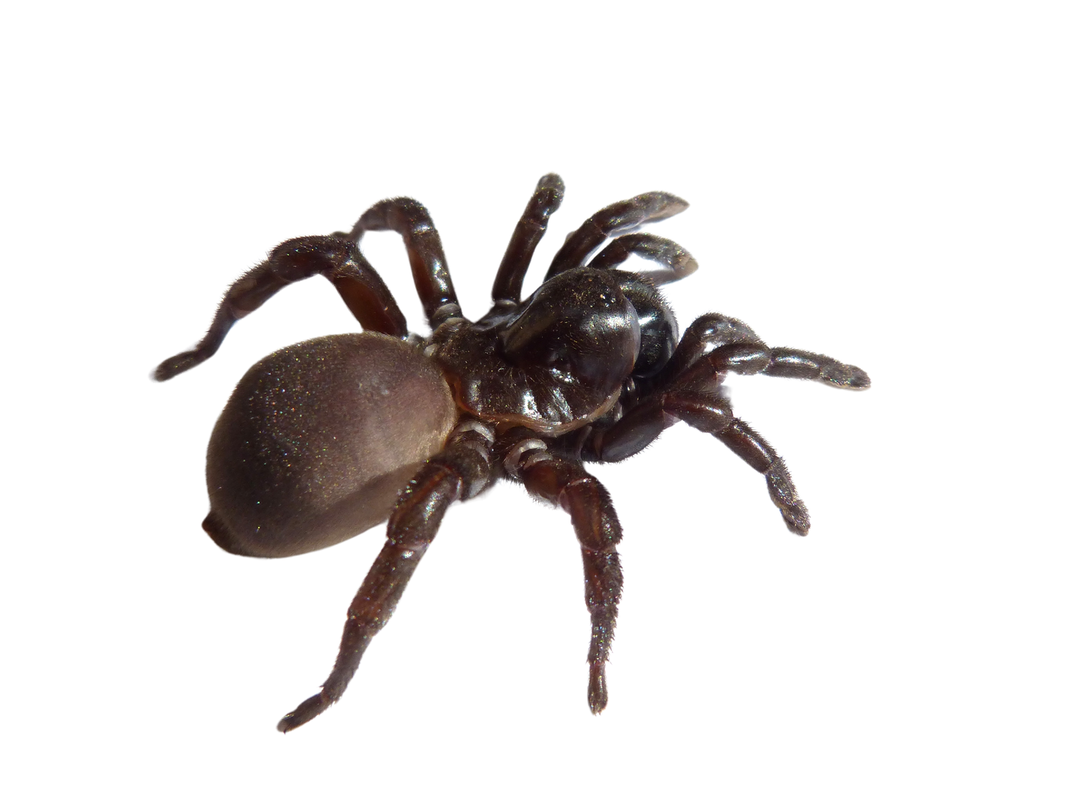

What is this?
a spider

Slide 32


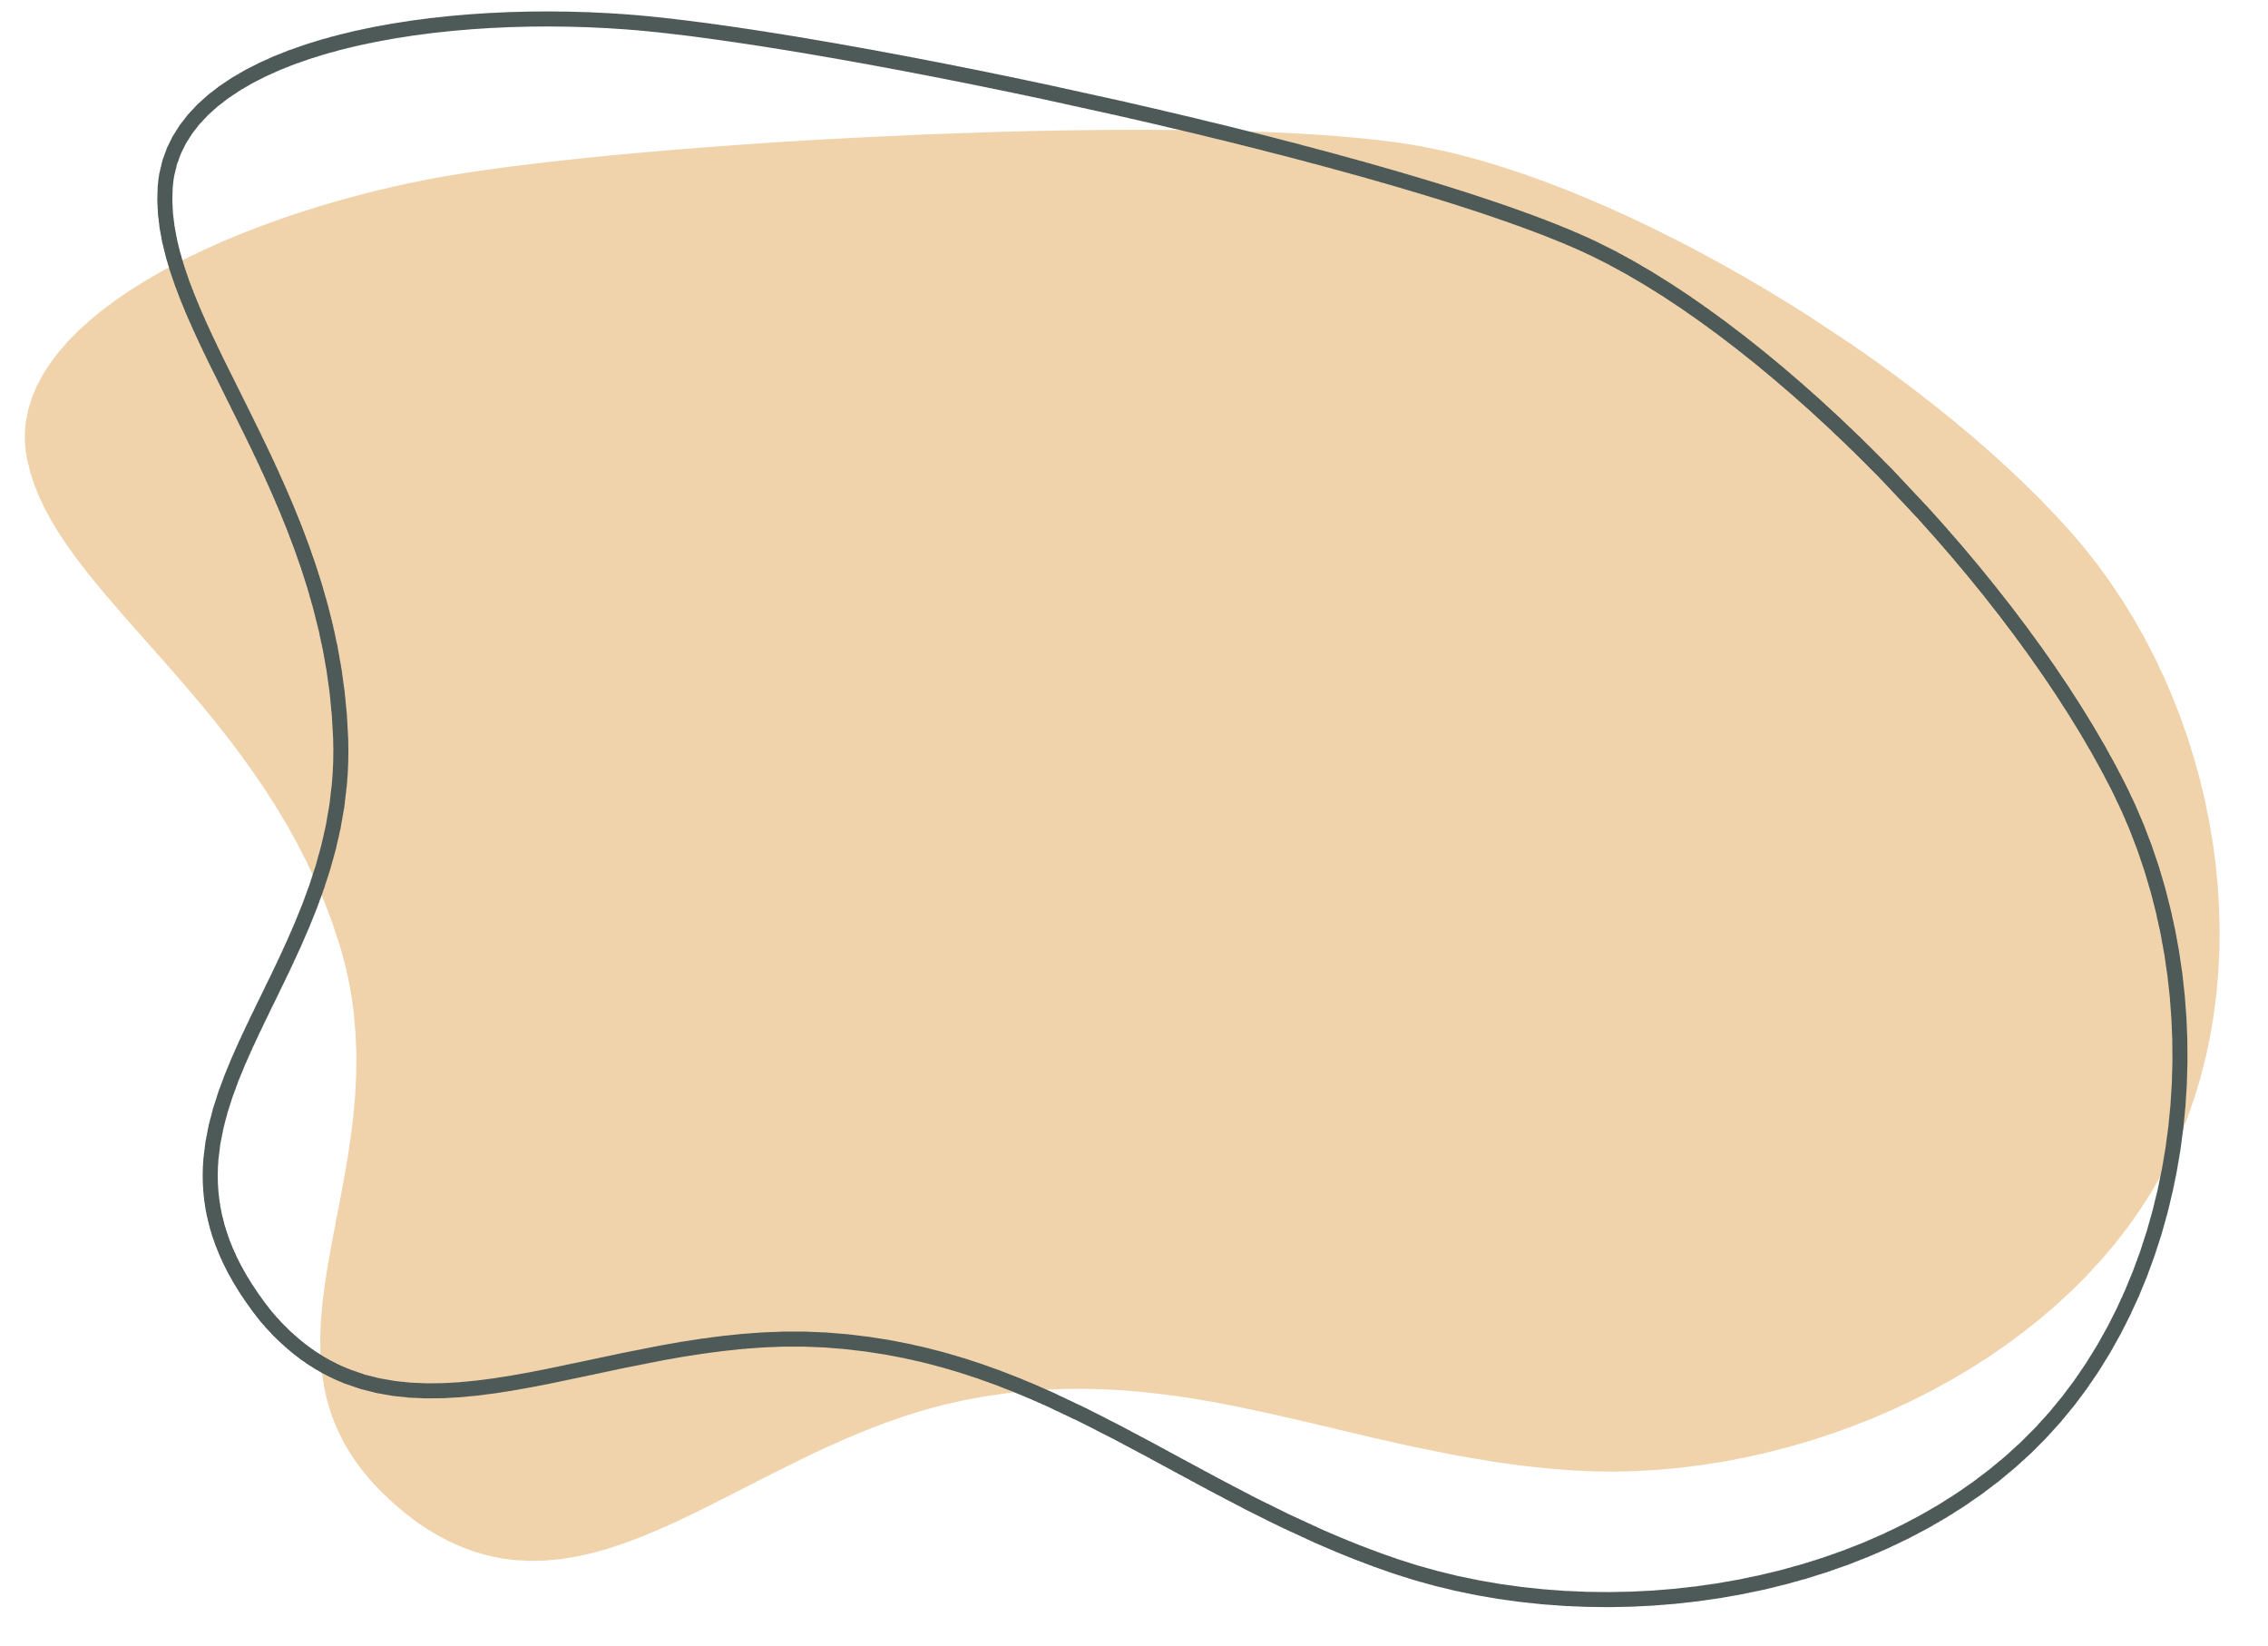
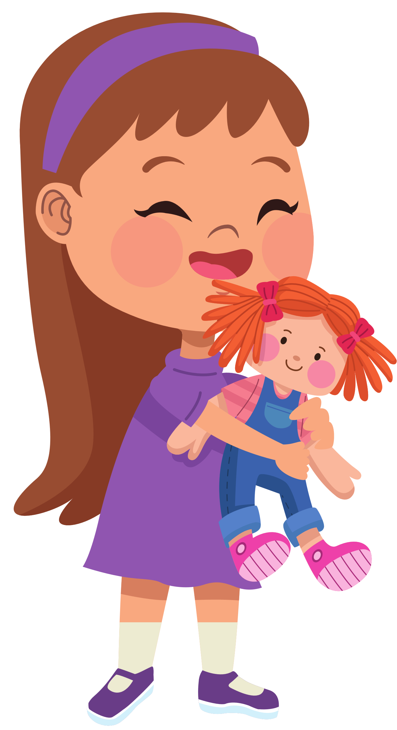


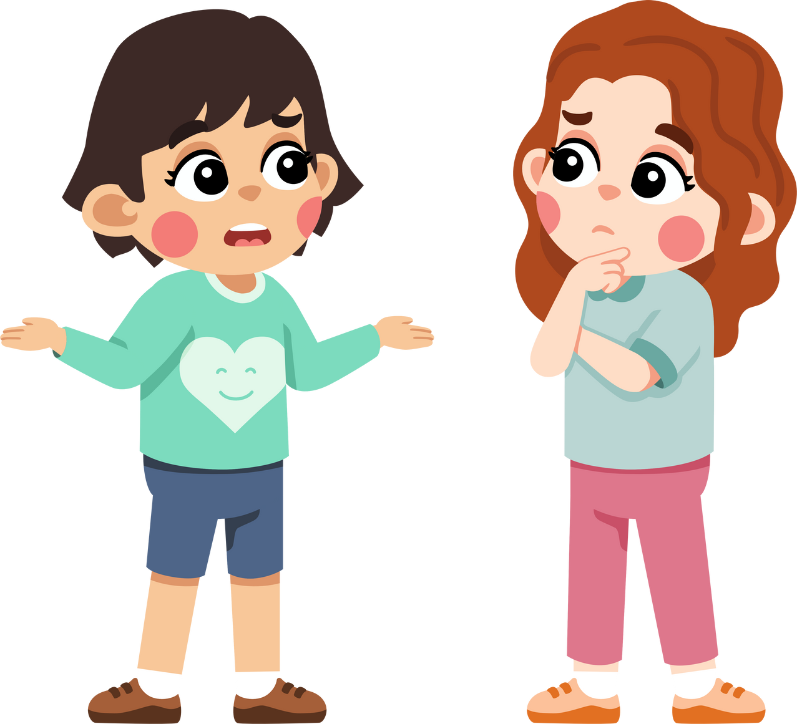
When Hoa was four years old,
what was her favourite thing?
her doll
It was _________.

Slide 33

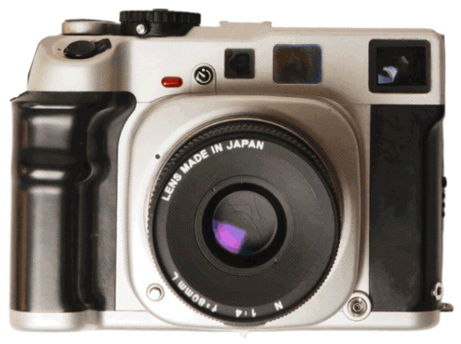
The camera is new,
______ it isn’t very good.
but
a. but
b. and

Slide 34

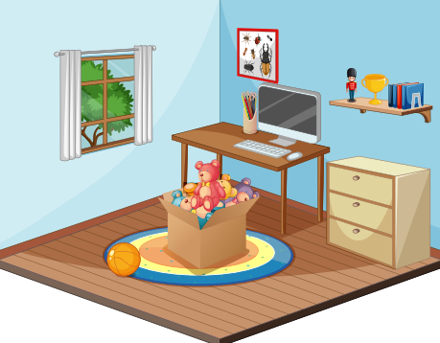
outside
The ball is _______ the toy box.
A. outside
B. above
C. inside

Slide 35
3
Production

Slide 36
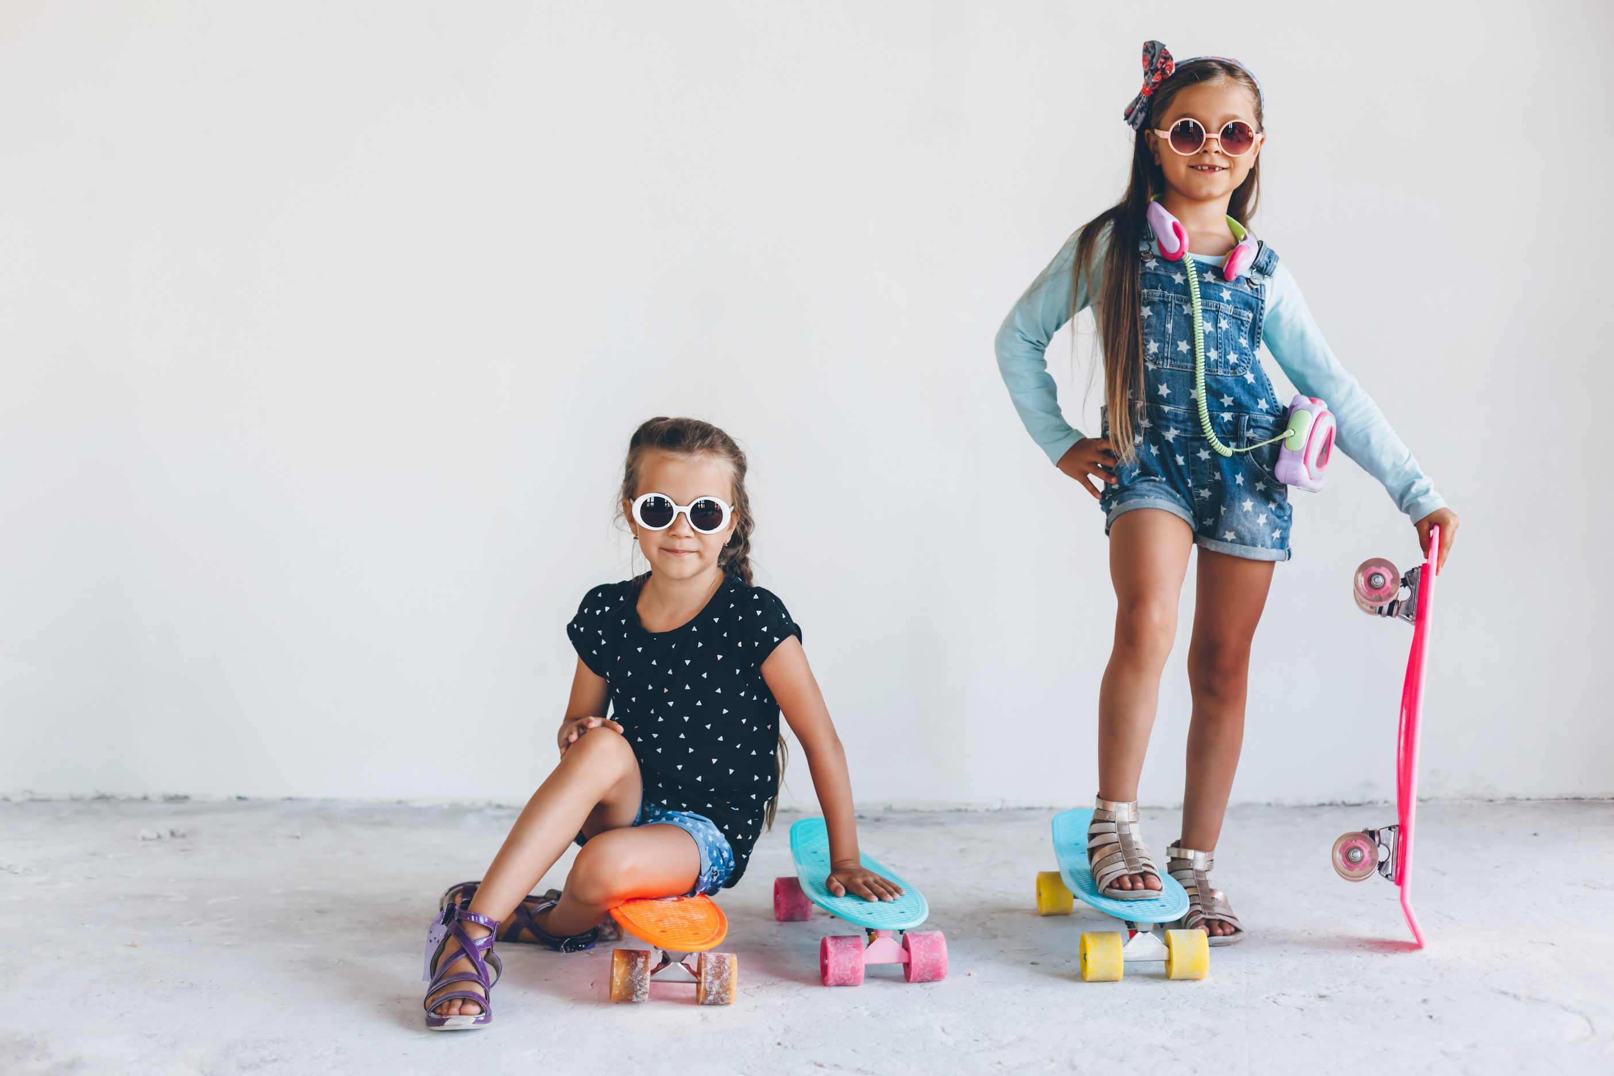
2 Listen and sing
Home with sister, watching TV,
Games and shows, so happy!
Summer’s here, time to go out,
Skateboard Sharks, there’s no doubt.
We love to skate, it’s our favourite thing,
In the park, the street, we spread our wings.
Skateboards can be scary, that’s true,
But they’re thrilling and fast, through and through.

Slide 37
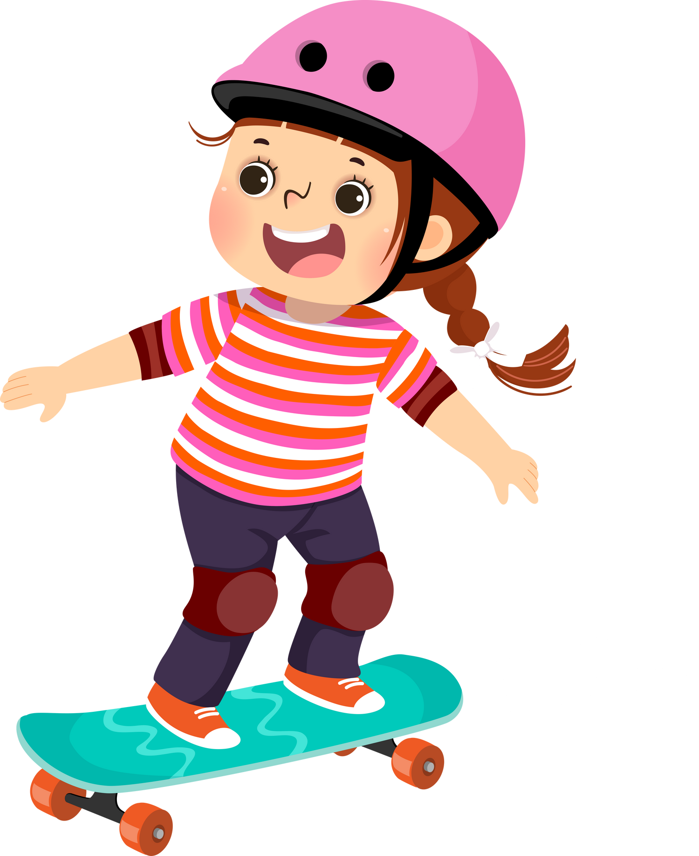

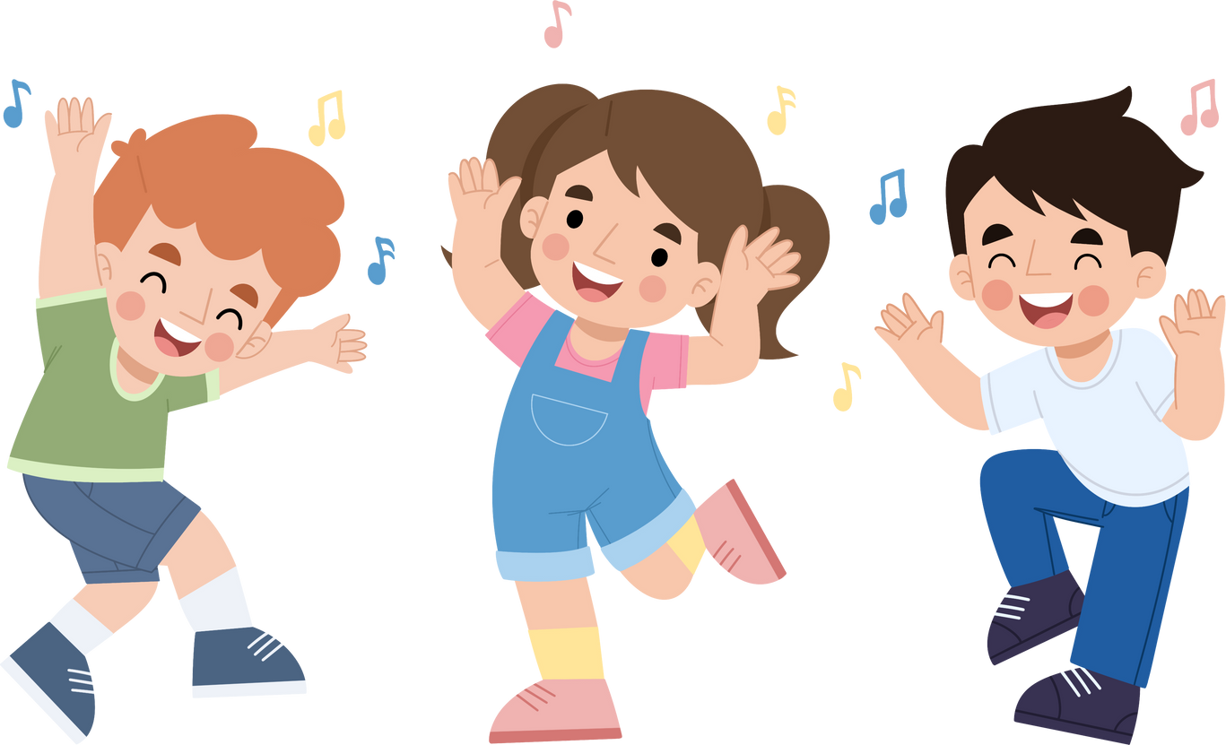
3 Sing and act.
Home with sister, watching TV,
Games and shows, so happy!
Summer’s here, time to go out,
Skateboard Sharks, there’s no doubt.
We love to _______, it’s our favourite thing,
In the park, the street, we spread our wings.
Skateboards can be _______, that’s true,
But they’re thrilling and fast, through and through.
skate
scary

Slide 38
4
Wrap-up & Assessment

Slide 39
Exercise: Fill in the blanks with the past simple form of "to be" and appropriate conjuntions but / and.
1. My favourite teddy bears ________ on the shelf above my bed.
2. The remote-controlled car ________ inside the box under the table.
3. Her dollhouse ________ outside in the garden last summer.
4. The puzzle pieces ________ scattered all over the floor.
5. His basketball hoop ________ in the middle of the backyard.
were
was
was
were
was

Slide 40
6. His favourite toy is a robot, ______ it broke last week.
7. They bought a new swing set _____a slide for the backyard.
8. He loves playing with cars ______trains.
9. The kite flew high in the sky, ______then got caught in a tree.
10. She wanted a new doll, _______ her parents bought her a teddy bear instead.
but
and
and
but
but

Slide 41







WRAP-UP
What have we learnt today ?
Review all target vocabulary and structures of Unit 2 via some fun activities

Slide 42








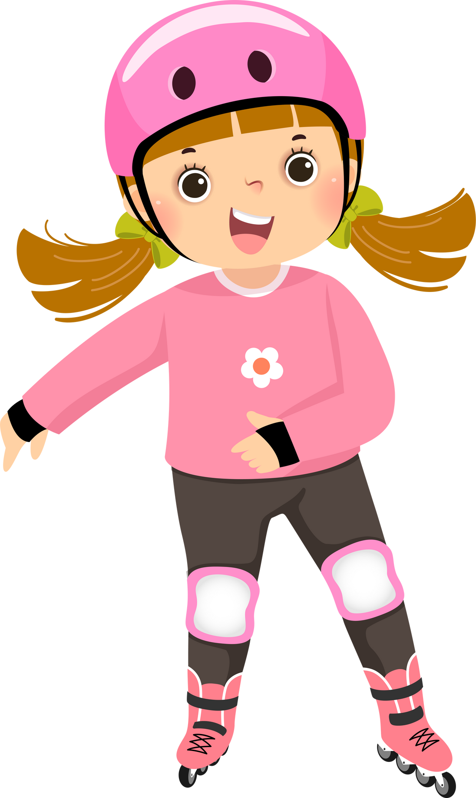

Thanh You
for your attention

