Slide 1





















Notes:
Để nguyên trang bìa như này, chỉ thay đổi tên bài trong quá trình làm. Logo của sách Wonderful World

Slide 2
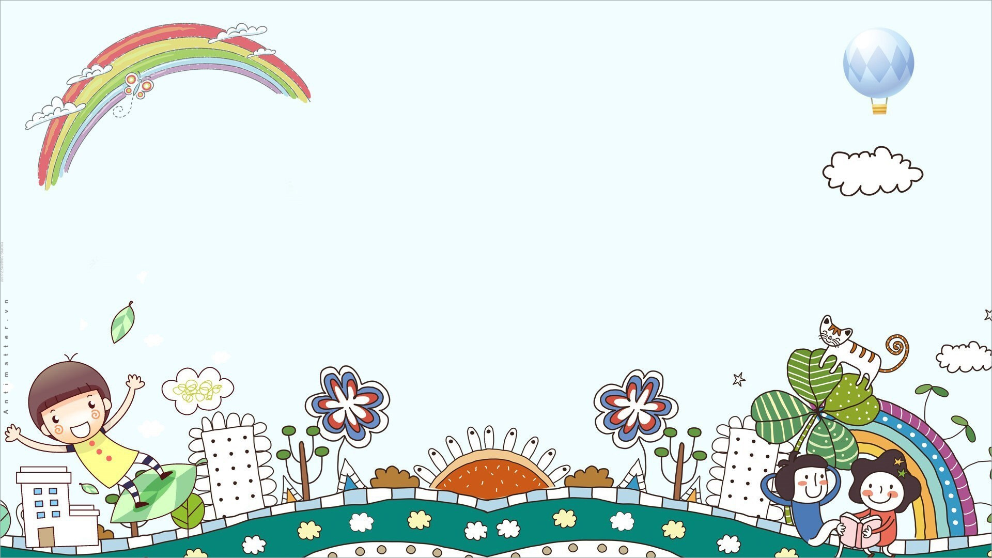




Unit: 4
FREE TIME
Lesson 2: Part 4, 5, 6

Slide 3





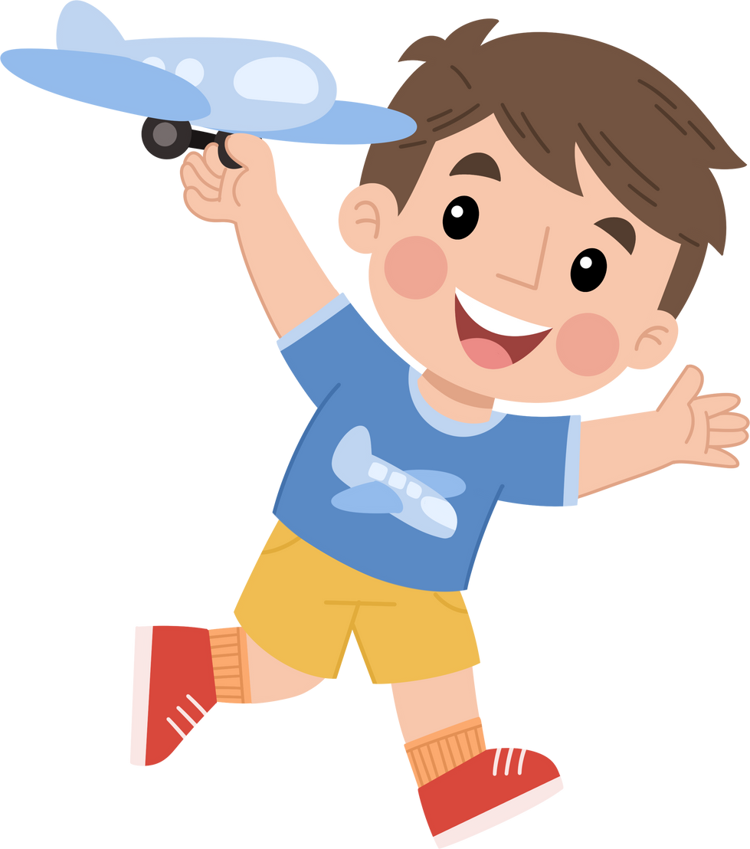



Table of contents
01
02
Warm-up
Presentation
04
Production
03
Practice
05
Wrap-up & Assessment

Slide 4
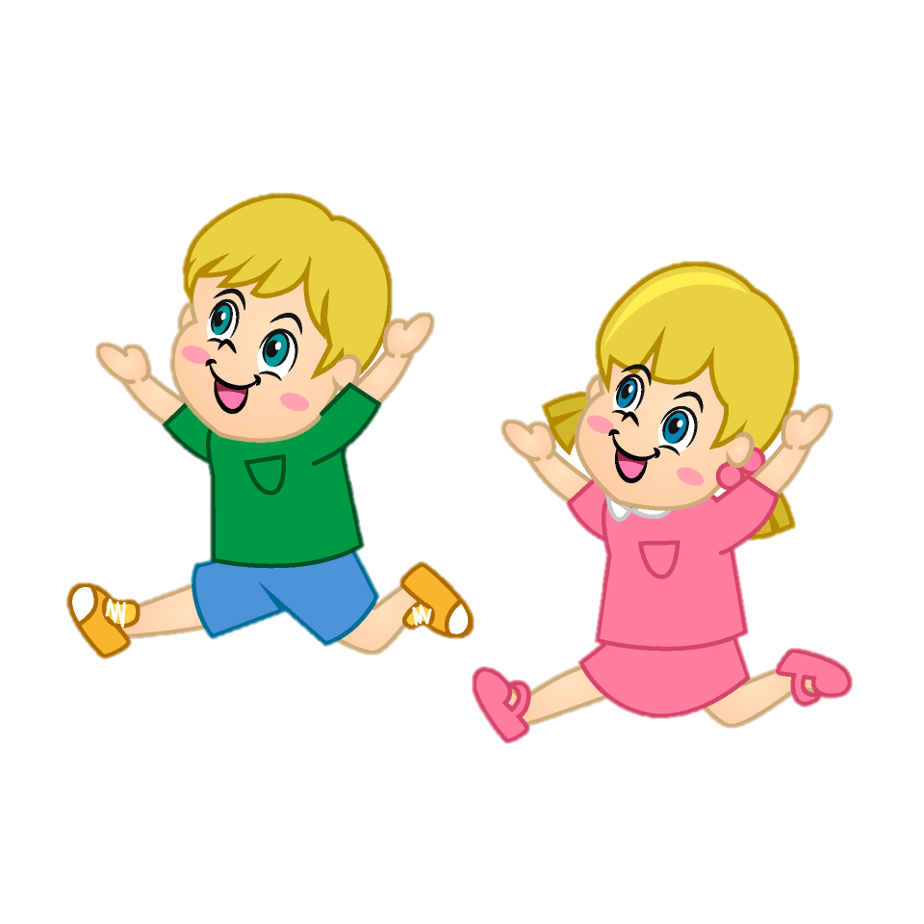
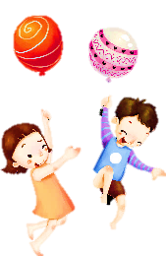


Warm-up
01
Let’s play a game:
“FREEZE”

Slide 5


Slide 6
Presentation
02

Slide 7



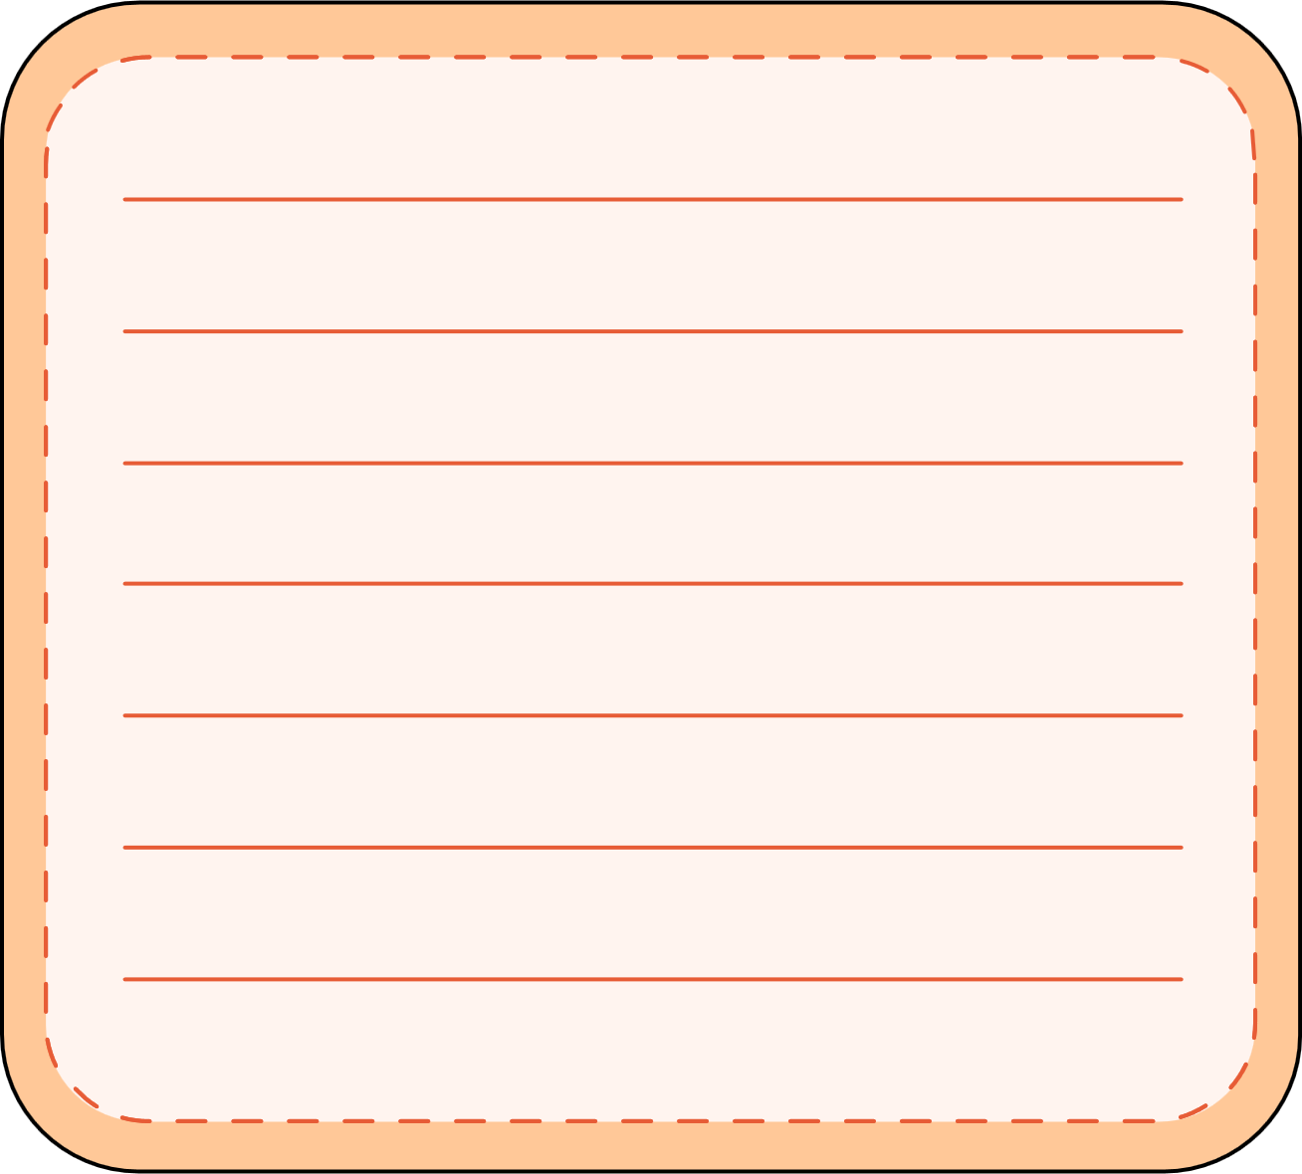


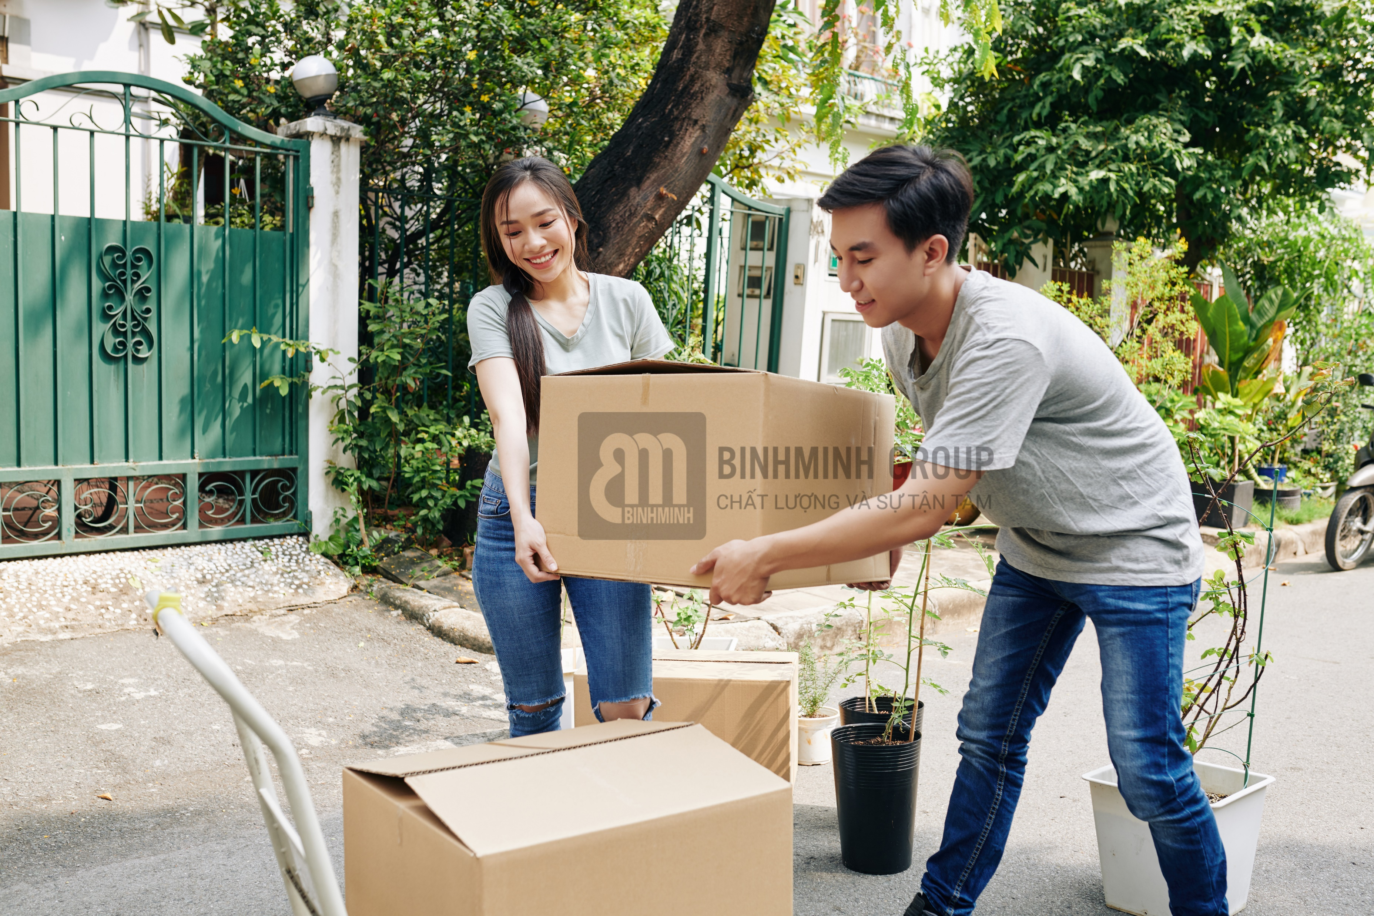

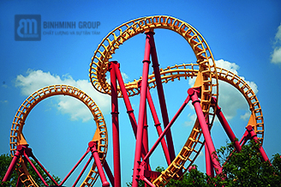
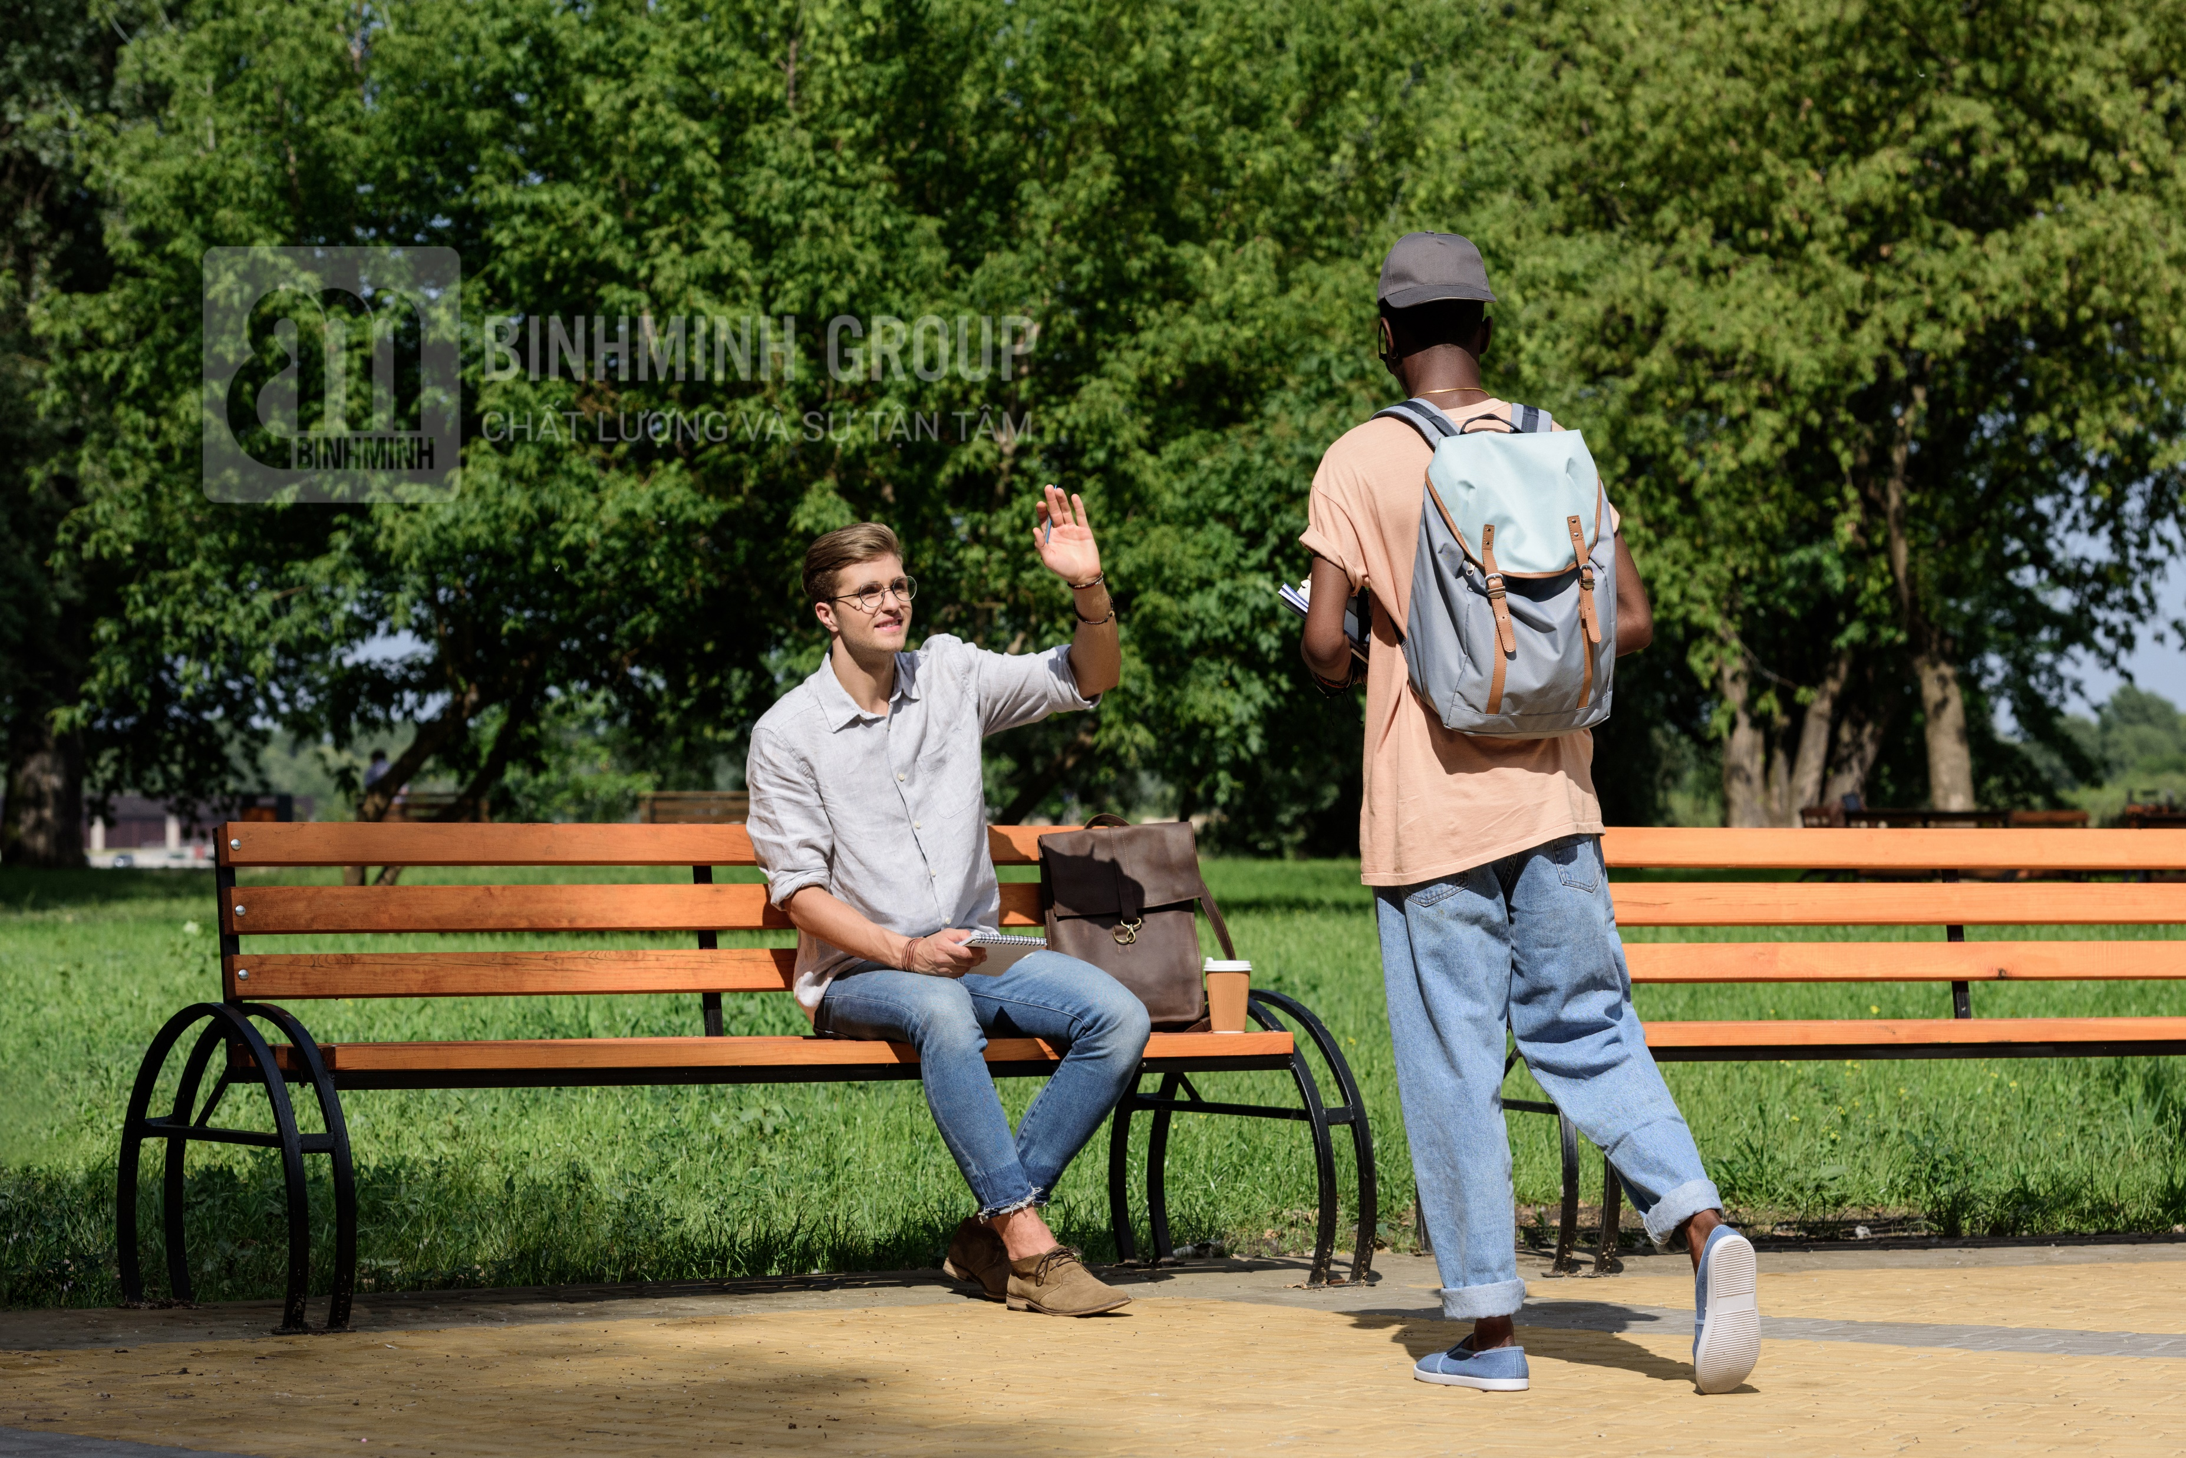


4 Listen and read. Then match and say.

Slide 8


4 Listen and read. Then match and say.
Dad, I need some books. Can I go to the bookshop now?
- Yes, you can.
2 Mum, can we go on a ride?
- No, you can’t. It’s scary.
✓
a
b
✓
3 Excuse me! These boxes are so
heavy. Can we put them here for
a few minutes?
- Yes, of course.
4 Excuse me, can I sit here?
- Sure, go ahead.
c
d
✘
✓

Slide 9






Grammar: can and can’t
“Can” is a modal auxiliary which is used for:
1. ability
Example:
I can go to the bookshop.
S + can/can’t + V infinitive + …
2. polite requests
She can’t swim well.
Can + S + V infinitive +…?
✓ Yes, S + can.
x No, S + can’t.
= cannot.
Can we go on a ride?
Yes, we can.
x No, we can’t.

Slide 10








Practice speaking
Mini-game:
Lucky the colors

Slide 11











Lucky the colors
10 stars
4 stars
2 stars
1 star
20 stars
1 star
15 stars
8 stars
10 stars
1
2
3
4
Notes:
Ấn vào trái tim link với các bức tranh để làm hội thoại.
Bấm vào mũi tên chuyển học phần tiếp theo.

Slide 12
Sure, go ahead.
Excuse me,
can I sit here?
Notes:
Bấm vào bông hoa quay trở lại chọn màu lấy sao cho đội.

Slide 13

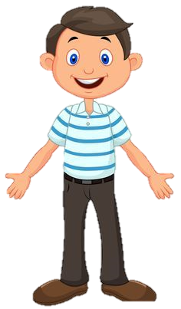

Yes, you can.
Dad, I need some books.
Can I go to the bookshop now?

Slide 14
Yes, of course.
Excuse me!
These boxes are so heavy. Can we put them here for a few minutes?

Slide 15
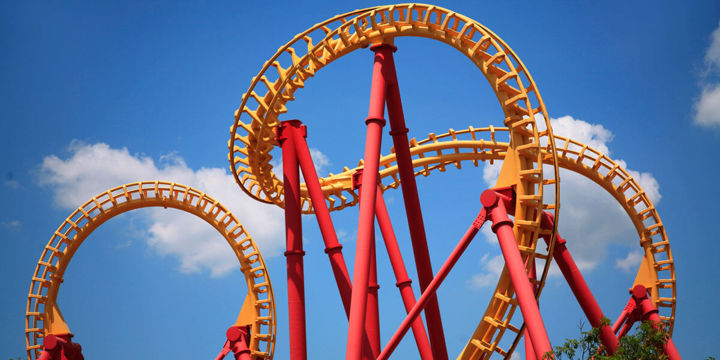
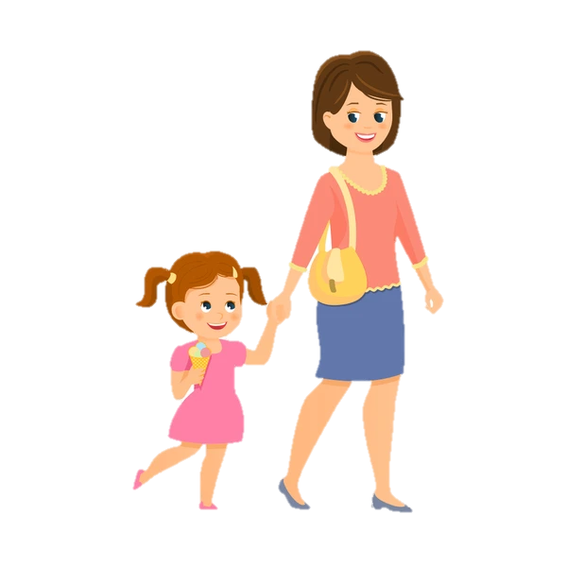
Mum, can we go on a ride?
No, you can’t. It’s scary.

Slide 16
Practice
03

Slide 17



5 Complete with can / can’t.
1 A: Mum, ____ Sarah and Mifa go on a ride with me?
B: No, they ____ . They’re too young.
2 A: Excuse me, ____ I move your bag a little bit, sir?
B: Yes, I’m sorry.
3 A: Oh, no. I don’t have my pencil with me. ____ I borrow
your pencil, Mai?
B: Sure! Here it is.
4 A: Teacher, ____ I go out for 5 minutes?
B: I’m sorry, you ____ .
can
can’t
can
Can
can
can’t

Slide 18
6 Write the correct questions to ask for your mother’s permission.
go to the park go to the bookshop go to the museum
go to the cinema play the piano

Slide 19
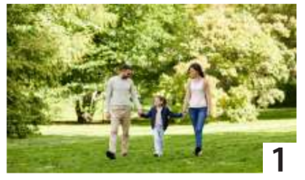

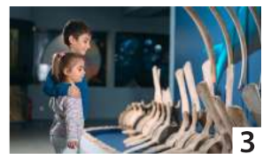
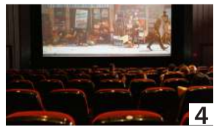
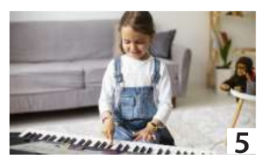
6 Write the correct questions to ask for your mother’s permission.
go to the park go to the bookshop go to the museum
go to the cinema play the piano
Mum, can I go to the museum?
Mum, can I go to the park?
Mum, can I go to the bookshop?
Mum, can I go to the cinema?
Mum, can I play the piano?

Slide 20
Production
04

Slide 21

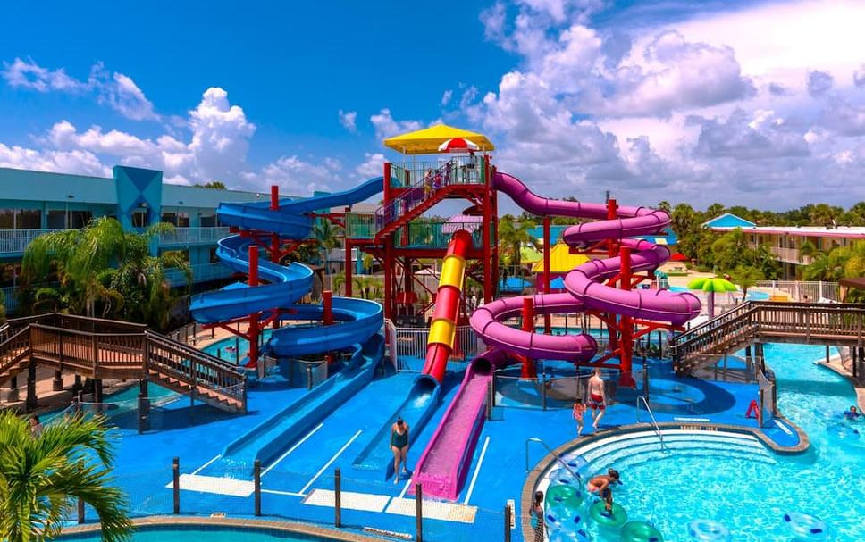
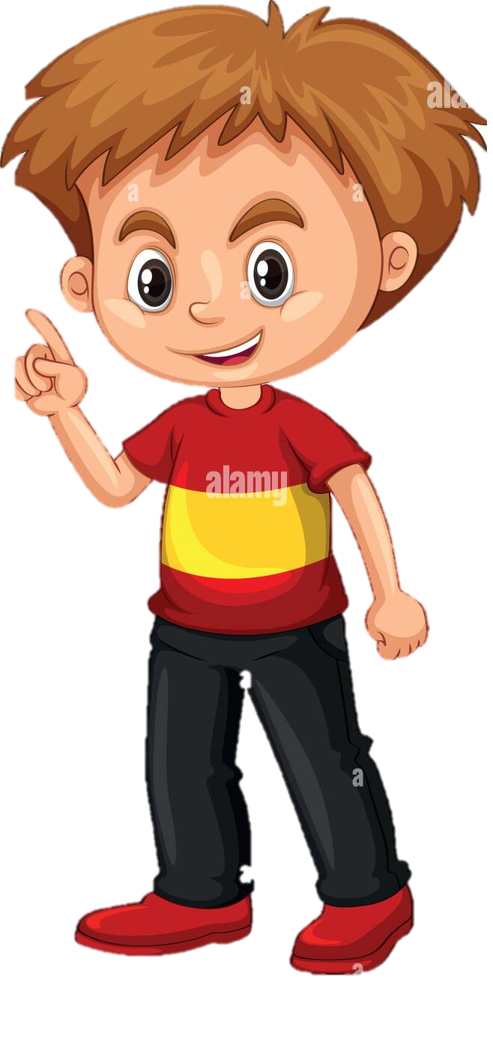
Yes, we can.
Dad, the weather is so hot. Can we go to the water park?

Slide 22
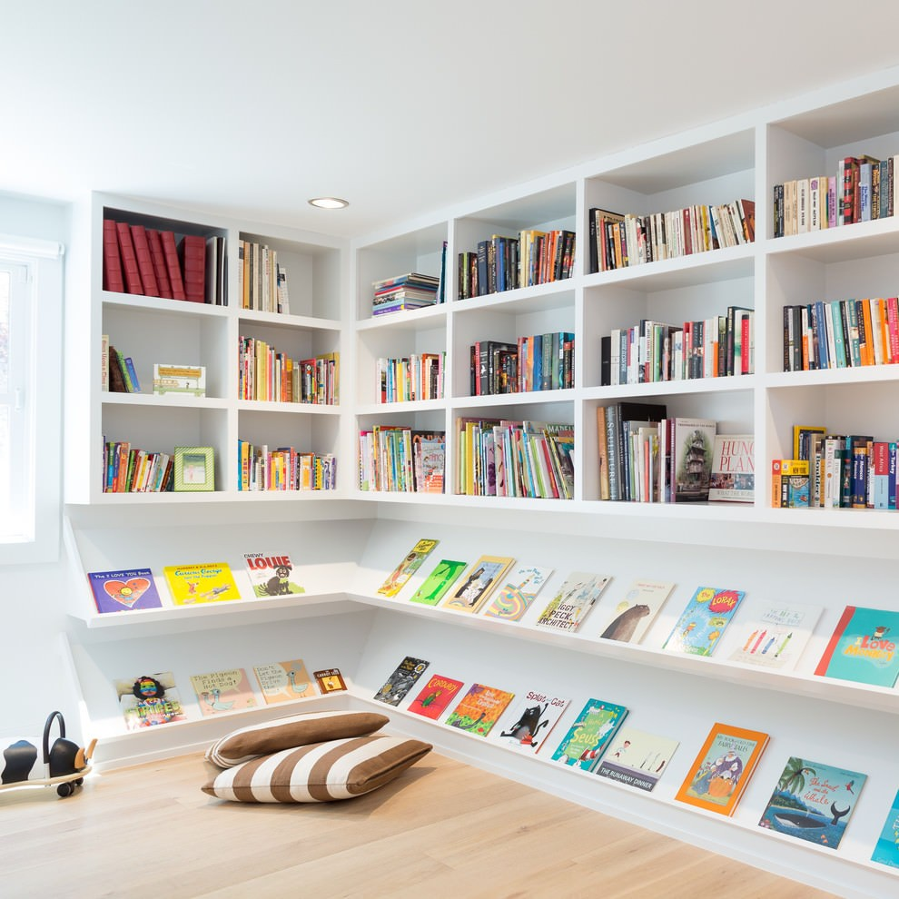
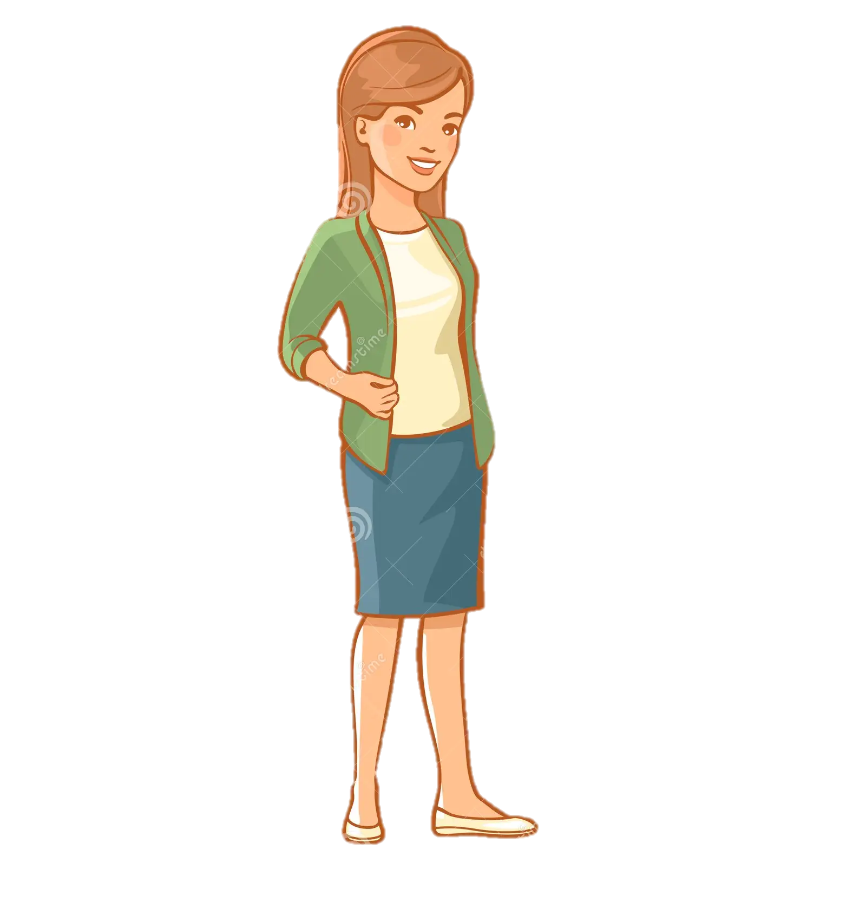
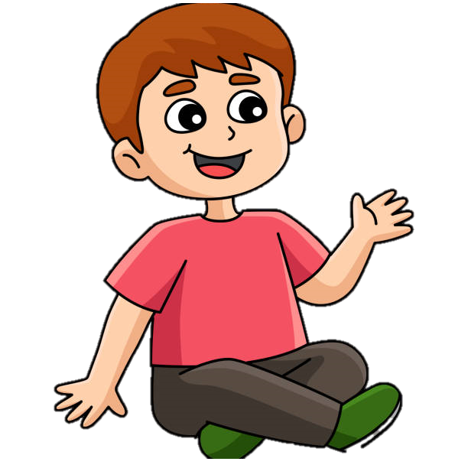
Yes, of course.
Mum, can you get the red book for me, please?

Slide 23
Wrap-up & Assessment
05

Slide 24








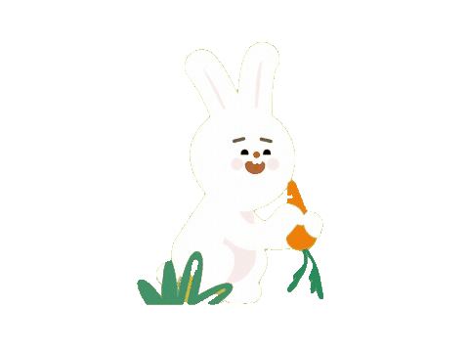

Pick a carrot

Slide 25




Do you want to try?
I am hungry. Can you give me a carrot?
I will let you pick up your own carrots.
Yes, I agree!

Slide 26





Rearrange the sentence :
I / Can / bookshop / to / go /the /?
A : Can I go to the bookshop?
B : I can go to the bookshop?
C : go to I can the bookshop?
D : the bookshop can I go to?
A B C D

Slide 27
Rearrange the sentence :
I / Can / cinema / to / go /the / ?
A : I Can go to the cinema?
B : Can I go to the cinema?
C : Can I go the cinema to?
D : the cinema I Can go to?
A B C D

Slide 28

Rearrange the sentence :
we / put / Can / here / for / them / minutes / a / few /?
A : we Can put a few minutes them for here?
B : Can we put them for here a few minutes?
C : Can we put them here for a few minutes?
D : Can we put a few minutes for here them?
A B C D

Slide 29

Rearrange the sentence :
can / the / play / She/ piano/ .
A : the piano play can she.
B : She play the piano can.
C : can She the piano can.
D : She can play the piano.
A B C D

Slide 30
Can we go to the amusement park ?
✓
A : No, I can.
B : Yes, we can.
C : Yes, we can’t.
D : Yes, I can.
A B C D

Slide 31



Wrap-up
Vocabulary review:
go to the park
go to the cinema
go to the bookshop
play the piano
go to the museum
Grammar:
can /can’t
Unit 4: Free time Lesson 2 – Part 4,5,6
What have we learnt today?

Slide 32
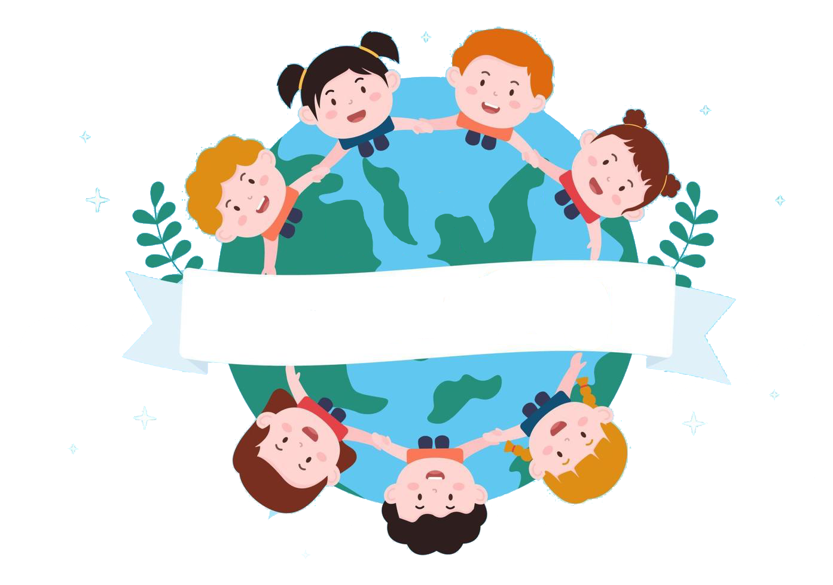
Thank you
& goodbye!

