Slide 1




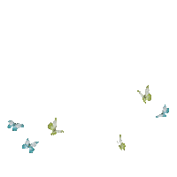
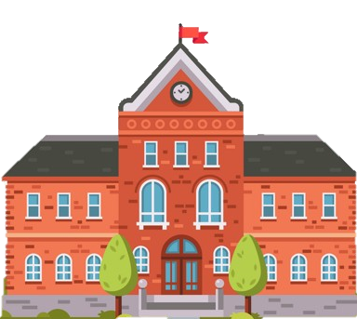




Slide 2

Unit 5
Celebrations
Lesson 3: Activity 4-5-6

Slide 3





Table of contents
01
02
Warm-up
Presentation
04
05
Production
Wrap-up & Assessment
03
Practice

Slide 4
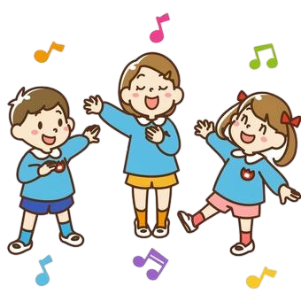
01
Warm-up

Slide 5

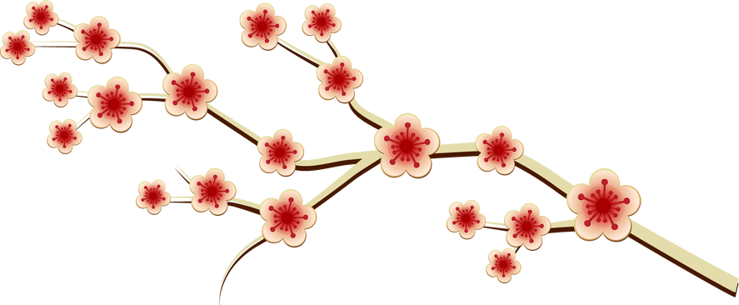

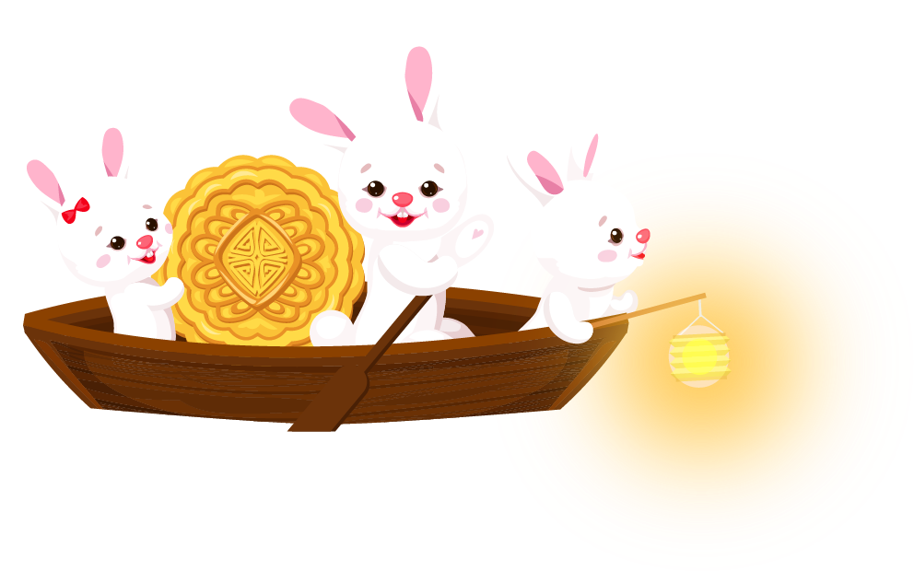
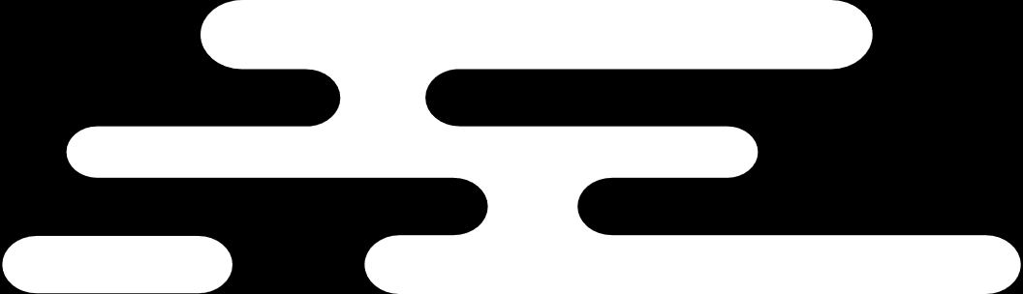
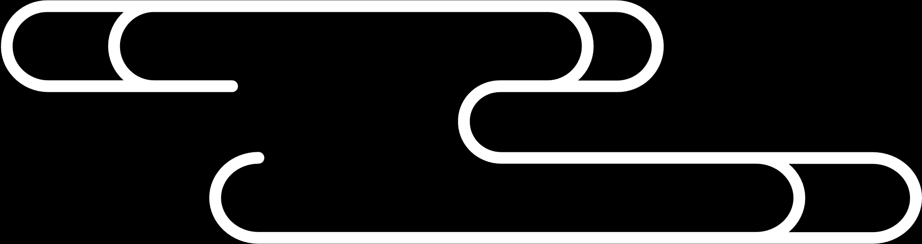

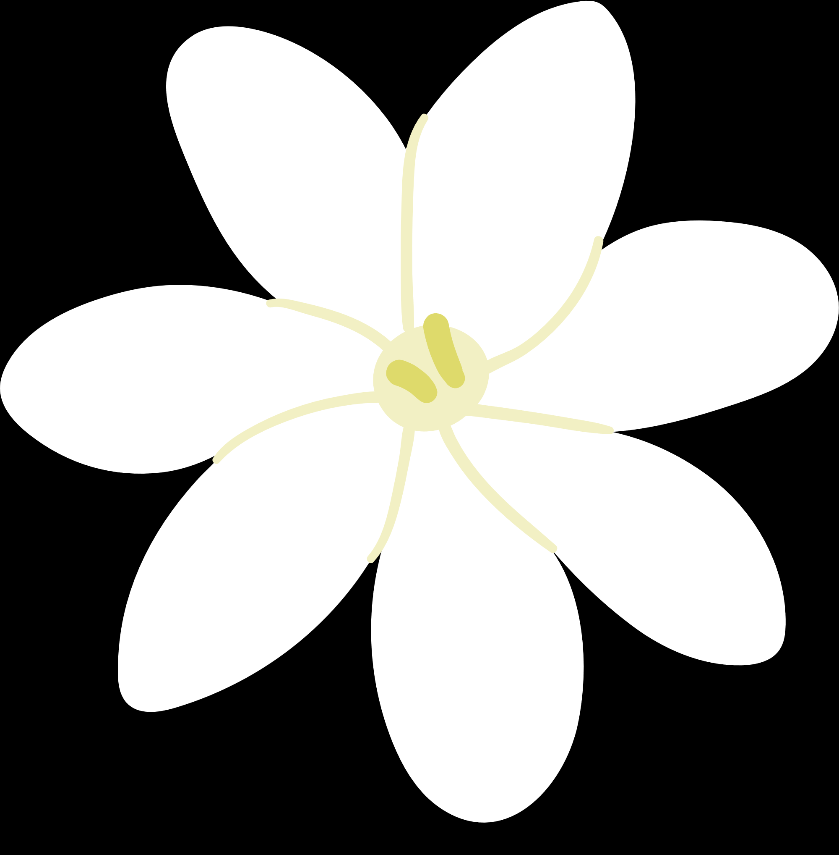

Catch the words

Slide 6




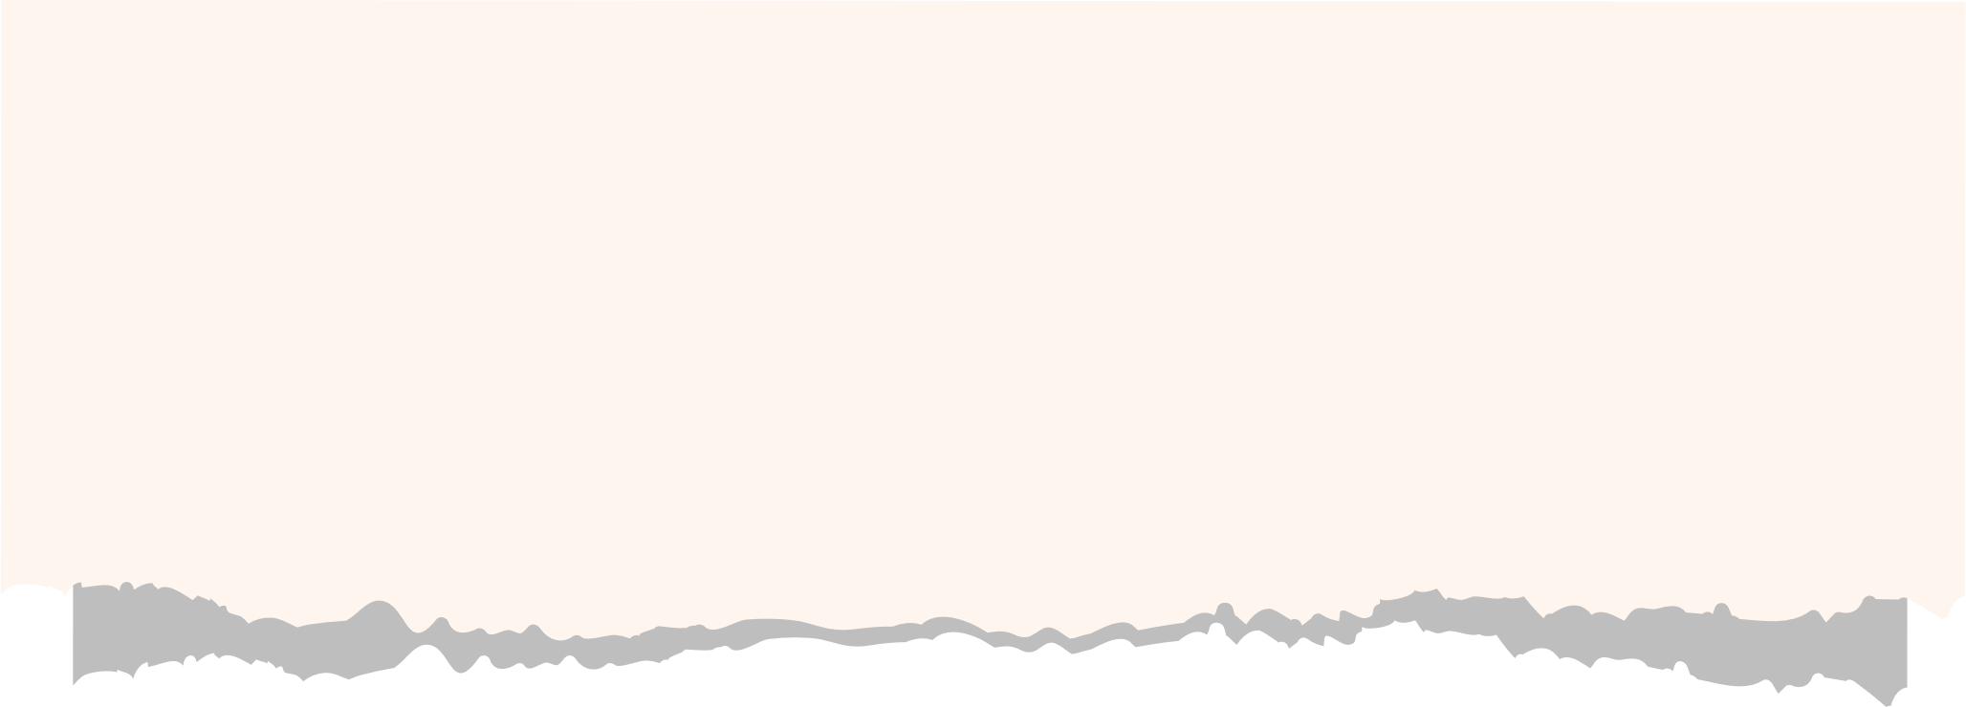
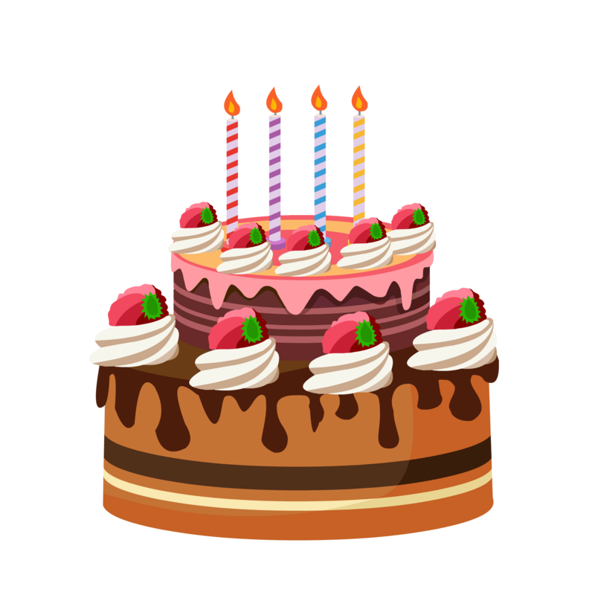




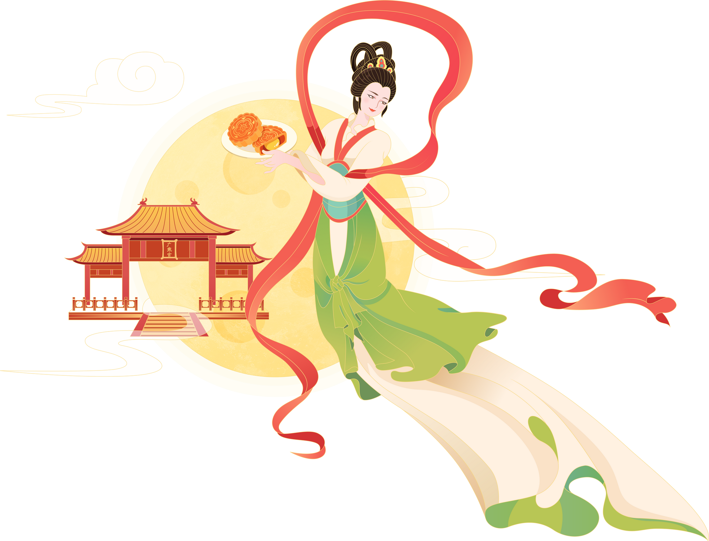


mooncake
Notes:
Click button Check để xem đáp án
Click button Next để chuyển sang slide tiếp theo

Slide 7
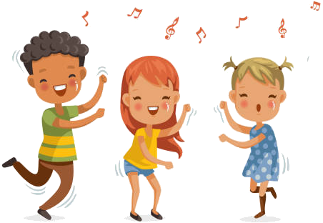

lion dance

Slide 8
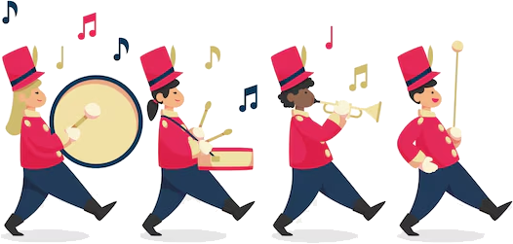
lantern parade

Slide 9
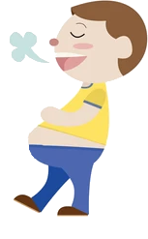
full moon

Slide 10

sky lantern

Slide 11

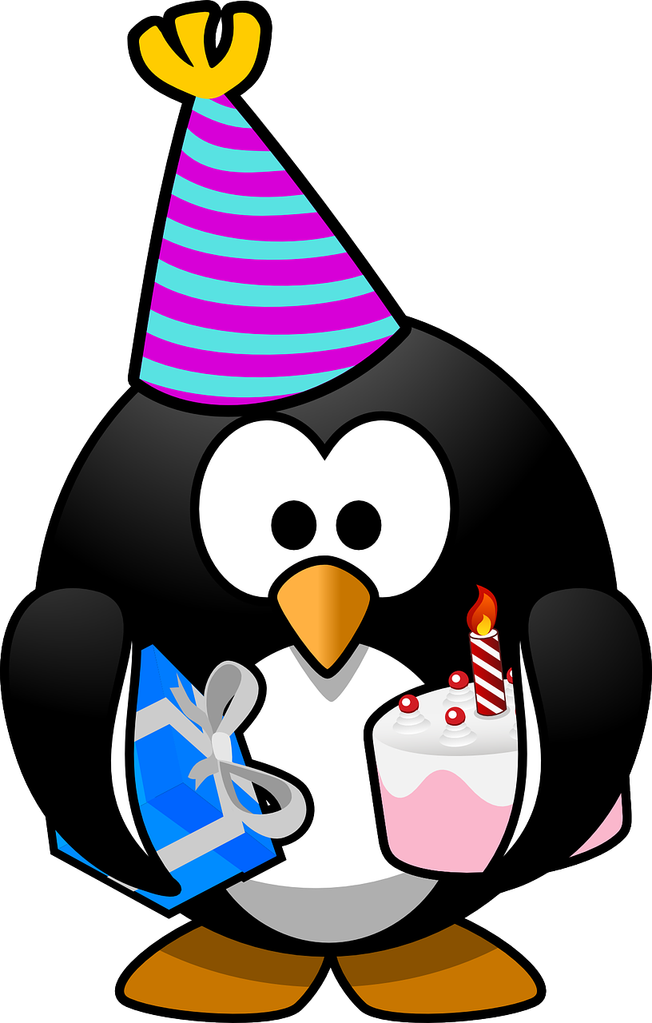
02
PRESENTATION

Slide 12

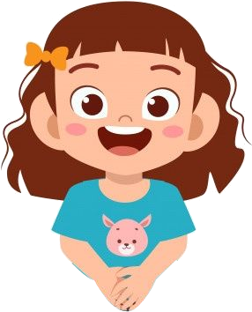
What is “past tense”?
Past
Present
Future
Completed activities
I went to a birthday party yesterday.
I go to a birthday party.

Slide 13
What is “past tense”?
Last year
Past
Last month
Present
Last week
Last year
was/were
ate
went
did
had
…
…
Last month
Last week
When was your birthday?
It was yesterday.
was/were
ate
went
did
had
…
to be
eat
go
do
have/has
…

Slide 14
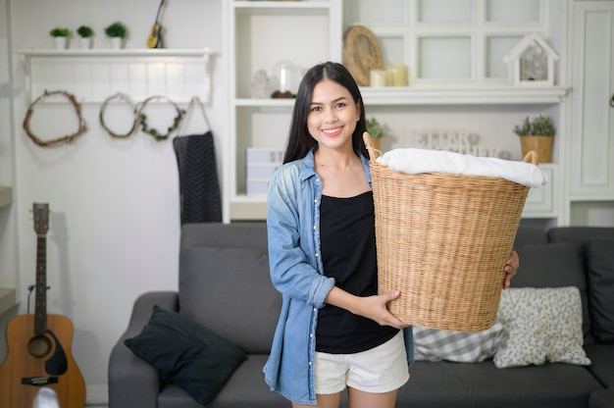
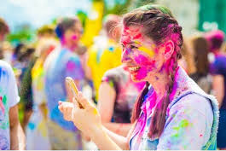
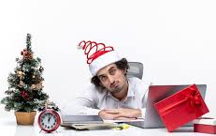
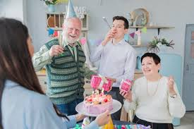
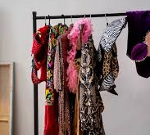
4 Listen and read. Then match.
1. I went to a birthday party last weekend.
2. He had a lot of work during Christmas.
3. My mother did a lot of housework before Tet holiday.
4. At the Holi festival last year, we went into the streets with powder and paint.
5. My sister had a lot of Halloween costumes last October.

Slide 15
03
PRACTICE

Slide 16
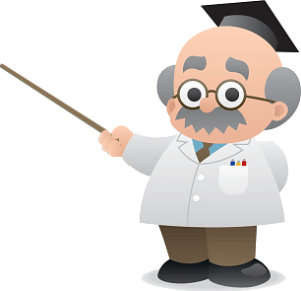
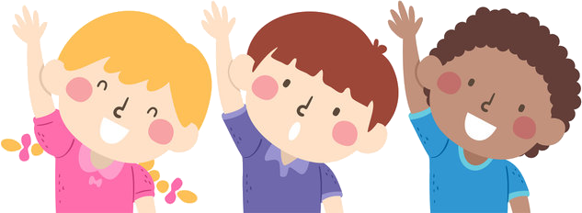
5 Listen and write ONE word.
got
1. I _______ some flowers from my parents on my birthday.
2. A lot of students _______ to the music show last night.
3. My younger brother _______ all his homework before going to
the park.
4. He _______ on a parade, and it was so much fun.
5. We _______ some nice costumes for Halloween last October.
6. She _______ a lot of cooking for the weekend party.
went
did
went
had
did

Slide 17
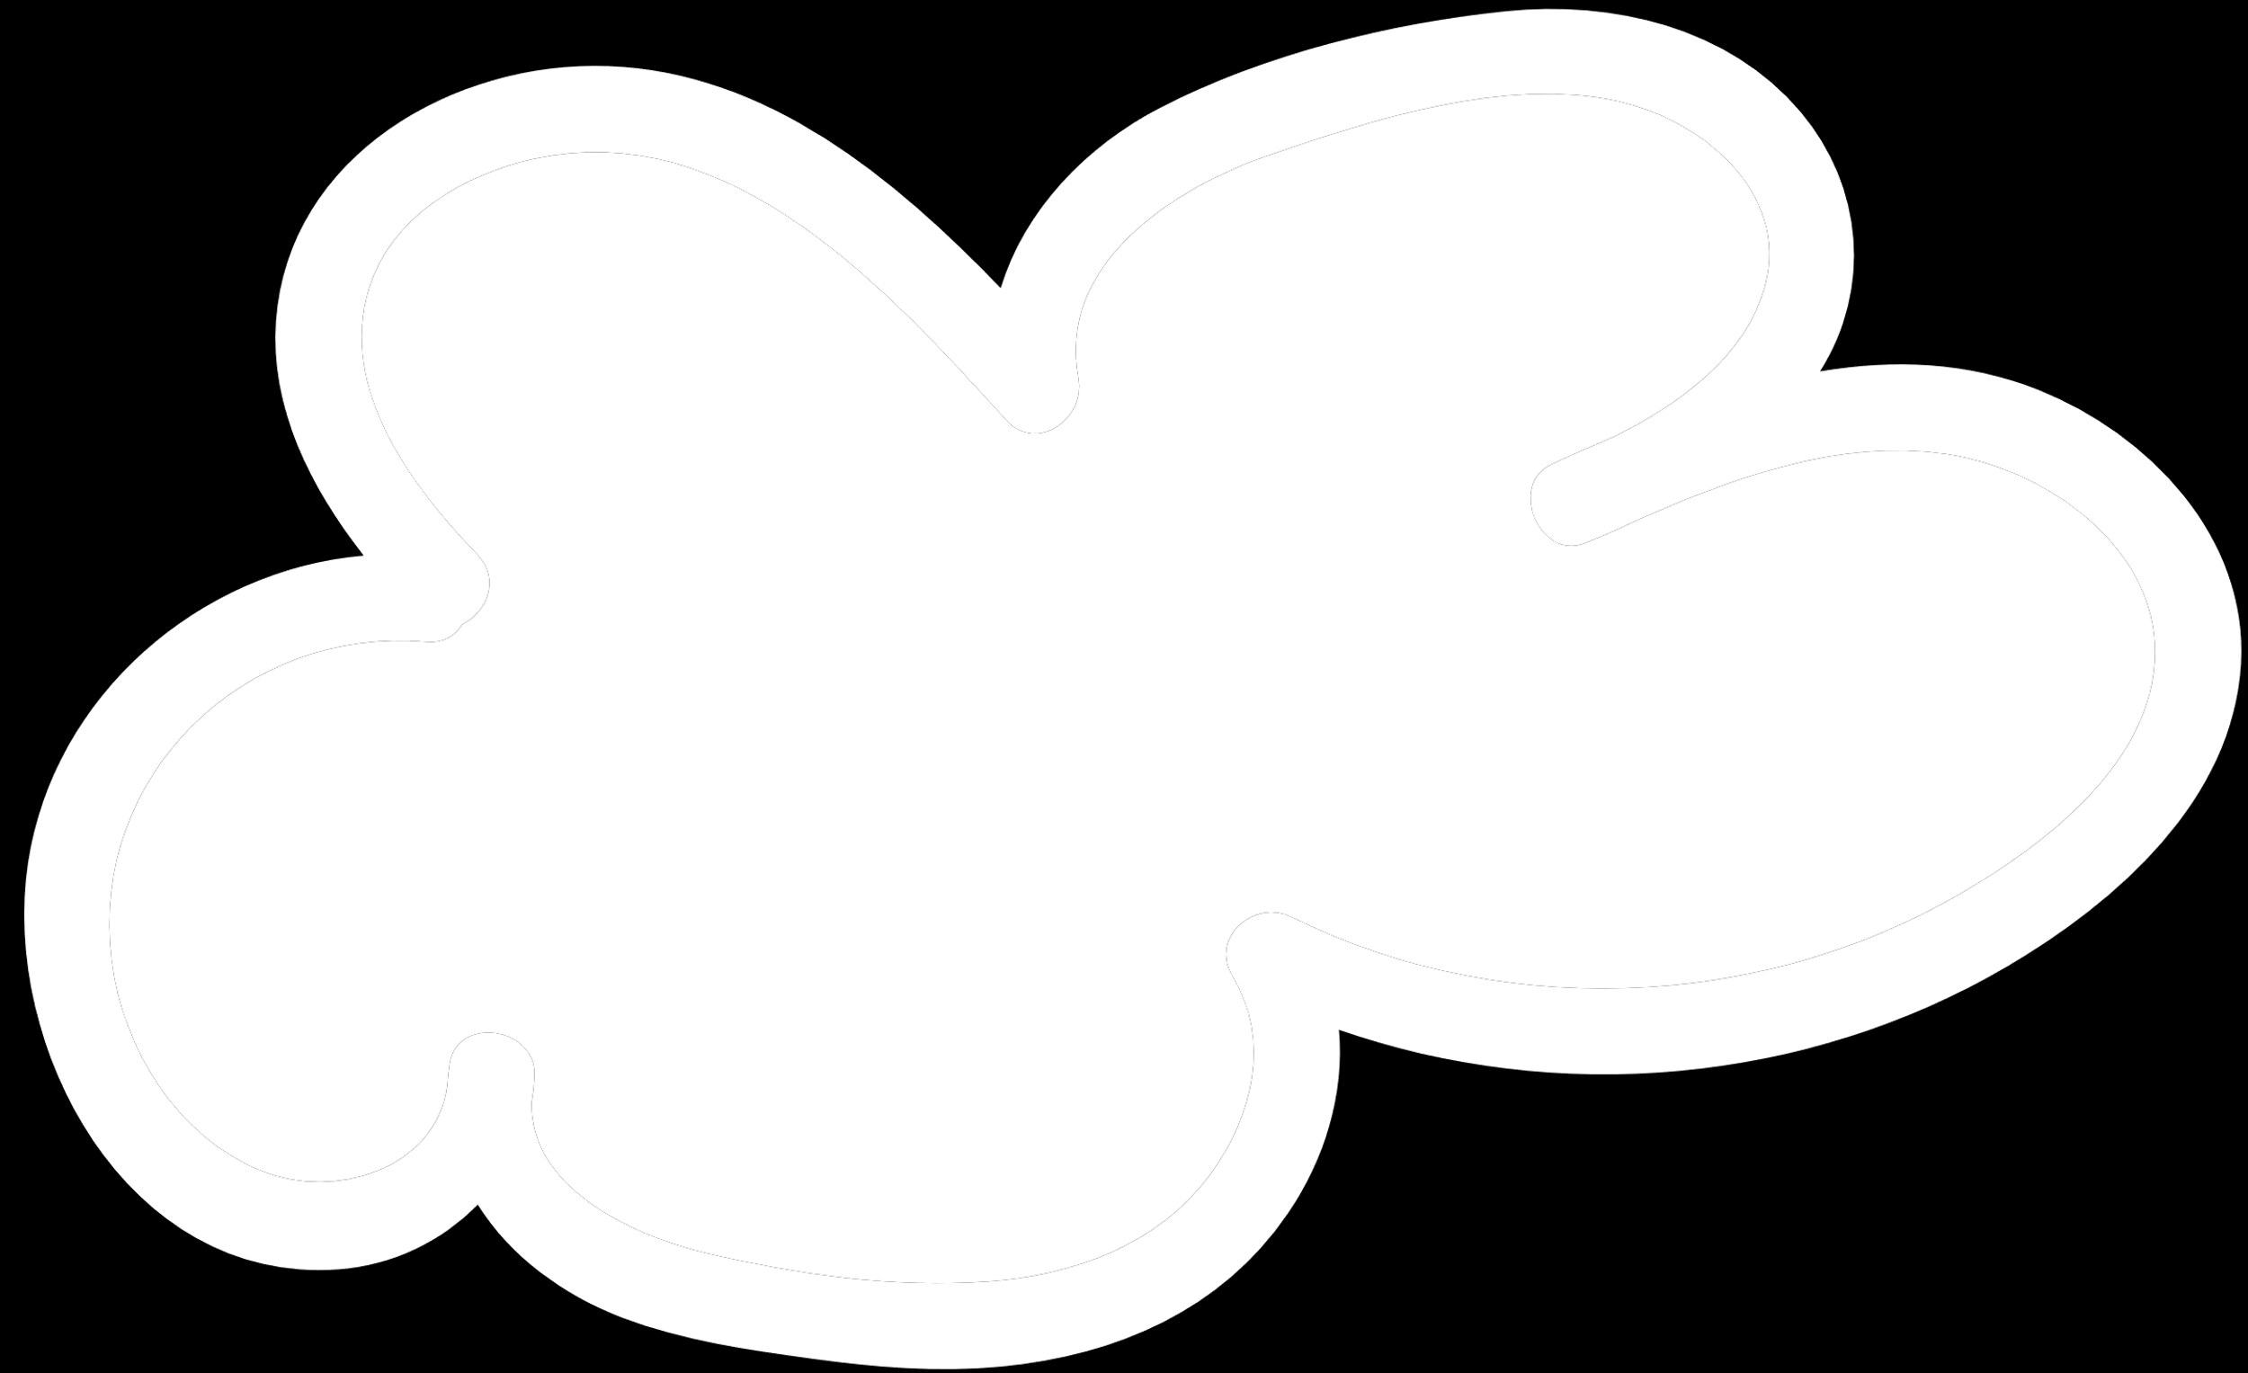

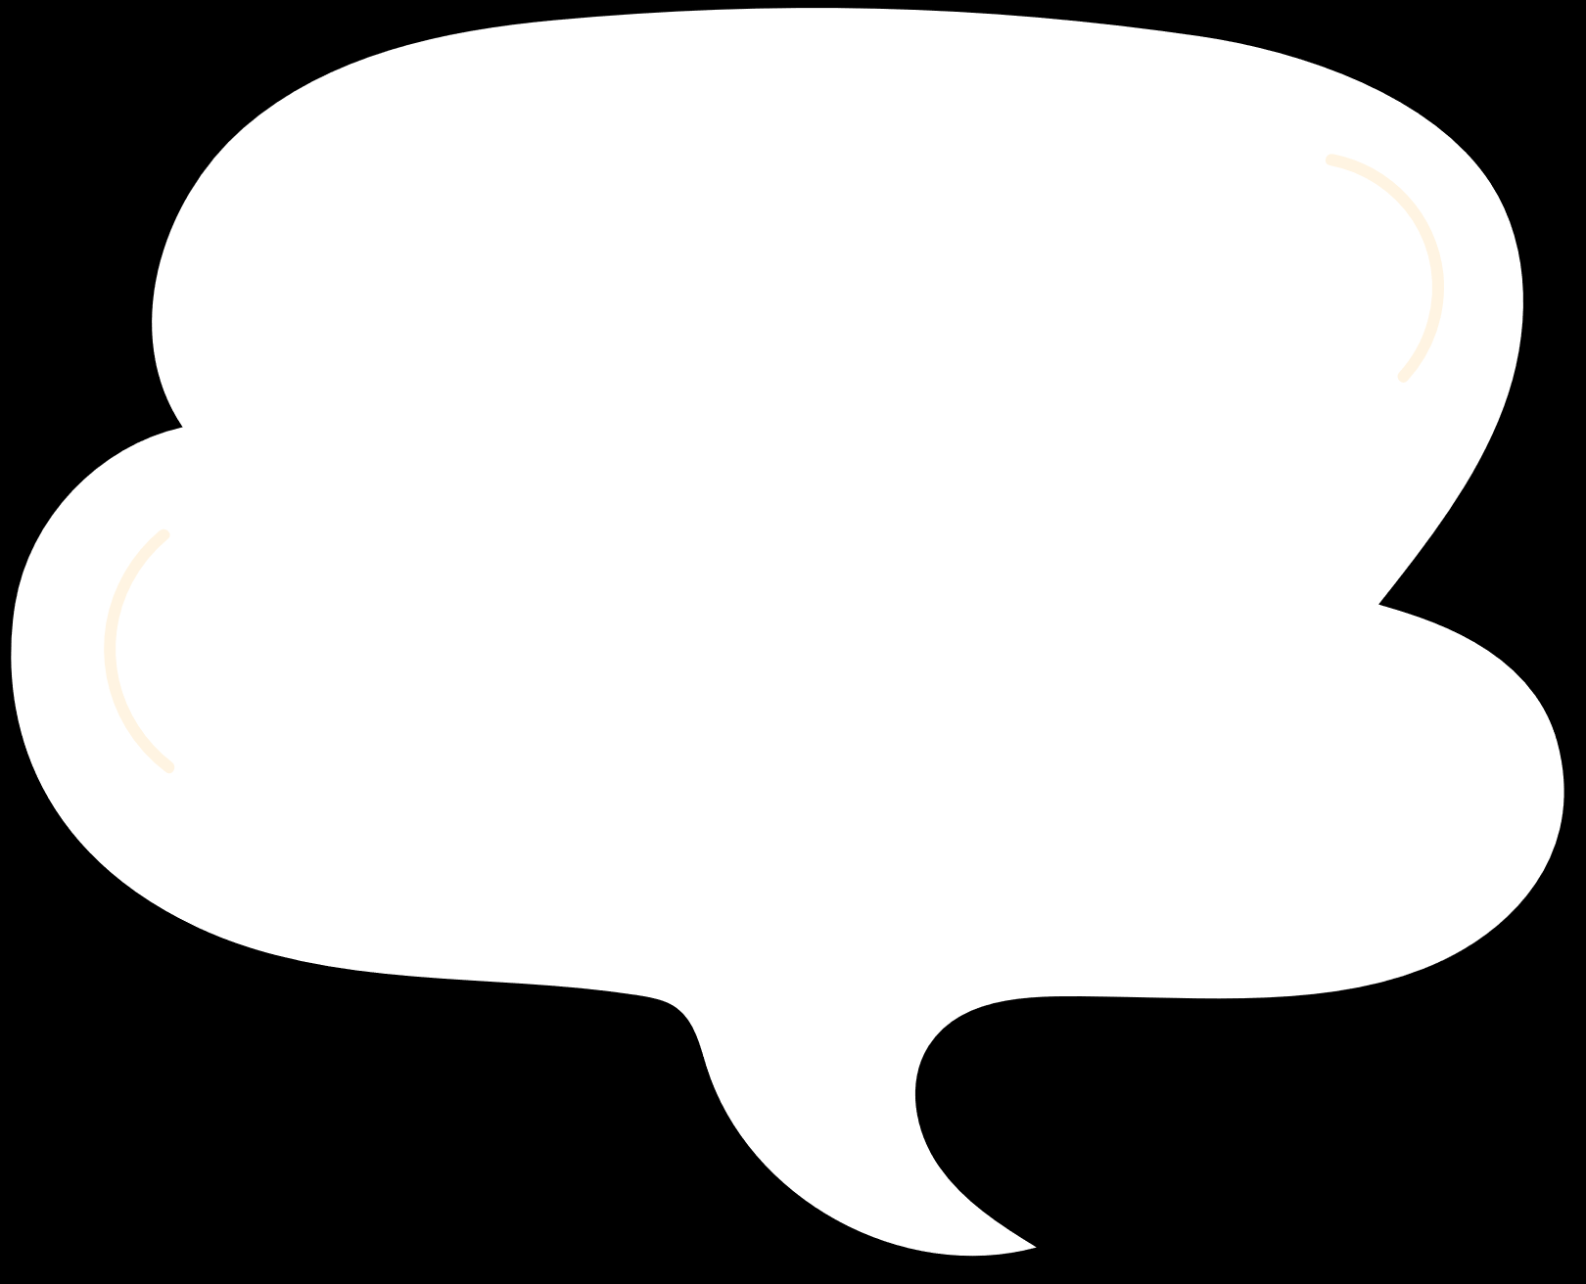
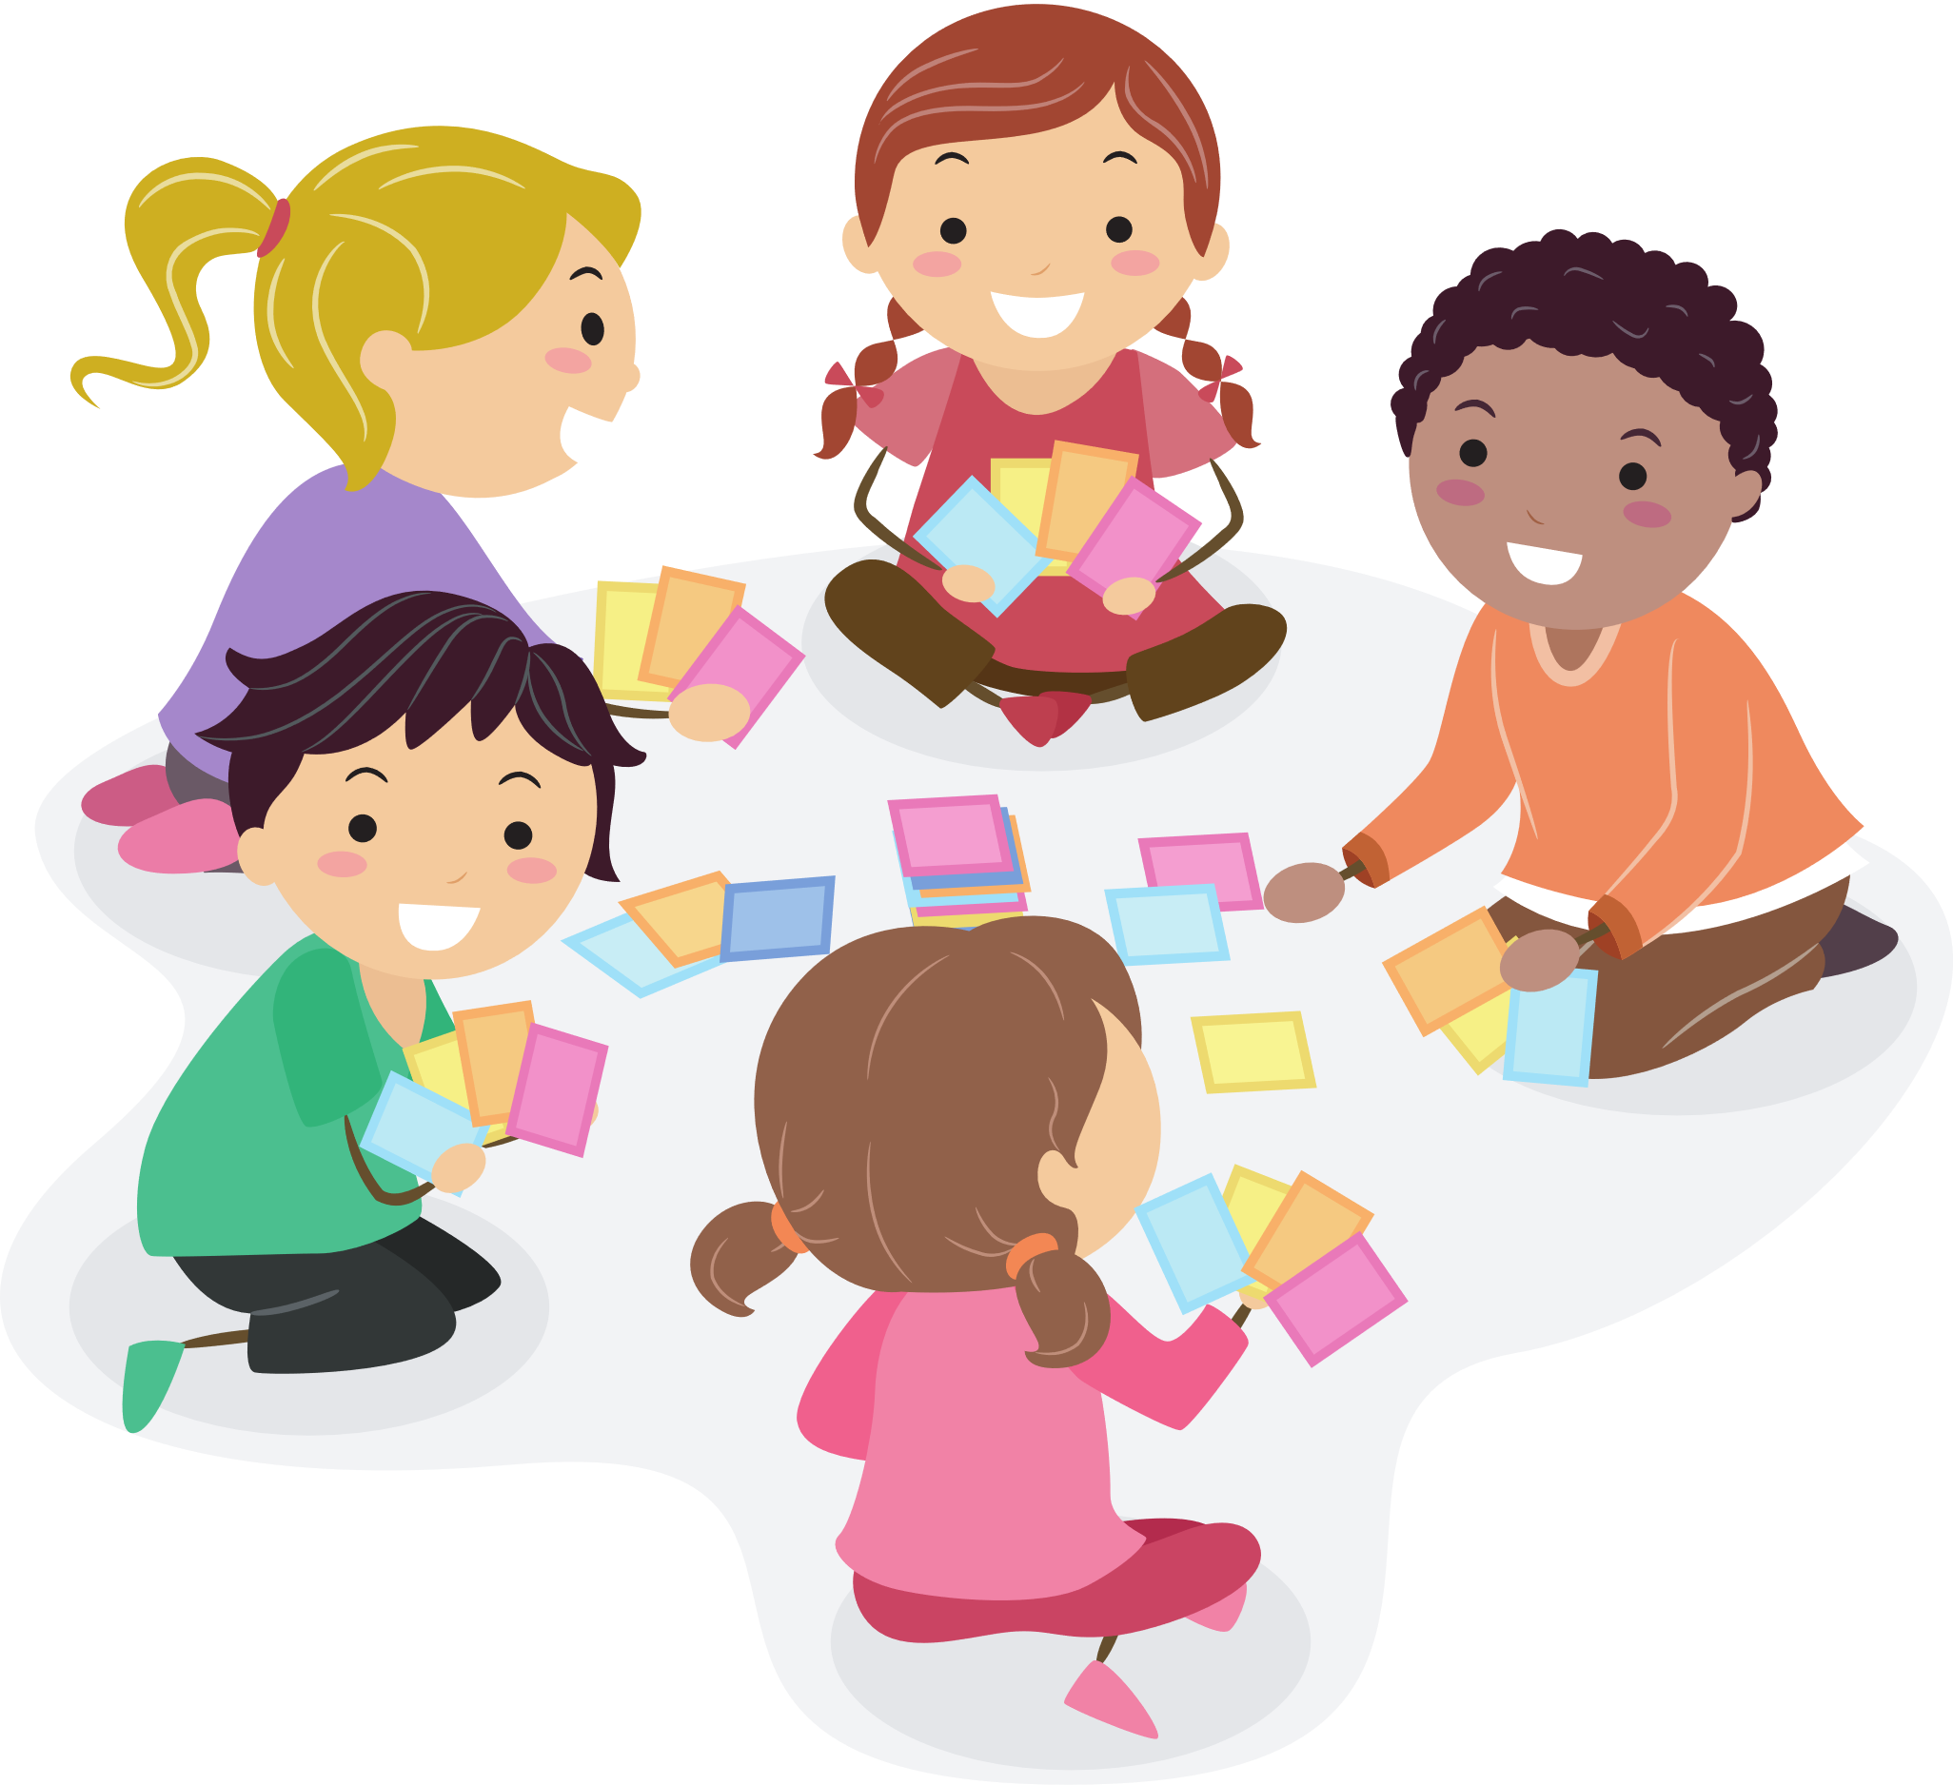

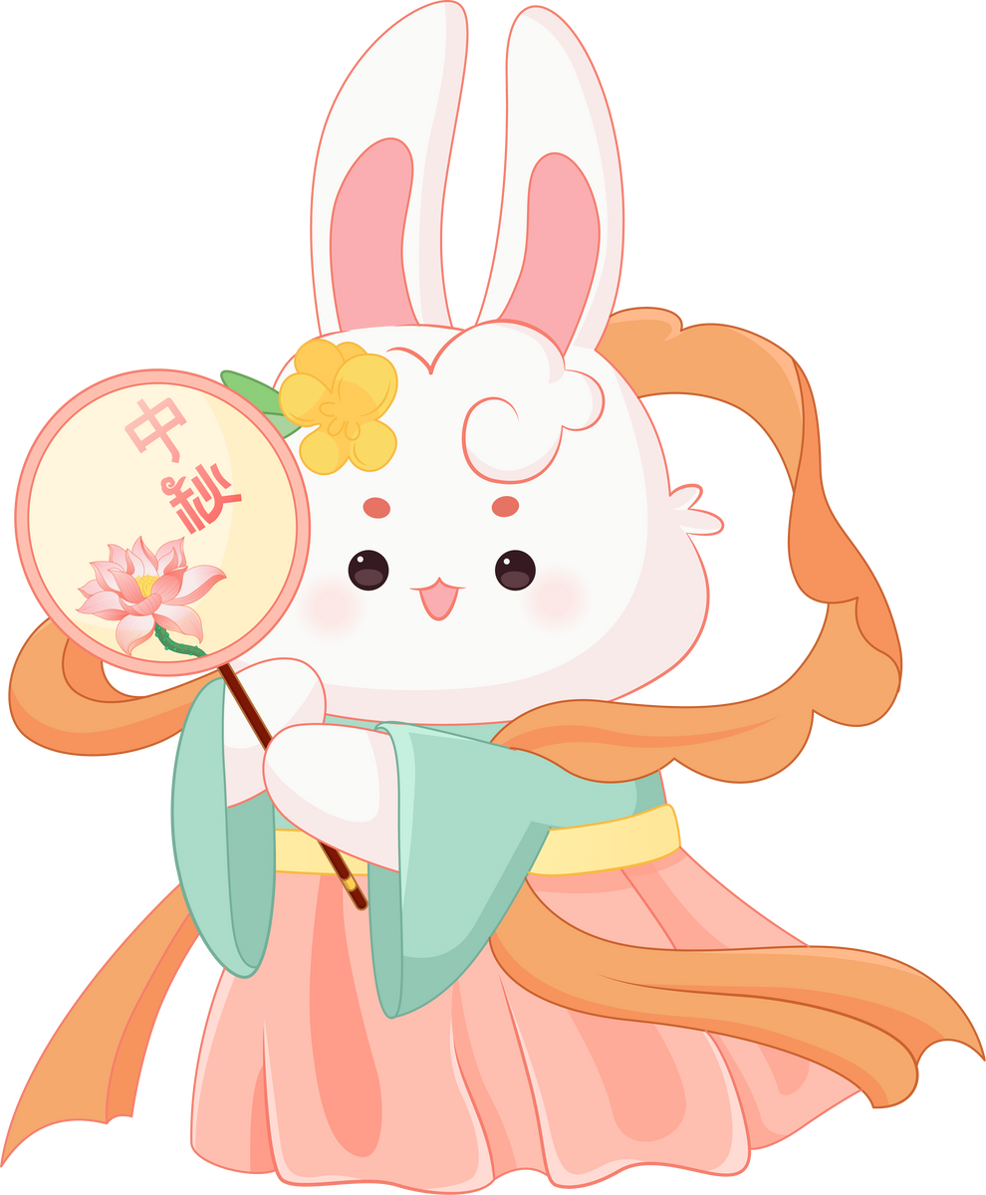



Mid-Autumn Festival game

Slide 18


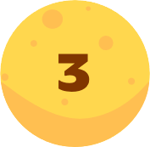
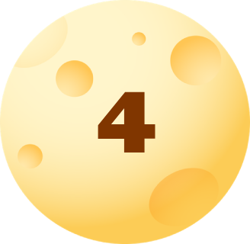

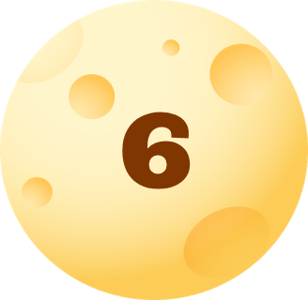


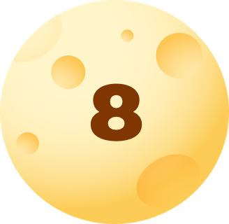
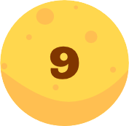
Let’s choose a number
STOP
Notes:
Click chọn số để di chuyển đến câu hỏi
Click button Stop để dừng trò chơi và chuyển sang phần tiếp theo

Slide 19

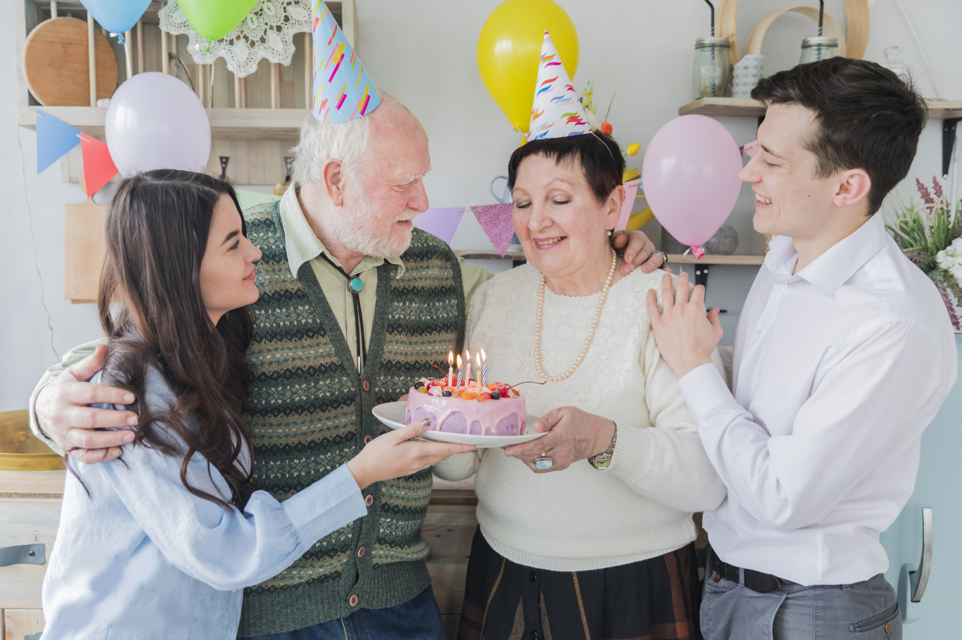

went
eat
made
I ___ to a birthday party last weekend.
Notes:
Click vào text để kiểm tra đáp án
Click icon Home để quay về màn hình chọn câu hỏi

Slide 20
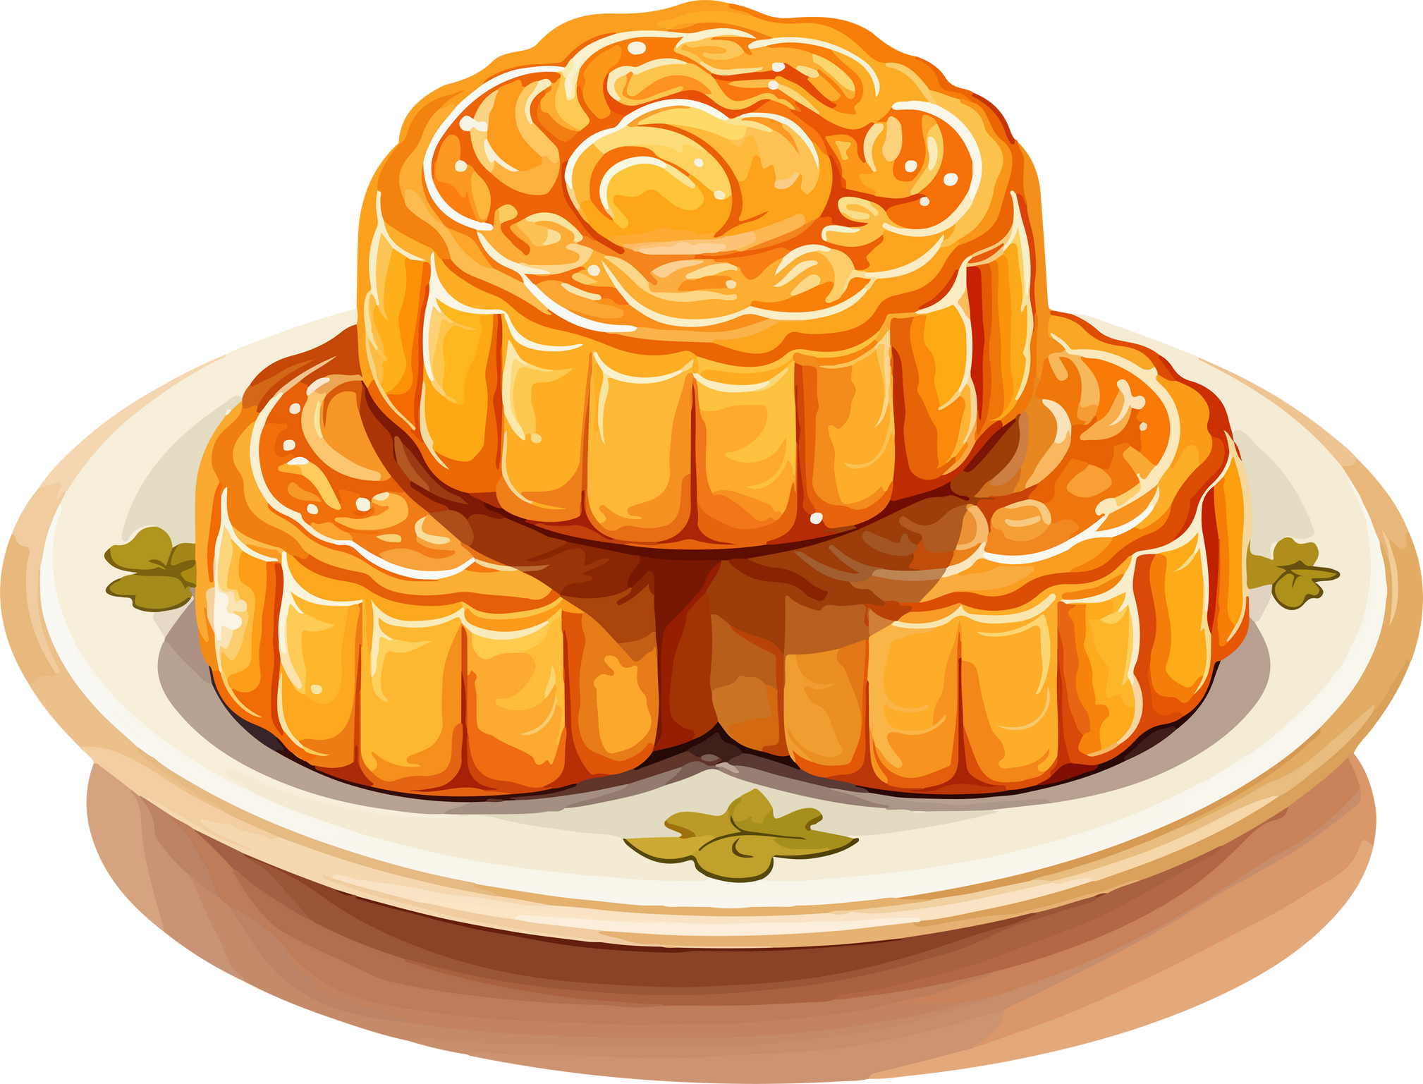
He eat mooncakes.
He eats mooncakes.
He ate mooncakes.
What did he eat?
Notes:
Click vào text để kiểm tra đáp án
Click icon Home để quay về màn hình chọn câu hỏi

Slide 21
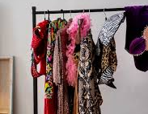
gave
ate
had
My sister ___ a lot of Halloween costumes last October.
Notes:
Click vào text để kiểm tra đáp án
Click icon Home để quay về màn hình chọn câu hỏi

Slide 22

His birthday was yesterday.
Listen and choose the correct answer.
Yesterday is his birthday.
Yesterday was my birthday.
When was his birthday?
Notes:
Click vào text để kiểm tra đáp án
Click icon Home để quay về màn hình chọn câu hỏi

Slide 23
was
did
went
My mom ___ a lot of housework before last Mid-Autumn festival.
Notes:
Click vào text để kiểm tra đáp án
Click icon Home để quay về màn hình chọn câu hỏi

Slide 24
ate
Listen and choose the correct answer.
did
went
A lot of students __ to the music show last night.
Notes:
Click vào text để kiểm tra đáp án
Click icon Home để quay về màn hình chọn câu hỏi

Slide 25
This Monday
Today
Yesterday
___ was his birthday.
Notes:
Click vào text để kiểm tra đáp án
Click icon Home để quay về màn hình chọn câu hỏi

Slide 26
went
Listen and choose the correct answer.
did
had
We ___ some good memories about Halloween last October.
Notes:
Click vào text để kiểm tra đáp án
Click icon Home để quay về màn hình chọn câu hỏi

Slide 27
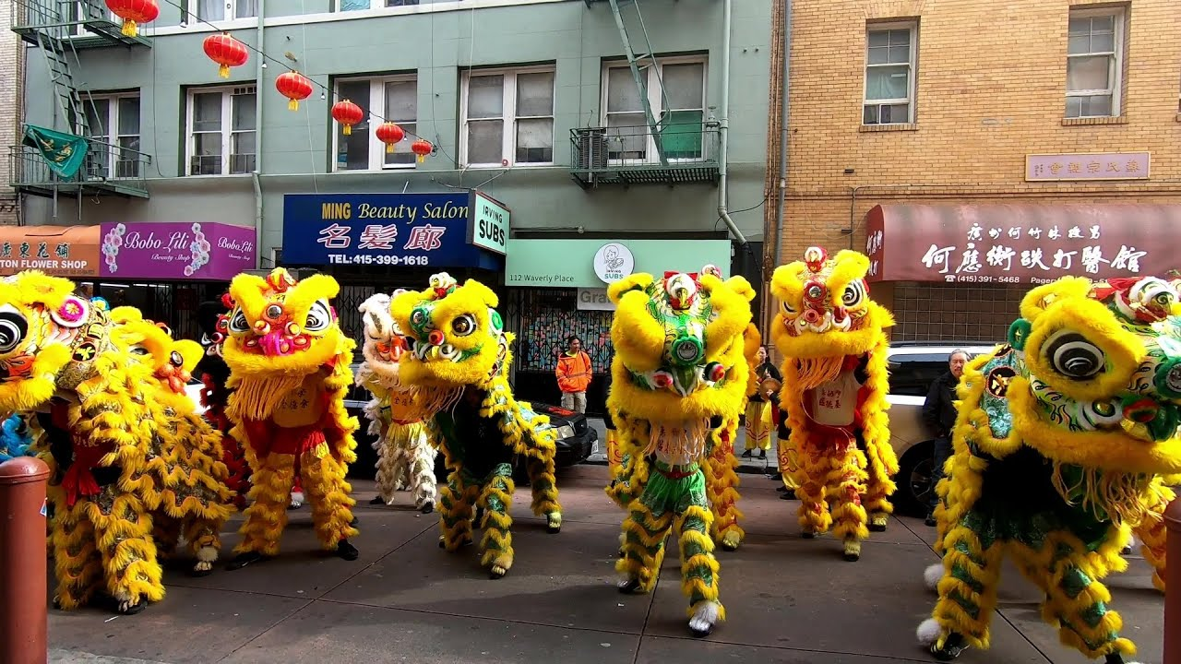
did
was
had
He went on a parade, it __ so much fun.
Notes:
Click vào text để kiểm tra đáp án
Click icon Home để quay về màn hình chọn câu hỏi

Slide 28
04
PRODUCTION
Let’s write about your last Mid-Autumn Festival

Slide 29
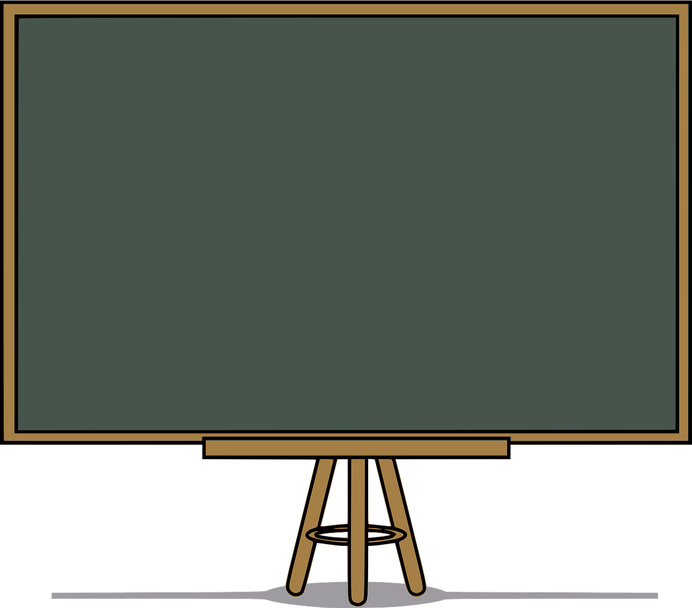
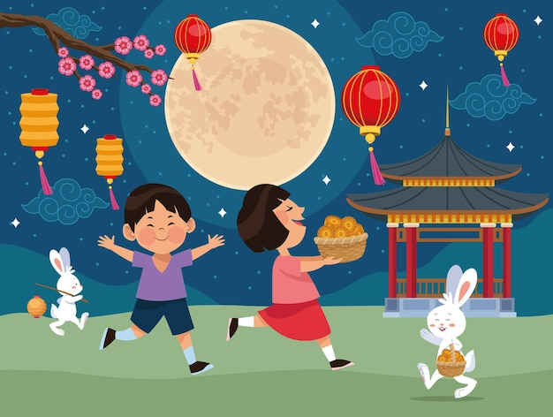
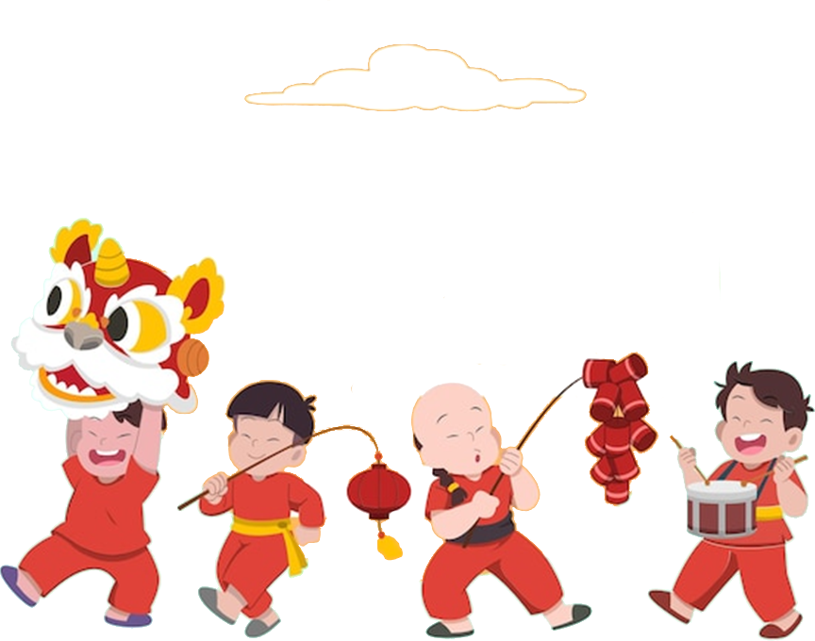
Mid-Autumn symbols and activities.
Symbols: lanterns, dragon, mooncakes, full moon
Activities: watch lion dance, make lanterns, parade, eat mooncake,

Slide 30
Write five sentences about your activities last Mid-Autumn Festival, using had, did, went
The Mid-Autumn Festival is a …. Last year, we (have / work) ….
My brother (do / his homework) ….
My mother (do / cooking) ….
In the evening, we (go / a parade) ….

Slide 31
05
WRAP-UP & ASSESSMENT

Slide 32
Fill in the blanks:
went
1. I _________ to a birthday party last weekend.
2. He _________ a lot of work during Christmas.
3. My mother _________ a lot of housework before Tet holiday.
4. At the Holi festival last year, we _________ into the streets with powder and paint.
5. My sister _________ a lot of Halloween costumes last October.
had
1
did
went
had
3

Slide 33
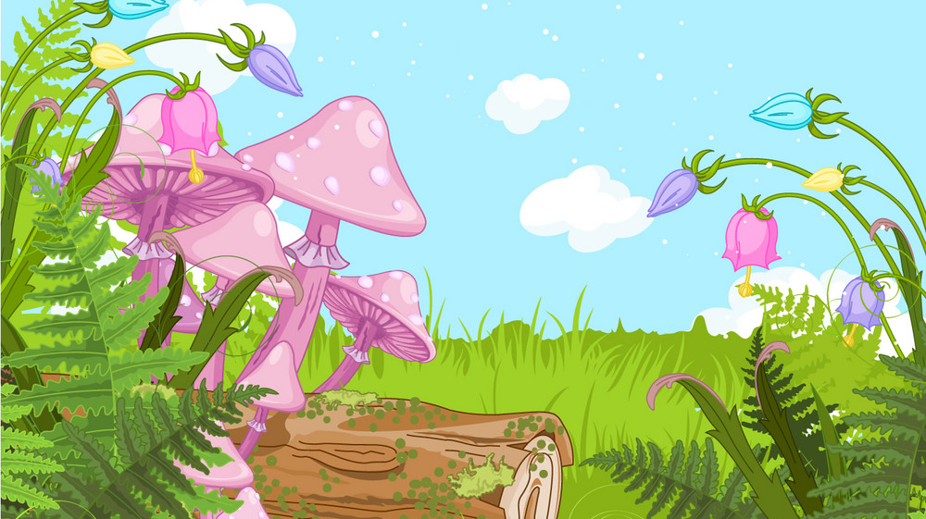
Unit 5: CELEBRATIONS
Lesson 3 – Task 4-5-6
What have we learnt today?
Past tense:
Structures:
Verbs:
go – went
do – did
have/has – had
Adv: last year, last month, last week
I went to a birthday party last week.
He had a lot of work during Christmas.
My mother did a lot of housework before Tet holiday.

Slide 34




Thank you & goodbye!

