Slide 1









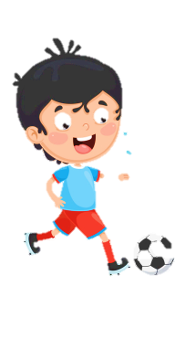
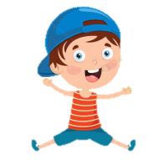





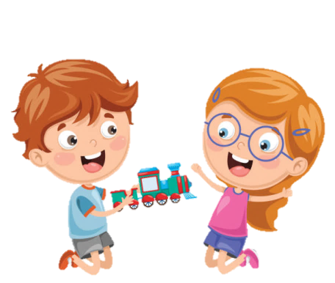





Slide 2





Table of contents
01
02
Warm-up
Presentation
05
04
Production
03
Practice
Wrap-up & Assessment

Slide 3
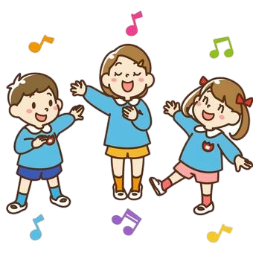
01
Warm-up
Guessing game

Slide 4
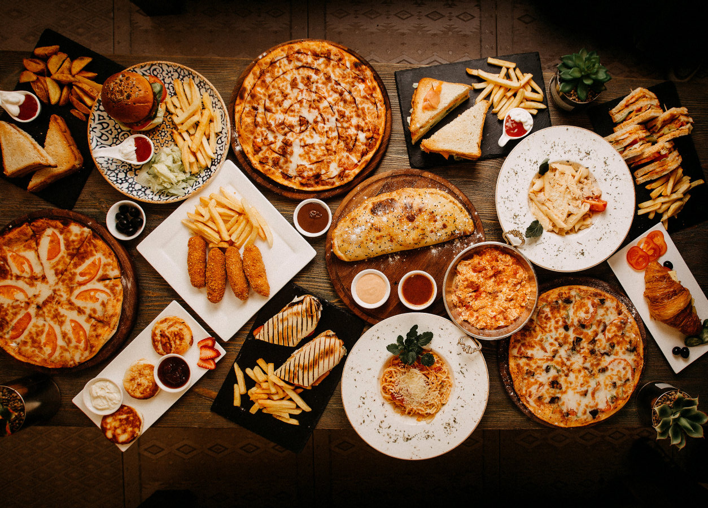
1
2
3
4
5
6
7
8
9
10
11
12
13
14
15
16
17
18
19
20
21
22
23
24

Slide 5
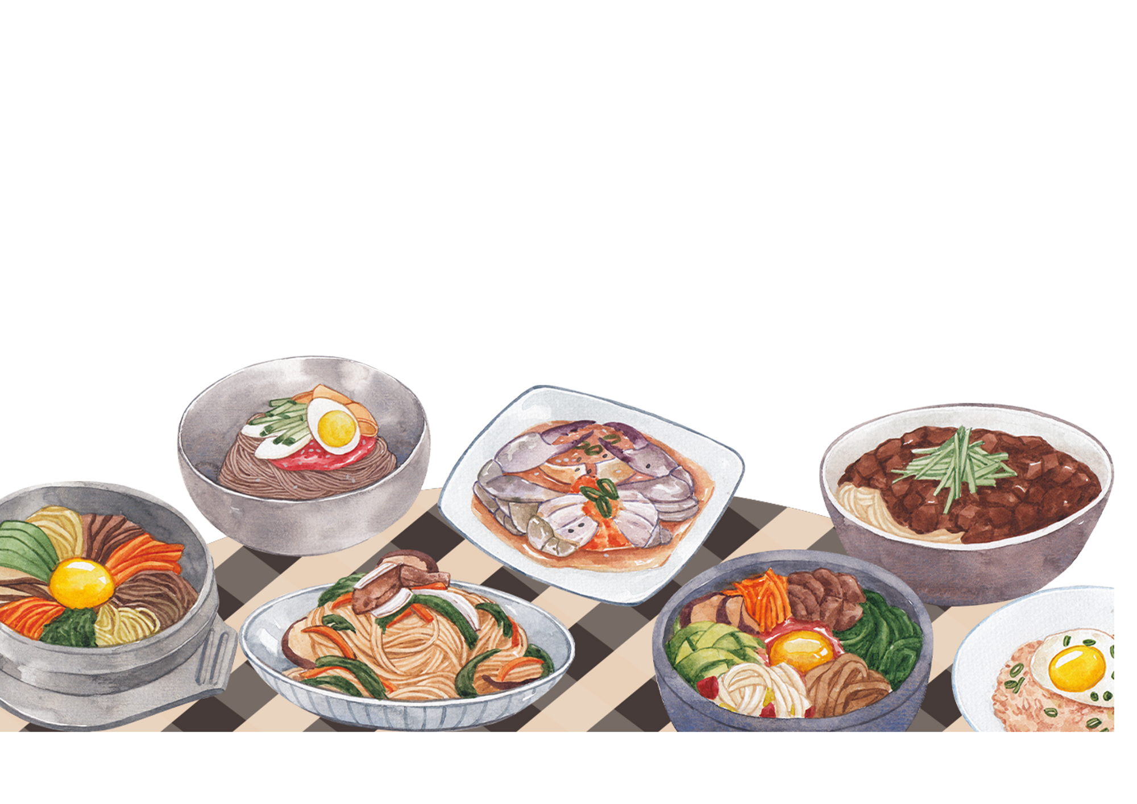
Unit 6: FOOD
Lesson 1 – Task 1, 2, 3

Slide 6

What kinds of foods are they? Look and say.
Can you say the names of these foods?
fast food
seafood
Vietnamese food
Japanese food

Slide 7
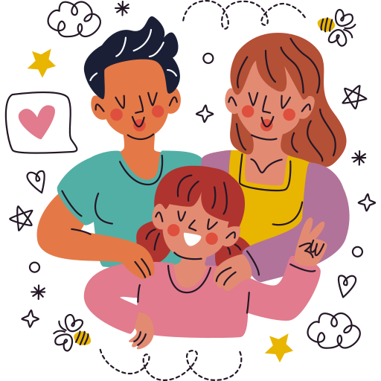
02
PRESENTATION

Slide 8
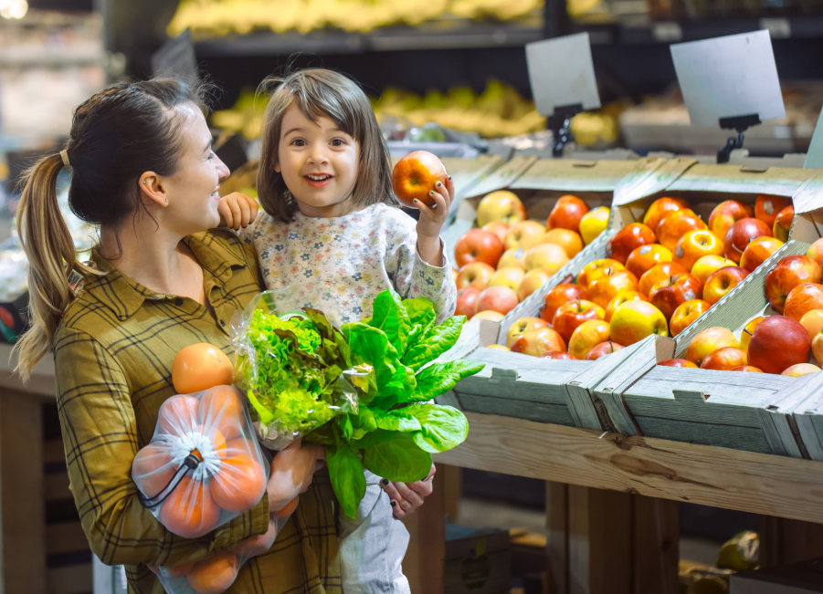
1 Listen and read
Who are they?
Where are they?
What are they doing?
Why are they buying food at the supermarket?

Slide 9
1 Listen and read
Mum:
Daughter:
Mum:
Daughter:
Mum:
Daughter:
Mum:
What do we need for dinner?
Let’s make some spaghetti.
OK then, we need to buy spaghetti and tomatoes.
Do we need any bread?
No, we’ve got a lot of bread. But we haven’t got much butter.
How much butter do we need?
Just a little.
Notes:
- GV click vào bất kì chỗ nào trên slide trừ biểu tượng loa để chạy chữ.

Slide 10
1 Listen and read
Daughter:
Mum:
Daughter:
Mum:
Daughter:
Mum:
Daughter:
Do you want to make a salad, too?
Yes. Let’s get a lot of vegetables for a salad.
What about dessert?
Well, we’ve got a lot of chocolate.
No, I don’t like chocolate.
Let’s buy cupcakes then!
Good idea. We’ll get a lot of cupcakes. I love cupcakes.

Slide 11
What do they need to buy for dinner?
1 Listen and read
Mum: What do we need for dinner?
Daughter: Let’s make some spaghetti.
Mum: OK then, we need to buy spaghetti and some tomatoes.
Daughter: Do we need any bread?
Mum: No, we’ve got a lot of bread. But we haven’t got much butter.
Daughter: How much butter do we need?
Mum: Just a little.
Daughter: Do you want to make a salad, too?
Mum: Yes. Let’s get a lot of vegetables for a salad.
Daughter: What about dessert?
Mum: Well, we’ve got a lot of chocolate.
Daughter: No, I don’t like chocolate. Let’s buy cupcakes then!
Mum: Good idea. We’ll get a lot of cupcakes.
Daughter: I love cupcakes.
Notes:
underline

Slide 12
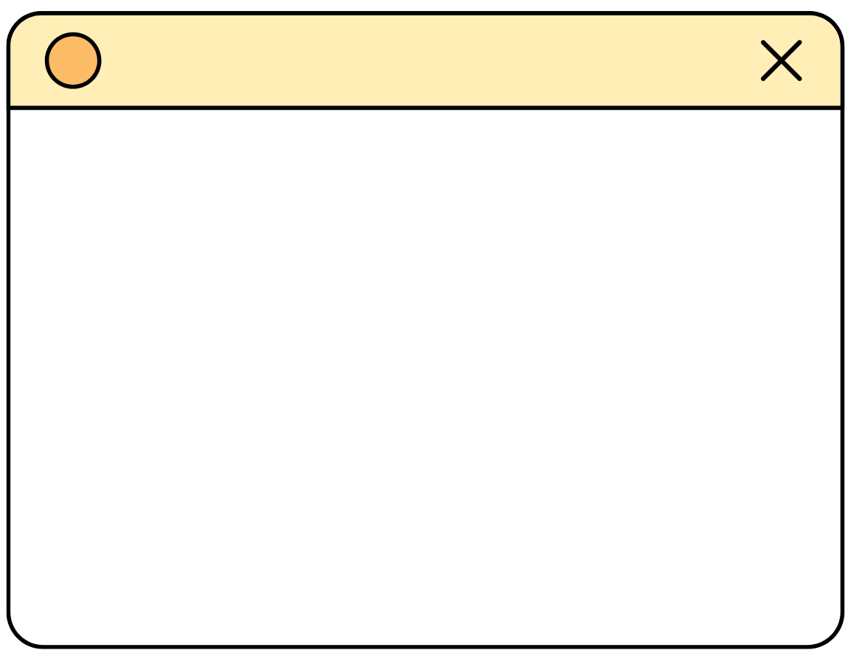
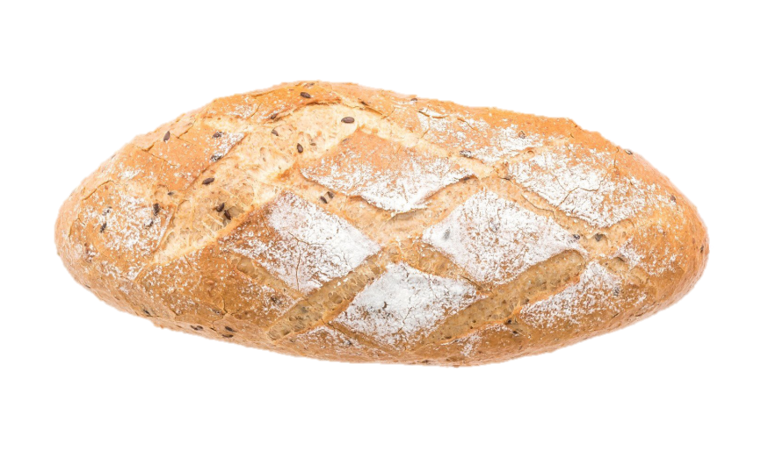
bread /bred/
Notes:
- GV click vào loa để lặp lại nhiều lần.

Slide 13
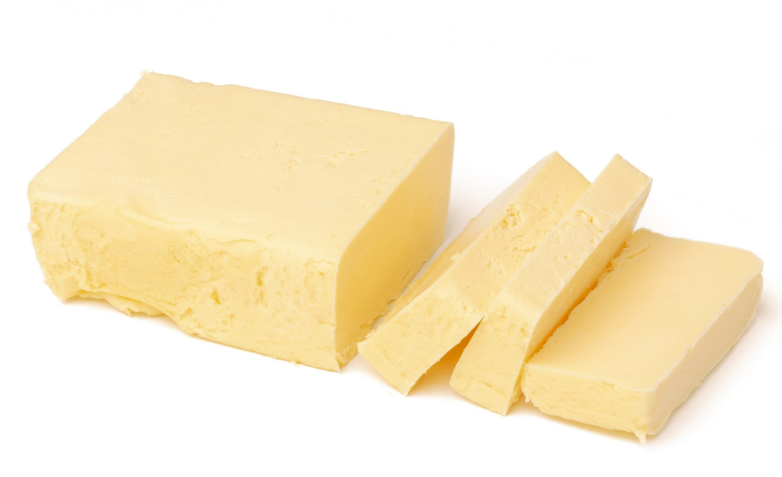
butter /ˈbʌt.ər/
Notes:
- GV click vào loa để lặp lại nhiều lần.

Slide 14
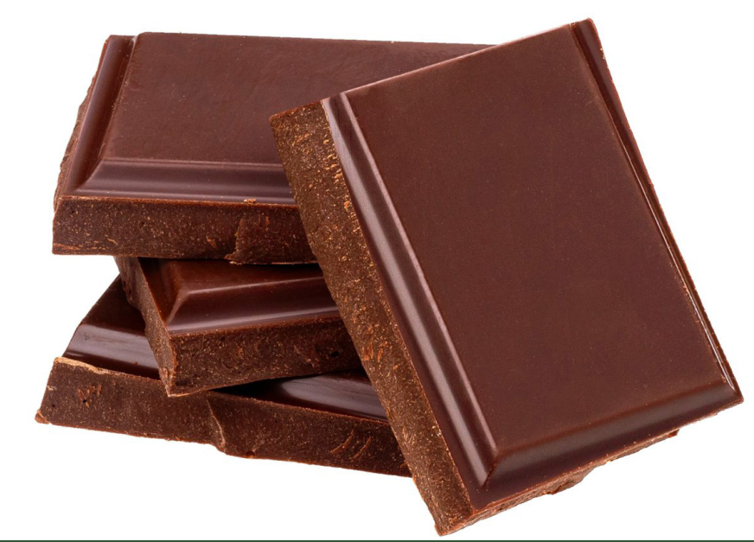
chocolate /ˈtʃɒk.lət/
Notes:
- GV click vào loa để lặp lại nhiều lần.

Slide 15
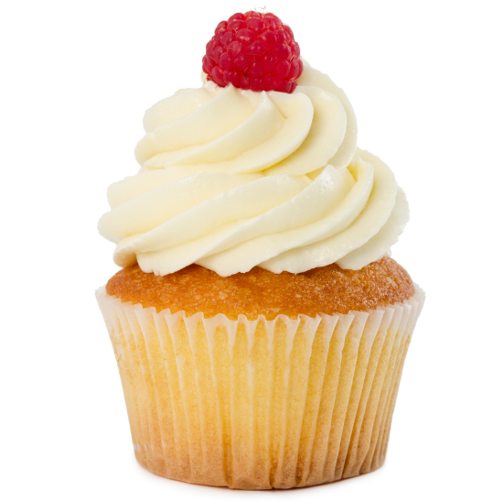
cupcake /ˈkʌp.keɪk/
Notes:
- GV click vào loa để lặp lại nhiều lần.

Slide 16
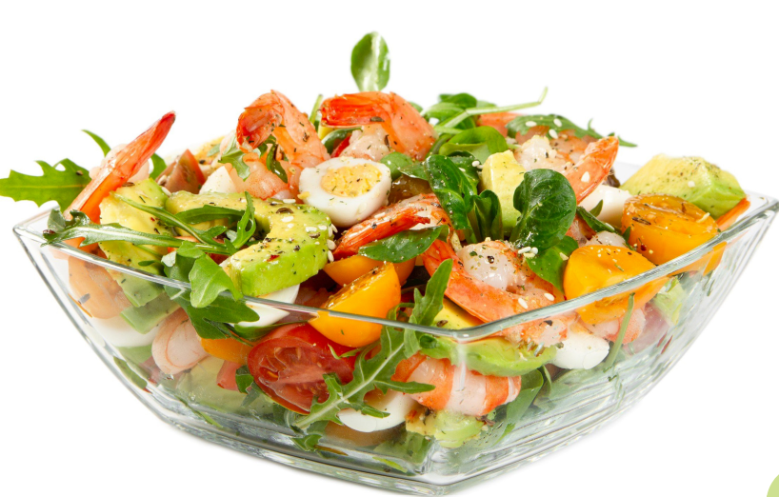
salad /ˈsæl.əd/
Notes:
- GV click vào loa để lặp lại nhiều lần.

Slide 17
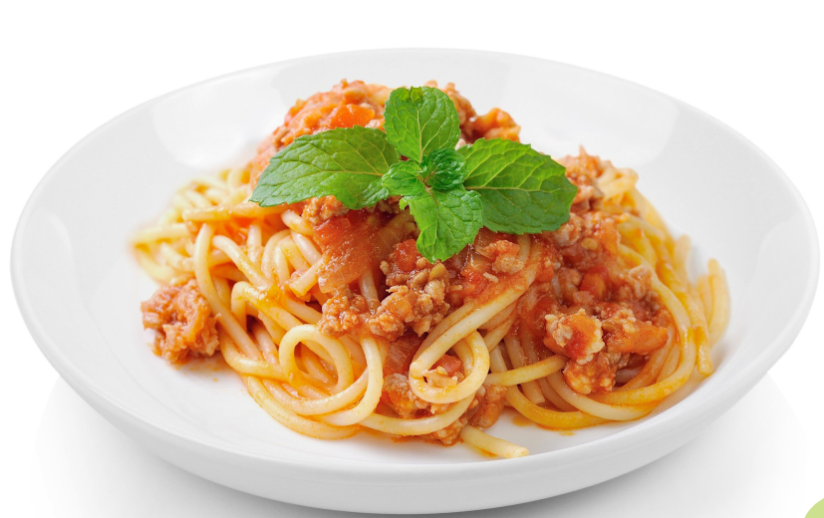
spaghetti /spəˈɡet.i/
Notes:
- GV click vào loa để lặp lại nhiều lần.

Slide 18
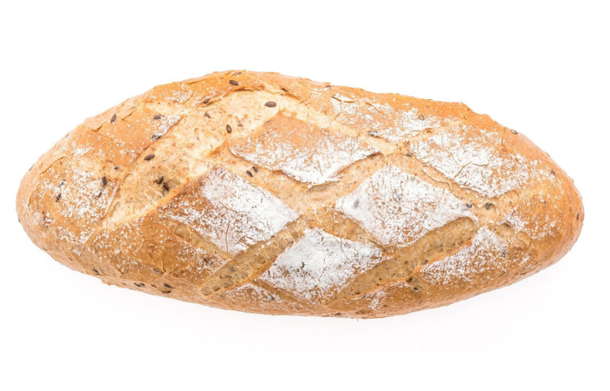
2 Listen, point and repeat.
bread
butter
chocolate
cupcake
salad
spaghetti

Slide 19
03
PRACTICE
What food am I?

Slide 20
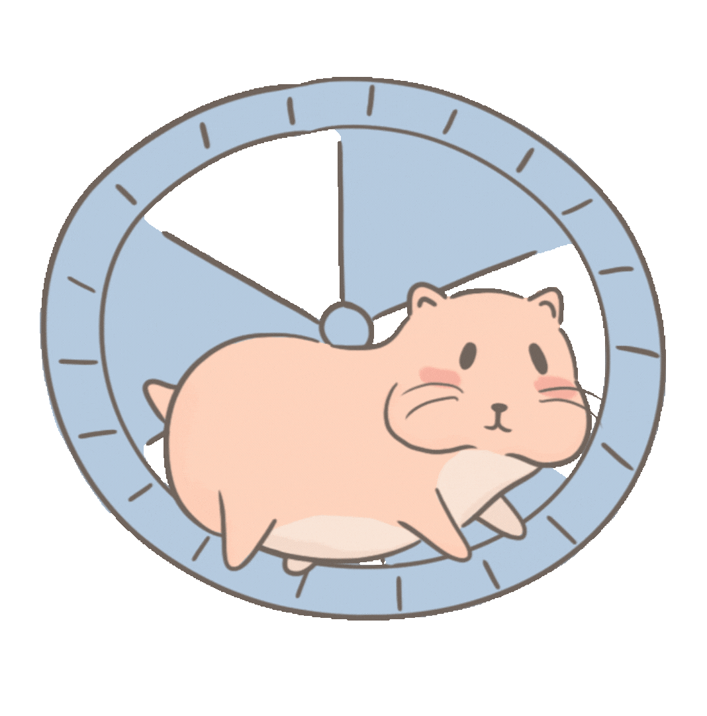
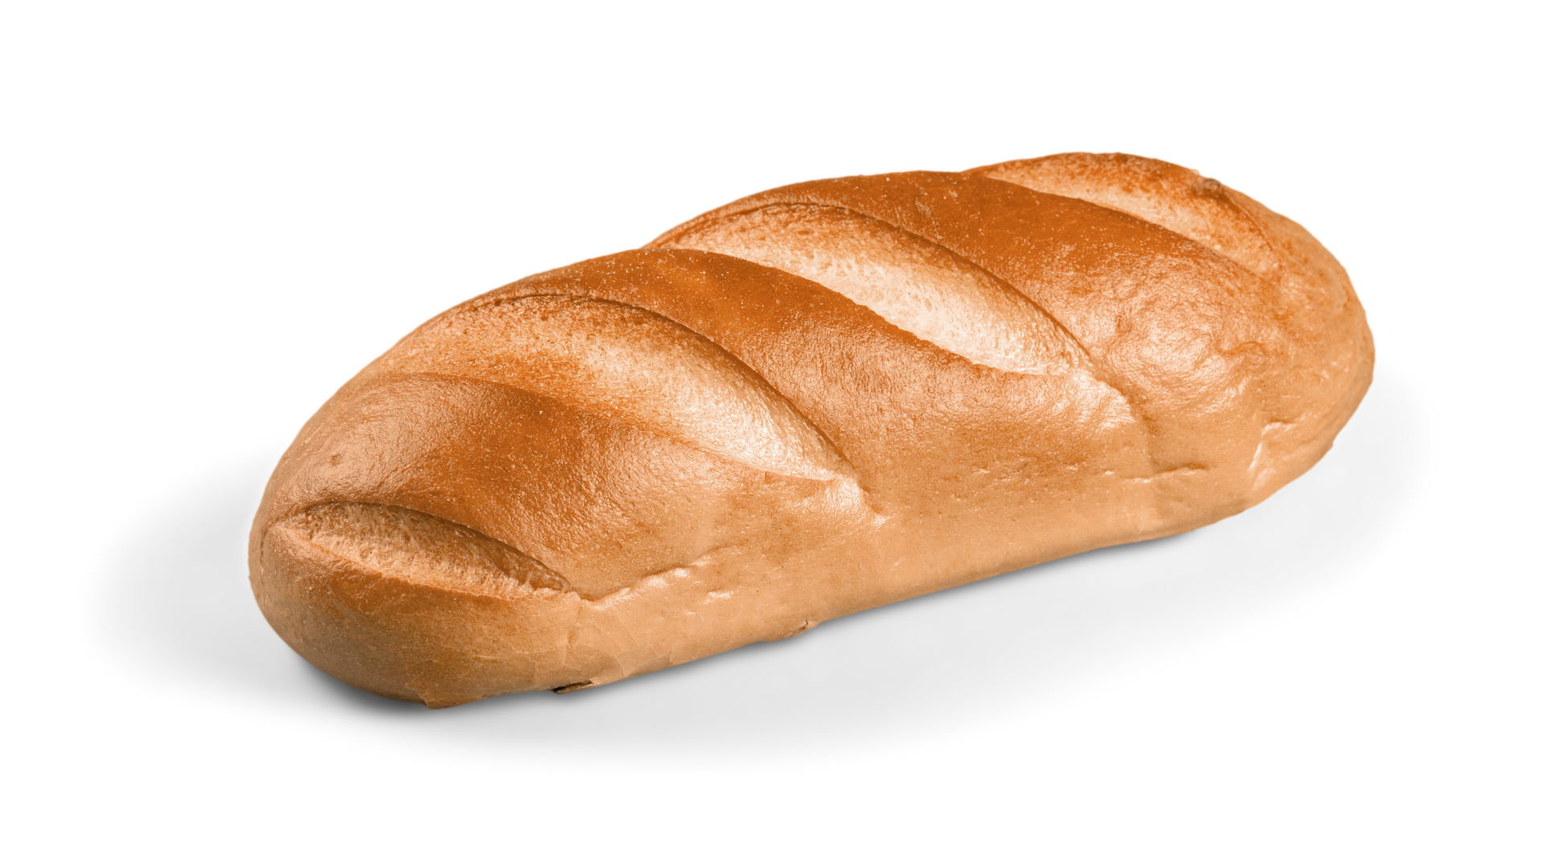
I am white inside.
I am eaten at breakfast.
I am brown.
I am bread.
Notes:
- Click số để quay về trang đầu.

Slide 21
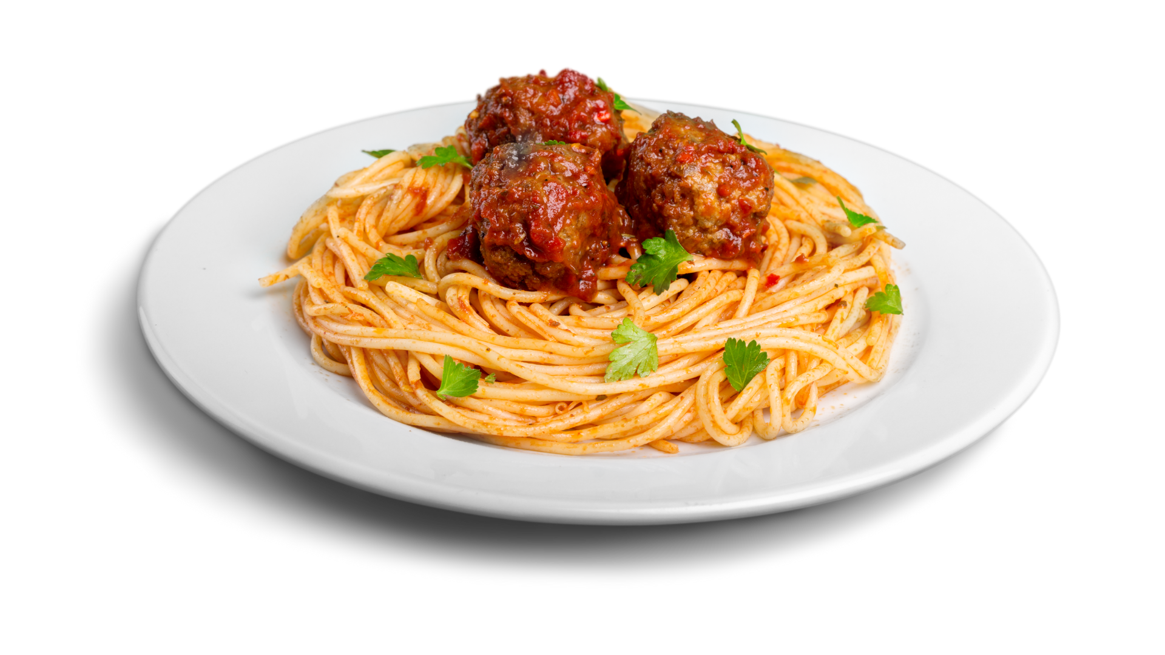
I am from Italy.
I am long.
I am eaten with tomato sauce.
I am spaghetti.
Notes:
- Click số để quay về trang đầu.

Slide 22
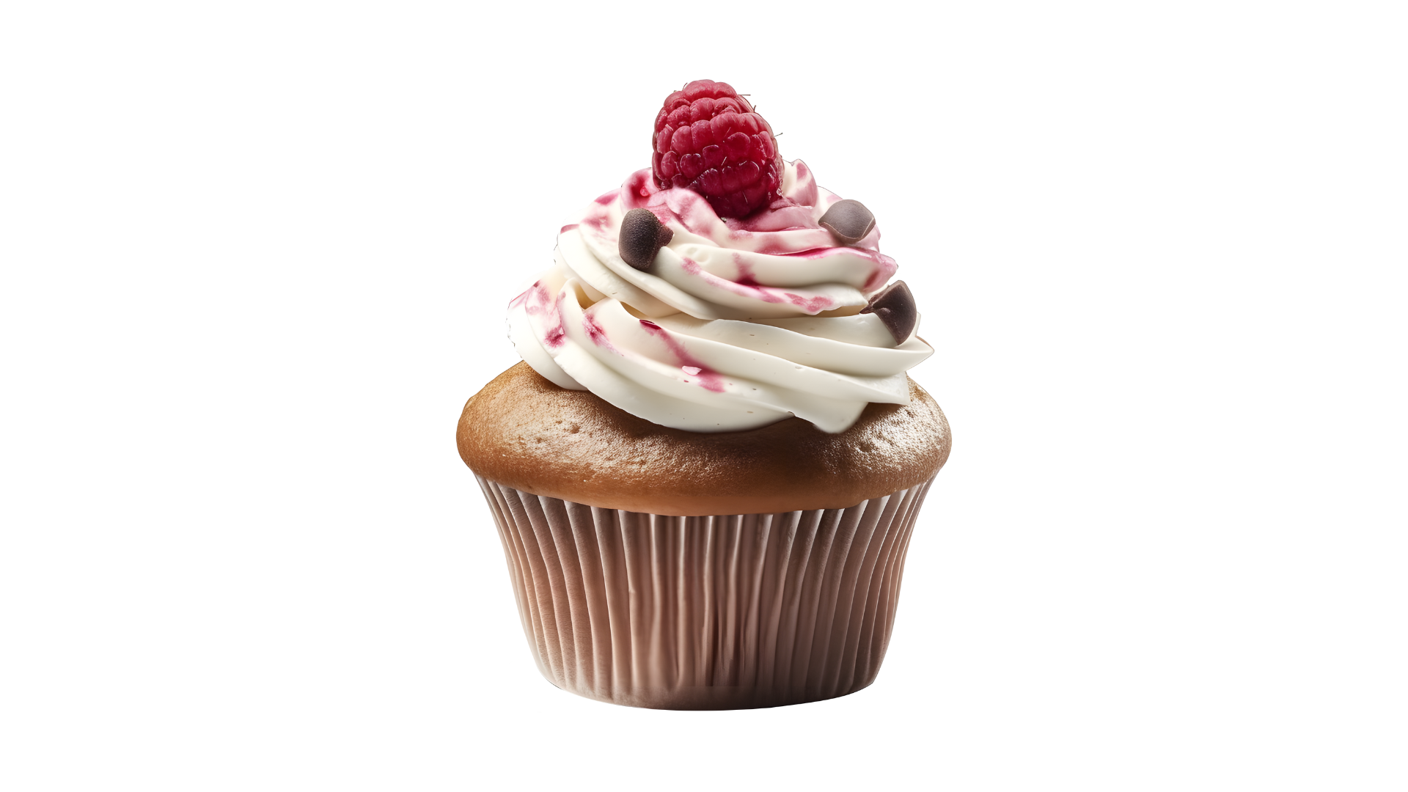
I am sweet.
I am colourful.
I have cream on top.
I am a cupcake.
Notes:
- Click số để quay về trang đầu.

Slide 23
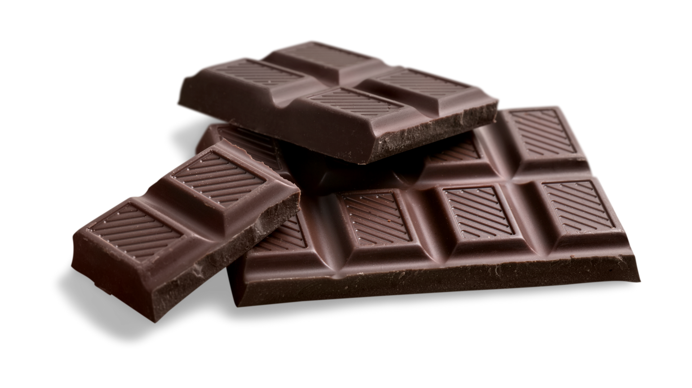
I begin with letter “C”.
I am brown or black.
I am made from a type of fruit.
I am chocolate.
Notes:
- Click số để quay về trang đầu.

Slide 24
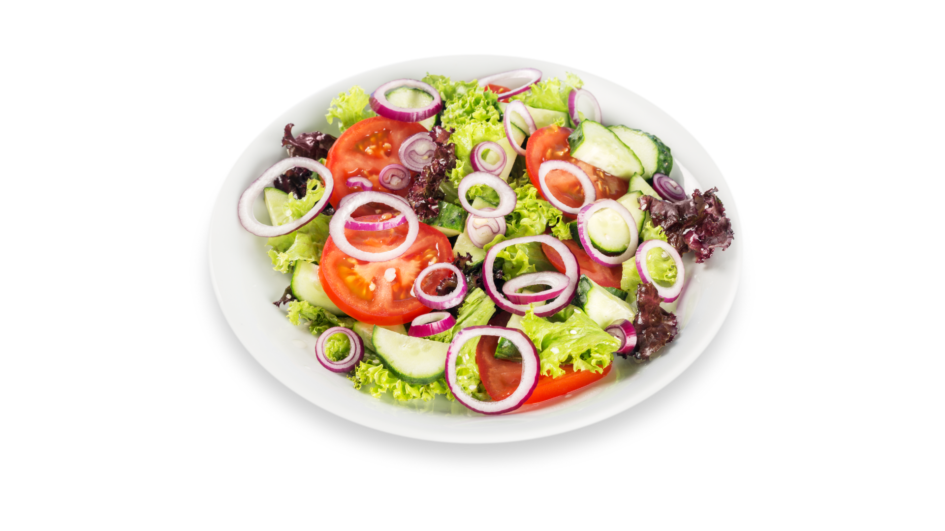
I have vegetables or fruits.
I have many colours.
I am healthy.
I am salad.
Notes:
- Click số để quay về trang đầu.

Slide 25
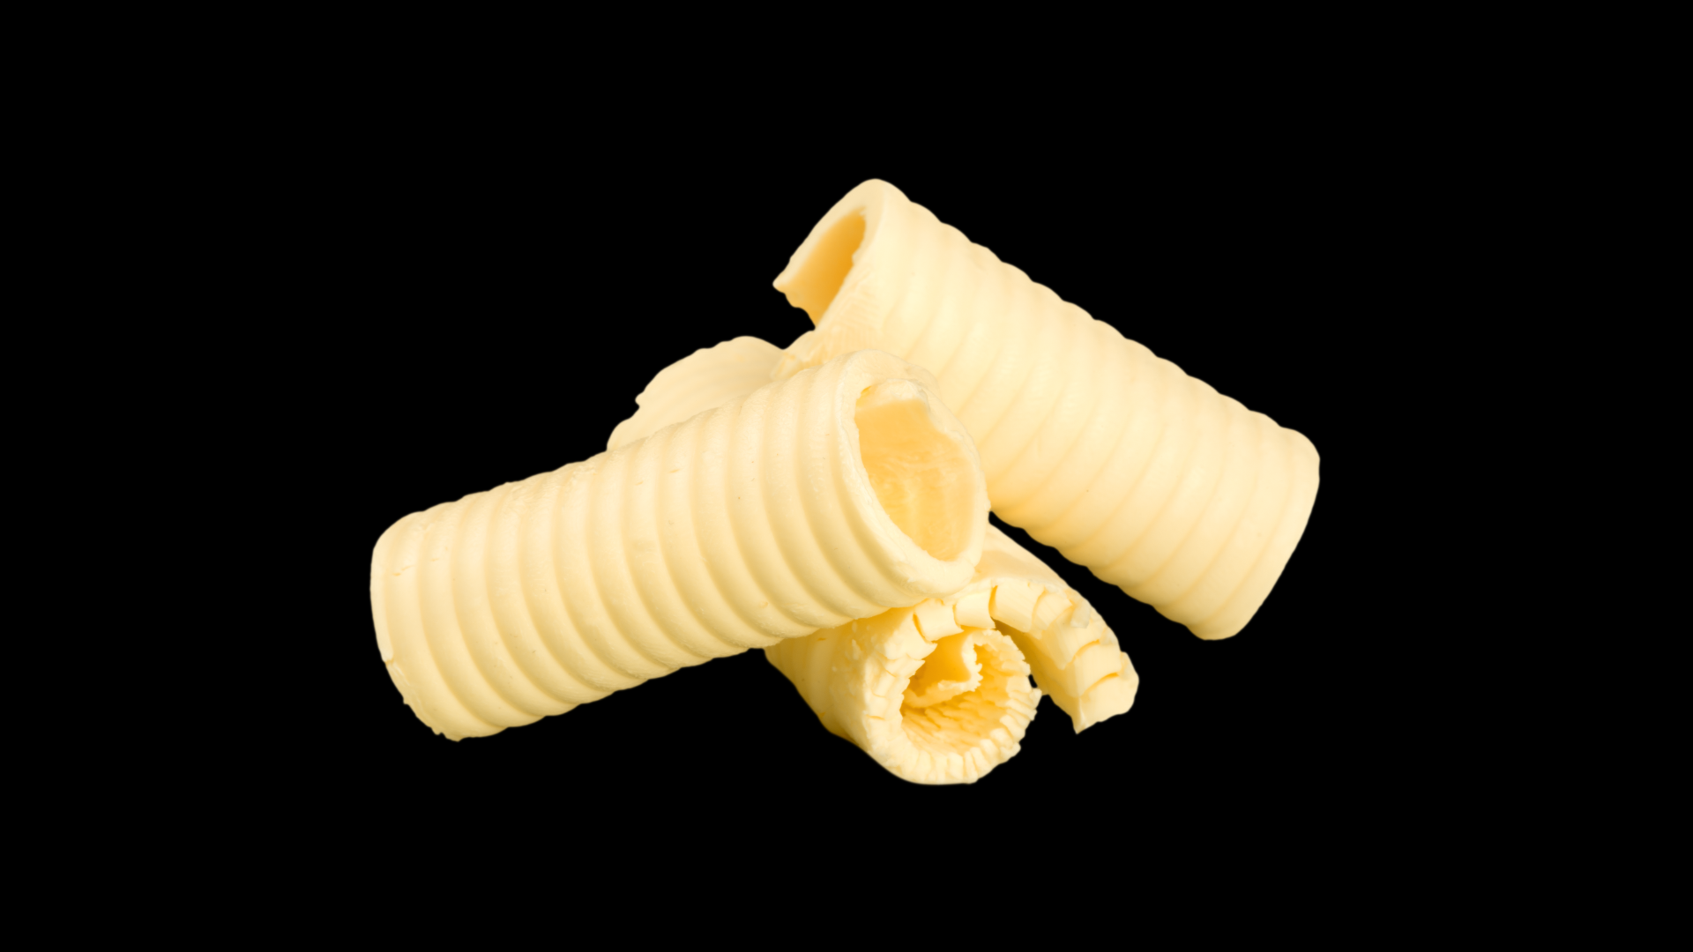
I am made from milk.
I am yellow.
I can be eaten with bread.
I am butter.
Notes:
- Click số để quay về trang đầu.

Slide 26
04
PRODUCTION
3 Let’s talk

Slide 27
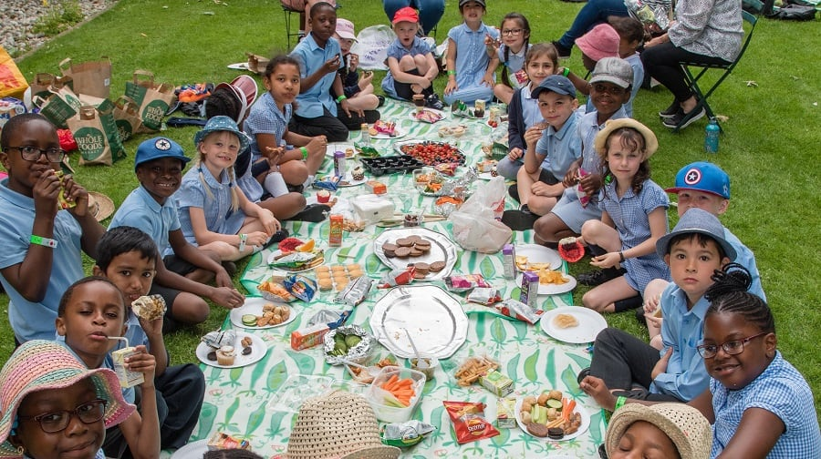
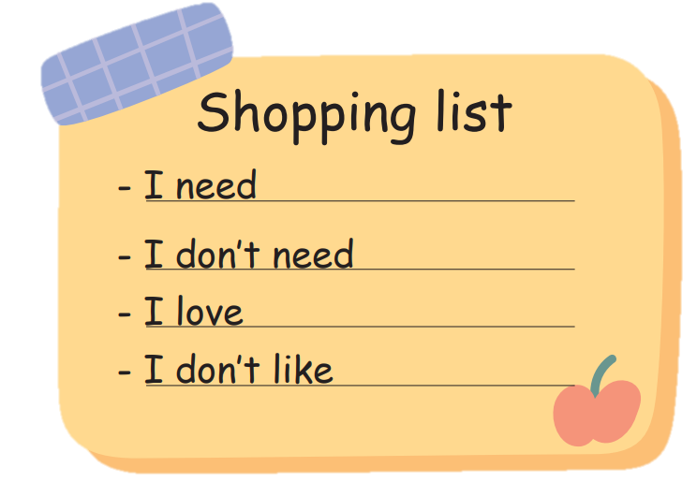
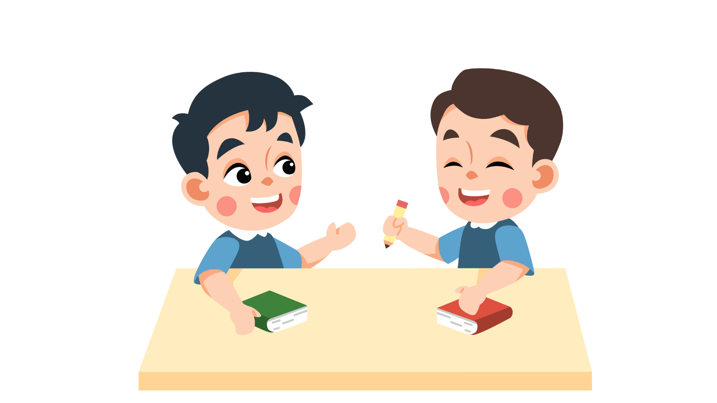
Imagine you’re having a picnic. Complete the shopping list and talk to your friend.
For the picnic, I need ____________.
Notes:
- Click số để quay về trang đầu.

Slide 28
05
WRAP-UP & ASSESSMENT

Slide 29
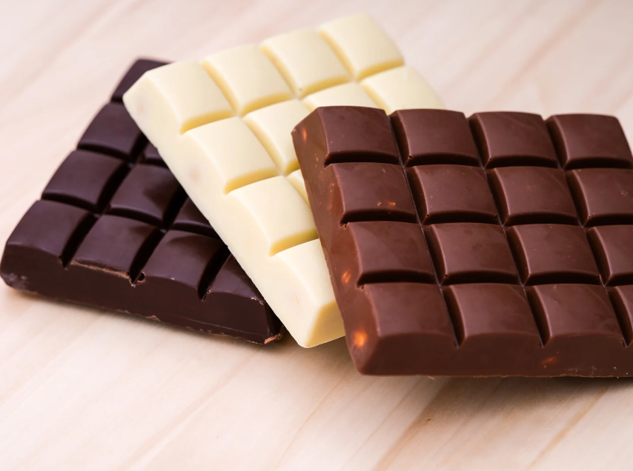
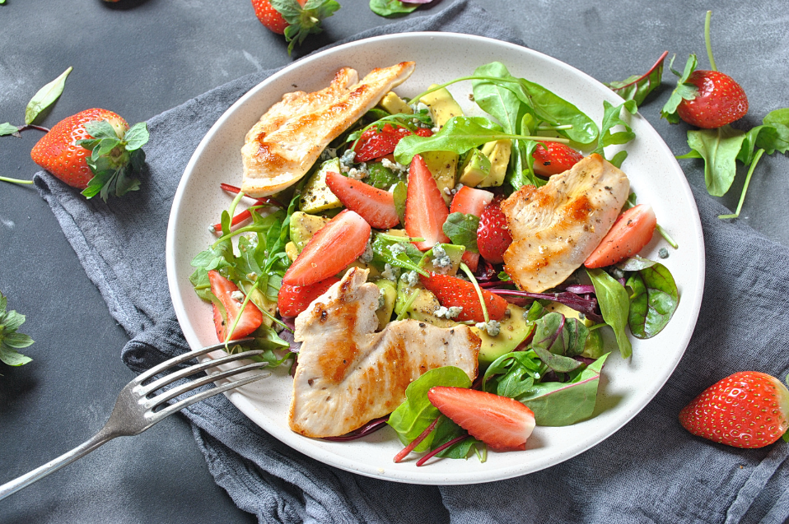
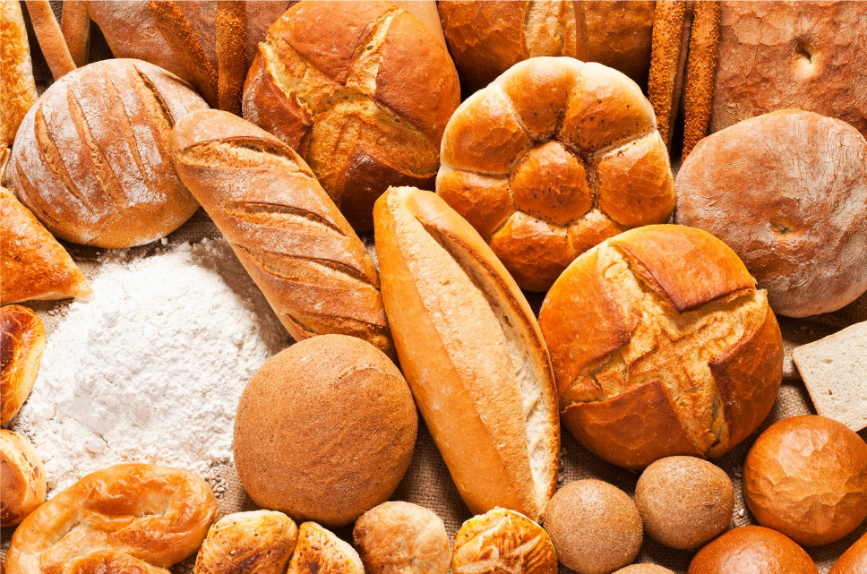
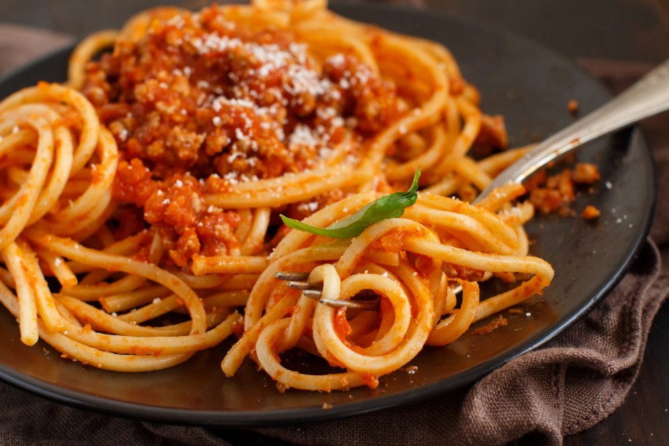
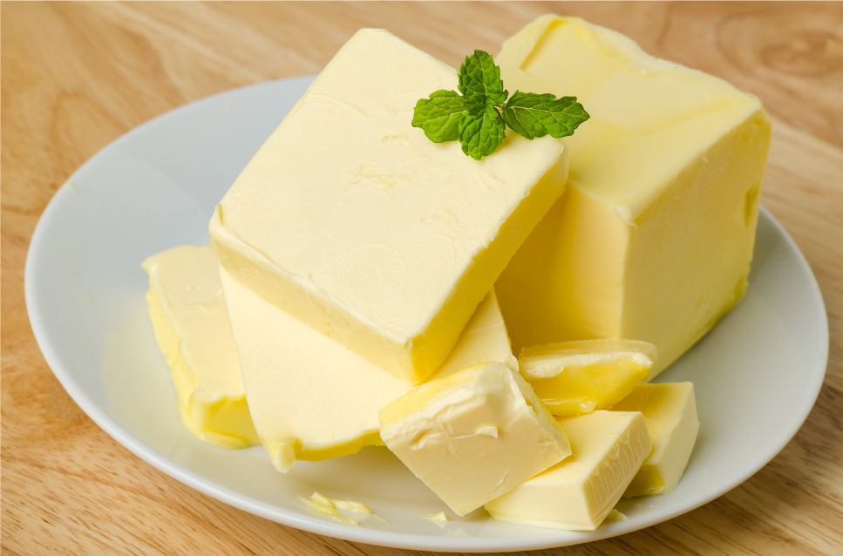
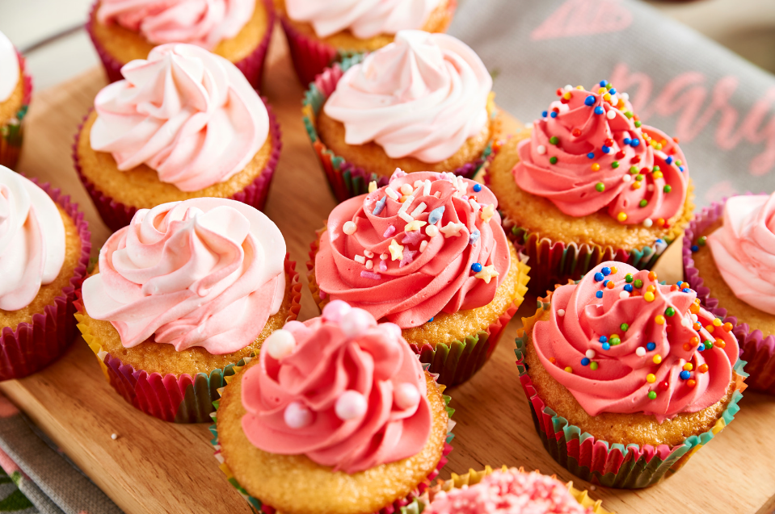
I am made from milk.
Fill in the missing letters.
I am yellow.
I can be eaten with bread.
2. _ _ l _ _
3. _ _ _ _ d
1. c _ _ _ _ _ _ _ _
s a a d
b r e a
h o c o l a t e
6. _ _ p _ _ _ _
5. _ _ _ _ e _
c u c a k e
4. _ _ _ _ _ _ t _ _
b u t t r
s p a g h e t i

Slide 30
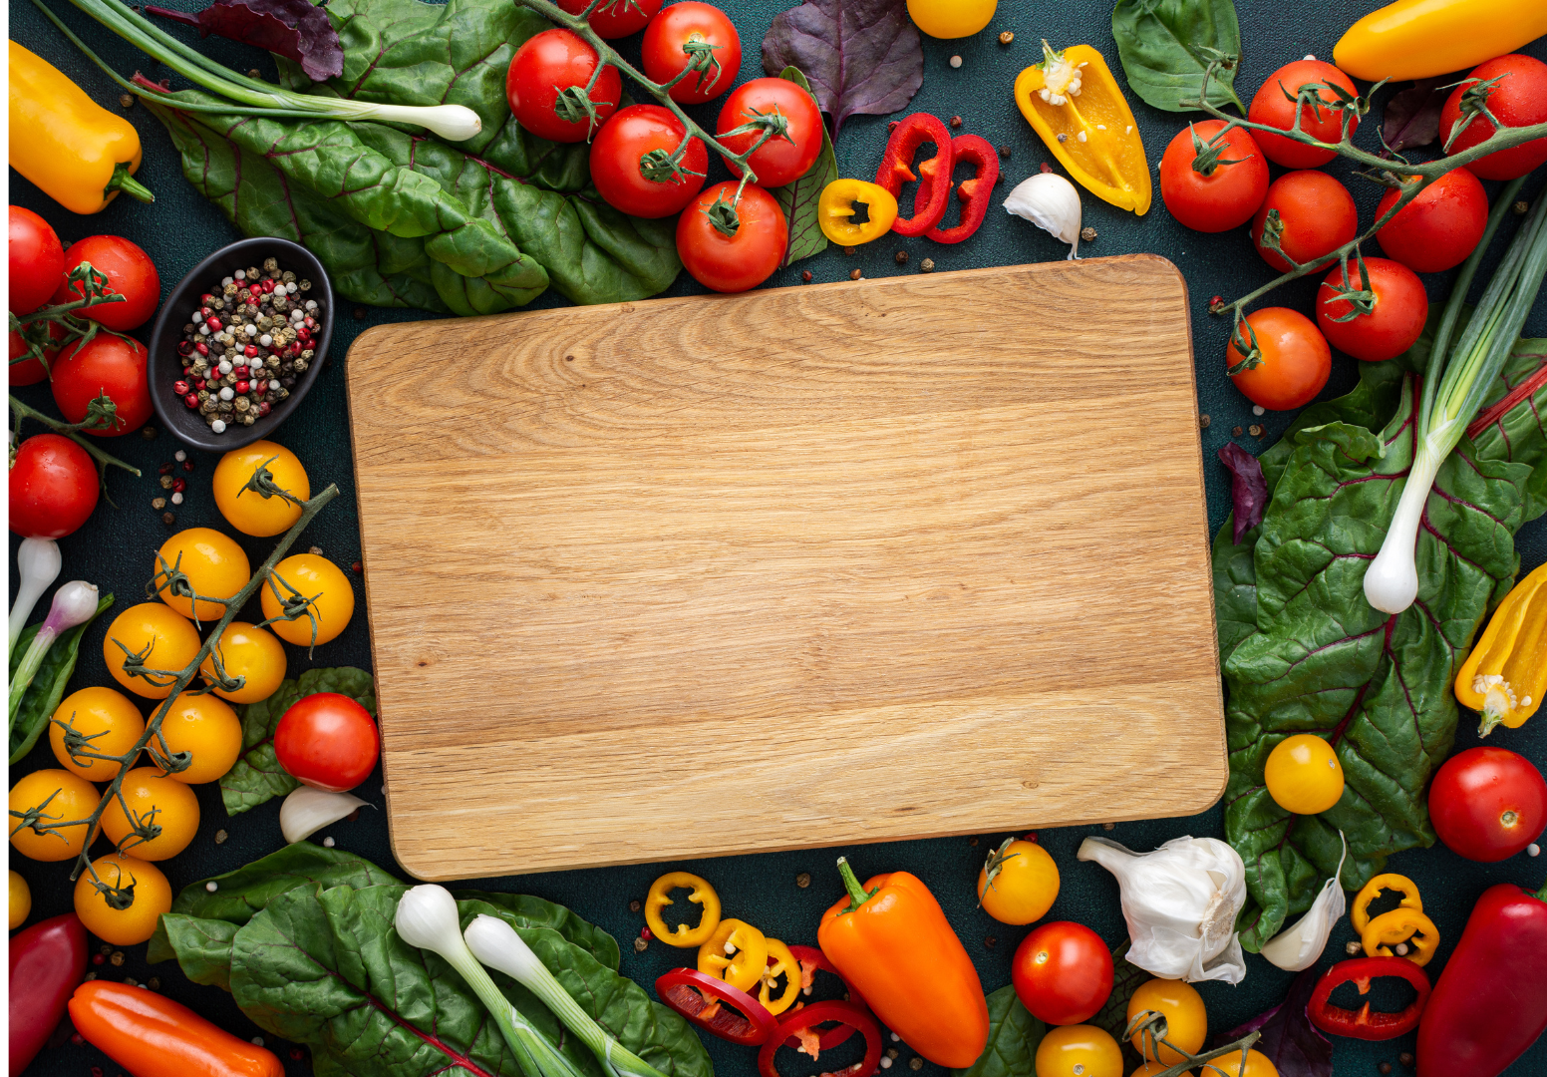
Unit 6: Food
Lesson 1 – Part 1,2,3
What have we learnt today?
Vocabulary:
bread
butter
chocolate
cupcake
salad
spaghetti

Slide 31

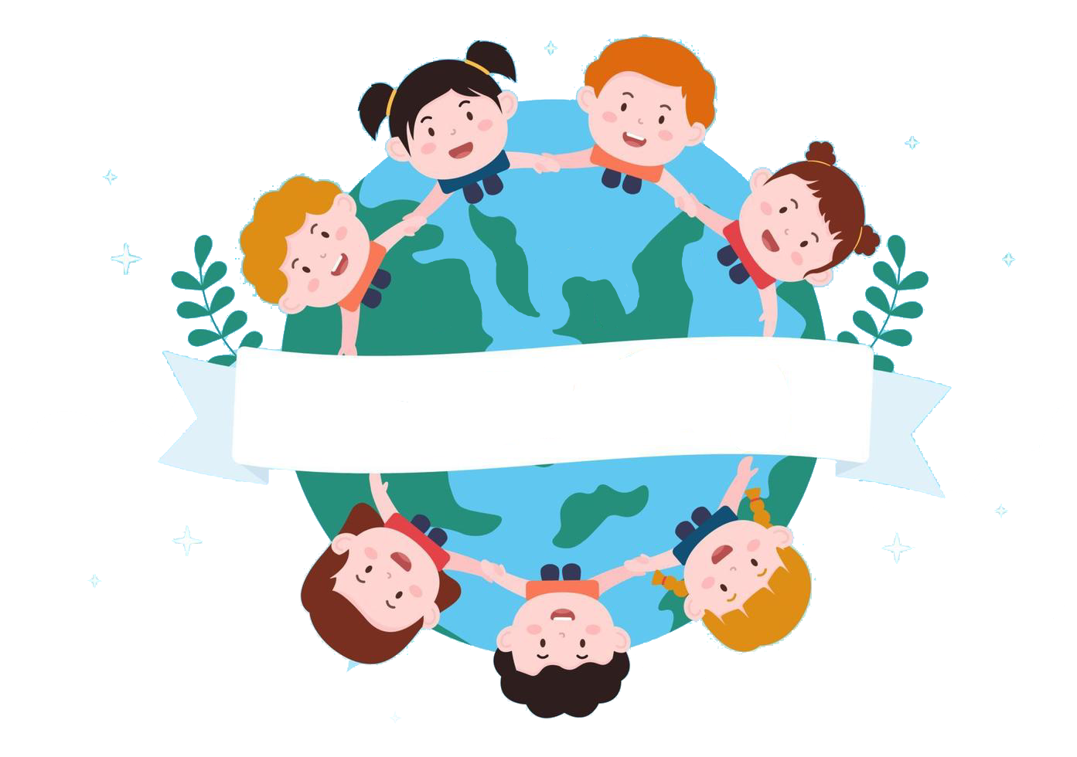
Thank you
& goodbye!

