Slide 1










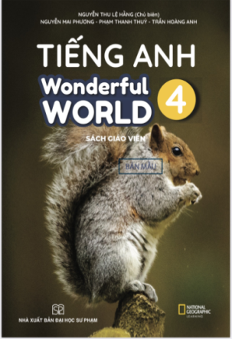








Slide 2










Unit 2: My Home
Lesson 3 – Task 1,2,3

Slide 3

Racing game.
1 WARM UP
Notes:
Warm up
Guessing game cho 1 dòng

Slide 4
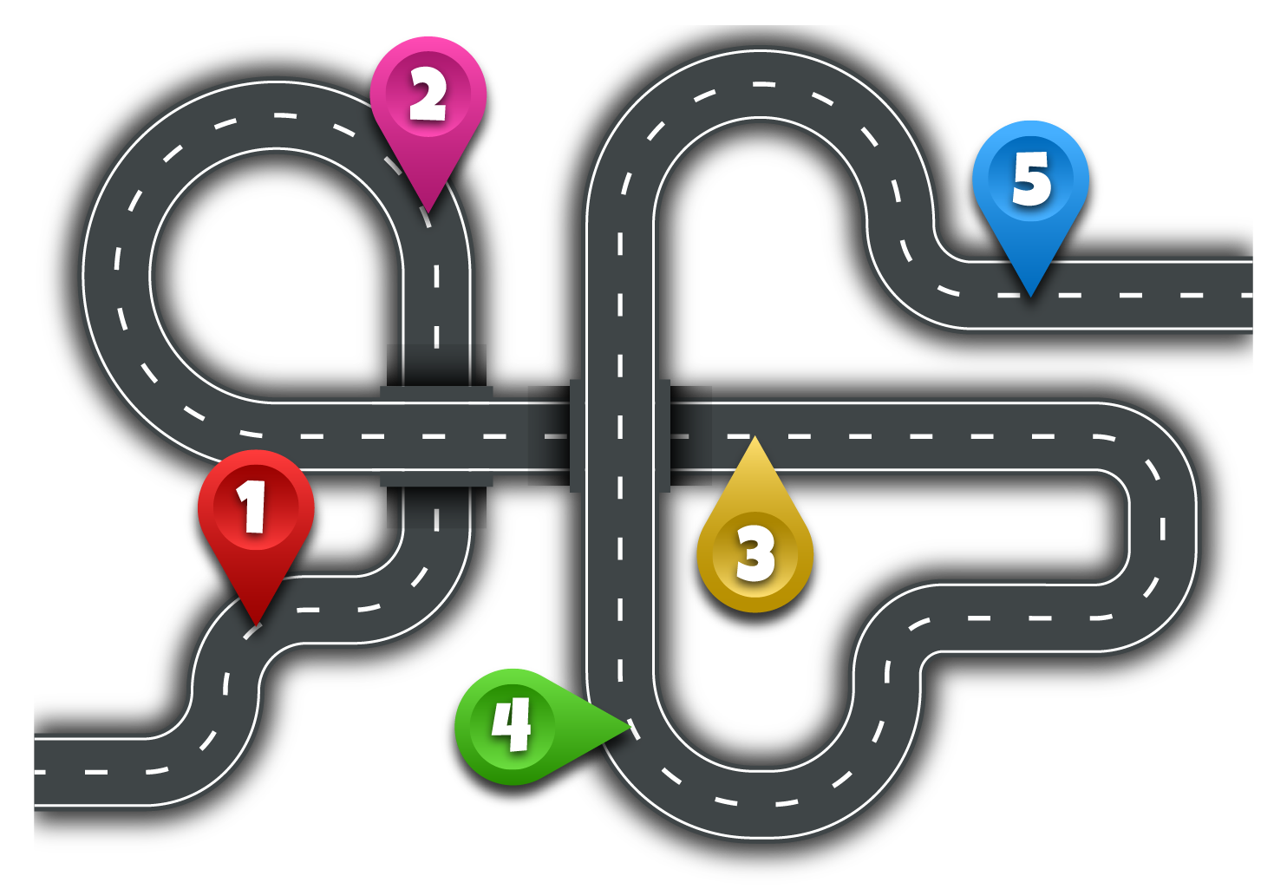








2
5
1
3
4
Next
Notes:
Bắt đầu từ số 1

Slide 5

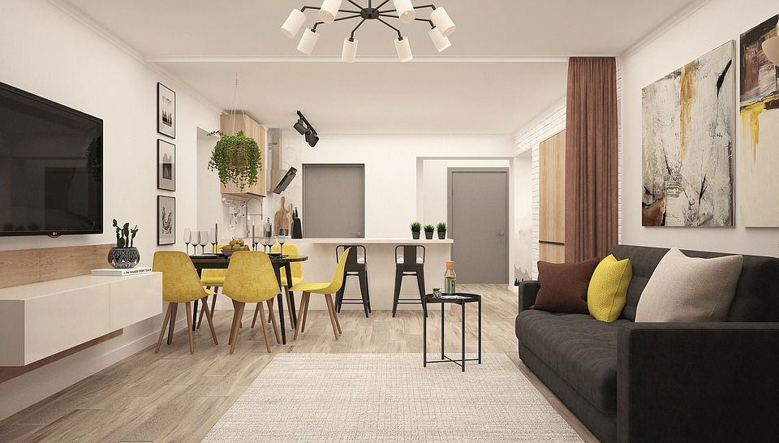
Q1: Where is the sofa?
The sofa is in the
living room.
Check
Go
Notes:
T shows question and picture, then asks sts to answer
Check their answers.

Slide 6
Where is the rug?
Q2
It’s under the table.
Check
Go

Slide 7
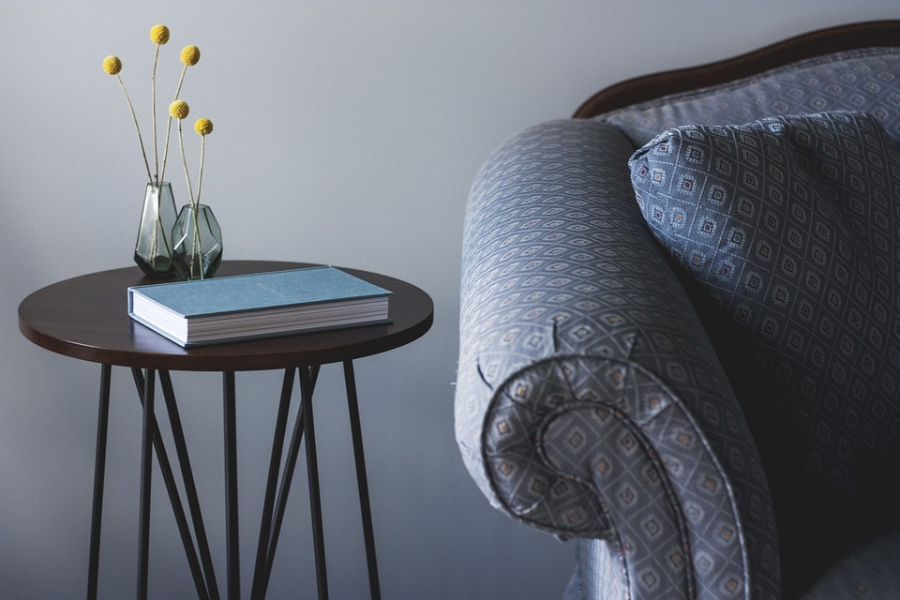
Q3: The table is next to ____.
the sofa
Check
Go

Slide 8
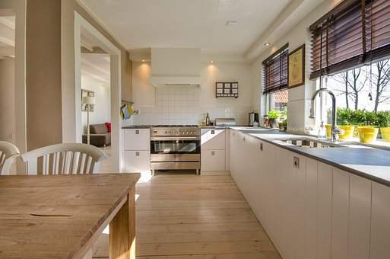
Q4: The trees are _____ the sink.
behind
Check
Go

Slide 9
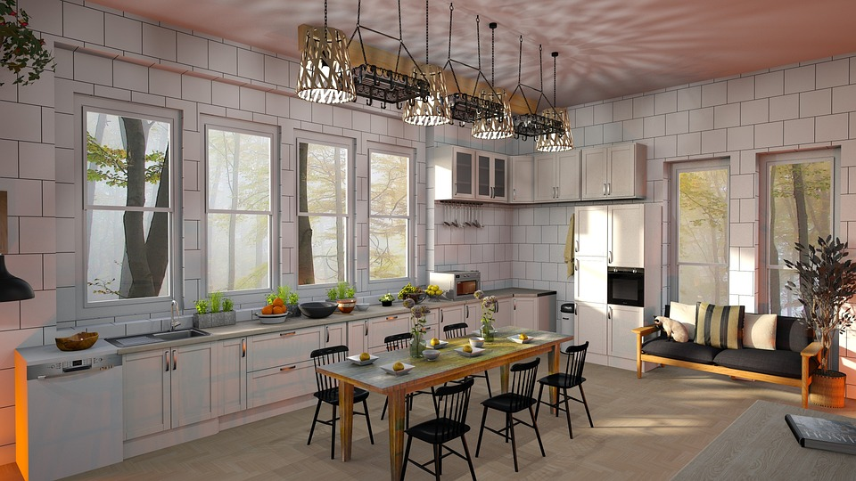
Q5: Your _____ is so big!
kitchen
Check
Go

Slide 10
Presentation
Task 1 Listen and point.
Repeat.
Notes:
Dấu câu

Slide 11


1 Listen and point. Repeat.
bookshelf
What is it?

Slide 12

floor
What is it?

Slide 13
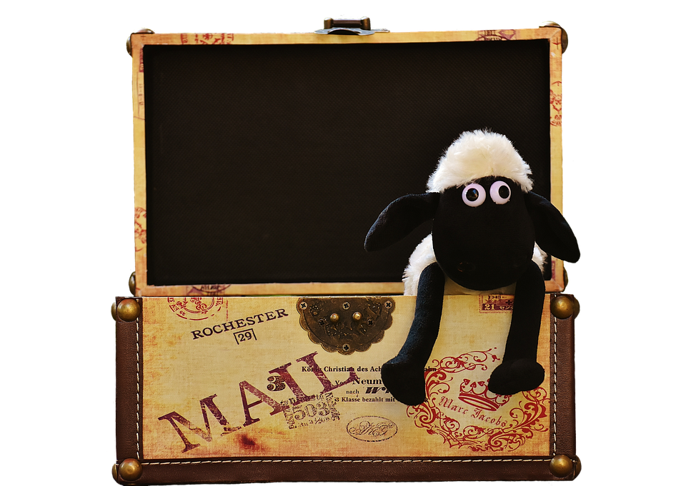
toy box
What is it?

Slide 14
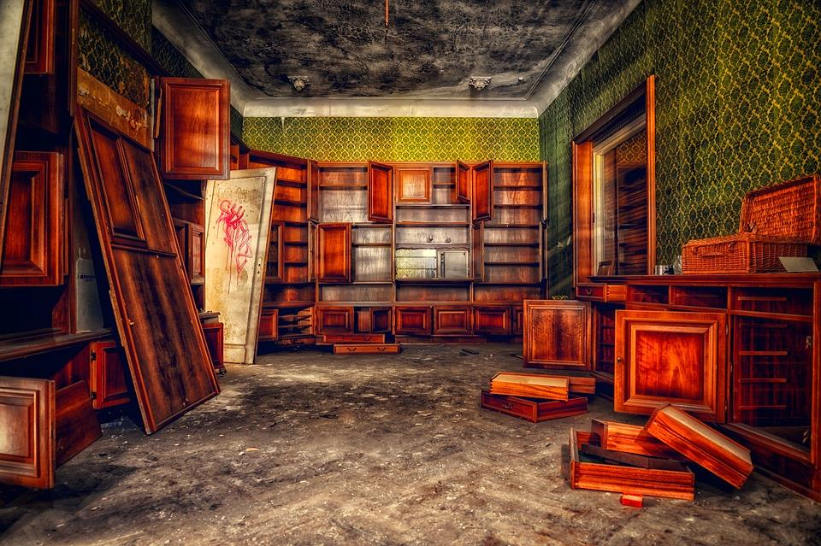
messy

Slide 15

tidy

Slide 16

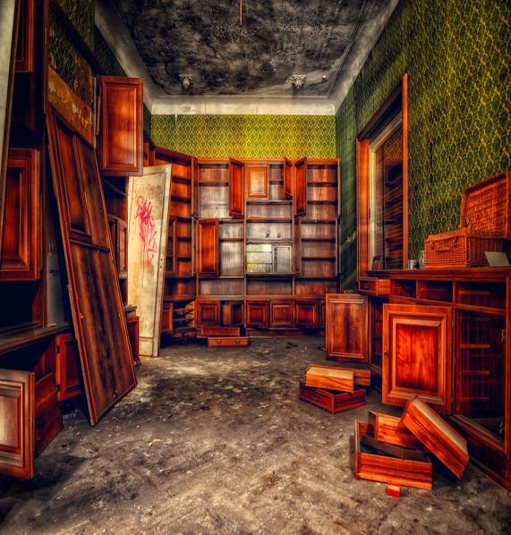



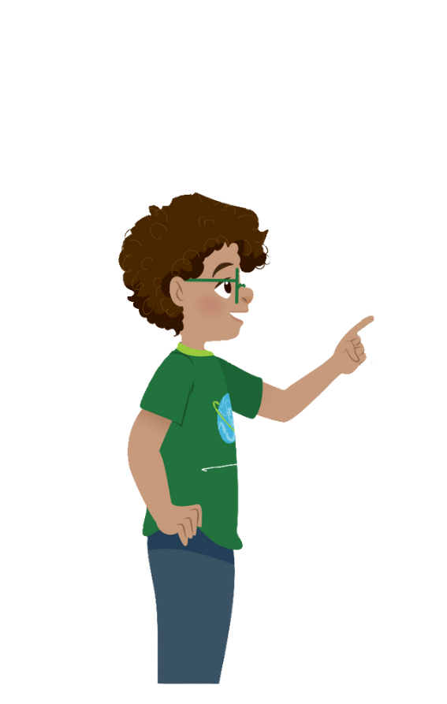
1 Listen and point.Repeat.
messy
floor
bookshelf
toy box
tidy

Slide 17











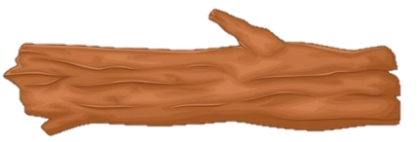


PROTECT
JUNGLE

Slide 18
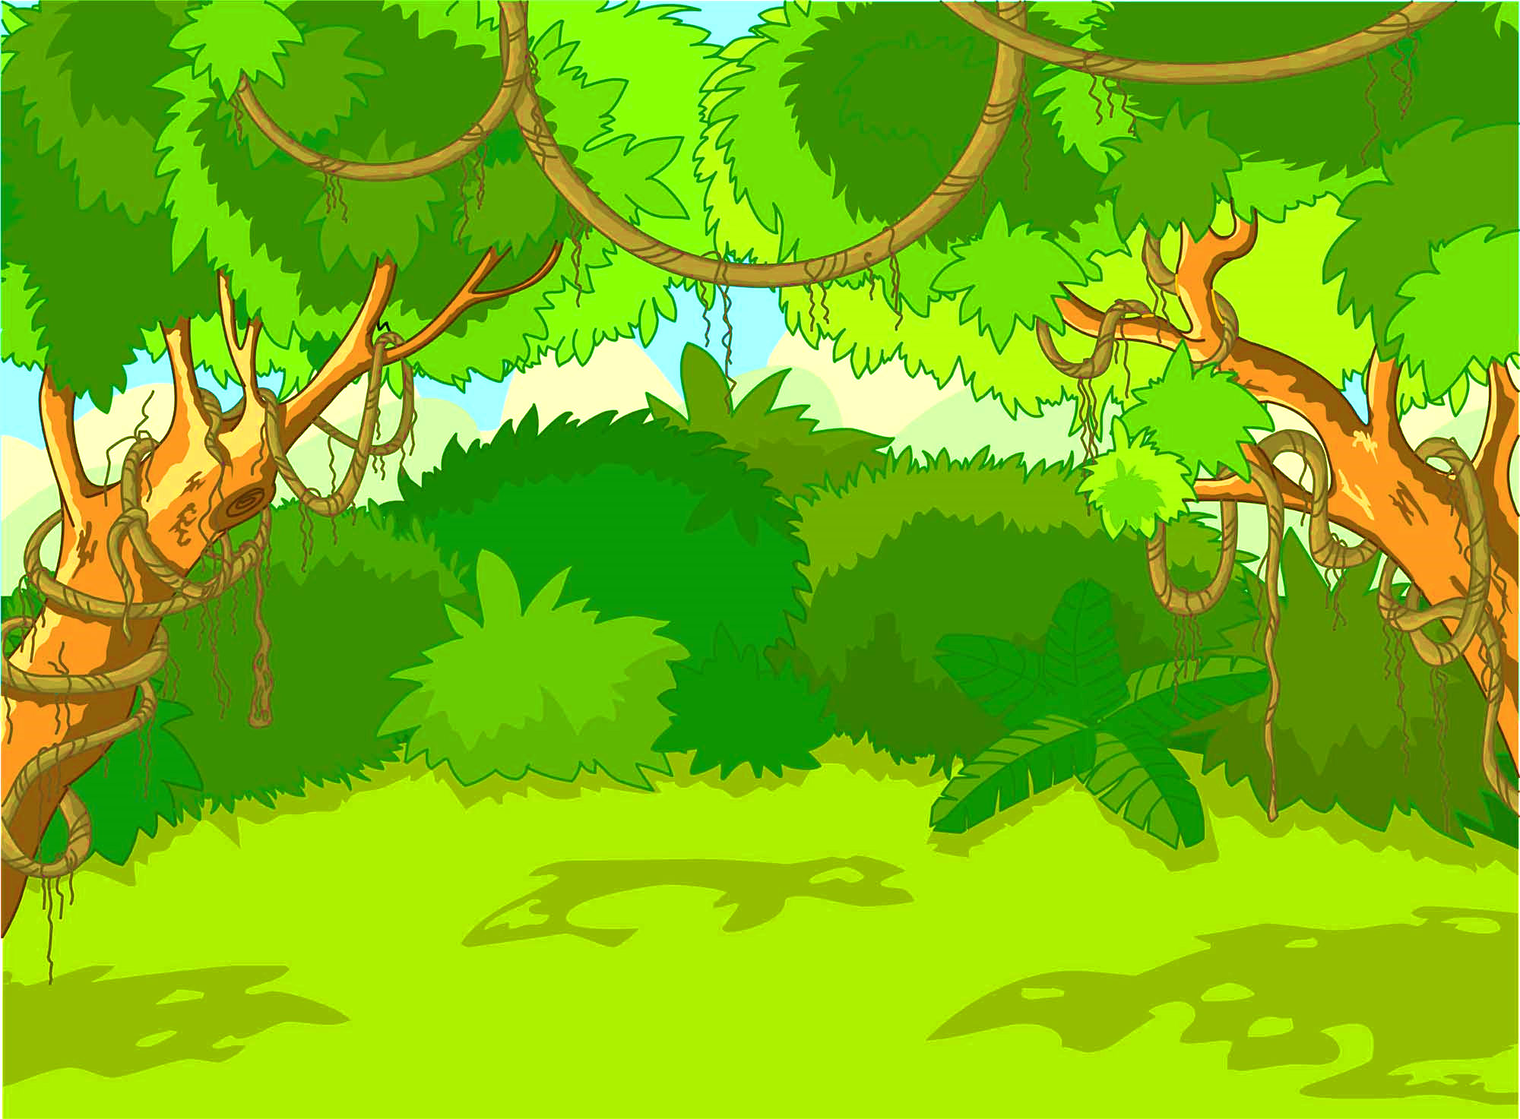


















1
2
3
4
Notes:
Hs chọn số, GV mở câu hỏi và bức tranh đi kèm
Hs trả lời, GV ấn mũi tên để quay lại và ấn vào con khỉ phía trên để đánh bại thợ săn
Trả lời hết 4 câu hỏi chọn mũi tên gỗ để chuyển game

Slide 19
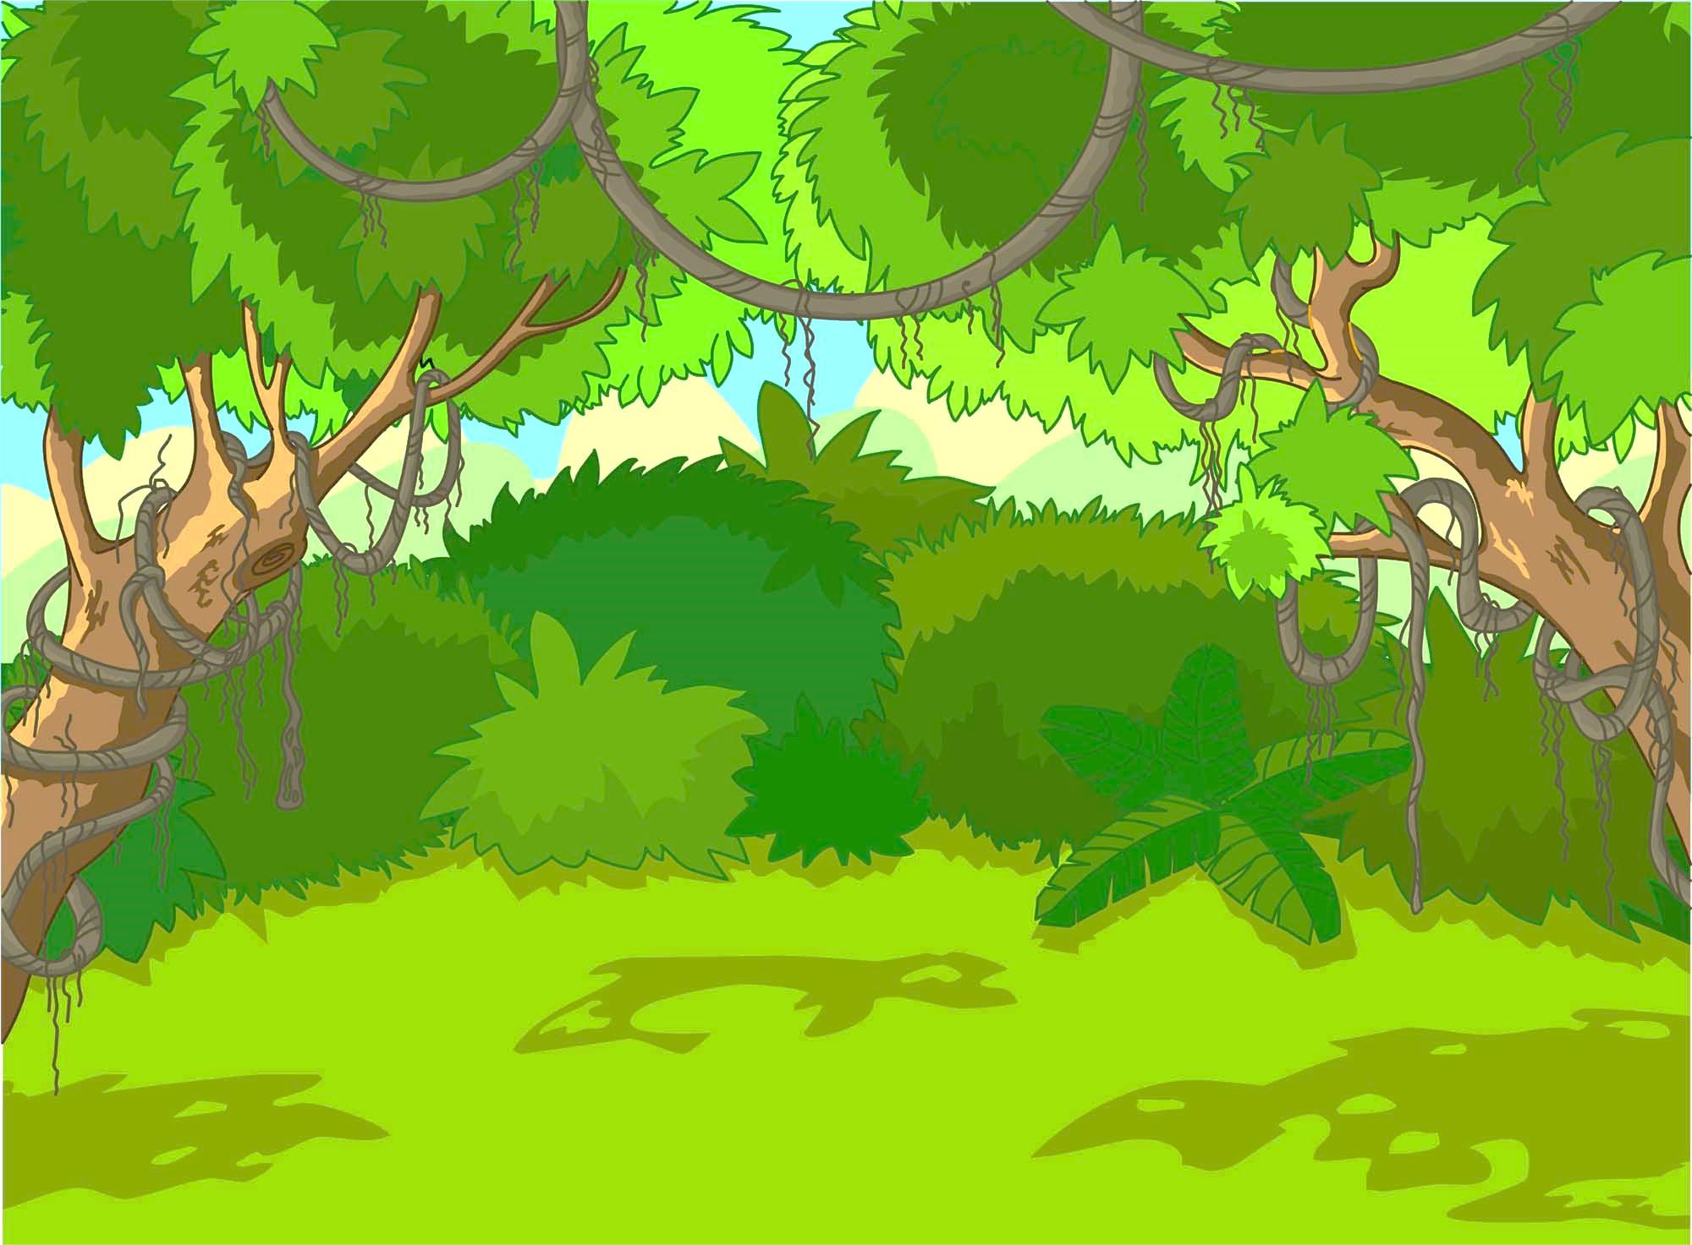

What is it?
bookshelf

Slide 20

Where is
the toy sheep?
It’s in the toy box.

Slide 21
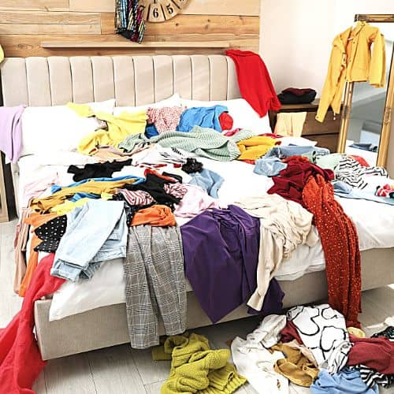
Your room is ___.
messy
Notes:
Thay hình ảnh ; hình này trông như nhà gỗ - ko phù hợp ; và đồ như này cũng k omessy dc

Slide 22
The tree is on the ____.
A.rug
B. floor
B. floor

Slide 23
Practice
Task 2 Listen and tick.
Notes:
Dấu câu

Slide 24

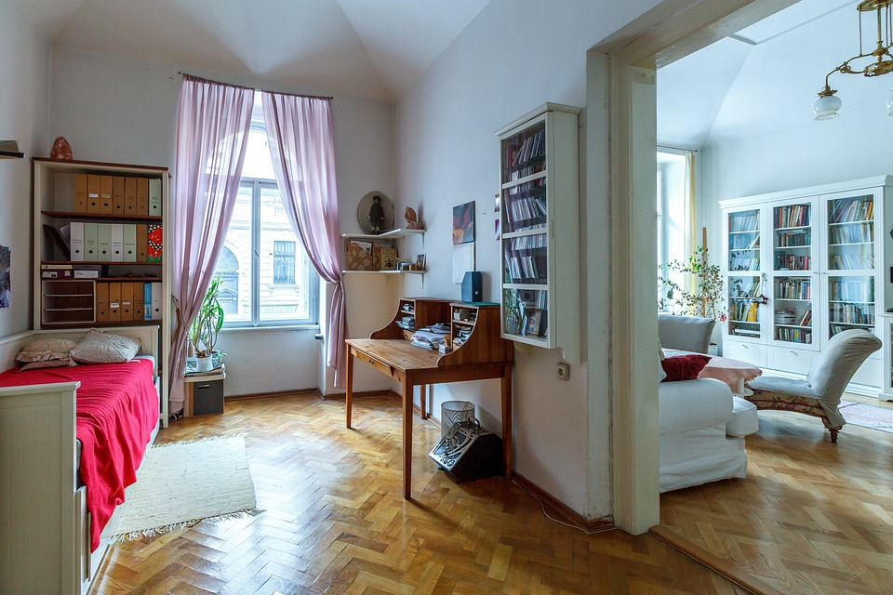
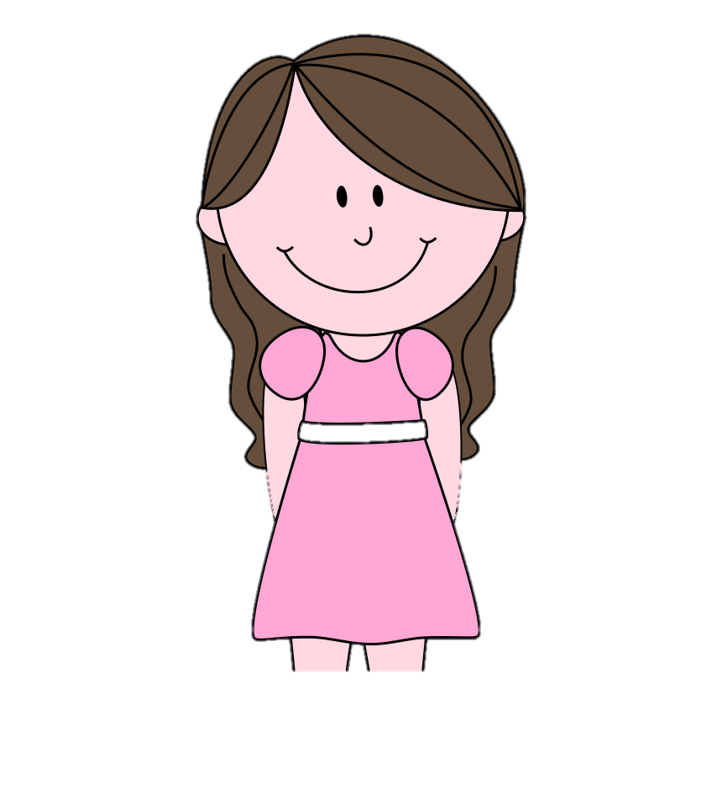

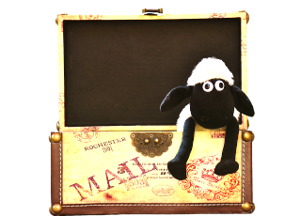
2
Listen and tick.
This is my son and this is his bedroom.
Wow! It’s tidy.
There aren’t any books or toys on the floor.
How is his bedroom?
Jane
Ms. Kim
Notes:
Không click chuột vào loa mà kích ra ngoài để chạy theo trình tự

Slide 25
2
Listen and tick.
His books are on the bookshelf.
Yes, his toys are in the toy box.
Jane
Ms. Kim

Slide 26
2
Listen and tick.
2. His toys are in the
✓
toy box.
bookshelf.
His room is
messy.
✓
tidy.
Jane
Ms. Kim

Slide 27
2
Listen and tick.
3. His books are on the
✓
bookshelf.
floor.
Jane
Ms. Kim

Slide 28
Practice
Task 3 Point and say.
Notes:
Dấu câu

Slide 29



3
Point and say.
bookshelf/ next to/ television
Where is
the bookshelf?
It’s next to
the television.

Slide 30
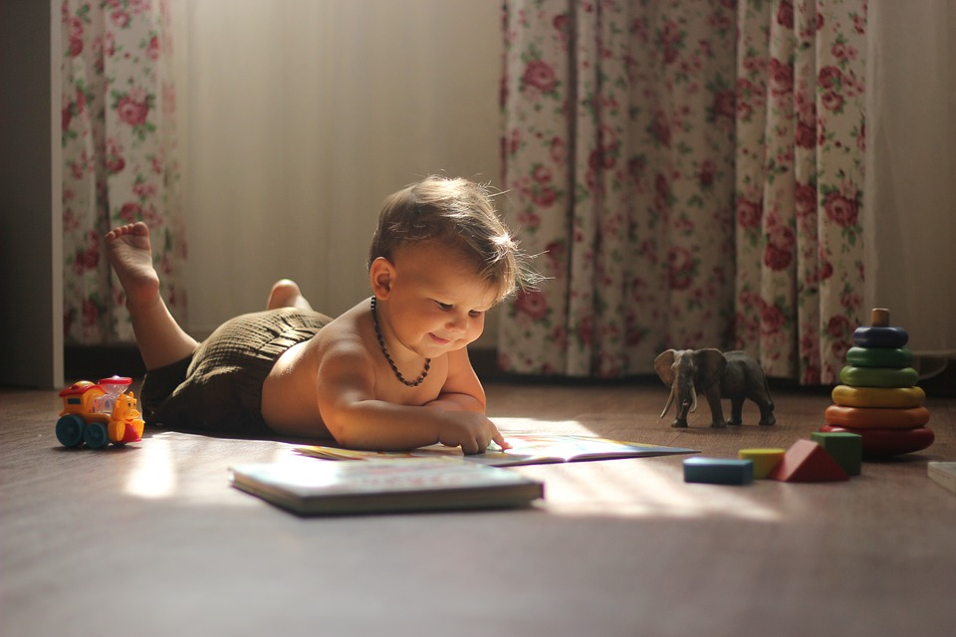
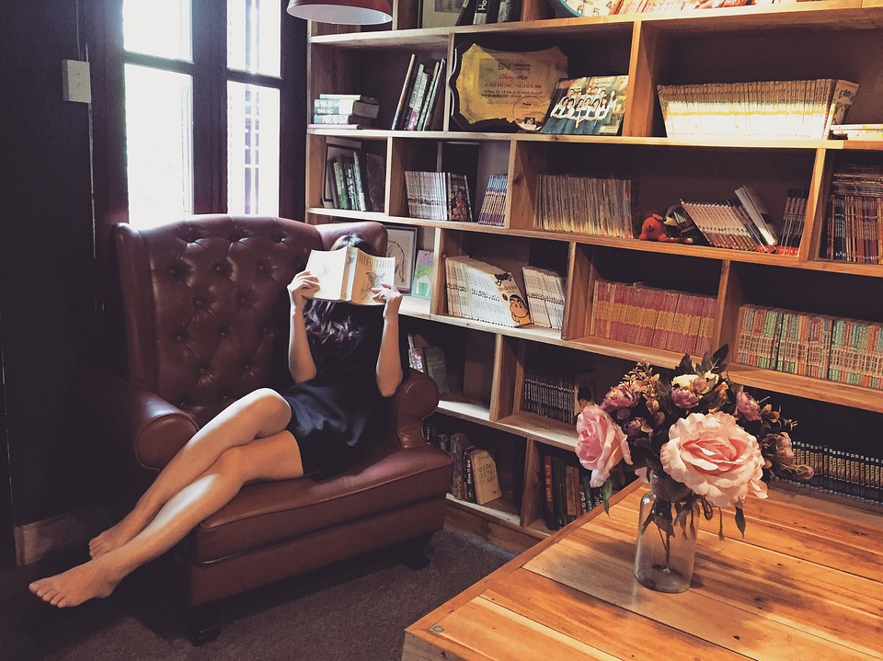

Click to the picture to get the dialogue
1
2

Slide 31


bookshelf/ behind/ table
HOME
Where is the
bookshelf?
The bookshelf
is behind the
table.
Notes:
Trình bày lại chữ

Slide 32
toys/ in front of/ my brother
HOME
Where are
your toys?
They’re in
front of
my brother.
Notes:
Trình bày lại chữ

Slide 33
Production
Notes:
Đây k phải là extra, đây là hđ 3 của bài

Slide 34
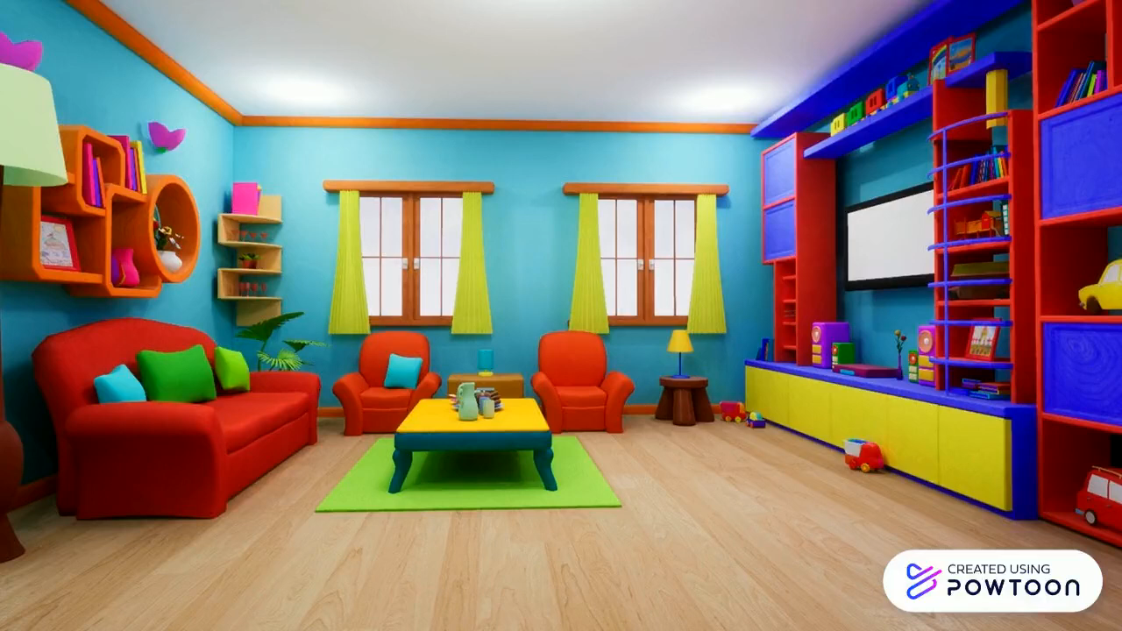
Watch the video!

Slide 35
Assessment
Notes:
Đây k phải là extra, đây là hđ 3 của bài

Slide 36


Look and read. Put tick (✓) or cross (✗) in the box.
True
False
1. The toys are around the baby.
✓
2. The bookshelf is on the table.
✓
3. The bed is next to the table.
✓

Slide 37

Wrap up
Notes:
Đây k phải là extra, đây là hđ 3 của bài

Slide 38
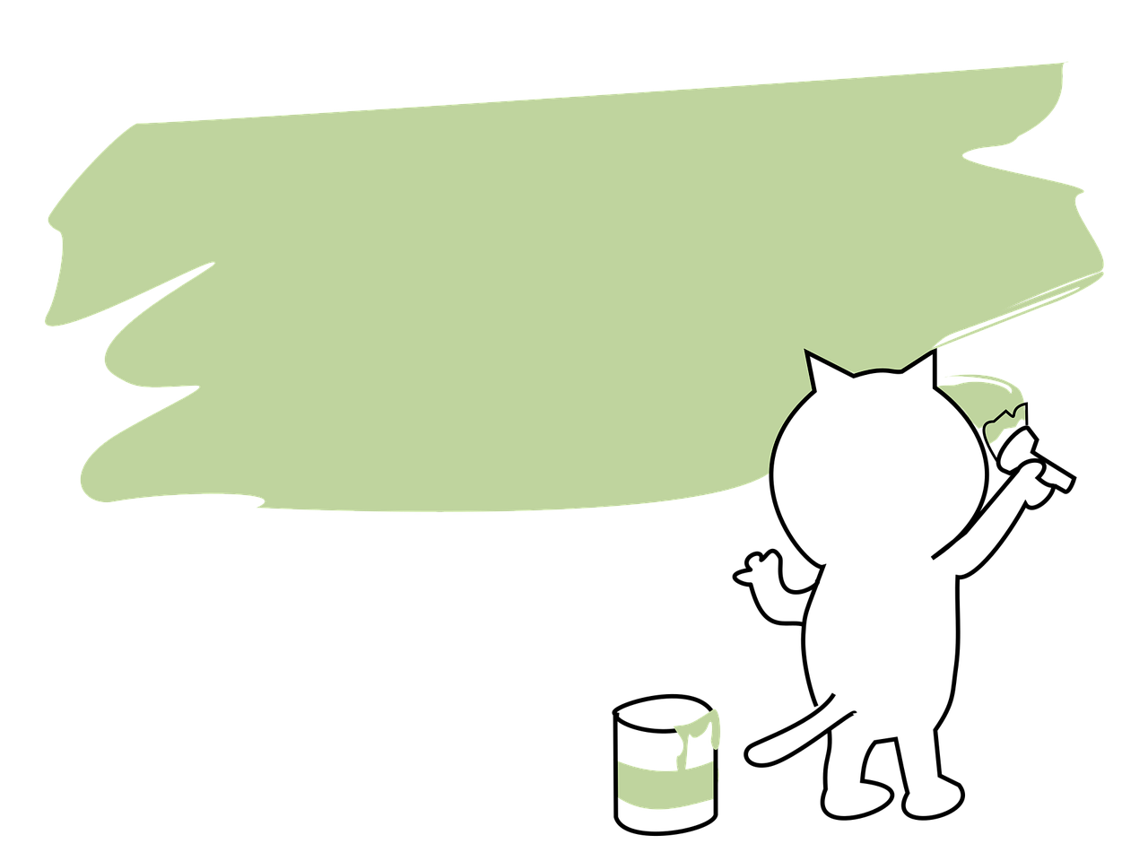
Vocabulary
Structure
Bookshelf
Floor
Toy box
Messy
Tidy
Where is/ are__?
It’s____.
They’re ___.

Slide 39




Thank you & goodbye!

