Slide 1





















Fun time
and project

Slide 2



1
Fun time
Let’s sing a song!

Slide 3

Song: My House

Slide 4

1
Fun time

Slide 5







5
2
3
7
8
1
6
4
Next

Slide 6


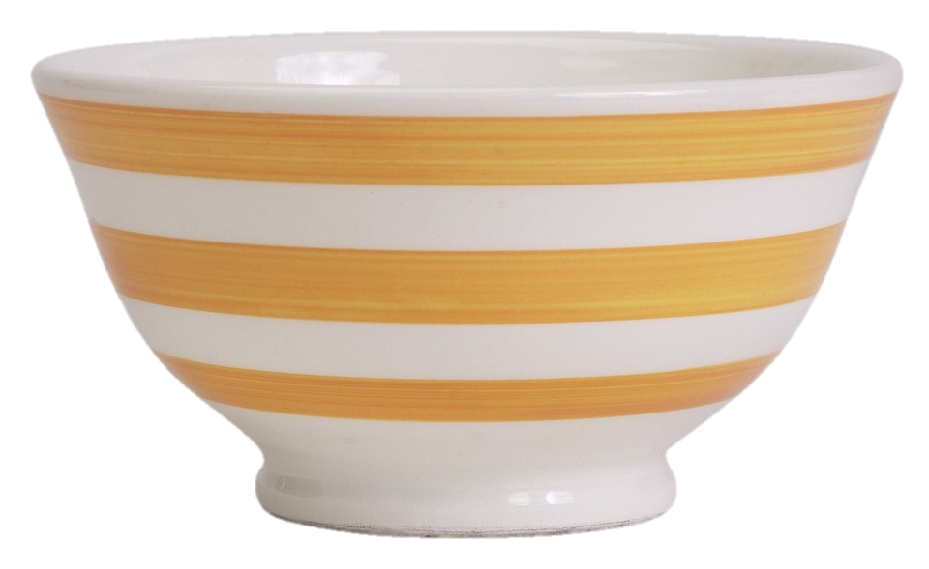




Plate
Spoon
Bowl
Bowl
Bowl
Back

Slide 7


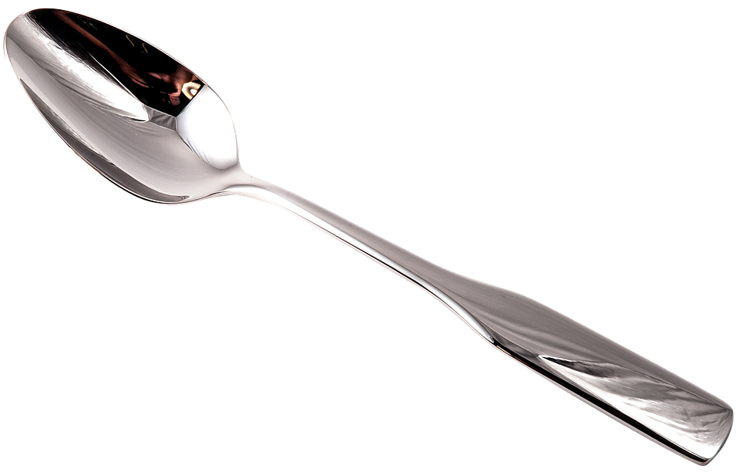
Spoon
Plate
Spoon
Dining room
Back

Slide 8


Floor
Floro
Floor
Olrof
Back

Slide 9

Fridge
Sofa
Bookshelf
Bookshelf
Bowl
Back

Slide 10
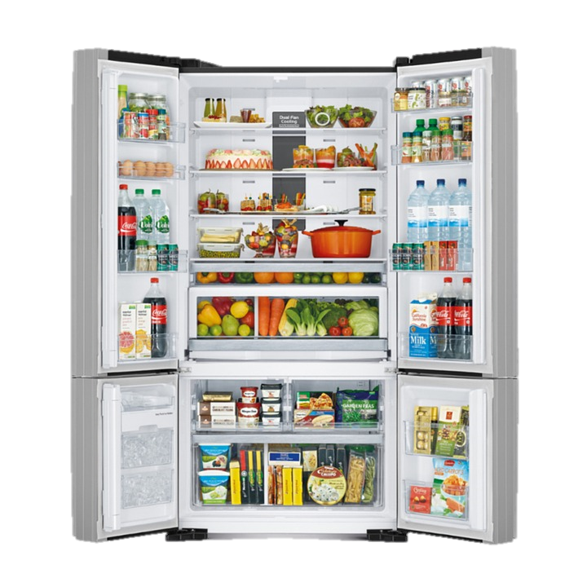
Fridge
Fidgre
Fridge
Drfige
Back

Slide 11
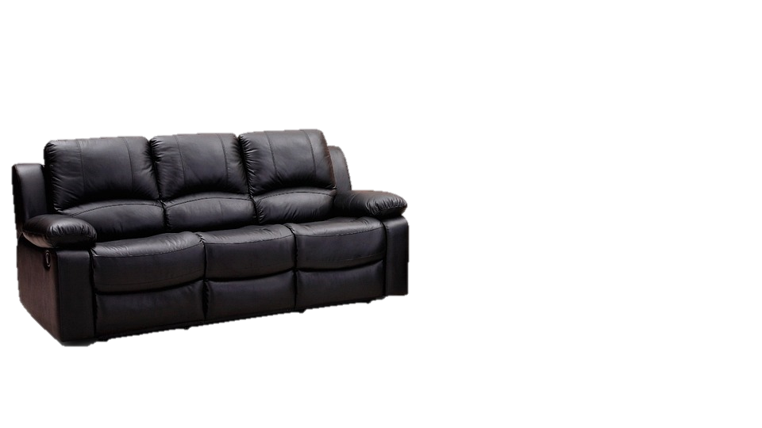
Fridge
Sofa
Sofa
Bookshelf
Bowl
Back

Slide 12
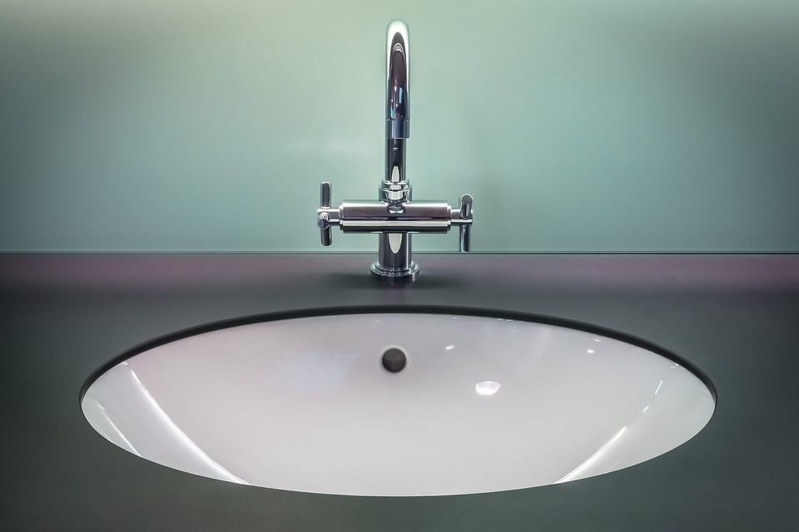
Sill
Sikn
Sink
Sink
Bowl
Back

Slide 13
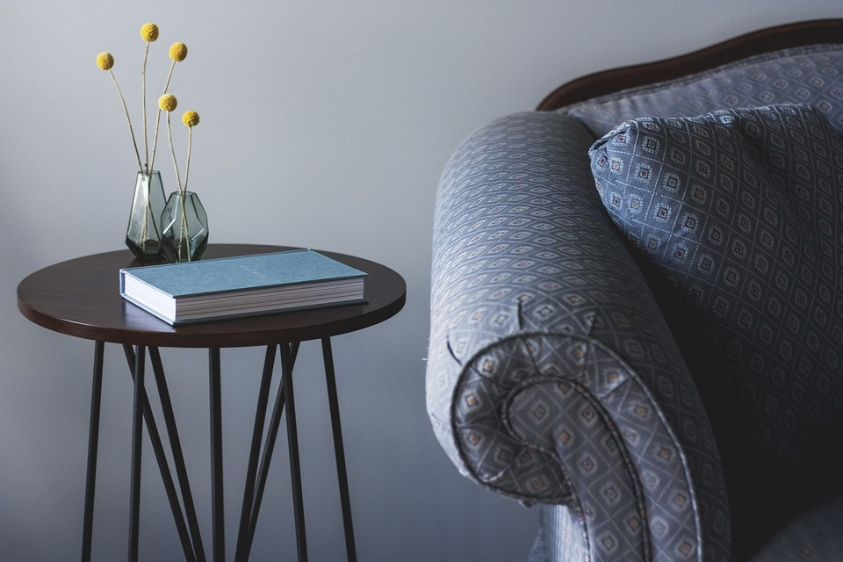
Table
Table
Fridge
Chair
Back

Slide 14

2
Project
House quiz

Slide 15




GAME TIME

Slide 16


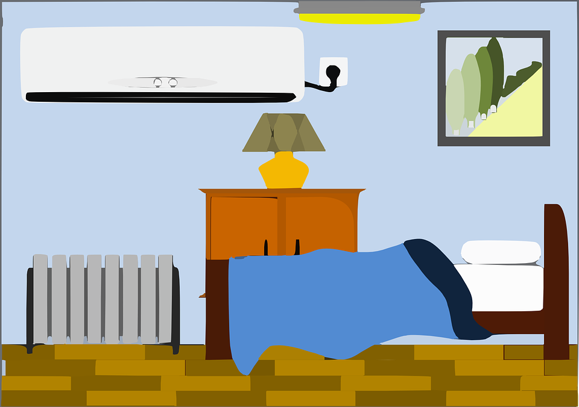
Look and tick
rug
spoon
bowl
✔
toy box
✔
car
teddy
bear
sink
sofa
✔
bookshelf
✔
bedroom
kitchen
dining room

Slide 17

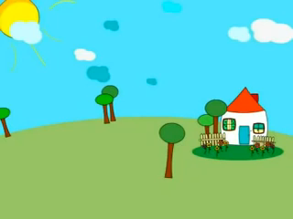

Slide 18
2
Project
My Dream House

Slide 19
REMEMBER !
This is my….
There’s a ….

Slide 20
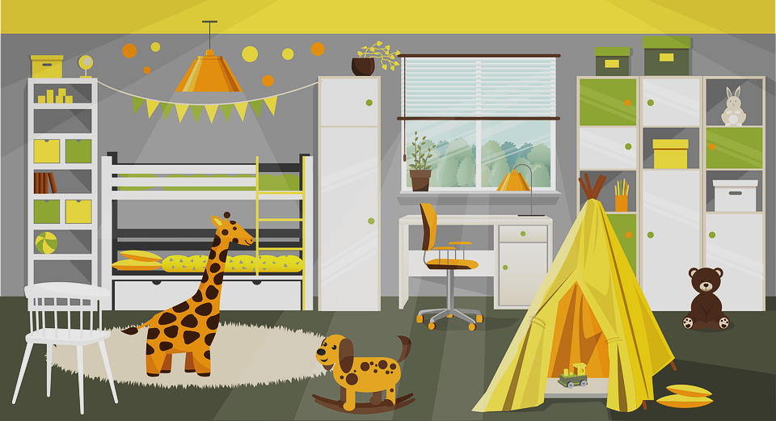
This is my dream room.

Slide 21


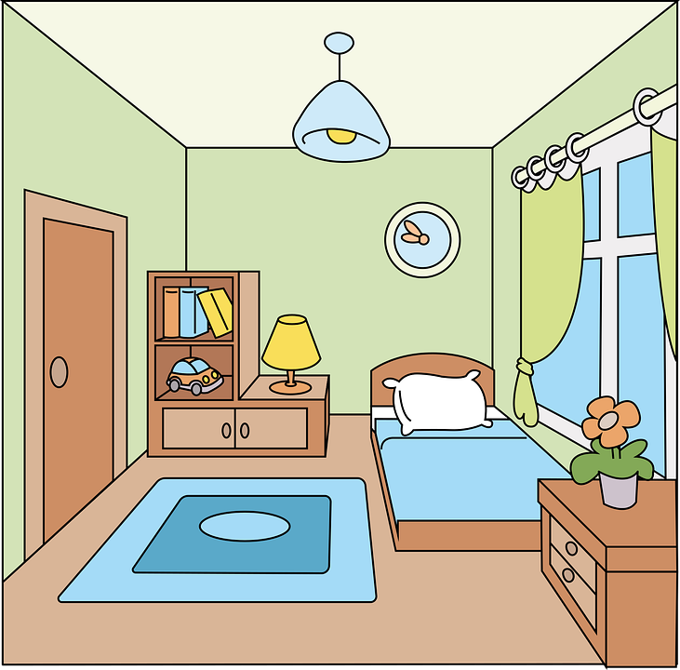

What’s this?
There is a big bookshelf
next to my bed.

Slide 22
Where are the toys?
There are some toys
on the floor.

Slide 23

Where is the chair?
The chair is in front of
the window.

Slide 24
Your Dream House

Slide 25
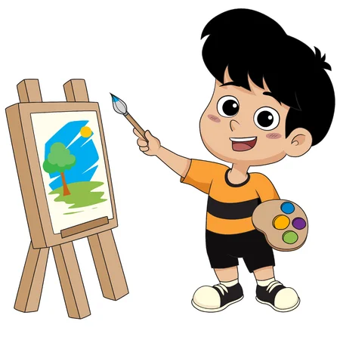

Drawing and Presenting

Slide 26




Thank you & goodbye!

