Slide 1




















Notes:
Để nguyên trang bìa như này, chỉ thay đổi tên bài trong quá trình làm. Logo của sách Wonderful World

Slide 2








Unit 1: My family
and friends
Lesson 1. Task 1 2 3

Slide 3
1
Warm Up
Guess “Who“?

Slide 4


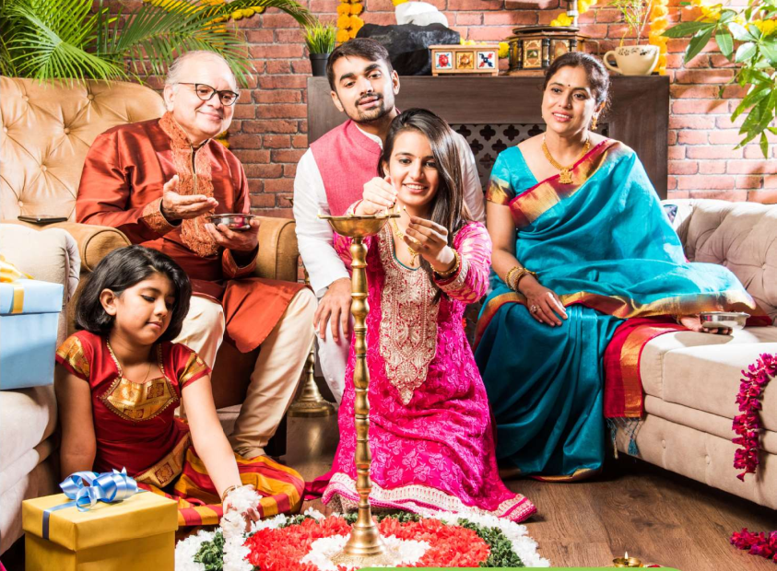



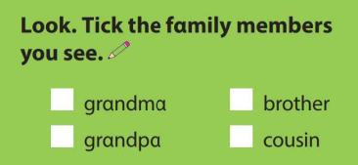
✓
✓
A happy Indian family celebrating festivals.
Notes:
Lead in: Photo time! “ Hidden faces”
Teacher shows the picture with hidden faces and give students some questions : Are they Vietnamese ? Are they at school / at home ? Are they friends ?
Is (No 1 ) the boy or the girl ? / Is she young or old ?-→ Who is she ?
Then , Sts can guess the members of the India and recall the learnt vocabulary like “ young, old, grandma, grandpa, sister, father….”

Slide 5




Notes:
Lead in: the topic “ FAMILY”
- Teacher holds up a photo of his/her family.
- Point at you and ask "Who is this?". Elicit that it is you (teacher), then elicit and teach the family vocabulary and stick the photo in one of the circle and write the word (e.g. "mum") under the photo. Do the same with other members.
- Encourage your students to bring in photos of their family.
- Write on the board Family and introduce the lesson.

Slide 6

Presentation
2

Slide 7
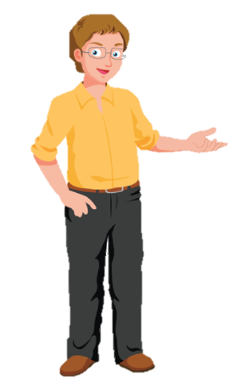
father
Notes:
Remember to tell students that “ Dad” and “father” is the same meaning.

Slide 8

mother
Notes:
Remember to tell students that “ Mum” and “ mother” is the same meaning.

Slide 9
father
mother

Slide 10

son
daughter
Notes:
Mũi tên chỉ sai. Mặc dù có dấu ngoặc sang – nhưng 1 slide 2 mũi tên - confusing

Slide 11
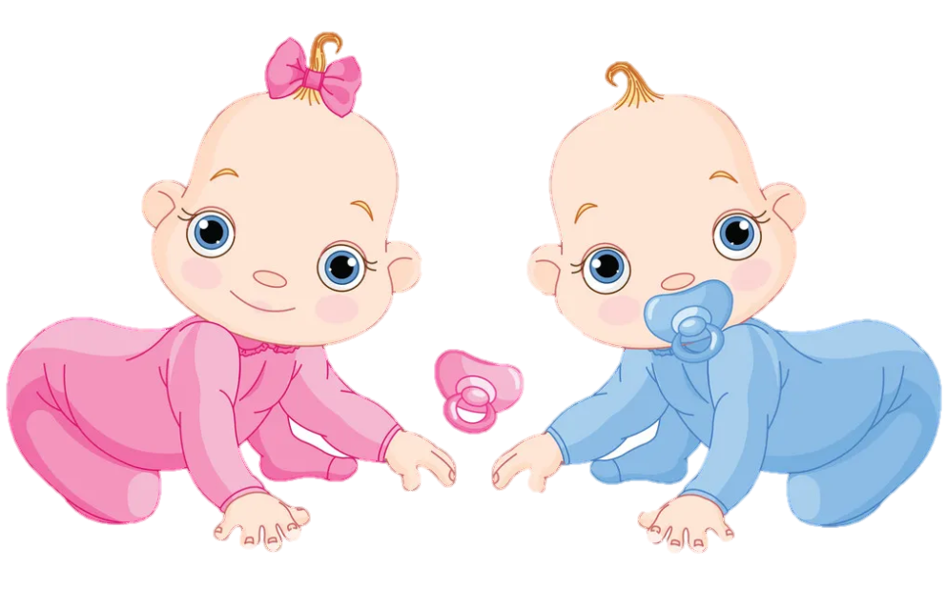
twins

Slide 13




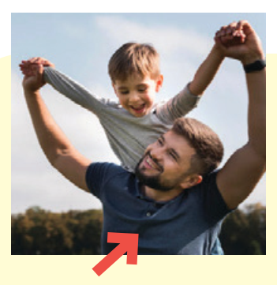
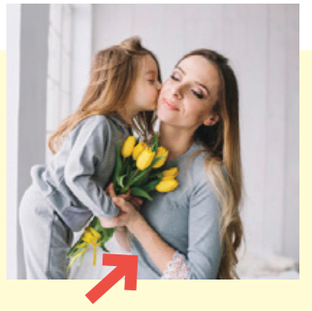
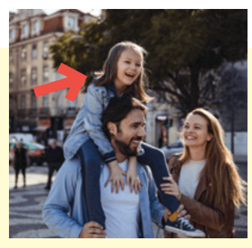
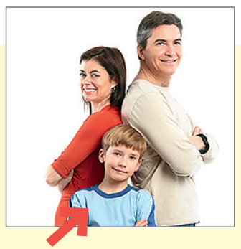

1 Listen and point. Repeat.
father
mother
daughter
son
twins

Slide 14
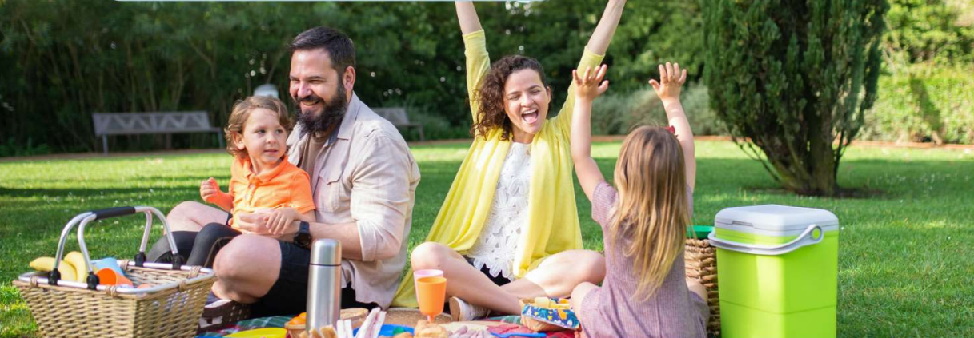


2 Listen and read. Write.
Tom: Look! This is my family.
We’re going on a picnic in the park.
Jack: That’s great! Who is he ?
Tom: He’s my father.
Jack: And who is she ?
Tom: She’s my mother.
Jack: Wow! She’s young.

Slide 15
2. Listen and read. Write.
There are people in the photo:
a mother, a , a son and a daughter.
four/4
father
Notes:
Đề bài và audio đọc khác tiêu đề - KT lại xem bản cập nhập SGK

Slide 16
3
Practice

Slide 17

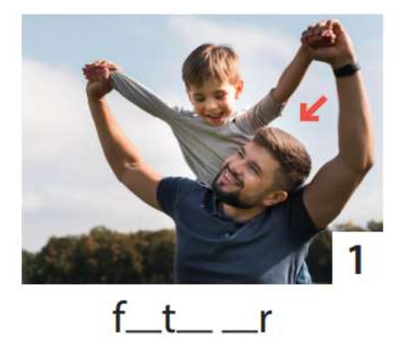
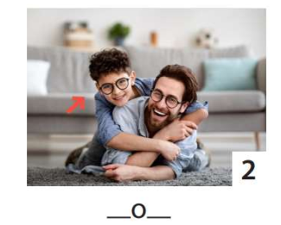
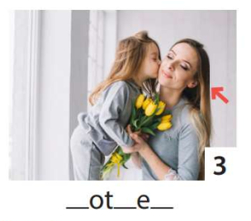
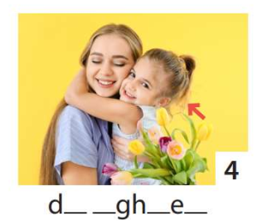
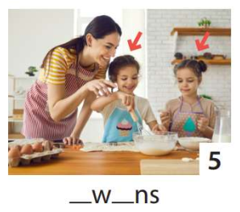
3 Write. Point and say.
1
2
3
4
5
He’s my father.
He’s my son.
She’s my daughter.
She’s my mother.
They’re twins.

Slide 18
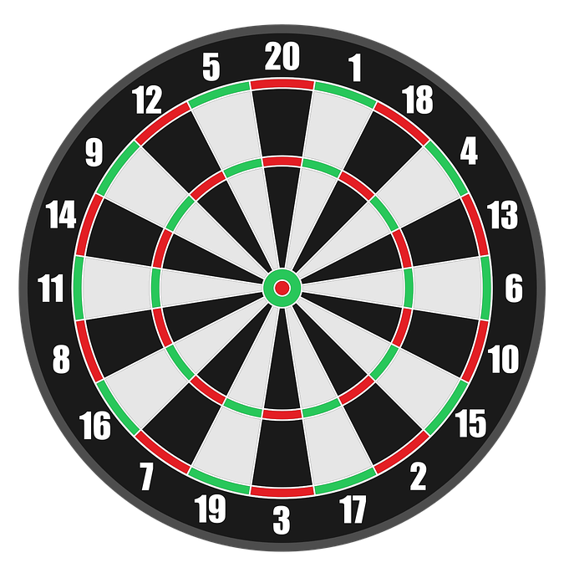

4
Production
Game: Dart Board
Look and answer
PLAY

Slide 19










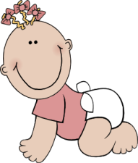
PETER & ANNA’S FAMILY
LET’S PLAY
Notes:
First, let’s meet the family of Peter and Anna. And then answer the questions and get the stars.

Slide 20







grandfather
grandmother
father
mother
PETER
ANNA
sister
Me
brother
twins

Slide 21

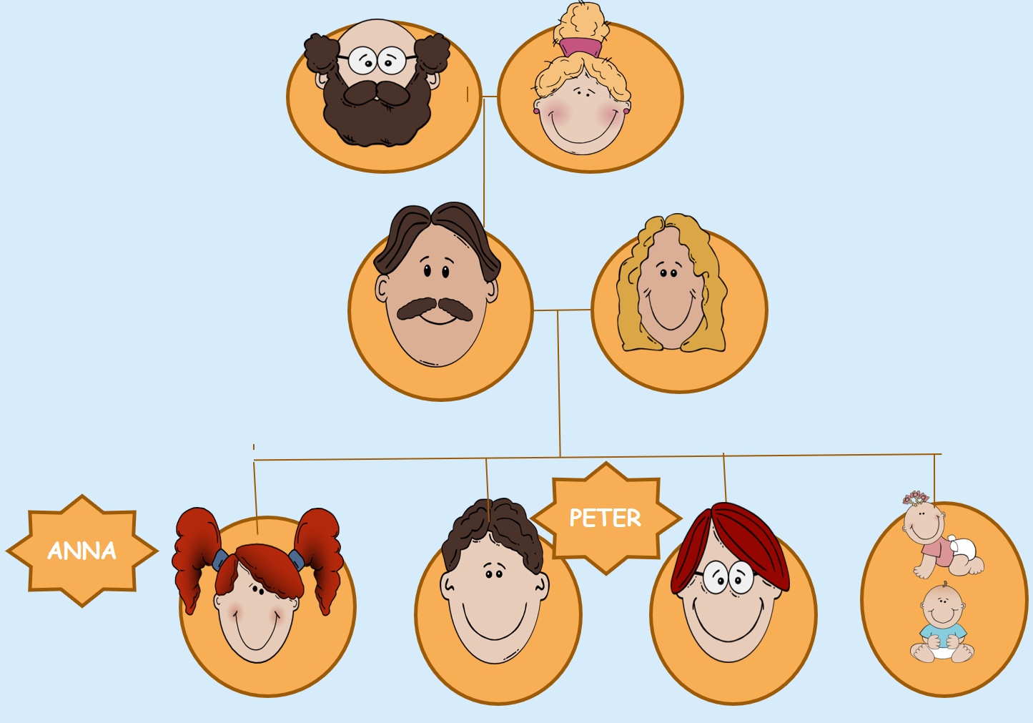

+ 9
She’s my grandmother.
She’s my mother .
Abc.xyz789
Notes:
Ms Huyền Phạm - 0936.082.789 – YOUTUBE: MsPham. Facebook: Dạy và học cùng công nghệ.

Slide 22

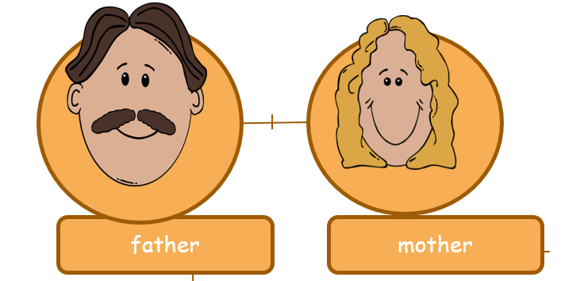
WHO IS PETER?
+50
PETER
son
daughter
Next
Abc.xyz789
Notes:
Ms Huyền Phạm - 0936.082.789 – YOUTUBE: MsPham. Facebook: Dạy và học cùng công nghệ.

Slide 23
WHO IS ANNA?
3
+50
Anna
daughter
son
Next
Abc.xyz789
Notes:
Ms Huyền Phạm - 0936.082.789 – YOUTUBE: MsPham. Facebook: Dạy và học cùng công nghệ.

Slide 24

+ 9
He’s my father.
He’s my grandfather .
Abc.xyz789
Notes:
Ms Huyền Phạm - 0936.082.789 – YOUTUBE: MsPham. Facebook: Dạy và học cùng công nghệ.

Slide 25

They are …………..
+25
brothers
twins
Next
Abc.xyz789
Notes:
Ms Huyền Phạm - 0936.082.789 – YOUTUBE: MsPham. Facebook: Dạy và học cùng công nghệ.

Slide 26
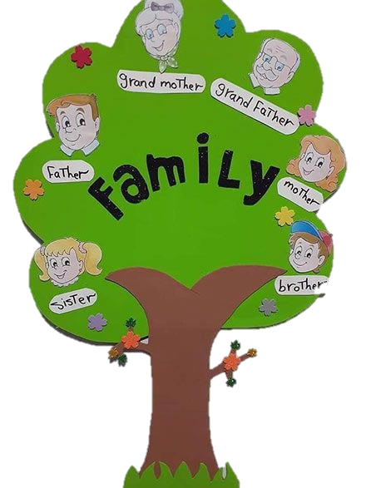

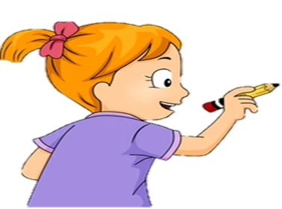
WORK IN PAIRS
Draw the family tree

Slide 27



ASSESSMENT
TEAM 1
TEAM 2
TEAM 3
TEAM 4
Vận dụng xuất sắc những kiến thức đã học vào thực hành
Vận dụng tốt những kiến thức đã học vào thực hành
Biết cách vận dụng những kiến thức đã học vào thực hành

Slide 28
5
Assessment

Slide 29

MATCH
son
twins
daughter
father

Slide 30
UNIT 1: Family and Friends
LESSON 1 – PERIOD 1
What we learnt today
Vocabulary:
father
mother
son
daughter
twins
Structure:
She‘s my mother.
He’s my father.

Slide 31
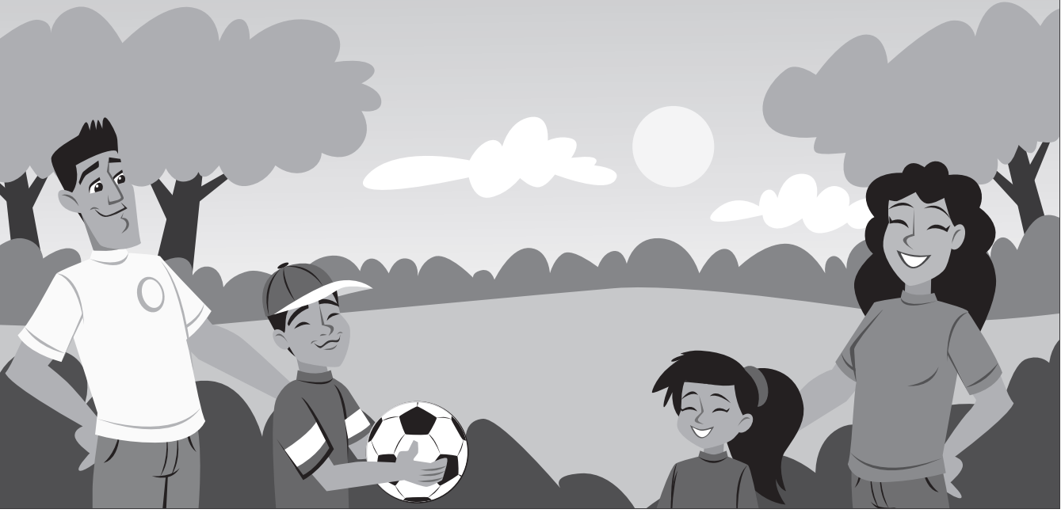
HOMEWORK
hsjhfathermkmsonbxskxdaughternsxjnxjsmother
Notes:
Find and circle the correct words in the letters line .

Slide 32




Thank you & goodbye!

