Slide 1




















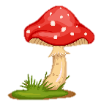
Notes:
Để nguyên trang bìa như này, chỉ thay đổi tên bài trong quá trình làm. Logo của sách Wonderful World

Slide 2




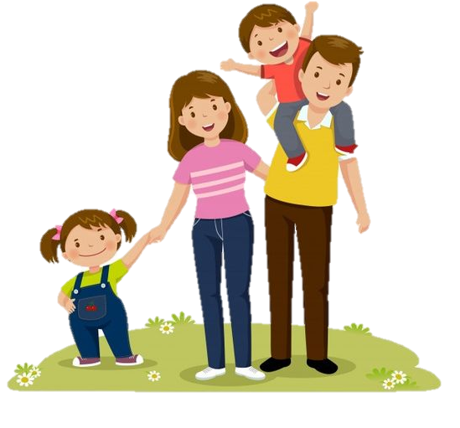
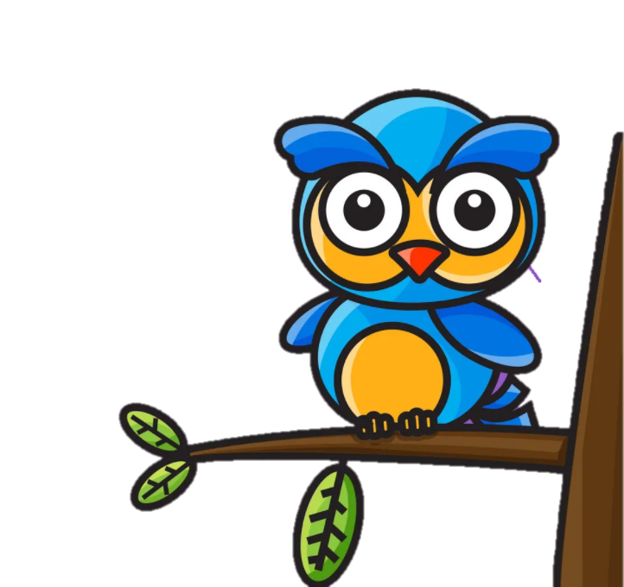


Unit 1:
My family and friends
Lesson 3- Period 3- Task 7 8 9

Slide 3
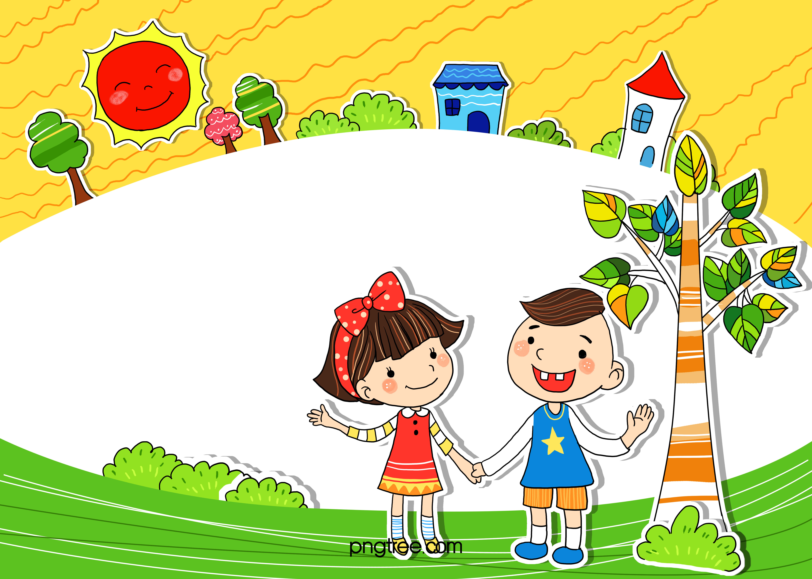
WARM-UP
01

Slide 4
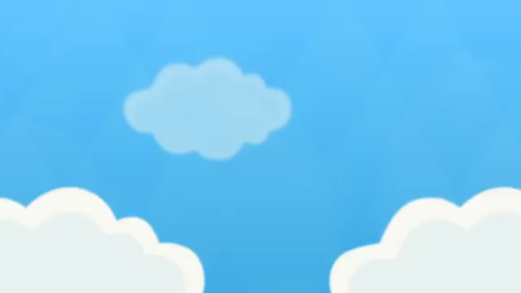
Notes:
Sing or say, “Head, shoulders, knees and toes,” as follows:
“Head, shoulders, knees and toes, knees and toes. Head, shoulders, knees and toes, knees and toes. Eyes and ears, and mouth and nose. Head, shoulders, knees and toes, knees and toes.”
Have the children touch the body part as it is named. Start off slowly and increase speed as you sing it over and over.

Slide 5
02
PRESENTATION

Slide 6


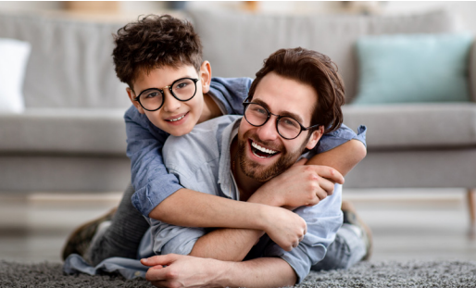
th
father
Notes:
Game: Listen and choose!
Play the recording and let the sts tick on the correct one.
This can be played as “slap the board game”: Teacher says a word/sound for sts to slap to the correct one.

Slide 7
o
son
Notes:
Game: Listen and choose!
Play the recording and let the sts tick on the correct one.
This can be played as “slap the board game”: Teacher says a word/sound for sts to slap to the correct one.

Slide 8
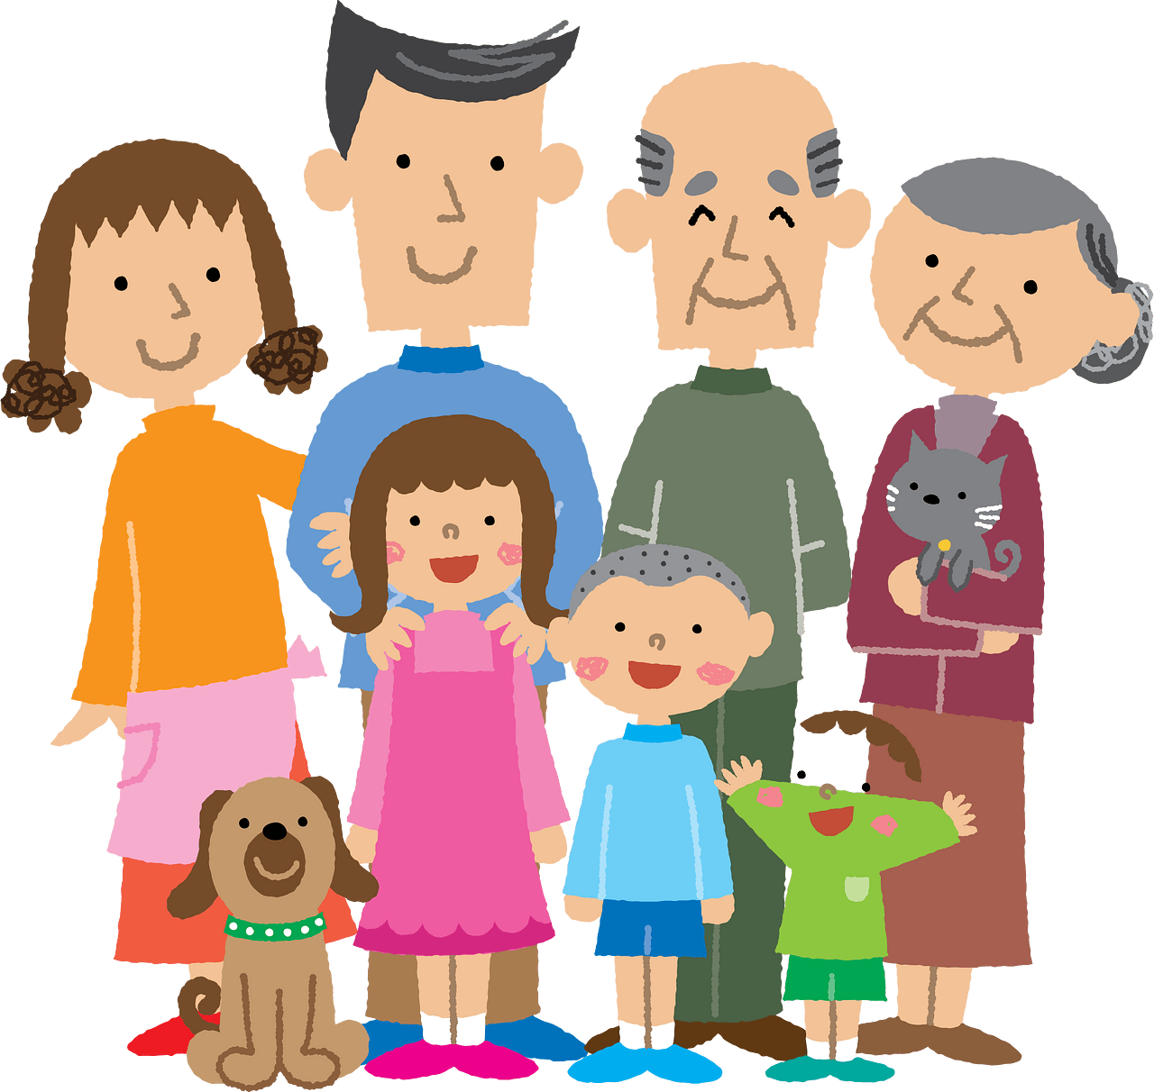
03
PRACTICE

Slide 9
7. Listen and repeat. (Track 1.12)
father
son
He’s my father.
I’m his son.

Slide 10

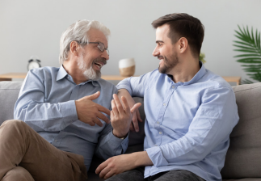

8. Listen and chant. (Track 1.13)
Fαther, fαther, fαther
He's my fαther. He's my fαther.
He's my fαther.
Son, son, son
I'm his son. I'm his son.
I'm his son.

Slide 11

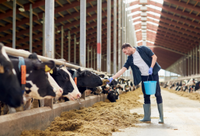
9. Say it.
1. She's my mother. She's nice.
2. This is my uncle.
He's tαll αnd kind.

Slide 12
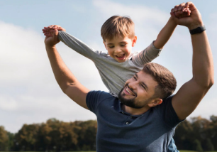
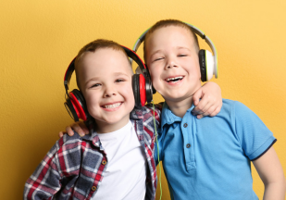
9. Say it.
3. He’s my fαther.
He is young αnd kind.
4. They're my brothers.
They αre cute αnd clever.

Slide 13
04 PRODUCTION

Slide 14
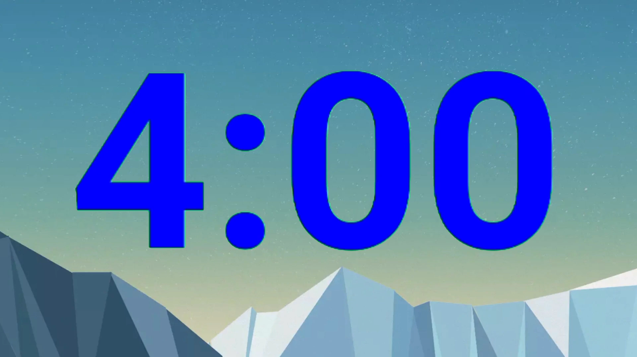

Shopping list game
/ð/
/ʌ/
Notes:
Có giải thích cho giáo viên mục đích của hình ảnh này là gì

Slide 15
05 ASSESSMENT

Slide 16



ASSESSMENT
TEAM 1
TEAM 2
TEAM 3
TEAM 4
Vận dụng xuất sắc những kiến thức đã học vào thực hành
Vận dụng tốt những kiến thức đã học vào thực hành
Biết cách vận dụng những kiến thức đã học vào thực hành

Slide 17
Fill in the blanks. Using “ th” or “o”.
th
o
fa___er
br__ther
s__n
mo__er
th
o
o
th

Slide 18

UNIT 1: MY FAMILY AND FRIENDS
TASK 7 8 9
What we learnt today
- Identify and write th and o
- Identify and pronounce words
with initial sounds /ð /and /ʌ /

Slide 19



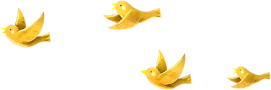
Thank you & goodbye!

