Slide 1





















Fun time
and project

Slide 2




1
Fun time
Let’s sing a song!

Slide 3

Song : Family Song

Slide 4
1
Fun time

Slide 5


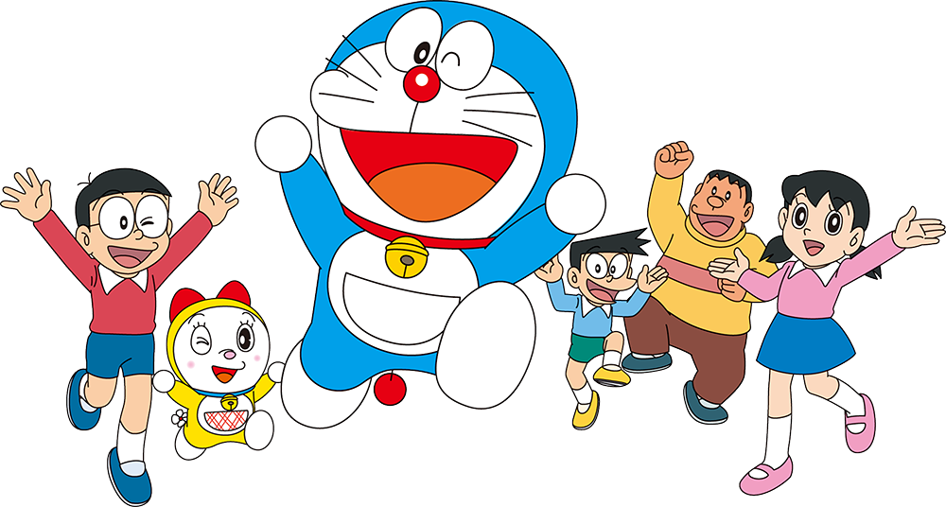
Puzzles

Slide 6
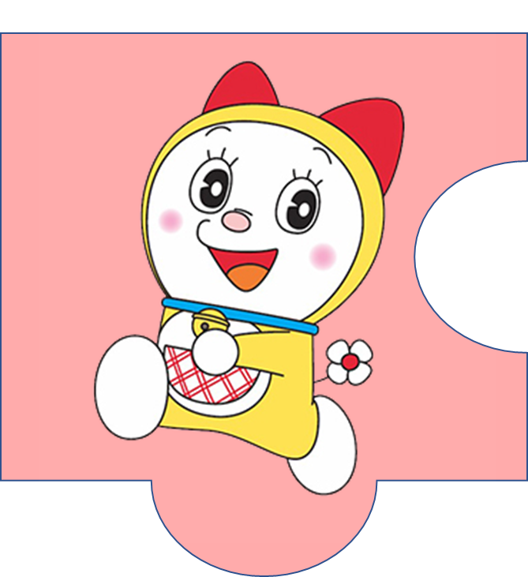

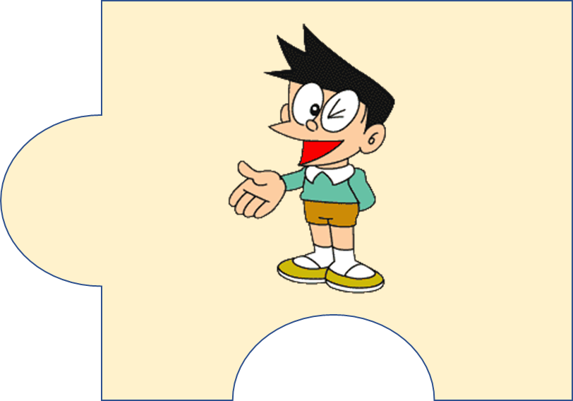
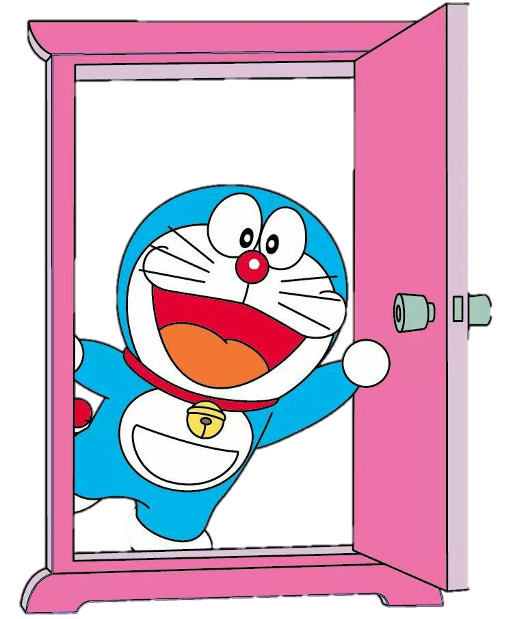



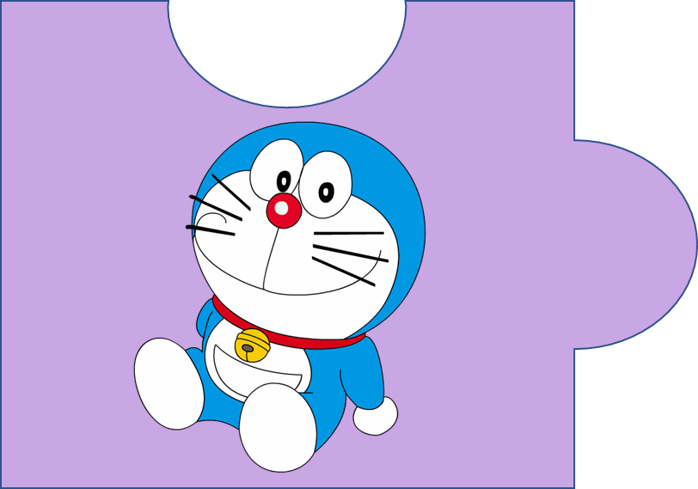


?
20
It’s a magic door.

Slide 7
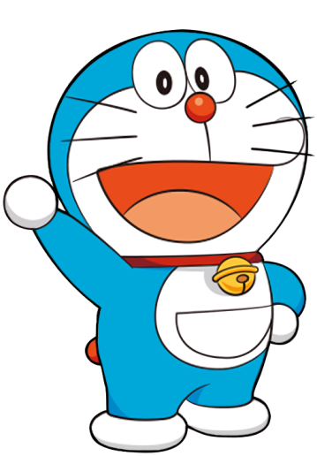
f c h u l r e e
  cheerful
4

Slide 8

p e s l a n t a
  pleasant
5

Slide 9

c l r e v e
  clever
3

Slide 10
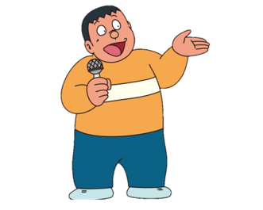
f r e d l n i y
  friendly
4

Slide 11
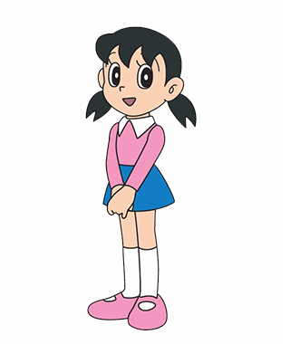
h a d r i n w o g r k
  hard-working
6

Slide 12
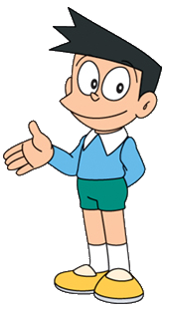
k n i d
  kind
2

Slide 13

2
Project
Family quiz

Slide 14




MATCHING GAME

Slide 15
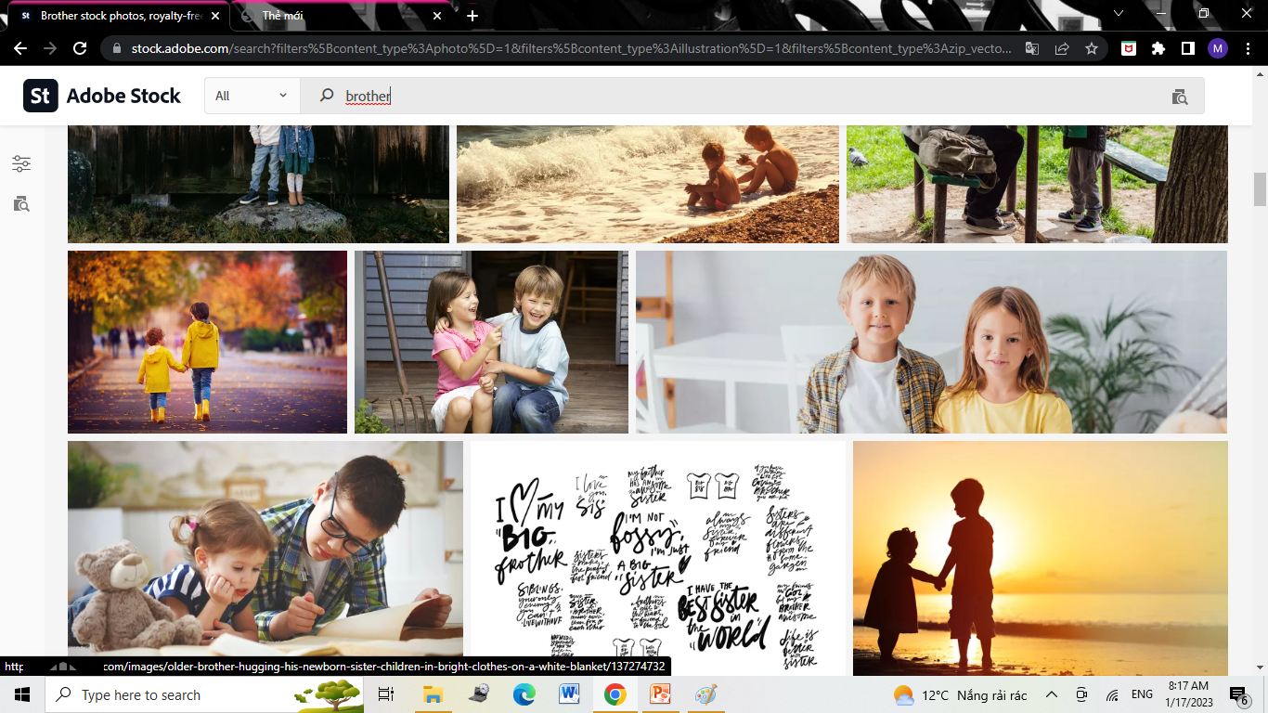

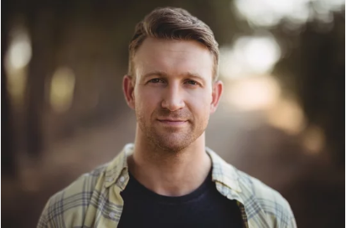
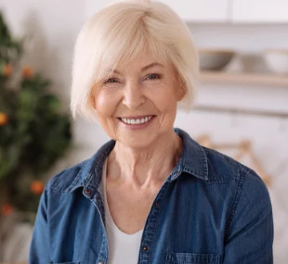
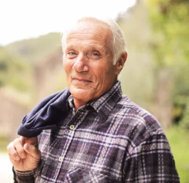
mother
father
4
1
sister
brother
2
5
grandpa
grandma
3
6

Slide 16
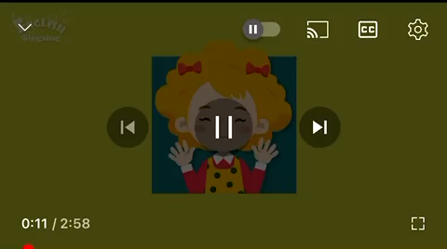

Slide 17
2
Project
My Family

Slide 18

REMEMBER !
This/That is my ….
He/She is … .

Slide 19
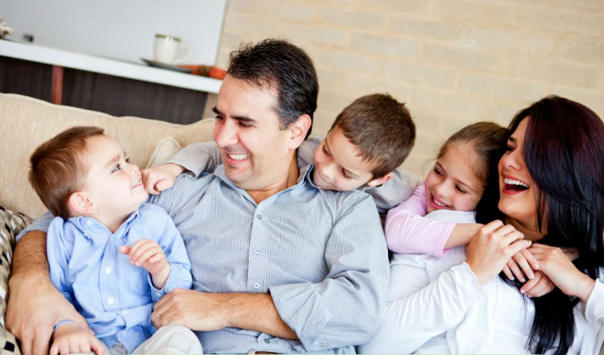
There are 5 people in my family.

Slide 20


Who’s this?
This is my father.
He’s friendly and kind.

Slide 21
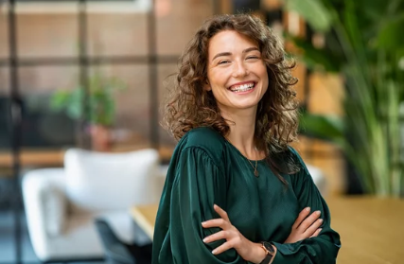
Who’s that?
That is my mother.
She’s pretty and nice.

Slide 22
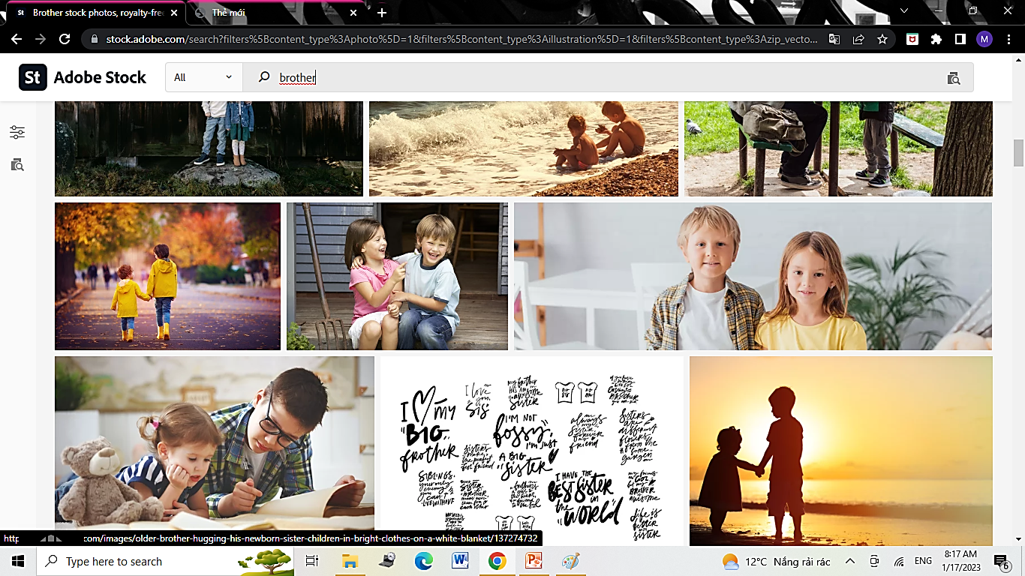
Who’s he?
He is my brother.
He’s clever and pleasant.

Slide 23
Who’s she?
She is my sister.
She’s hard-working and young.

Slide 24
2
Project
Your Family

Slide 25
kind
k_nd
pretty
pr_tty
_ardwor_ing
hard-working
h_ndsom_
handsome
cheerful
che_ful
funny
funn_
cu_e
cute
clever
clev_r
fr_endl_
friendly
pleas_nt
pleasant
sh_rt
short

Slide 26
There are … people in my family.
This is/ That is my ….
His name’s/ Her name’s….
He’s/ She’s ….

Slide 27
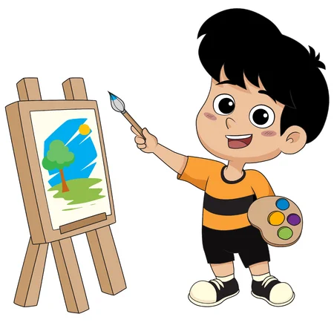
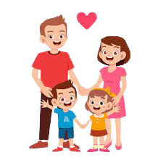
Drawing and Presenting

Slide 28
3
Assessment

Slide 29
Circle the correct answer
There are 3 … in my family.
people B. person C. kid
This is my mother. She is ….
nice B. Sunday C. sunny
3. Her uncle is not ….. He is tall.
ugly B. smelly C. short
My sister and I love … family so much.
A. his B. our C. their

Slide 30




Thank you & goodbye!

