Slide 1




















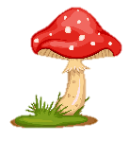
Notes:
Để nguyên trang bìa như này, chỉ thay đổi tên bài trong quá trình làm. Logo của sách Wonderful World

Slide 2




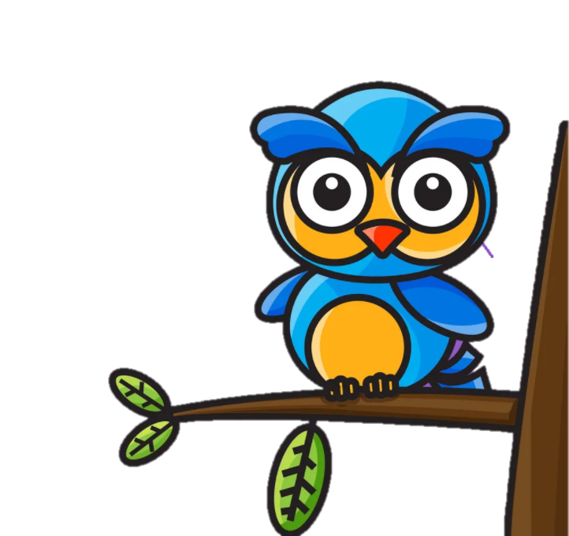


REVIEW 2: PART 3

Slide 3
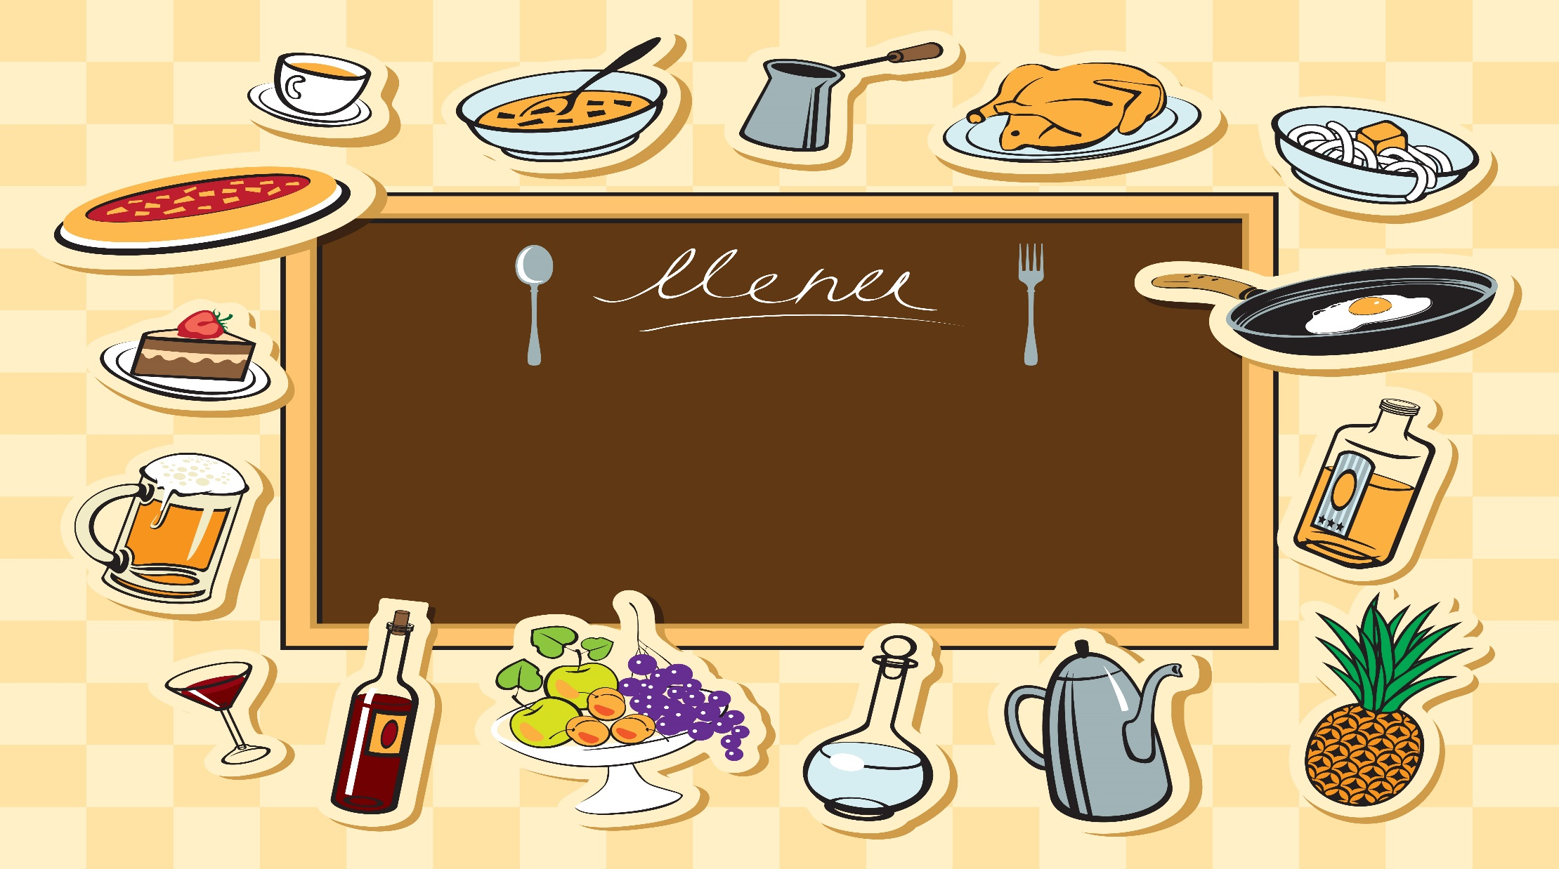

1
Warm up
Notes:
Warm-up: Play a small game “ Puzzle game”
The teacher asks SS to identify different colors and choose a color to guess the image behind the puzzles.
T calls Ss to answer and check their answers.
T asks Ss to repeat names of objects in the image.
Answer keys:
1. rope
2. horse
3. seesaw
4. hide-and-seek

Slide 4
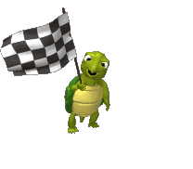


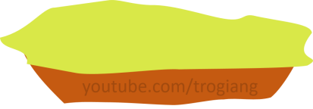
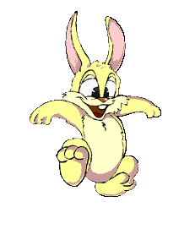



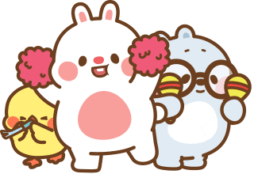



Practice
Good job!
Good job!
1
1
2
2
3
3

Slide 5
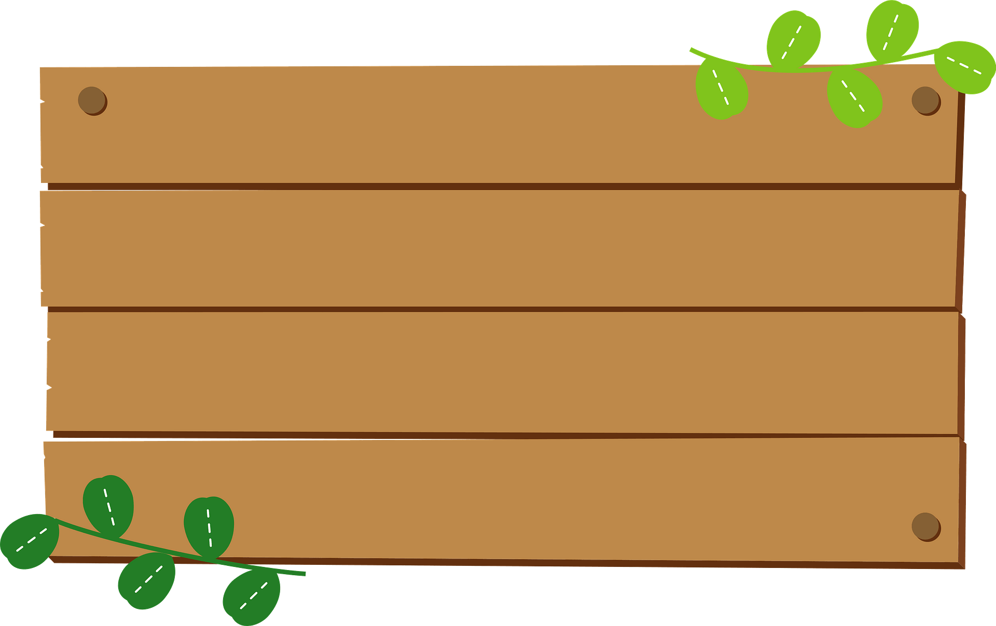
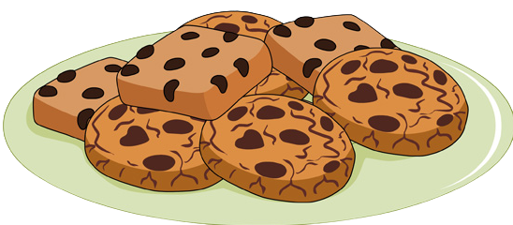

Next
1. My favourite food is_____
a
cupcake
b
cookie

Slide 6

Next
2. My favourite drink is_____
a
lemonade
b
orange juice

Slide 7

Next
3. Would you like an orange?
a
No, thanks.
✓
b
Yes, please.

Slide 8
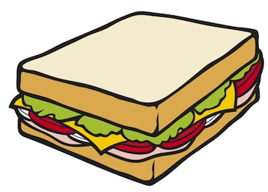
Next
1. My favourite food is_____
a
sandwich
b
hamburger

Slide 9

Next
2. My favourite drink is_____
a
soda.
b
bubble tea.

Slide 10

Next
3. Would you like an egg?
a
Yes, please.
✓
b
No, thanks.

Slide 11
2
Presentation
Notes:
Warm-up: Play a small game “ Puzzle game”
The teacher asks SS to identify different colors and choose a color to guess the image behind the puzzles.
T calls Ss to answer and check their answers.
T asks Ss to repeat names of objects in the image.
Answer keys:
1. rope
2. horse
3. seesaw
4. hide-and-seek

Slide 12

A. Watch the video. Video 2: Let’s go to savanna in Africa

Slide 13
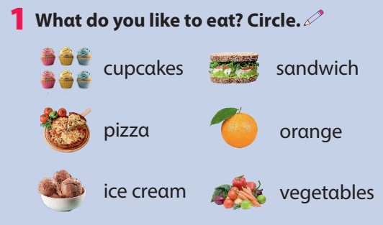

Slide 14
3
Practice
Notes:
Warm-up: Play a small game “ Puzzle game”
The teacher asks SS to identify different colors and choose a color to guess the image behind the puzzles.
T calls Ss to answer and check their answers.
T asks Ss to repeat names of objects in the image.
Answer keys:
1. rope
2. horse
3. seesaw
4. hide-and-seek

Slide 15

2. What can you see in the video? Circle?
vegetables pizza nuts
fruit cheese yoghurt

Slide 16
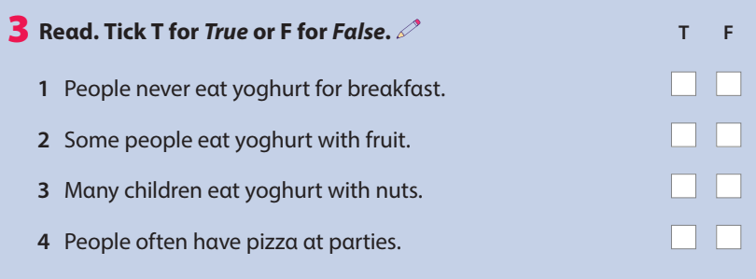
✓
✓
✓
✓

Slide 17
4
Production
Notes:
Warm-up: Play a small game “ Puzzle game”
The teacher asks SS to identify different colors and choose a color to guess the image behind the puzzles.
T calls Ss to answer and check their answers.
T asks Ss to repeat names of objects in the image.
Answer keys:
1. rope
2. horse
3. seesaw
4. hide-and-seek

Slide 18
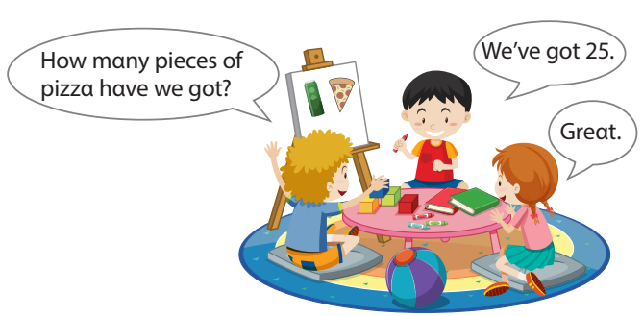
Food for class party.
Would you like some pizza?
Yes, please.

Slide 19



ASSESSMENT
TEAM 1
TEAM 2
TEAM 3
TEAM 4
Vận dụng xuất sắc những kiến thức đã học vào thực hành
Vận dụng tốt những kiến thức đã học vào thực hành
Biết cách vận dụng những kiến thức đã học vào thực hành

Slide 20

4
Assessment

Slide 21
Look and fill in the blank.
1. ______is your favourite food?
What
Would
2. Her favourite _____ is water.
food
3. _____ you like some vegetables?
drink
4. My favourite _____ is spaghetti.

Slide 22

REVIEW 2: PART 3
- Watch a video about food.
- Review words and structures from Unit 3,4.

Slide 23




Thank you & goodbye!

