Slide 1





















Notes:
Để nguyên trang bìa như này, chỉ thay đổi tên bài trong quá trình làm. Logo của sách Wonderful World

Slide 2





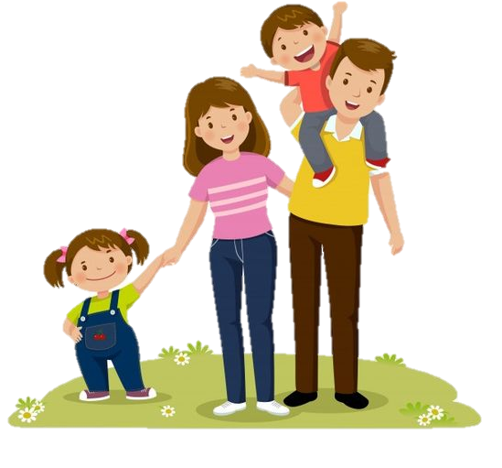



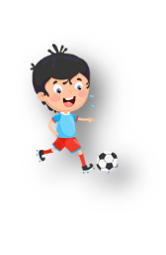


Unit 5: Leisure time
Lesson 3: Task 7, 8, 9

Slide 3

1
Warm up
Sentence puzzle
Guess “ Weather“
Notes:
Warm-up: Play a small game “ Sentence puzzle”
T divides the class into 2 teams.
T introduces the rule of game:
(Game: Sentence puzzle
- T calls SS to choose a number and reorder the words to make a full sentence.Who gets correct answers gets points in the box. Which team has more points will be a winner.)
T asks Ss to repeat after checking.

Slide 4








Slide 5

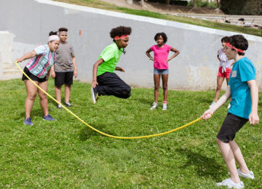

They’re
rope
jumping
+3
____ _______ _____.
They’re jumping rope
Notes:
Click để hiện đáp án.
Nhấn vào hộp quà để quay lại

Slide 6
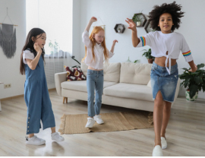
singing
They’re
and
dancing
+5
____ _______ ___ _____.
They’re singing and dancing

Slide 7
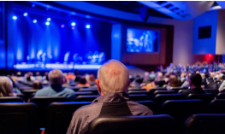
watching
He’s
film
a
+4
___ _______ __ _____.
He’s watching a film

Slide 8
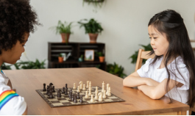
living
games
room
the
board
playing
in
They’re
+6
___ _____ ____ ____ __ __ ___ _____.
They’re playing board games in the living room

Slide 9
2
Presentation

Slide 10


/dʒ/
jump
Notes:
Task 7: Listen and repeat. Track 5.12.
- T asks SS to look at board and introduce 2 sounds in English.
- T guides SS to read these sounds.
- T calls SS to repeat in the chorus.

Slide 11


/θ/
think

Slide 12
Let’s listen.
/dʒ/
/θ/
Sounds
jump
think
Words

Slide 13

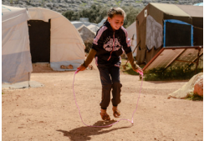

7 Listen and repeat. TR: 5.12
jump
jump
think
think
She's jumping rope.
She's jumping rope.
She's thinking αbout her friends.
She's thinking αbout her friends.
Notes:
- T asks SS to look at 2 pictures and identify what they can see.
- T plays track 5.12 and asks SS to repeat in the chorus.
- T calls SS to present in front of the class.

Slide 14

3
Practice

Slide 15
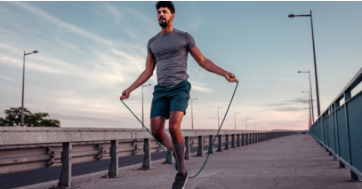
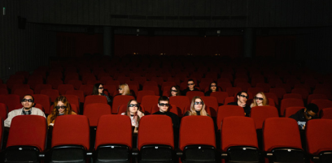
8 Listen and chant. TR: 5.13
Jαck, Jαck, Jαck!
/dʒ/
Jump, jump, jump!
Jαck's jumping rope.
Think, think, think!
Theαtre, theαtre, theαtre!
/θ/
We’re thinking αbout
going to the theαtre.
Notes:
Task 8: Listen and chant. Track 5.13
- Ask SS to look at the picture and identify what activity they can see in each picture.
-Ask SS to find the words with each sound they have introduced.
- Call SS to read aloud the words they have found.
- Play track 5.13 and ask Ss to repeat in chorus.
- Teach SS to chant each sentence.
- Ask SS to work in groups of 4 and chant, then present in front of the class.
- Give their feedback.

Slide 16
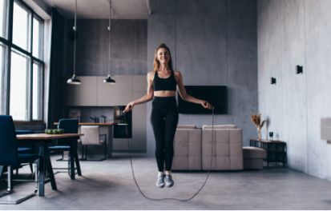

9 Say it!
1. My sister is jumping rope.
2. She’s thinking αbout her fαmily.
Notes:
Task 9: Say it!
- Ask SS to identify what they can see in each picture.
- Ask SS to listen and repeat each sentence.
- Ask SS to work in pairs to read again.
- Call some students to present in front of the class.
- Give their feedback.

Slide 17
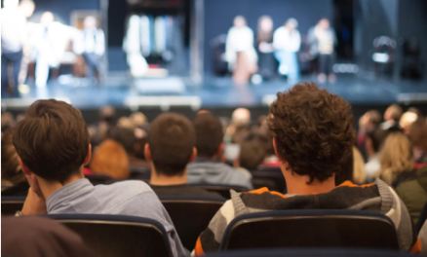

9 Say it!
3. They're wαtching α plαy
αt the theαtre.
4. They're drinking juice.
Notes:
Task 9: Say it!
- Ask SS to identify what they can see in each picture.
- Ask SS to listen and repeat each sentence.
- Ask SS to work in pairs to read again.
- Call some students to present in front of the class.
- Give their feedback.

Slide 18
4
Production

Slide 19
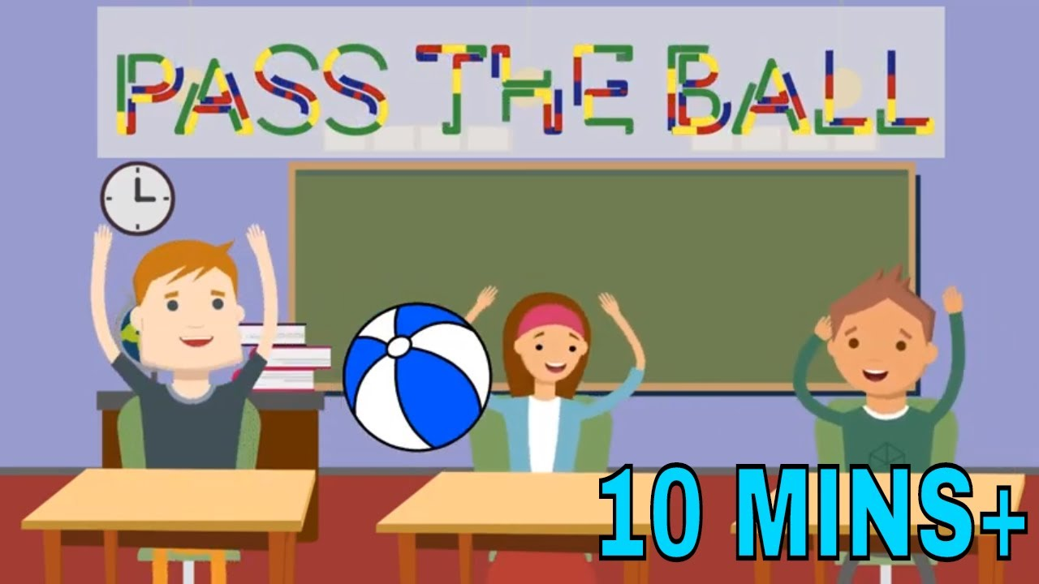
Notes:
Let’s talk
- Ask SS to play a game “pass the ball”.
- Introduce the rule of game.
(the rule of game: Pass the ball
T plays music and SS have to pass the ball. When the music stops, the student who has the ball will find a word with one of 2 sounds they have learnt. Who can’t find will be a loser and have to do a request from students in the class.)
- Check and give feedback.

Slide 20
5
Assessment

Slide 21
10 Listen and tick.

Jack
think
jump

theatre

jacket
thin
Jane

thank

Slide 22
UNIT 5: LEISURE TIME
LESSON 3 – PERIOD 3
What we learnt today
jump
think
● She’s jumping rope.
● She’s thinking about her friends.
Pronunciation

Slide 23




Thank you & goodbye!

