Slide 1












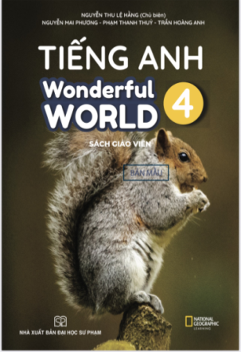








Slide 2




Unit 8 - Lesson 2 – Task 7,8,9

Slide 3


1 WARM UP
Game:Sleep and Wake up

Slide 4
2 Presentation
Task 7 Listen and circle.

Slide 5




7. Listen and circle.
Notes:
Cho hs nghe 1 lần

Slide 6



7. Listen and circle.
1. Laura and her friends ____ learn English together.
A. sometimes
B. always
C. don’t
Notes:
Nghe và khoanh đáp án đúng

Slide 7
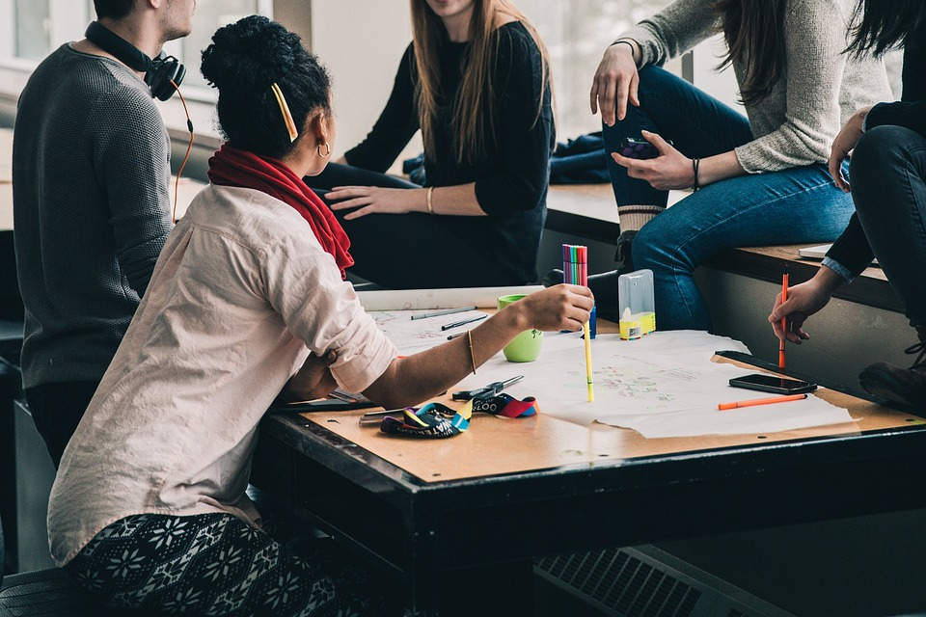
2. They work ______ and do their homework.
A. in class
B. in pairs
C. in groups

Slide 8

3. There are nice photos and ____ in the units.
A. lessons
B. colour
C. videos

Slide 9
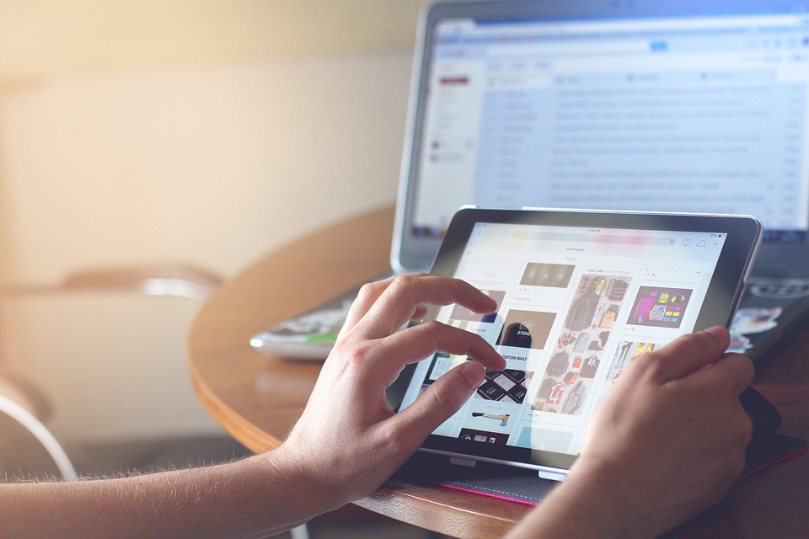
4. They sometimes use the computer or ____,too.
A. tablet
B. smartphone
C. book

Slide 10
3 Practice
Notes:
Dấu câu

Slide 11


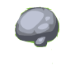







1
4
HELP THE POOH
2
5
3
Notes:
Ấn Help the pooh để hiện số 1. Ấn số và trả lời câu hỏi. Ấn bình honey để nhảy sang slide Look and say

Slide 12
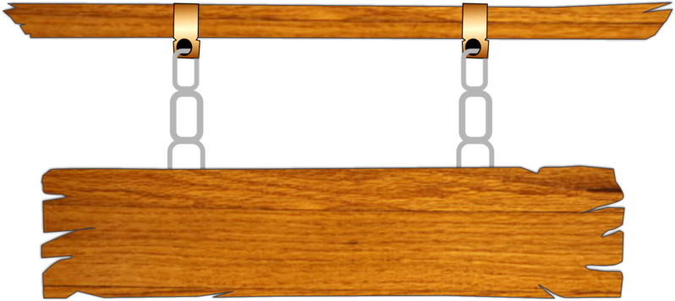





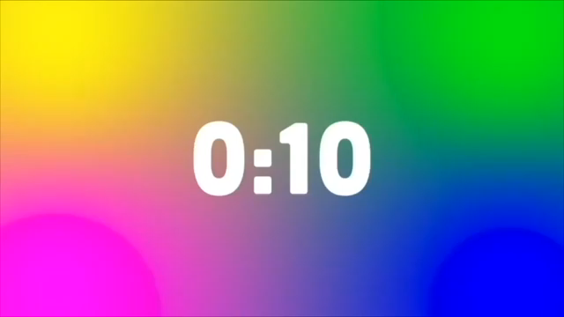



1.We can use the _______.
tablet
A
phone
B
computer
C
watch
D
BACK

Slide 13
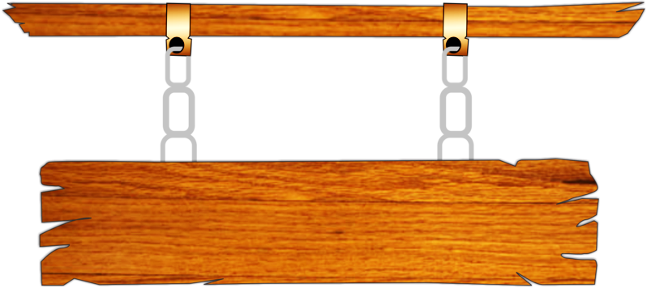


2.We can work in______.
A
pairs
B
groups
C
class
D
individual
BACK

Slide 14

3. I ___ write emails on my smartphone.
A
sometimes
B
never
C
often
D
always
BACK

Slide 15

4. She ___ surf the Internet in class.
x
can’t
A
can
B
do
C
does
D
BACK

Slide 16

5.Can we play the games?
A
Yes, they is.
B
No, you can’t.
C
No, they can.
D
No, they aren’t.
BACK

Slide 17

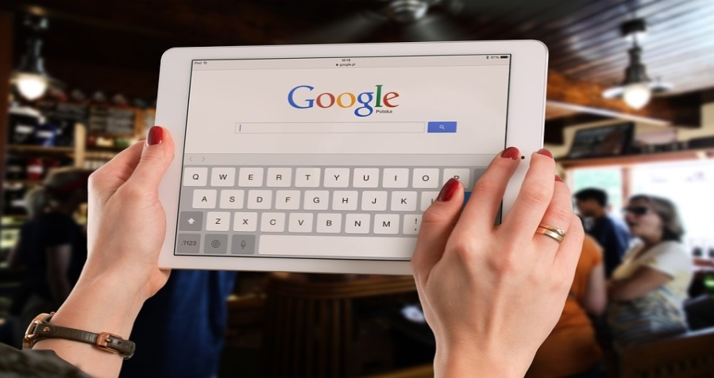


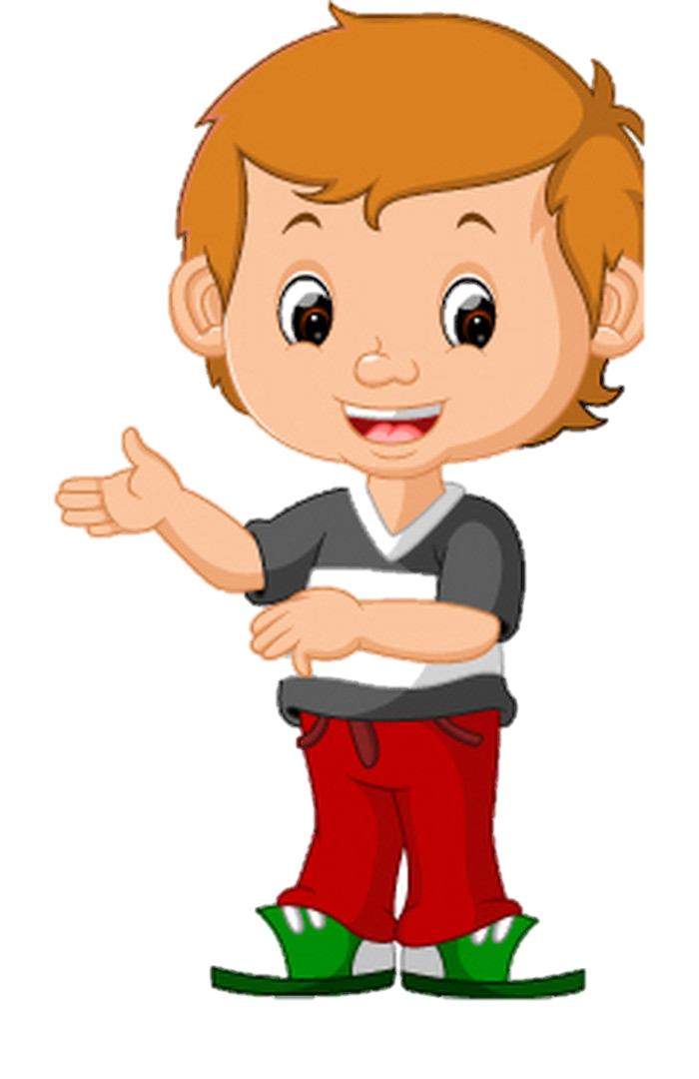

8. Point and say.
We can’t use
the tablet in class.
x
2. We can work in groups in class.
✔
Notes:
Nhìn hình và sử dụng cấuu trúc We can/ can’t

Slide 18

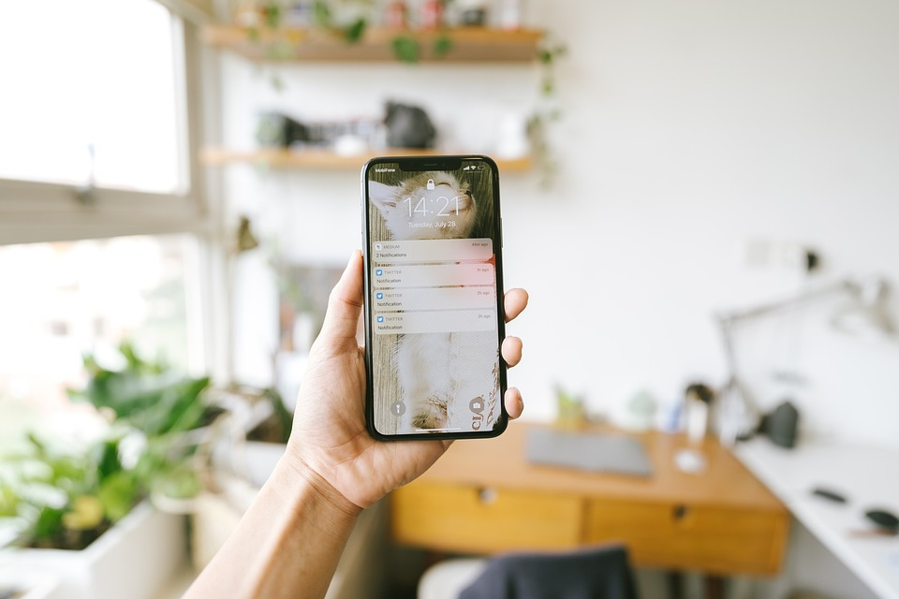

8. Look and say.
3. We can work in pairs in class.
✔
4. We can’t use the smartphone in class.
x

Slide 19


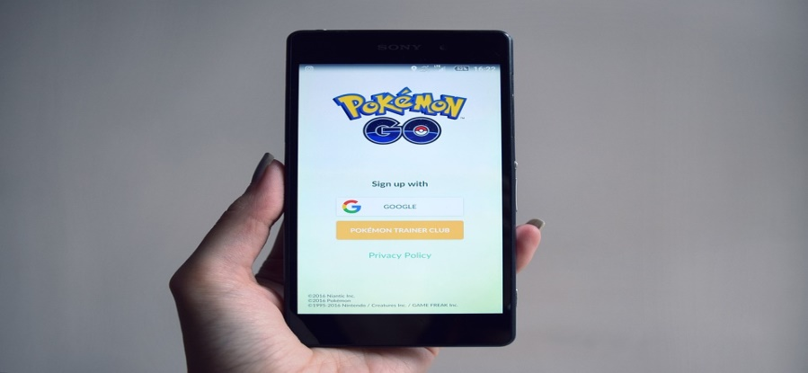
8. Point and say.
5. We can’t surf
the Internet in class.
x
6. We can’t play the video games on phone in class.
x
Notes:
Trình bày lại chữ

Slide 20
4 Production
Task 9 Let’s play.
Notes:
Dấu câu

Slide 21
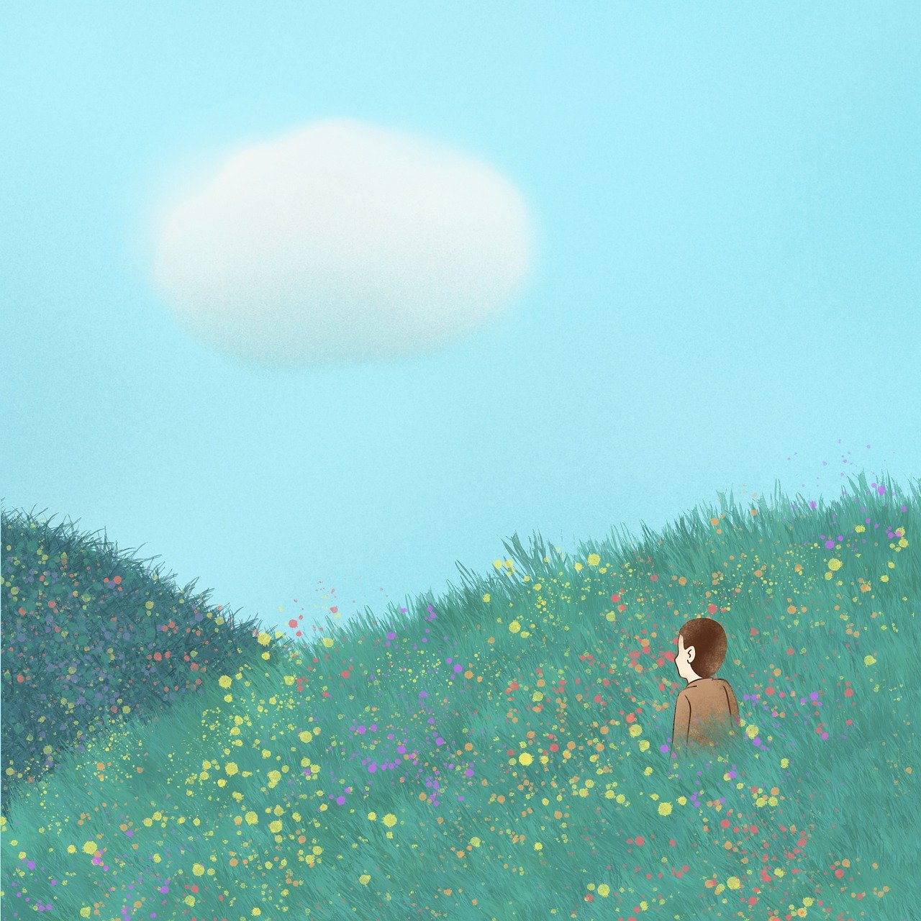

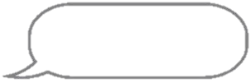
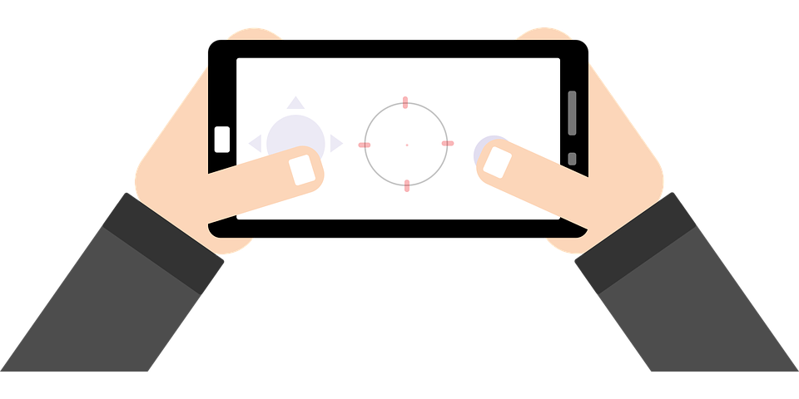
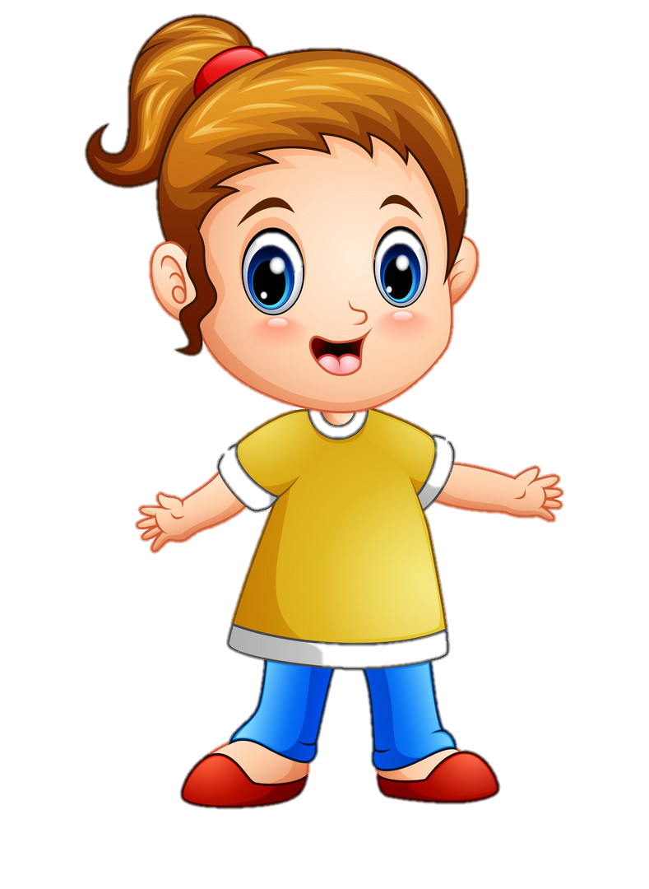
9
Let’s play.
Teacher, can
we work in
groups?
Yes, you can.
x
✔
No, you can’t.
Teacher, can
we play video
games in class?

Slide 22
Team 1 : make mind map about what we can or can’t do in class
Team 2 : make situations about asking for permission in class

Slide 23
5 Wrap up
Notes:
Đây k phải là extra, đây là hđ 3 của bài

Slide 24
REMEMBER
STRUCTURE:
Teacher, can we use the tablet?
-Yes, you can.
-No, you can’t.
24

Slide 25




Thank you & goodbye!

