Slide 1






















Unit 8
My Town
Lesson 2 – Task 4,5,6

Slide 2






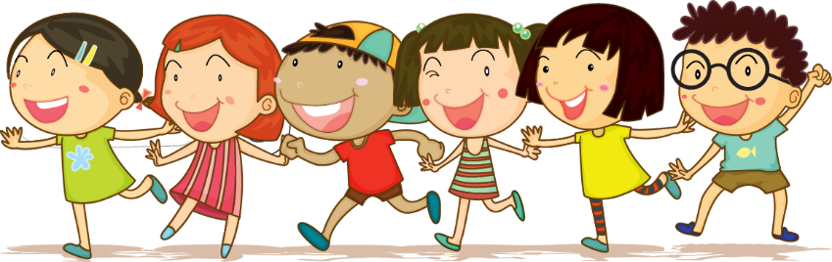



1 Warm up

Slide 3
Puzzle word
1
w | r | i | t | e
2
j | u | m | p
3
s | w | i | m
4
d | a | n | c | e
5
r | u | n
6
r | e | a | d
Next
Notes:
T clicks to numbers (1-6) to show the hints, clicks the puzzles to show the answers.

Slide 4
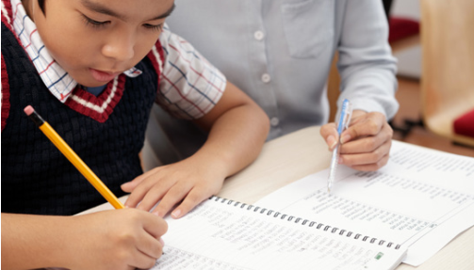
write
Back

Slide 5

jump
Back

Slide 6
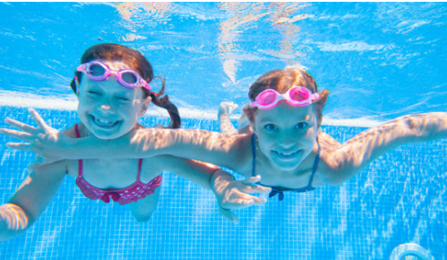
swim
Back

Slide 7
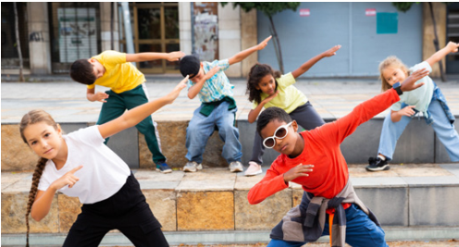
dance
Back

Slide 8
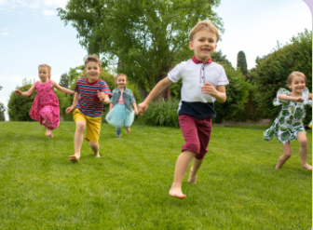
run
Back

Slide 9

read
Back

Slide 10
2 Presentation

Slide 11

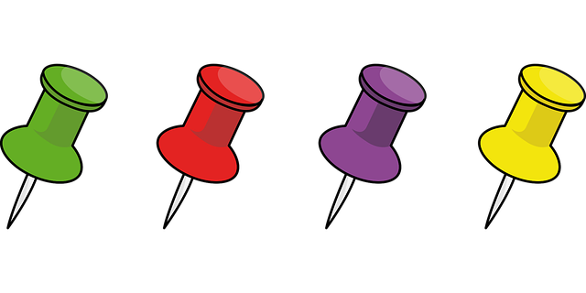
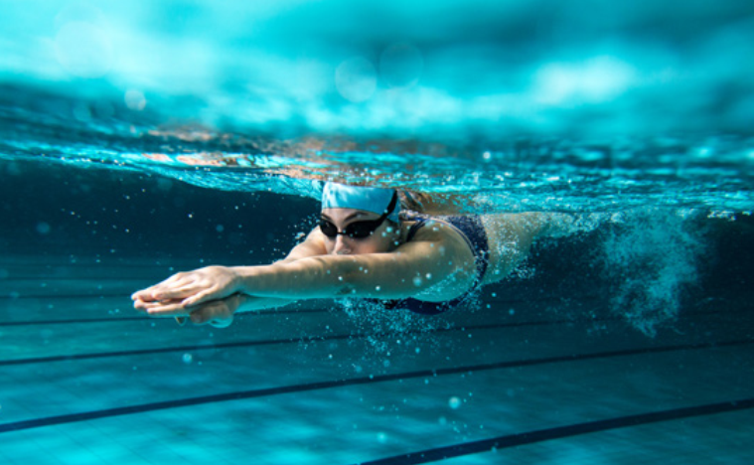
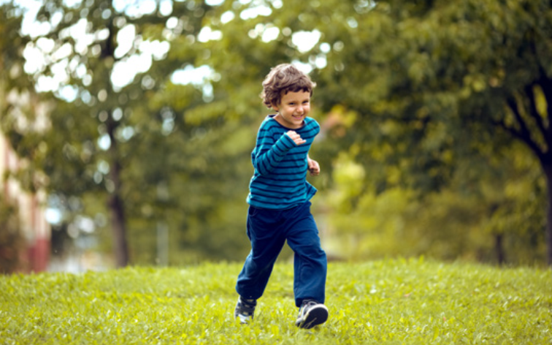
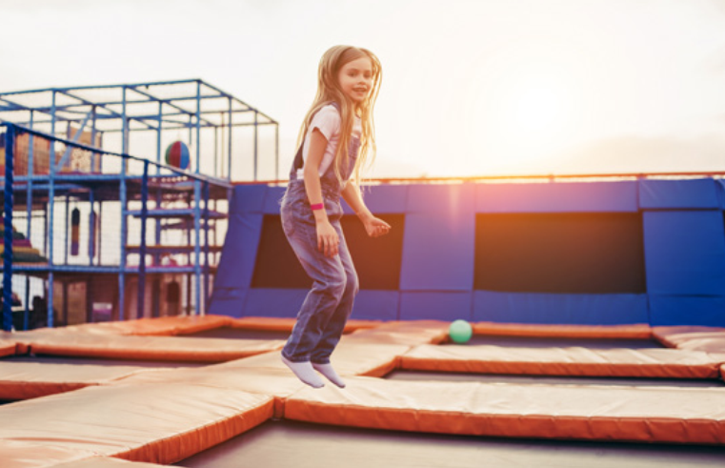
swimming
running
jumping

Slide 12

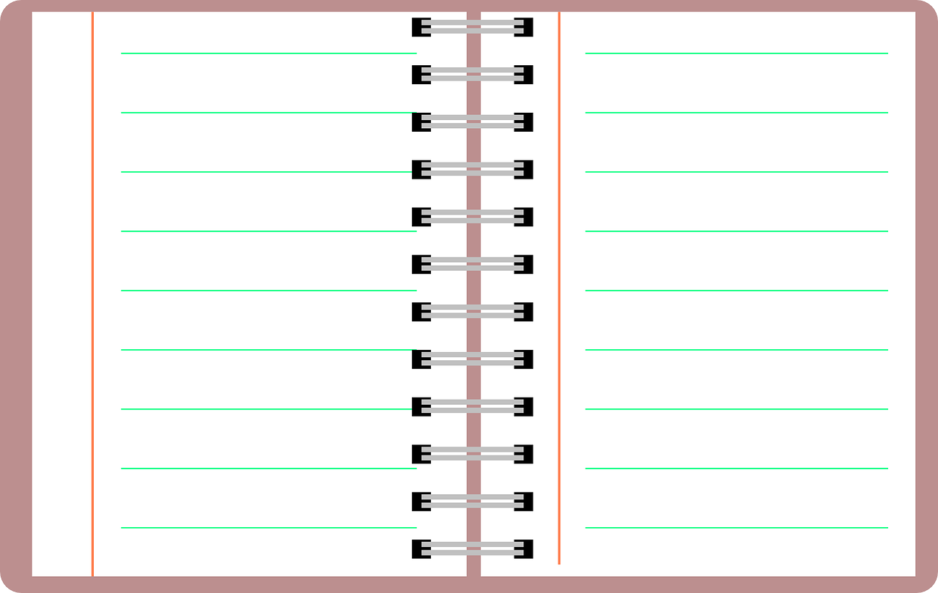
New structure
What are you doing?
I’m ____________.
What is he doing?
He’s __________.
What is she doing?
She’s __________.
What are they doing?
They’re__________.

Slide 13
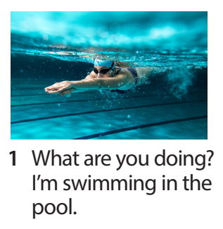
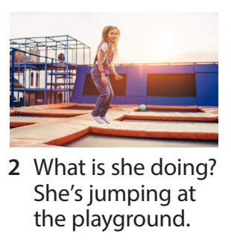
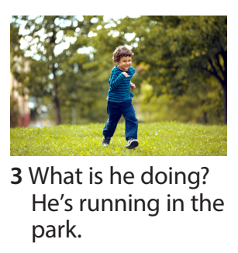
Task 4 Listen and repeat.

Slide 14
3 Practice

Slide 15

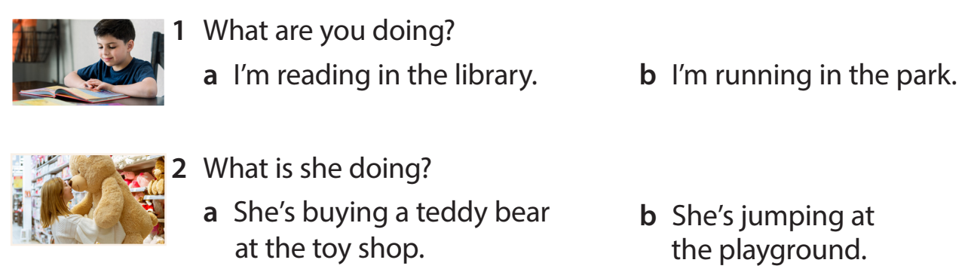
Task 5 Look and read. Circle and say.

Slide 16
4 Production

Slide 17
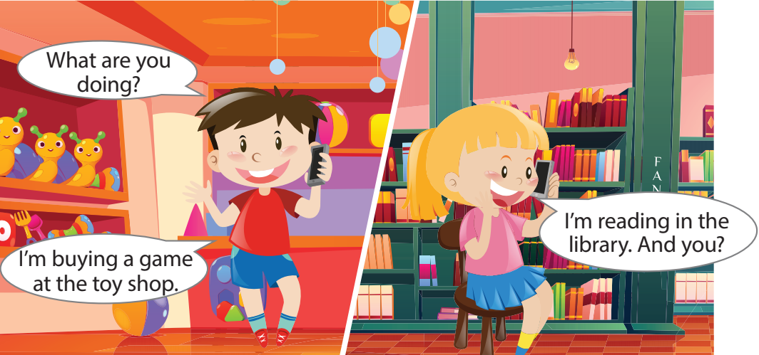
Task 6 Let’s talk.
Notes:
- Allow them enough time to make their own and practise the dialogue.
- Ask some volunteers to go to the broard to make a phone call( one is in the class, one is out of the class.)

Slide 18
5 Assessment

Slide 19
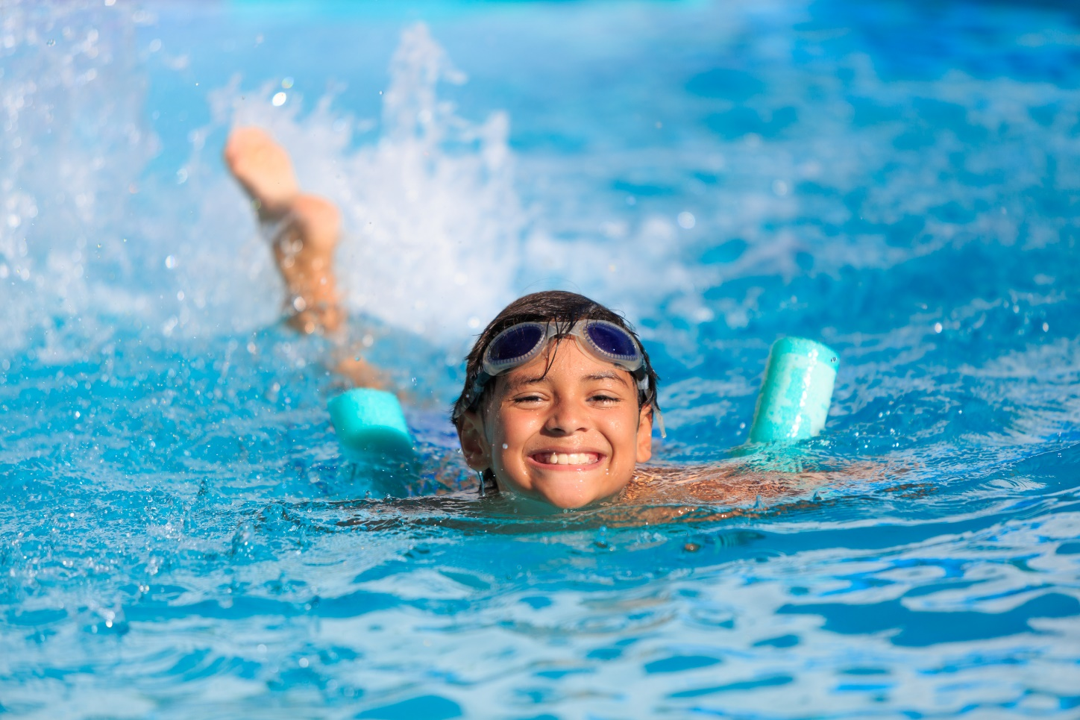
What is he doing?
A. He’s swimming in the pool.
B. He’s jumping.
C. He’s smiling.

Slide 20
What is she doing?
A. She’s singing.
B. She’s driving a car.
C. She’s jumping.

Slide 21
What is he doing?
A. He’s eating.
B. He’ running.
C. He’s run.

Slide 22
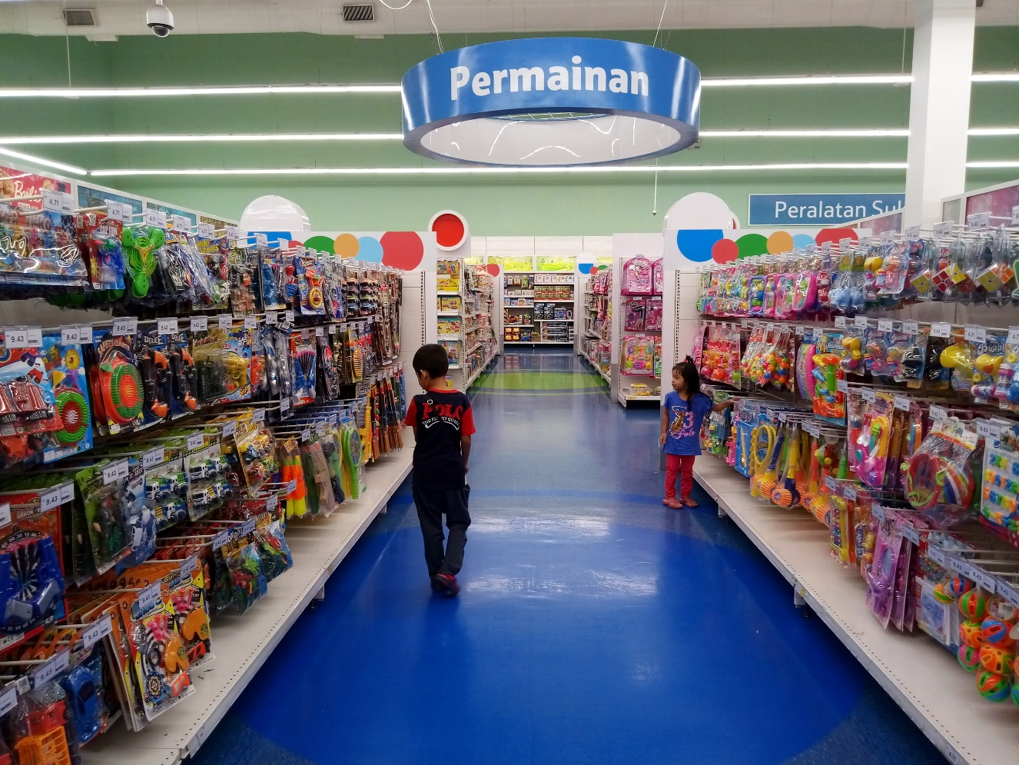
Fill in the blank.
We’re ______ balls at the toy shop now.
buying

Slide 23
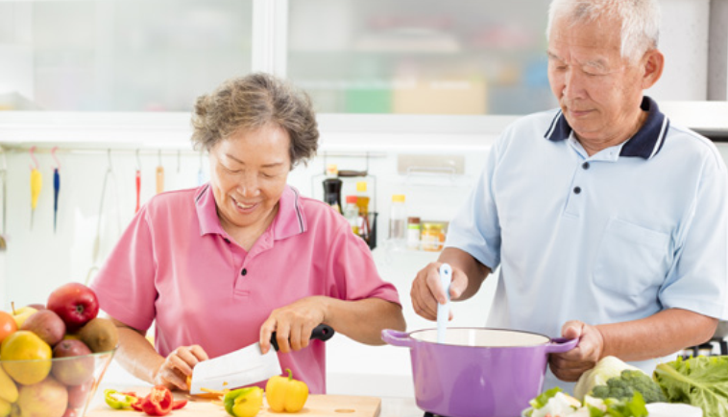
Fill in the blank.
They ’re ______ in the kitchen.
cooking

Slide 24




Thank you & goodbye!

