Slide 1








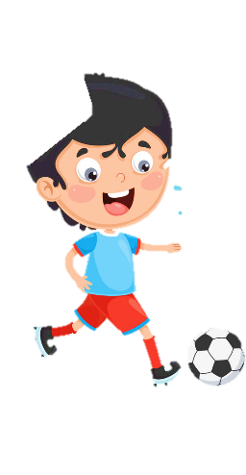













Slide 2
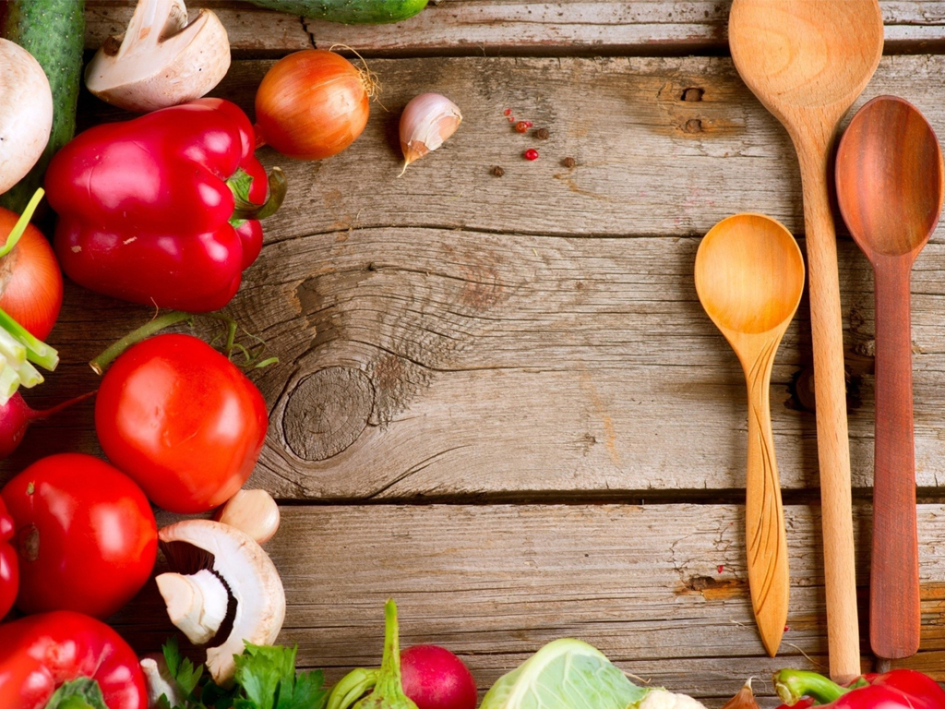


Unit 9:
My Favourite Food
FUN TIME & PROJECT

Slide 3
1 WARM UP
Climbing trees

Slide 4
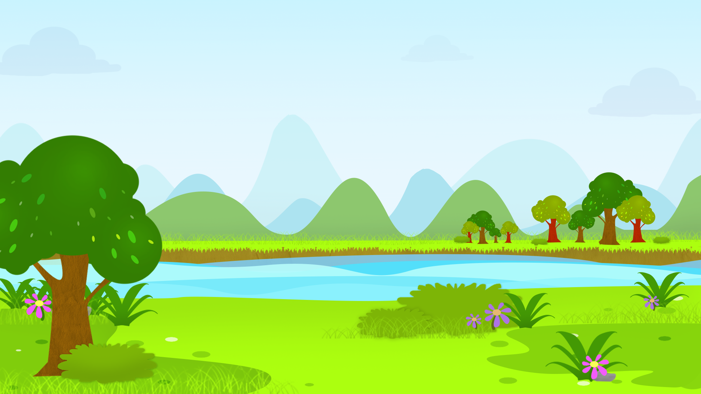


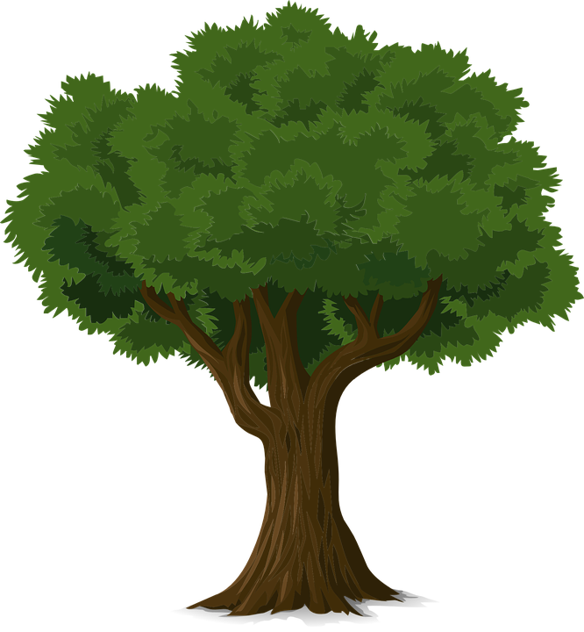
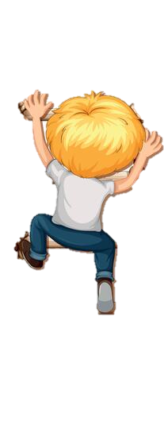

1
2
3
4
5
6
7
8
Next
Notes:
Bấm vào số để chọn câu hỏi
Bấm vào bé trai, bé gái để trèo cây
Bấm vào next để thoát game

Slide 5
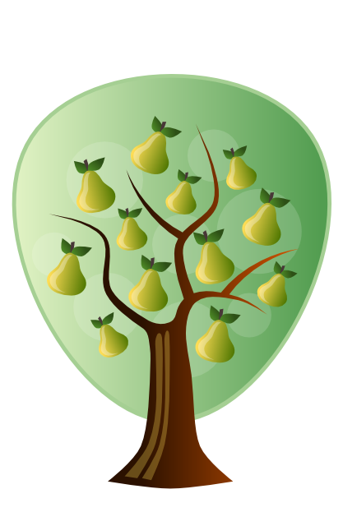
How many pears are there?
Twelve.
Back
Notes:
Bấm vào back để quay về trang chủ

Slide 6

How many tomatoes are there?
Fifteen.
Back
Notes:
Bấm vào back để quay về trang chủ

Slide 7
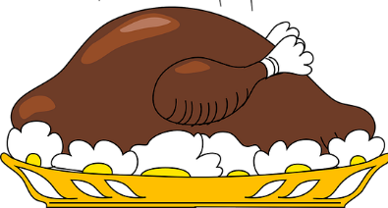

Where is the chicken?
It’s on the table.
Back
Notes:
Bấm vào back để quay về trang chủ

Slide 8
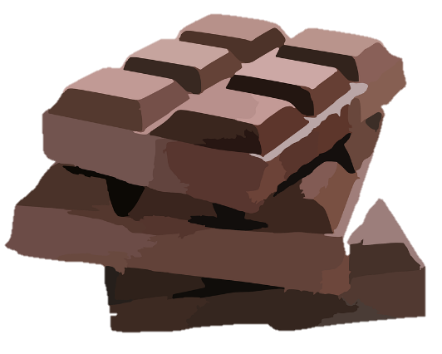
Fill in the blanks
There ____ a lot of chocolate.
There ____ some apples.
is
are
Back
Notes:
Bấm vào back để quay về trang chủ

Slide 9
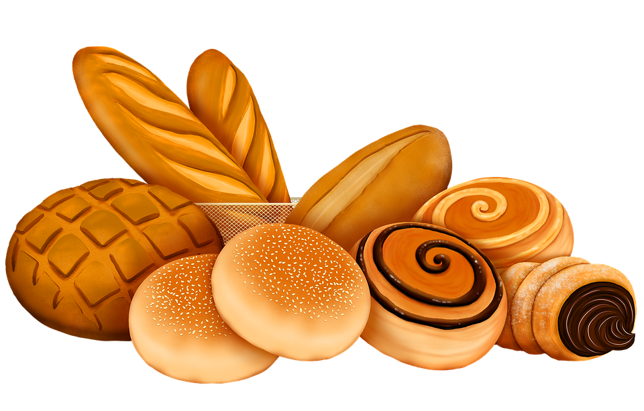
Look and choose
There are a lot of/many/some breads.
Back
Notes:
Bấm vào back để quay về trang chủ

Slide 10

What is it?
It’s juice.
Back
Notes:
Bấm vào back để quay về trang chủ

Slide 11
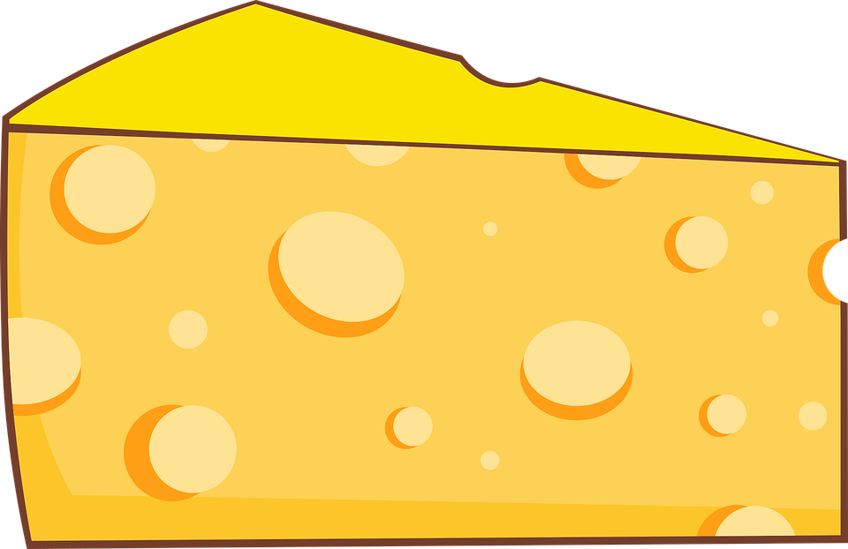
What is it?
It’s cheese.
Back
Notes:
Bấm vào back để quay về trang chủ

Slide 12

What is it?
It’s rice.
Back
Notes:
Bấm vào back để quay về trang chủ

Slide 13

2 REVIEW
Task 1 Read and match.

Slide 14

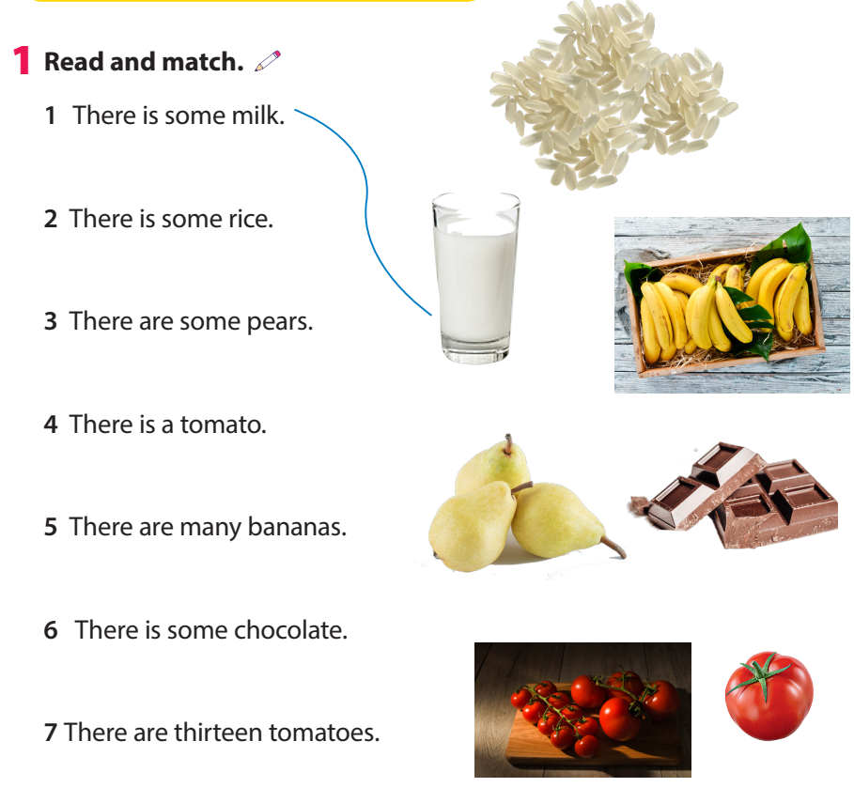
Task 1 Read and match.

Slide 15
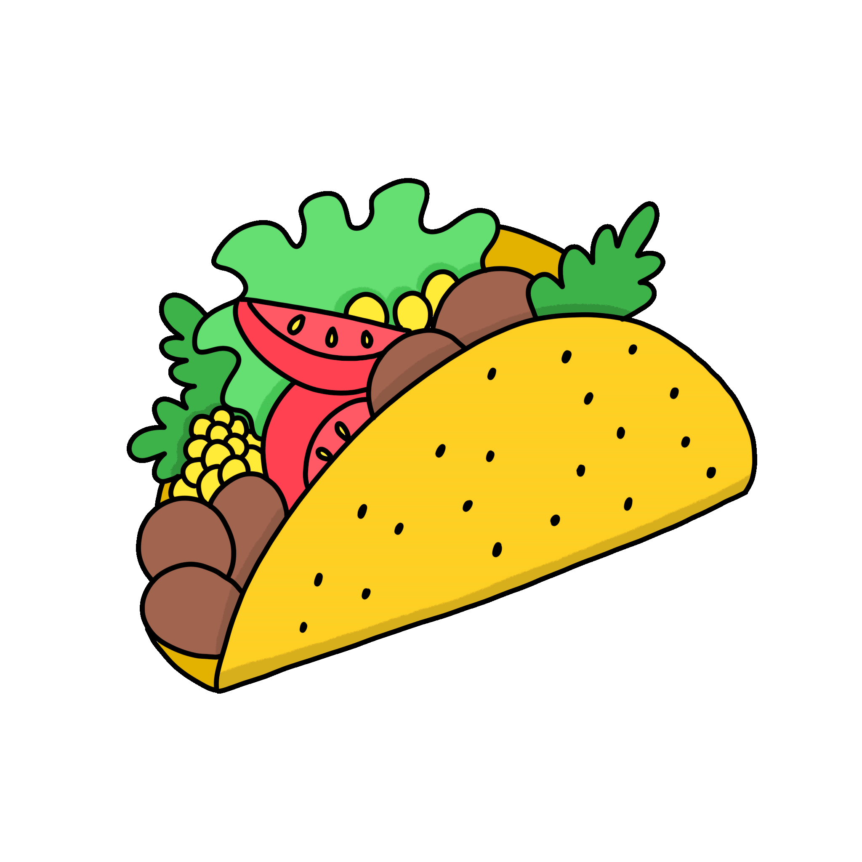
3 PROJECT
My favourite food.

Slide 16

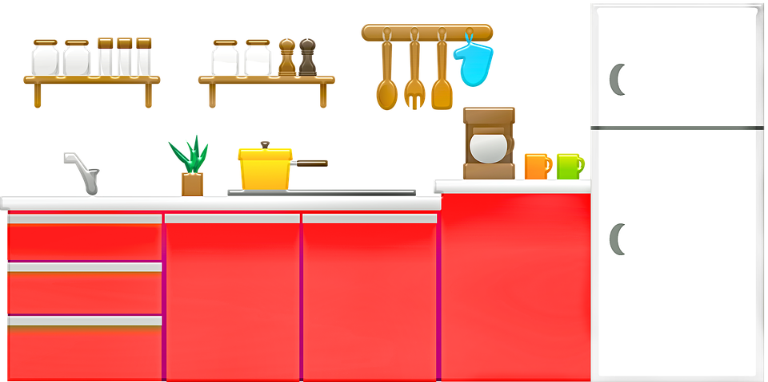


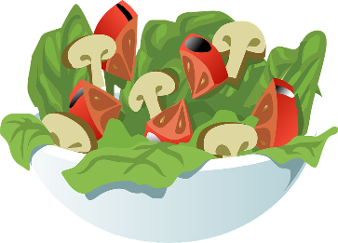
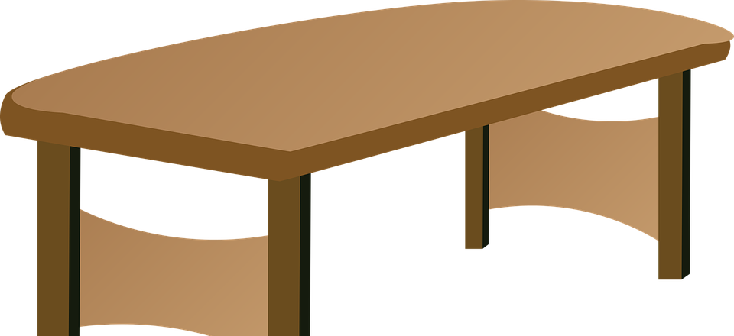


Draw a picture of food in your kitchen.
Tell your class about it.
This is my kitchen. There is a lot of food. There are some biscuits on the table.

Slide 17
4 ASSESSMENT
Look and circle

Slide 18
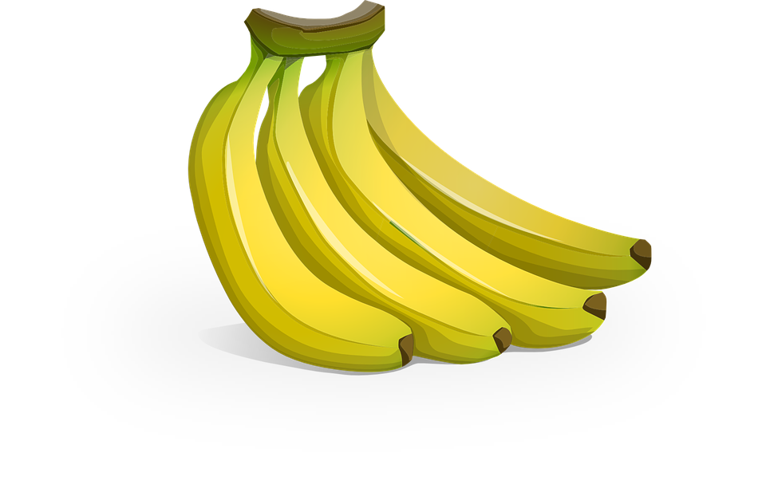
1 How many bananas are there?
A Nineteen.
B Sixteen.
C Twenty.

Slide 19
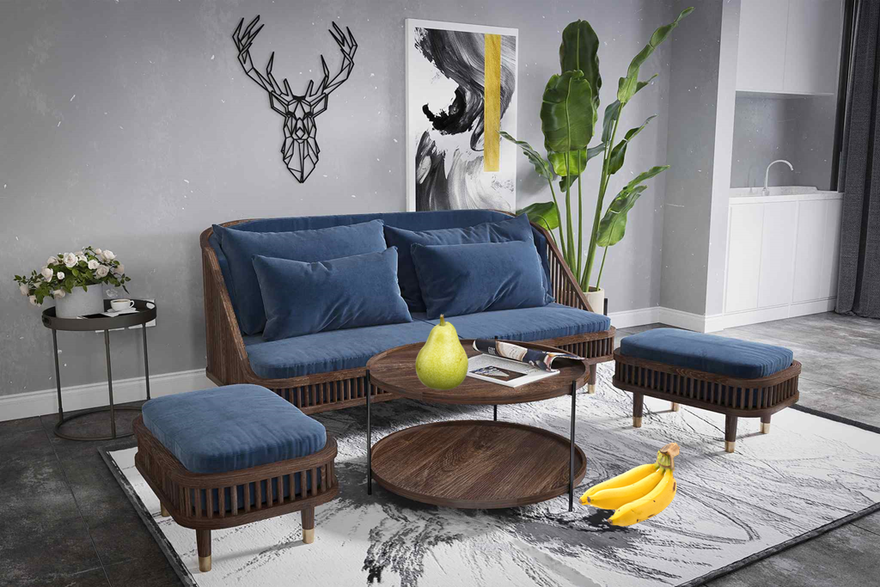
2 Where’s the pear?
A It’s on the table.
B It’s under the table.
C It’s in the table.

Slide 20
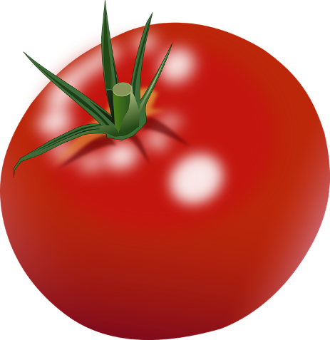
3 There are ______ tomatoes.
A many
B some
C a lot of

Slide 21
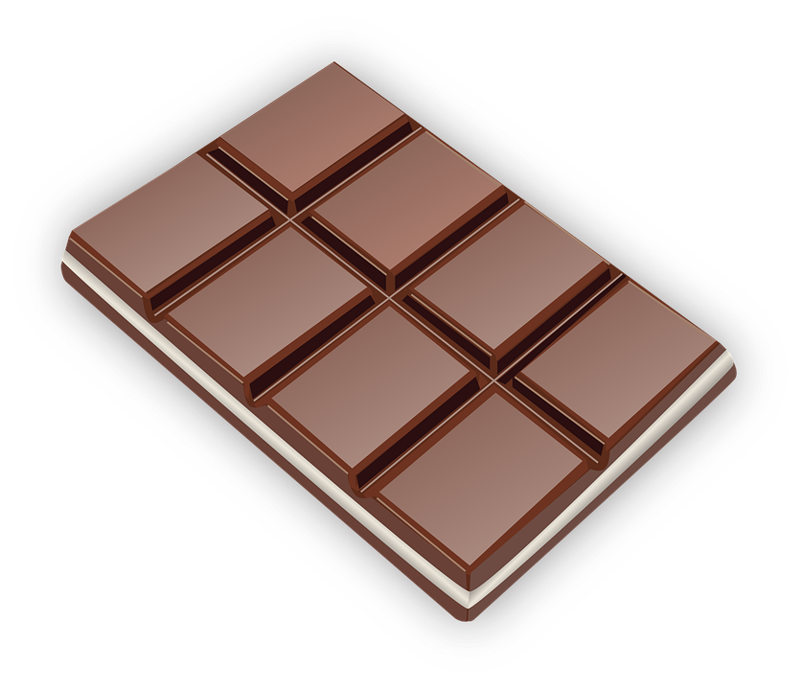
4 There is some _______.
A milk
B chocolate
C rice

Slide 22

5 There are ______ sweets.
A sixteen
B some
C a lot of

Slide 23




Thank you
& goodbye!

