Slide 1









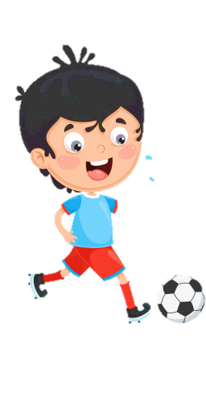
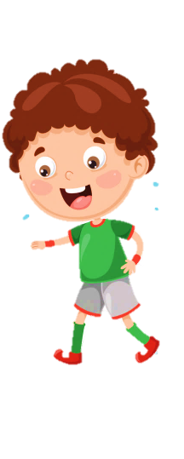












Slide 2


Unit 10
Our World
Lesson 3 – Task 7,8,9

Slide 3


01
Warm Up

Slide 4
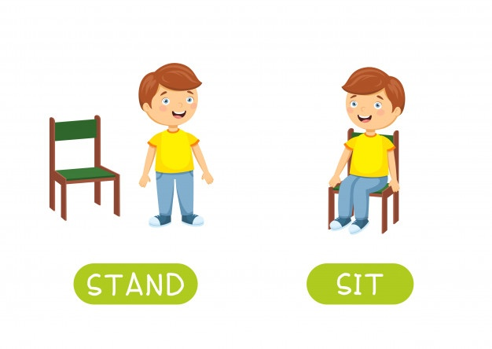



Slide 5

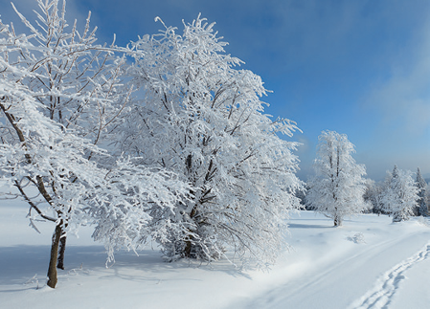
w
Next

Slide 6

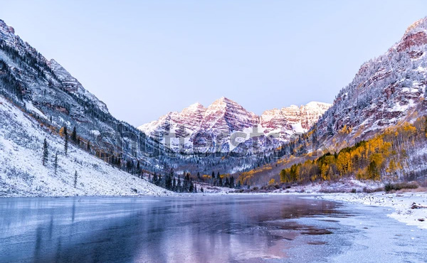

1. What is the missing letter?
M
L
W
W
I
N
T
E
R
Next

Slide 7
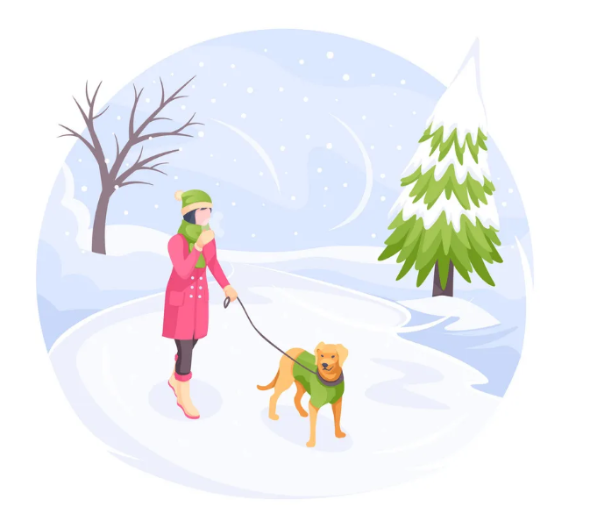
2. What is the missing letter?
U
A
O
C
O
L
D
Next

Slide 8
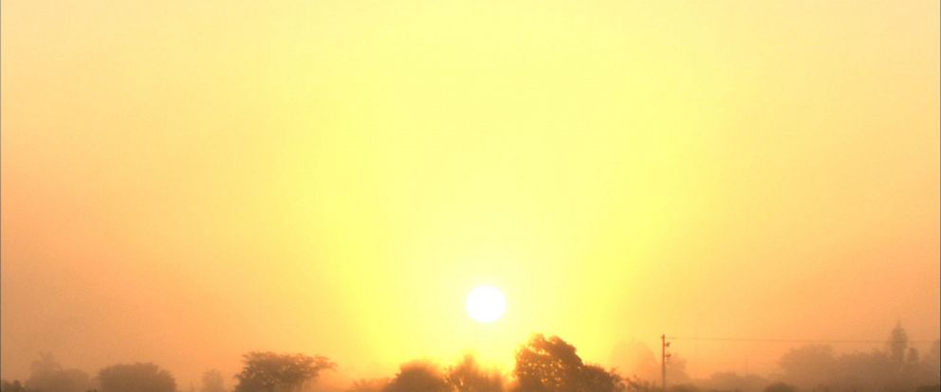
3. What is the missing letter?
U
O
A
W
A
R
M

Slide 9
02
Presentation

Slide 10


Task 7. Listen and repeat.
wet
cold
It’s wet and cold in winter.

Slide 11


/w/
wet

Slide 12
/o/
cold

Slide 13
Listen and say
wet
cold
Words
/w/
/əʊ/
Sounds

Slide 14
Sound checking
/w/
winter
snowy
cold

Slide 15
Sound checking
/əʊ/
cool
summer
hold

Slide 16
Sound checking
/əʊ/
hot
tour
old

Slide 17
Sound checking
/w/
rainy
autumn
what

Slide 18
03
Practice

Slide 19
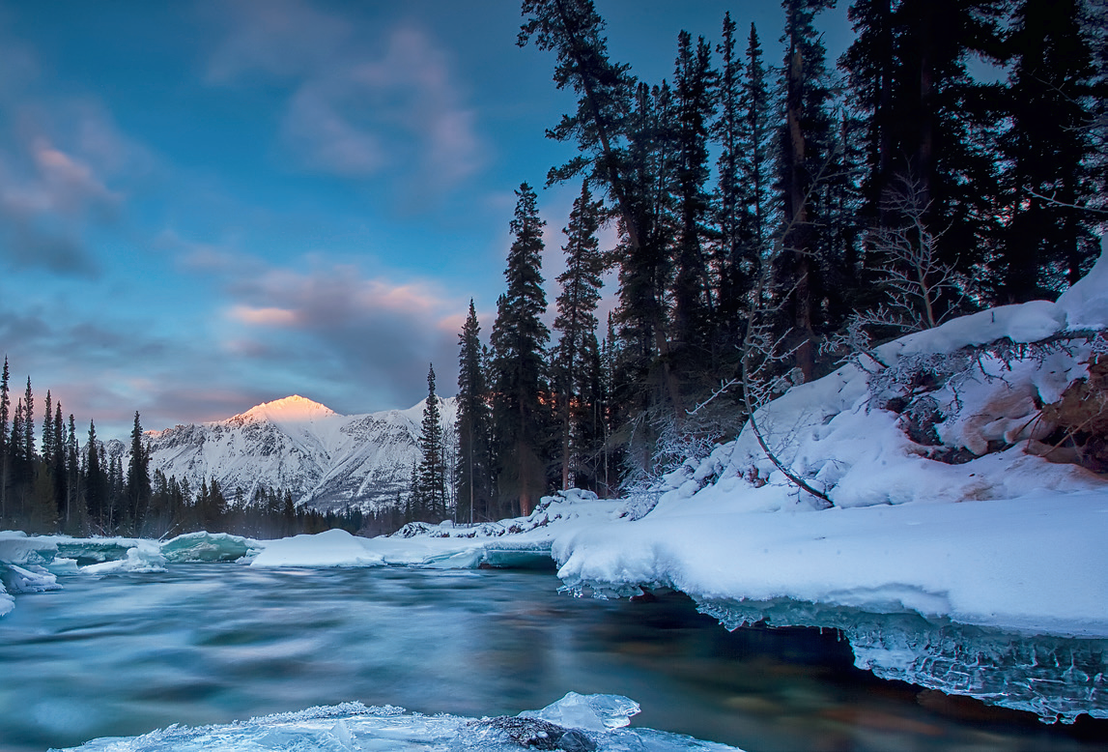
Task 8. Listen and chant.
W, w, w!
Wet, wet, wet.
In winter, the water is wet!
O, o, o!
Cold, cold, cold.
In winter, the water is cold!

Slide 20
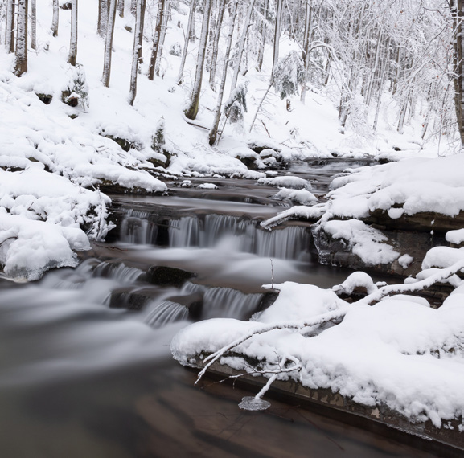

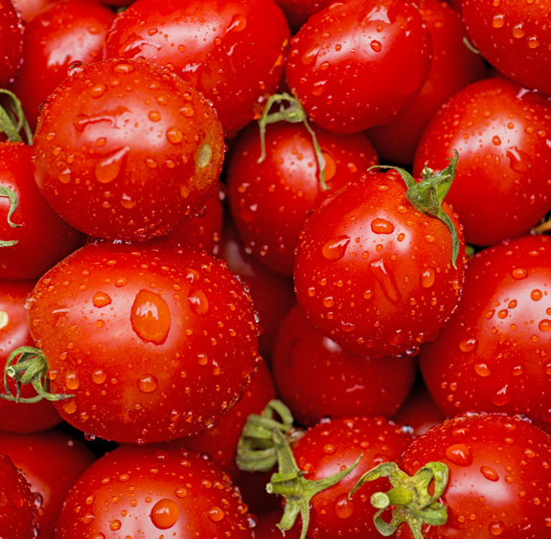
Task 9. Say it

Slide 21
The water in the river is cold.
It’s summer. The water is warm.
The tomatoes are wet.

Slide 22
4
Production

Slide 23


Let’s compose the chant!

Slide 24
SUGGESTION
W, w, w!
Warm, warm, warm.
It's summer.
The water is warm!

Slide 25
5
Assessment

Slide 26
Find the words with the sound /w/ and /əʊ/ and circle
summer cold hot warm
autumn rock water hello
Notes:
HOẠT ĐỘNG TƯƠNG TÁC

Slide 27




Thank you & goodbye!

