Slide 1
Welcome to my class
Da Phuc Primary School
Teacher: Do Tra Giang
Class: 4a3

Slide 2


Our summer holidays
10
Lesson 1 (1,2,3)

Slide 3
01
Warm-up
Let’s chant.

Slide 4
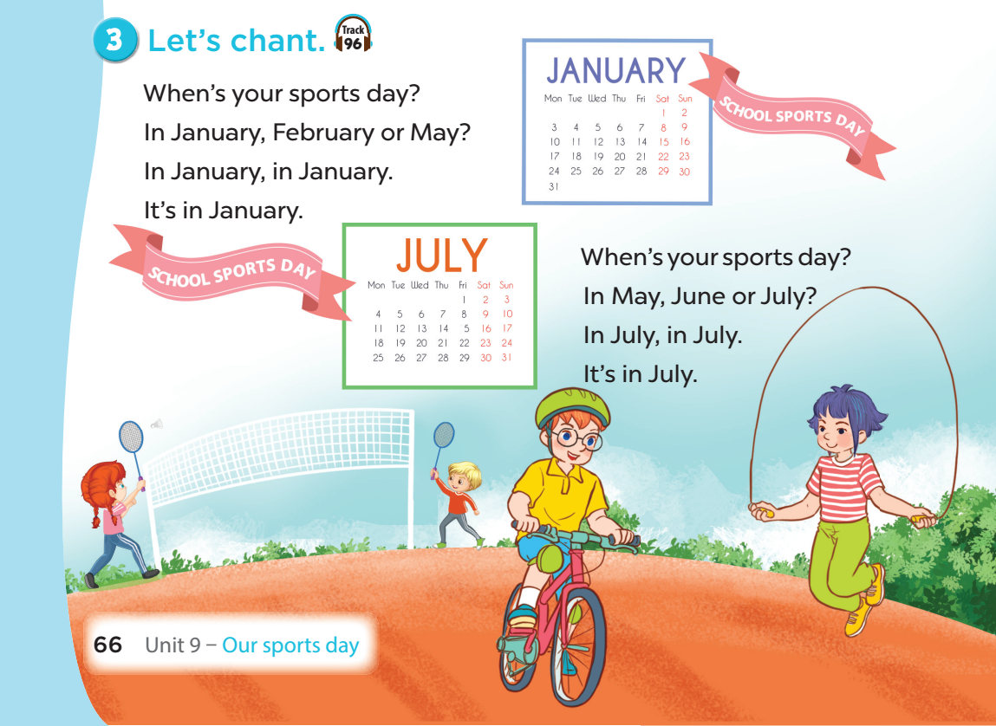


Slide 5
02
Activity 1
Look, listen and repeat.

Slide 6
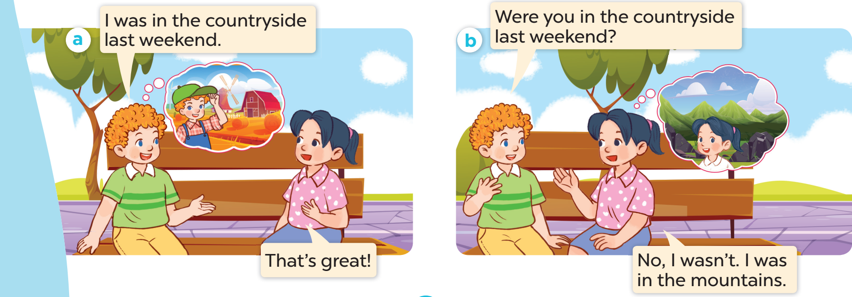

Look and listen.

Slide 7
03
New words
Places

Slide 8
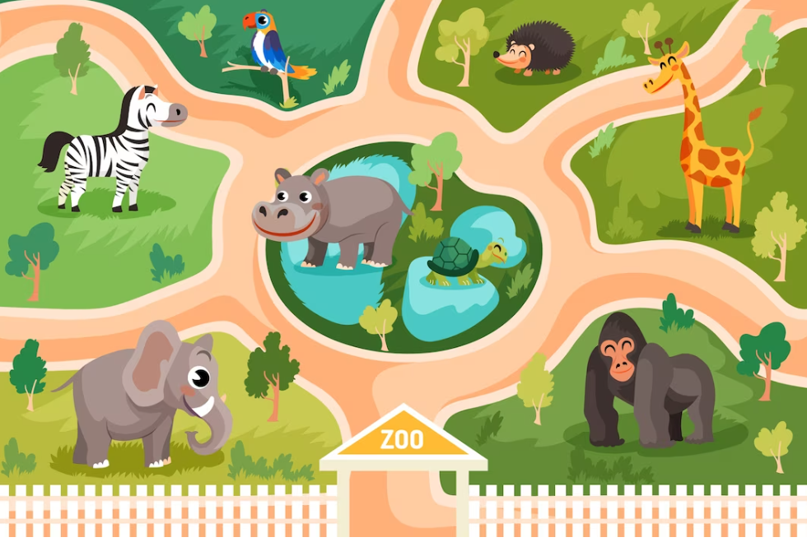
at the
zoo

Slide 9
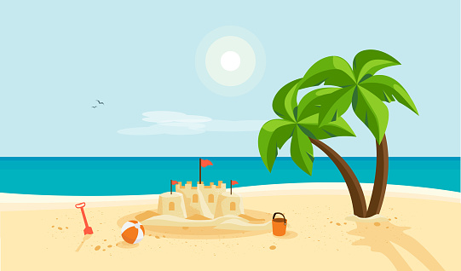
on the
beach

Slide 10

in the
countryside

Slide 11
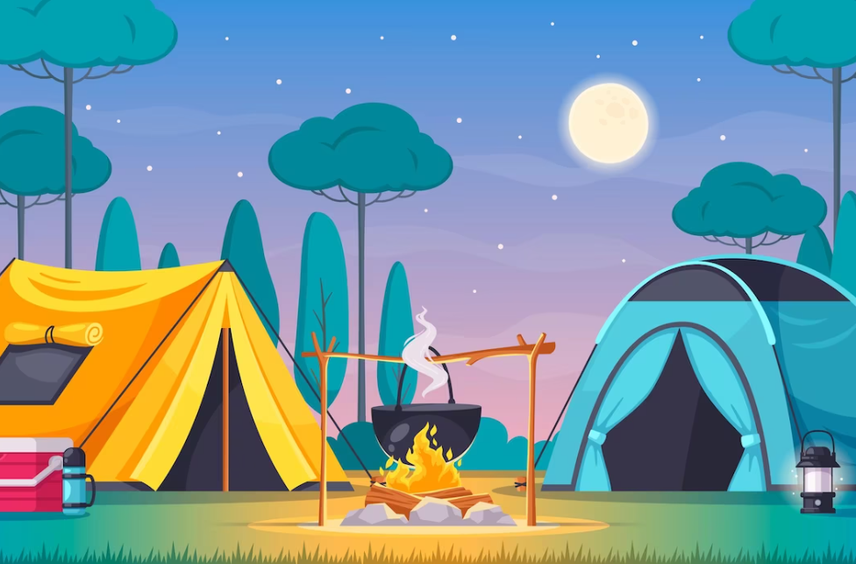
at the
campsite

Slide 12
beach
countryside
campsite
zoo

Slide 13
04
Activity 2
Listen, point and say.

Slide 14
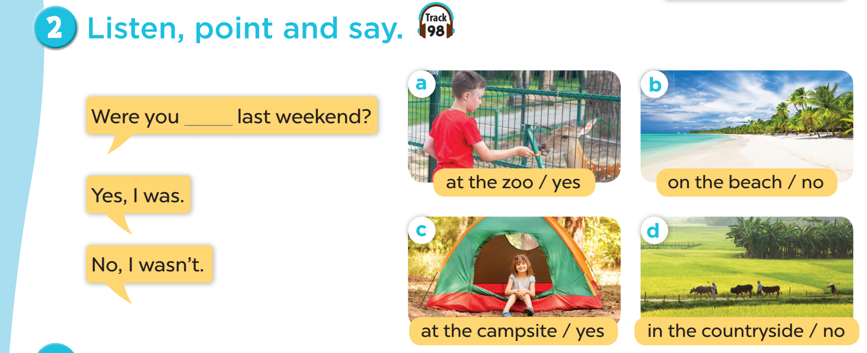

Slide 15

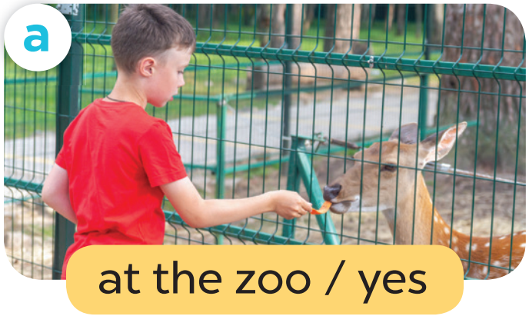

Work in pairs. Role play.
Were you at the zoo last weekend?
Yes, I was.

Slide 16
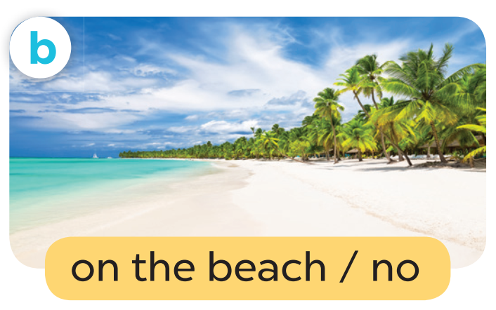
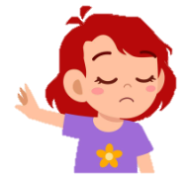
Work in pairs. Role play.
Were you on the beach last weekend?
No, I wasn’t.

Slide 17
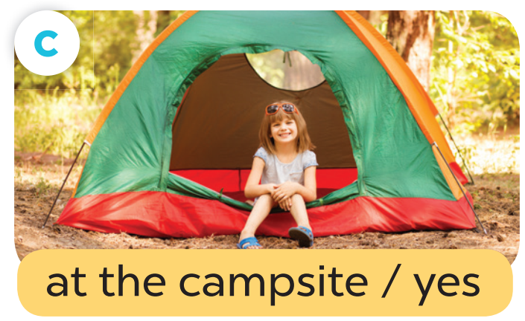
Work in pairs. Role play.
Were you at the campsite last weekend?
Yes, I was.

Slide 18

Work in pairs. Role play.
Were you in the countryside last weekend?
No, I wasn’t.

Slide 19
05
Activity 3
Let’s talk.

Slide 20
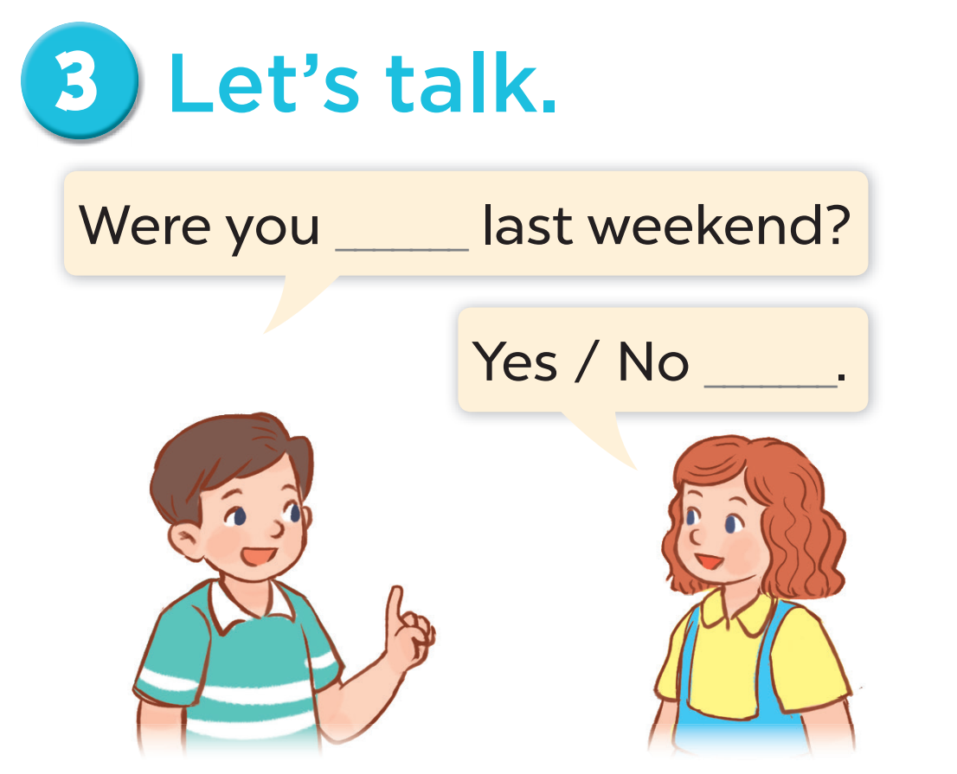
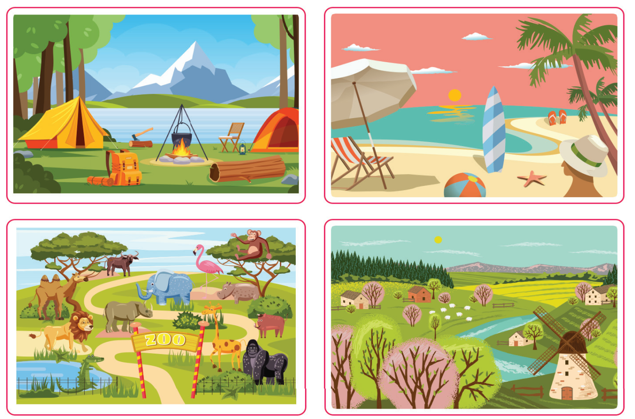

Slide 21
06
FUN CORNER

Slide 22

Notes:
This template is for educational, non-commercial purposes only. For more free game templates like this one, visit https://www.taysteachingtoolkit.com

Slide 23




Were you in the countryside last weekend? (No)
No, I wasn’t.
A
B
C
Notes:
Click to hide the Pokémon
Click again to shuffle the Pokéballs
Once the Pokéballs have stopped shuffling, music will start playing to let students know it’s time to write (~25 seconds, feel free to delete if you don’t want the music)
After music stops, click reveal where the Pokémon.
Click to go to the next slide
(Also note: To save space, for longer sentences you can use the top text box for the part of the sentences that are the same and the bottom text boxes for the parts that are different. i.e. TOP TEXT BOX SAYS: Where is the // BOTTOM TEXT BOXES SAY: bathroom – library – park > Then, students write either: Where is the bathroom? Where is the library? OR Where is the park? - Feel free to delete this box if not needed or use it for other purposes.)

Slide 24
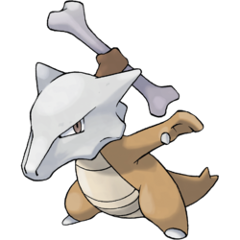
Were you on the beach last weekend? (Yes)
Yes, I was.
A
B
C
Notes:
Click to hide the Pokémon
Click again to shuffle the Pokéballs
Once the Pokéballs have stopped shuffling, music will start playing to let students know it’s time to write (~25 seconds, feel free to delete if you don’t want the music)
After music stops, click reveal where the Pokémon.
Click to go to the next slide
(Also note: To save space, for longer sentences you can use the top text box for the part of the sentences that are the same and the bottom text boxes for the parts that are different. i.e. TOP TEXT BOX SAYS: Where is the // BOTTOM TEXT BOXES SAY: bathroom – library – park > Then, students write either: Where is the bathroom? Where is the library? OR Where is the park? - Feel free to delete this box if not needed or use it for other purposes.)

Slide 25

Were you at the campsite last weekend? (No)
No, I wasn’t.
A
B
C
Notes:
Click to hide the Pokémon
Click again to shuffle the Pokéballs
Once the Pokéballs have stopped shuffling, music will start playing to let students know it’s time to write (~25 seconds, feel free to delete if you don’t want the music)
After music stops, click reveal where the Pokémon.
Click to go to the next slide
(Also note: To save space, for longer sentences you can use the top text box for the part of the sentences that are the same and the bottom text boxes for the parts that are different. i.e. TOP TEXT BOX SAYS: Where is the // BOTTOM TEXT BOXES SAY: bathroom – library – park > Then, students write either: Where is the bathroom? Where is the library? OR Where is the park? - Feel free to delete this box if not needed or use it for other purposes.)

Slide 26

Were you at the zoo last weekend? (Yes)
Yes, I was.
A
B
C
Notes:
Click to hide the Pokémon
Click again to shuffle the Pokéballs
Once the Pokéballs have stopped shuffling, music will start playing to let students know it’s time to write (~25 seconds, feel free to delete if you don’t want the music)
After music stops, click reveal where the Pokémon.
Click to go to the next slide
(Also note: To save space, for longer sentences you can use the top text box for the part of the sentences that are the same and the bottom text boxes for the parts that are different. i.e. TOP TEXT BOX SAYS: Where is the // BOTTOM TEXT BOXES SAY: bathroom – library – park > Then, students write either: Where is the bathroom? Where is the library? OR Where is the park? - Feel free to delete this box if not needed or use it for other purposes.)

Slide 27


