Slide 1

Review 2
Period 2

Slide 2


01
Warm-up and Review

Slide 3


Hot seat
Game

Slide 4
Notes:
Giáo viên nháy chuột để bật nhạc và dừng nhạc. Dừng nhạc bạn nào ngồi được vào ghế thì trả lời câu hỏi. Trả lời đúng thì được thưởng còn trả lời sai thì đến lượt bạn khác trả lời.

Slide 5


What did you do yesterday?

Slide 6

Notes:
Giáo viên nháy chuột để bật nhạc và dừng nhạc. Dừng nhạc bạn nào ngồi được vào ghế thì trả lời câu hỏi. Trả lời đúng thì được thưởng còn trả lời sai thì đến lượt bạn khác trả lời.

Slide 7
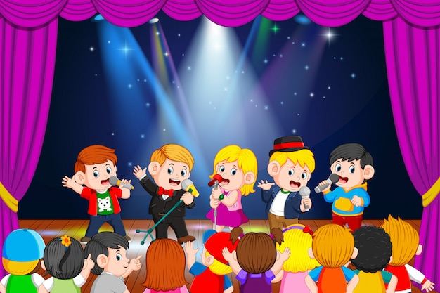
What did you do yesterday?

Slide 8
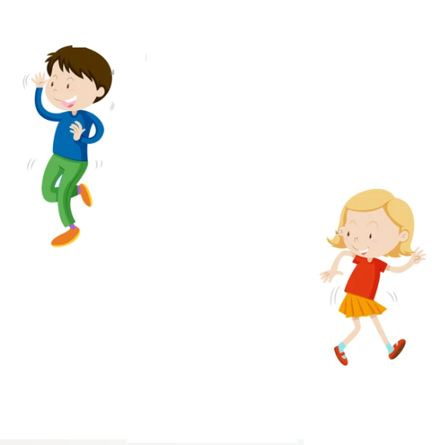
Notes:
Giáo viên nháy chuột để bật nhạc và dừng nhạc. Dừng nhạc bạn nào ngồi được vào ghế thì trả lời câu hỏi. Trả lời đúng thì được thưởng còn trả lời sai thì đến lượt bạn khác trả lời.

Slide 9
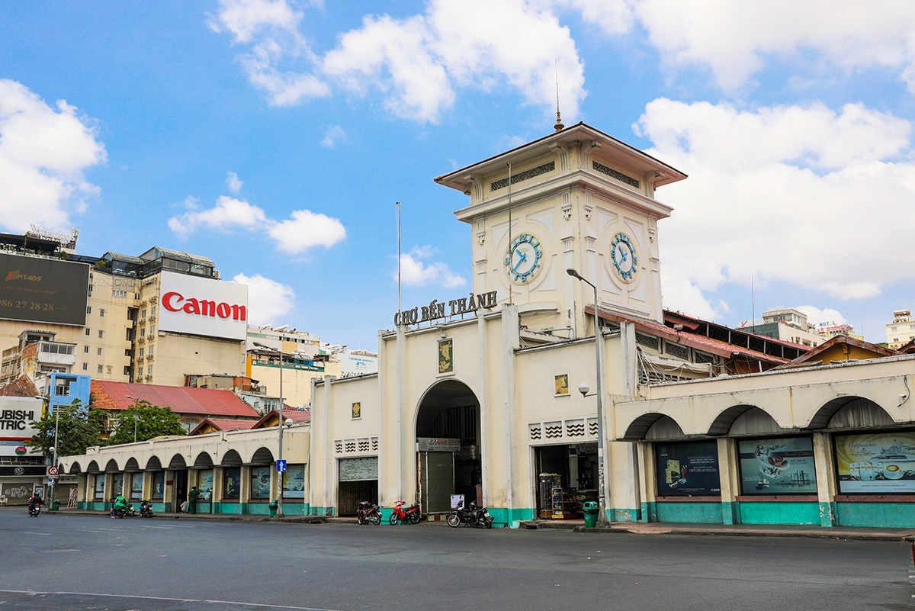
Where did you go last November?

Slide 10
Notes:
Giáo viên nháy chuột để bật nhạc và dừng nhạc. Dừng nhạc bạn nào ngồi được vào ghế thì trả lời câu hỏi. Trả lời đúng thì được thưởng còn trả lời sai thì đến lượt bạn khác trả lời.

Slide 11
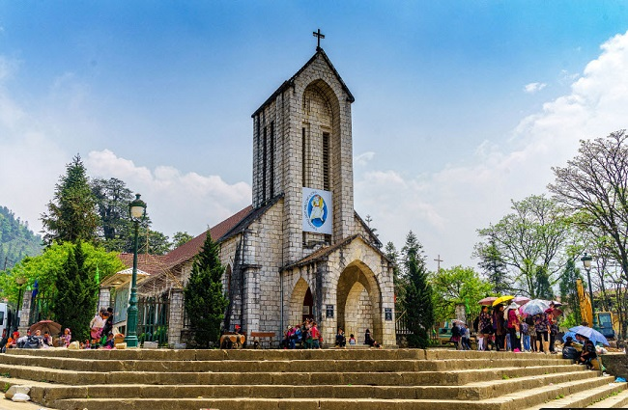
Where did you go last September?

Slide 12


Very Good!

Slide 13
02
Activity 3. Read and match.

Slide 14

Read and match.
1. Could you tell me the way to the art room?
a. It’s Lucy’s
2. What school activity does Minh like?
b. Yes, we were.
3. Whose set square is this?
c. Because she thinks it’s interesting.
4. Were you at Hoan Kiem Lake last weekend?
d. He likes doing projects.
5. Why does Lan like reading books?
e. Go upstairs. It’s on the first floor.

Slide 15

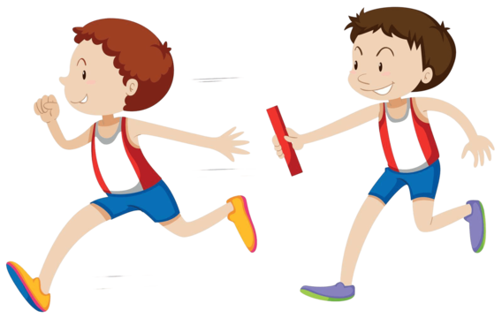
Relay Game

Slide 16
Read and match.
1. Could you tell me the way to the art room?
a. It’s Lucy’s.
2. What school activity does Minh like?
b. Yes, we were.
3. Whose set square is this?
c. Because she thinks it’s interesting.
4. Were you at Hoan Kiem Lake last weekend?
d. He likes doing projects.
5. Why does Lan like reading books?
e. Go upstairs. It’s on the first floor.

Slide 17
03
Activity 4.
Read and number.

Slide 18
Read.
Last Saturday, Lan and her class went to Ba Na Hills in Da Nang. The weather was so beautiful. They arrived there early in the morning. First, they enjoyed the cable car ride. They walked over Golden Bridge. Then they visited the famous buildings and went to the wax museum. After that, they played some games at the amusement park. They had some
delicious seafood at a well-known restaurant. They went home late in the afternoon. Their trip was a lot of fun. Lan really wants to visit Ba Na Hills again next summer to see some more interesting places there.

Slide 19
Read and number.
Last Saturday, Lan and her class went to Ba Na Hills in Da Nang. The weather was so beautiful. They arrived there early in the morning. First, they enjoyed the cable car ride. They walked over Golden Bridge. Then they visited the famous buildings and went to the wax museum. After that, they played some games at the amusement park. They had some
delicious seafood at a well-known restaurant. They went home late in the afternoon. Their trip was a lot of fun. Lan really wants to visit Ba Na Hills again next summer to see some more interesting places there.
2
a. They visited the famous buildings and the wax museum.

Slide 20
Read and number.
Last Saturday, Lan and her class went to Ba Na Hills in Da Nang. The weather was so beautiful. They arrived there early in the morning. First, they enjoyed the cable car ride. They walked over Golden Bridge. Then they visited the famous buildings and went to the wax museum. After that, they played some games at the amusement park. They had some
delicious seafood at a well-known restaurant. They went home late in the afternoon. Their trip was a lot of fun. Lan really wants to visit Ba Na Hills again next summer to see some more interesting places there.
4
b. They went home late in the afternoon.

Slide 21
Read and number.
Last Saturday, Lan and her class went to Ba Na Hills in Da Nang. The weather was so beautiful. They arrived there early in the morning. First, they enjoyed the cable car ride. They walked over Golden Bridge. Then they visited the famous buildings and went to the wax museum. After that, they played some games at the amusement park. They had some
delicious seafood at a well-known restaurant. They went home late in the afternoon. Their trip was a lot of fun. Lan really wants to visit Ba Na Hills again next summer to see some more interesting places there.
1
c. Lan and her class enjoyed the cable car ride and walked over Golden Bridge.

Slide 22
Read and number.
Last Saturday, Lan and her class went to Ba Na Hills in Da Nang. The weather was so beautiful. They arrived there early in the morning. First, they enjoyed the cable car ride. They walked over Golden Bridge. Then they visited the famous buildings and went to the wax museum. After that, they played some games at the amusement park. They had some
delicious seafood at a well-known restaurant. They went home late in the afternoon. Their trip was a lot of fun. Lan really wants to visit Ba Na Hills again next summer to see some more interesting places there.
3
d. They played some games at the amusement park and had some delicious seafood at a well-known restaurant.

Slide 23
04
Activity 5. Let’s write.

Slide 24
Let’s write.
– Where did you go last Sunday?
– What did you do there in the morning?
– What did you do in the afternoon?
– How was your trip?
My trip last Sunday
Last Sunday, I went to _
__________________
__________________

Slide 25
Let’s write.
Suggestion
My trip last Sunday
Last Sunday, I went to Hoan Kiem Lake with my friends. In the morning, we walked around the lake. We visited Ngoc Son Temple. In the afternoon, we went to see the water puppet show at the waterpuppet theatre by the lake. Our trip was a lot of fun!

Slide 26
Let’s write.
– Where did you go last Sunday?
– What did you do there in the morning?
– What did you do in the afternoon?
– How was your trip?
My trip last Sunday
Last Sunday, I went to _
__________________
__________________

Slide 27
05
Fun corner and Wrap-up

Slide 28
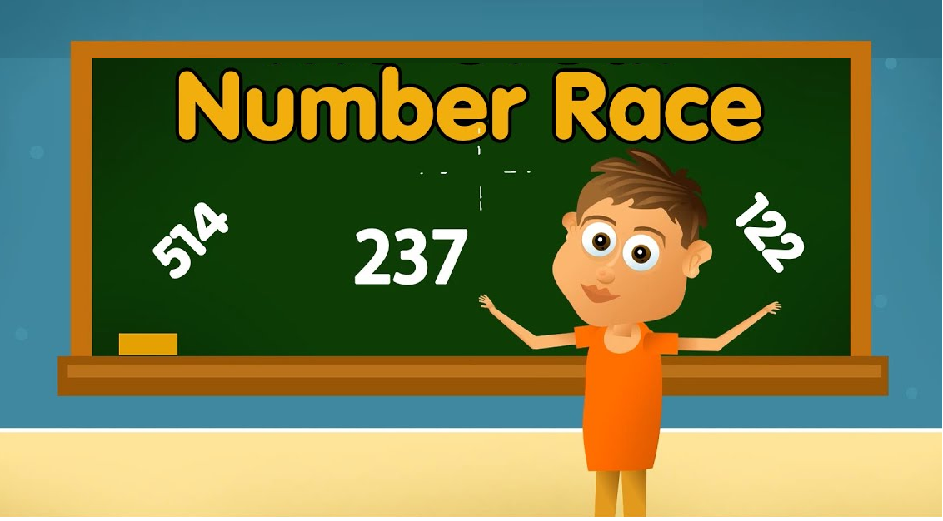

Slide 29



Where were you yesterday?

Slide 30
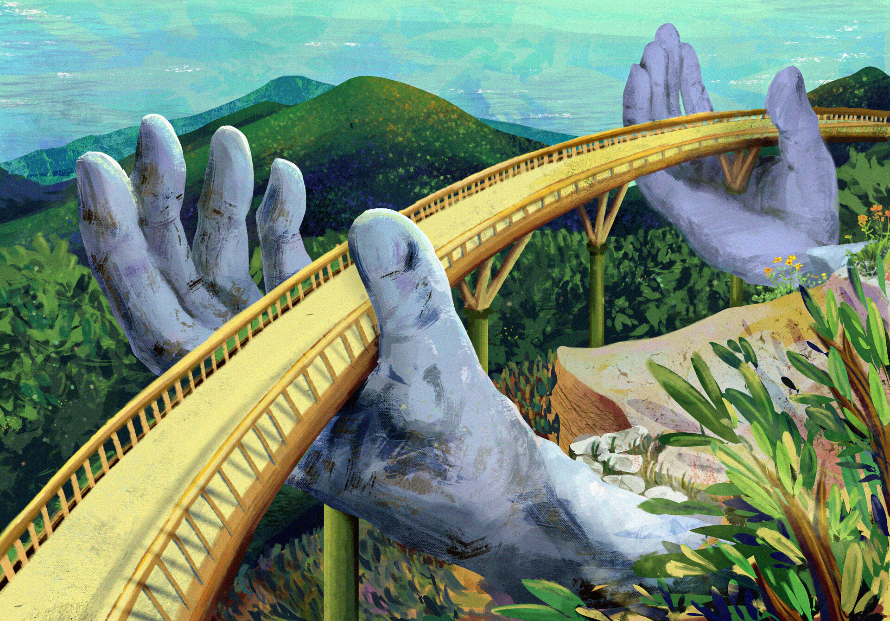
Where were you yesterday?

Slide 31

What did you do yesterday?

Slide 32
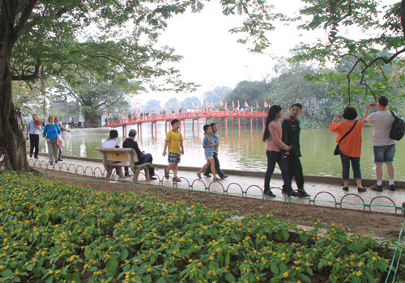
What did you do yesterday?

Slide 33

What did you do yesterday?

Slide 34

Summary
Team 1
Team 2

Slide 35
Website: hoclieu.vn
Fanpage: https://www.facebook.com/tienganhglobalsuccess.vn/

