Slide 1
Unit 11: My home
Lesson 1 - period 1

Slide 2
Table of Contents
01
02
03
04
Look, listen and repeat.
Warm-up
Listen, point and say.
Let’s talk.
05
fun corner & Wrap-up

Slide 3
01
Warm-up

Slide 4
02
Look, listen and repeat.

Slide 5

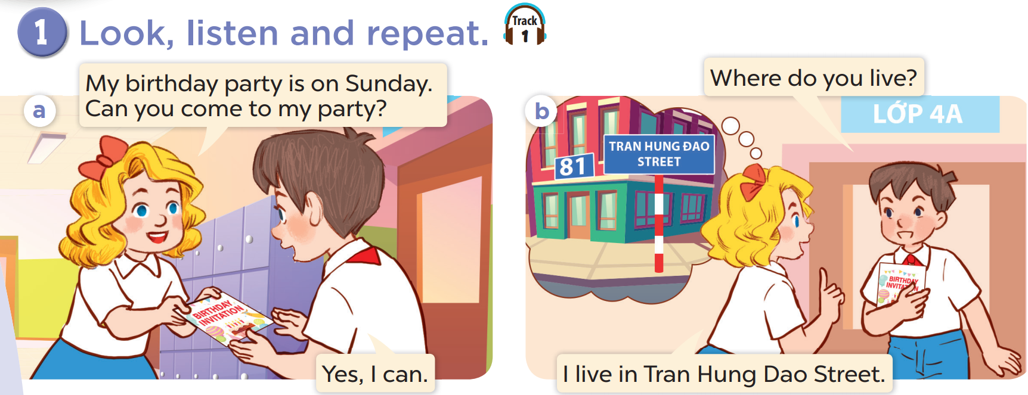

Slide 6
03
Listen, point and say.

Slide 7
vocabulary

Slide 8
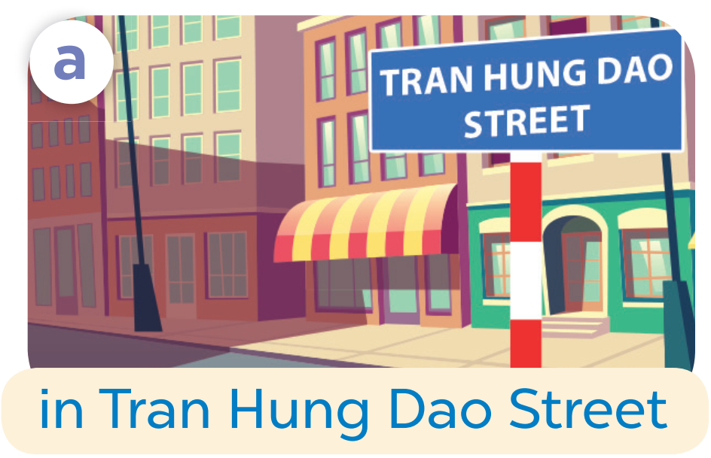

Slide 9
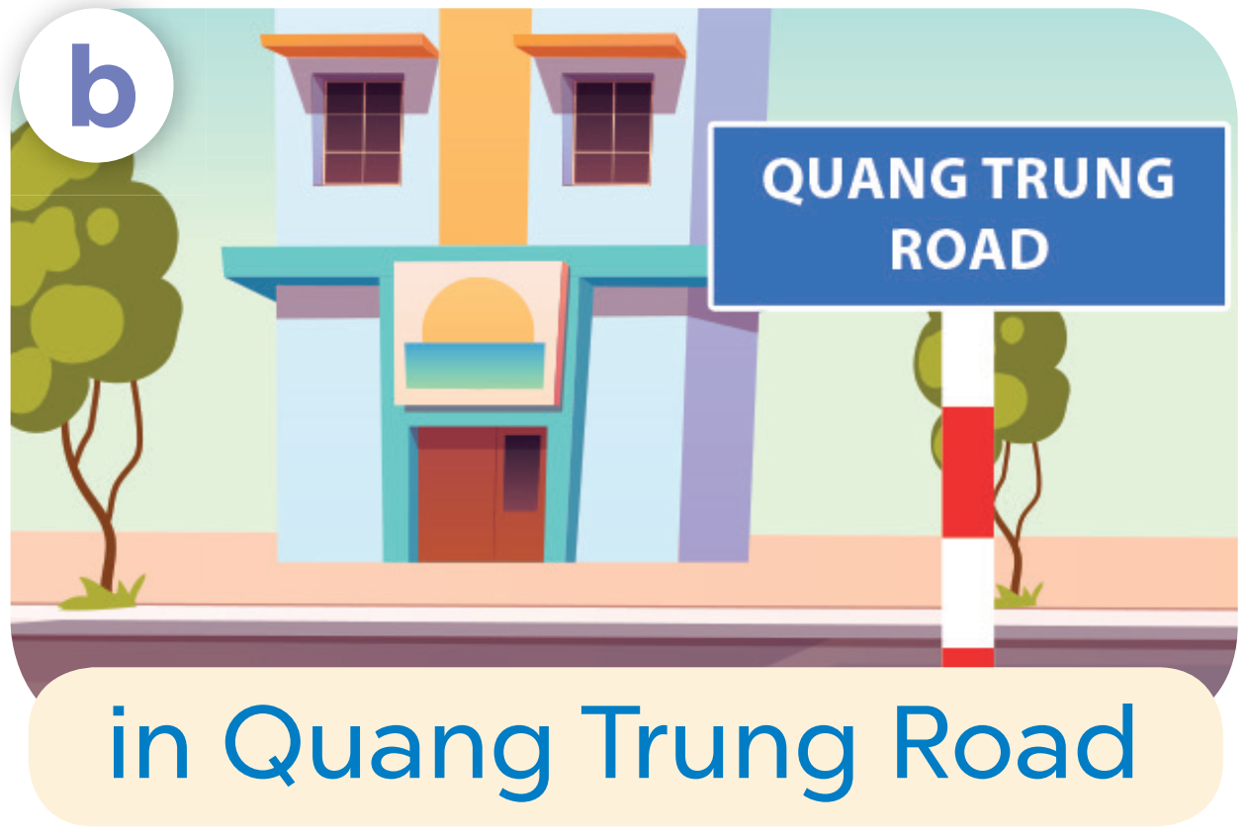

Slide 10
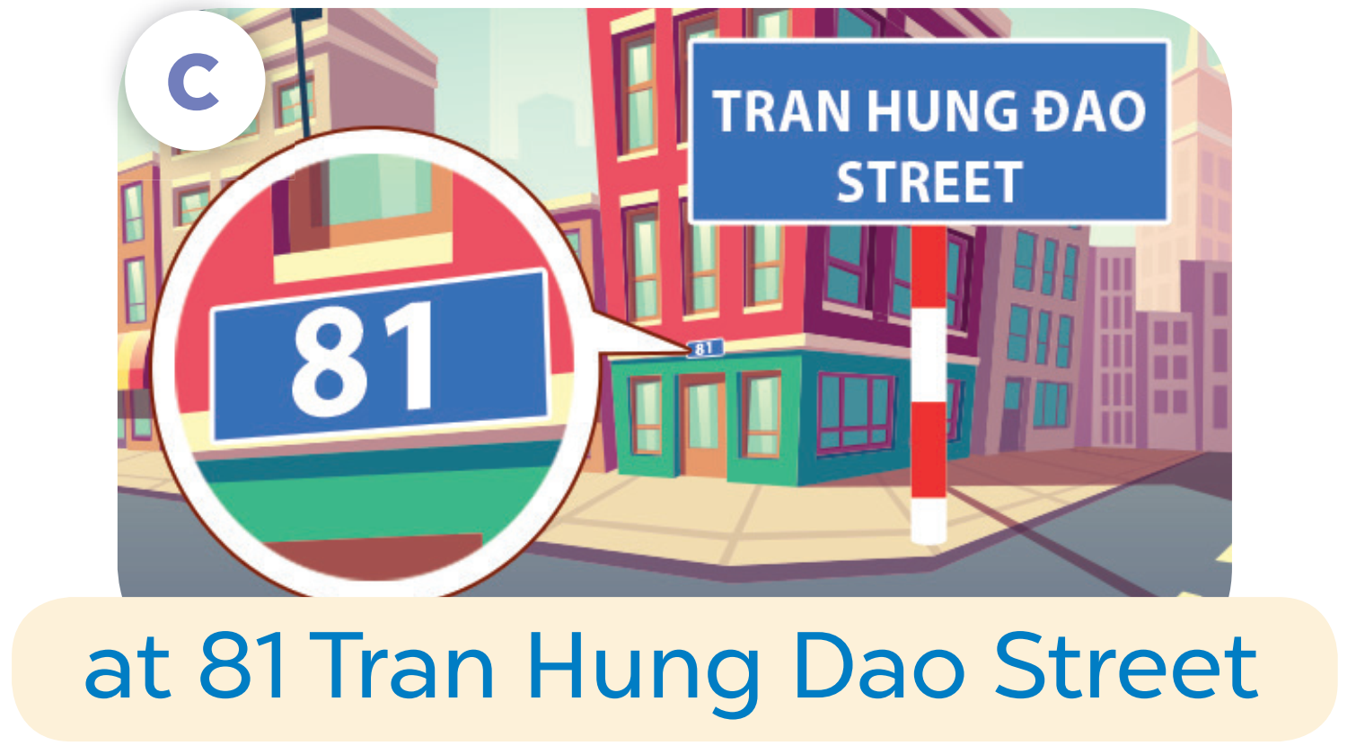

Slide 11
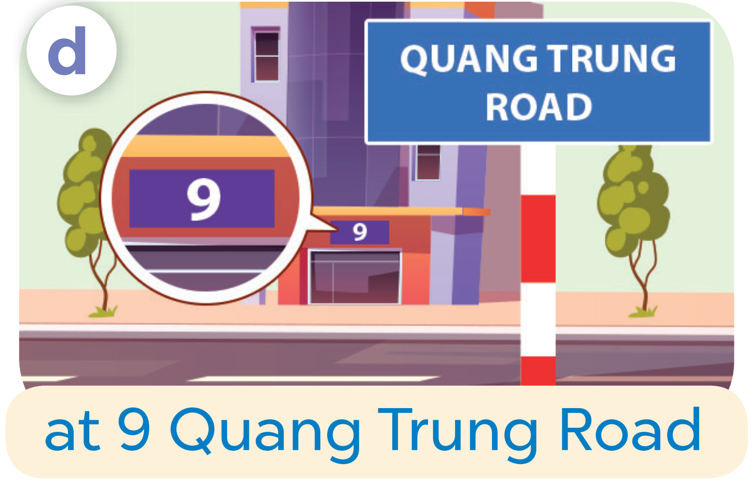

Slide 12
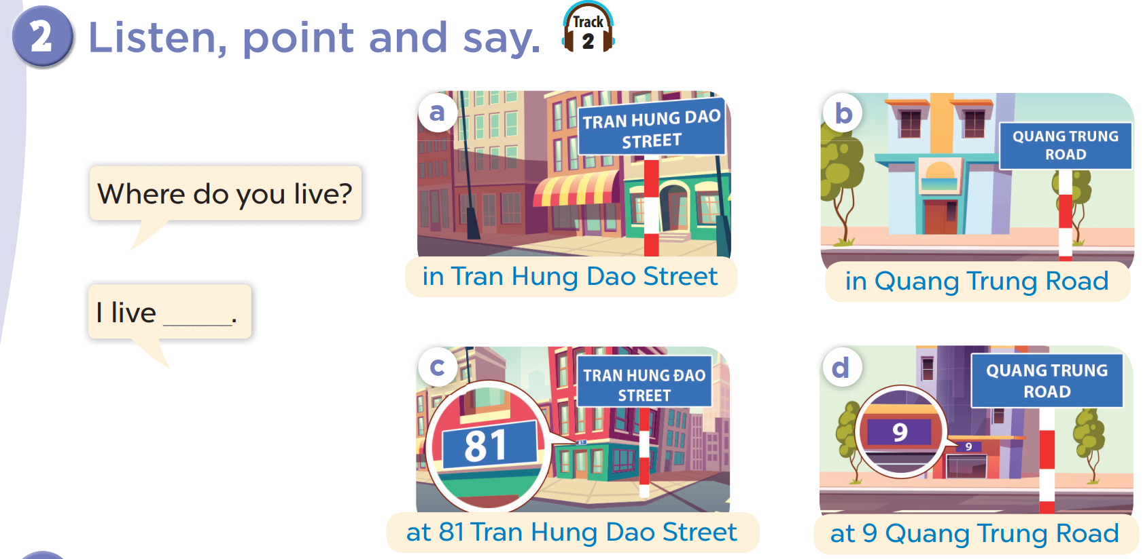

Slide 13
Where do you live?
I live in Tran Hung Dao Street.

Slide 14
04
Let’s talk.

Slide 15
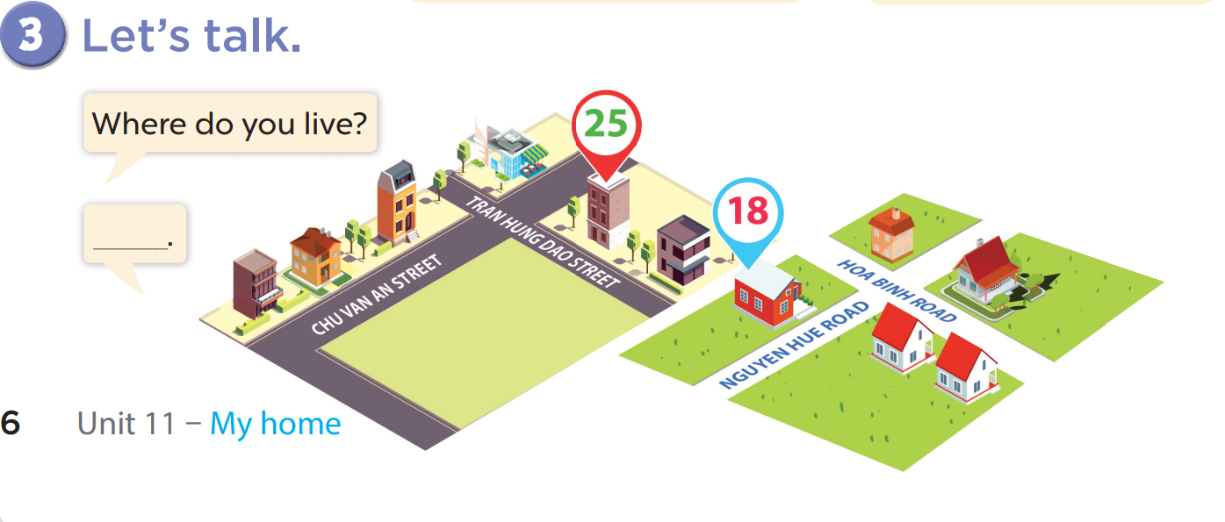

Slide 16
05
fun corner & Wrap-up

Slide 17
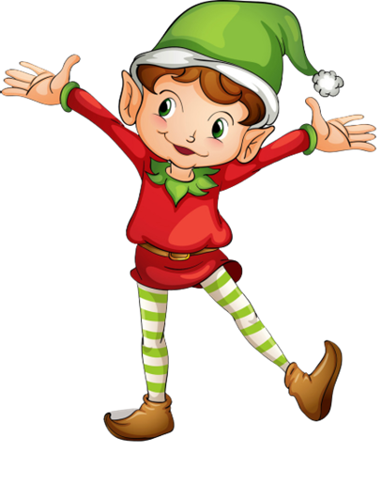
1
point
5
points
Lucky wheel!
Question
Question
Question
Question
Question
Question
SPIN
Question
3
points
2
points
10
points
End
Notes:
Click on “spin” button to spin the wheel, click again to stop

Slide 18
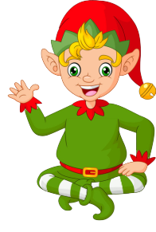
Ask and answer!
Where do you live?
I live in Tran Hung Dao Street.
Check
Back

Slide 19
Ask and answer!
Where do you live?
I live in Quang Trung Road.
Back
Check

Slide 20
Ask and answer!
Where do you live?
I live at 81 Tran Hung Dao Street.
Back
Check

Slide 21
Ask and answer!
Where do you live?
I live at 9 Quang Trung Road.
Back
Check

Slide 22
Ask and answer!
Where do you live?
I live in/at…….
Back
Check

Slide 23
Ask and answer
Where do you live?
I live in/at…….
Back
Check

Slide 24

Ask and answer!
Where do you live?
I live in/at…….
Back
Check

