Slide 1







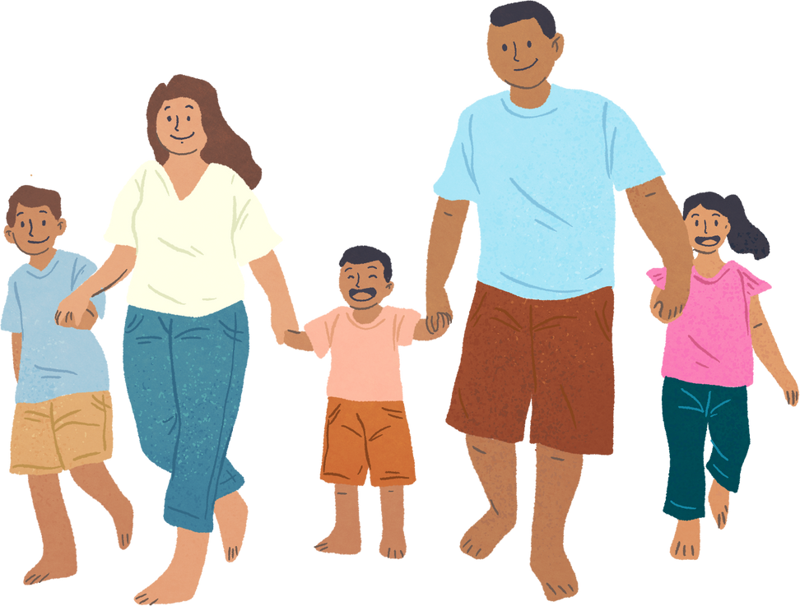


Unit 11: FAMILY TIME
Lesson 2 - Period 3

Slide 2





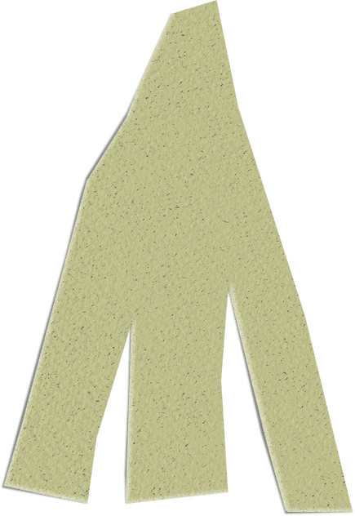


01
Warm-up and Review.

Slide 3






WHISPER GAME

Slide 4









1
I swam with my mother yesterday.

Slide 5
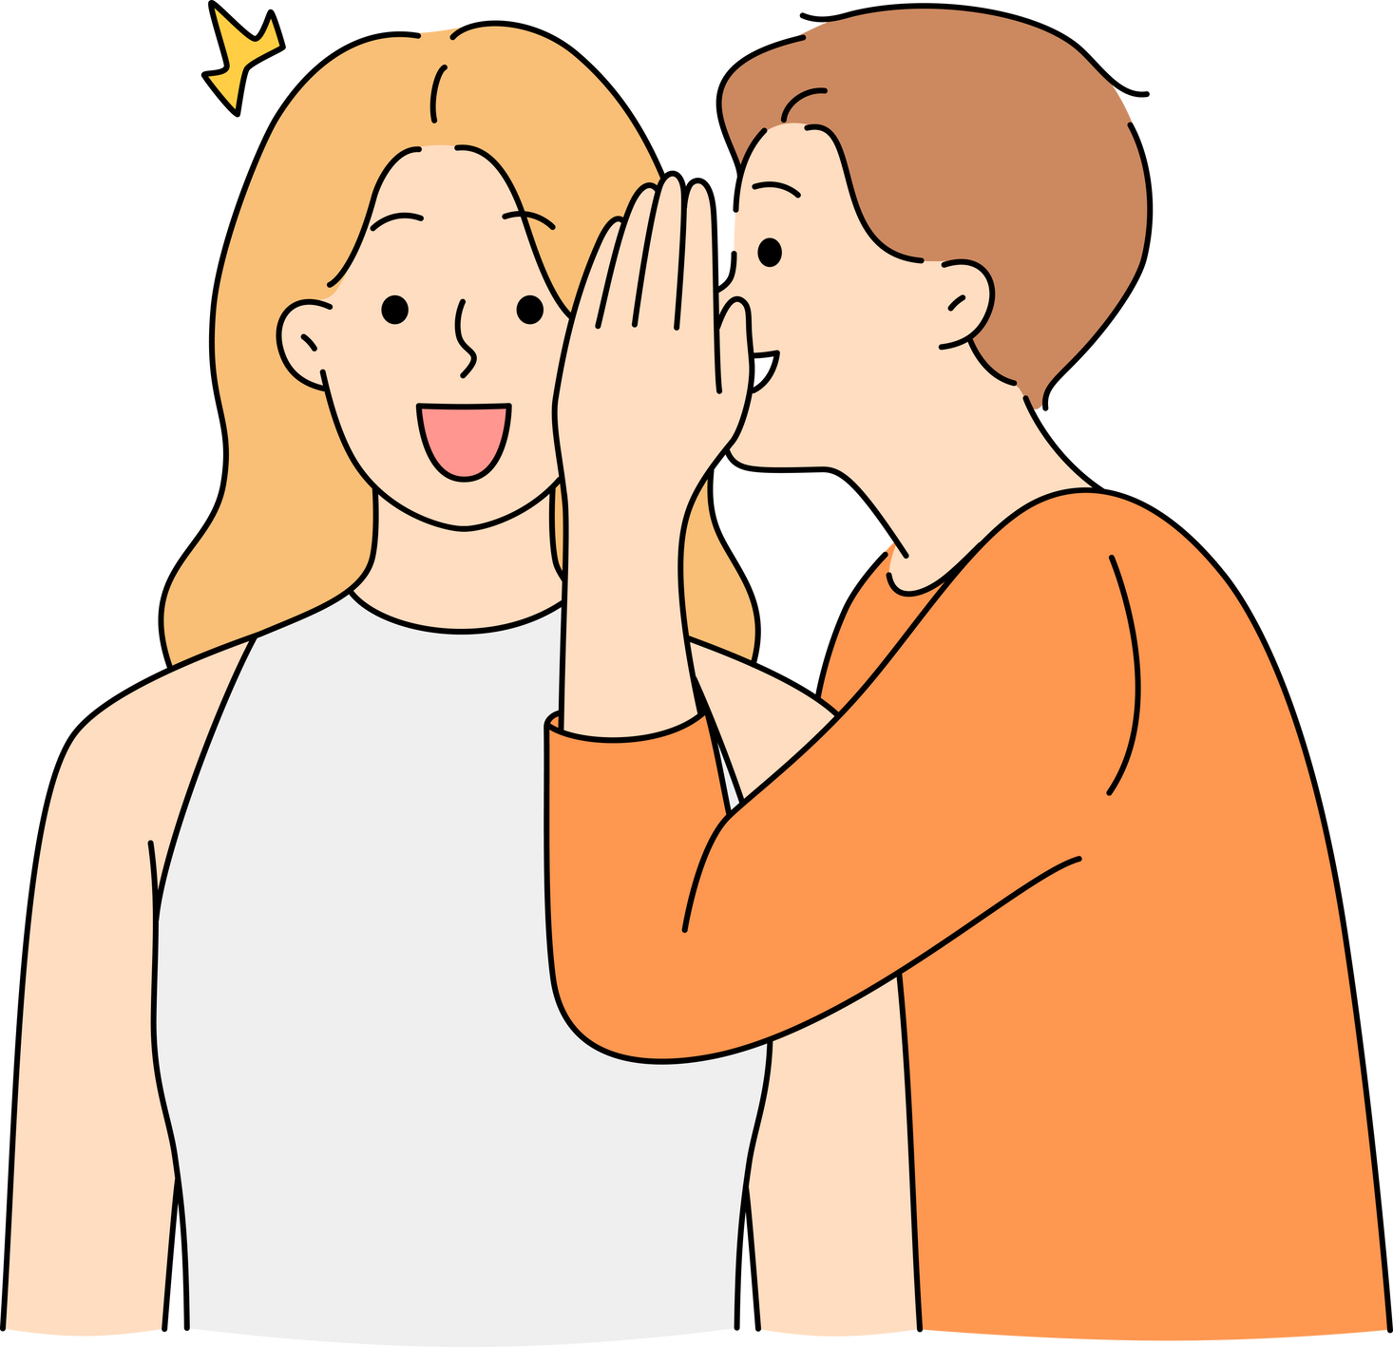
2
I collected shells with my brother last Sunday.

Slide 6

3
I walked on the beach with my family yesterday.

Slide 7

4
I took a photo with my sister.

Slide 8

GOOD JOB!

Slide 9
02
Activity 1
Look, listen and repeat.

Slide 10



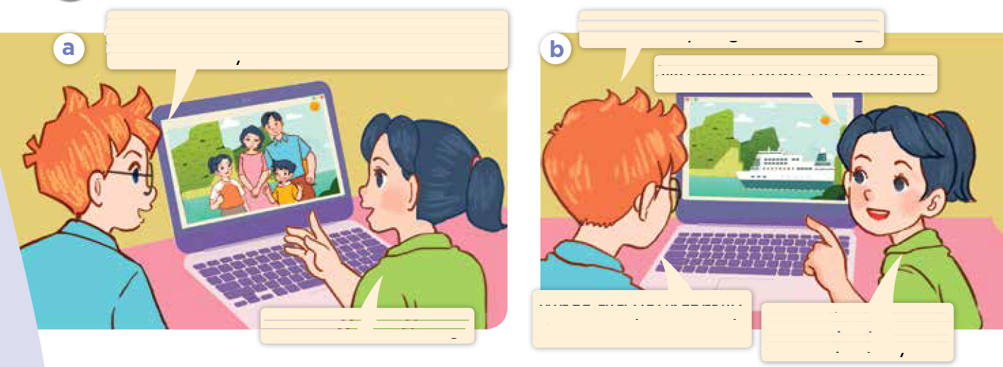

Look and say.
Notes:
Step 1: Have pupils look at Pictures a and b and identify the place, characters and their activities in the pictures.

Slide 11
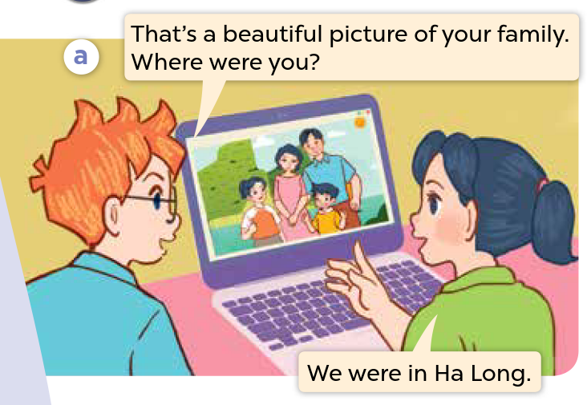

Look, listen and repeat.
Notes:
Step 2: Ask pupils to look at Picture a. Play the recording for them to listen. Play the recording again, sentence by sentence, for pupils to listen and repeat. Follow the same procedure with Picture b. Correct their pronunciation where necessary.

Slide 12
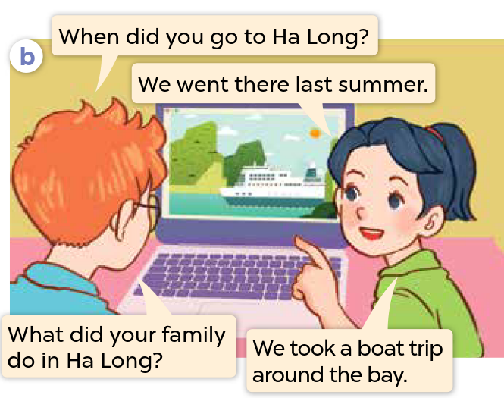
Look, listen and repeat.
Notes:
Step 2: Ask pupils to look at Picture a. Play the recording for them to listen. Play the recording again, sentence by sentence, for pupils to listen and repeat. Follow the same procedure with Picture b. Correct their pronunciation where necessary.

Slide 13
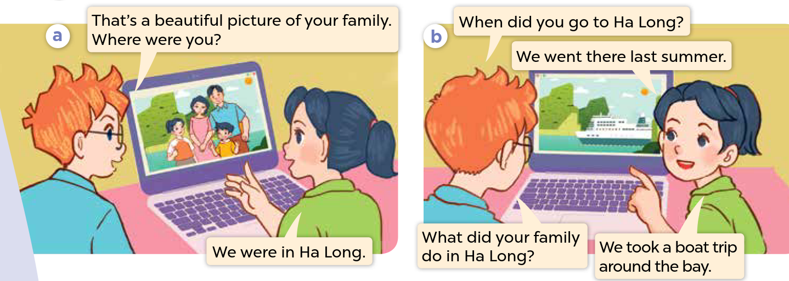
Look, listen and repeat.
Notes:
Step 3: Play the recording again for pupils to listen and repeat in chorus, sentence by sentence.
Step 4: Invite a few pairs to the front of the classroom to listen and repeat the sentences in the recording.

Slide 14
03
Activity 2
Listen, point and say.

Slide 15



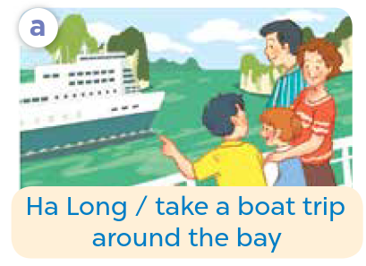
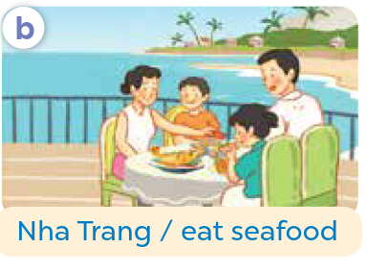
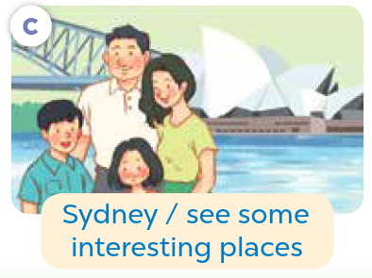
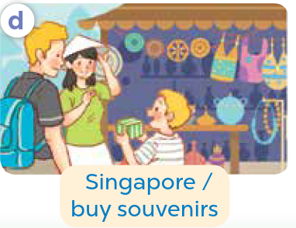

Look and say.
Notes:
Step 1: Have pupils look at the Pictures a, b, c and d and elicit the activities of the characters.

Slide 16

Listen, point and say.
Notes:
Step 2: Have pupils point at Picture a, listen to the recording and repeat the words (Ha Long Bay / took a boat trip around the bay). Point at the bubbles and Picture a again and have pupils listen and repeat after the recording (What did your family do in Ha Long Bay? – We took a boat trip around the bay).

Slide 17
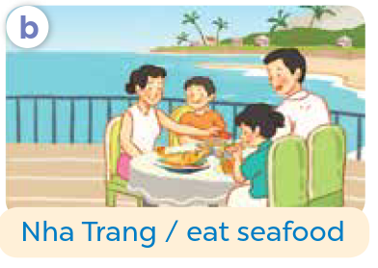
Listen, point and say.
Notes:
Step 3: Follow the same procedure with the other three pictures (b, c, d). Have the class repeat the questions and answers a few times.

Slide 18
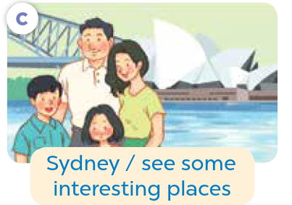
Listen, point and say.
Notes:
Step 3: Follow the same procedure with the other three pictures (b, c, d). Have the class repeat the questions and answers a few times.

Slide 19
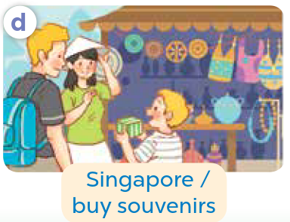
Listen, point and say.
Notes:
Step 3: Follow the same procedure with the other three pictures (b, c, d). Have the class repeat the questions and answers a few times.

Slide 20
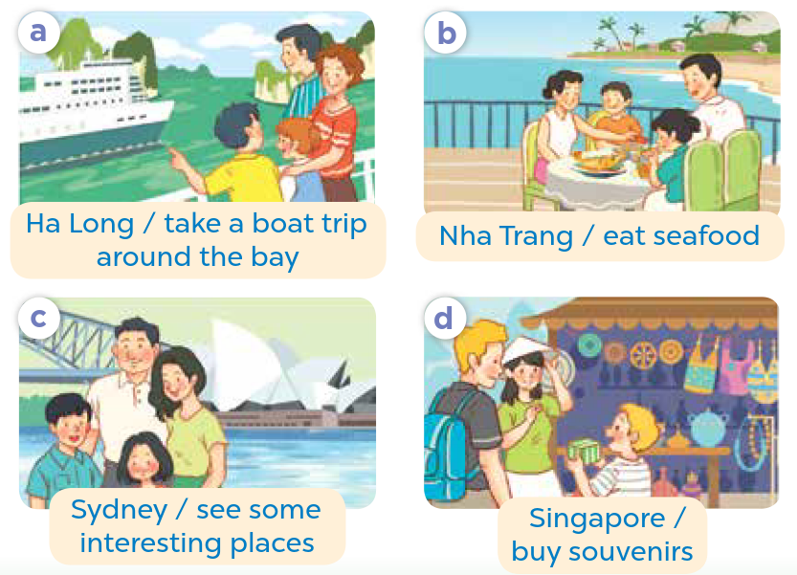

Work in pairs.
What did your family do in _____?
We _____.
Notes:
Step 4: Have pairs practise asking and answering the question What did your family do in ____? – We ____. using the picture cues.

Slide 21






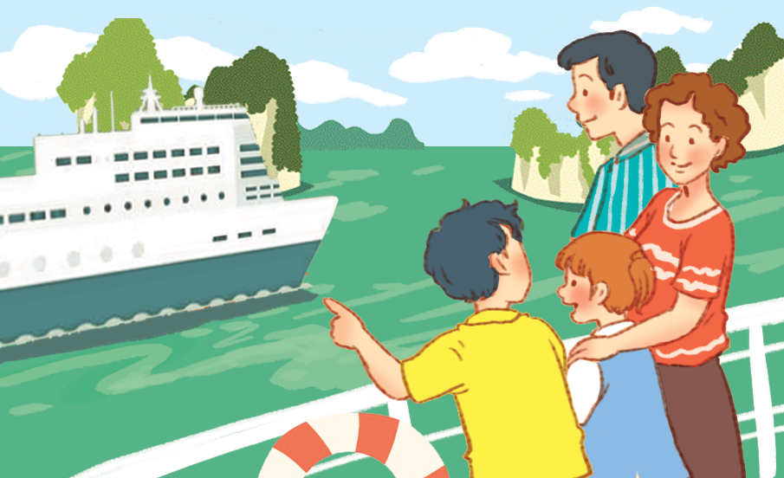

Practice
What did your family do in Ha Long?
We took a boat trip around the bay.
Ha Long / take a boat trip around the bay
Notes:
Step 5: Invite a few pairs to point at the pictures and say the questions and answers in front of the class.

Slide 22
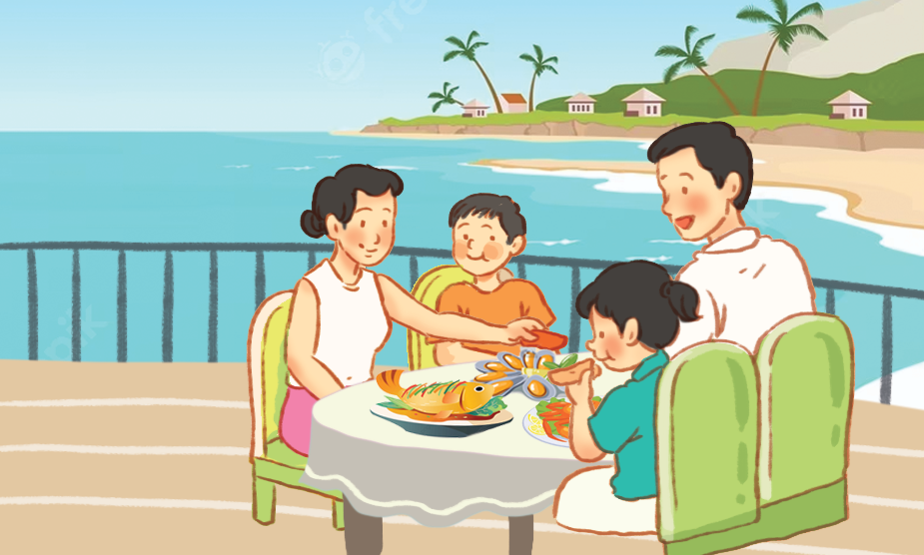
Practice
What did your family do in Nha Trang?
We ate seafood.
Nha Trang / eat seafood
Notes:
Step 5: Invite a few pairs to point at the pictures and say the questions and answers in front of the class.

Slide 23

Practice
What did your family do in Sydney?
We saw some
interesting places.
Sydney / see some
interesting places
Notes:
Step 5: Invite a few pairs to point at the pictures and say the questions and answers in front of the class.

Slide 24
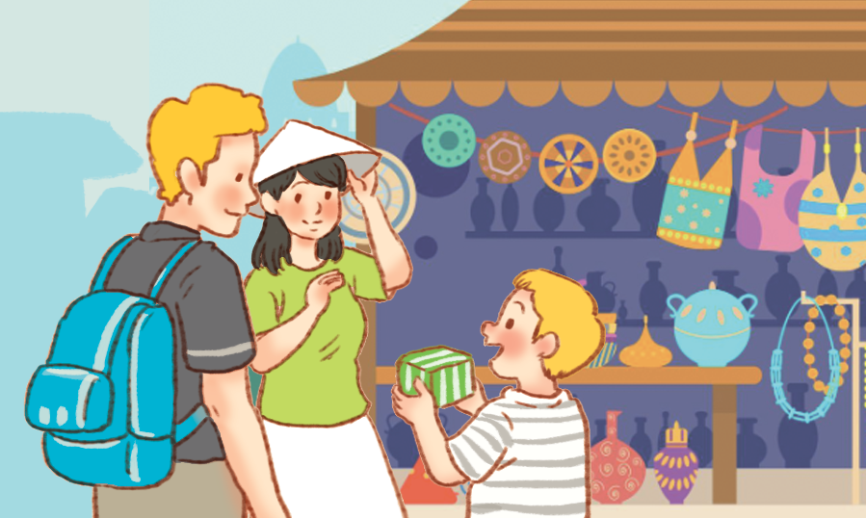
Practice
What did your family do in Singapore?
We bought souvenirs.
Singapore / buy souvenirs
Notes:
Step 5: Invite a few pairs to point at the pictures and say the questions and answers in front of the class.

Slide 25



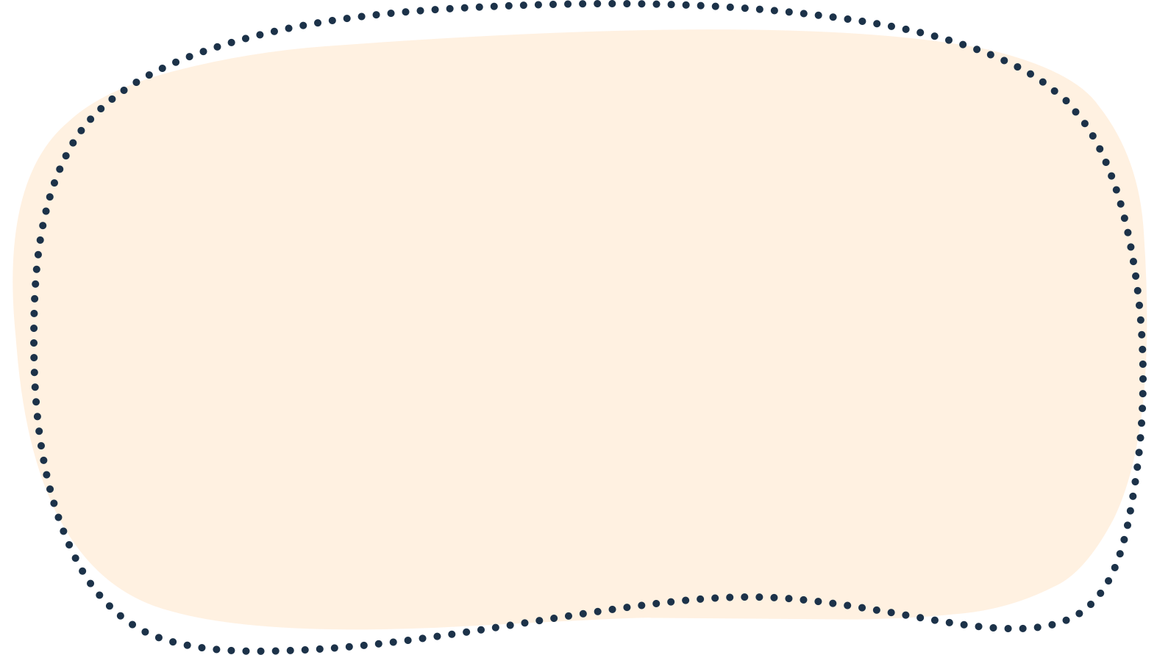

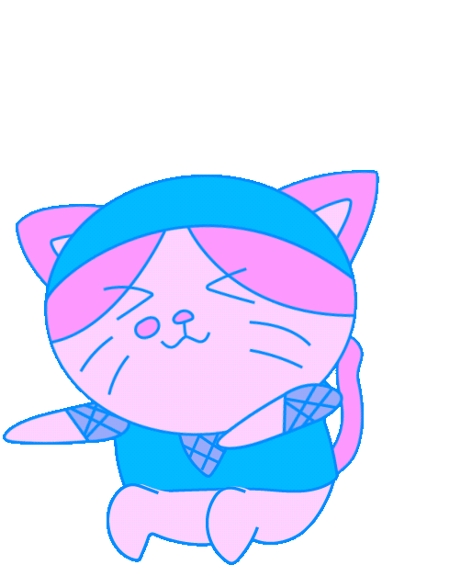





Slide 26
04
Activity 3
Let’s talk.

Slide 27



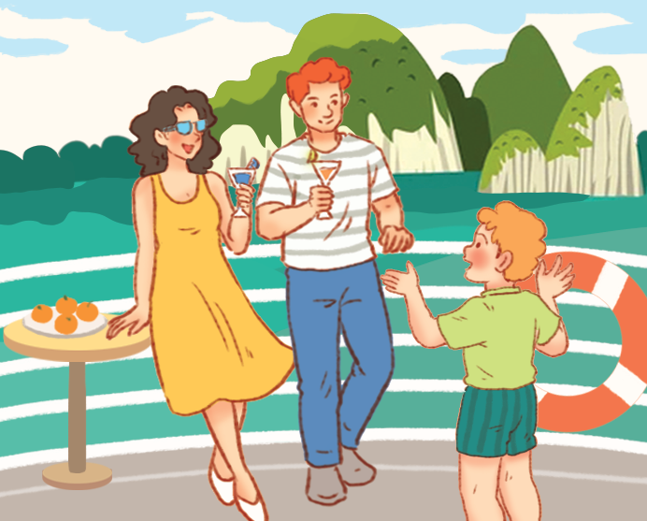


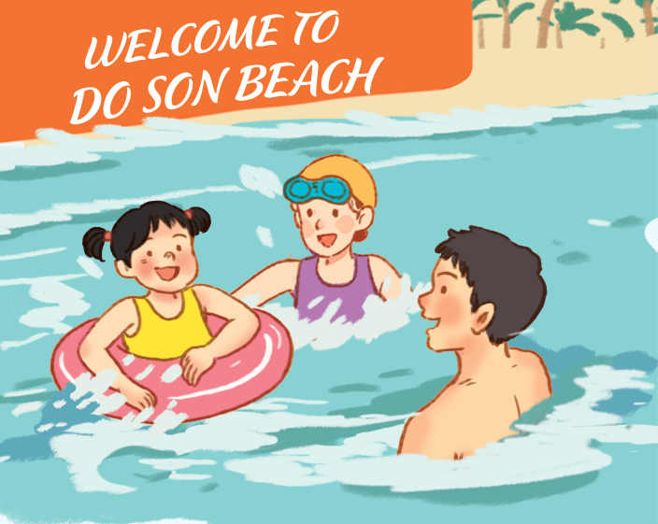



Let’s talk.
What did your family do in _____?
_____.
Notes:
Step 1: Draw pupils’ attention to the pictures. Ask questions to help them identify the context (see Input).

Slide 28

Work in pairs.
What did your family do in_____?
_____.
Notes:
Step 2: Put pupils into pairs and encourage them to ask and answer questions about what someone did somewhere in the past using What did your family do in _____? - ___. Go around the classroom to offer support where necessary.

Slide 29
05
Fun corner and wrap-up.

Slide 30










MULTIPLE CHOICE

Slide 31


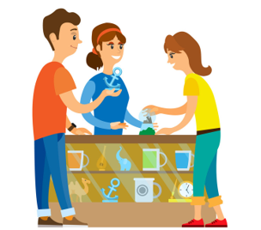



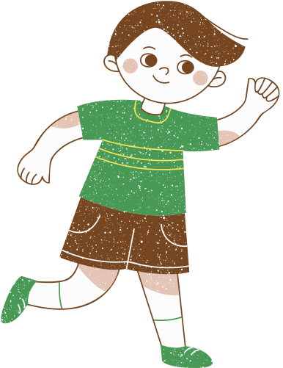



Round 1
buy food
buy souvenirs
buy school things

Slide 32
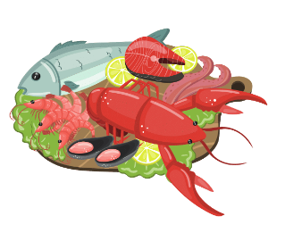

Round 2
eat seafood
eat fast food
eat chicken

Slide 33

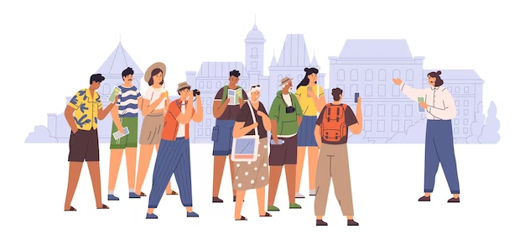


Round 3
eat seafood
see some
interesting places
take a boat trip

Slide 34


Round 4
buy food
buy souvenirs
took a boat trip

Slide 35
GREAT JOB!

