Slide 1
Da Phuc primary school
Welcome to my class
Teacher: Do Tra Giang
Class: 4A3

Slide 2
Unit 11: My home
Lesson 3 - period 5

Slide 3
Table of Contents
01
02
03
04
Listen and repeat.
Warm-up
Listen and circle.
Let’s chant.
fun corner & wrap-up
05

Slide 4
01
Warm-up

Slide 5

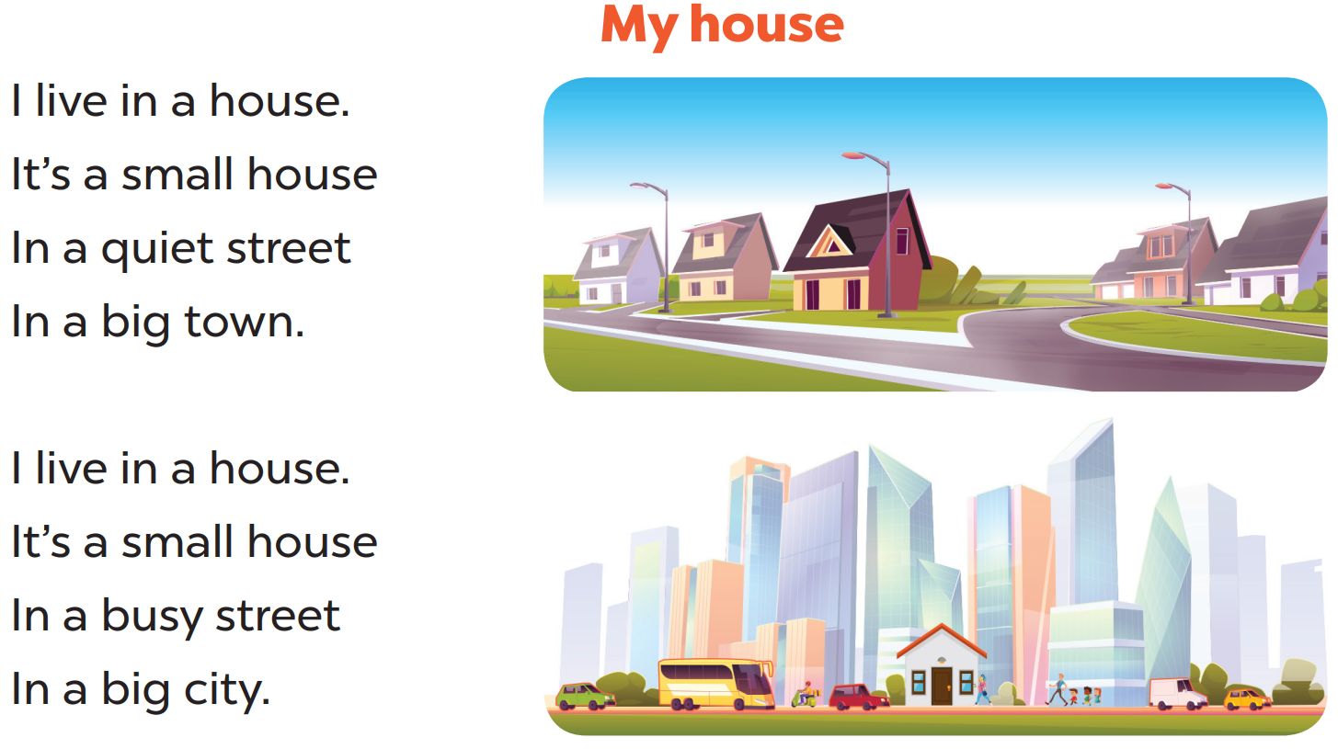

Slide 6
02
Listen and repeat.

Slide 7
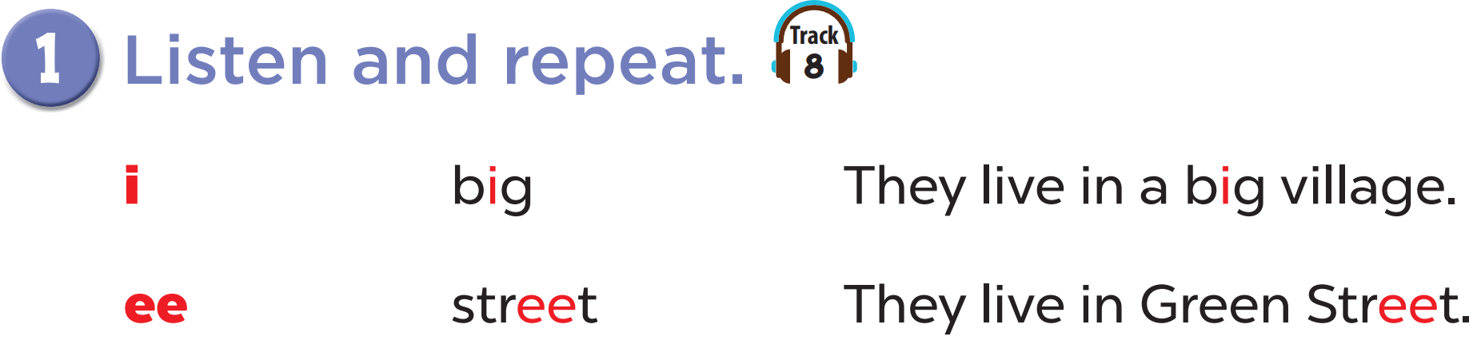

Slide 8
03
Listen and circle.

Slide 9
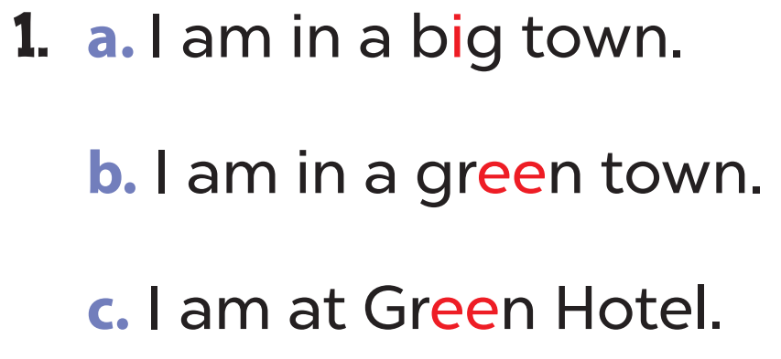
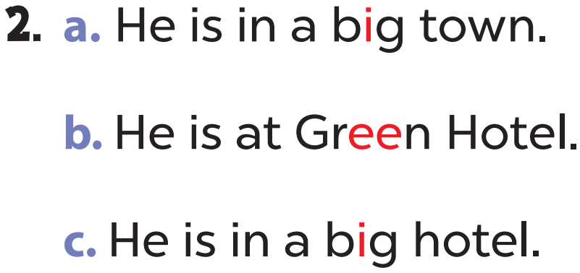

Slide 10


Slide 11
04
Let’s chant.

Slide 12
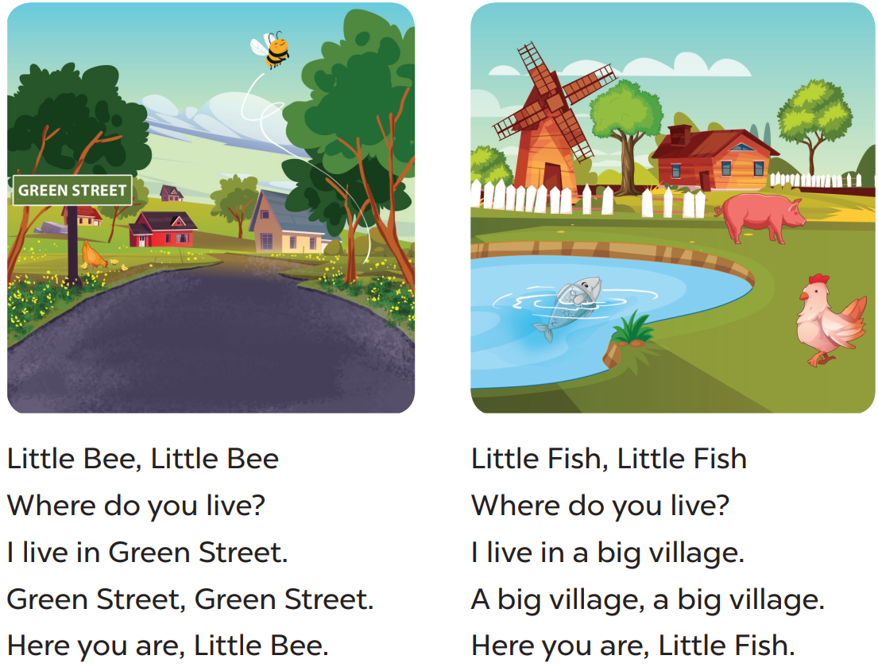

Slide 13
05
fun corner & wrap-up

Slide 14
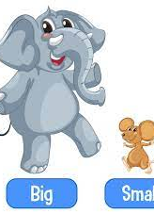
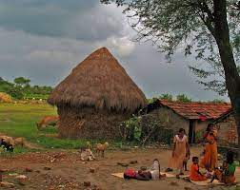
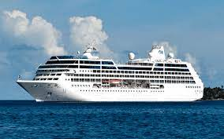
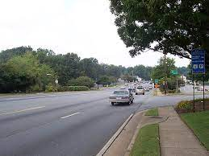
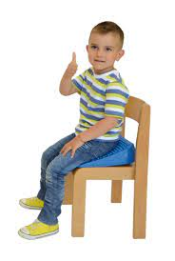

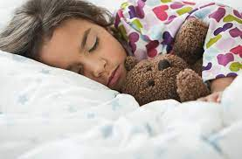
1
2
7
3
6
4
5
Start/Stop
Notes:
1- big
2- village
3- street
4- green
5- sleep
6- sit
7- ship

Slide 15
What have you learnt today?

