Slide 1
Da Phuc primary school
Welcome to my class
Teacher: Do Tra Giang
Class: 4A3

Slide 4

Notes:
https://www.youtube.com/watch?v=fyVsNVf9b3I

Slide 5
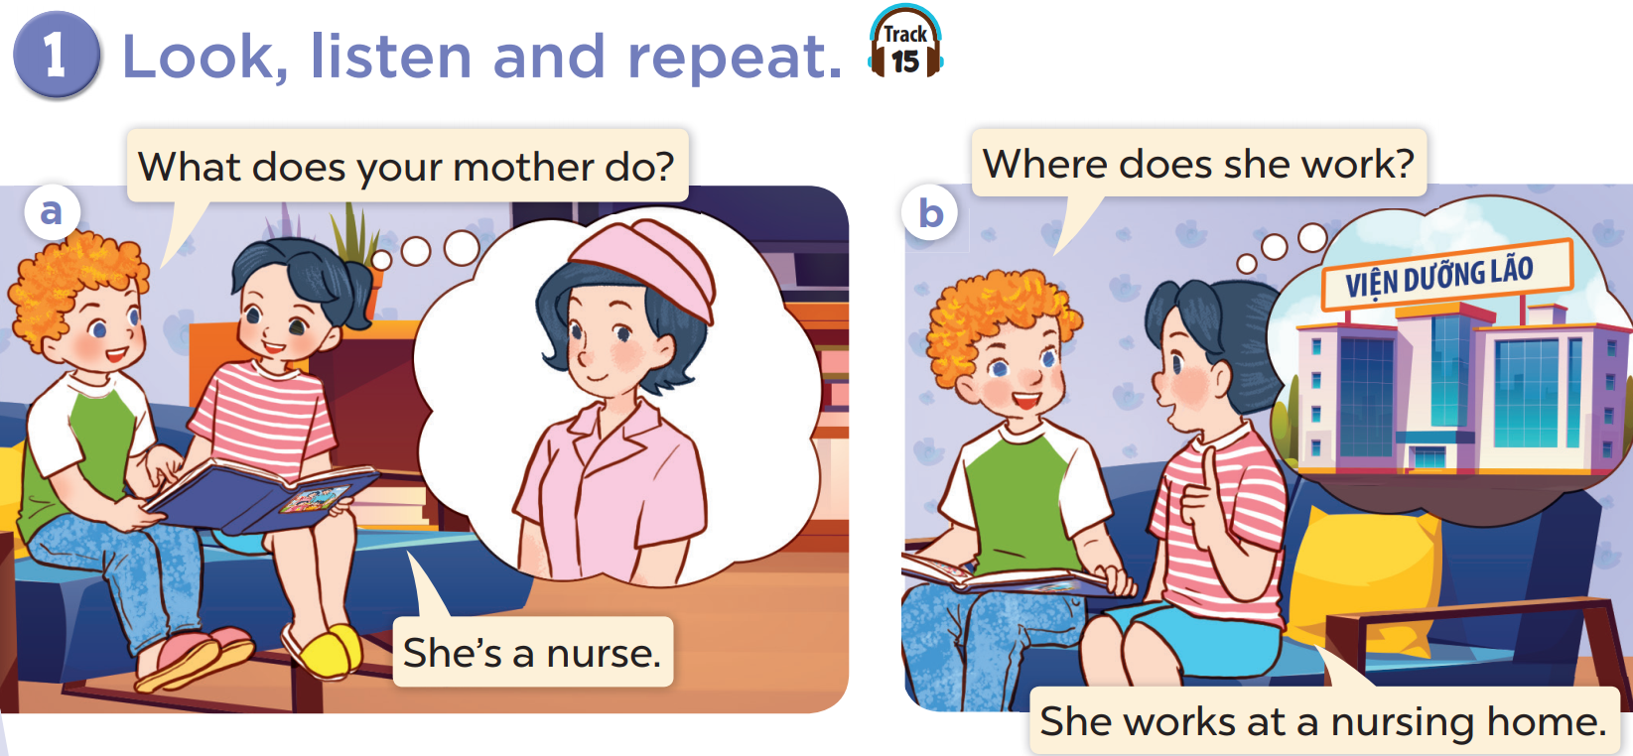

Slide 6
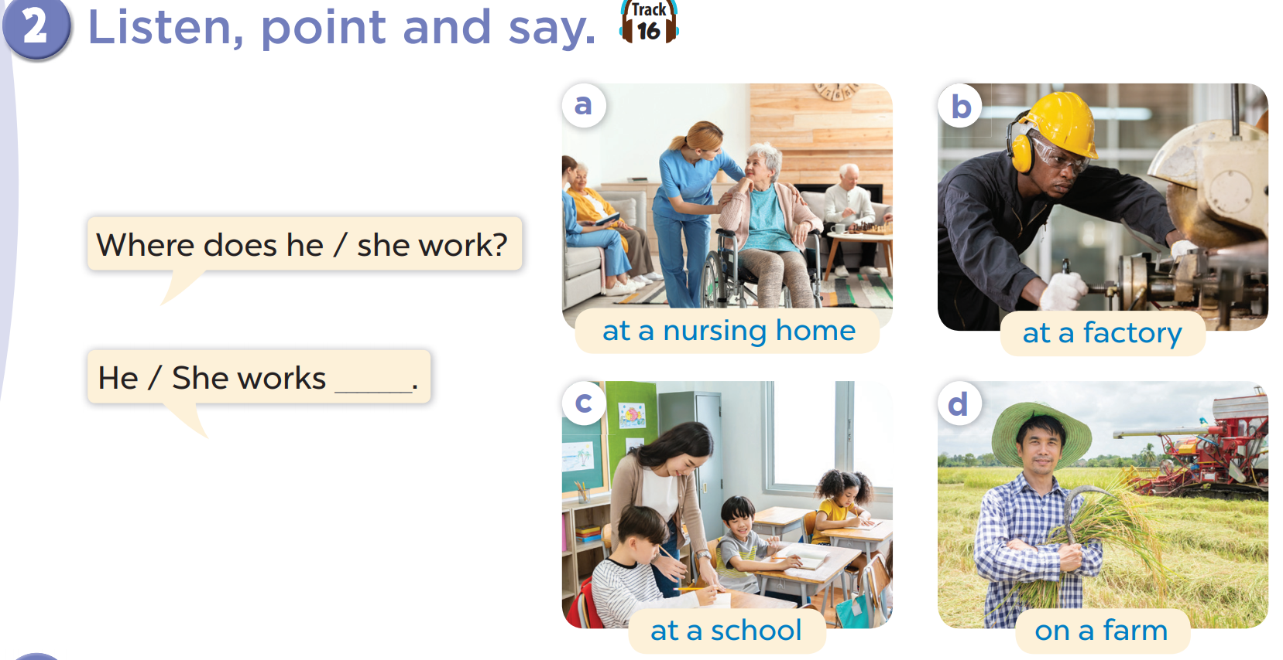

Slide 7
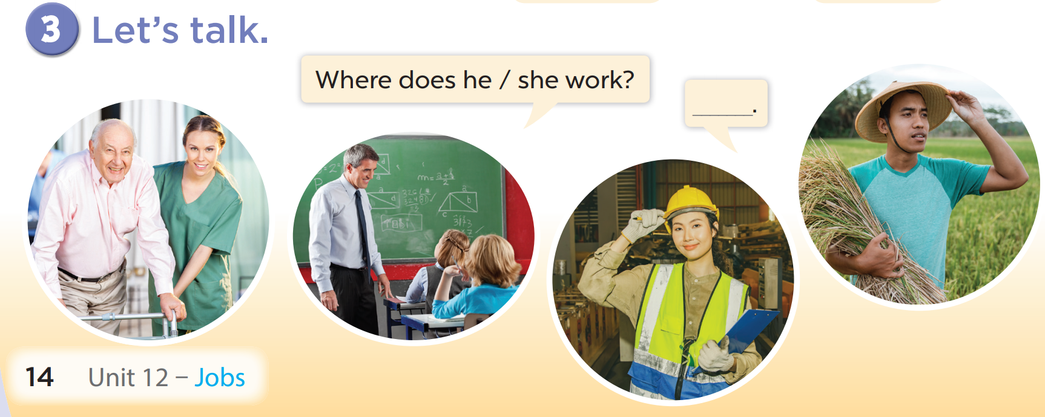

Slide 9
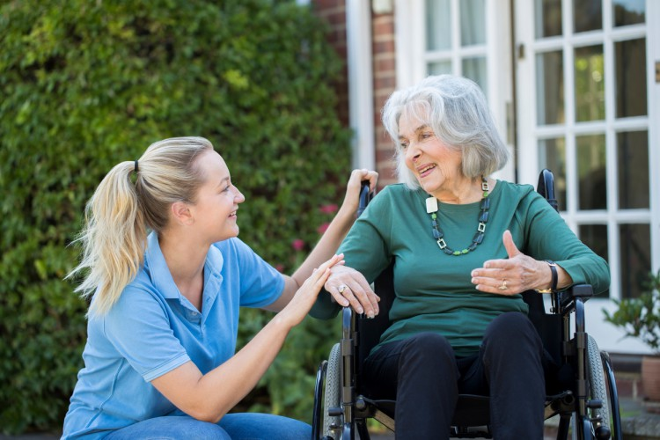
Where does she work?
She works at a nursing home.

Slide 10
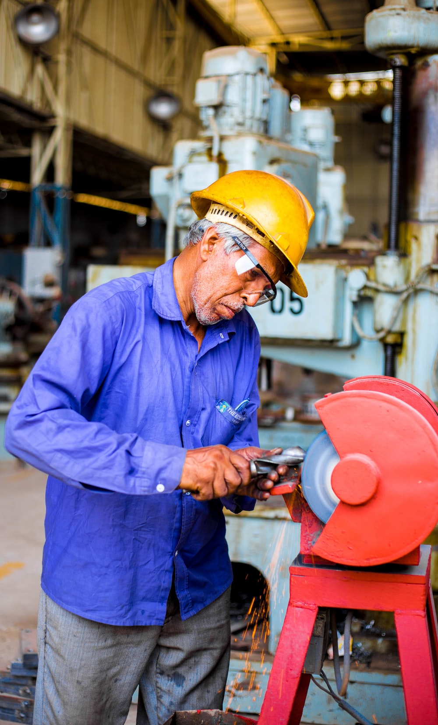
Where does he work?
He works at a factory.

Slide 11

Where does he work?
He works at a school.

Slide 12
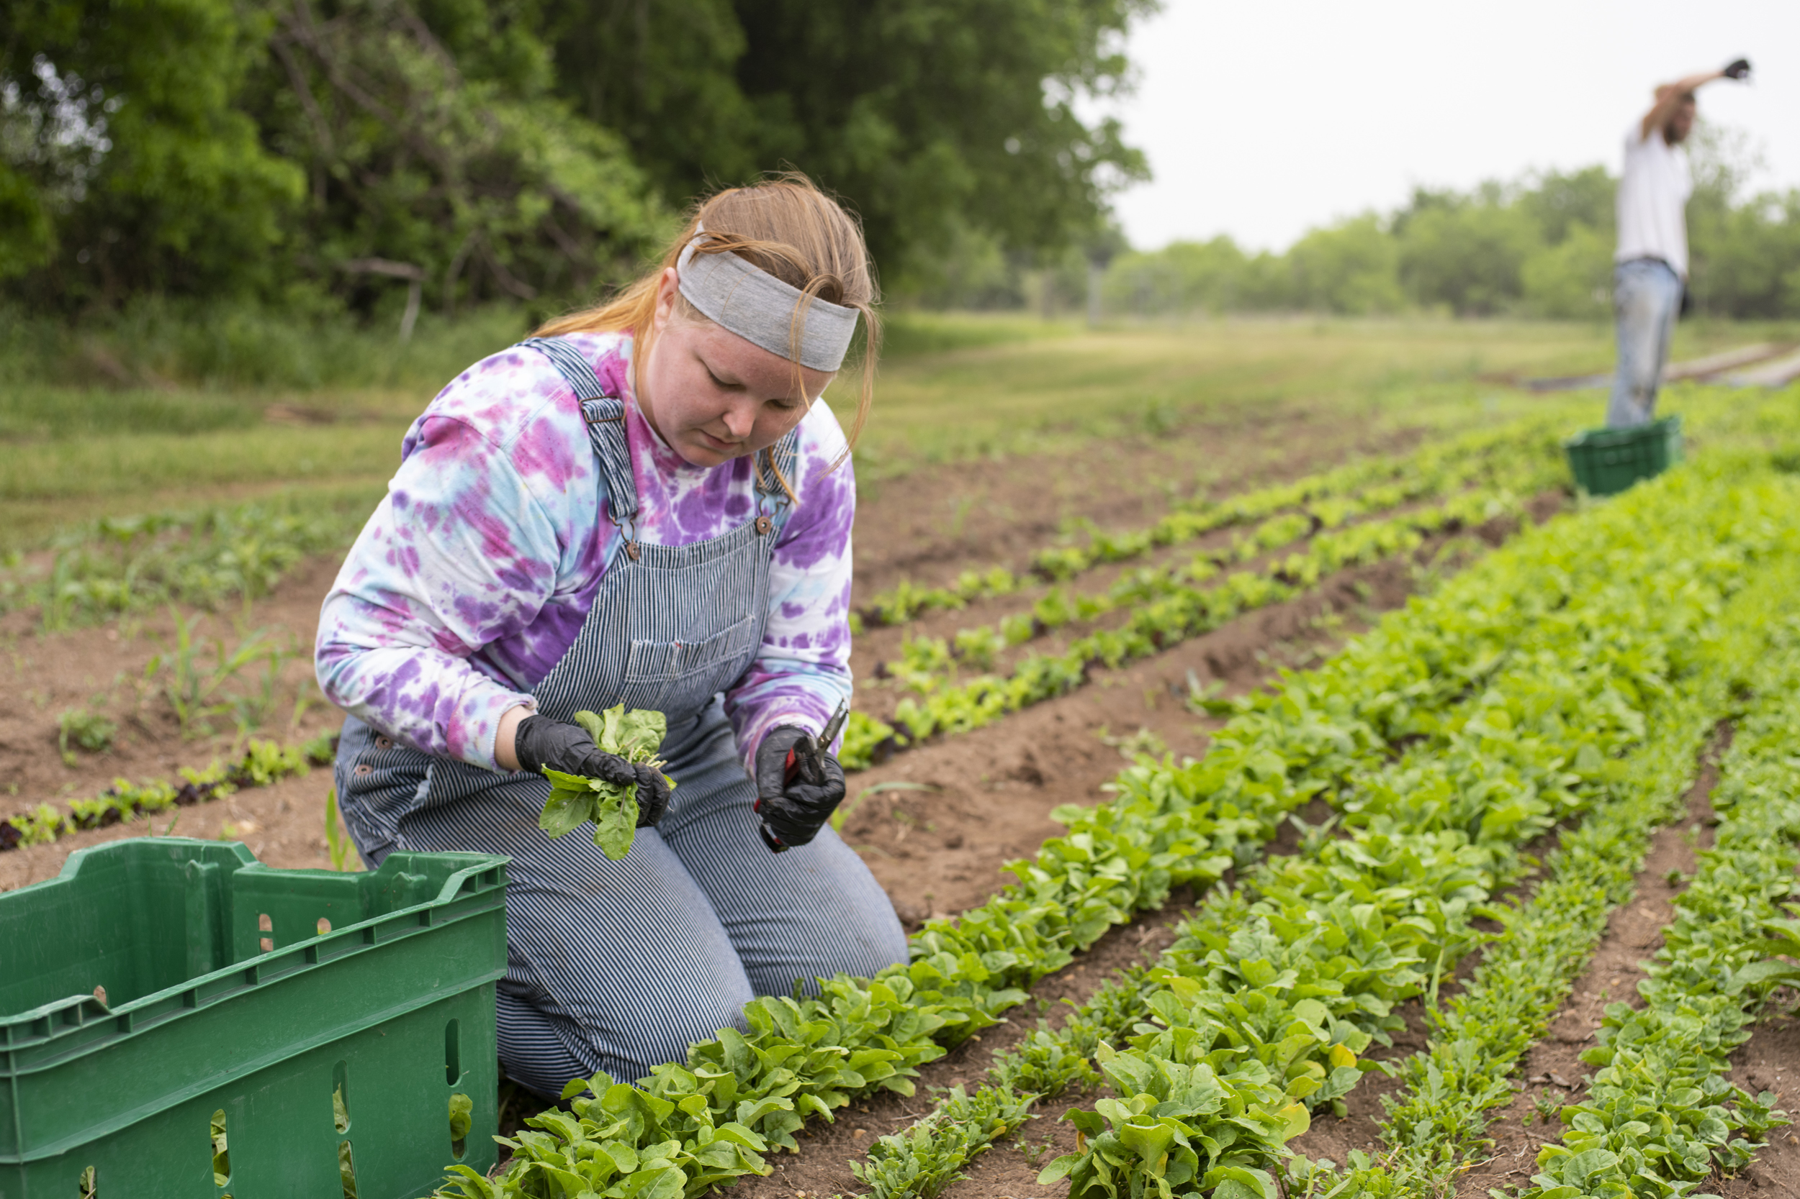
Where does she work?
She works on a farm.

